Slide 1
Value-Based Reinforcement Learning in Sandbox Environment
Yihan Zhang

Slide 2
Content
Motivation
Introduction
Environment Definition
Experiment
Next Step

Slide 3
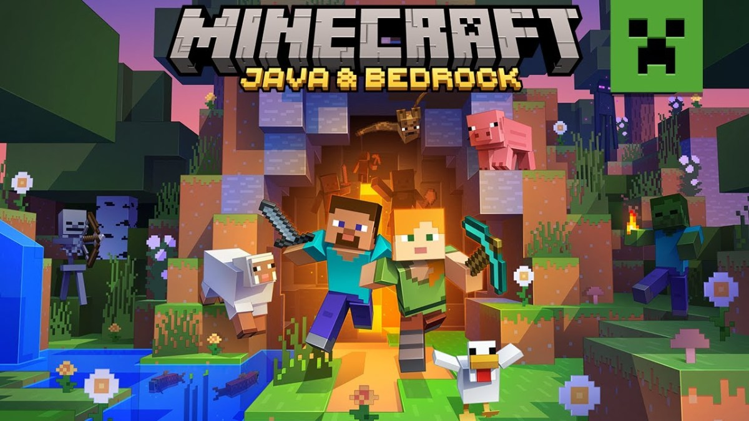
Motivation
Why is reinforcement learning not widely adopted as NPC in sandbox game?
Tessler, C., Givony, S., Zahavy, T., Mankowitz, D., & Mannor, S. (2017). A Deep Hierarchical Approach to Lifelong Learning in Minecraft. Proceedings of the AAAI Conference on Artificial Intelligence, 31(1).
Frazier, S., & Riedl, M. (2019). Improving Deep Reinforcement Learning in Minecraft with Action Advice. Proceedings of the AAAI Conference on Artificial Intelligence and Interactive Digital Entertainment, 15(1), 146-152.

Slide 4
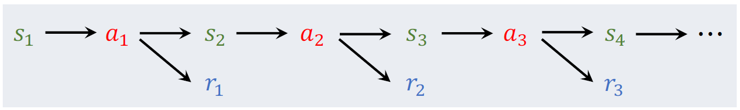
Introduction
Reinforcement Learning

Slide 5
Value-Based Reinforcement Learning
Discounted return
Action-value function

Slide 6


Optimal action-value function
It is a function of action and state, so if state is fixed
Use neural network to approximate this function

Slide 7
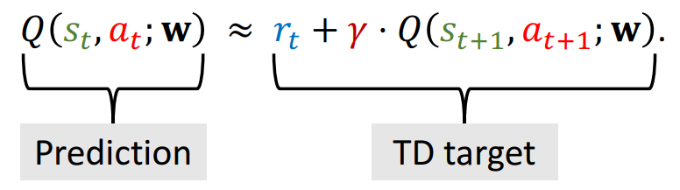
But how can we get the true return of an action?
Temporal Difference (TD) Learning

Slide 8

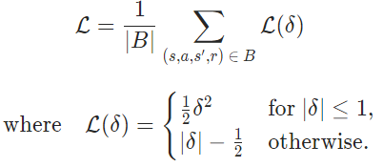
Temporal difference error:
We use Huber loss to minimize this error:
it is more robust to outliers when the estimates of Q are very noisy

Slide 9
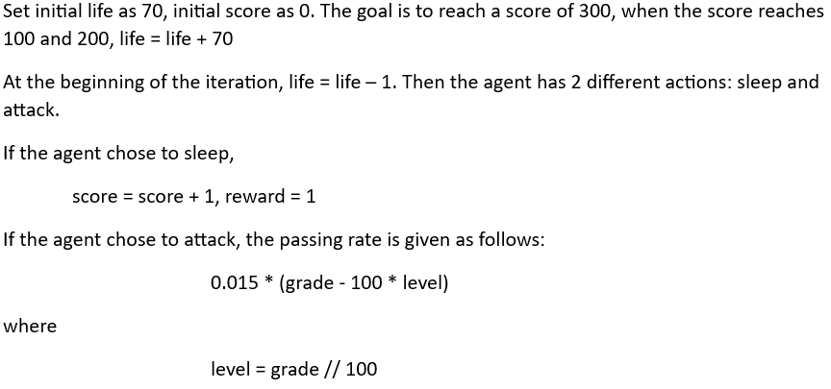
Environment Definition

Slide 10
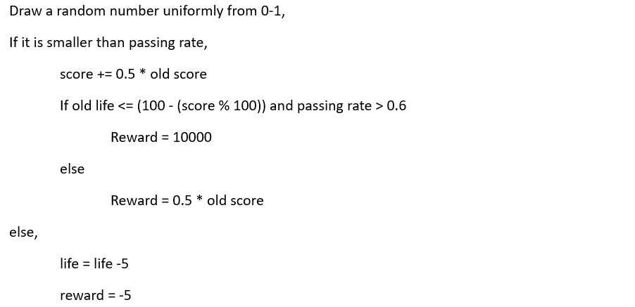

Slide 11
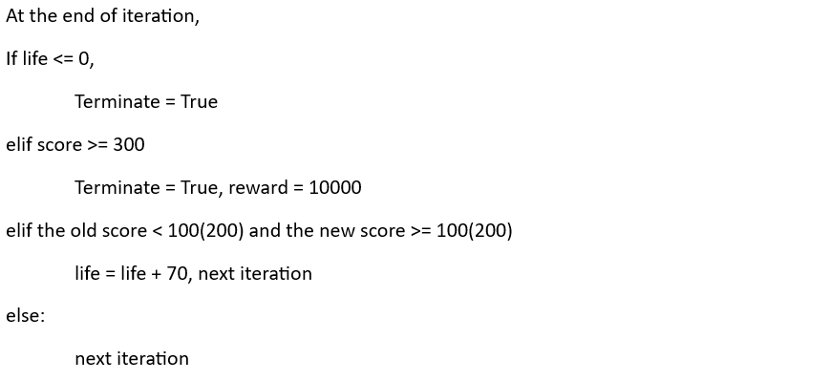

Slide 12
To introduce action randomness into the experiment,
The probability of random action selection:
EPS END + (EPS START – EPS END) * e^(-1 * steps done / EPS DECAY)

Slide 13
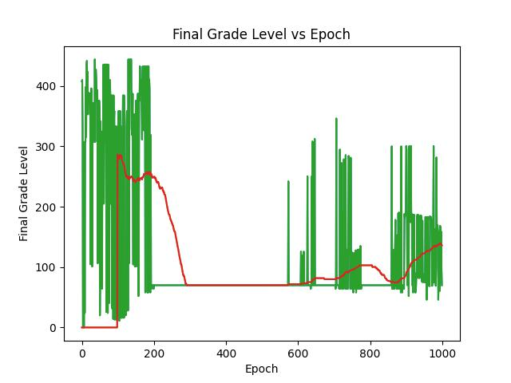
No random selection of action

Slide 14
Experiment
Input: life and score
Model: 3-layer fully connected network
Memory length = 100000,
EPS START = 0.9, EPS END = 0.05, EPS DECAY = 1000,
Original environment setting

Slide 15
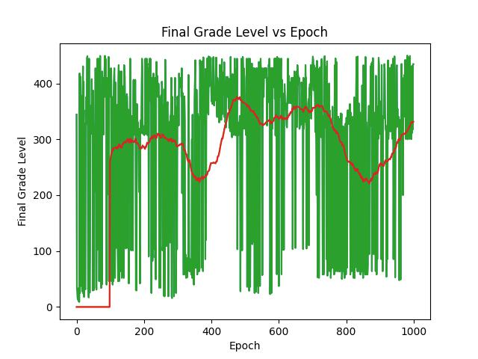

Slide 16
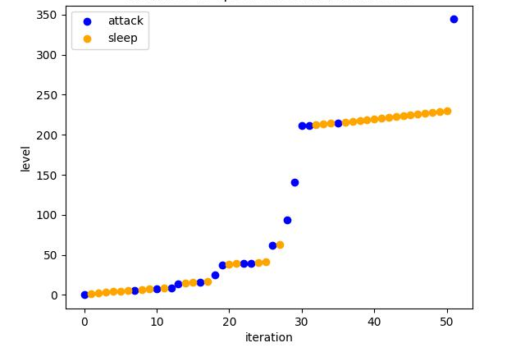
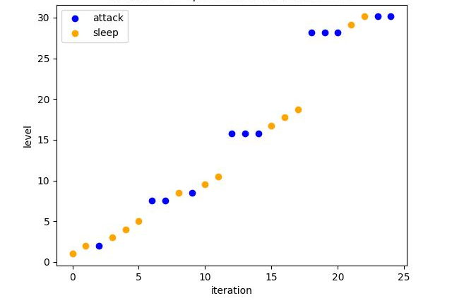
Agent using network before training

Slide 17
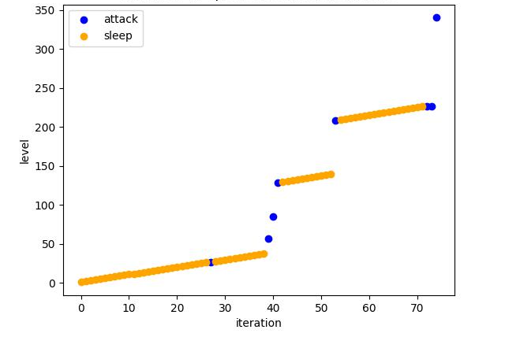
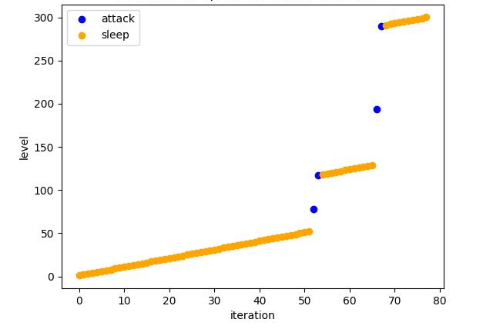
Agent using network after training

Slide 18
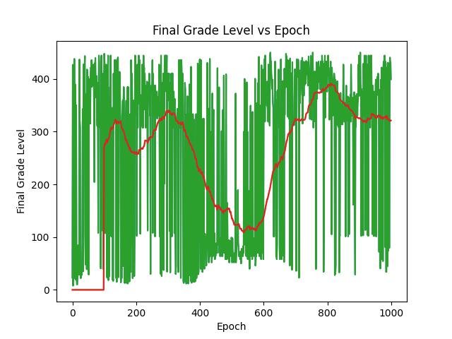

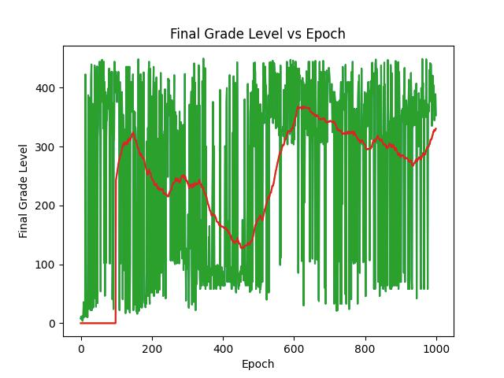
Results with different memory max-length
10^4 10^5 10^6

Slide 19
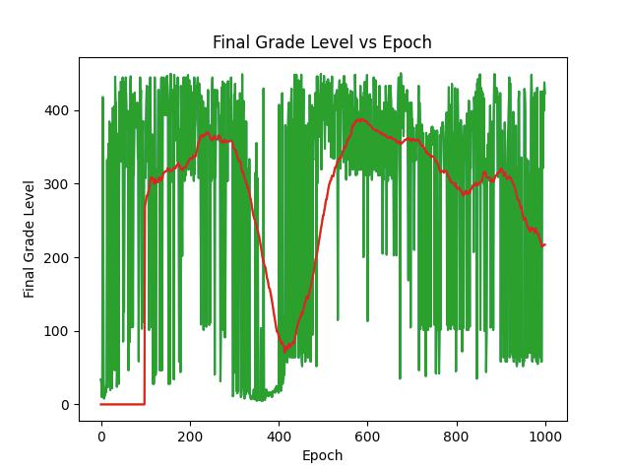
Results with Different Reward Definition
No definition of additional reward Original result

Slide 20
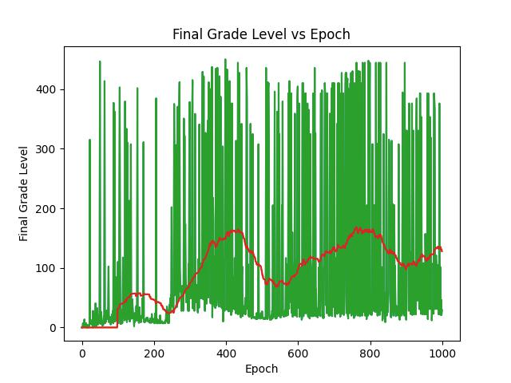

Results with Different Environment Setting
difficult situation(life -20 on failure) easy situation(life -5 on failure)

Slide 21
Next Step
The next step is to put a number of agents into the same environment.
Every few iterations, they will be randomly paired and compared. Those with lower scores will be eliminated directly.
And observe the impact of different comparison intervals and time points on the model.

Slide 22
I have conducted some experiments so far, but cannot obtain stable results, and the model could not converge.
I guess the reason may be that in this multi-agent situation, the model is also part of the environment.
Changes of the model make the environment change, which in turn causes the data distribution to change.

Slide 23
In essence, Value-Based Reinforcement Learning is to classify the data set generated by itself(depended on the environment definition), so changes in data distribution will cause the model to not converge.
Next, I will try to find a solution, which may involve using other methods in reinforcement learning.

Slide 24
Thank you

