Slide 1

ASL2TEXT
Ferran Vera Filella
AI

Slide 2
Introduction
American Sign Language (ASL) is a vital mode of communication for the hard of hearing community.
Project objective:
The primary objective is to develop an ASL-to-text translation system using deep learning techniques.
The system's goal is to facilitate seamless communication between the ASL-speaking community and non-signers
Scope of Research:
Utilization of advanced machine learning algorithms, including TensorFlow and Transformer models.
Notes:
American Sign Language (ASL) plays a crucial role in enabling communication within the hard of hearing community. It's a rich and complex form of expression.
Our project has a clear objective. We're aiming to develop an ASL-to-text translation system using deep learning techniques. This system is designed to bridge the communication gap between ASL users and non-signers.
The scope of our research is quite comprehensive. We're diving into the world of advanced machine learning algorithms, utilizing tools like TensorFlow and Transformer models.

Slide 3
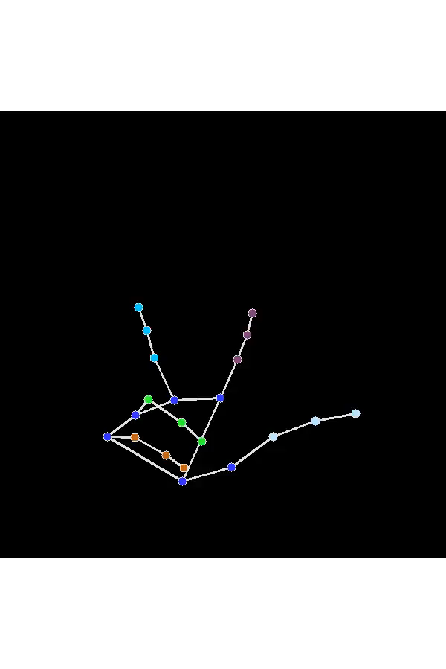
Project goal
phrase: 3 creekhouse

Slide 4
Preprocess Dataset
Data Rearrangement:
Restructured Parquet Files: Each file now integrates landmark data alongside associated phrases.
Adopting TFRecord Format:
Improved Efficiency: TFRecords offer enhanced data processing speed and efficiency.
Enhanced Data Handling: This format streamlines access and utilization of landmark and phrase data.
With a set of functions, we standardize the lenght of frames, address missing values within the dataset, and structure the hand and pose data uniformly. The goal is to streamline the data preparation phase, enabling smoother downstream tasks such as analysis and machine learning modeling.
Notes:
We changed how our data is organized to include landmarks with phrases in our files. By using TFRecord format, our data processing got faster and smoother, making it easier to access landmarks and phrases. We also made sure all frames had the same length, fixed missing values, and organized hand and pose data in a similar way. This helps us get the data ready for analysis and machine learning more easily.

Slide 5
Methodology Overview
Dataset: Acquired ASL gesture dataset from Kaggle's "Google - American Sign Language Fingerspelling Recognition" competition
Model architecture:
Implemented a Transformer-based architecture for its capability to handle sequence-to-sequence tasks.
Utilized token embeddings for ASL gestures and positional encodings to preserve spatial information.
Incorporated encoder-decoder layers to capture gesture features and perform text translation.
Training and Validation:
Split the dataset into training, validation, and test sets for model development.
Trained the Transformer model using Categorical Cross-Entropy Loss and optimized with the Adam optimizer.
Validated model performance using metrics like Levenshtein Distance to assess translation accuracy.
Notes:
For our dataset, we've sourced ASL gesture data from Kaggle's "Google - American Sign Language Fingerspelling Recognition" competition
Our chosen model architecture revolves around a Transformer-based design. This architecture is particularly adept at handling sequence-to-sequence tasks
Within the Transformer architecture, we've implemented specific strategies to enhance performance. Token embeddings are utilized to represent ASL gestures, while positional encodings are employed to maintain spatial information crucial for accurate translation.
To facilitate the translation process, we've integrated encoder-decoder layers within the architecture. These layers enable the model to capture gesture features effectively and perform the necessary text translation.
The dataset has been divided into training, validation, and test sets, essential for model development and evaluation.
During the training phase, the Transformer model was trained using Categorical Cross-Entropy Loss, a common choice for sequence-to-sequence tasks
To validate the model's performance, we utilized metrics such as the Levenshtein Distance. This metric helps assess the accuracy of translation by measuring the differences between predicted and actual text outputs.

Slide 6
Model architecture
Transformer Model Overview
LandmarkerEmbedding: Initial encoding of hand pose landmarks.
Encoder spatial relationships of hand gestures.
Captures essential features of sign language gestures.
TokenEmbedding: Conversion of phrases to tokens for model input.
Transforms linguistic information (phrases) into a format understandable by the model.
Enables the integration of language context with gestures.
Transformer Layers: Sequential layers facilitating information flow and translation.
Facilitate interactions between the landmark and token embeddings
Enable learning complex relationships between language and gesture.
Notes:
We use a Transformer model for our project. It starts by encoding hand pose landmarks, capturing important features of sign language gestures. Then, phrases are turned into tokens to make them understandable by the model, blending language context with gestures. The Transformer's layers help information flow and translation. They make it possible for the model to learn how language and gesture relate and interact.

Slide 7
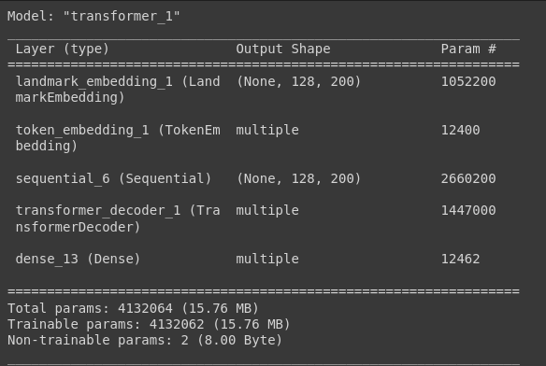
Notes:
This is the model summary and as you can see it has 4.1 millon paramaters.

Slide 8
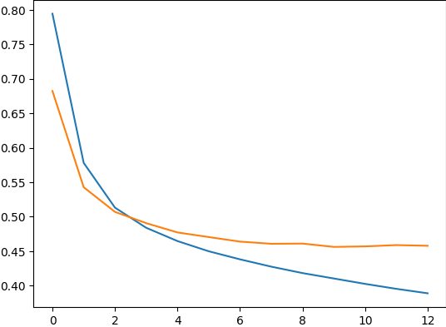
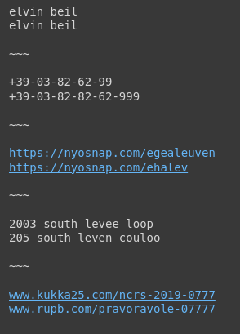
Results
Loss
Accuracy Score: 66.88%
Transformer Model Hyperparameters
Hidden Dimension Size: 200
Attention Heads: 4
Feed-forward Network Dimension: 400
Number of Encoder Layers: 2
Number of Decoder Layers: 1
Loss Function:
Categorical Crossentropy with label smoothing (0.1)
Optimizer:
Adam with learning rate 0.0001
Train loss
Validation loss
Notes:
The "hidden dimension size" refers to the number of neurons or units in the hidden layers of a neural network.
The attention mechanism allows the model to focus on different parts of the input sequence when processing information. Within the attention layer, multiple attention heads work concurrently to attend to different parts of the input, enabling the model to capture various relationships and dependencies within the data.
As you can see in the image there are some preditions that are completely correct, and others where there are some words that do not translate perfectly but are close to it.

Slide 9
Challenges and Future Work
Challenges Encountered
Data Complexity: Handling diverse hand gestures and variations in sign language can be challenging due to variations in hand movements, lighting conditions, and backgrounds.
Training Duration: With the current setup, dataset size and using GPU, training the model for13 epochs takes roughly 1 hour.
Future Work and Improvements
Real-time Translation: Developing a system for real-time interpretation of sign language gestures in live scenarios could significantly aid communication and accessibility.
Bidirectional Translation: Exploring the development of a system capable of translating from text or video to American Sign Language (ASL) could further bridge communication gaps and enhance inclusivity.

Slide 10
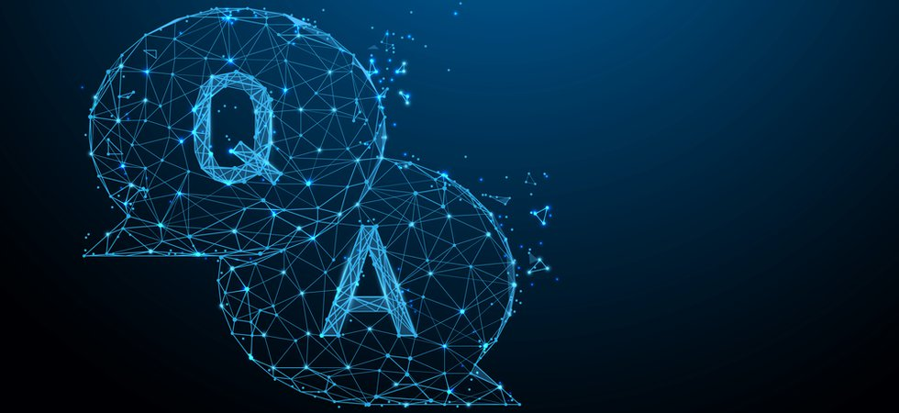
Thank you!

