Slide 1


Emotion Detection
CIS 5603 – Artificial Intelligence
Presented by Punrong Rany

Slide 2
Content
Introduction
Methodology
Result and discussion
Real-time webcam test
Future Direction
Reference

Slide 3

Introduction
Motivation
Emotions shape human experience, and this study is driven by curiosity to decode human emotions.
Objective
This project aims to develop an emotion recognition system to achieve a more robust and accurate emotion prediction.

Slide 4
Methodology

Slide 5
Dataset
Two datasets are used, namely, FER-2013 by Manas Sambare and Facial Emotion Expressions by Samaneh Eslamifar.
After combing them,
  The training set has 57,530 images
  The testing set has 14,244 images
The dataset consists of 48 x 48 pixel grayscale images of faces
There are seven categories : angry, disgust, fear, happy, sad, surprise, neutral.

Slide 6
Model Architecture
Model Architecture
  5 Convolutional layers
  1 Flatten layer
  3 Fully Connected (Dense) layers
  1 Output layer with softmax
Each of Convolutional layer is followed by Batch Normalization, ReLU Activation, MaxPooling layer, and Dropout layer.
Each of fully connected layers comes with L2 regularization, Batch Normalization, ReLU Activation and Dropout layer

Slide 7

Training Optimization Techniques
Early stop: To prevent overfitting
Model saving callback: To save best performing model during the training
Pre-defined reduce learning rate callback: To reduce the learning rate when improvements in the metric become less frequent
Class Weight Computation: Utilized class imbalance-aware technique to address imbalances in the training data

Slide 8
Result and Discussion

Slide 9
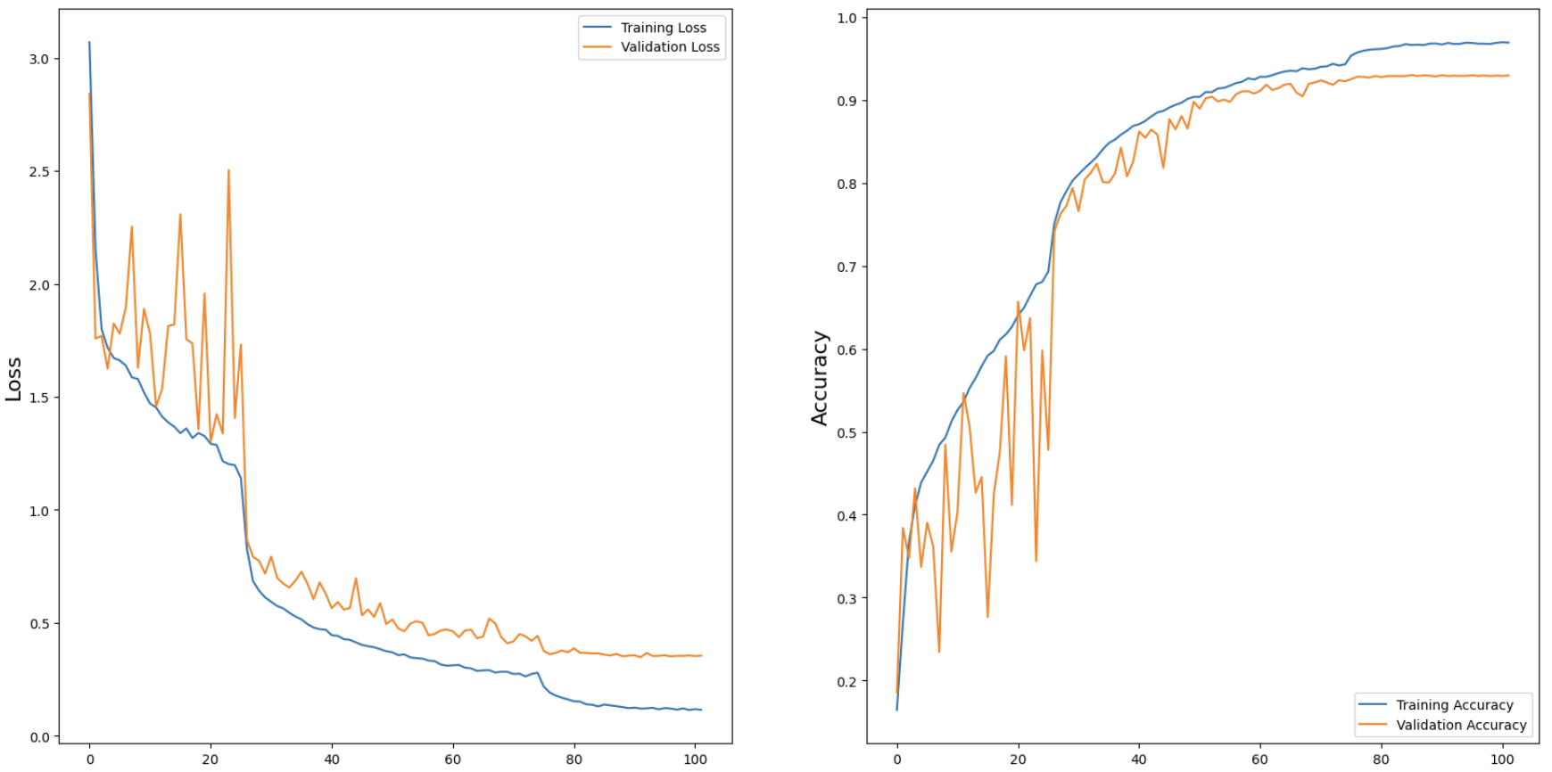
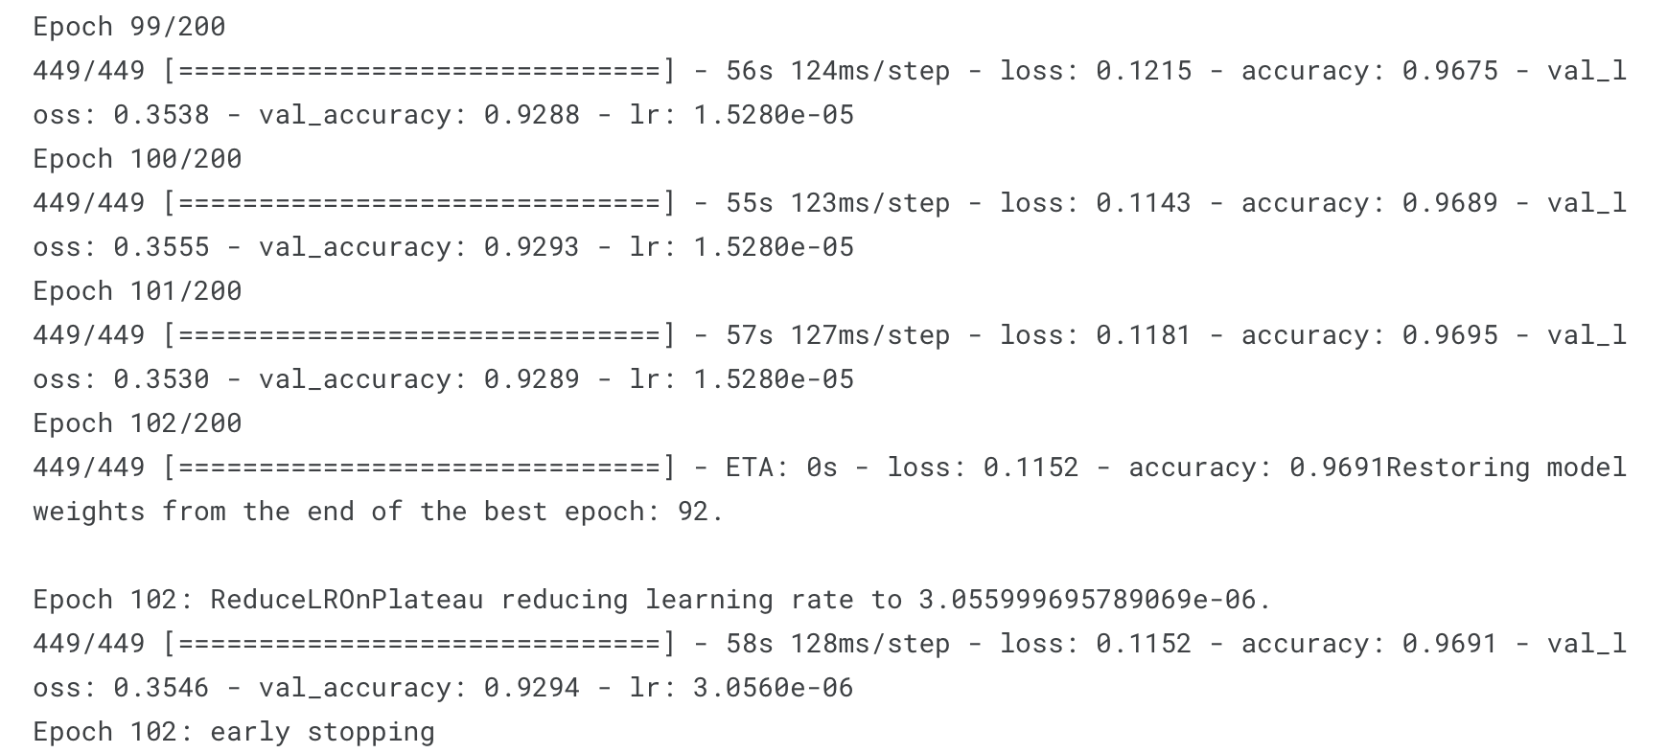
Training Progress with RMSprop Optimization
Test loss: 0.3480
Test Accuracy: 0.9288

Slide 10
Discussion on Training
The training loss consistently decreased throughout epochs, indicating effective learning from the training data
The validation loss closely followed, signifying good generalization and a well-optimized model.
The convergence of both losses in later epochs suggests a stable and robust model configuration.

Slide 11
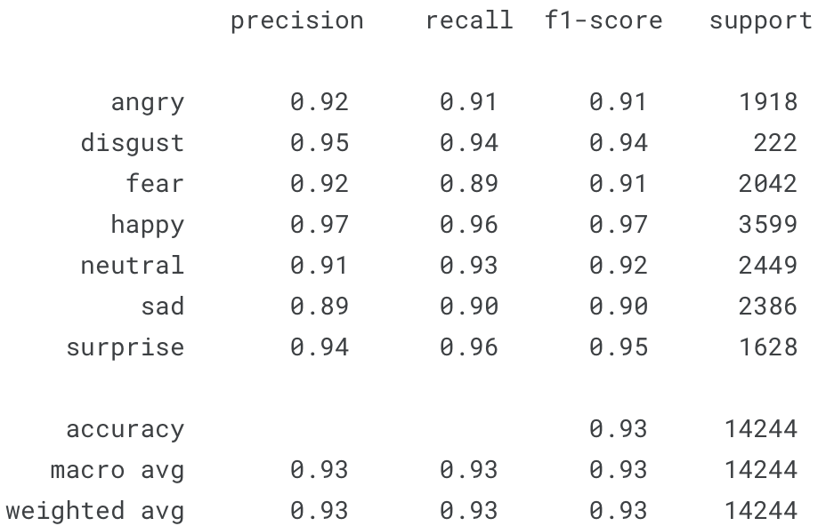
Classification Report

Slide 12
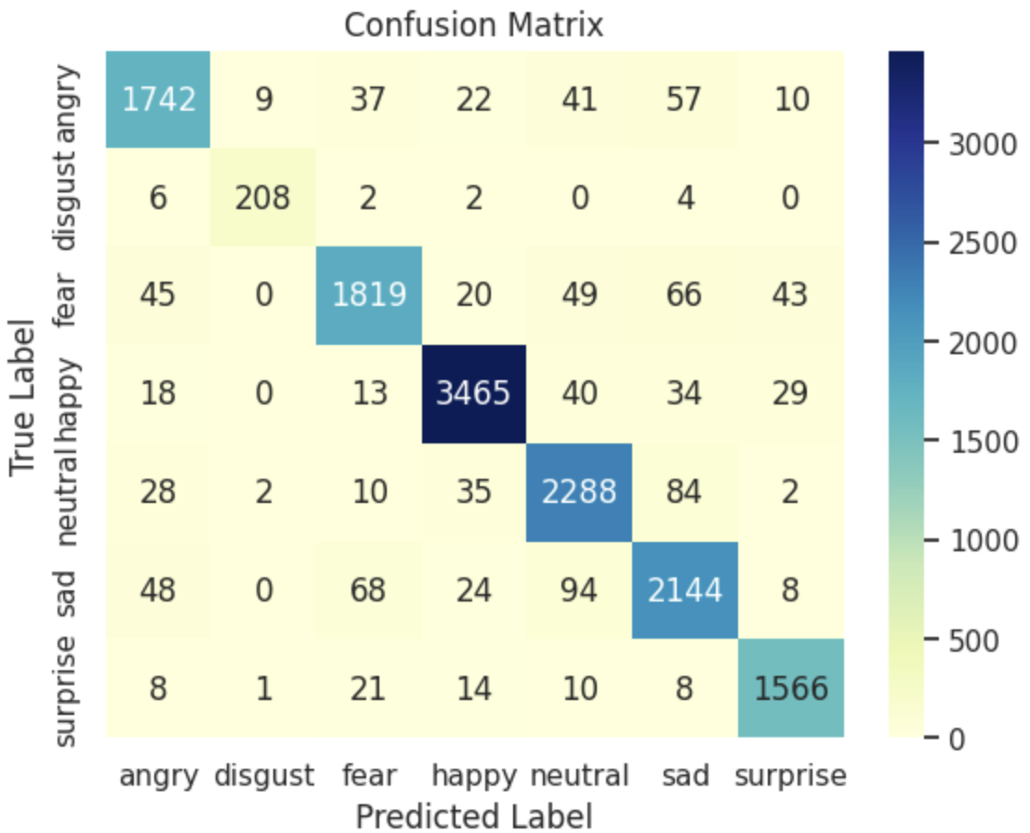
Confusion Matrix

Slide 13
Discussion on Classification
Consistent Precision and Recall: The report highlights high precision and recall for various emotions, showcasing the model's accuracy in emotion classification.
Balanced Performance: A macro-average F1-score of 0.92 indicates a well-balanced performance across emotions, with minimal bias.
Impressive Accuracy: Achieving 93% accuracy, the model excels in accurately predicting emotional states, demonstrating its reliability.
Robust Generalization: Strong weighted average metrics indicate the model's consistent performance across the entire dataset, emphasizing its generalization capabilities.
‘Disgust’ Class Imbalance: Address the imbalance in the "disgust" class (support: 222) through techniques like data augmentation or resampling.

Slide 14
Real-time webcam

Slide 15
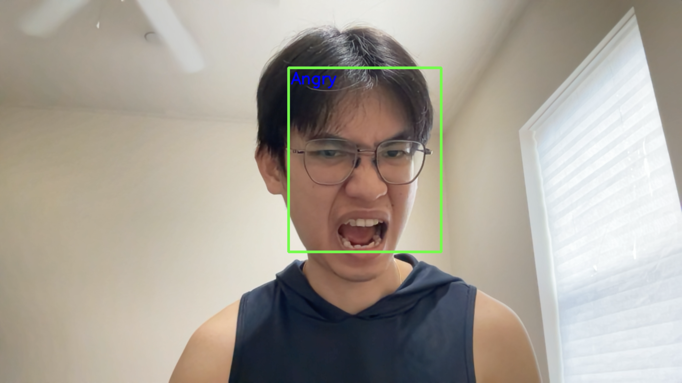
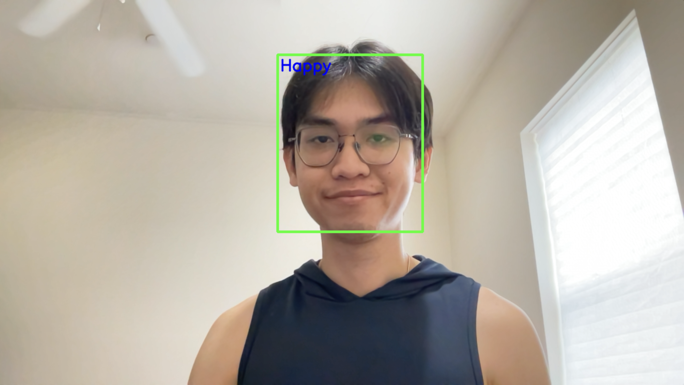
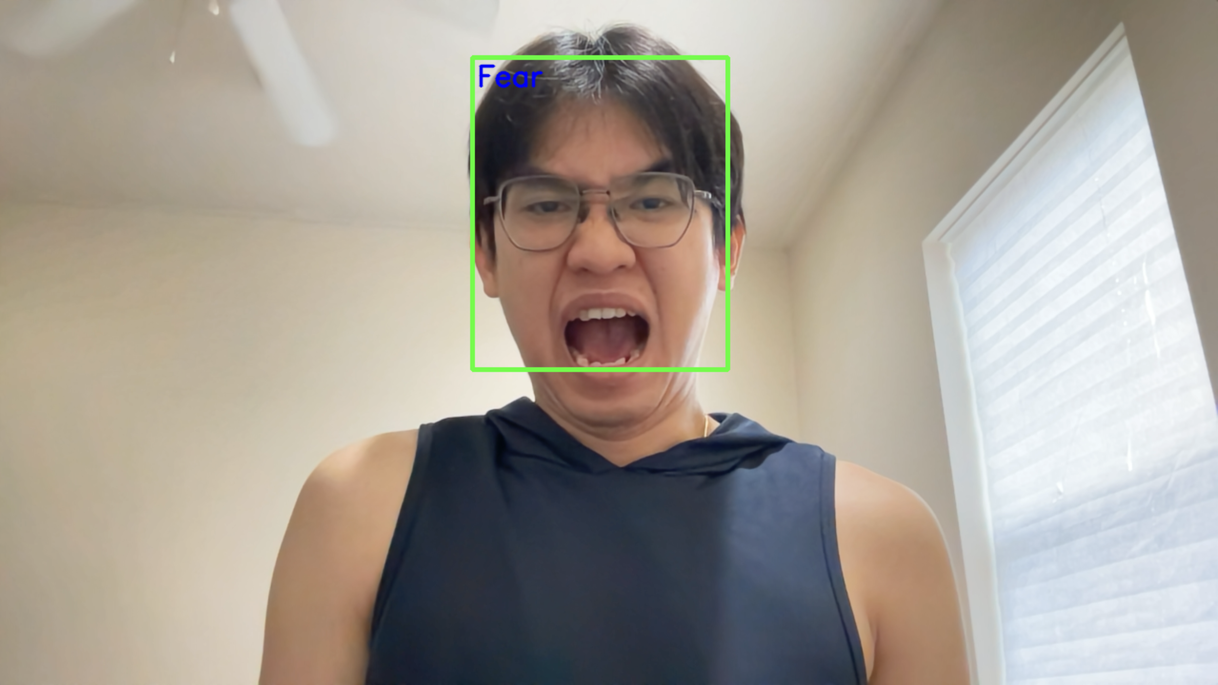
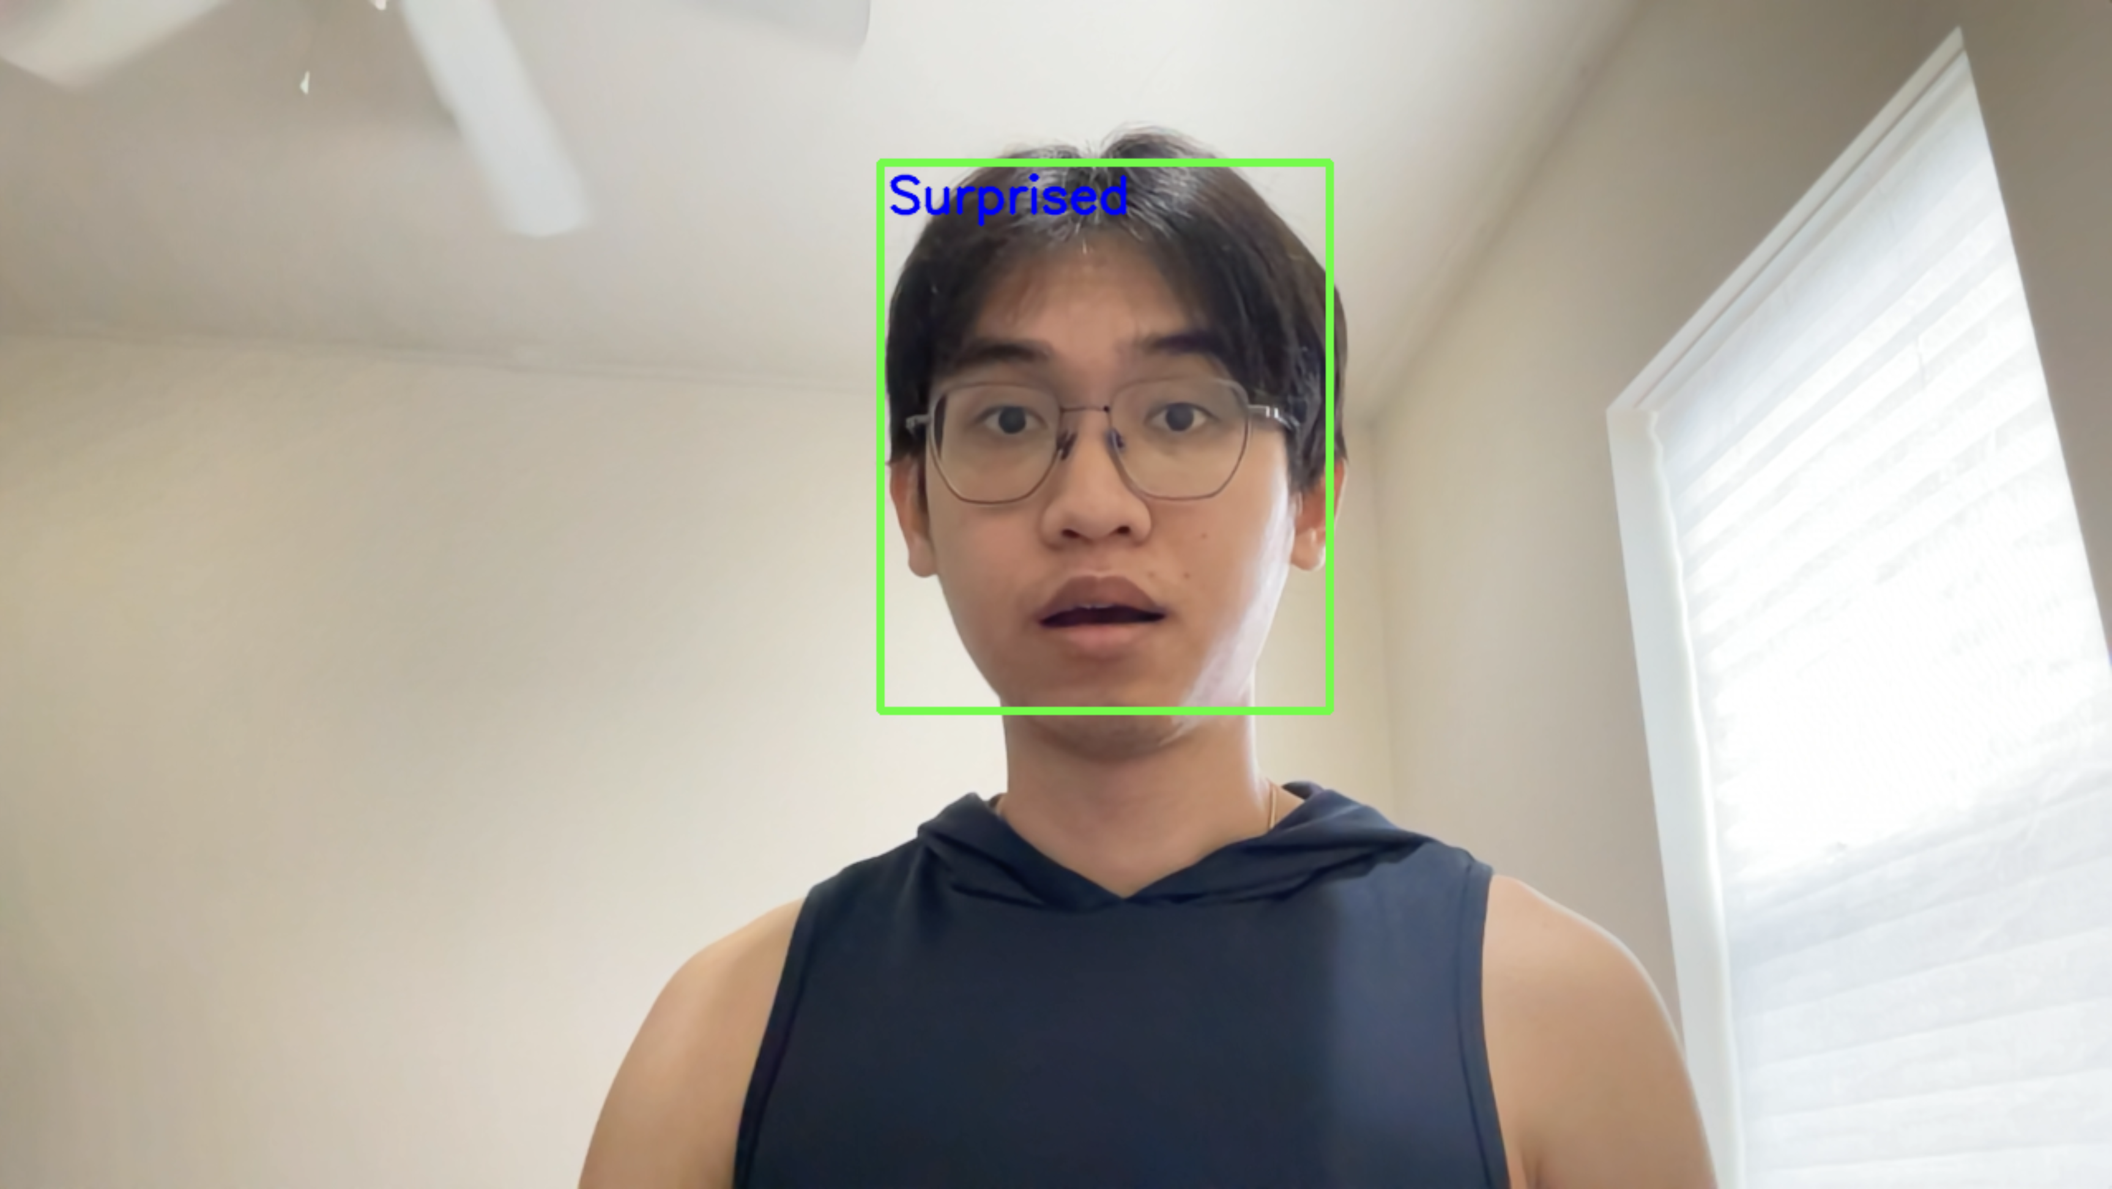
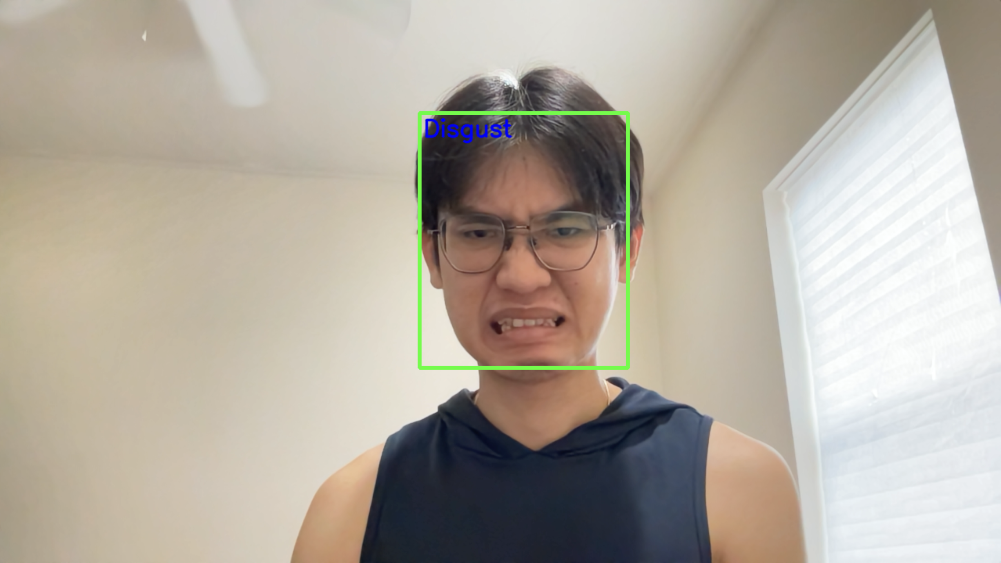
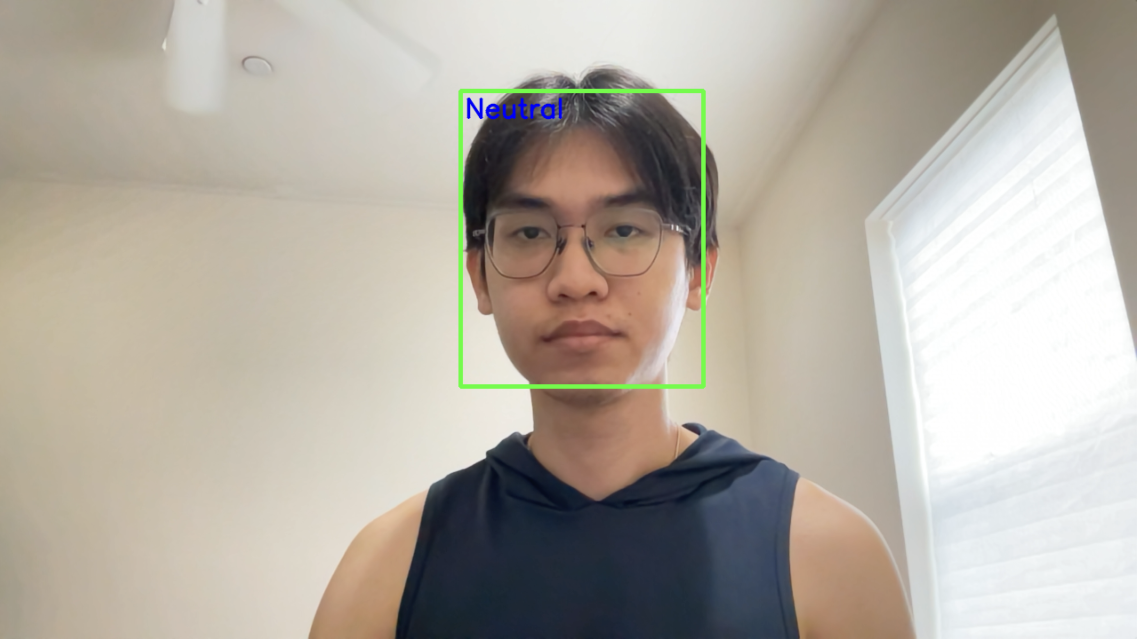
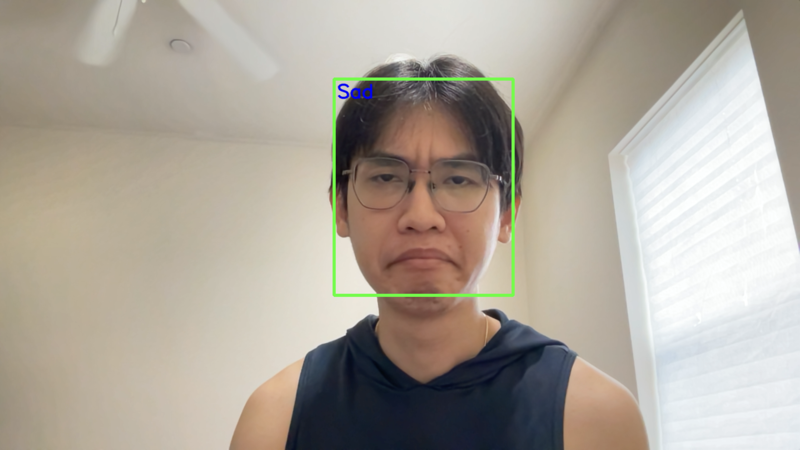
Real-time webcam
Angry
Happy
Fear
Surprised
Disgust
Neutral
Sad

Slide 16
Future directions

Slide 17
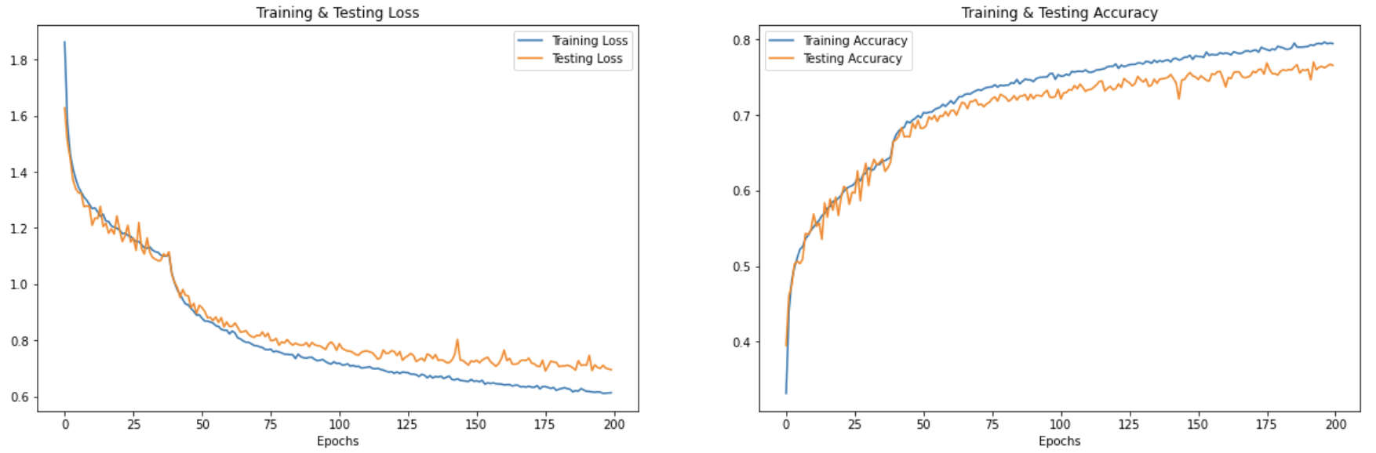
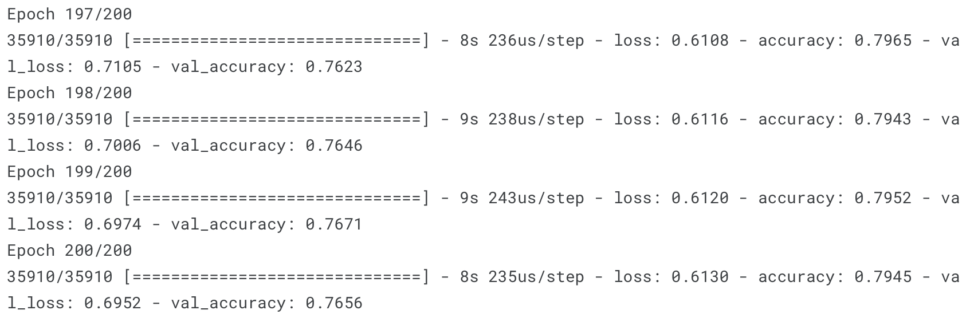
Work in progress - Speech emotion recognition: Training Progress
Test loss: 0.6952
Test Accuracy: 0.7656

Slide 18
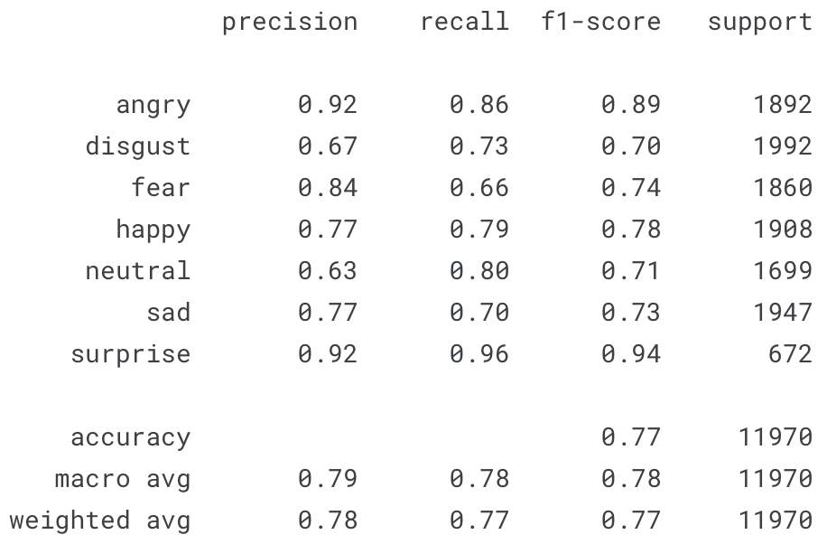
Work in progress - Speech emotion recognition: Classification Report

Slide 19
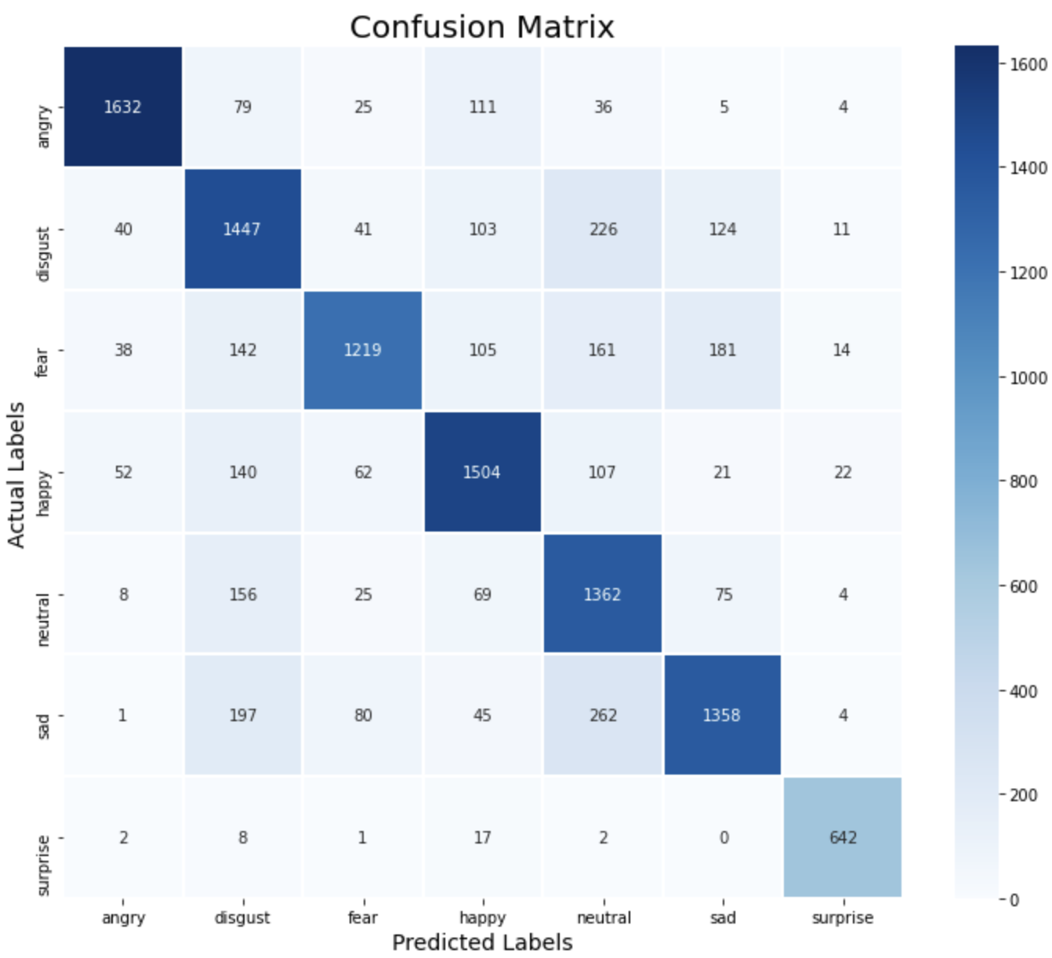
Work in progress - Speech emotion recognition: Confusion Matrix

Slide 20
Next steps
Improve the speech emotion recognition to be roughly as accurate as that of the facial emotion recognition
Integrate both facial and speech emotion recognition through the late fusion
  Late fusion involves making independent predictions using separate models for facial and speech data, and then combining these predictions at a later stage, usually at the output level.

Slide 21
Reference
Aouani, H., & Ben Ayed, Y. (2020). Speech Emotion Recognition with deep learning. Procedia Computer Science, 176, 251-260. https://doi.org/10.1016/j.procs.2020.08.027
Emerich, S., Lupu, E., & Apatean, A. (2009). Emotions recognition by speech and facial expressions analysis. In 17th European Signal Processing Conference (EUSIPCO 2009). https://www.eurasip.org/Proceedings/Eusipco/Eusipco2009/contents/papers/1569192455.pdf
Huang, ZY., Chiang, CC., Chen, JH. et al. A study on computer vision for facial emotion recognition. Sci Rep 13, 8425 (2023). https://doi.org/10.1038/s41598-023-35446-4
Mellouk, W., & Handouzi, W. (2020). Facial emotion recognition using deep learning: review and insights. Procedia Computer Science, 175, 689-694. https://doi.org/10.1016/j.procs.2020.07.101
T. M. Wani, T. S. Gunawan, S. A. A. Qadri, M. Kartiwi and E. Ambikairajah, "A Comprehensive Review of Speech Emotion Recognition Systems," in IEEE Access, vol. 9, pp. 47795-47814, 2021, doi: 10.1109/ACCESS.2021.3068045

Slide 22
Reference: Dataset
Facial Dataset
https://www.kaggle.com/datasets/msambare/fer2013
https://www.kaggle.com/datasets/samaneheslamifar/facial-emotion-expressions
Speech Dataset
https://www.kaggle.com/datasets/uwrfkaggler/ravdess-emotional-speech-audio
https://www.kaggle.com/datasets/ejlok1/toronto-emotional-speech-set-tess
https://www.kaggle.com/datasets/ejlok1/cremad
https://www.kaggle.com/datasets/ejlok1/surrey-audiovisual-expressed-emotion-savee

Slide 23
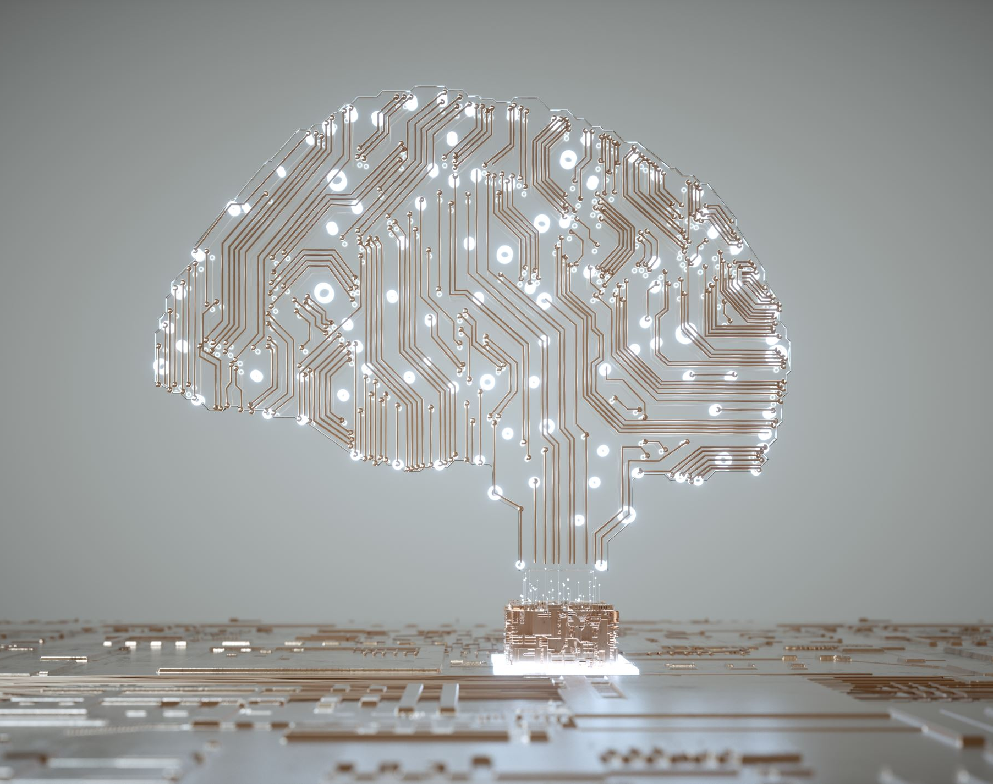
Thank you

