Slide 1
Photo Culling with Machine Learning
CIS-5603
Sayantan Kundu
Temple University – Fall '23

Slide 2
Introduction
Automating the process of sorting and organizing vast collections of images through machine learning algorithms.
Automated Selection: Using AI to intelligently identify and select images based on specified criteria.
Efficient Sorting: Streamlining the categorization and arrangement of images for easy access and management.
Enhanced Workflow: Reducing manual effort and time spent on organizing visual content, optimizing productivity.

Slide 3
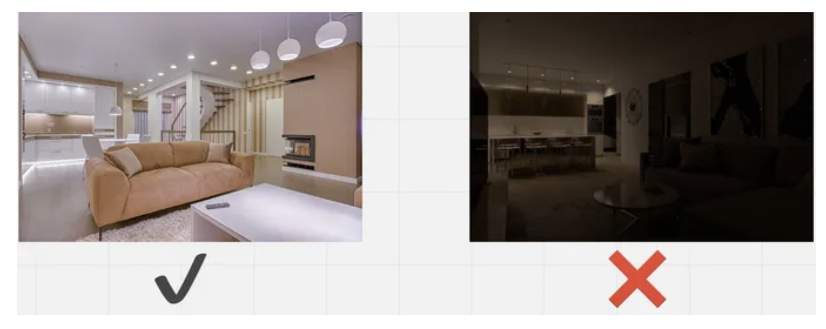
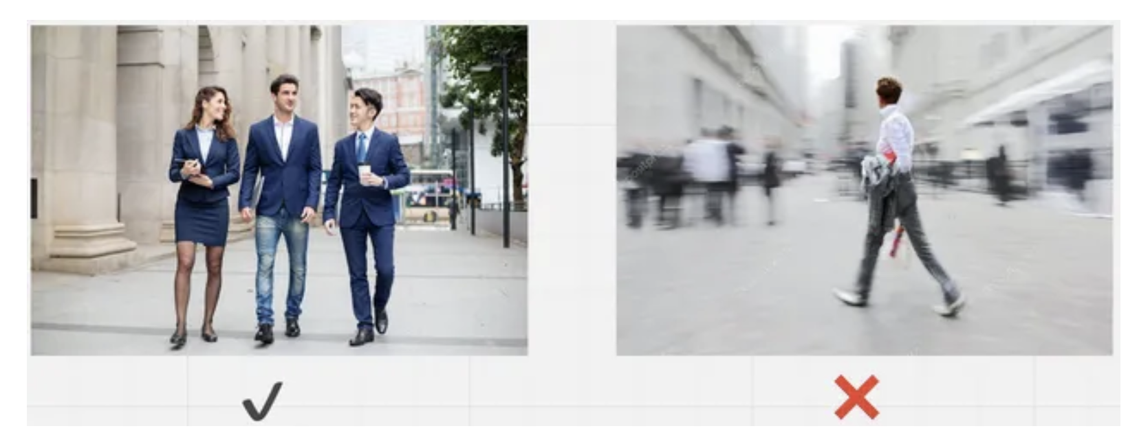
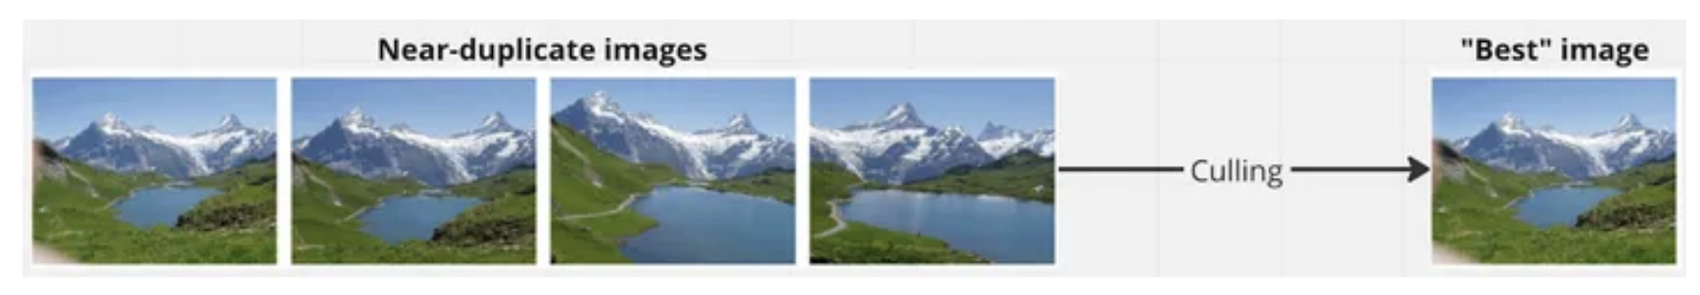
Overview
This project leverages machine learning models such as VGG16, EfficientNETB0, and ResNet50 to automate photo culling, sorting vast image collections efficiently. Focused on a custom dataset, the goal is to achieve high accuracy in selecting and optimizing the curation process for diverse visual content.
Photo Blur Detection
Exposure Assessment
Distortion Recognition

Slide 4
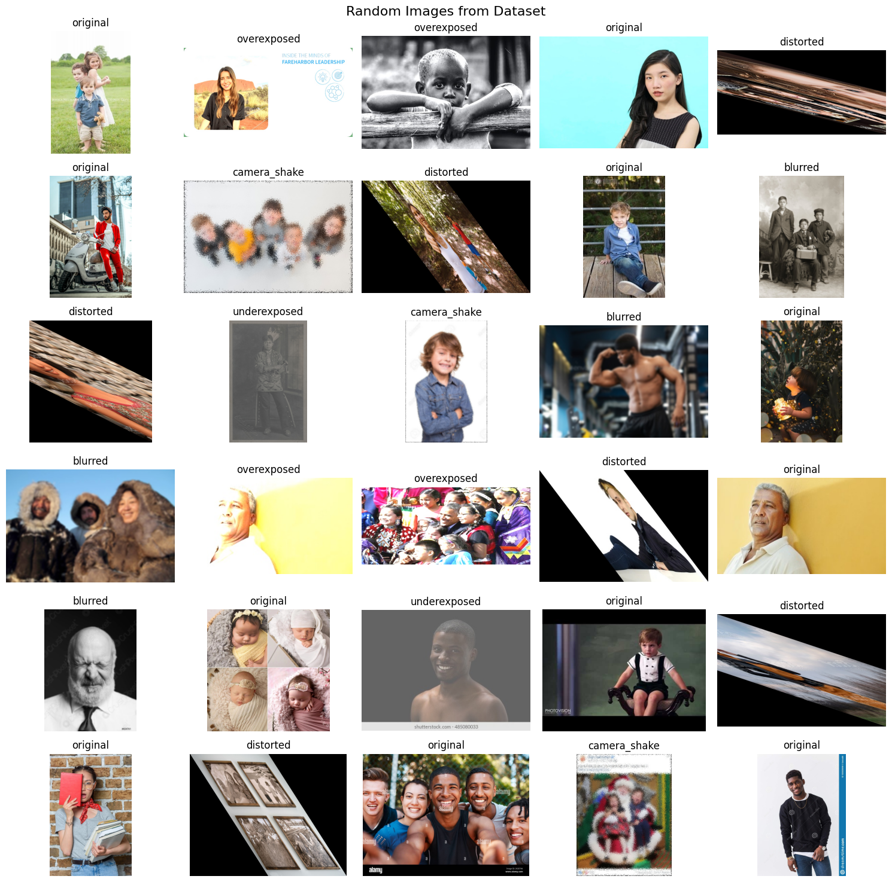
Project Framework
Project Basics
Custom Dataset Sample
Base Dataset - https://www.kaggle.com/datasets/sbaghbidi/human-faces-object-detection
Models:
VGG16, EfficientNETB0, ResNet50
Labels:
Original, Blurred, Camera_Shake, Distorted, Overexposed, Underexposed
Best Model (After Experiment) - ResNet50
Model Efficiency (After Experiment) - 0.991
Total No. Of Images in Dataset - 1680
Project Part 1 – Create Custom Dataset (from Base Dataset) for 6 Labels.
Project Part 2 – Finding the best model.
Project Part 3 – Creating a WebUI to use custom Images

Slide 5
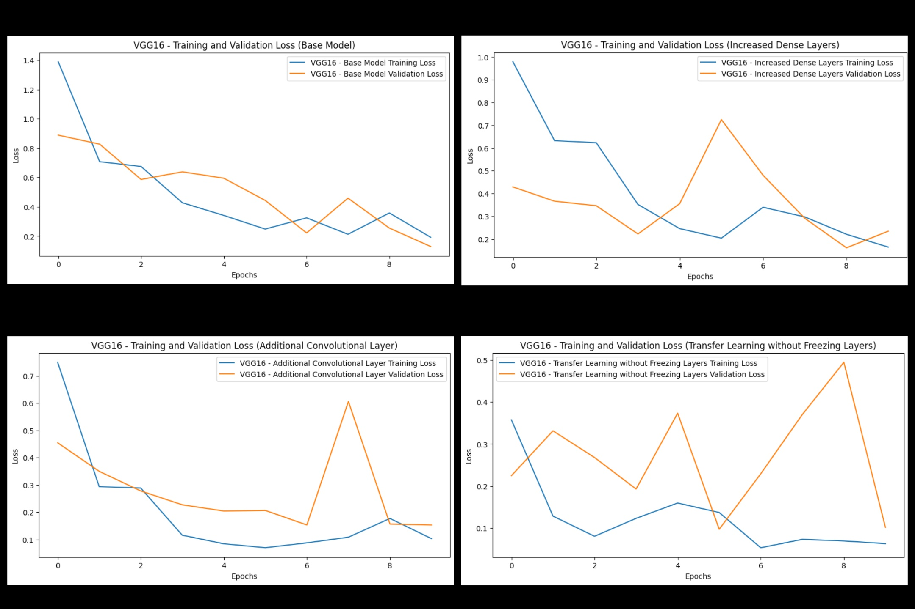
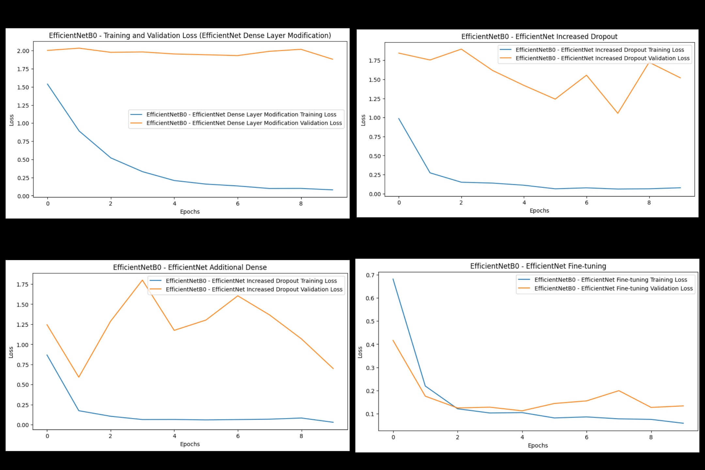
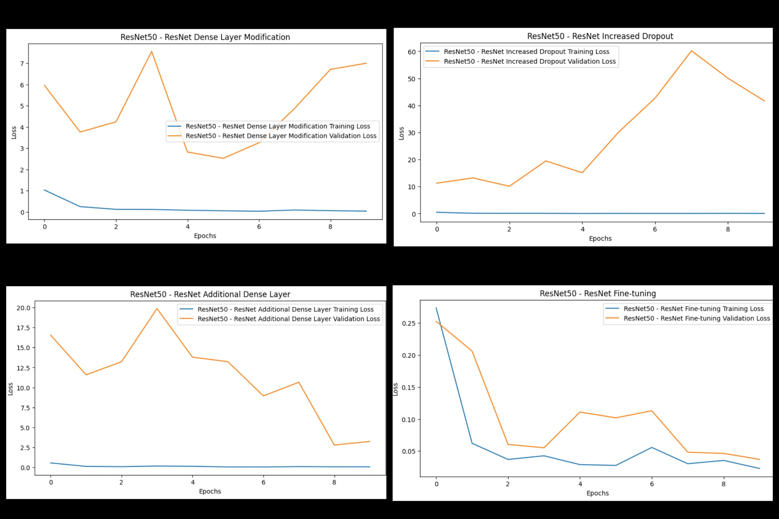
Model Performance
VGG16 Performance
EfficientNETB0 Performance
ResNet50 Performance

Slide 6

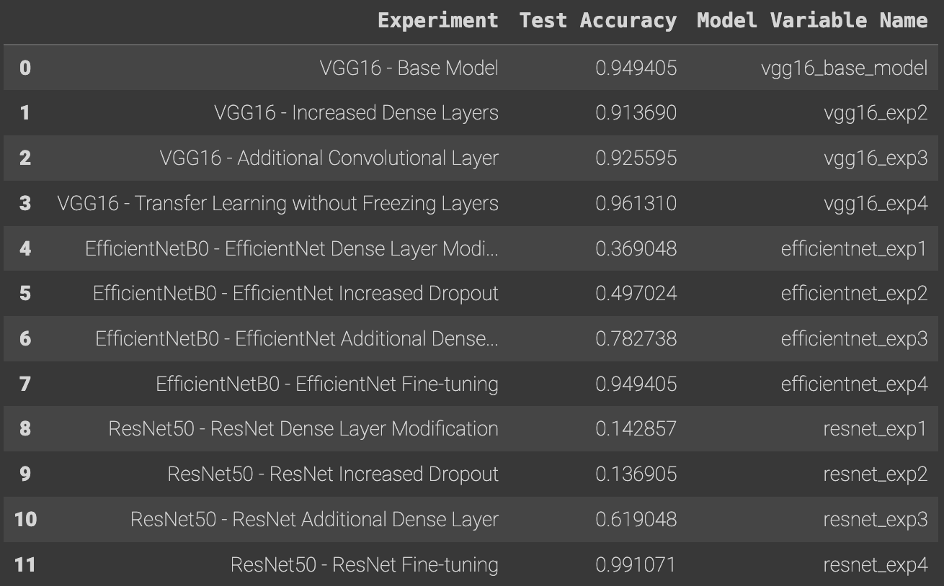
Accuracy & Prediction
Accuracy List
Prediction – Test Data

Slide 7
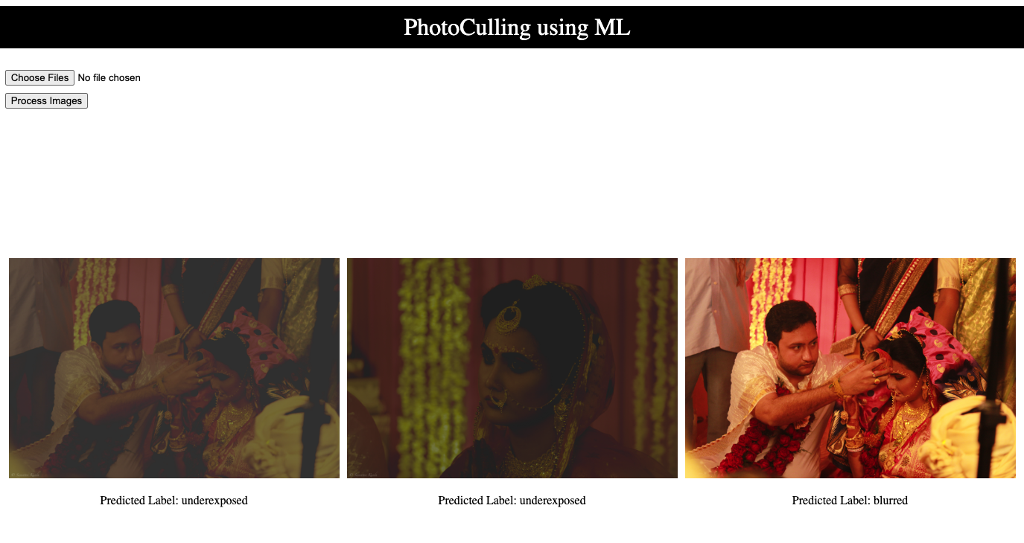
Real World Implementation & Future Work
WebUI – Custom Image
Future Extension
Doesn't work good with shallow depth of focus on subject, classifies as blurred.
Camera Shake data must be more real life like dataset.
Eyes blink detection.
Nearby Duplicate Detection should be added.
Facial Expression Recognition.
Should be able to divide images in 3 buckets of "To be Deleted", "Must Haves" & "Maybes" based on priority labels.
More complex implementation of rule-of-third and golden ration.
http://127.0.0.1:5000/

Slide 8
Thank you

