Slide 1
Creating Artificial Intelligence to Play Games - Chess
CIS 5603: Artificial Intelligence
John Bannan and Arpita Das

Slide 2
Chess- Background and Rules
Rules and Game State
Chess is played on a 8 x 8 grid with black and white pieces, with white going first
Players each take turns moving a single piece on the board
The goal is to capture the opponent's King which ends with a checkmate
There are 6 Chess pieces: pawns, knights, bishops, rooks, queens, and king, each with their own rules for movement and capture
Board rules and conditions are supplied by the Python Chess library

Slide 3
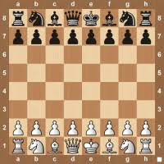
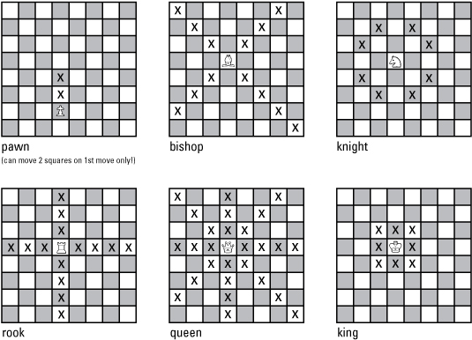
Chess- Background and Rules

Slide 4
Chess AI Implementation: Evaluation Function/ Min-Max Method
Algorithm Steps:
Board Evaluation
Movement Selection
Min Max
Alpha-Beta Pruning
Quiescence Search

Slide 5
Chess AI Implementation: Board Evaluation
Game state for both players has to be evaluated in some numerical way, we can do this through an evaluation function.
  Evaluation function = Material Score + pawn Score + KnightS score + Rook Score + Queen Score + King Score
We can assign Piece Square Tables, to each piece for each position on the board
  For example: A knight on the edge of the board has more restricted movement, so the squares on the edge will have negative scores for the knight.
We also need to check if the game is done (checkmate), returns -9999 if white loses or +9999 if white wins
Score calculations for evaluation function:
  Individual Piece Score: Sum of the piece square values of the current positions in the game
  Material Score: Sum of all piece weights multiplied by the difference between the number of that piece between each player

Slide 6
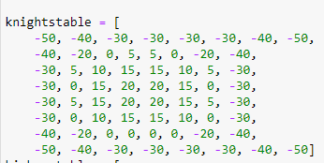
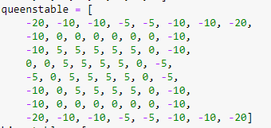
Chess AI Implementation: Board Evaluation

Slide 7
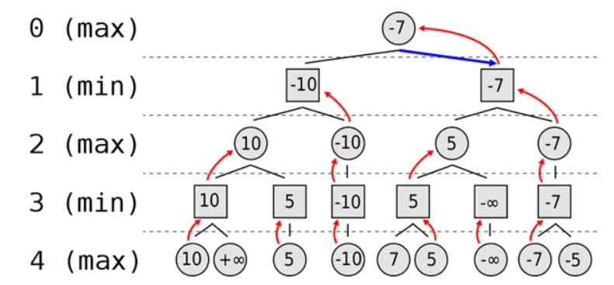
Chess AI Implementation: Min Max Algorithm and Movement Selection
The Min Max Algorithm is typically used in two player games like Chess and Checkers and is used as our decision rule in our AI
The Min Max Algorithm focuses on minimizing the loss for each scenario, i.e each player is attempting to minimize the chance they lose, or maximize their chances of winning

Slide 8
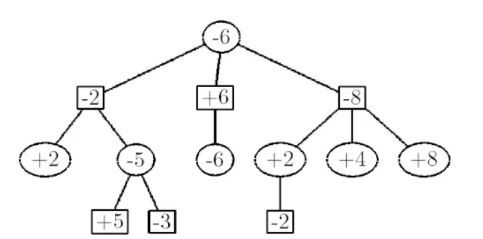
Chess AI Implementation: Min Max Algorithm and Movement Selection
A variation of Min Max Algorithm is called Negated Min Max in which one player’s loss is equivalent to the other player’s gain. Thus the game is zero-sum.

Slide 9
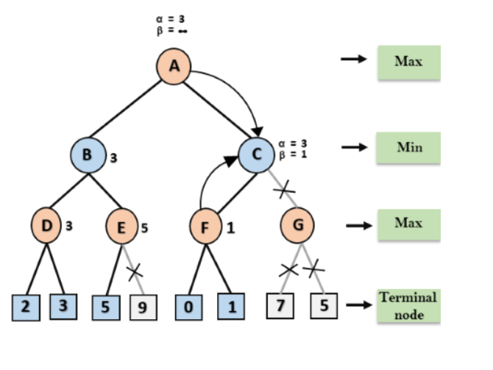
Chess AI Implementation: Min Max Algorithm and Movement Selection
Movement Selection:
The first move is selected from a library of opening moves from Chess Grandmasters
The best move (not the first move) is selected from all possible legal moves. For each move a score is generated and then the most optimal move is returned
Using an optimization method of Alpha-Beta Pruning, we can optimize the min max algorithm
Alpha is the best choice for the maximizer (high value), Beta is best choice for minimizer (low value)
Alpha-Beta Pruning prunes or cuts node of a decision tree that will not be computed and thus reduce computational time

Slide 10
Chess AI Implementation: Quiescence Search and Horizon Effect
The horizon effect is an problem due to the number of possible states being so large and the limitations of the computer to search a small portion of space.
Because of this limitation, an AI algorithm may pick a move that seems to beneficial now, but may be detrimental in the future, but the computer could not tell because of the limit or ‘horizon’ of the search
In Chess, an example of the horizon effect is the computer analyzing two moves:
  1. The next move results in the loss of a Queen
  2. The next move results in the loss of a rook, but the move after (beyond the horizon) results in the loss of the Queen
  The computer will pick move 2, because losing a rook is better than the loss of a queen, but in actuality move 2 is worse because it eventually results in the loss of both the rook and the queen
To limit the effects of the horizon effect, we can implement a quiescence search

Slide 11
Chess AI Implementation: Quiescence Search and Horizon Effect
Quiescence Search: An additional search at the terminal nodes to get a better idea of the optimal move.
Typically search is limited to high volatile moves, rather than ‘quiet’ ones, i.e moves in which captures and game state is drastically changed (evaluation score is changed drastically) vs. moves in which the game state is more stable
Search lasts usually as long as the states remain volatile
In other games like Go, where the game is more ”unstable”, a lot of computational time is given to Quiescence Search

Slide 12
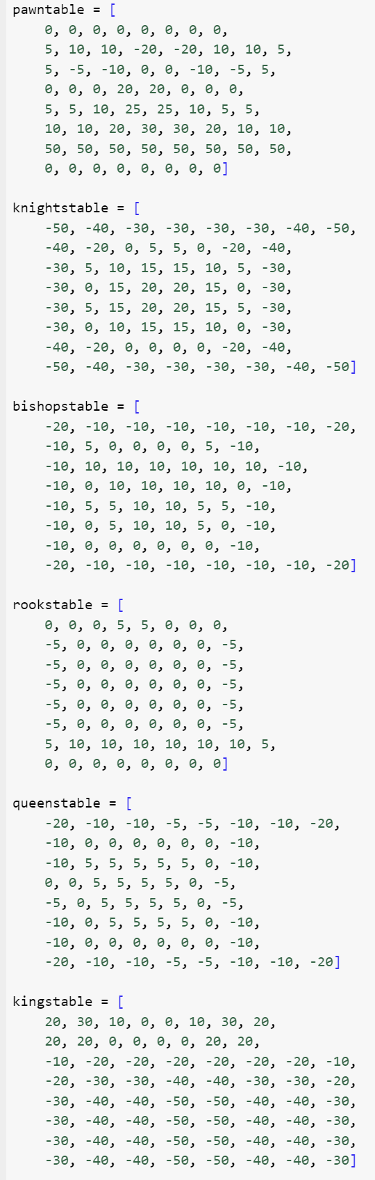
Implementation
Avoid exchanging one minor piece for three pawns.
Always have the bishop in pairs.
Avoid exchanging two minor pieces for a rook and a pawn.
the equations from the above insights will be:
Bishop > 3 Pawns & Knight > 3 Pawns
Bishop > Knight
Bishop + Knight > Rook + Pawn

Slide 13
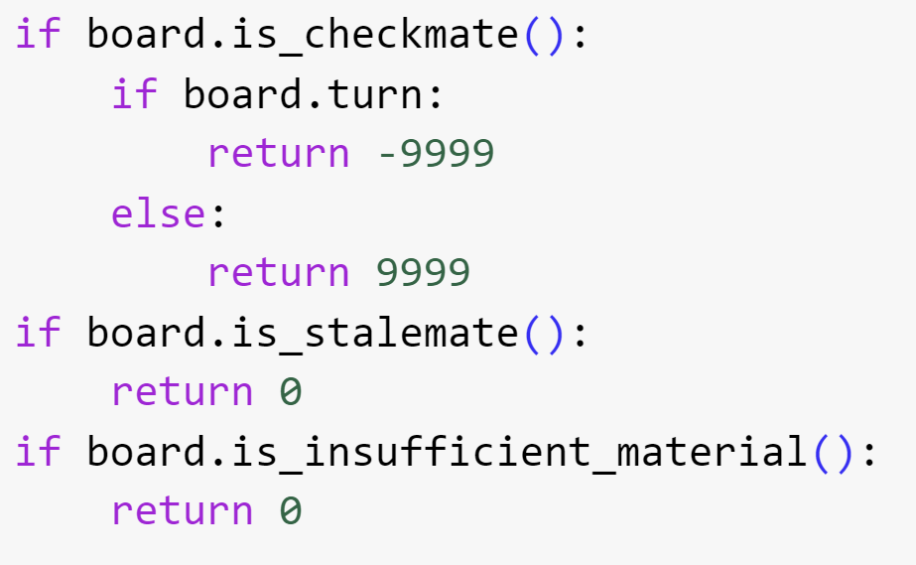
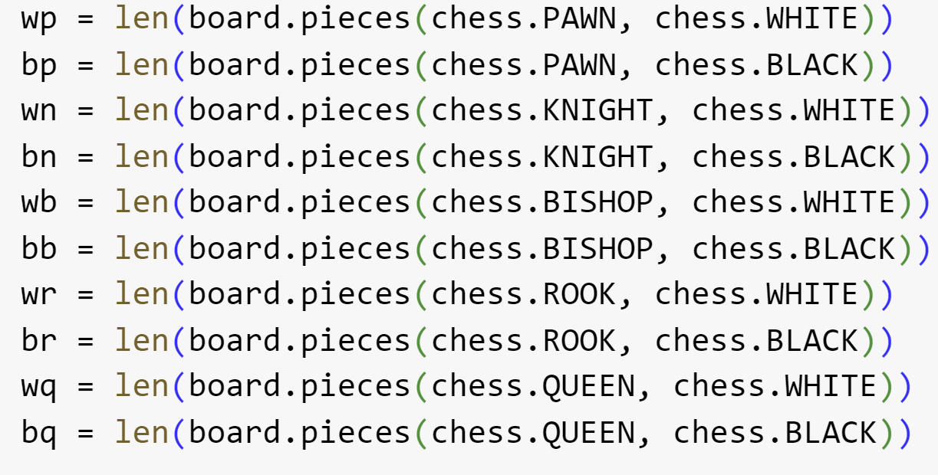
Implementation

Slide 14
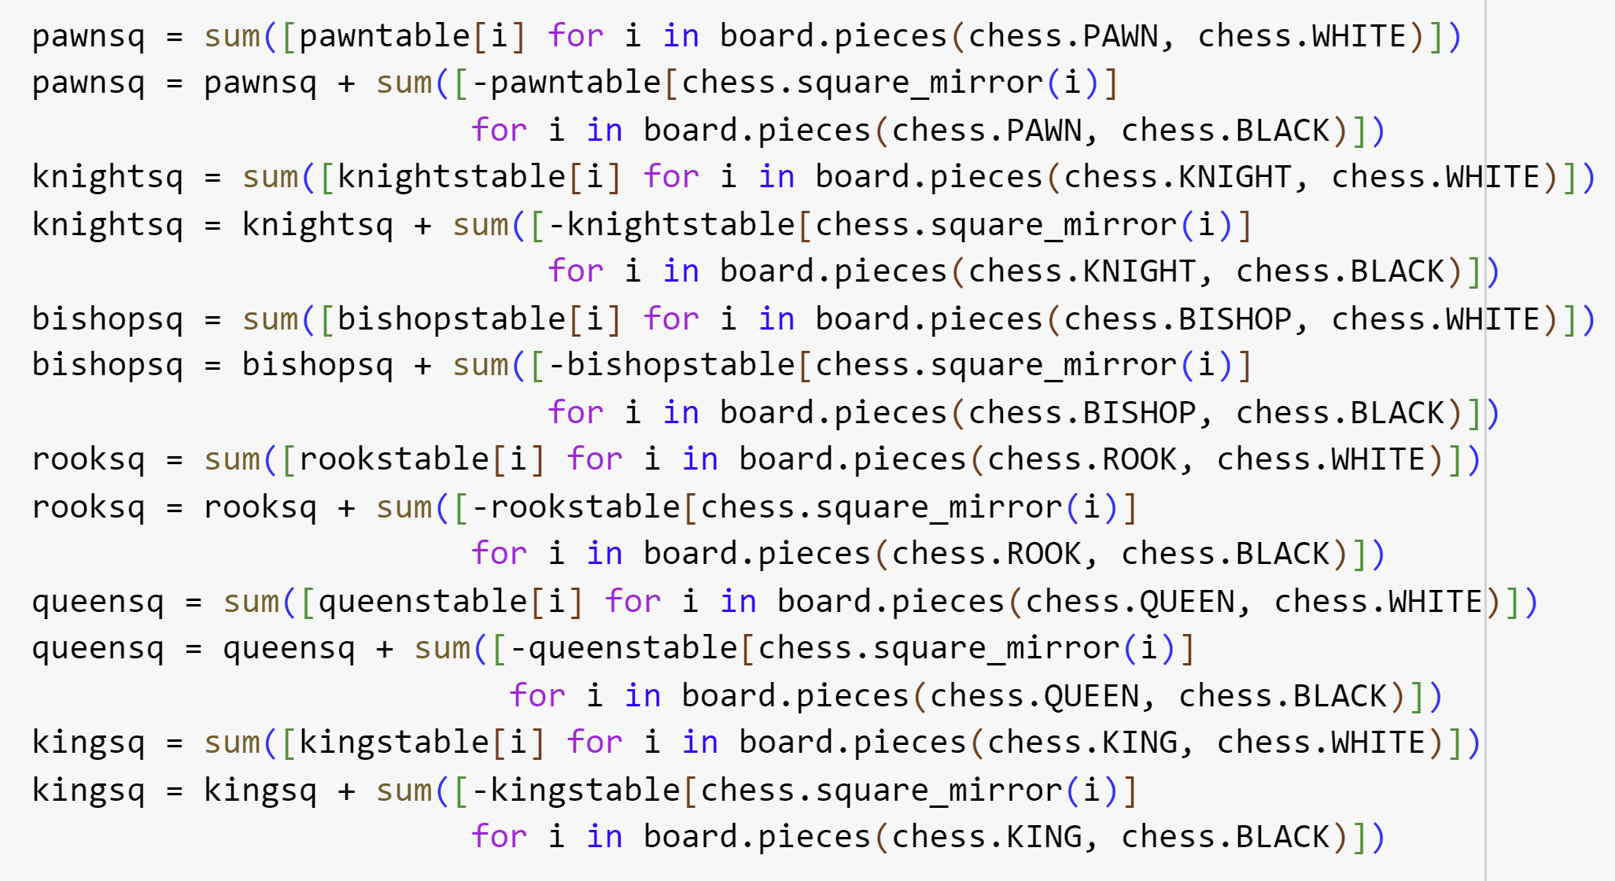
Implementation

Slide 15
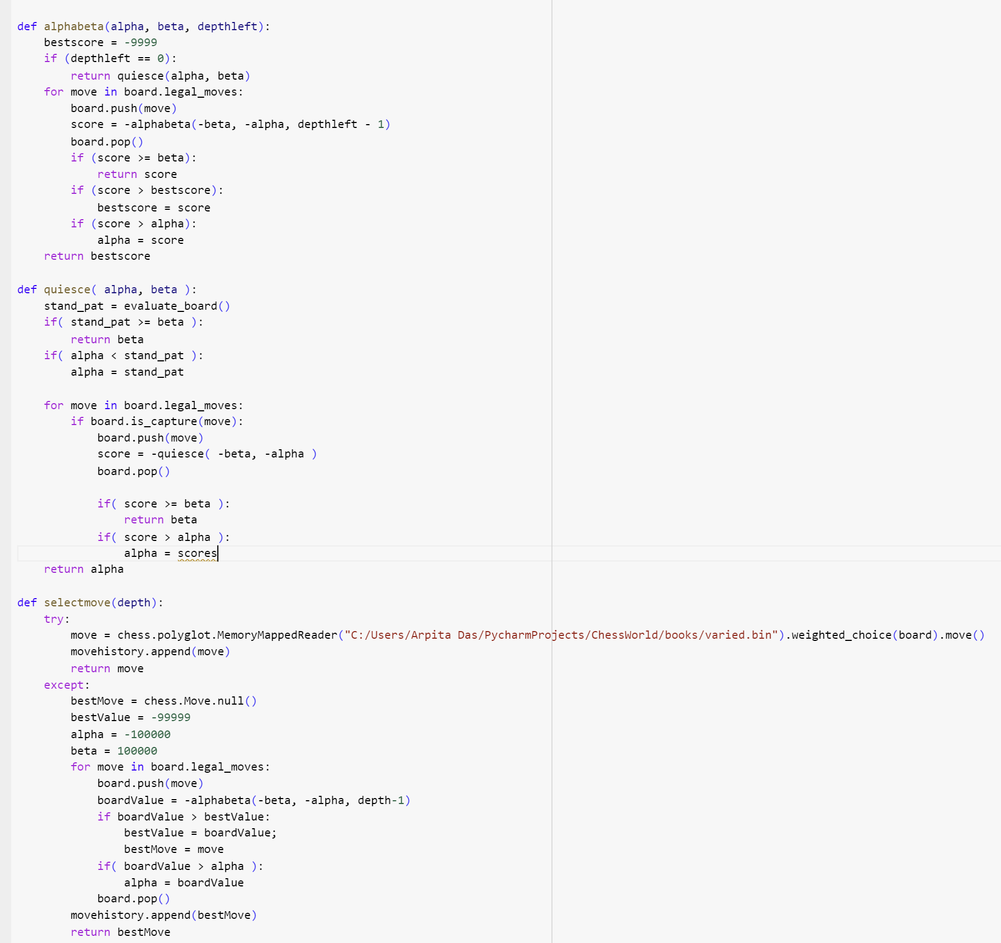
Implementation

Slide 16
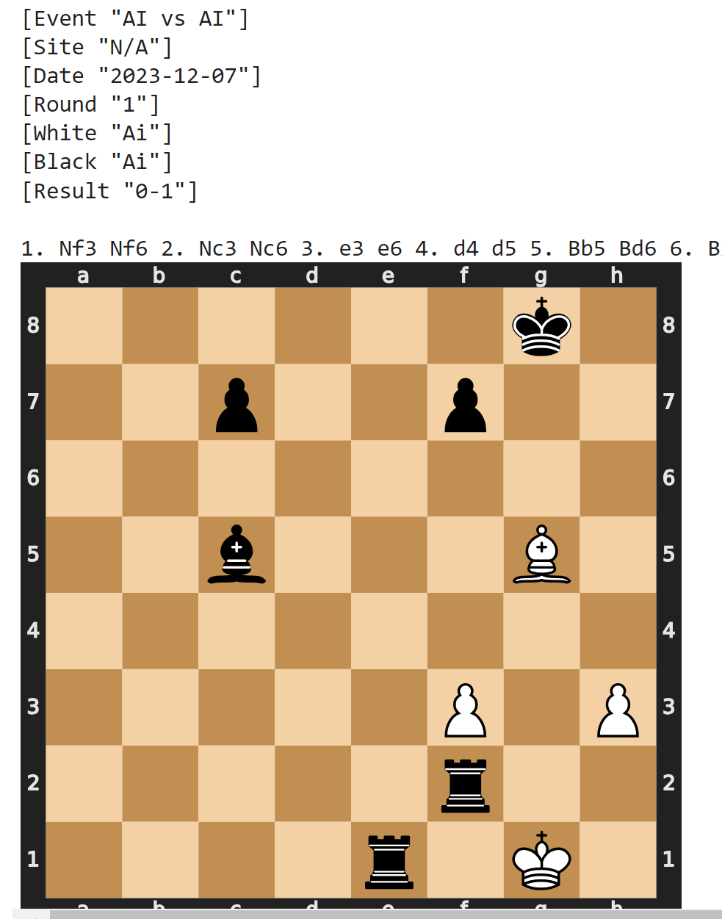
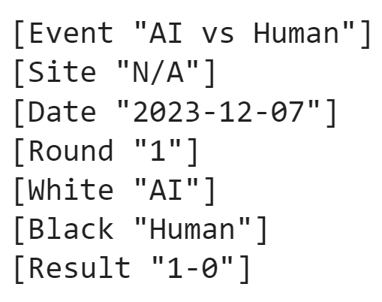
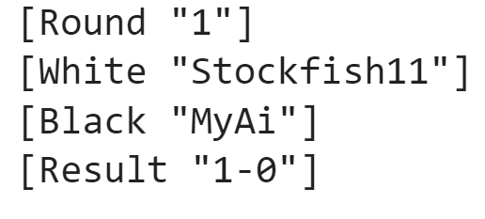
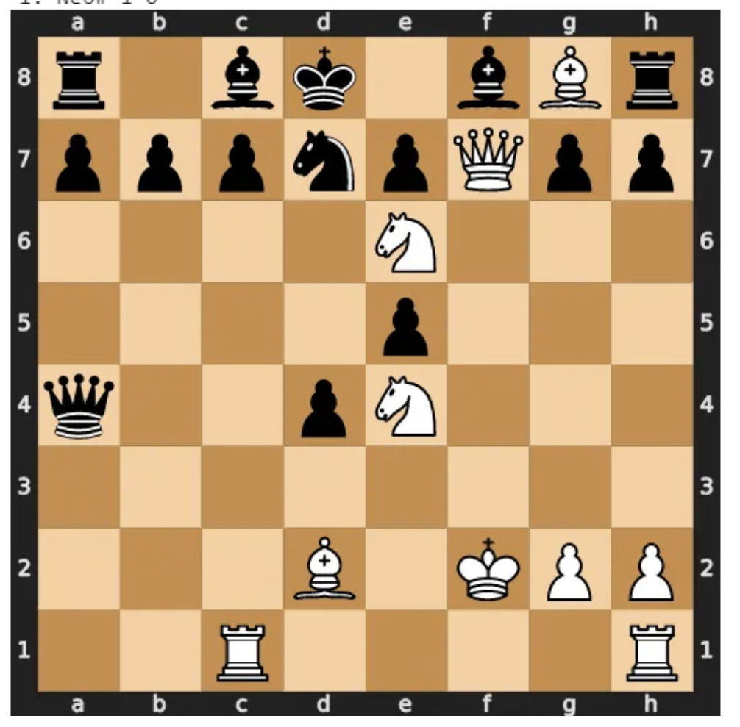
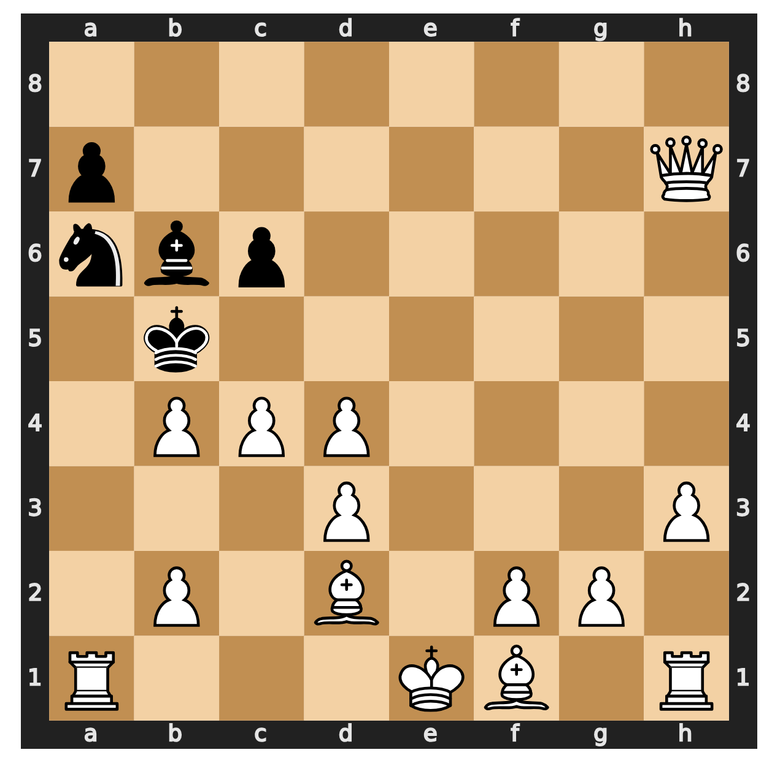
Results
AI vs AI
AI vs Human
AI vs Stockfish

Slide 17
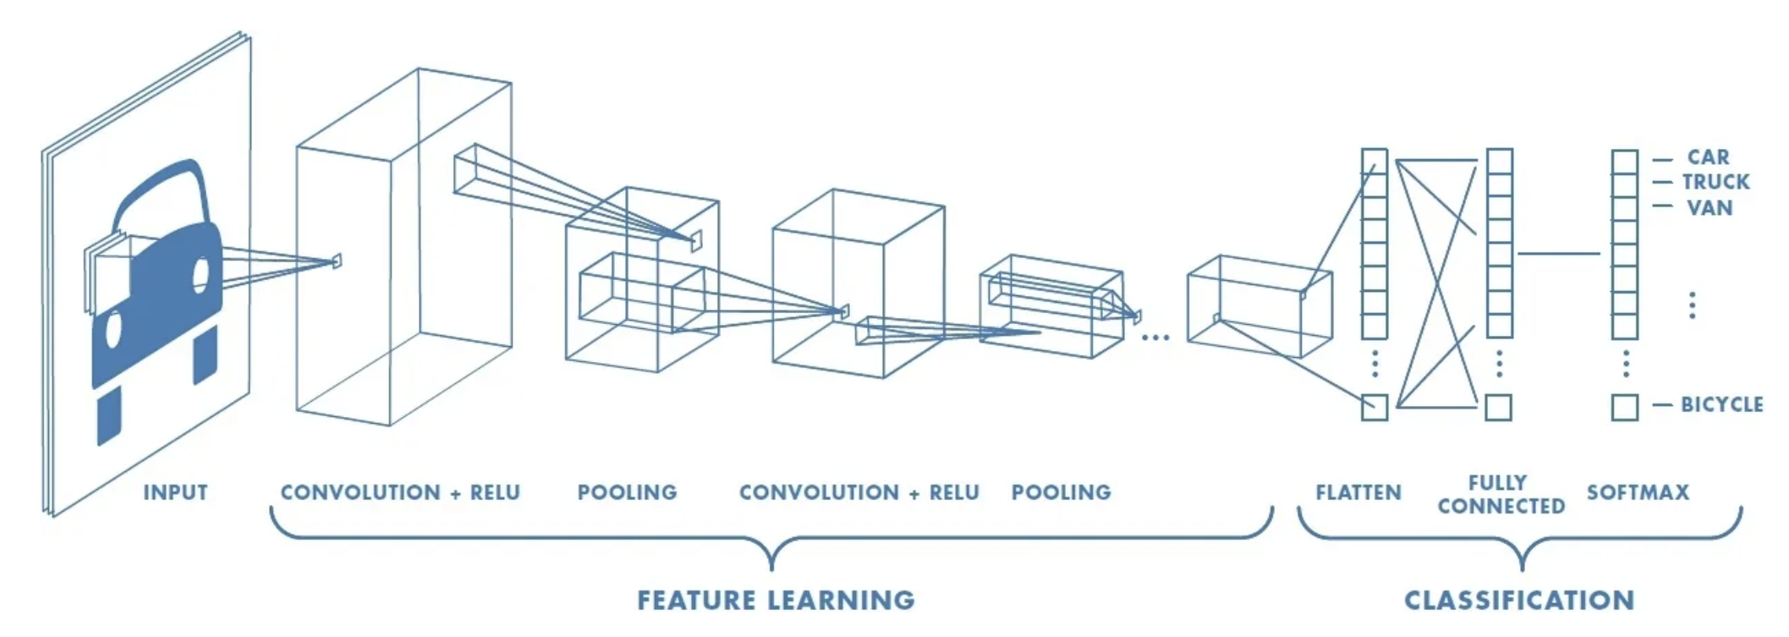
Implementation (mini-max with Tensorflow CNN)

Slide 18
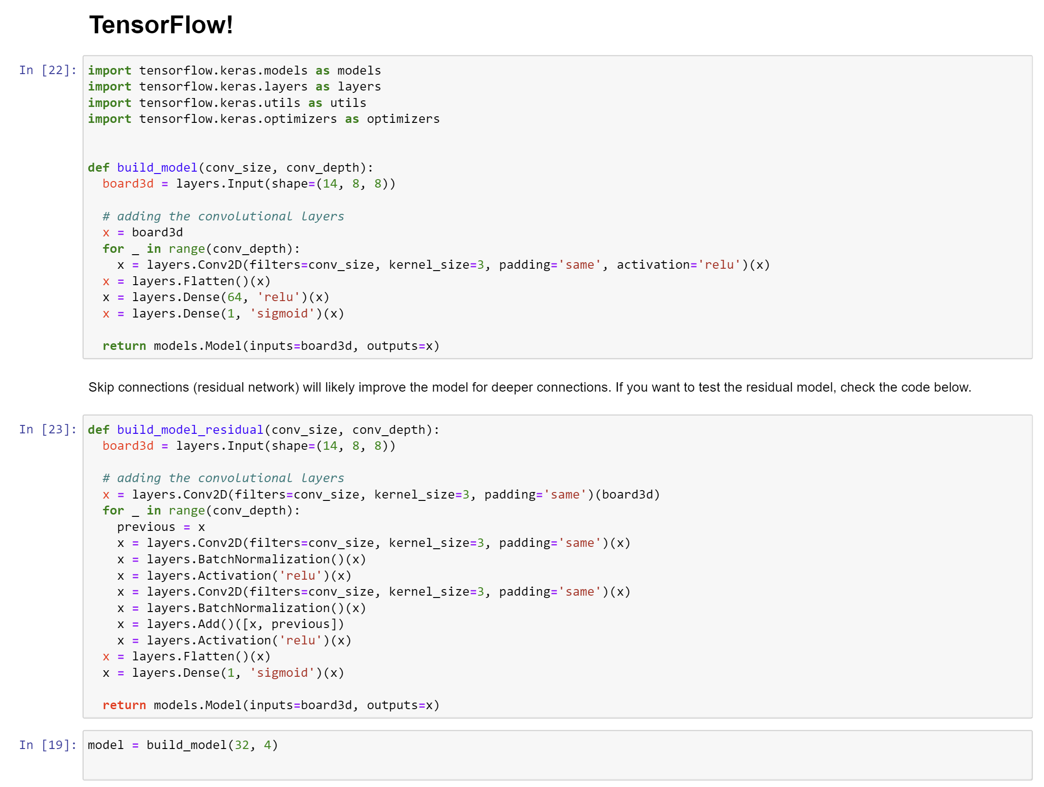
Implementation (mini-max with Tensorflow CNN)

Slide 19
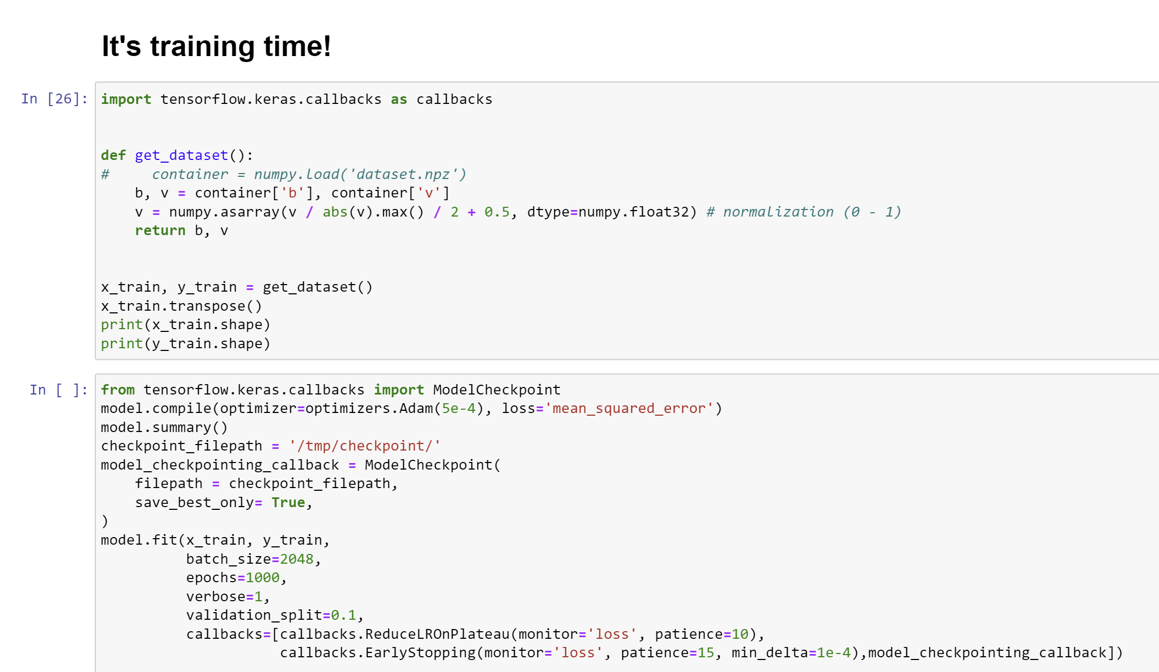
Implementation (mini-max with Tensorflow CNN)

Slide 20
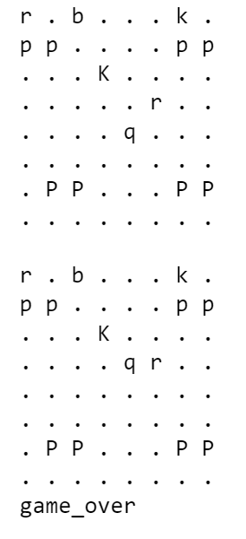
Result (mini-max move algorithm with Tensorflow CNN)
AI vs Stockfish

Slide 21
Conclusion
Addition of CNN made the move more complex and intelligent.
Min-max model served as the basic algorithm for the moves.

Slide 22
References
https://www.chessprogramming.org/Piece-Square_Tables
https://www.chessprogramming.org/Negamax
https://www.geeksforgeeks.org/minimax-algorithm-in-game-theory-set-4-alpha-beta-pruning/#
https://medium.com/dscvitpune/lets-create-a-chess-ai-8542a12afef
https://www.javatpoint.com/ai-alpha-beta-pruning
https://www.javatpoint.com/ai-alpha-beta-pruning
https://www.chessprogramming.org/Horizon_Effect
https://en.wikipedia.org/wiki/Horizon_effect
https://en.wikipedia.org/wiki/Quiescence_search

