Slide 1


AI-driven Medical Diagnosis System
CIS 5603 AI PROJECT PRESENTATION
Biruk Aweke

Slide 2
Introduction
What are Medical Diagnosis Systems (MDS)?
Medical Diagnosis Systems (MDS), often referred to as medical expert systems, are computer-based systems designed to mimic the decision-making ability of a human expert in the field of medicine.
They are systems designed to assist in the diagnosis of diseases based on patient symptoms and medical data.
They leverage AI and machine learning to analyze complex patterns in symptoms and medical histories.
They contain a vast repository of medical knowledge, including symptoms, diseases, and their relationships, treatment protocols, and diagnostic procedures.
These systems have an inference engine, a core component that applies logical rules to the stored knowledge to deduce new information or reach conclusions. This engine is responsible for the diagnostic process.

Slide 3
Introduction
Why MDS? Understanding the Need
.
Current Challenges in Preliminary Diagnosis
  Accessibility, Speed, and Accuracy
Growing demand for Digital Health Solutions
AI's Role in Healthcare
  Early detection, provide immediate & accessible guidance to users.

Slide 4
Objectives and Background
Diagnosis Assistance
  Focuses on aiding individuals to self-diagnose based on symptoms reported.
Treatment Recommendations
  Provides suggestions for treatments, aligning with current medical guidelines and personalized patient factors..
Data Analysis
  Offers valuable insights for medical research and enhances healthcare delivery systems.
Support Clinical Decision-Making
  Aids healthcare professionals in making informed decisions, particularly in complex cases involving multiple conditions

Slide 5
System Overview: AI and Prolog-based Architecture
1
Symptom Analysis
The system employs a detailed questioning process to compile and analyze symptoms reported by the user.
Prolog Integration
2
The architecture incorporates Prolog, a logical programming language, to manage medical knowledge and enable intelligent reasoning.
3
Efficient Decision Making
By combining AI and Prolog, the system achieves faster and accurate diagnoses, ensuring optimal patient care.

Slide 6
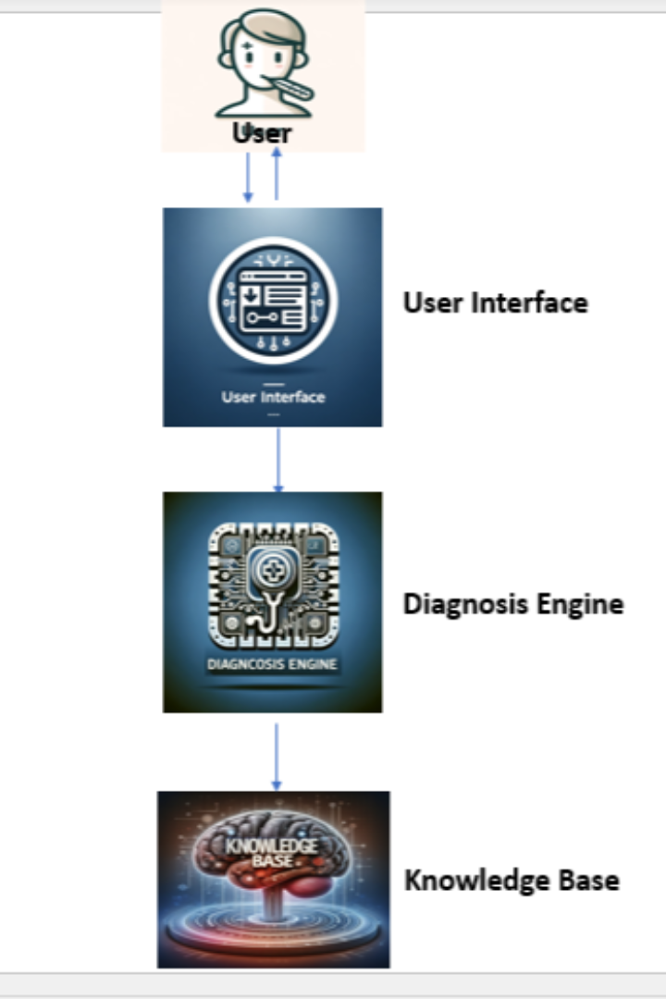
Architecture Details
• User Interface (UI)
- Facilitates symptom input and interaction
• AI-powered Diagnosis Engine
- Analyzes these inputs, queries the Knowledge Base, and applies Rule-Based Reasoning, Pattern matiching and Probabilistic (Bayesian) reasoning to suggest possible conditions.
• Knowledge base
- A comprehensive database of medical knowledge including conditions, symptoms, and their interconnections, encoded in Prolog for logical processing efficiency.
- MedlinePlus.gov, Mayoclinic.org

Slide 7
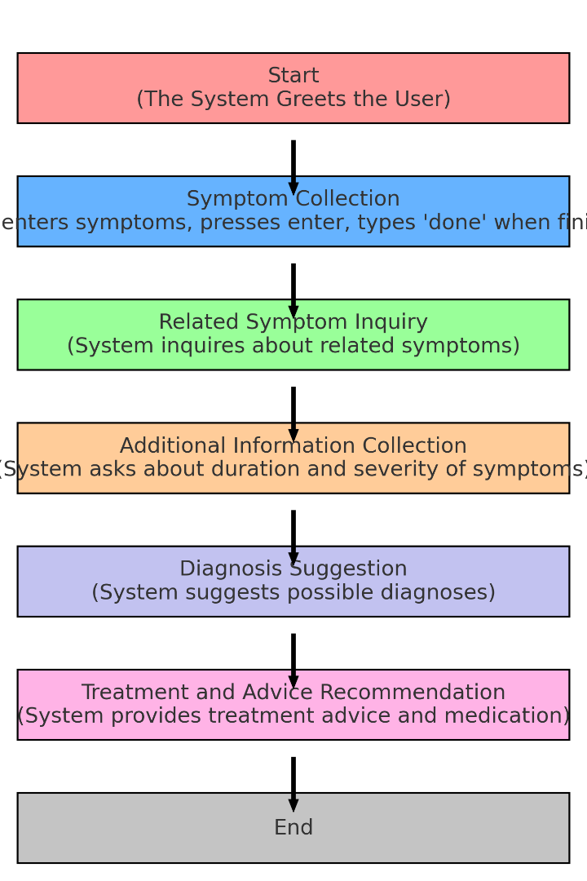
MDS System Workflow
Initial Interaction: User is welcomed by the system and prompted to enter symptoms one at a time.
Symptom Collection: The system queries the user for more details on each symptom, such as duration and severity, to enhance the accuracy of the diagnosis.
Related Symptoms Inquiry: Utilizing a comprehensive knowledge base, the system identifies and inquires about additional symptoms related to those initially reported.
Bayesian Reasoning for Diagnosis: Using Bayesian reasoning, the system updates disease probabilities based on symptom presence and severity, allowing for a nuanced analysis of potential diagnoses.
Diagnosis and Recommendations: The system presents possible diagnoses along with corresponding advice and treatment recommendations. If uncertain, it advises consultation with a healthcare professional.

Slide 8
Unique Features
Interactivity
  Engages users in symptom reporting.
Adaptability
  Scalable architecture allows for seamless updates ensuring that the medical information remains
  current and accurate.
Comprehensive Knowledge Base
  Extensive and continually updated repository of medical knowledge.
Accuracy and Limitations
  Combines user inputs and machine learning for high-precision diagnostic suggestions.
  Transparent about its probabilistic nature and advises professional consultation for conclusive diagnosis.

Slide 9
Challenges Faced
Technical Expertise in Prolog
  Learning Curve: Prolog is a logic programming language and can be quite different from more commonly used procedural or object-oriented languages, which means there's a steeper learning curve.
  Debugging Difficulty: Prolog's declarative nature can make debugging challenging, as it may not be clear how the program arrived at a certain conclusion.
Symptom and Disease Modeling
  Modeling symptoms, diseases, and their relationships in a way that allows for complex reasoning and differential diagnosis.
  Handling comorbidities and symptom overlap between different diseases
Time Constraint
  Building a medical diagnosis system is time-consuming due to the need for meticulousness
  and precision.

Slide 10



Impact and Applications
Self-Triage for Patients
Remote Patient Monitoring and Telemedicine
Support for Healthcare Professionals
Patients can use the MDS to perform an initial self-triage before deciding whether to seek professional medical care.
The MDS can be integrated into telemedicine services to provide preliminary assessments of patients in remote locations.
The system can act as a decision support tool for healthcare providers by offering a quick reference to potential diagnoses based on the symptoms presented.

Slide 11


