Slide 1
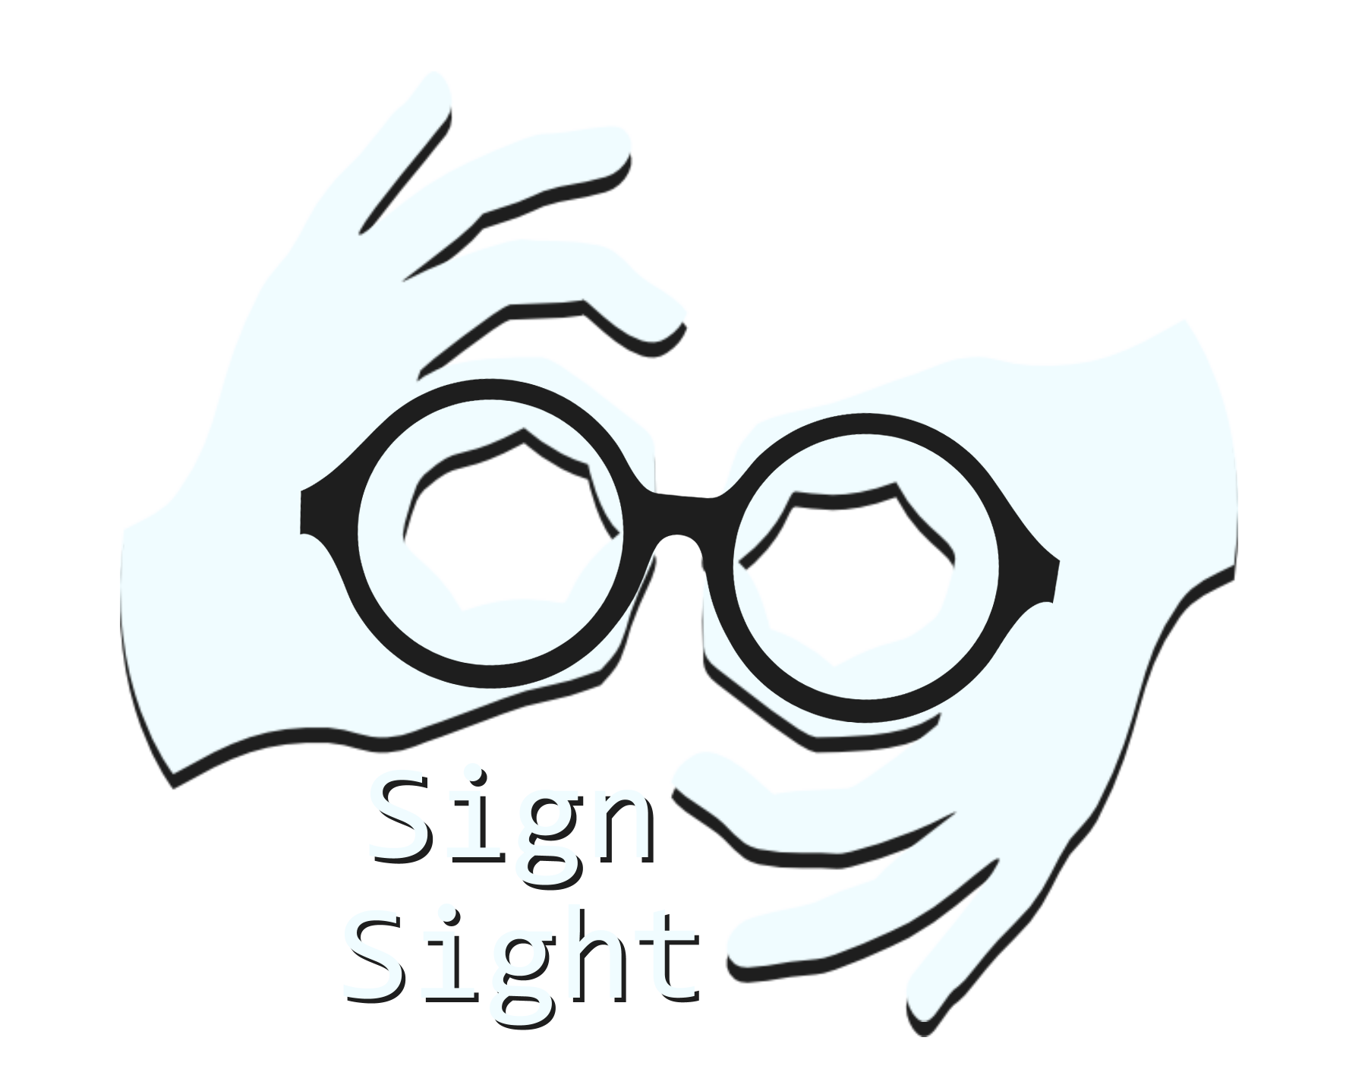
Group: Abbey Liu and Dalvir Singh
Translation: Unity

Slide 2
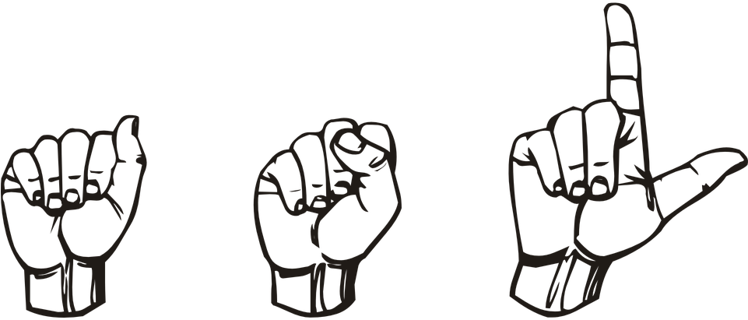
Goal:
Create a machine learning model to help dismantle the spoken/signed communication barrier, with a focus on American Sign Language
Translation: ASL
Notes:
Abbey

Slide 3

Project Vision
Vision
  Create a platform to evaluate how well our machine learning models work in real-time and static images
Steps
  Gather image data, and perform exploratory data analysis (EDA)
  Build and train various machine learning models
  Design and develop a web application
  Integrate the model with the web application
  Deploy the web application
Models
  CNN, ResNet50, InceptionV3, YoloV3
Translation: Y

Slide 4

Data Set
Translation: Q
Sign Language MNIST
  Original images feature gestures of multiple users against different backgrounds
    Applied data augmentation
  27,455 training + 7,172 testing grayscale images of size 28x28
    Saved pixel values in CSV files
  ASL signs for all 26 letters
    Skipped J and Z since those gestures include motion
    Multi-class classification problem
      mutually exclusive
Notes:
Abbey

Slide 5
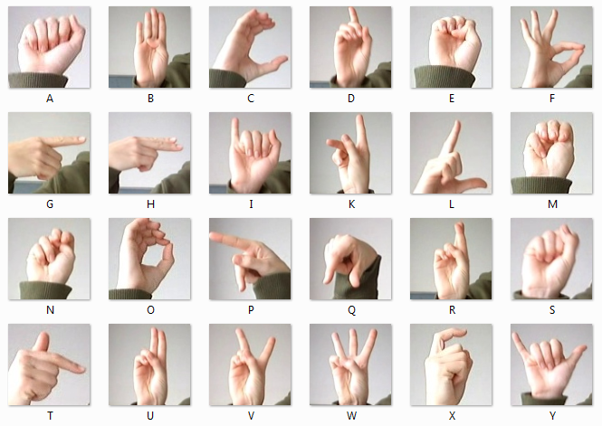
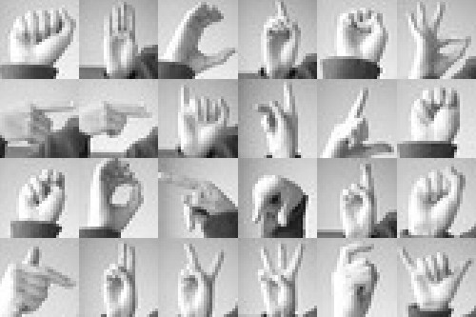
Sign Language MNIST

Slide 6

Data Set Limitations
Very, very clean
  Different background were still relatively clean
Synthetic augmentation does not create same level of diversity as a good dataset of different images
Cropped hands
Only alphabetical characters
  ASL in context is phrases and words
We decided to only use this dataset to focus on training models and deployment.

Slide 7
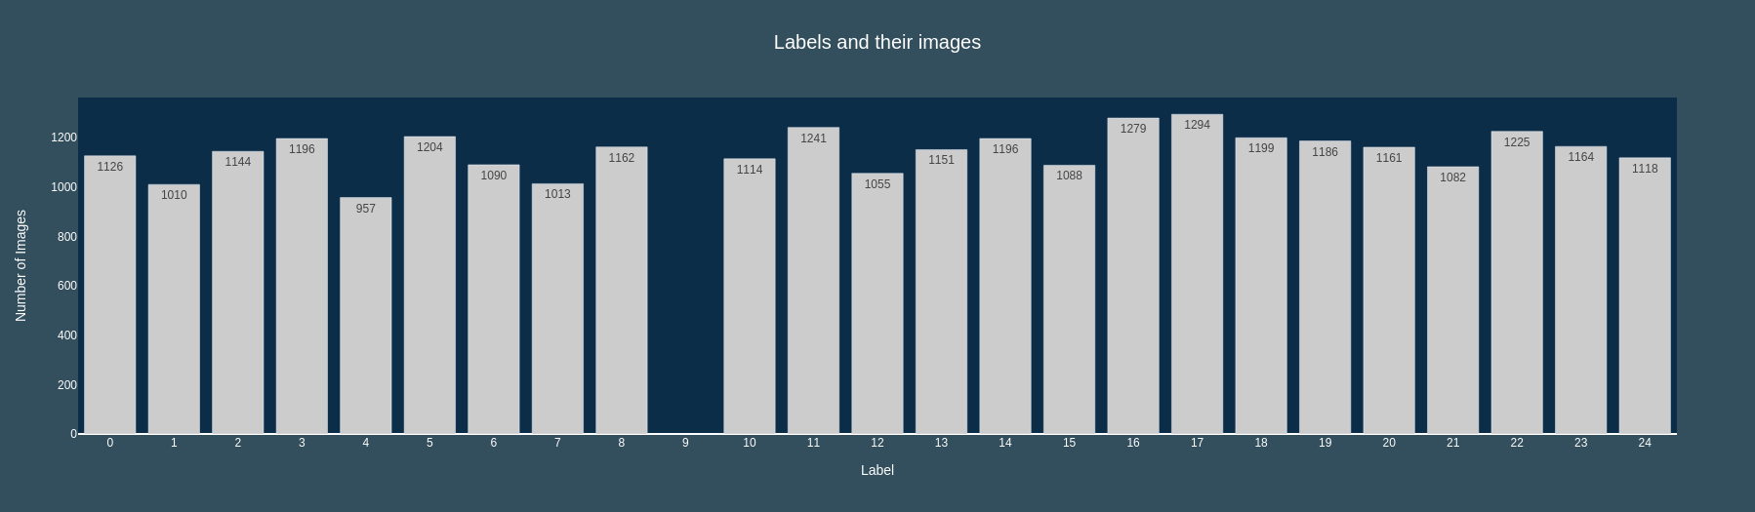
Training Data Distribution, 9 = J and 25 = Z are not in dataset

Slide 8
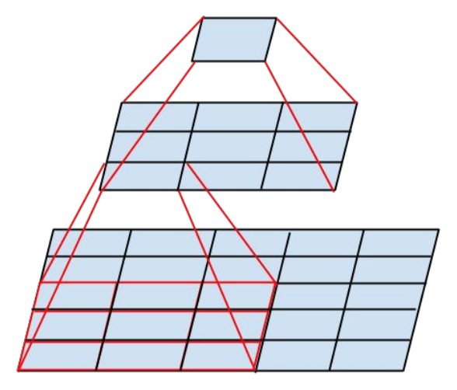
Model 1: CNN (Convolutional Neural Network)
Classic choice
  All layers have multiple convolutional filters, which perform dimensionality reduction
  Capture the most important features of an image
Easiest and fastest to train
Architecture
  3 convolutional layer
  1 Flatten layer
  2 dense layer
  Softmax activation function
Model | Accuracy | Recall (Weighted) | Precision(weighted) | F1 score(weighted)
CNN | 0.9911 | 0.9889 | 0.9918 | 0.9903

Slide 9
Model | Accuracy | Recall (Weighted) | Precision(weighted) | F1 score(weighted)
CNN | 0.9911 | 0.9889 | 0.9918 | 0.9903
InceptionV3 | 0.9838 | 0.9917 | 0.9736 | 0.9826
ResNet50 | 0.9976 | 0.9976 | 0.9976 | 0.9976

Slide 10

Model 2: ResNet50
Translation: Z
50 layer model CNN
  Deep learning
  Larger and more complex than Model 1 CNN
Residual network mapping to overcome Vanishing Gradient problem
Pre-trained on ImageNet
  Transfer learning
  ImageNet: 1 million images, 1000 categories
Model | Accuracy | Recall (Weighted) | Precision(weighted) | F1 score(weighted)
ResNet50 | 0.9976 | 0.9976 | 0.9976 | 0.9976
(Digits differed after the 7th decimal place)

Slide 11
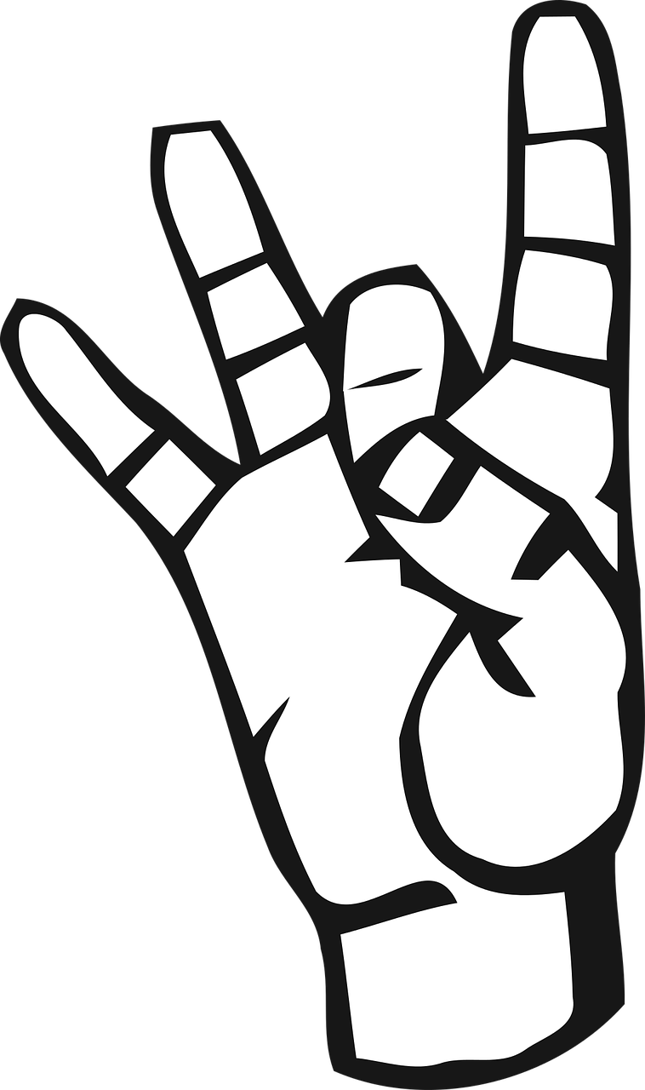
Model 3: InceptionV3
Translation: 8
Another deep CNN
Focus on being more computationally efficient
  Allows for a deeper network without increasing number of parameters
    “Under 25 million” vs. “60 million”
  (We found this to be the opposite when training, compared to our other models)
Pre-trained ImageNet
  Transfer learning
  ImageNet: 1 million images, 1000 categories
Model | Accuracy | Recall (Weighted) | Precision(weighted) | F1 score(weighted)
InceptionV3 | 0.9838 | 0.9917 | 0.9736 | 0.9826

Slide 12

Model 4: YoloV3
Uses bounding boxes
  You Only Look Once
    Good speed for real-time detection
  Found another dataset, with labels
    Good for objects in context
Pre-trained on Darknet weights
Version and Dependency issues
  Performance was not as good as previous models
  Eventually decided to focus on the other models and deployment
Translation: 9

Slide 13

Deployment: Website
Upload a cropped picture of hand and model will predict and give probability of sign
Demo
Drawbacks
  Great performance on test data
  Our uploaded pictures causes performance to drop
    Messy background
    Orientation of hand
Translation: 0

Slide 14
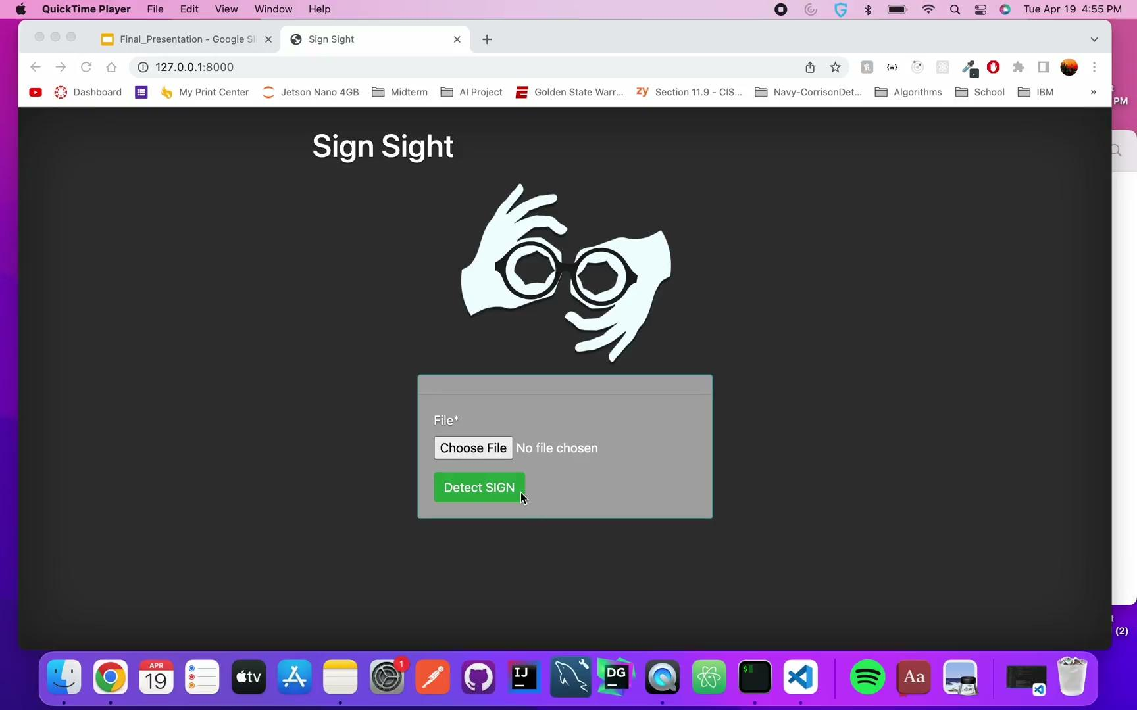

Slide 15

Deployment: Real-Time Camera Input
Use camera input to capture gestures and predict in real-time
Original version
  Low accuracy due to noise in input background
  Training data was “too clean” for use in context
Modified version
  Limit input to a box to make input more like training data
  Hand must still be close to camera
  Produced better results
    Still needs blank background for more stable results
Demo
Translation: T

Slide 16
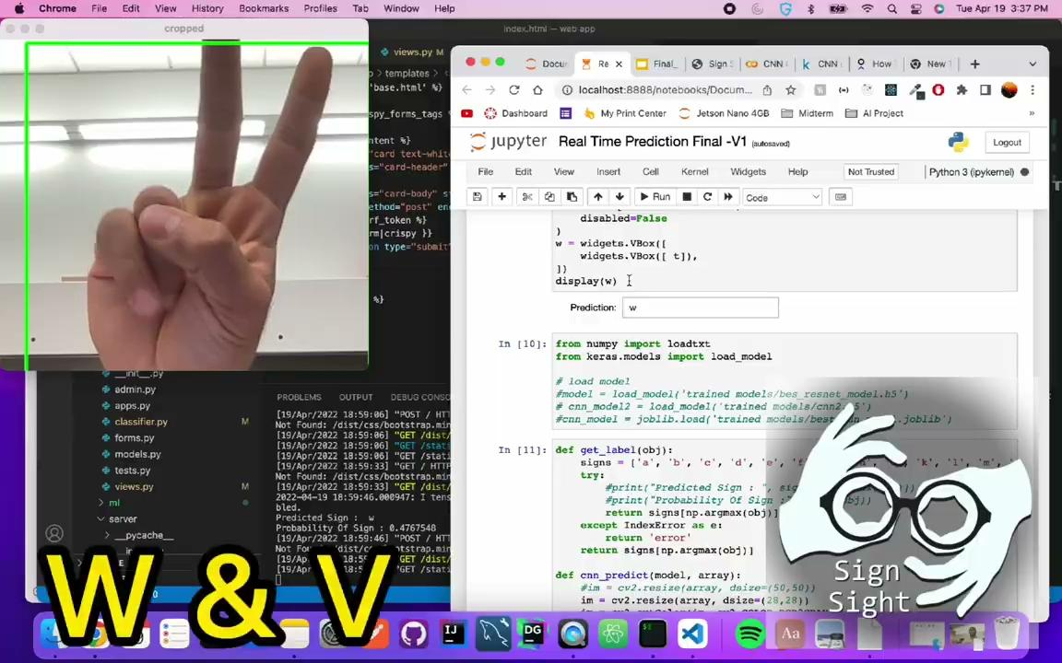

Slide 17

Future steps
Clean data vs. Real-time input
Further analysis of model errors
Gathering more data
  “In context” of deployment usage
  Need for expert in domain knowledge
Translation: 1

Slide 18
References
https://www.aaai.org/Papers/Symposia/Fall/1996/FS-96-05/FS96-05-017.pdf
https://link.springer.com/content/pdf/10.1007/978-3-319-16178-5_40.pdf
https://www.nidcd.nih.gov/health/american-sign-language
https://www.hrw.org/news/2018/09/23/sign-language-key-deaf-peoples-rights#:~:text=Lack%20of%20awareness%20of%20sign,services%20mandated%20to%20assist%20them
https://dsq-sds.org/article/view/316/380#:~:text=It%20is%20more%20common%20for,deaf%20youths%20integration%20into%20society.
https://www.bu.edu/sph/news/articles/2018/healthcare-language-barriers-affect-deaf-people-too/

