Slide 1
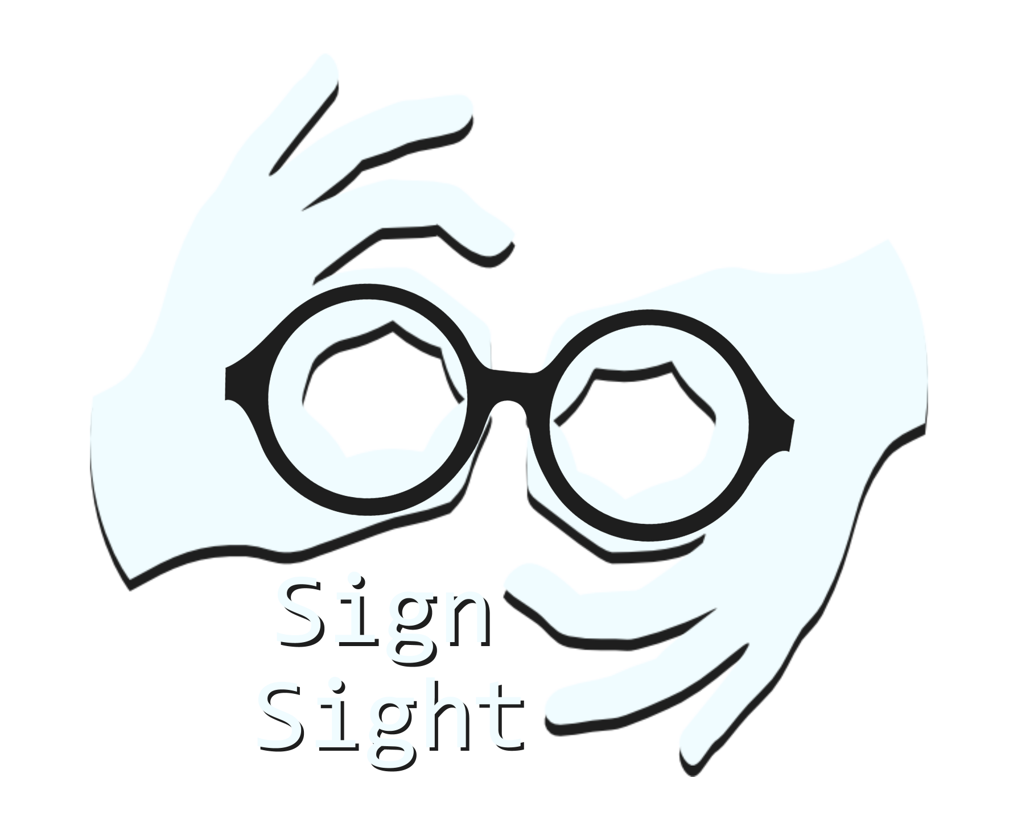
Group: Abbey Liu and Dalvir Singh
Translation: Unity

Slide 2

Motivation
Sign Language
  Complete, natural language that uses movements of the hand and face
  Sign language varies by region and country
    shared/borrowed gestures from other sign languages
  Often used by the mute, deaf, or hard of hearing
Communication Barrier between spoken and signed languages
  Most daily activities assume a person is able to use spoken language
    Causes sign language users to become isolated
  Lack of general awareness
  Shortage of available, accessible interpreters
  Other communication barriers are amplified
    Health literacy between laypeople and specialists
Translation: 3
Notes:
Abbey

Slide 3

Goal:
Create a machine learning model to help dismantle the spoken/signed communication barrier, with a focus on American Sign Language
Translation: ASL
Notes:
Abbey

Slide 4

Project Vision
Ideal Results
  A web application that can recognize ASL in real time through video input
Translation: 1

Slide 5

Related Literature 1
Real-Time American Sign Language Recognition from Video Using Hidden Markov Models
  Description: In this paper, the researchers created a real time system that interprets American Sign Language using Hidden Markov Models. The system tracks hands by color(glove or skin) and tracks their shape, orientation, and gesture which serves as the input to the HMM model to recognize the signed gesture.
  Technique: Hidden Markov Models
  Results: The research conducted two experiments: The first experiment tracked hands wearing colored gloves and achieved an accuracy of 99% In the second experiment, they used hands without gloves and achieved a 92% accuracy
Translation: G

Slide 6

Related Literature 2
Sign Language Recognition Using Convolutional Neural Networks
  Description: In this paper, the researchers aimed to build a real time system to recognize 20 Italian gestures using Microsoft Kinect, CNN, and GPU acceleration. The CNN model was used to extract features from the frames and an artificial neural network used for the classification. Their system performed well regardless of user or surrounding.
  Technique: CNN(Feature Extraction) & ANN(Classification)
  Results: The study observed a validation accuracy of 91.70% (8.30% error rate) for their best model.
Translation: P

Slide 7

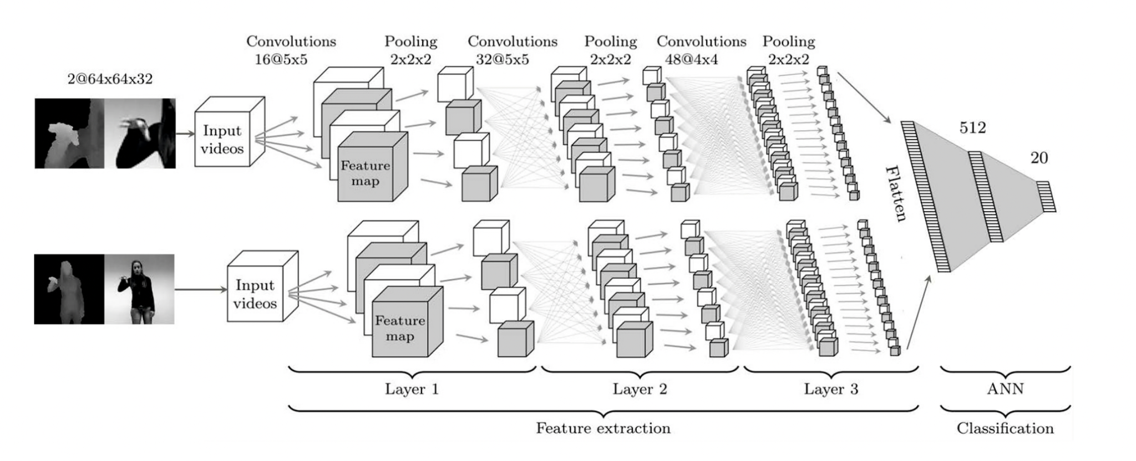
Related Literature 2

Slide 8

Data Set
Translation: Q
American Sign Language Dataset
  2,515 PNG images of size 400x400
  ASL signs for all 26 letters and 10 digits
    65-70 images per gesture
Sign Language MNIST
  27,455 training + 7,172 testing grayscale images of size 28x28
    Saved pixel values in CSV files
  ASL signs for all 26 letters and 10 digits
Notes:
Abbey

Slide 9
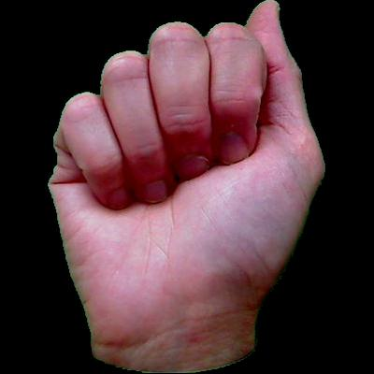

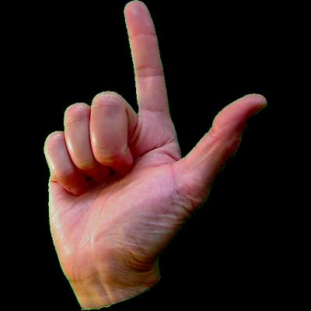
American Sign Language Dataset
Translation: ASL

Slide 10
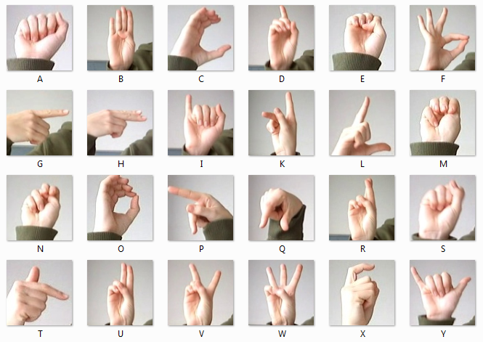
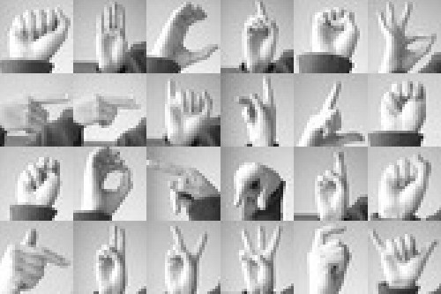
Sign Language MNIST

Slide 11

Approach / Tasks
Idea: We will train and test a Keras CNN model on our dataset and integrate the best performing model into a web application
Steps
  Gather image data, and perform exploratory data analysis (EDA)
  Build and train various machine learning models
  Design and develop a web application
  Integrate the model with the web application
  Deploy the web application
Translation: Y

Slide 12

Estimated Project Timeline
Translation: 8
Week 1
  Gather image data of sign language hand gestures
  Perform EDA
  Clean any data, if needed
Weeks 2-4
  Implement various models and train on image data
    Possible models: CNN, HMM
  Choose one (or more) well-performing models for web application
Weeks 5-6
  Create, integrate, and deploy web application
Notes:
Abbey

Slide 13
References
https://www.aaai.org/Papers/Symposia/Fall/1996/FS-96-05/FS96-05-017.pdf
https://link.springer.com/content/pdf/10.1007/978-3-319-16178-5_40.pdf
https://www.nidcd.nih.gov/health/american-sign-language
https://www.hrw.org/news/2018/09/23/sign-language-key-deaf-peoples-rights#:~:text=Lack%20of%20awareness%20of%20sign,services%20mandated%20to%20assist%20them
https://dsq-sds.org/article/view/316/380#:~:text=It%20is%20more%20common%20for,deaf%20youths%20integration%20into%20society.
https://www.bu.edu/sph/news/articles/2018/healthcare-language-barriers-affect-deaf-people-too/

