Slide 1
Advancements in Artificial Intelligence and Computer Vision for Dental Imaging Analysis: Dissertation Defense
Presented By:
Amani Almalki, BSCS, MSCS
PhD Candidate in Computer Science
Committee: Dr. Longin Jan Latecki (Advisor)
Dr. Xinghua Mindy Shi
Dr. Stephen MacNeil
Dr. Louis Dipede

Slide 2
Research Contributions
Amani Almalki and Longin Jan Latecki. "Self-Supervised Learning with Masked Image Modeling for Teeth Numbering, Detection of Dental Restorations, and Instance Segmentation in Dental Panoramic Radiographs." IEEE/CVF Winter Conference on Applications of Computer Vision (WACV), Waikoloa, Hawaii, January 2023.
Amani Almalki and Longin Jan Latecki. "Enhanced Masked Image Modeling for Analysis of Dental Panoramic Radiographs." IEEE International Symposium on Biomedical Imaging (ISBI), Cartagena, Colombia, April 2023.
Amani Almalki and Longin Jan Latecki. "Self-Supervised Learning with Masked Autoencoders for Teeth Segmentation from Intra-oral 3D Scans." IEEE/CVF Winter Conference on Applications of Computer Vision (WACV), Waikoloa, Hawaii, January 2024.
Amani Almalki and Longin Jan Latecki. "Masked Deep Embeddings of Patches for Teeth Segmentation in Cone Beam CT Images." IEEE International Symposium on Biomedical Imaging (ISBI), Athens, Greece, May 2024.
Amani Almalki, Abdulrahman Almalki and Longin Jan Latecki. "Self-Supervised Learning of Deep Embeddings for Classification and Identification of Dental Implants." Submitted to Asian Conference on Computer Vision, Hanoi, Vietnam, December 2024.
Vivek Trivedy, Amani Almalki, and Longin Jan Latecki. "Learning Object Focused Attention." Submitted to International Conference on Pattern Recognition (ICPR), Kolkata, India, December 2024.
Amani Almalki and Longin Jan Latecki. "Self-Supervised Learning for Assessment of Peri-Implant Bone Loss in Dental Radiographs." Submitted to International Conference on Pattern Recognition (ICPR), Kolkata, India, December 2024.
Amani Almalki and Longin Jan Latecki. "Self-Supervised Masked Deep Embeddings for Dental Caries Detection." Submitted to IEEE/CVF Winter Conference on Applications of Computer Vision (WACV), Tucson, Arizona, USA, February 2025.

Slide 3
Outlines
Recap of Previous Work
Research Contribution 2: Self-Supervised Learning of Deep Embeddings for Classification and Identification of Dental Implants
Research Contribution 1: Masked Deep Embeddings of Patches for Teeth Segmentation in Cone Beam CT Images
Research Contribution 3: Self-Supervised Learning for Assessment of Peri-Implant Bone Loss in Dental Radiographs
Research Contribution 4: Self-Supervised Masked Deep Embeddings for Dental Caries Detection

Slide 4
Background

Slide 5
INTRODUCTION
Utilize self-supervised pre-training of Transformers for the analysis of dental imaging.
Why self-supervised pre-training? To alleviate the problem of the limited number of available dental images/ 3D models.
Why Transformers? The Transformer is notable for its use of attention to model long-range dependencies in the data.
Why dental imaging? To enable dentists to predict treatment outcomes with greater ease.

Slide 6
OBJECTIVES
Primary goals:
- Develop self-supervised learning methods.
- Increase the model efficiency and understanding of the limited number of dental X-rays/ CBCT.
- Automate the processes of dental imaging analysis.
Secondary goals:
Provide an efficient model to assist dental practitioners in diagnosis and treatment planning.
Reduce the risk of misdiagnosis.
Improve overall quality of care.
Reduce time consumption in manual data interpretation.

Slide 7
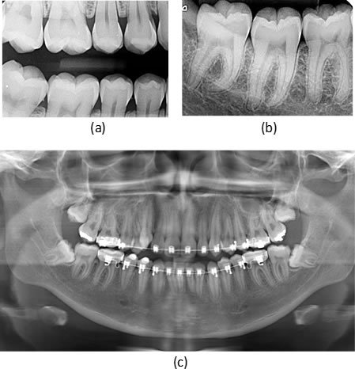
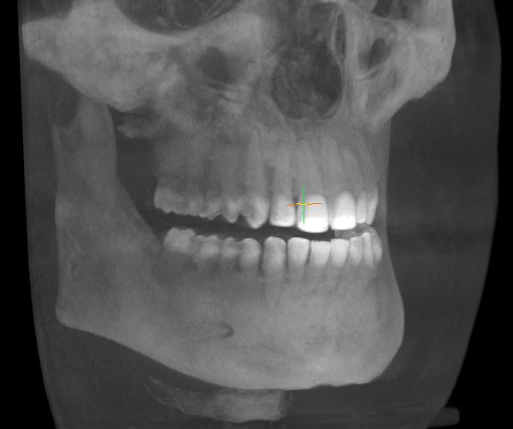
BACKGROUND
Dental X-rays:
Bitewing X-ray.
Periapical X-ray.
Panoramic X-ray.
Cone beam computed tomography
(CBCT) 3D radiograph.
(d)

Slide 8
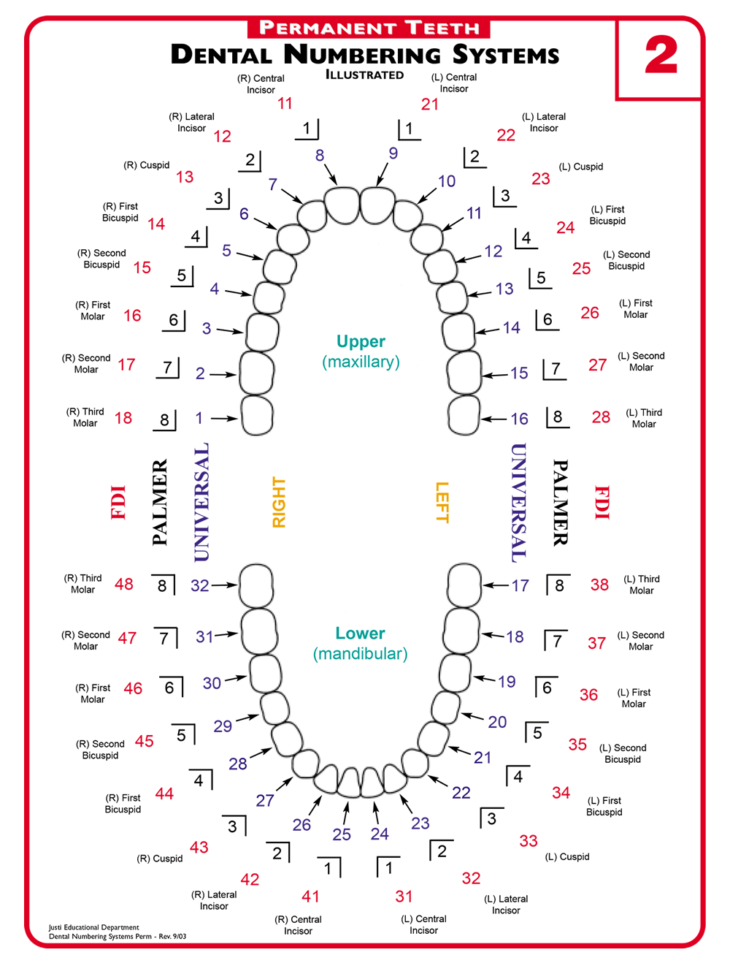
BACKGROUND
Teeth numbering systems:
The Universal Numbering System.
Palmer Notation Numbering System.
Federation Dentiaure International numbering system (FDI).

Slide 9
Related Work

Slide 10
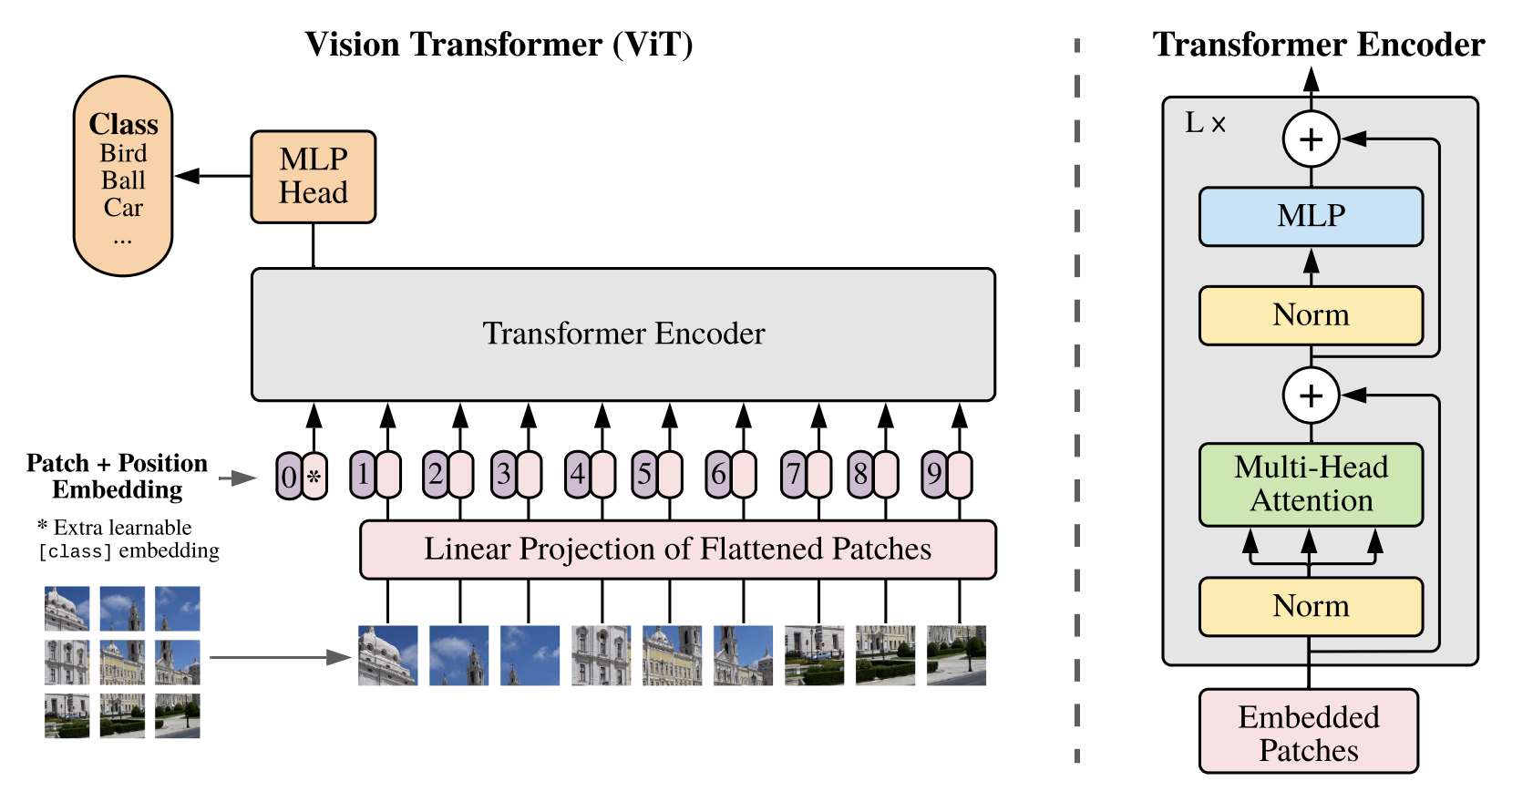
RELATED WORK
Vision Transformer (ViT)¹
Insights:
Exploring the use of a pure Transformer for vision.
Uses 1-dimensional positional embeddings.
Able to integrate information globally via attention.
1- Dosovitskiy, Alexey, et al. "An Image is Worth 16x16 Words: Transformers for Image Recognition at Scale". ICLR. 2021.

Slide 11
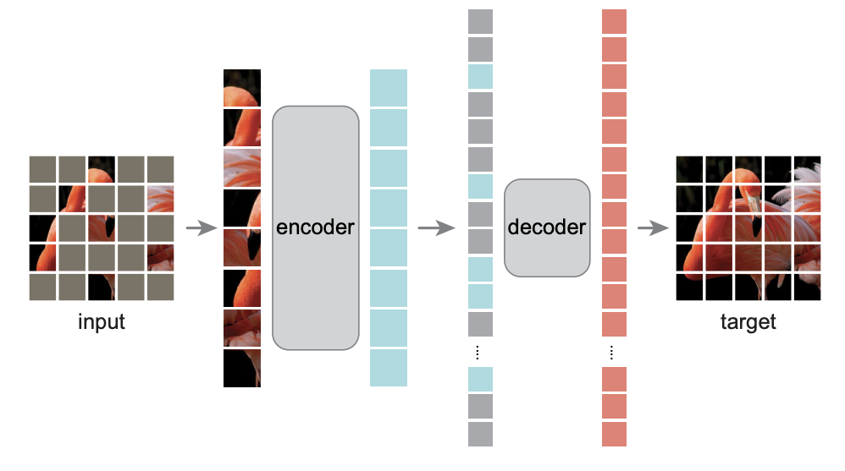
RELATED WORK
Masked Autoencoder (MAE)²
Insights:
Pre-train the model to help the downstream tasks.
SSL with masked image modeling.
Asymmetric encoder-decoder.
Only the visible embeddings will be fed into the Transformer.
Predicts pixel values on masked areas.
2- He, Kaiming, et al. "Masked autoencoders are scalable vision learners." CVPR. 2022.

Slide 12
Recap of Previous Work

Slide 13
RECAP - 1
Published in WACV 2023*
Self-Supervised Learning with Masked Image Modeling for Teeth Numbering, Detection of Dental Restorations, and Instance Segmentation in Dental Panoramic Radiographs
Objective:
Enhance model efficiency in dental panoramic radiographs using self-supervised learning (SimMIM and UM-MAE).
Challenges:
Limited Data for Training
Manual Intervention in Teeth Numbering and Restoration Identification
Inherent Inductive Biases in CNNs
Complexity of Dental Restorations Segmentation
* Amani Almalki and Longin Jan Latecki. "Self-Supervised Learning with Masked Image Modeling for Teeth Numbering, Detection of Dental Restorations, and Instance Segmentation in Dental Panoramic Radiographs." IEEE/CVF Winter Conference on Applications of Computer Vision (WACV), Waikoloa, Hawaii, January 2023.

Slide 14
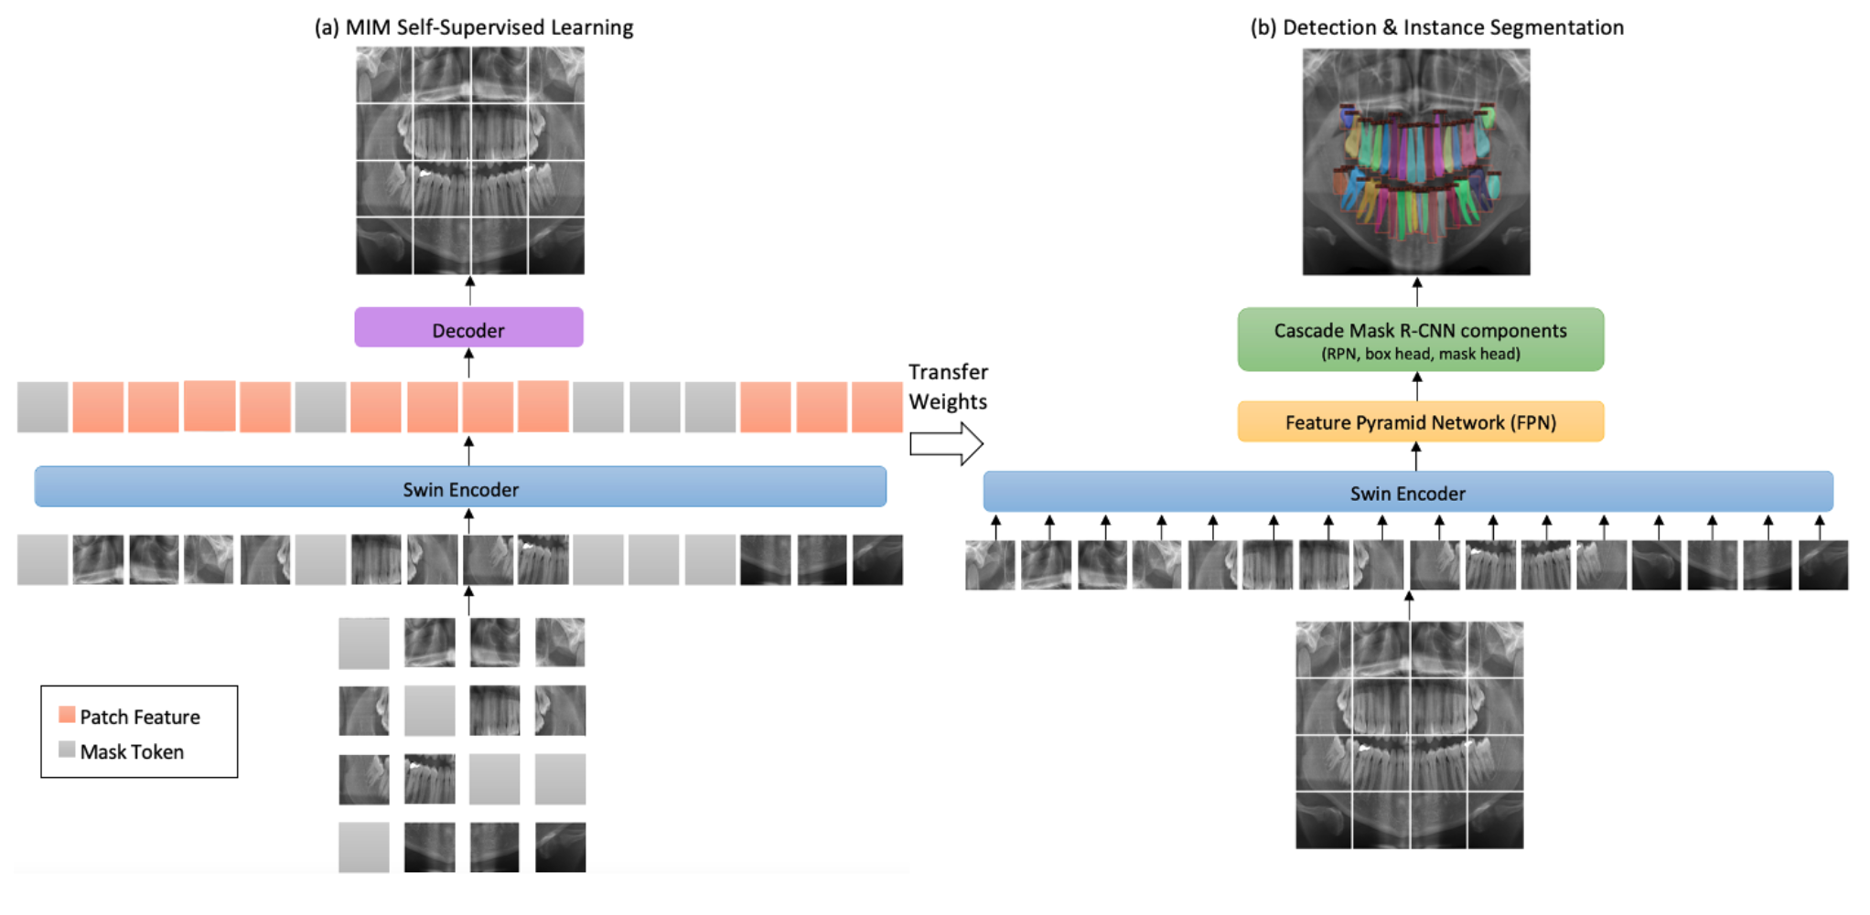
RECAP - 1

Slide 15
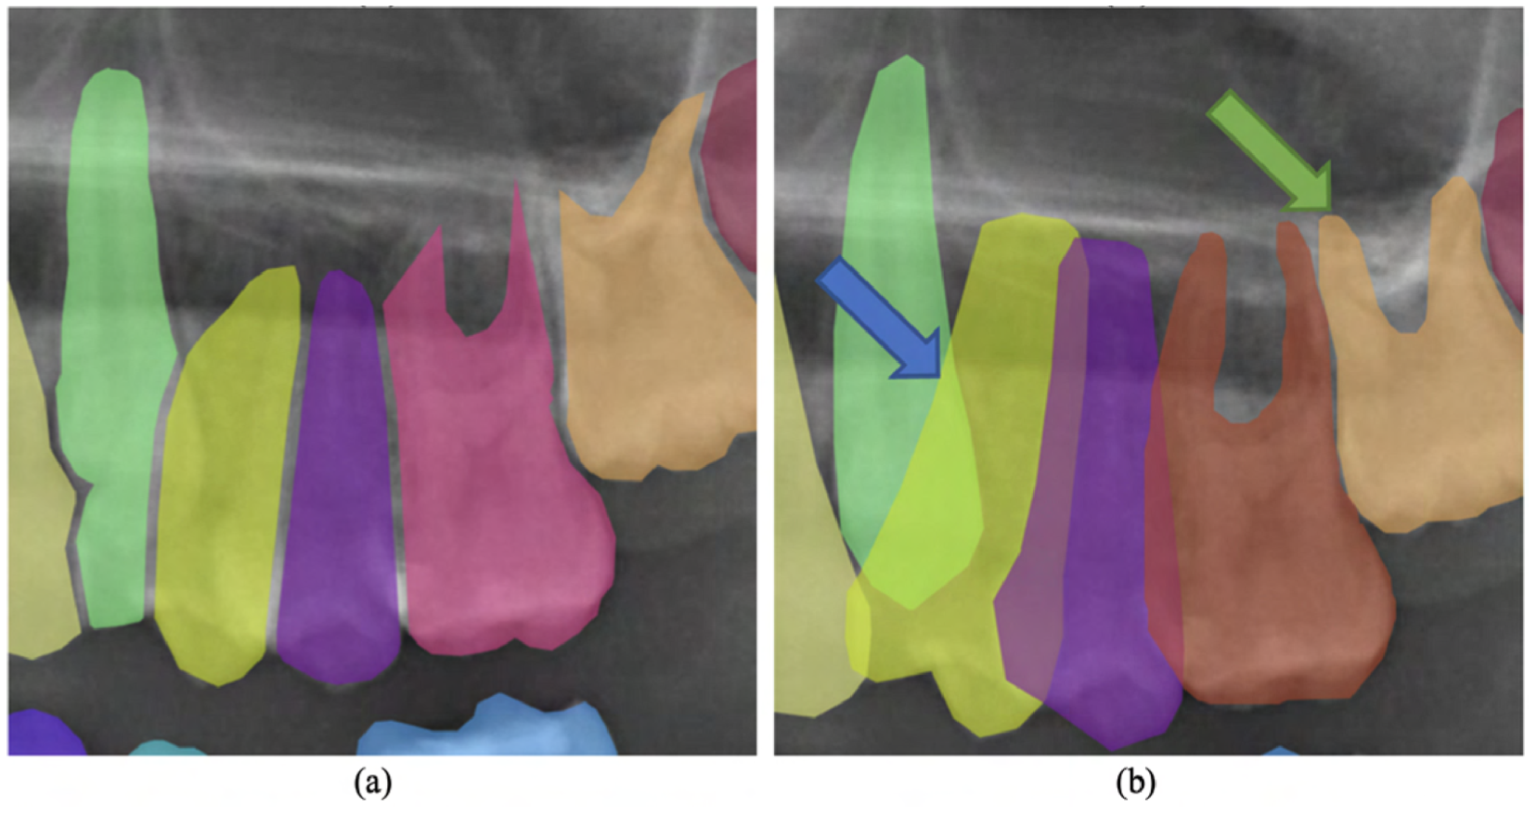
RECAP - 1
Dataset Improvement:
Corrected and enhanced dataset with annotations for direct and indirect restorations and root canal therapy, significantly boosting model performance.

Slide 16
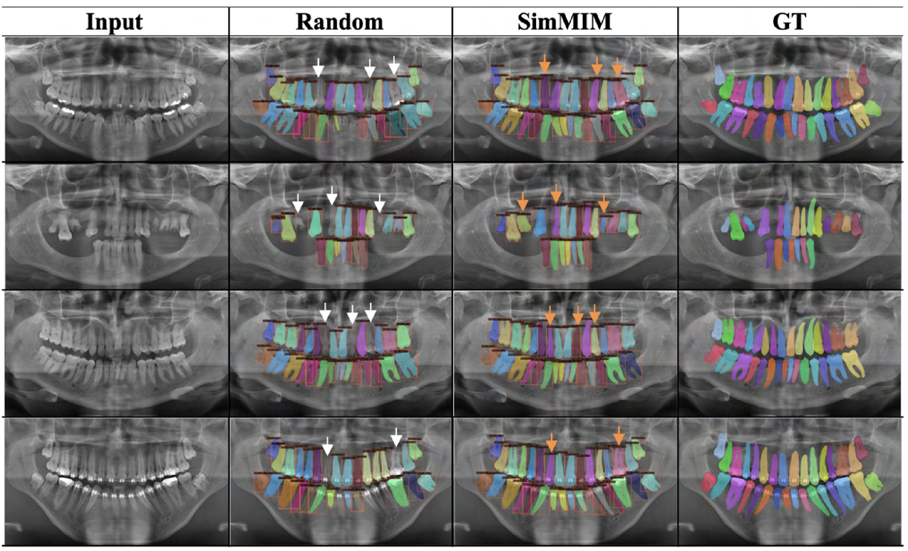
RECAP - 1
Performance: Our SimMIM achieved 90.4% accuracy for detecting teeth and 88.9% for instance segmentation, outperforming other methods.
Contributions:
Applied self-supervised learning to Swin Transformer in dental radiographs.
Enhanced dataset quality and provided TNDRS for future research.

Slide 17
RECAP - 2
Published in ISBI 2023*
Enhanced Masked Image Modeling for Analysis of Dental Panoramic Radiographs
Objective:
Improve analysis of dental panoramic radiographs using enhanced self-supervised learning (SD-SimMIM).
Challenges:
Limited Training Data
Class Imbalance and Complexity
Need for Enhanced Learning Techniques
Dataset Augmentation and Annotation
* Amani Almalki and Longin Jan Latecki. "Enhanced Masked Image Modeling for Analysis of Dental Panoramic Radiographs." IEEE International Symposium on Biomedical Imaging (ISBI), Cartagena, Colombia, April 2023.

Slide 18
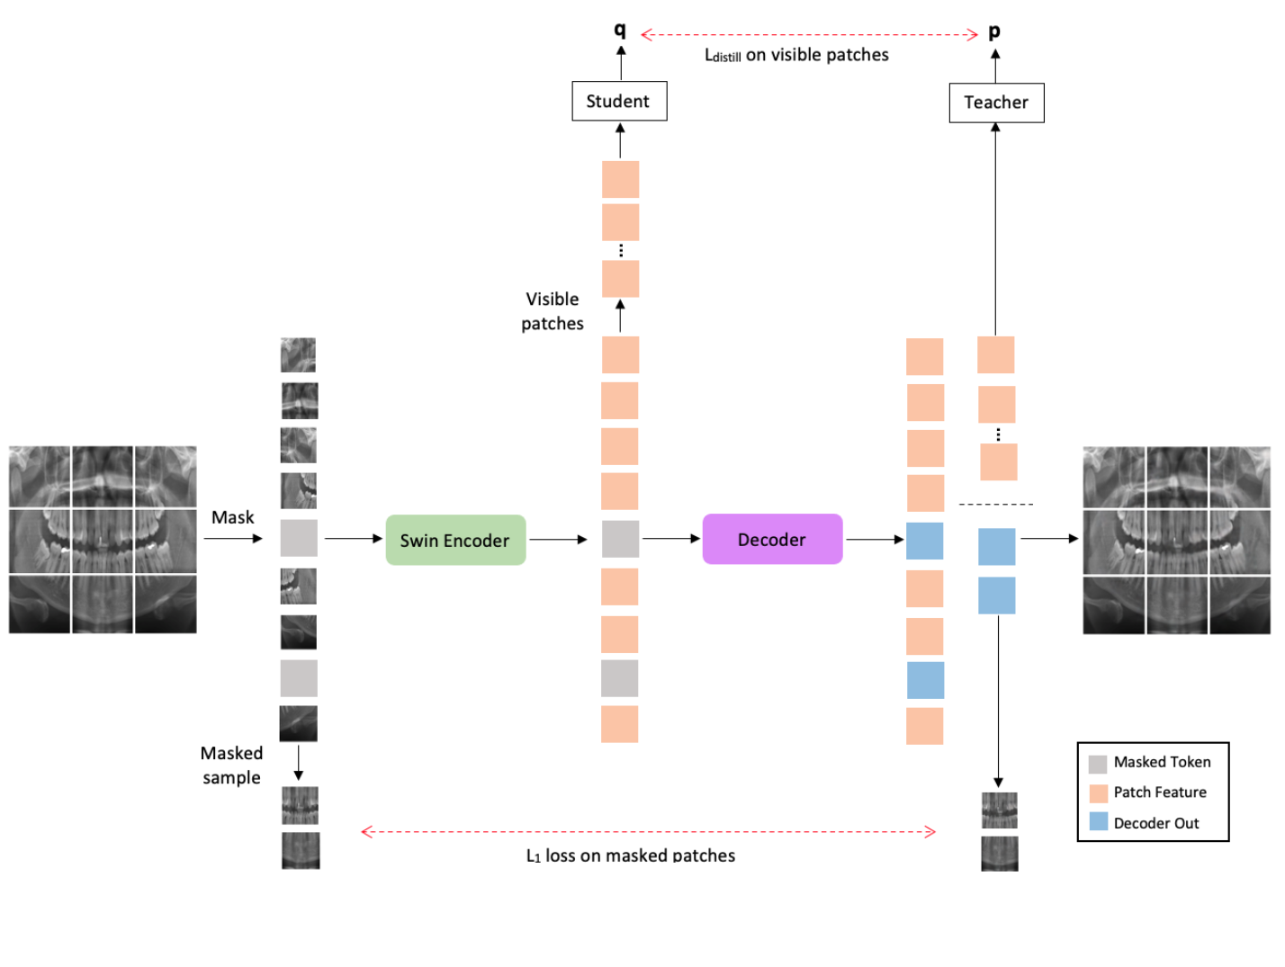
RECAP - 2

Slide 19
RECAP - 2
Dataset Improvement: Enhanced dataset with annotations for orthodontic appliances, including bands, brackets, and retainers, to improve model performance.

Slide 20
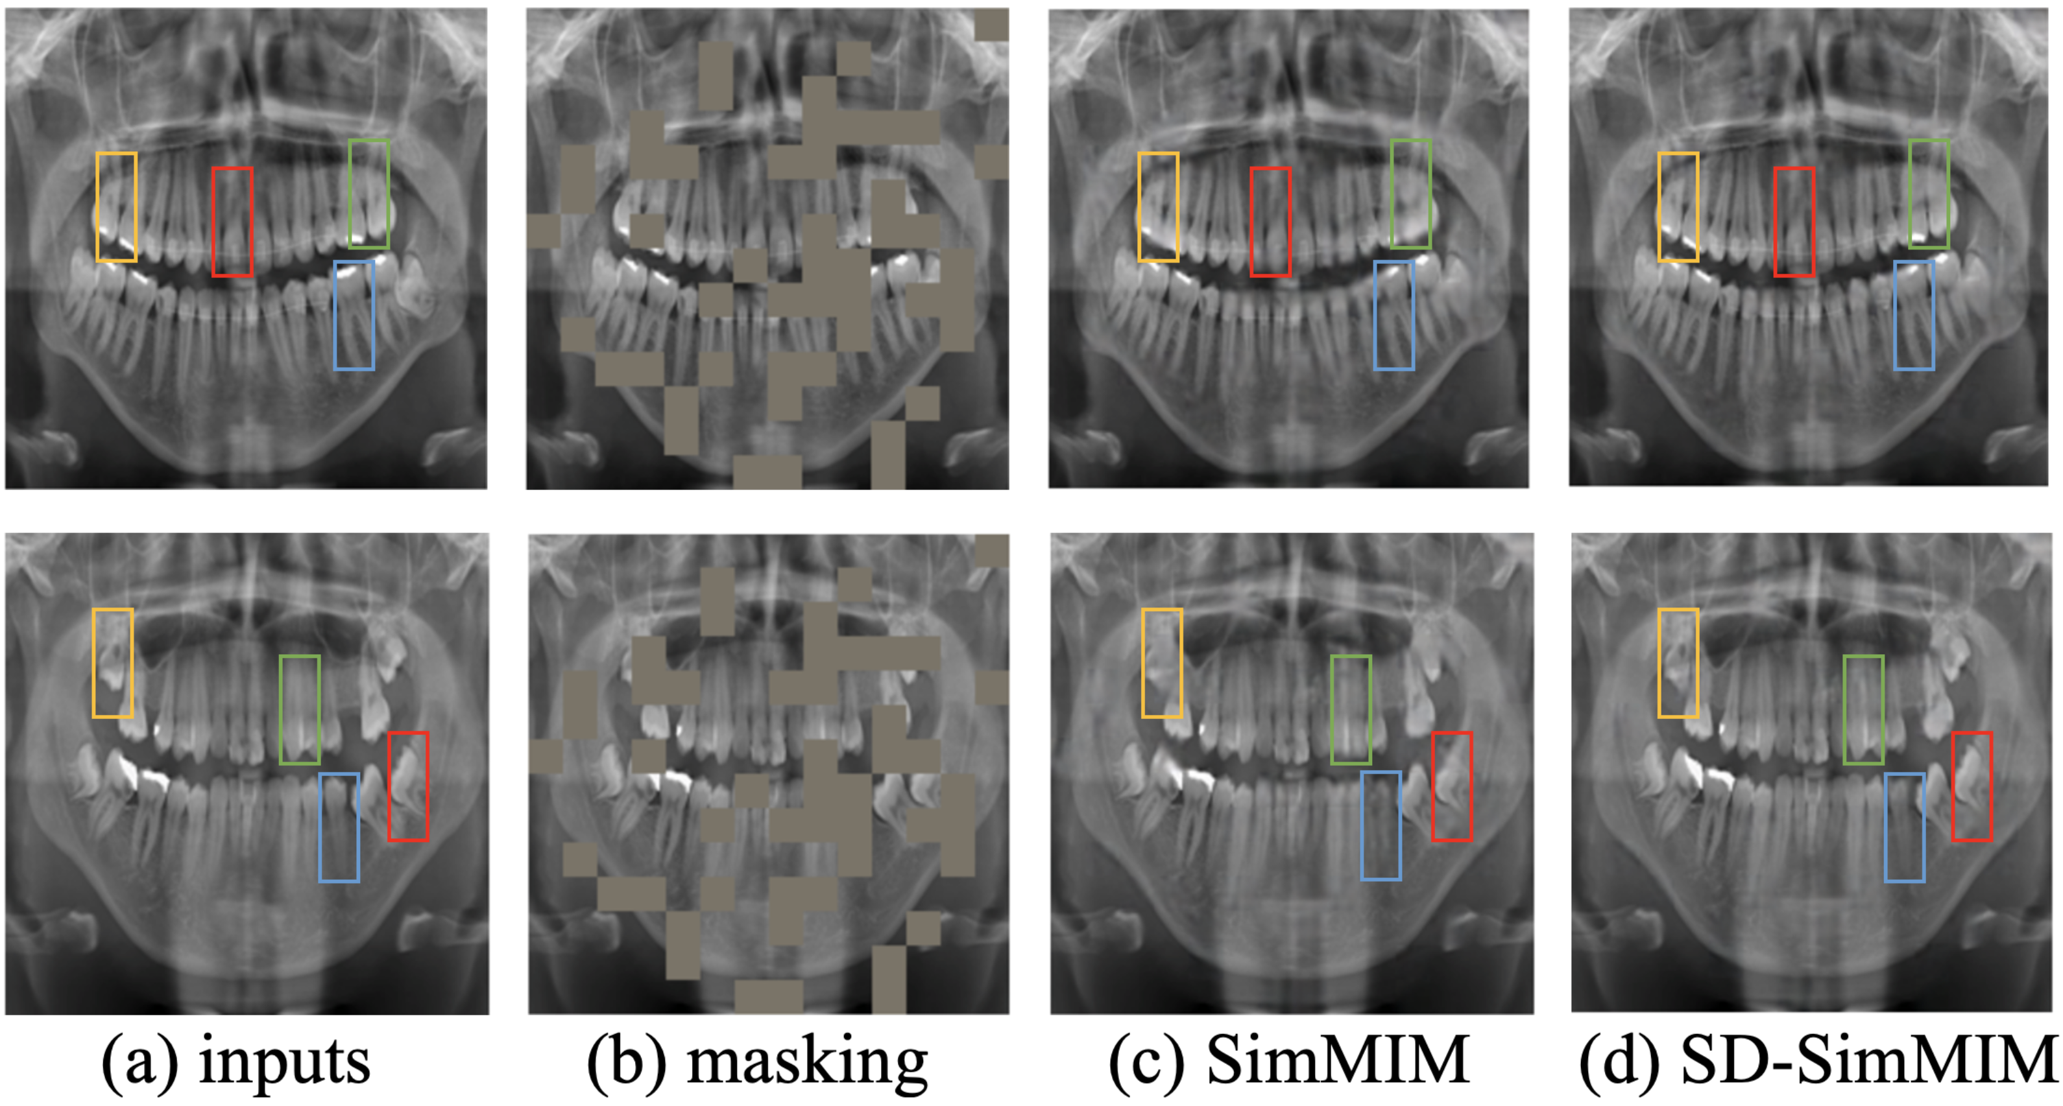
RECAP - 2
Performance: SD-SimMIM achieved 92.7% accuracy for detecting teeth and dental restorations, and 90.8% for instance segmentation.
Contributions:
Introduced SD-SimMIM to boost feature representation with limited data.
Provided an improved dataset (Dentalysis) for future research.

Slide 21
RECAP - 3
Published in WACV 2024*
Self-Supervised Learning with Masked Autoencoders for Teeth Segmentation from Intra-oral 3D Scans
Objective:
Improve teeth segmentation from intra-oral 3D scans using self-supervised learning (DentalMAE).
Challenges:
Variability in Teeth Characteristics
Complex Dental Anatomy
Computational Complexity
Need for Domain-Specific Pre-Training
* Amani Almalki and Longin Jan Latecki. "Self-Supervised Learning with Masked Autoencoders for Teeth Segmentation from Intra-oral 3D Scans." IEEE/CVF Winter Conference on Applications of Computer Vision (WACV), Waikoloa, Hawaii, January 2024.

Slide 22
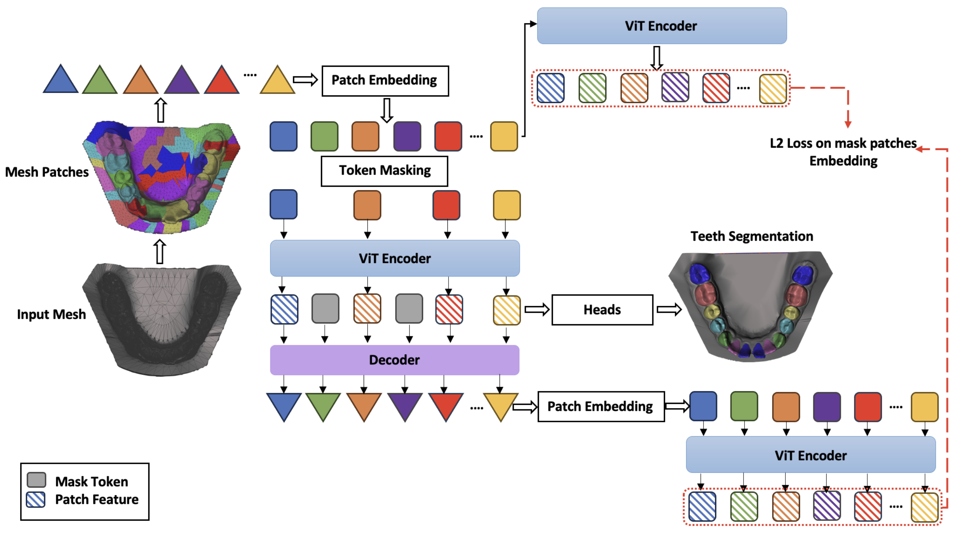
RECAP - 3

Slide 23
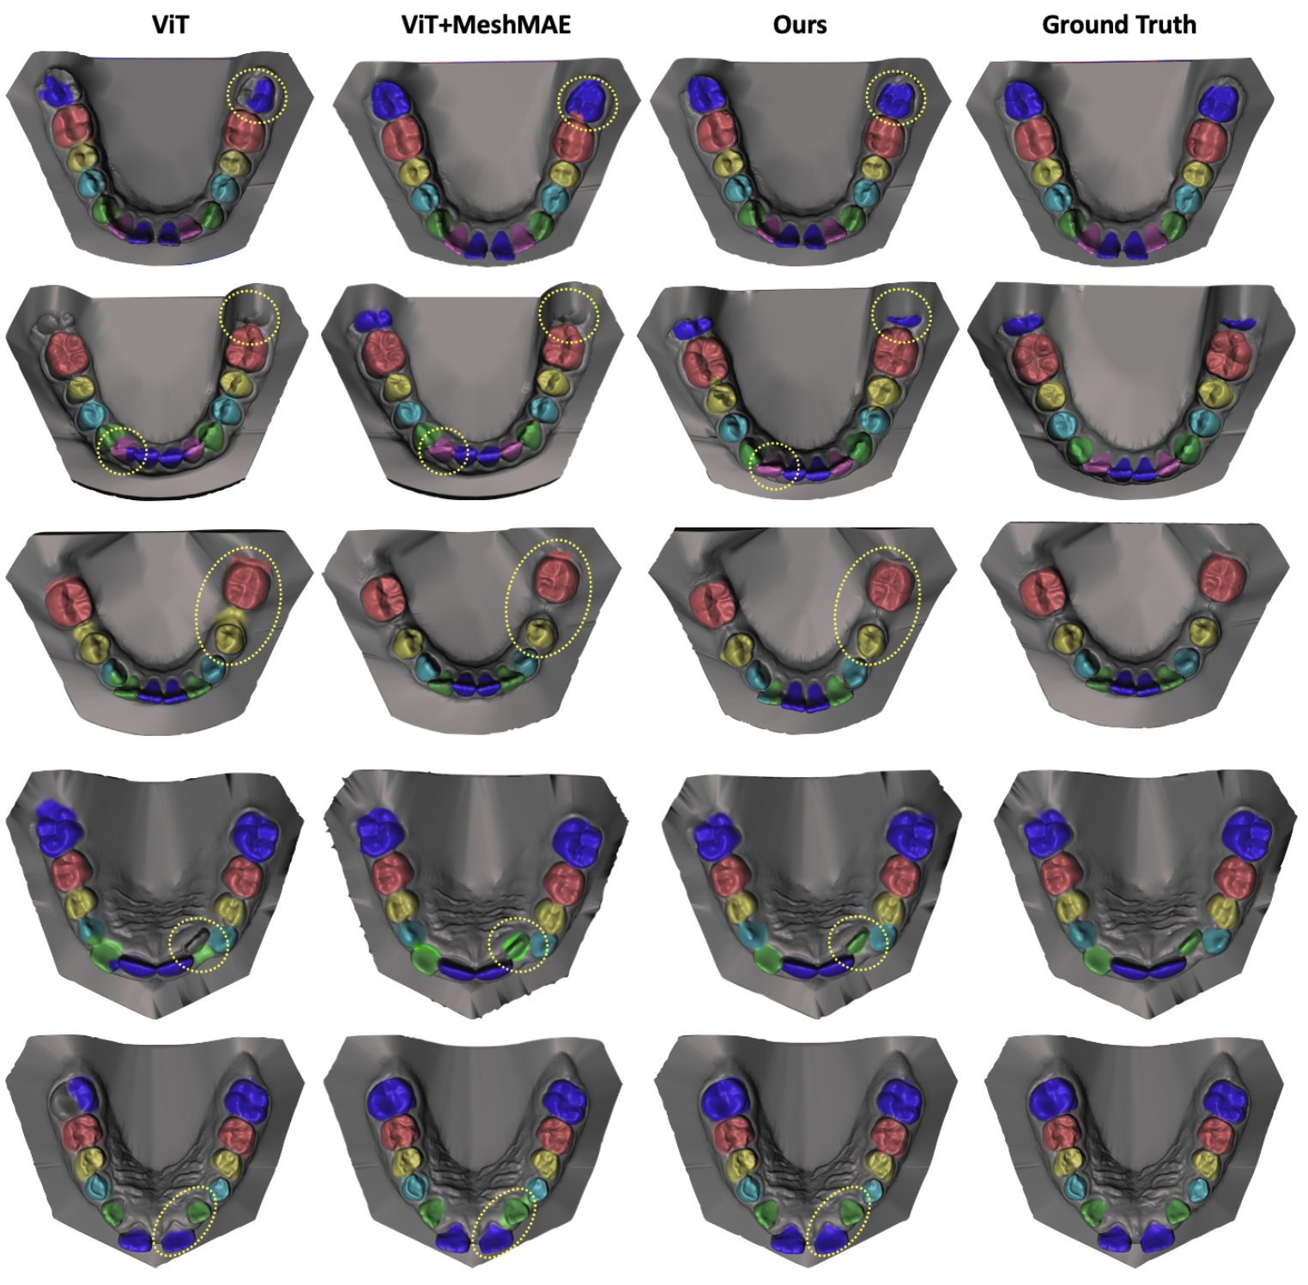
RECAP - 3
Key Findings:
Performance: DentalMAE achieved superior accuracy and segmentation results compared to other methods.
Dataset: Used a dataset of 1800 3D intra-oral scans for training and testing.
Contributions:
Introduced DentalMAE for self-supervised learning on 3D dental meshes.
Achieved state-of-the-art performance in tooth segmentation tasks.

Slide 24
Research contribution 1: Masked Deep Embeddings of Patches for Teeth Segmentation in Cone Beam CT Images

Slide 25
CHALLENGES
Published in ISBI 2024*
Objective:
Enhance teeth segmentation from CBCT images using a novel self-supervised learning method (UNETR+DEMAE).
Challenges:
Limited data availability for training.
Difficulties in distinguishing teeth from surrounding structures due to similar densities.
Issues with segmenting teeth in natural occlusion conditions.
* Amani Almalki and Longin Jan Latecki. "Masked Deep Embeddings of Patches for Teeth Segmentation in Cone Beam CT Images." IEEE International Symposium on Biomedical Imaging (ISBI), Athens, Greece, May 2024.

Slide 26
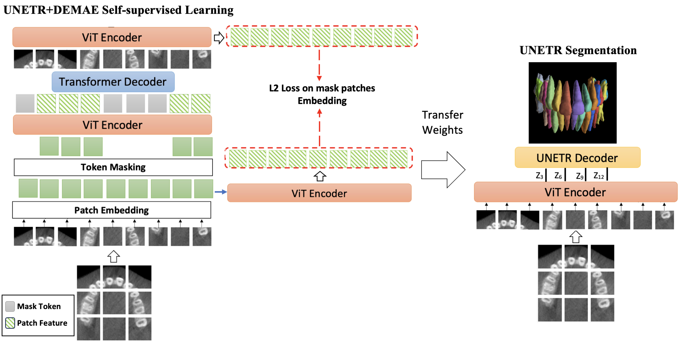
METHODS

Slide 27
EXPERIMENTS
Dataset:
150 CBCT images, resolution 0.25mm to 0.35mm.
Training: 80%, Validation: 20%.
18,000 sub-volumes for training.
Evaluation Metrics:
Dice Similarity Coefficient (DSC).
Detection Accuracy (DA).
Identification Accuracy (FA).

Slide 28
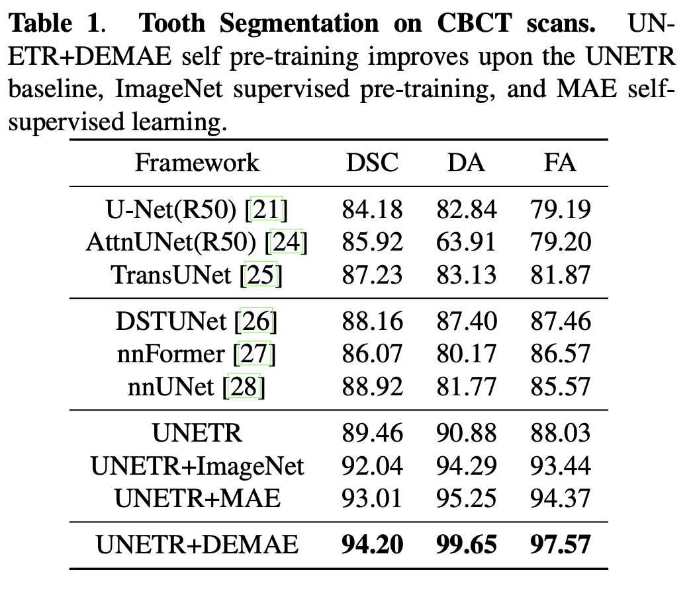
RESULTS
UNETR+DEMAE achieved the highest scores in all metrics.

Slide 29
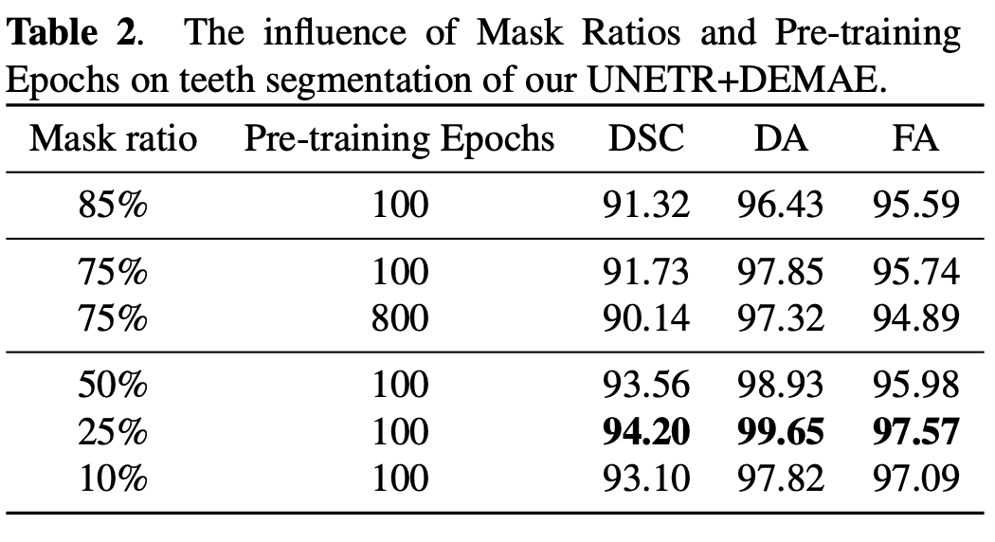
RESULTS
Significant improvement over other mask ratios and pre-training epochs.

Slide 30
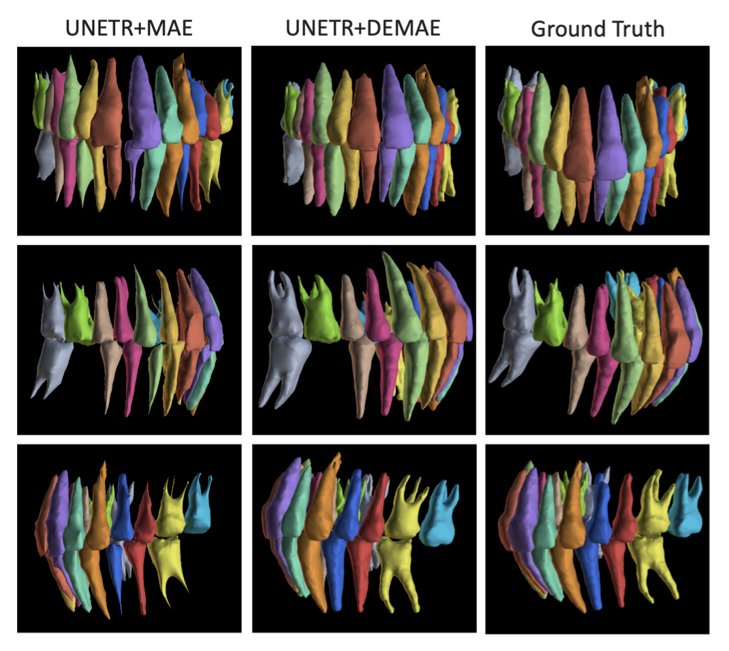
RESULTS
Comparison of segmentation results between UNETR+DEMAE and baseline methods.
Improved Segmentation:
Enhanced performance in teeth segmentation with UNETR+DEMAE.
Better delineation of tooth boundaries compared to other methods.

Slide 31
CONCLUSIONS
Introduced UNETR+DEMAE for self-supervised learning in CBCT teeth segmentation.
Achieved state-of-the-art performance on a small dataset.
Demonstrated the importance of mask ratio and strategy.

Slide 32
Research contribution 2: Self-Supervised Learning of Deep Embeddings for Classification and Identification of Dental Implants

Slide 33
CHALLENGES
Submitted to ACCV 2024*
There are more than 100 dental implant types.
To help dentists identify the implant system to easily place the compatible crown.
Objective:
Develop an automated system using deep learning to identify dental implants.
Challenges:
Determining the brand of an implant clinically or radiographically can be challenging. Whether AI can assist is unclear.
* Amani Almalki, Abdulrahman Almalki and Longin Jan Latecki. "Self-Supervised Learning of Deep Embeddings for Classification and Identification of Dental Implants." Submitted to Asian Conference on Computer Vision, Hanoi, Vietnam, December 2024.

Slide 34
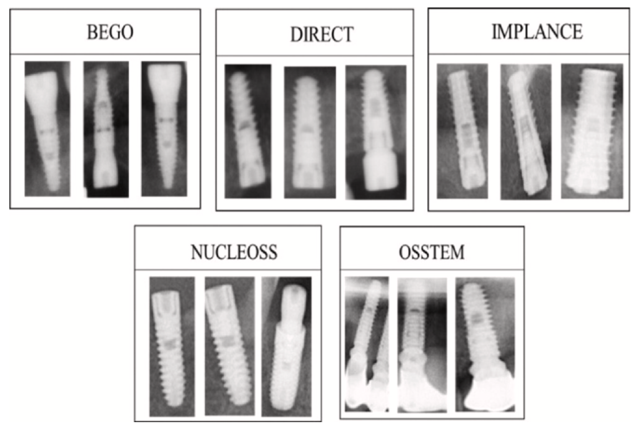
CHALLENGES
Dental implant brand identification
Tiryaki, Burcu, et al. "Dental implant brand and angle identification using deep neural networks." The Journal of Prosthetic Dentistry (2023).

Slide 35
METHODS
Dataset Enhancement:
Enriched dataset with annotations for implant design parts (coronal, middle, apical).

Slide 36
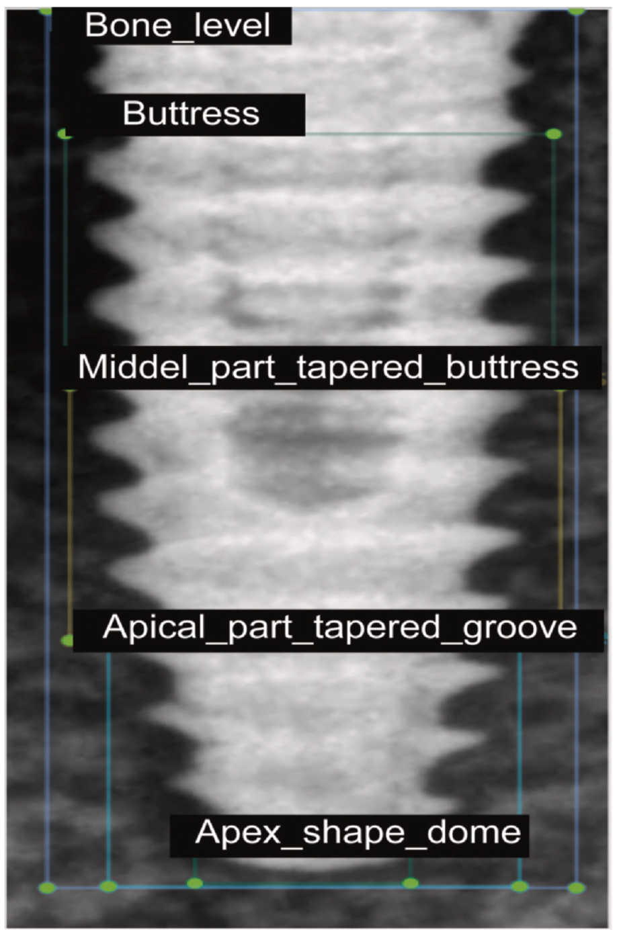
METHODS
Dental implant brand identification
Straumann Dental Implant System

Slide 37
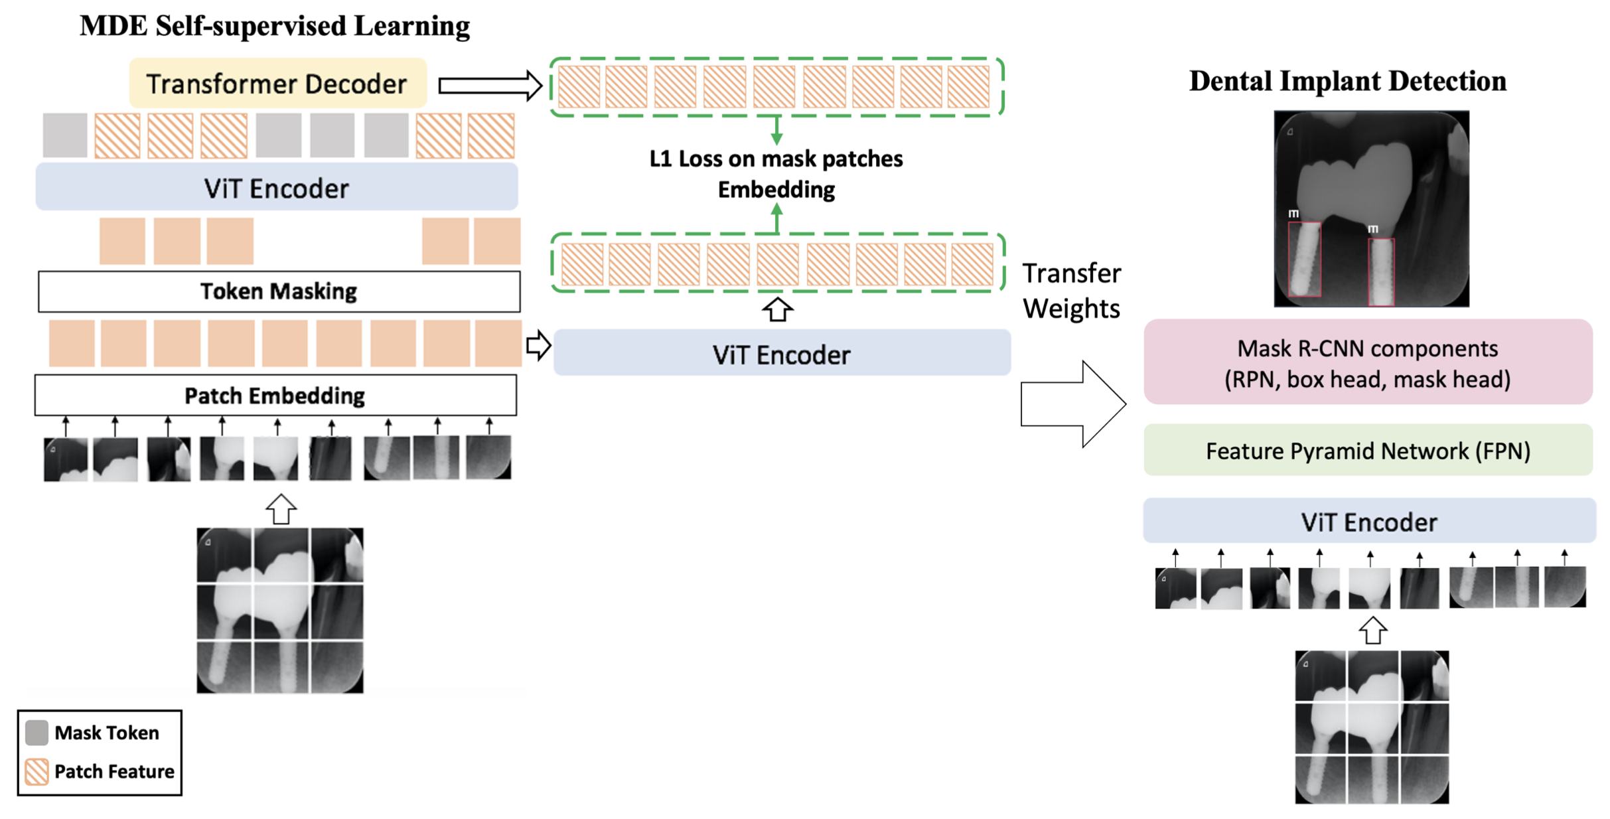
METHODS

Slide 38
EXPERIMENTS
Dataset:
5572 dental radiographs annotated for implant design parts (coronal, middle, apical).
Named Implant Design Dataset (IDD).
Experiments:
Five cross-validation with 80% training and 20% validation.
Evaluated using Average Precision (AP).

Slide 39
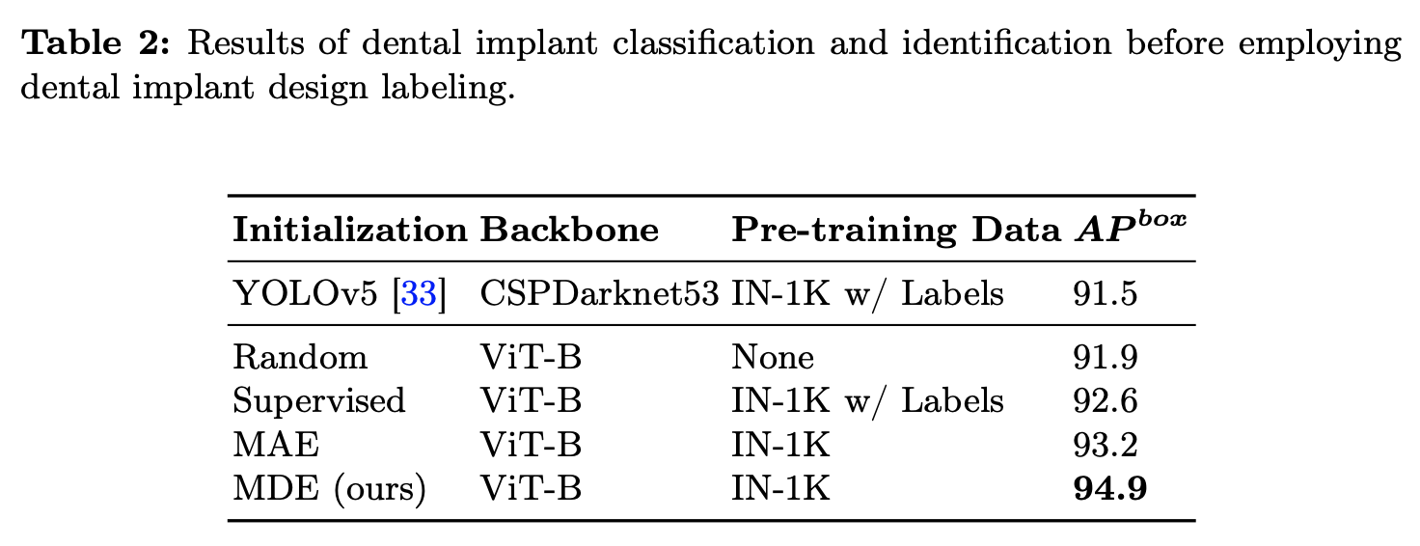
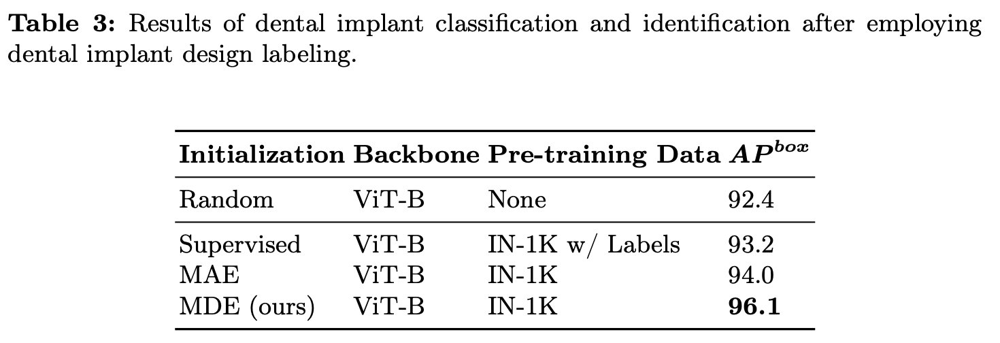
RESULTS

Slide 40
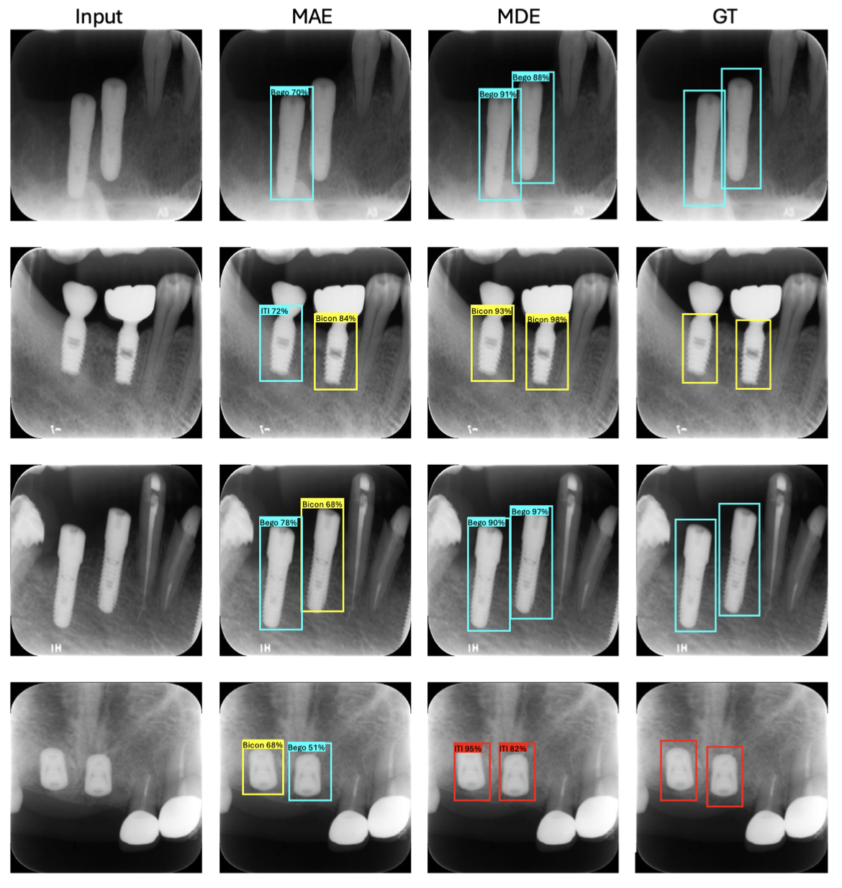
RESULTS

Slide 41
CONCLUSIONS
Introduced MDE for self-supervised learning in dental implant detection.
Created and enhanced the IDD dataset with detailed annotations.
Achieved state-of-the-art performance in detecting and identifying dental implants.

Slide 42
Research contribution 3: Self-Supervised Learning for Assessment of Peri-Implant Bone Loss in Dental Radiographs

Slide 43
CHALLENGES
Submitted to ICPR 2024*
Objective:
Develop an automated system for assessing peri-implant bone loss in dental radiographs using self-supervised learning.
Challenges:
Limited availability of annotated data.
Difficulty in detecting marginal bone levels due to similar densities and occlusion conditions.
* Amani Almalki and Longin Jan Latecki. "Self-Supervised Learning for Assessment of Peri-Implant Bone Loss in Dental Radiographs." Submitted to International Conference on Pattern Recognition (ICPR), Kolkata, India, December 2024.

Slide 44
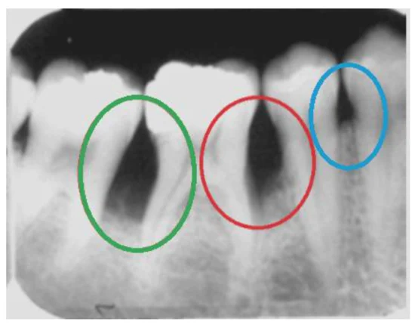
CHALLENGES
Bone Loss Measurement around dental implans
The severity of the bone loss is categorized into four groups:
Normal
Early
Moderate
Severe
Challenge: Dental images are not standardized.

Slide 45
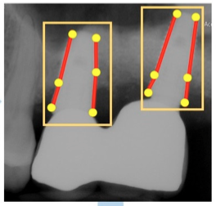
CHALLENGES
Bone Loss Measurement around dental implant
The severity of the bone loss is categorized into four groups:
Normal, if the percentage is ≤10%
Early, if the percentage is >10% and ≤25%
Moderate, if the percentage is >25% and ≤50%
Severe, if the percentage is >50%

Slide 46
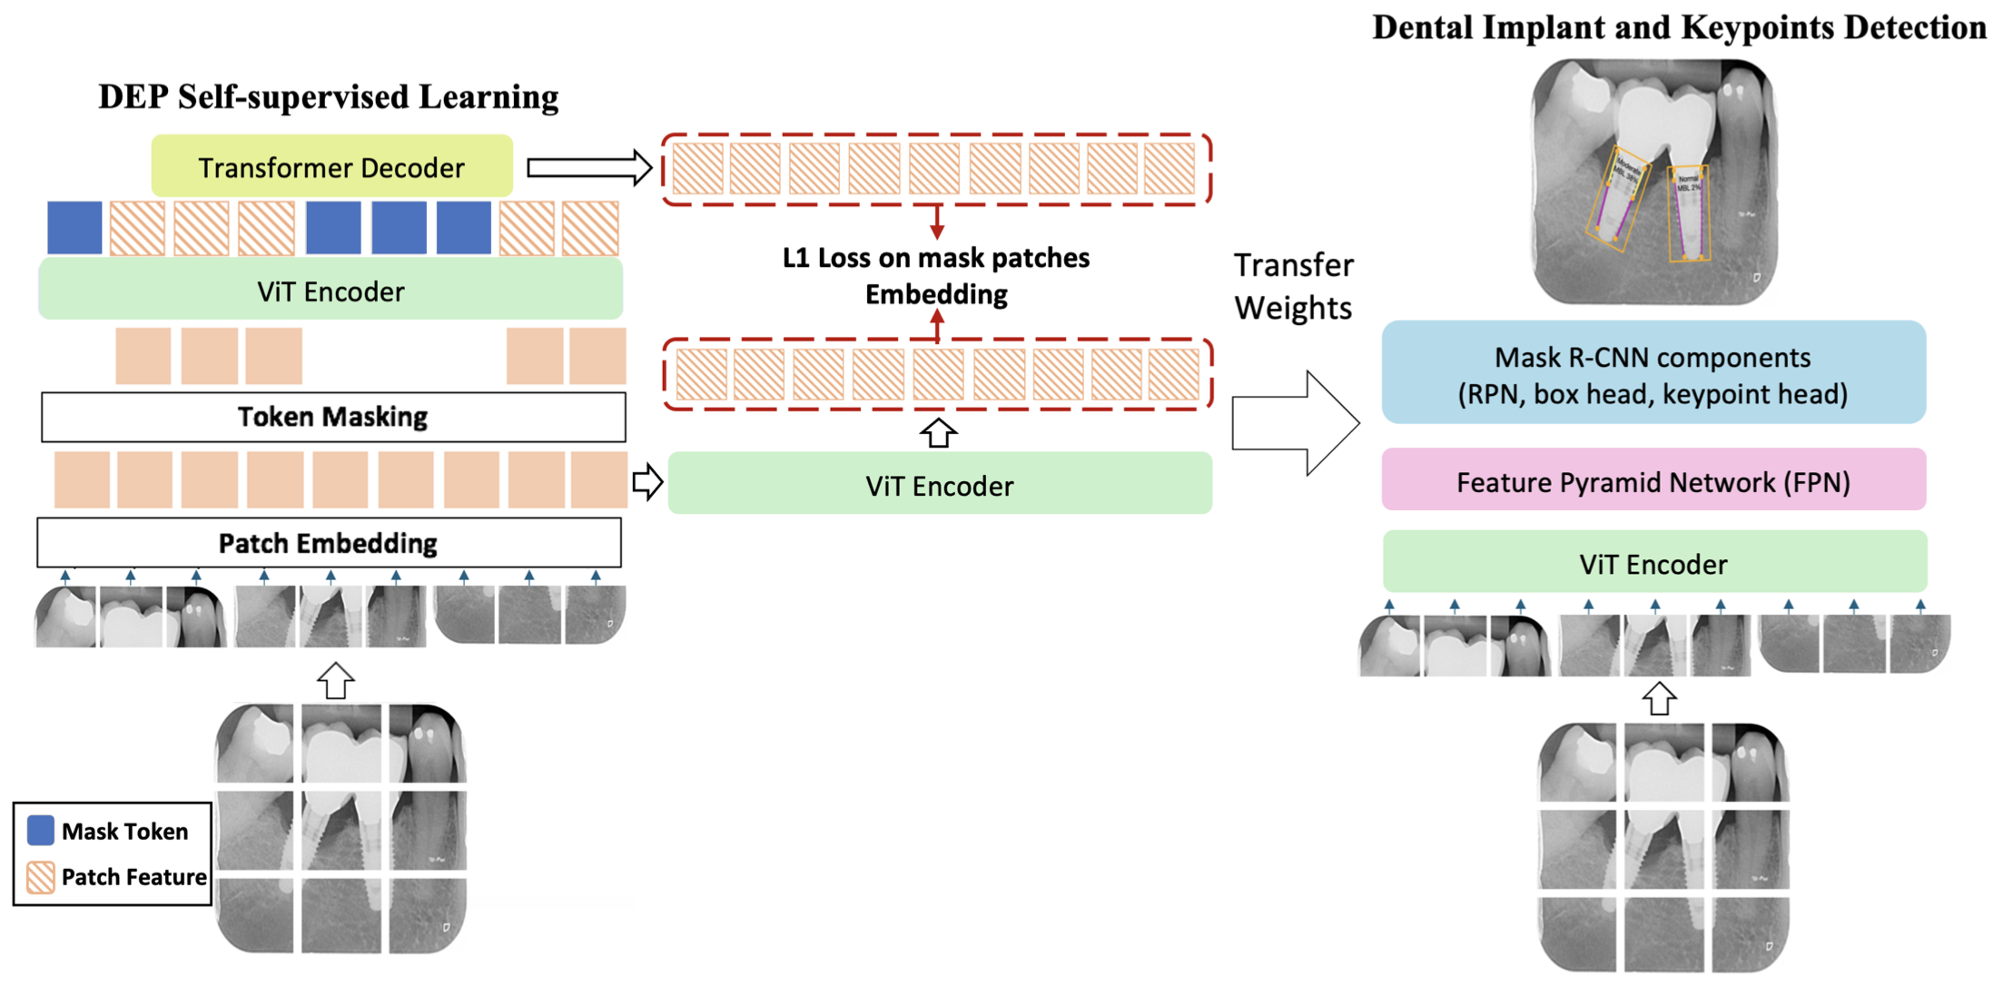
METHODS

Slide 47
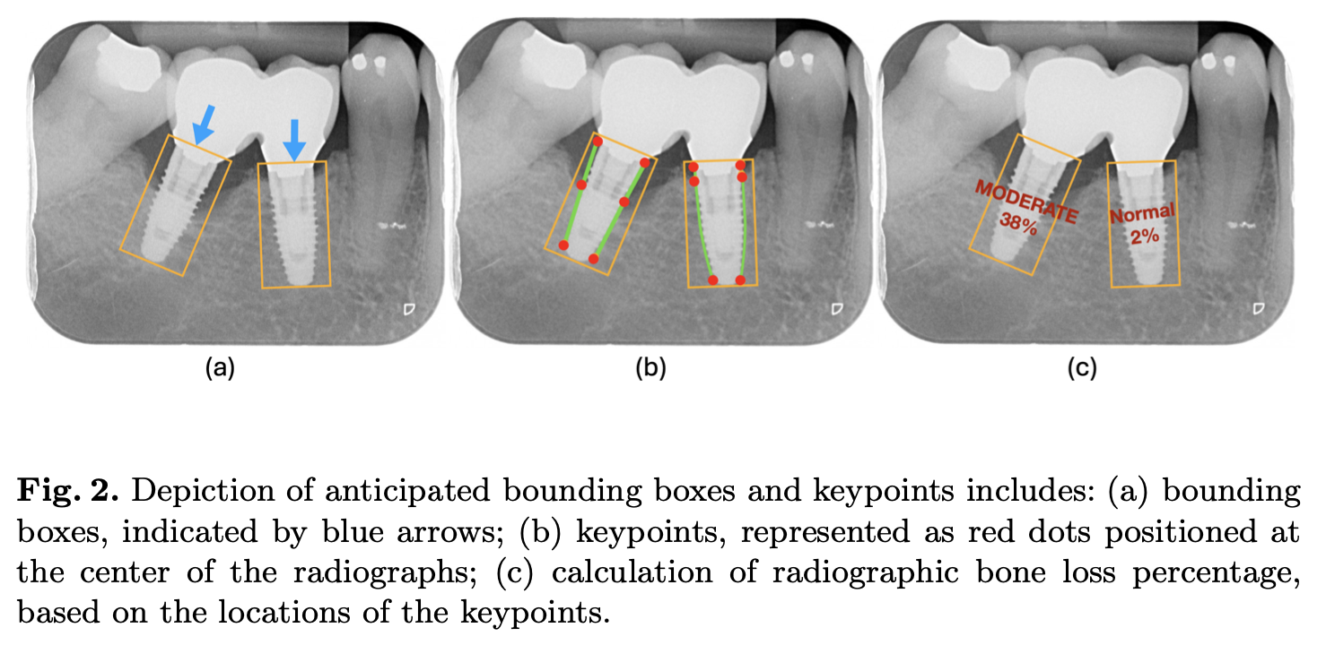
METHODS

Slide 48
EXPERIMENTS
Dataset:
5572 dental radiographs, 416x416 pixels, improved the previous dataset with keypoints for bone loss.
Named Bone Loss Assessment Dataset (BLAD).
Experiments:
Five cross-validation with 80% training and 20% validation.
Evaluated using Average Precision (AP) and Average Recall (AR).

Slide 49
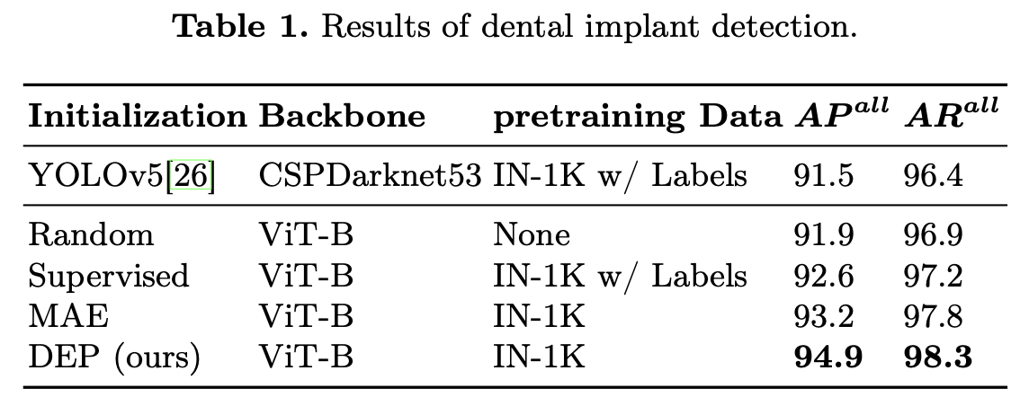
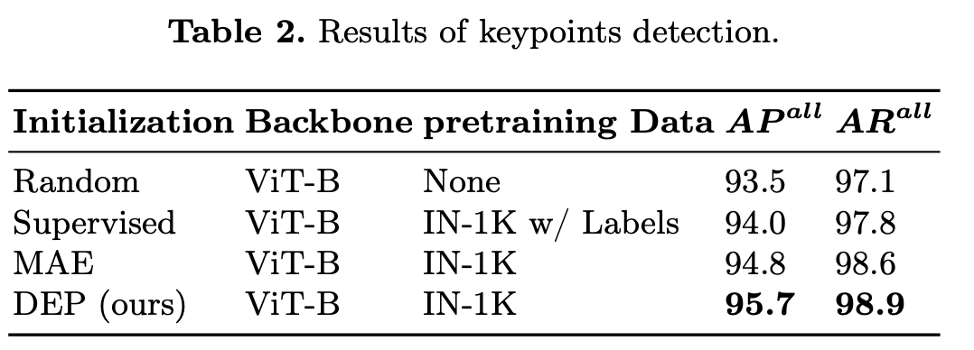
RESULTS
Enhanced performance in implant and keypoint detection with DEP.
Better delineation of key landmarks compared to other methods.

Slide 50
CONCLUSIONS
Introduced DEP for self-supervised learning in dental radiographs.
Created BLAD dataset with detailed annotations.
Achieved state-of-the-art performance in detecting peri-implant bone loss.

Slide 51
Research contribution 4:
Self-Supervised Masked Deep Embeddings for Dental Caries Detection

Slide 52
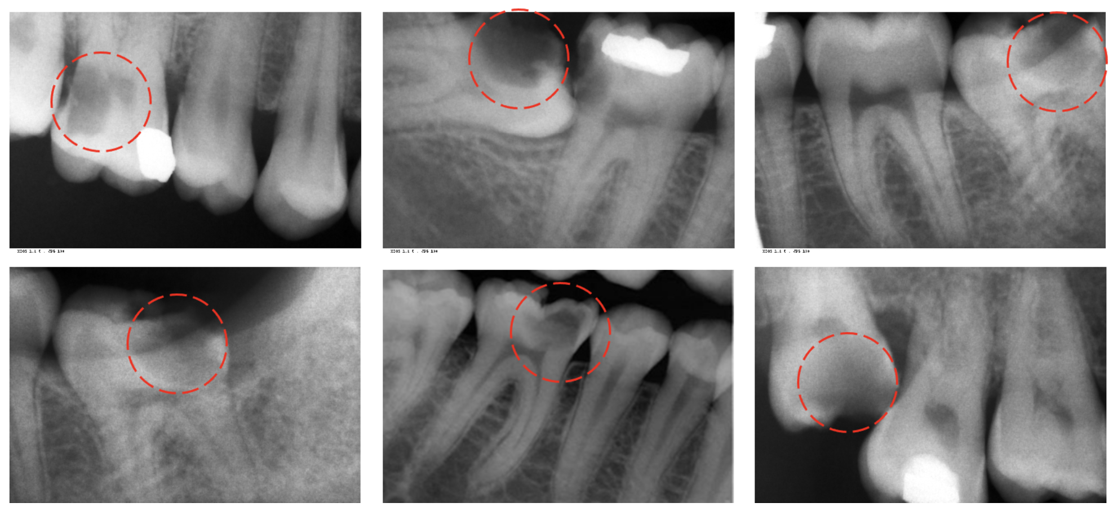
CHALLENGES
Submitted to WACV 2025*
Objective:
Develop an automated system for detecting dental caries in radiographs using self-supervised learning (MDEP).
Challenges:
Limited availability of annotated data.
Variability in caries appearance.
Overlapping structures in radiographs.
* Amani Almalki and Longin Jan Latecki. "Self-Supervised Masked Deep Embeddings for Dental Caries Detection." Submitted to IEEE/CVF Winter Conference on Applications of Computer Vision (WACV), Tucson, Arizona, USA, February 2025.

Slide 53
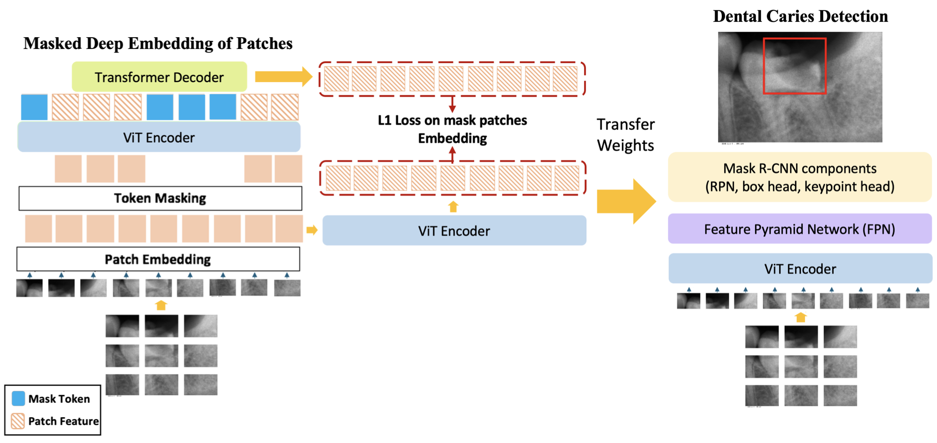
METHODS

Slide 54
EXPERIMENTS
Dataset:
936 periapical X-rays and 6,000 panoramic radiographs, annotated for caries.
Experiments:
Cross-validation with 80% training and 20% validation.
Evaluated using Precision, Recall, and Average Precision (AP).

Slide 55
RESULTS

Slide 56
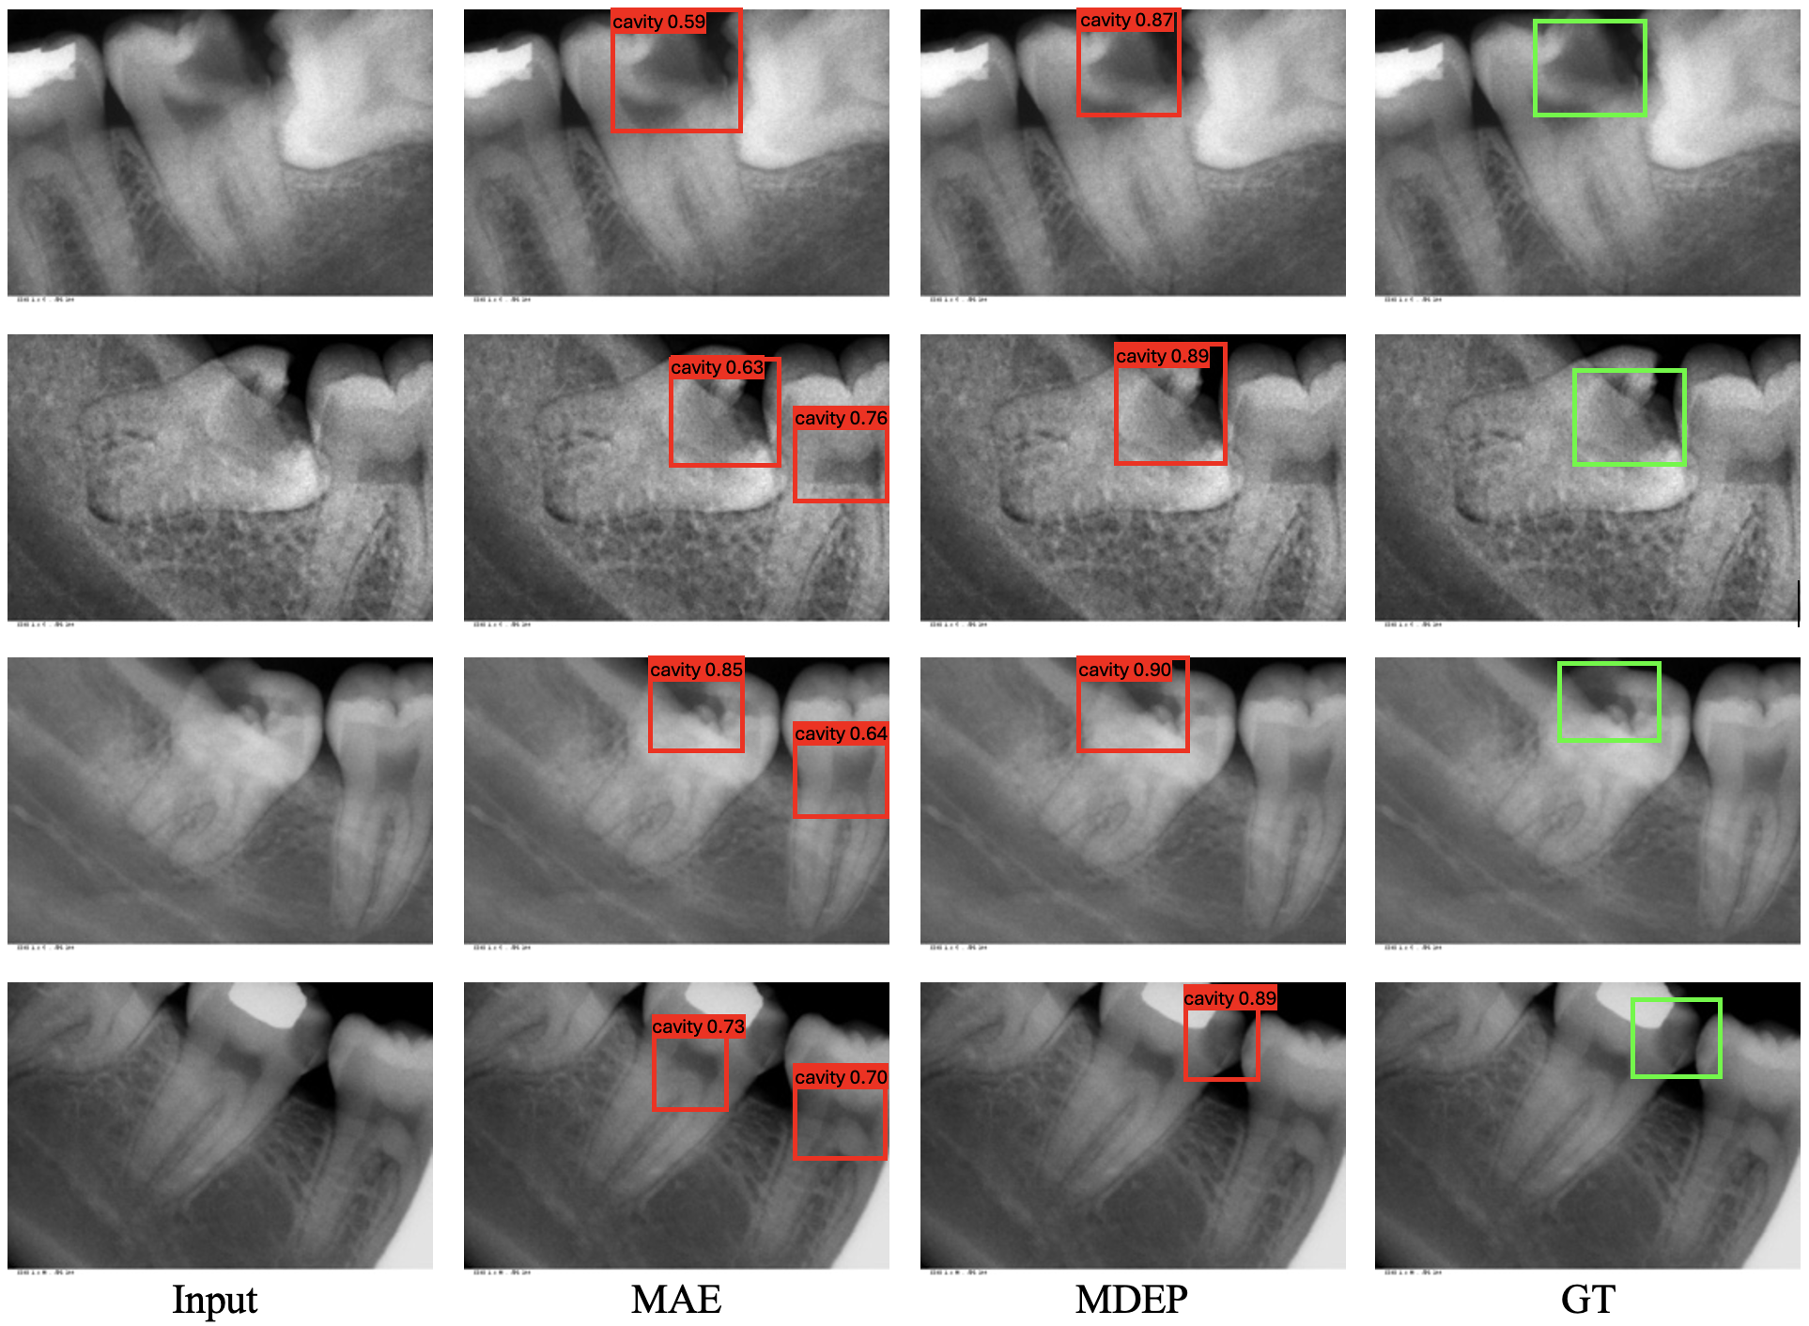
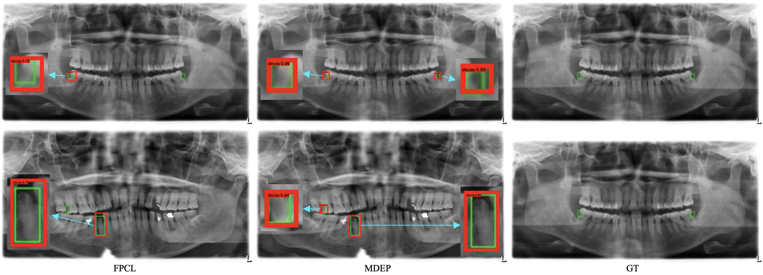
RESULTS

Slide 57
CONCLUSIONS
Introduced MDEP for self-supervised learning in dental radiographs.
Achieved state-of-the-art performance in detecting dental caries.

Slide 58
Thank you! Questions?

