Slide 1
Intro to Compute Vision
Collected from the Internet and modified by
Longin Jan Latecki
latecki@temple.edu
Sources:
Stanford CS 231. Deep Learning for CV: https://cs231n.stanford.edu/
Computer Vision Lectures by Svetlana Lazebnik
Other Internet Sources

Slide 2
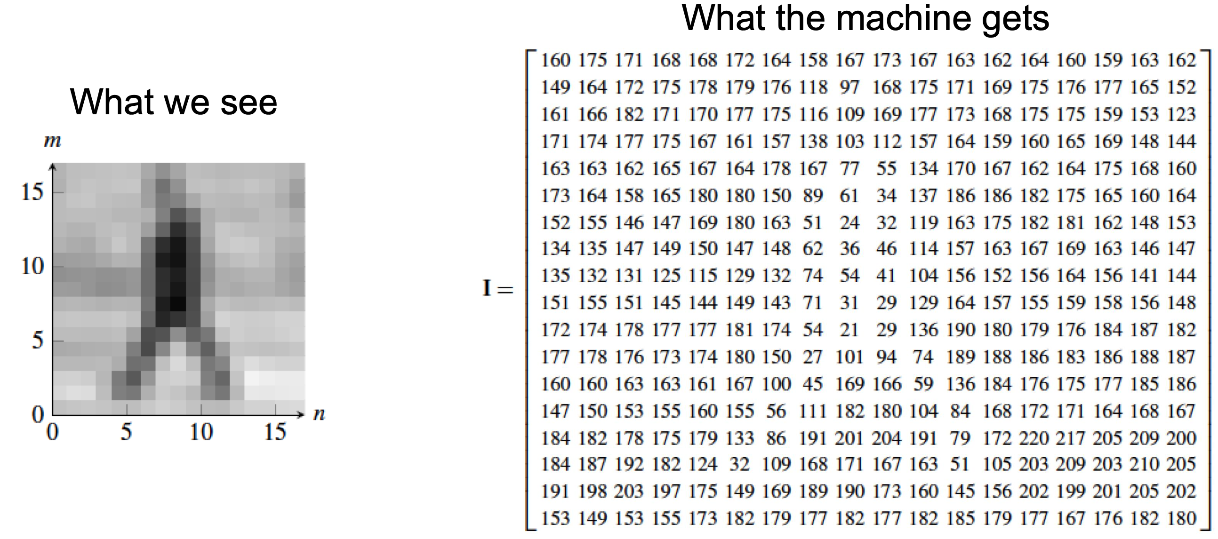
Human perception vs computer vision

Slide 3
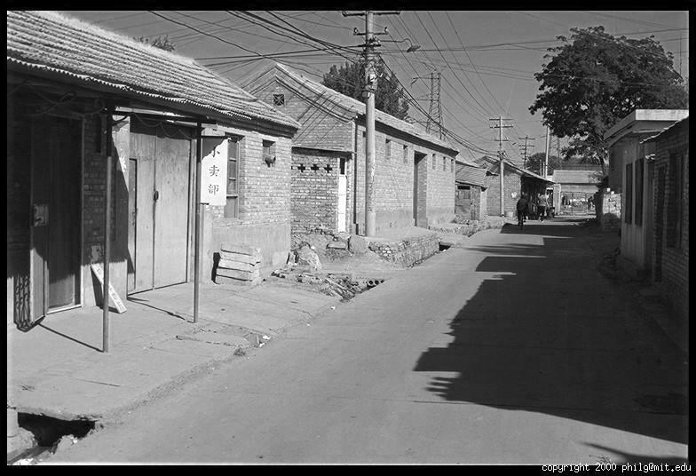
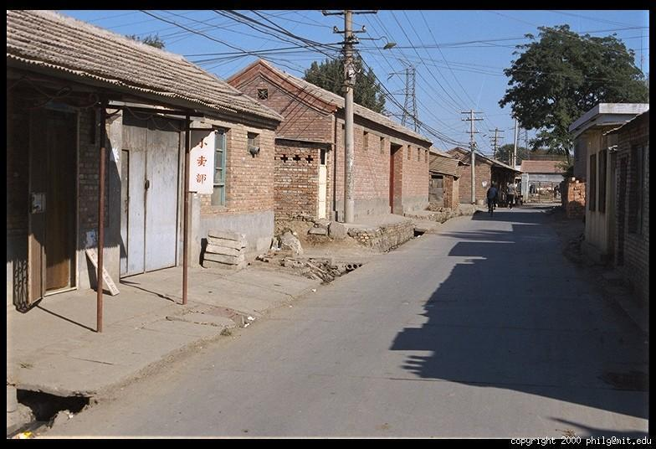
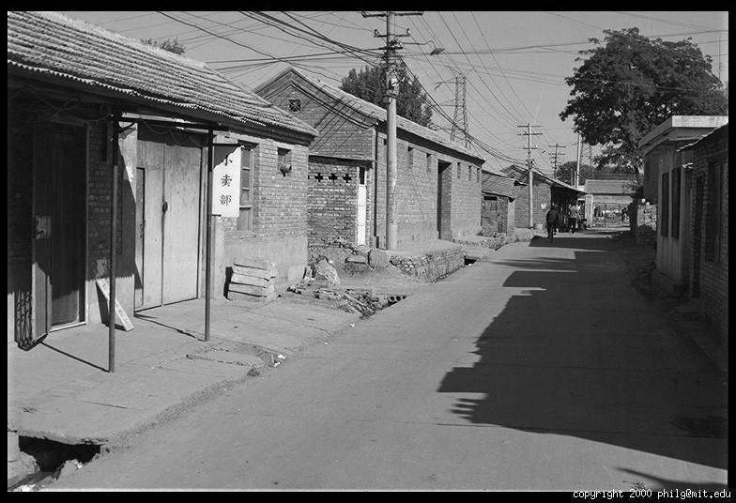
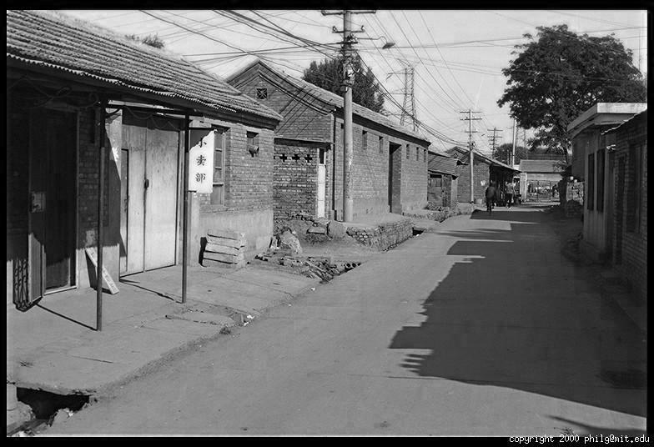
Digital color images
R
G
B

Slide 4
Digital color images in a computer
R
G
column
row
R
0.92 | 0.93 | 0.94 | 0.97 | 0.62 | 0.37 | 0.85 | 0.97 | 0.93 | 0.92 | 0.99
0.95 | 0.89 | 0.82 | 0.89 | 0.56 | 0.31 | 0.75 | 0.92 | 0.81 | 0.95 | 0.91
0.89 | 0.72 | 0.51 | 0.55 | 0.51 | 0.42 | 0.57 | 0.41 | 0.49 | 0.91 | 0.92
0.96 | 0.95 | 0.88 | 0.94 | 0.56 | 0.46 | 0.91 | 0.87 | 0.90 | 0.97 | 0.95
0.71 | 0.81 | 0.81 | 0.87 | 0.57 | 0.37 | 0.80 | 0.88 | 0.89 | 0.79 | 0.85
0.49 | 0.62 | 0.60 | 0.58 | 0.50 | 0.60 | 0.58 | 0.50 | 0.61 | 0.45 | 0.33
0.86 | 0.84 | 0.74 | 0.58 | 0.51 | 0.39 | 0.73 | 0.92 | 0.91 | 0.49 | 0.74
0.96 | 0.67 | 0.54 | 0.85 | 0.48 | 0.37 | 0.88 | 0.90 | 0.94 | 0.82 | 0.93
0.69 | 0.49 | 0.56 | 0.66 | 0.43 | 0.42 | 0.77 | 0.73 | 0.71 | 0.90 | 0.99
0.79 | 0.73 | 0.90 | 0.67 | 0.33 | 0.61 | 0.69 | 0.79 | 0.73 | 0.93 | 0.97
0.91 | 0.94 | 0.89 | 0.49 | 0.41 | 0.78 | 0.78 | 0.77 | 0.89 | 0.99 | 0.93
G
B
0.92 | 0.93 | 0.94 | 0.97 | 0.62 | 0.37 | 0.85 | 0.97 | 0.93 | 0.92 | 0.99
0.95 | 0.89 | 0.82 | 0.89 | 0.56 | 0.31 | 0.75 | 0.92 | 0.81 | 0.95 | 0.91
0.89 | 0.72 | 0.51 | 0.55 | 0.51 | 0.42 | 0.57 | 0.41 | 0.49 | 0.91 | 0.92
0.96 | 0.95 | 0.88 | 0.94 | 0.56 | 0.46 | 0.91 | 0.87 | 0.90 | 0.97 | 0.95
0.71 | 0.81 | 0.81 | 0.87 | 0.57 | 0.37 | 0.80 | 0.88 | 0.89 | 0.79 | 0.85
0.49 | 0.62 | 0.60 | 0.58 | 0.50 | 0.60 | 0.58 | 0.50 | 0.61 | 0.45 | 0.33
0.86 | 0.84 | 0.74 | 0.58 | 0.51 | 0.39 | 0.73 | 0.92 | 0.91 | 0.49 | 0.74
0.96 | 0.67 | 0.54 | 0.85 | 0.48 | 0.37 | 0.88 | 0.90 | 0.94 | 0.82 | 0.93
0.69 | 0.49 | 0.56 | 0.66 | 0.43 | 0.42 | 0.77 | 0.73 | 0.71 | 0.90 | 0.99
0.79 | 0.73 | 0.90 | 0.67 | 0.33 | 0.61 | 0.69 | 0.79 | 0.73 | 0.93 | 0.97
0.91 | 0.94 | 0.89 | 0.49 | 0.41 | 0.78 | 0.78 | 0.77 | 0.89 | 0.99 | 0.93
B
0.92 | 0.93 | 0.94 | 0.97 | 0.62 | 0.37 | 0.85 | 0.97 | 0.93 | 0.92 | 0.99
0.95 | 0.89 | 0.82 | 0.89 | 0.56 | 0.31 | 0.75 | 0.92 | 0.81 | 0.95 | 0.91
0.89 | 0.72 | 0.51 | 0.55 | 0.51 | 0.42 | 0.57 | 0.41 | 0.49 | 0.91 | 0.92
0.96 | 0.95 | 0.88 | 0.94 | 0.56 | 0.46 | 0.91 | 0.87 | 0.90 | 0.97 | 0.95
0.71 | 0.81 | 0.81 | 0.87 | 0.57 | 0.37 | 0.80 | 0.88 | 0.89 | 0.79 | 0.85
0.49 | 0.62 | 0.60 | 0.58 | 0.50 | 0.60 | 0.58 | 0.50 | 0.61 | 0.45 | 0.33
0.86 | 0.84 | 0.74 | 0.58 | 0.51 | 0.39 | 0.73 | 0.92 | 0.91 | 0.49 | 0.74
0.96 | 0.67 | 0.54 | 0.85 | 0.48 | 0.37 | 0.88 | 0.90 | 0.94 | 0.82 | 0.93
0.69 | 0.49 | 0.56 | 0.66 | 0.43 | 0.42 | 0.77 | 0.73 | 0.71 | 0.90 | 0.99
0.79 | 0.73 | 0.90 | 0.67 | 0.33 | 0.61 | 0.69 | 0.79 | 0.73 | 0.93 | 0.97
0.91 | 0.94 | 0.89 | 0.49 | 0.41 | 0.78 | 0.78 | 0.77 | 0.89 | 0.99 | 0.93

Slide 5
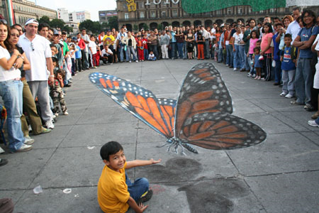
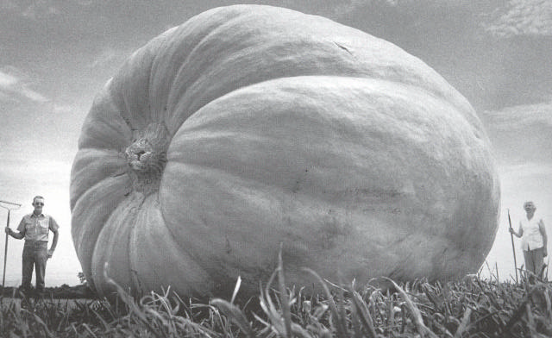
Remember: Images are fundamentally ambiguous!

Slide 6
Image by Street 1931.
Some images are hard to recognize. What do you see?

Slide 7
With grouping constraints, we can see (i.e., recognize the object).

Slide 8


Symbolic AI vs Classical Machine Learning vs Deep Learning
Rules
Symbolic AI/
expert system
Model
Answers
Data
Classical Machine Learning
Deep Learning
Automatic feature discovery => higher chance of success

Slide 9
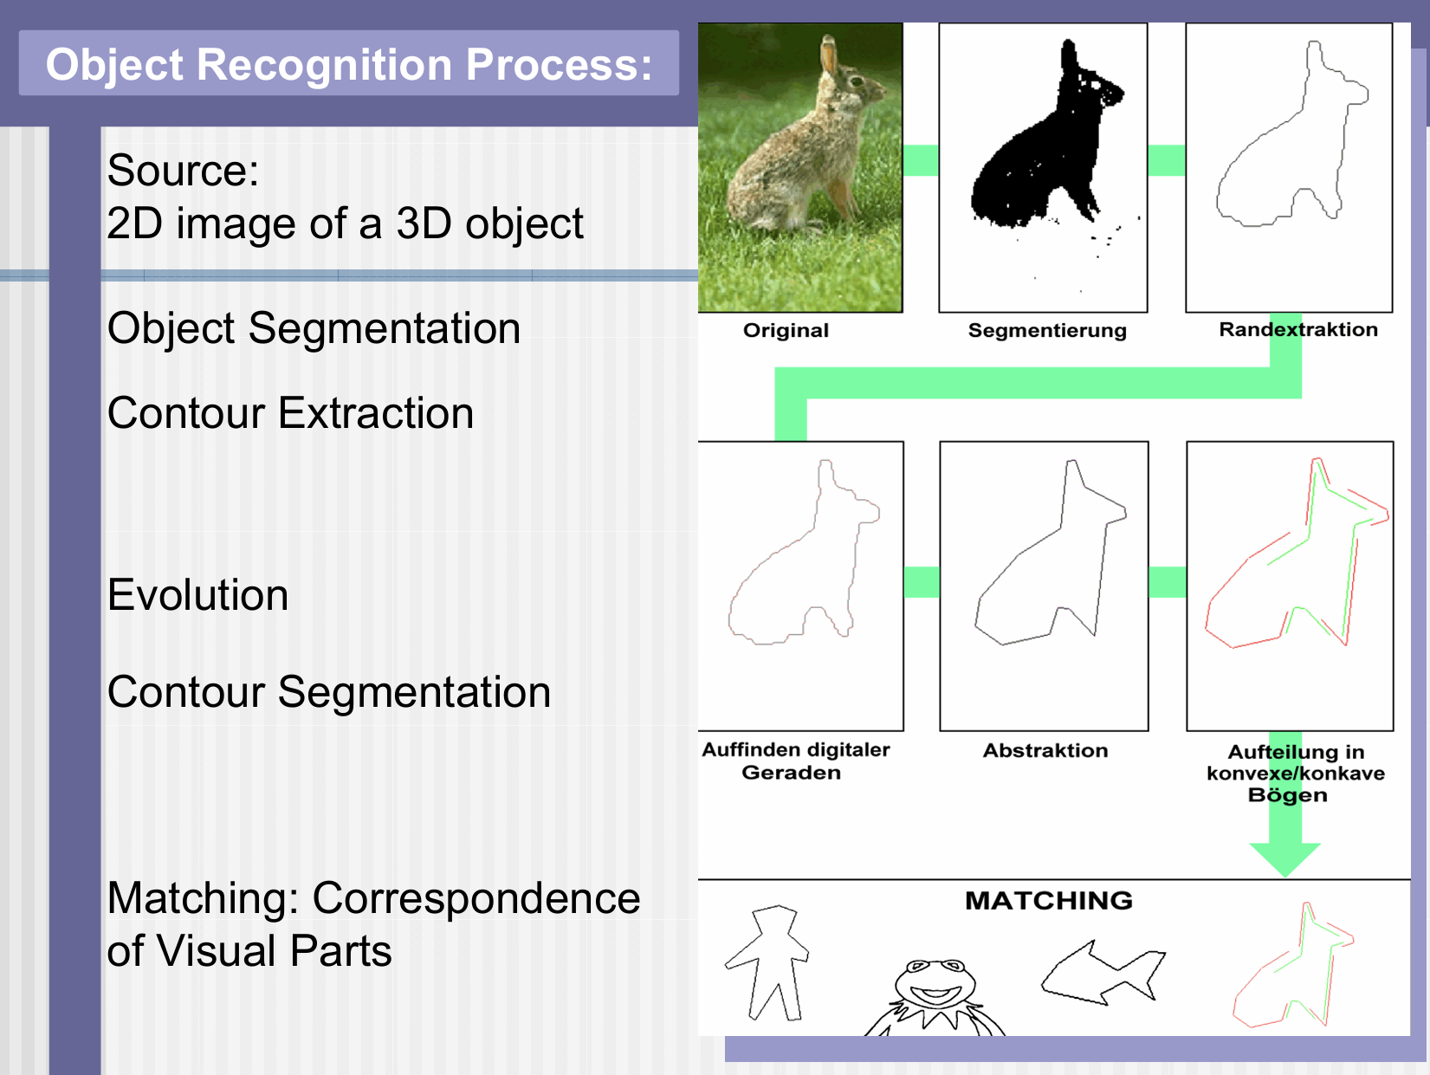
Symbolic AI example:
Latecki and Lakaemper,
IEEE PAMI, 2000.
(highly cited but
Irrelevant today)

Slide 10
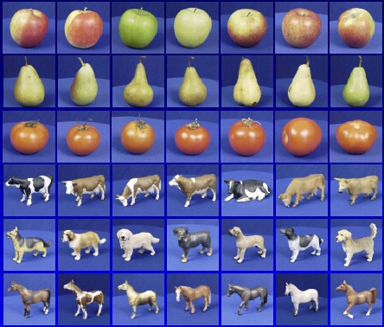

Modern AI learning framework
Training data
Training time
Training
Learned model
Test sample
Prediction
Inference
Test time
“apple”

Slide 11
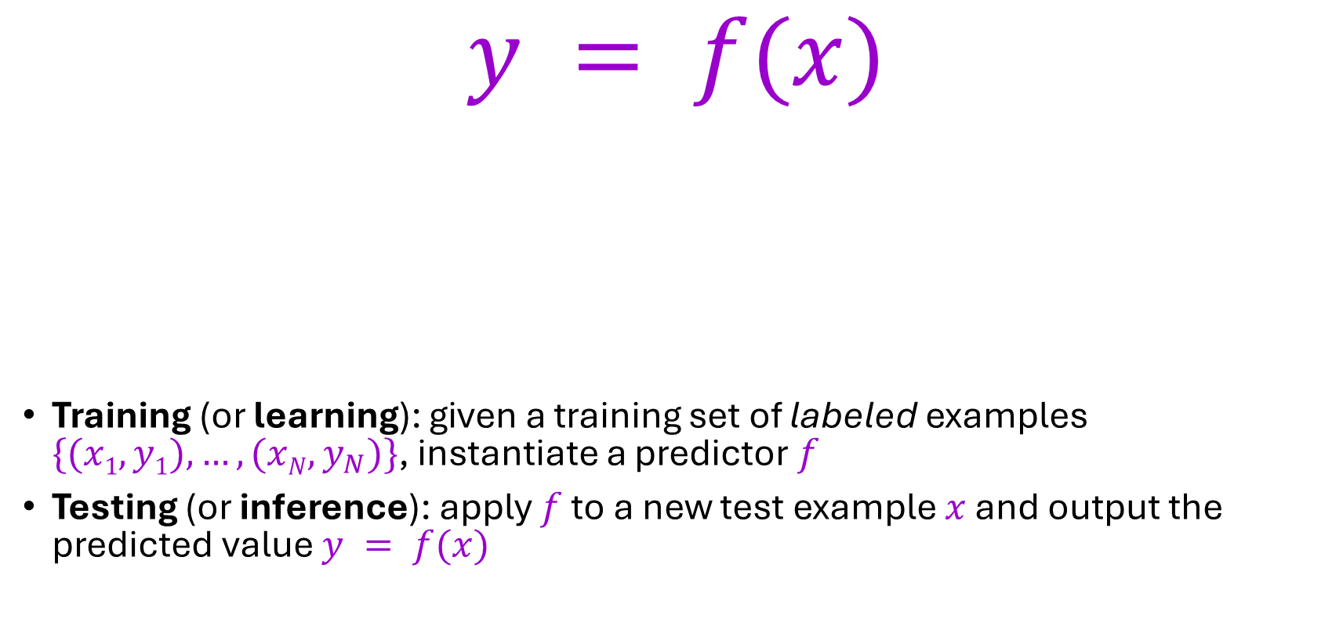
The modern learning framework (supervised)
$$y = f(x)$$
Training (or learning): given a training set of labeled examples $\{(x1,y1), …, (xN,y_{N})\}$, instantiate a predictor $f$
Testing (or inference): apply $f$ to a new test example $x$ and output the predicted value $y = f(x)$
output
prediction function
input

Slide 12
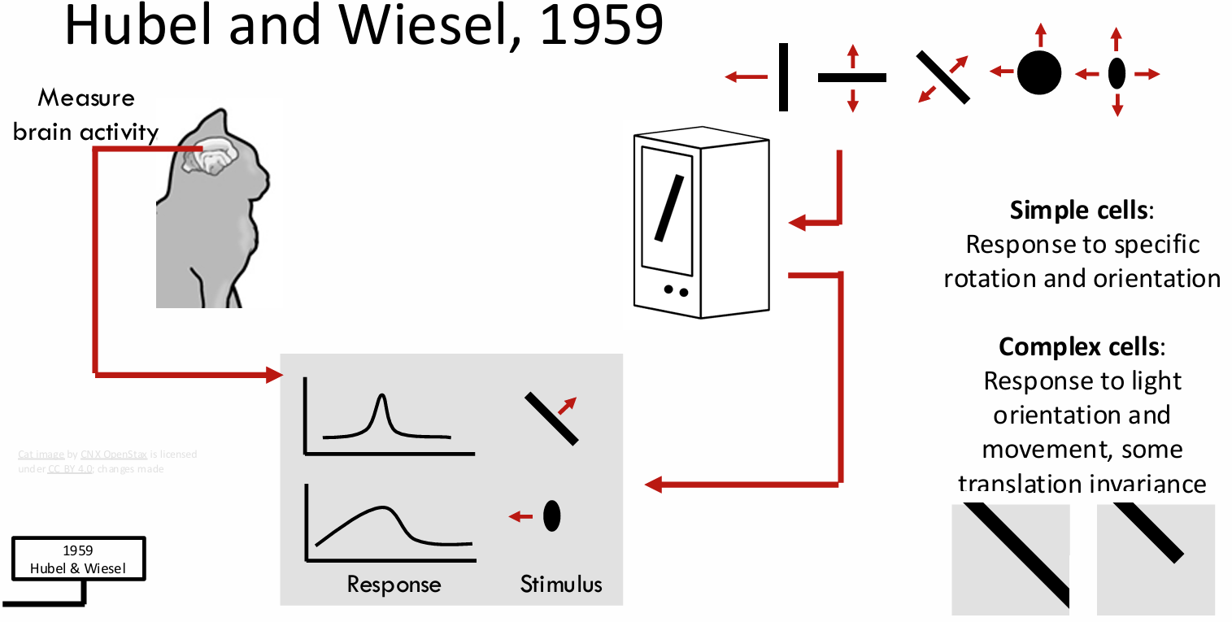
Some History: Early Days of Symbolic AI

Slide 13
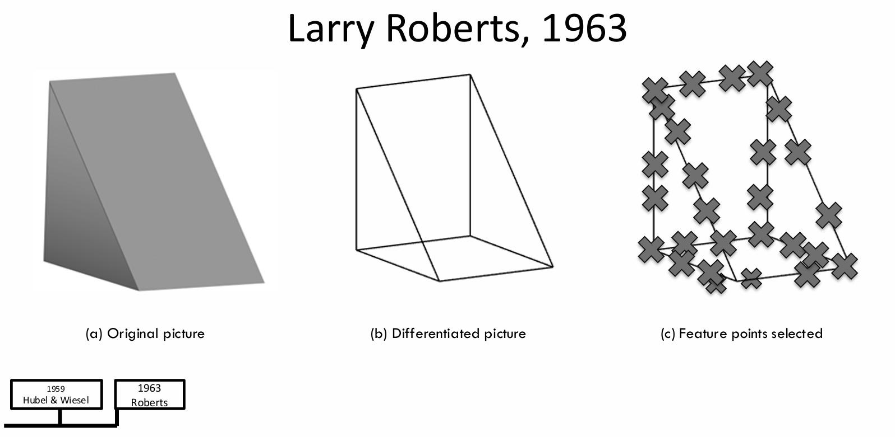

Slide 14
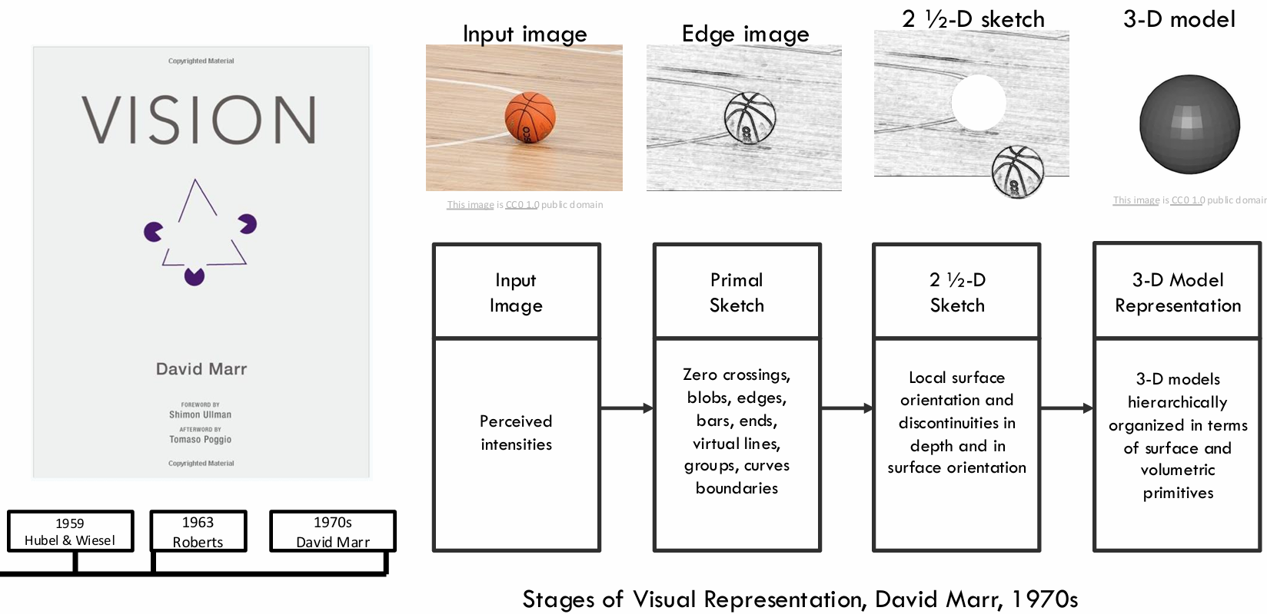

Slide 15
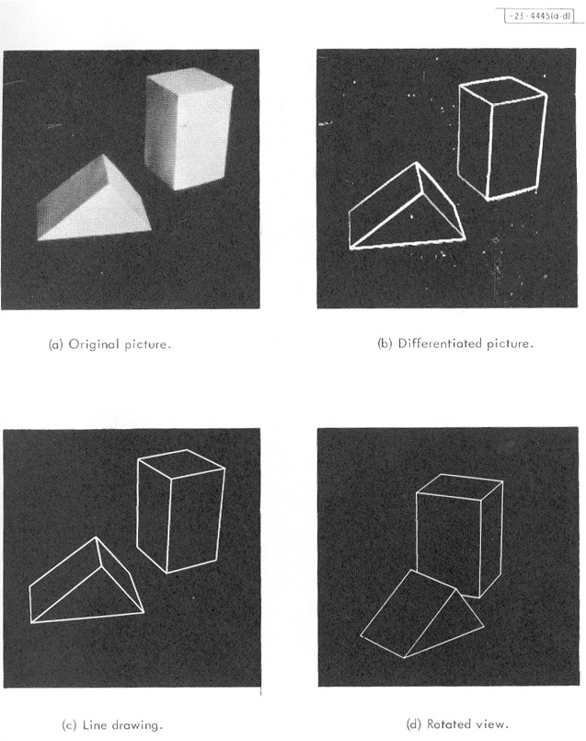
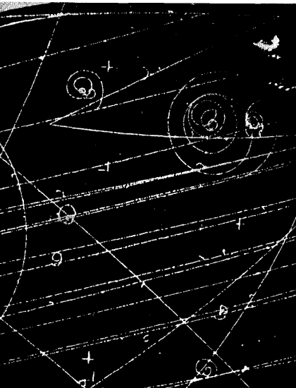
Origins of computer vision
Hough, 1959
Roberts, 1963
Rosenfeld, 1969
Duda & Hart, 1972

Slide 16
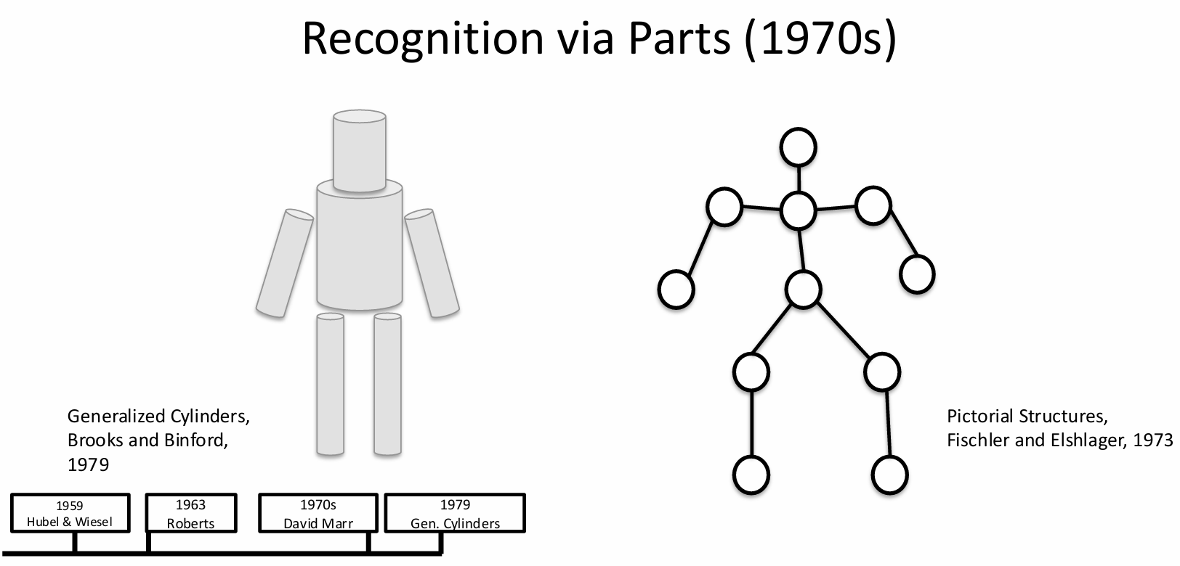

Slide 17
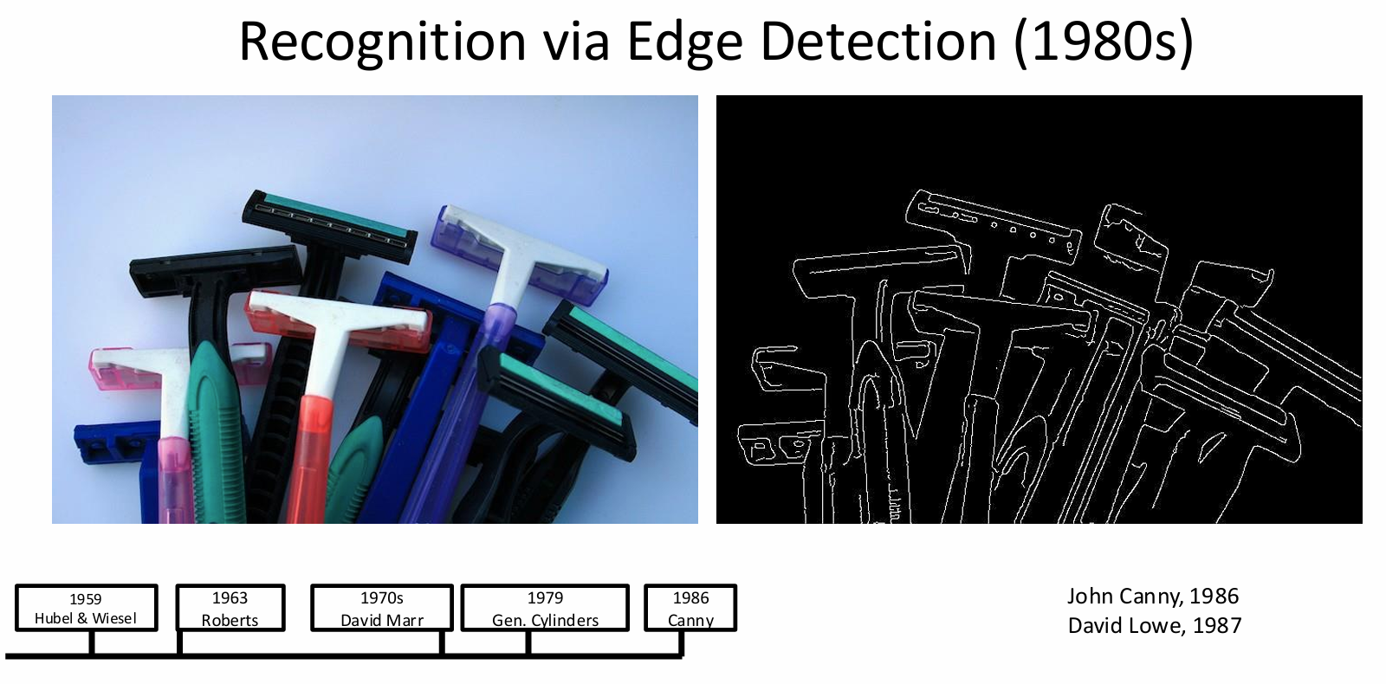

Slide 18
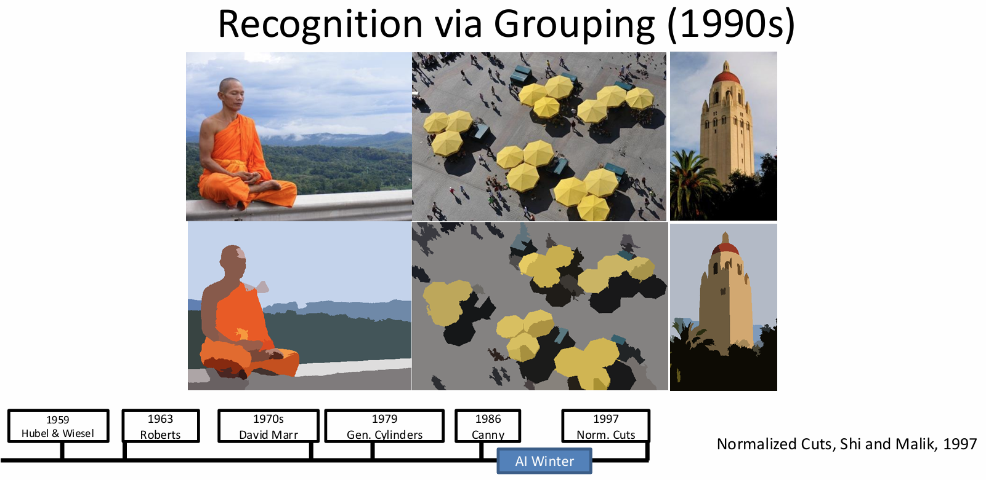

Slide 19
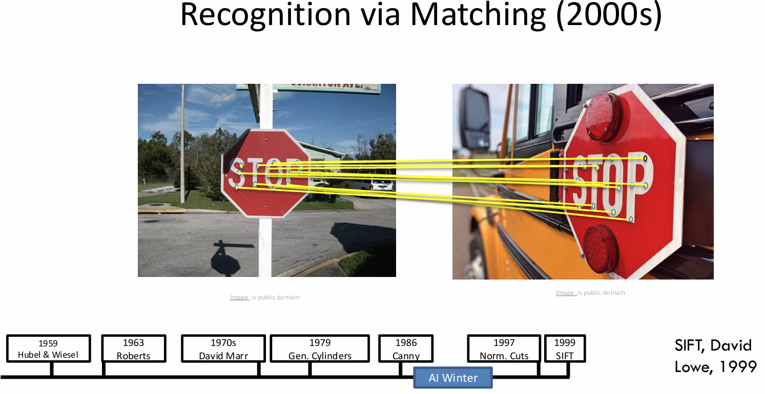

Slide 20
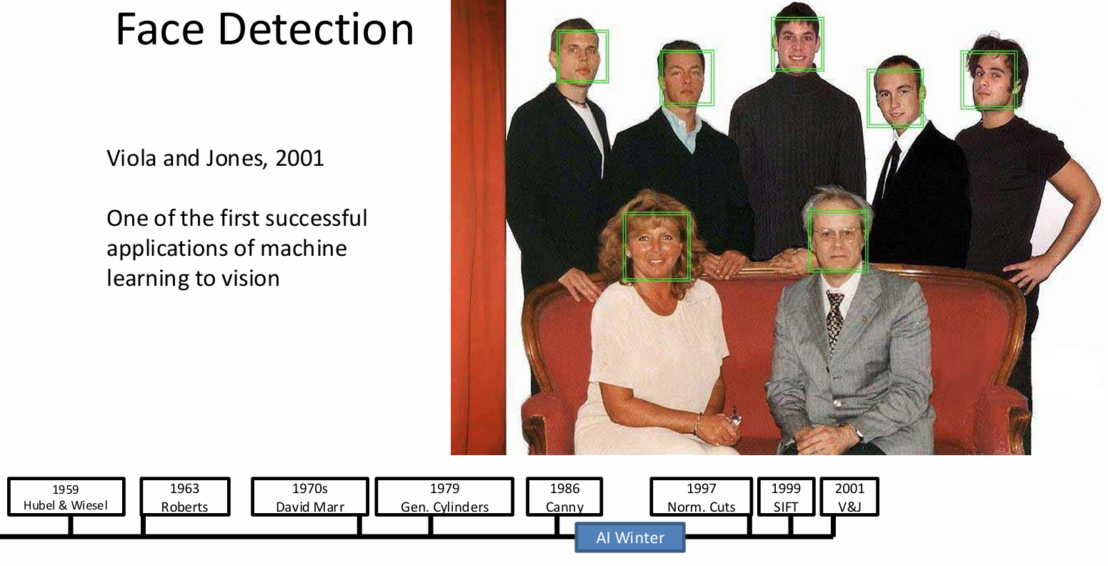

Slide 21
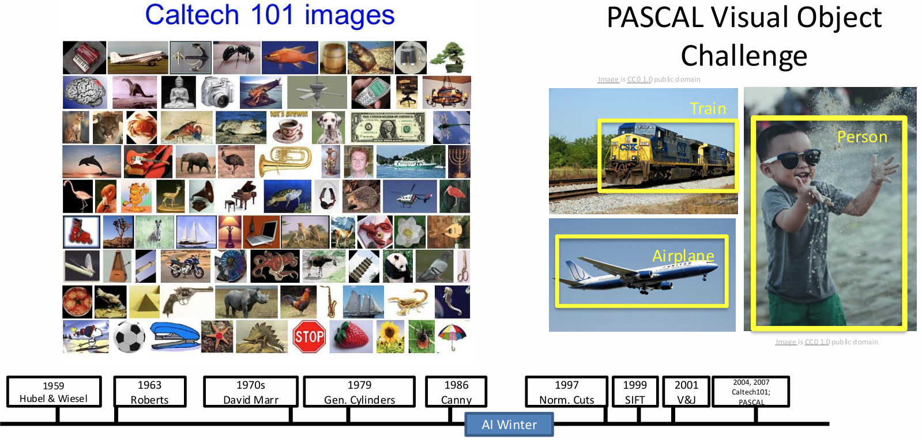

Slide 22
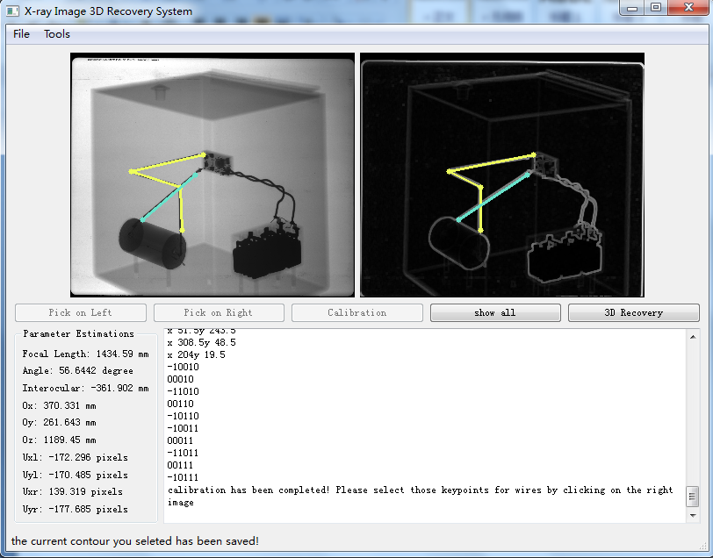
Some of my projects around the 2010s
Recovery of 3D Shapes from X-Ray Images, supported by Sandia Lab, DOE

Slide 23
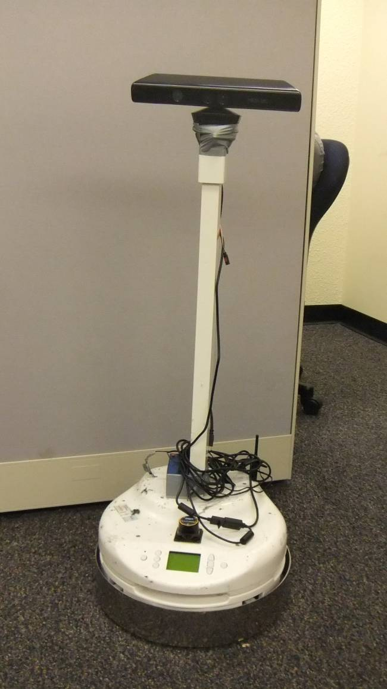
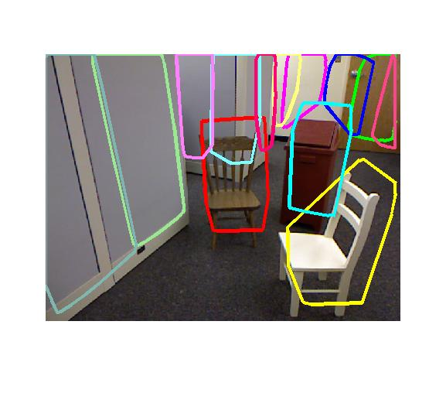
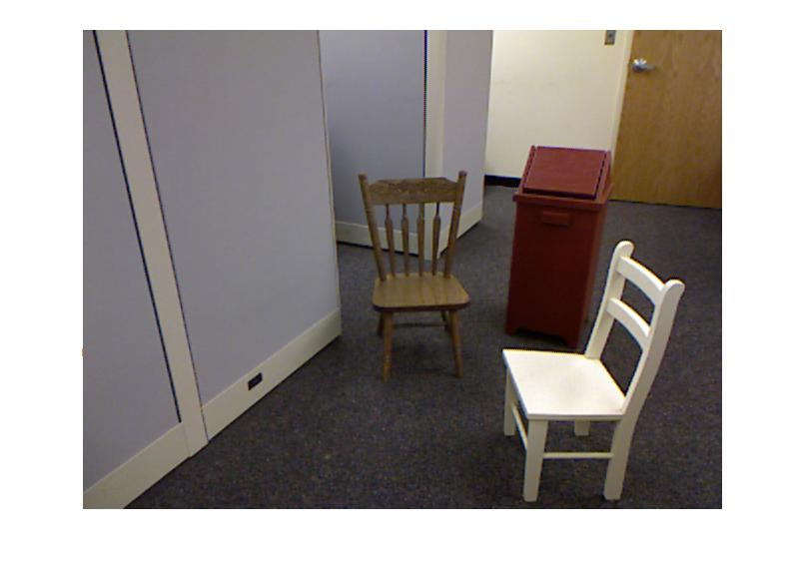
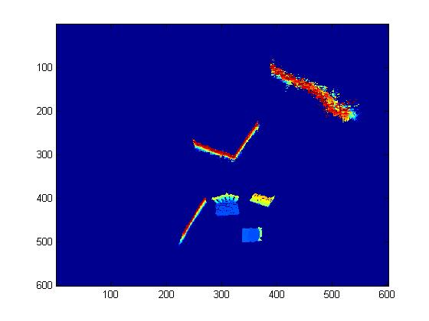
NSF CDI-Type II: Perception of Scene Layout by Machines and Visually Impaired Users
Collaborative with U. Maine and Upenn
Goal is to communicate the scene layout
to blind users.
There is a white chair
to your right,
a brown chair directly
in front of you.
To reach a stand go
between the two chairs.

Slide 24
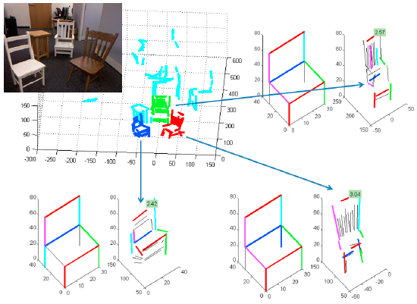
Recovery of 3D Shapes from Single Views co-PI: Zygmunt Pizlo, Purdue University, supported by NSF

Slide 25
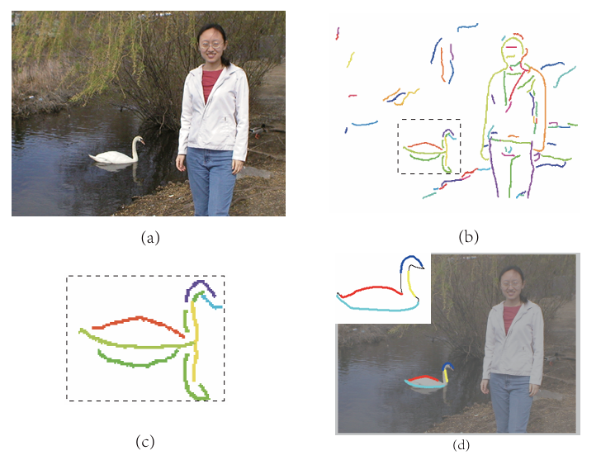
Contour Grouping, Tianyang Ma and Longin Jan Latecki, CVPR 2011

Slide 26
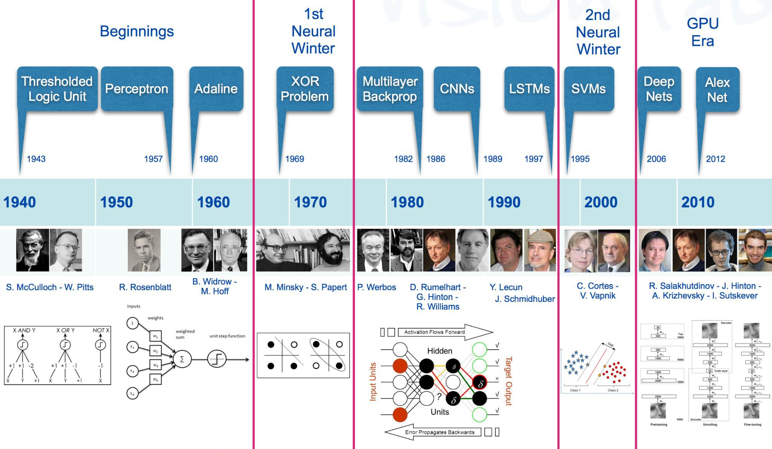
A bit of history of neural networks

Slide 27
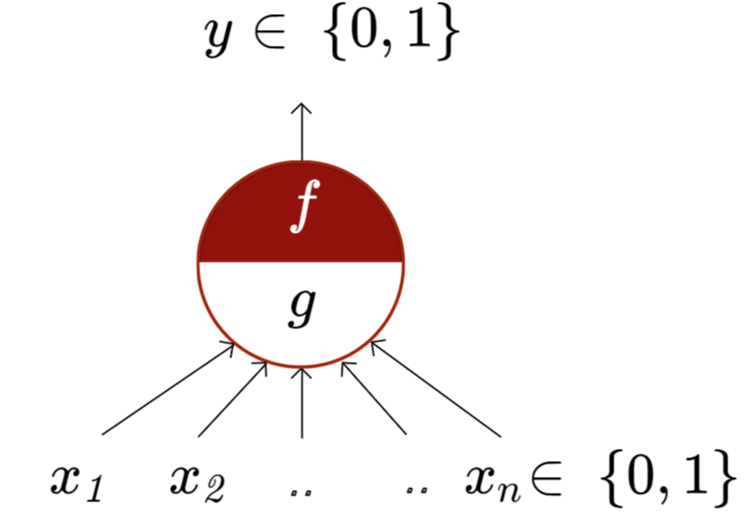
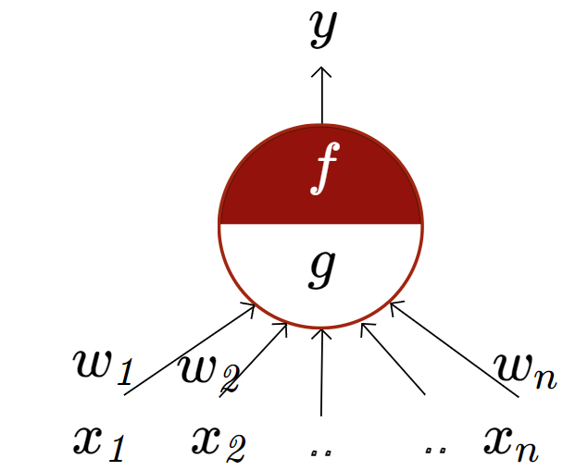
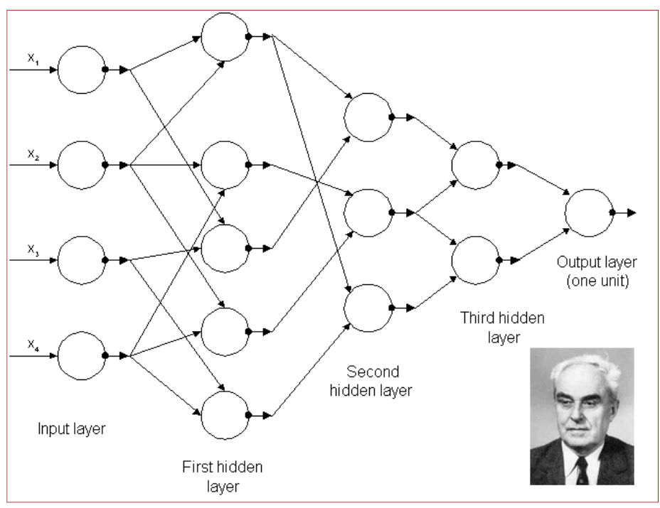
McCulloch Pitts Neuron
McCulloch (neuroscientist) and Pitts (logician) proposed a highly simplified model of the neuron (1943).
the perceptron may eventually be able to learn, make decisions, and translate languages” -Frank Rosenblatt, 1957-8
First generation Multilayer Perceptrons published by A. Ivakhnenko and V. G. Lapa,
CYBERNETIC PREDICTING DEVICES, 1966.

Slide 28
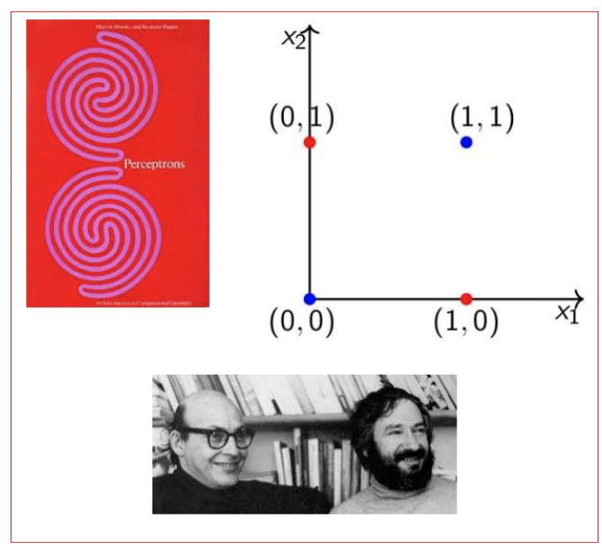
Perceptron Limitations
In book “Perceptrons” 1969,
Minsky and Papert outlined
the limits of what perceptrons
could do and killed them,
causing the first neural winter.

Slide 29
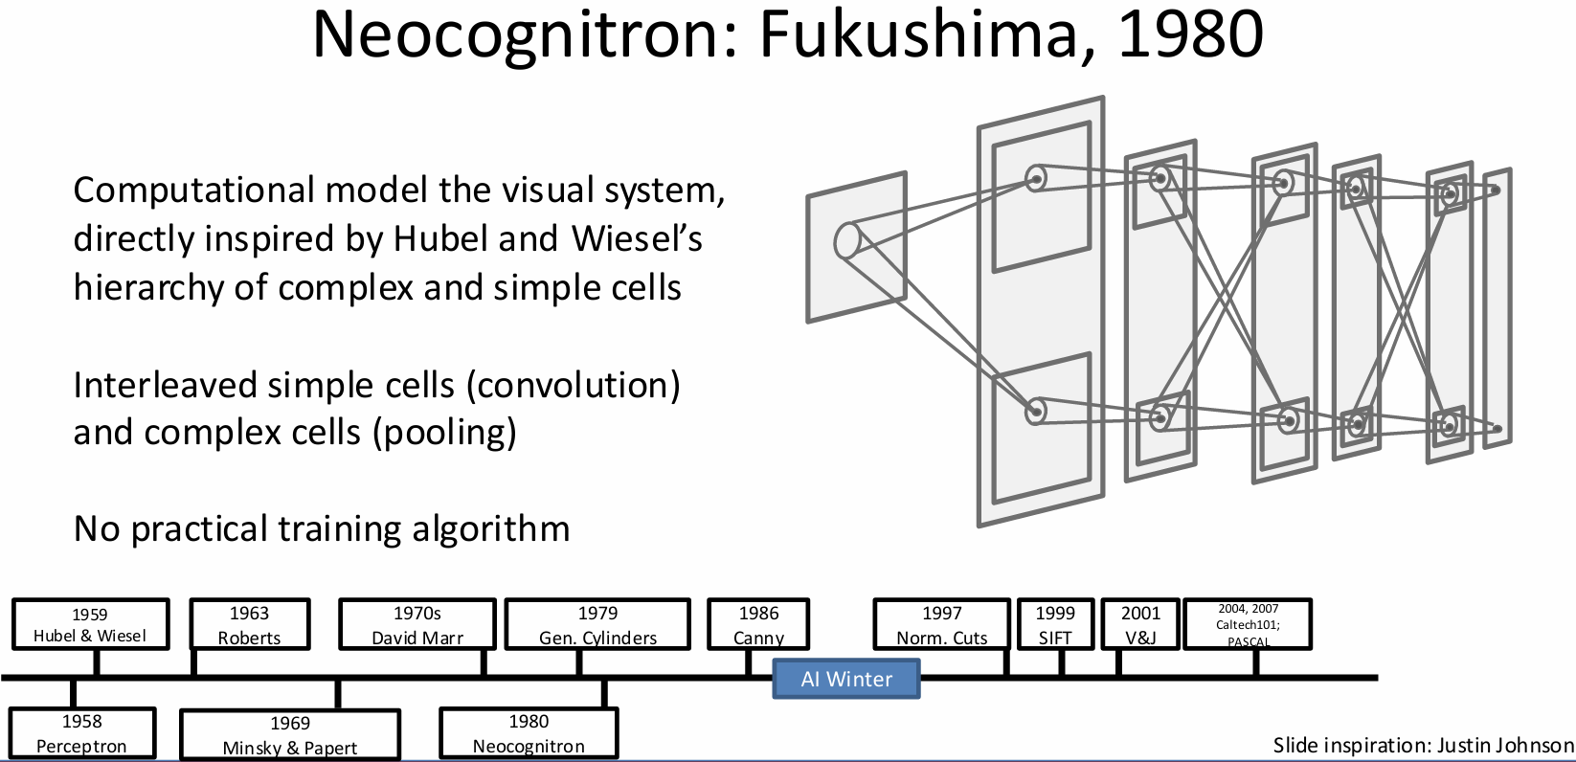

Slide 30
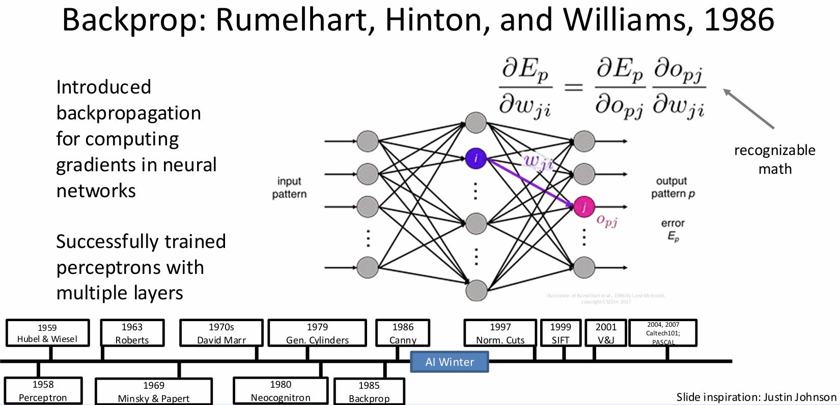

Slide 31
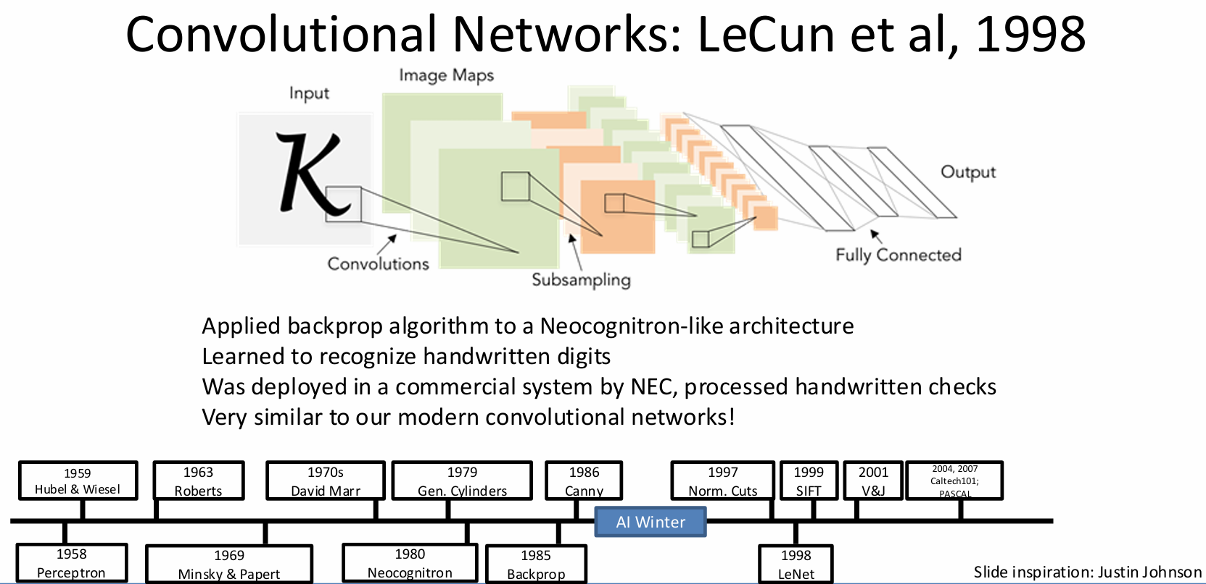

Slide 32
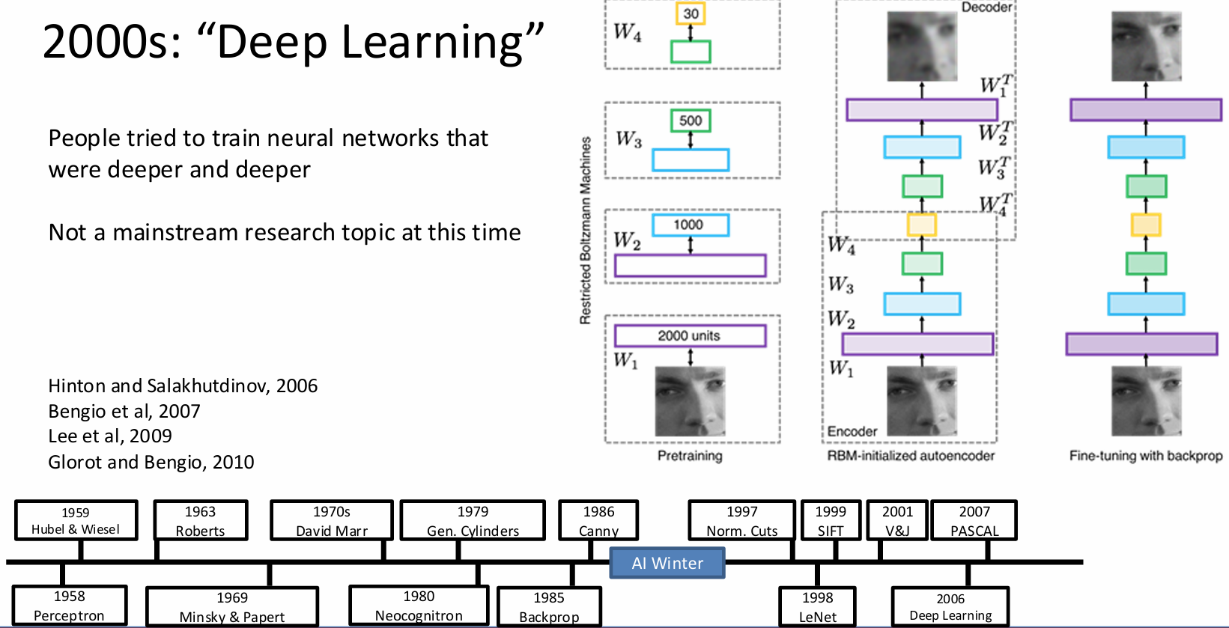

Slide 33
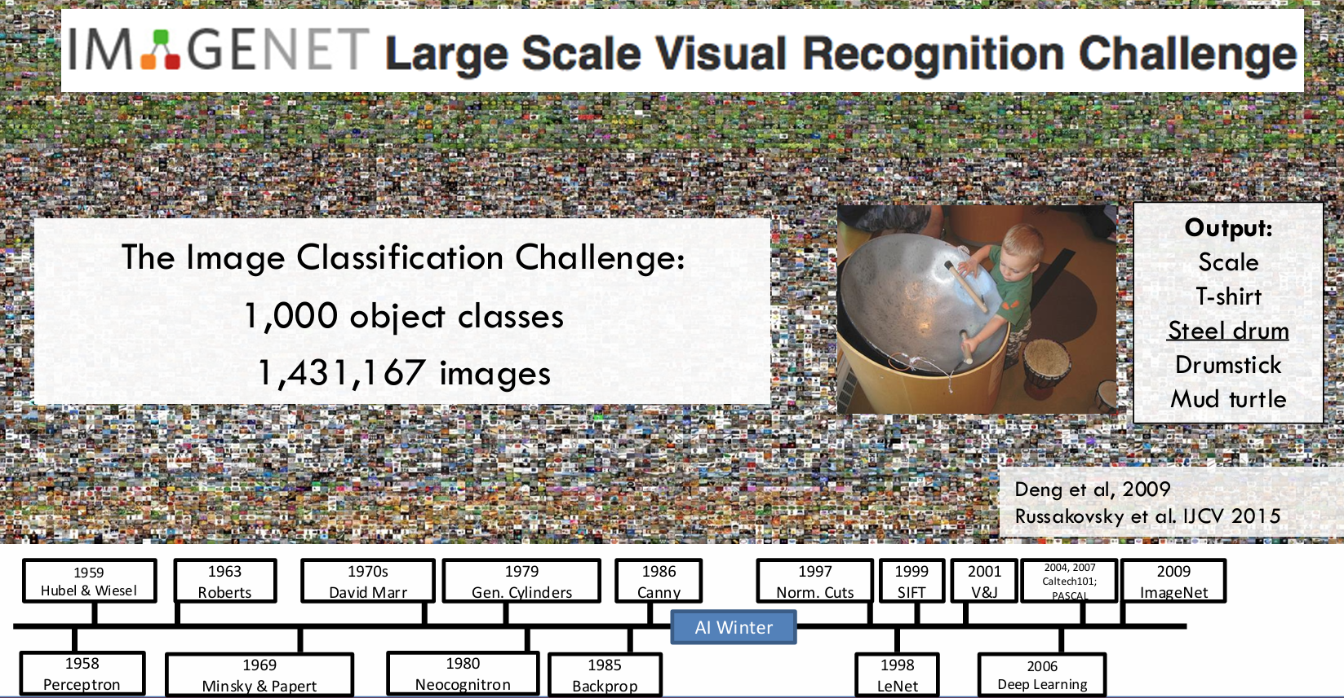

Slide 34
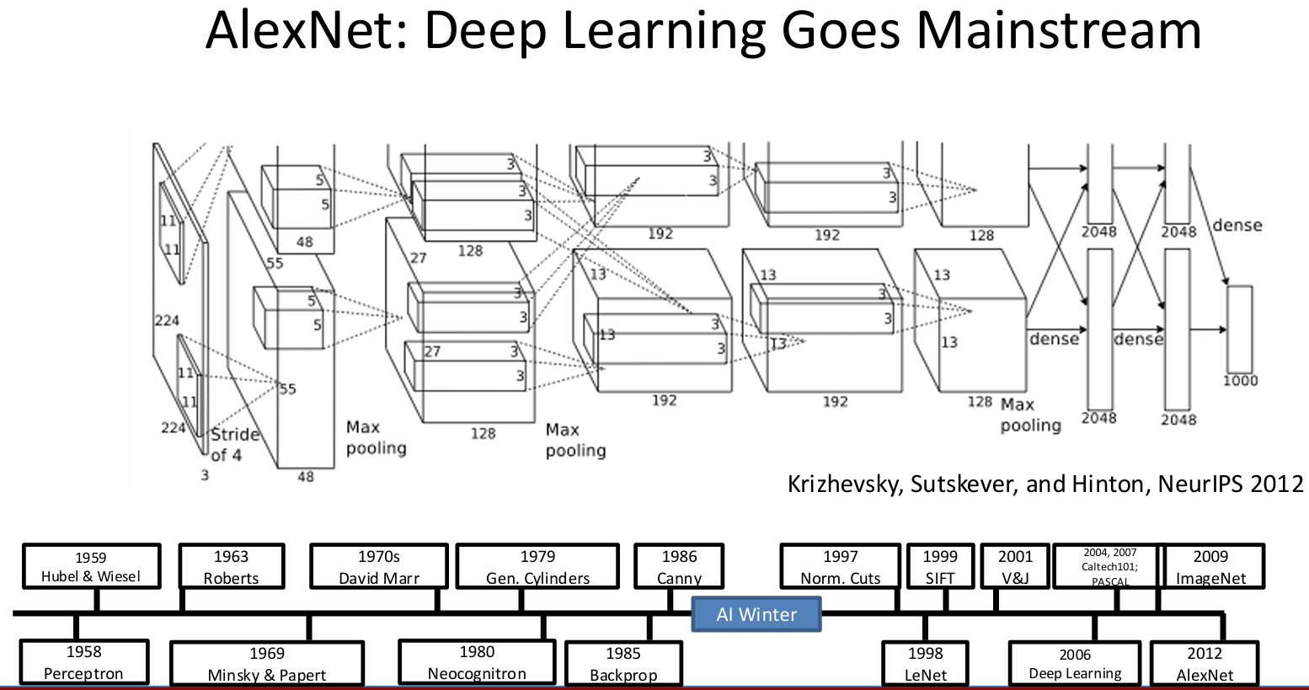
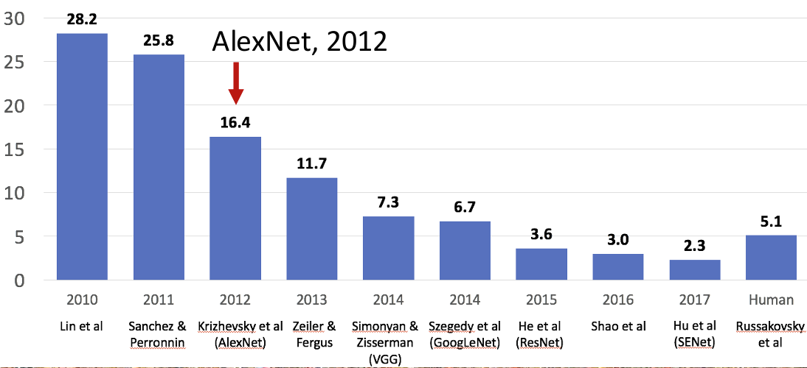

Slide 35
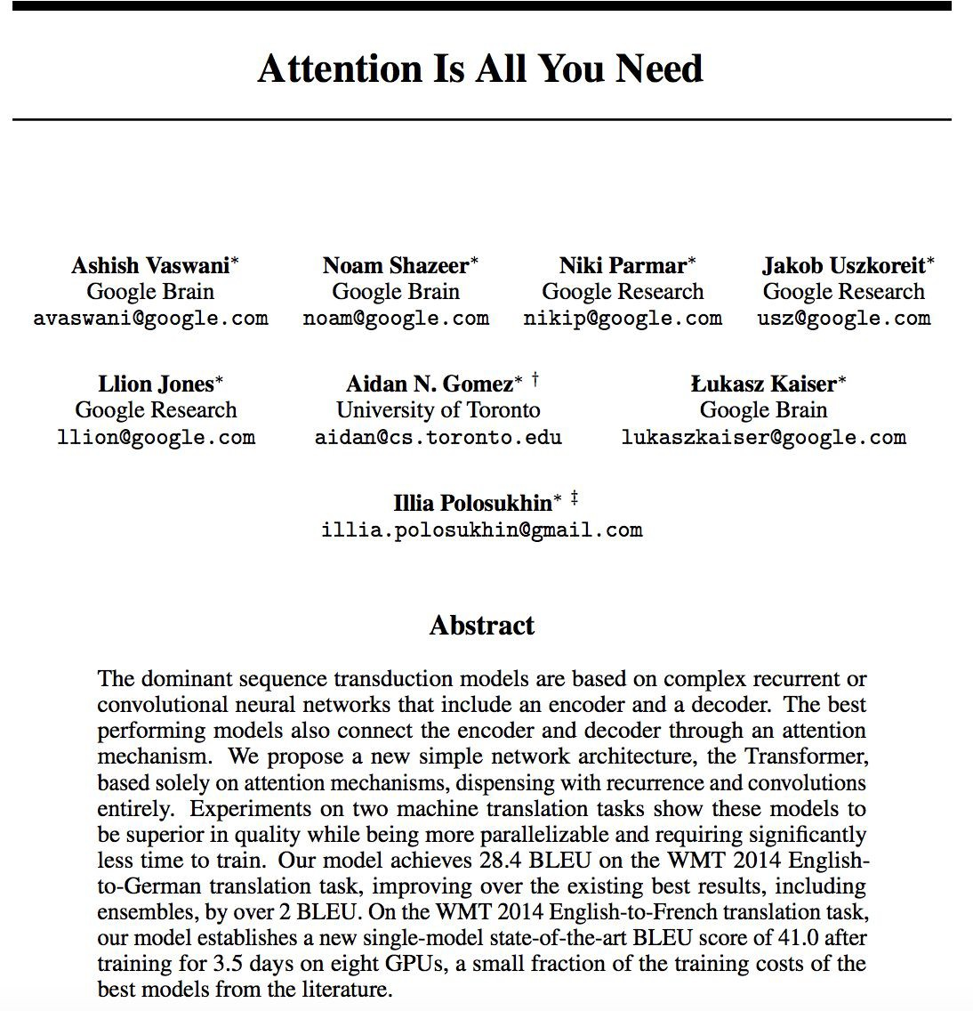
GenerativeTransformers 2017
Why now?
Big data
Fast algorithm for training
Compute Power (GPU)
Transformers as a new Neural Network Architecture

Slide 36
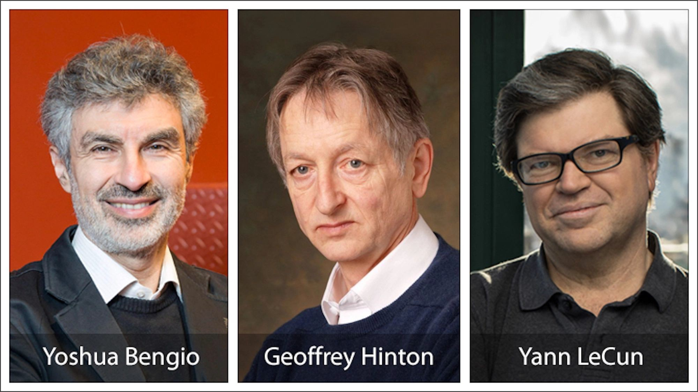
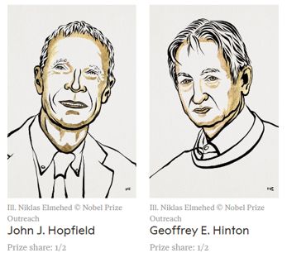
Turing Award 2019
2024 Physics Nobel Prize
"for foundational discoveries and inventions that enable machine learning with artificial neural networks"

Slide 37
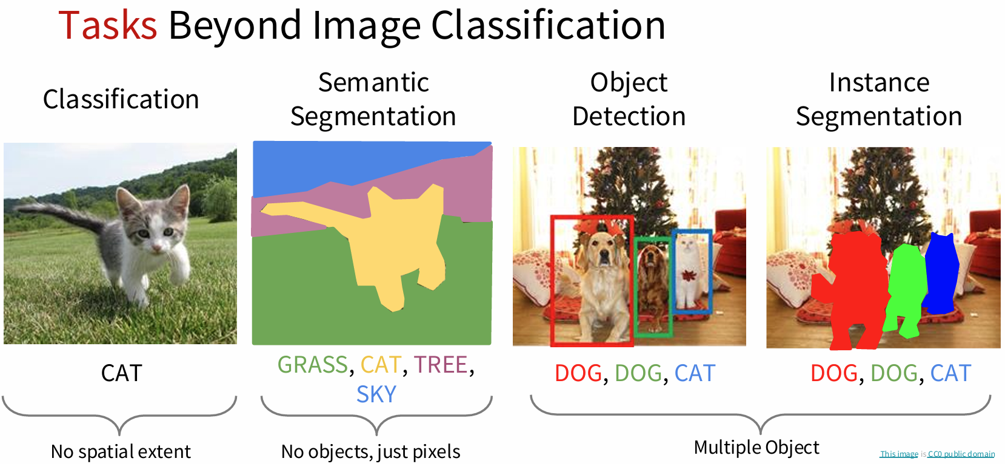

Slide 38
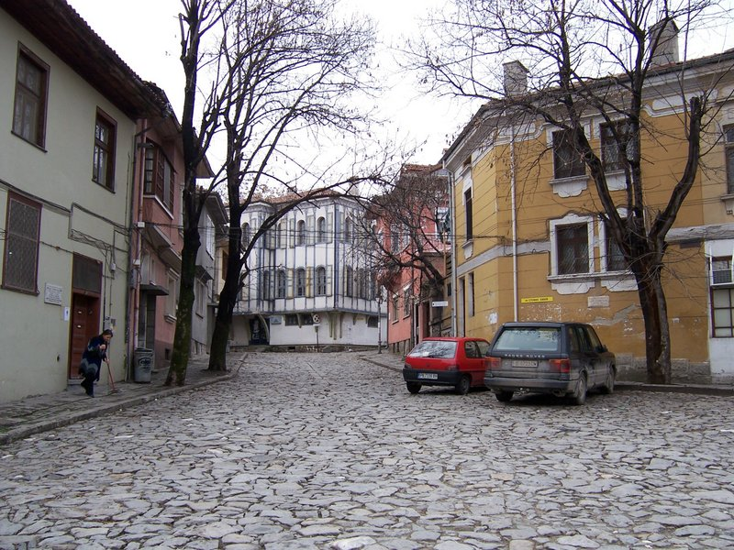
Goal: Image understanding, but what is it?
…

Slide 39
Goal: Image understanding
…
Geometric understanding

Slide 40
Goal: Image understanding
roof
tree
tree
sky
chimney
building
building
window
door
trashcan
car
car
person
Outdoor scene
ground
City
European
…
Semantic understanding

Slide 41
Goal: Image understanding
Vertical surface
Vertical surface
Can open,
be opened
Can be used to deposit trash
Can move
Walkable
Horizontal surface, rough
Walkable, drivable
Affordances

Slide 42
Goal: Image understanding
Actionable information

Slide 43

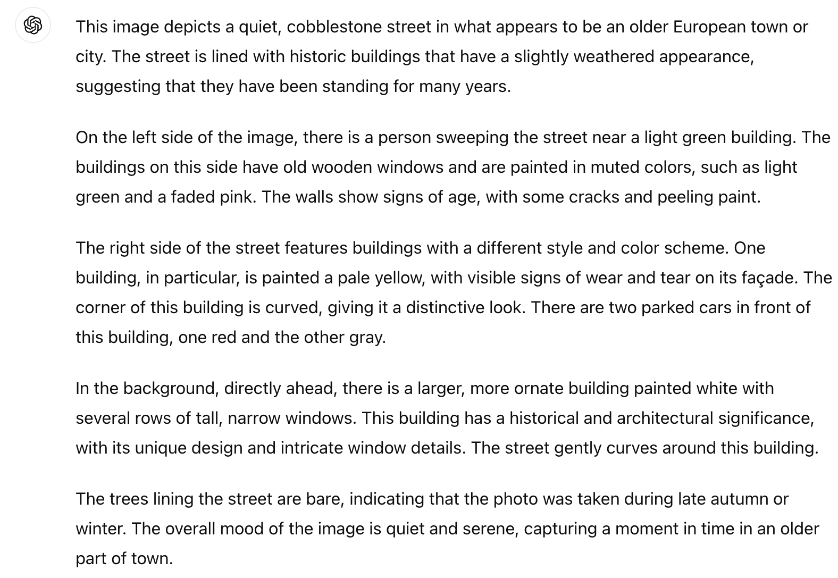

Goal: Image understanding

Slide 44
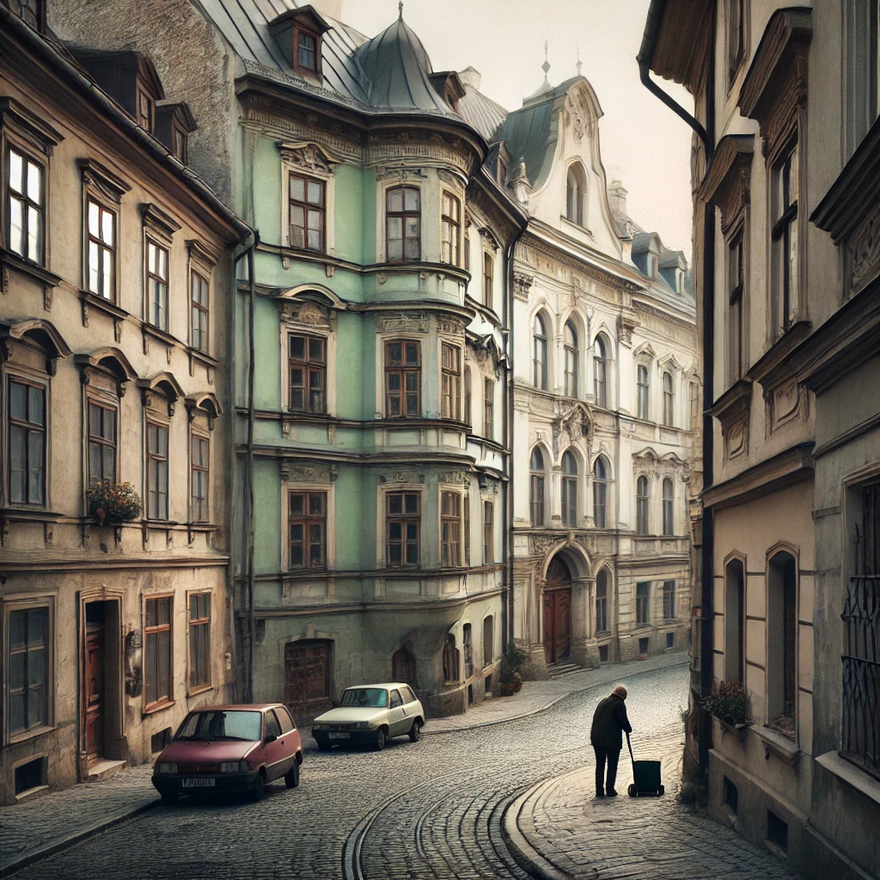

Goal: Image understanding
Image generation

