Slide 1
Bipartite Graph Matching and Linear Programming
Based on
http://www.cs.engr.uky.edu/~lewis/cs-heuristic/text/integer/linprog.html

Slide 2
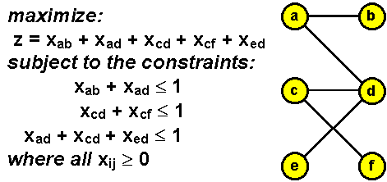
The bipartite graph matching problem is to find a set of unconnected edges which cover as many of the vertices as possible. If we select the set of edges: {<a, b>, <c, f>, <e, d>}
then we have covered all of the vertices of the graph. This is a maximal matching for the graph.
Now we shall state the problem in linear programming terms.
For each edge <u, v> of the graph we introduce the variable x_{uv}. If the variable is set to 1 then the edge is part of the matching, and if set to 0, the edge is not in the matching set. Next we must make sure that no connected edges occur in the matching. Since two edges leave vertex a, we add the constraint: x_{ab} + x_{ad} ≤ 1.

