Slide 1
Graphs
Chapter 10

Slide 2
Chapter Summary
Graphs and Graph Models
Graph Terminology and Special Types of Graphs
Representing Graphs and Graph Isomorphism
Connectivity
Euler and Hamiltonian Graphs
Shortest-Path Problems (not currently included in overheads)
Planar Graphs (not currently included in overheads)
Graph Coloring (not currently included in overheads)

Slide 3
Graphs and Graph Models
Section 10.1

Slide 4
Section Summary
Introduction to Graphs
Graph Taxonomy
Graph Models

Slide 5
Graphs
Definition: A graph G = (V, E) consists of a nonempty set V of vertices (or nodes) and a set E of edges. Each edge has either one or two vertices associated with it, called its endpoints. An edge is said to connect its endpoints.
Remarks:
  The graphs we study here are unrelated to graphs of functions studied in Chapter 2.
  We have a lot of freedom when we draw a picture of a graph. All that matters is the connections made by the edges, not the particular geometry depicted. For example, the lengths of edges, whether edges cross, how vertices are depicted, and so on, do not matter
  A graph with an infinite vertex set is called an infinite graph. A graph with a finite vertex set is called a finite graph. We (following the text) restrict our attention to finite graphs.
Example:
a
b
This is a graph with four vertices and five edges.
d
c

Slide 6
Some Terminology
In a simple graph each edge connects two different vertices and no two edges connect the same pair of vertices.
Multigraphs may have multiple edges connecting the same two vertices. When m different edges connect the vertices u and v, we say that {u,v} is an edge of multiplicity m.
An edge that connects a vertex to itself is called a loop.
A pseudograph may include loops, as well as multiple edges connecting the same pair of vertices.
Example:
This pseudograph has both multiple edges and a loop.
a
b
Remark: There is no standard terminology for graph theory. So, it is crucial that you understand the terminology being used whenever you read material about graphs.
c

Slide 7
Directed Graphs
Definition: A directed graph (or digraph) G = (V, E) consists of a nonempty set V of vertices (or nodes) and a set E of directed edges (or arcs). Each edge is associated with an ordered pair of vertices. The directed edge associated with the ordered pair (u,v) is said to start at u and end at v.
Remark:
  Graphs where the end points of an edge are not ordered are said to be undirected graphs.

Slide 8
Some Terminology (continued)
A simple directed graph has no loops and no multiple edges.
A directed multigraph may have multiple directed edges. When there are m directed edges from the vertex u to the vertex v, we say that (u,v) is an edge of multiplicity m.
Example:
a
b
This is a directed graph with three vertices and four edges.
c
Example:
In this directed multigraph the multiplicity of (a,b) is 1 and the multiplicity of (b,c) is 2.
a
b
c

Slide 9
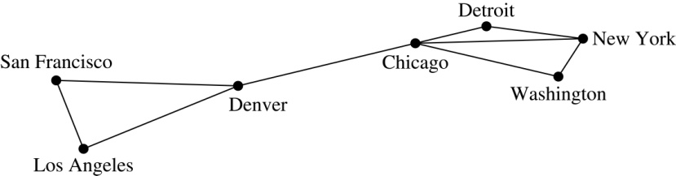
Graph Models: Computer Networks
When we build a graph model, we use the appropriate type of graph to capture the important features of the application.
We illustrate this process using graph models of different types of computer networks. In all these graph models, the vertices represent data centers and the edges represent communication links.
To model a computer network where we are only concerned with whether two data centers are connected by a communications link, we use a simple graph. This is the appropriate type of graph when we only care whether two data centers are directly linked (and not how many links there may be) and all communications links work in both directions.

Slide 10
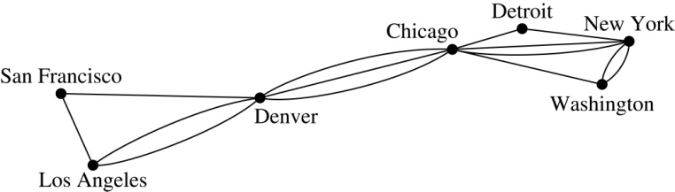
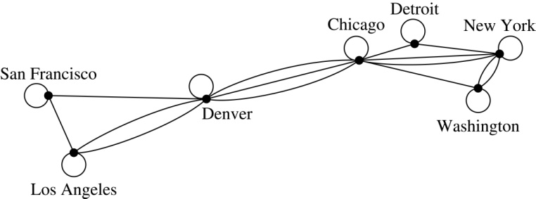
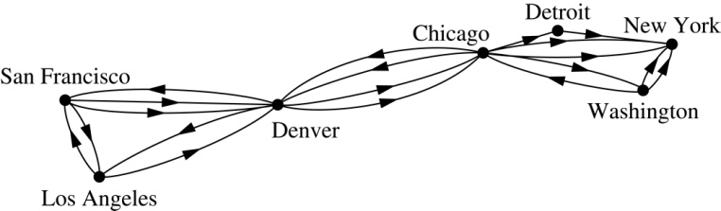
Graph Models:
Computer Networks (continued)
To model a computer network where we care about the number of links between data centers, we use a multigraph.
To model a computer network with diagnostic links at data centers, we use a pseudograph, as loops are needed.
To model a network with multiple one-way links, we use a directed multigraph. Note that we could use a directed graph without multiple edges if we only care whether there is at least one link from a data center to another data center.

Slide 11
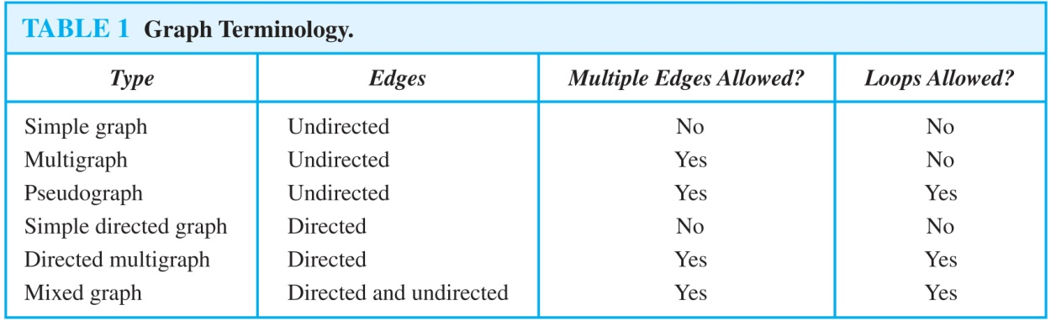
Graph Terminology: Summary
To understand the structure of a graph and to build a graph model, we ask these questions:
  Are the edges of the graph undirected or directed (or both)?
  If the edges are undirected, are multiple edges present that connect the same pair of vertices? If the edges are directed, are multiple directed edges present?
  Are loops present?

Slide 12
Applications of Graphs
We will illustrate how graph theory can be used in models of:
  Social networks
  Communications networks
  Information networks
  Software design
  Transportation networks
  Biological networks
It’s a challenge to find a subject to which graph theory has not yet been applied.

Slide 13
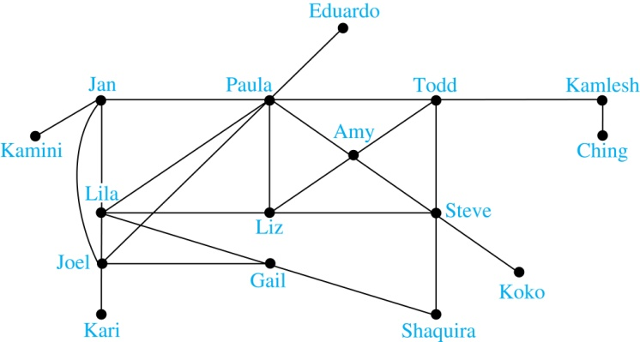
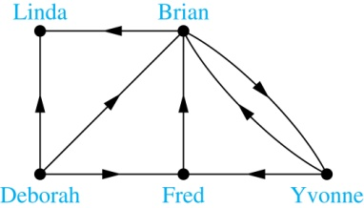
Graph Models: Social Networks
A friendship graph where two people are connected if they are Facebook friends.
An influence graph

Slide 14
Examples of Collaboration Graphs
The Hollywood graph models the collaboration of actors in films.
  We represent actors by vertices and we connect two vertices if the actors they represent have appeared in the same movie.
An academic collaboration graph models the collaboration of researchers who have jointly written a paper in a particular subject.
  We represent researchers in a particular academic discipline using vertices.
  We connect the vertices representing two researchers in this discipline if they are coauthors of a paper.
  We will study the academic collaboration graph for mathematicians when we discuss Erdős numbers in Section 10.4.

Slide 15
Applications to Information Networks
Graphs can be used to model different types of networks that link different types of information.
In a web graph, web pages are represented by vertices and links are represented by directed edges.
  A web graph models the web at a particular time.
  We will explain how the web graph is used by search engines in Section 11.4.
In a citation network:
  Research papers in a particular discipline are represented by vertices.
  When a paper A cites a paper B as a reference, there is an edge from vertex representing A to vertex representing B.

Slide 16
Transportation Graphs
Graph models are extensively used in the study of transportation networks.
Airline networks can be modeled using directed multigraphs where
  airports are represented by vertices
  each flight is represented by a directed edge from the vertex representing the departure airport to the vertex representing the destination airport
Road networks can be modeled using graphs where
  vertices represent intersections and edges represent roads.
  undirected edges represent two-way roads and directed edges represent one-way roads.

Slide 17
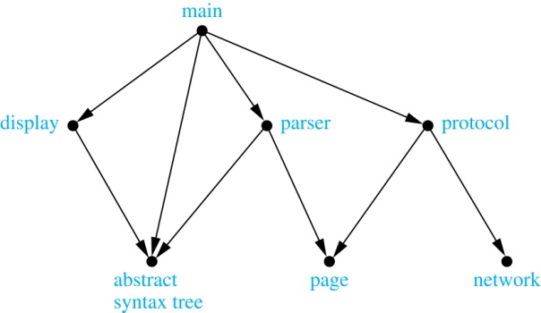
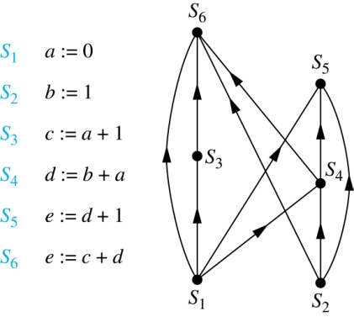
Software Design Applications
  In a module dependency graph
  vertices represent software modules
  and there is a directed edge from
  one module to another
  if the second module depends
  on the first.
We can use a precedence graph
to represent which statements (vertices)
must have already been executed
before we execute each statement.
There is a directed edge from a vertex
to a second vertex if the second vertex
cannot be executed before the first.

Slide 18
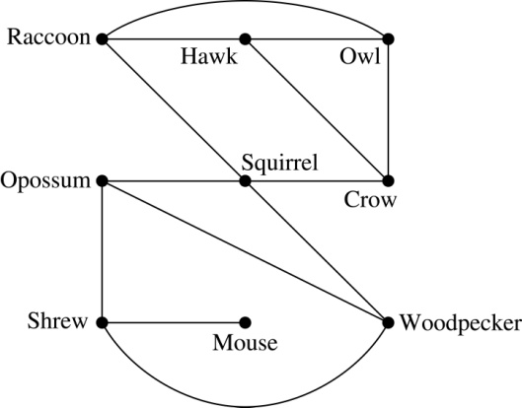
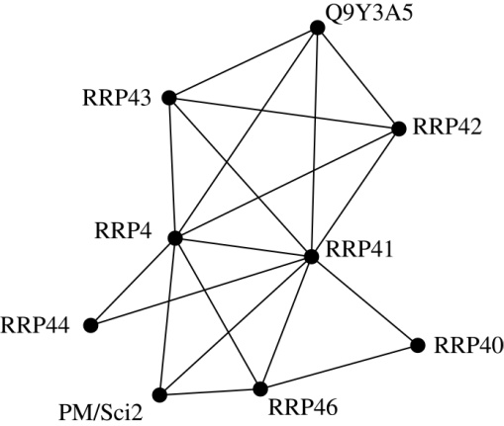
Biological Applications
Niche overlap graphs model competition
between species in an ecosystem.
Vertices represent species
and an edge connects
two vertices when they represent
species who compete for food resources.
In a protein interaction graph,
vertices represent proteins and
are connected by an edge
if the proteins interact. Such graphs
can be huge, more than 100,000 vertices,
representing a different protein,
and more than 1,000,000 edges.
So, they are often split into smaller graphs
called modules concerning proteins involved
in the protein interaction graph of a particular function.
This is a module of the proteins that degrade RNA in a human cell.

Slide 19
Graph Terminology and Special Types of Graphs
Section 10.2

Slide 20
Section Summary
Basic Terminology
Some Special Types of Graphs
Bipartite Graphs
Bipartite Graphs and Matchings (not currently included in overheads)
Some Applications of Special Types of Graphs (not currently included in overheads)
New Graphs from Old

Slide 21
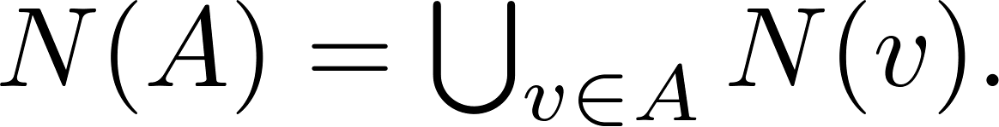
Basic Terminology
Definition 1. Two vertices u, v in an undirected graph G are called adjacent (or neighbors) in G if there is an edge e between u and v. Such an edge e is called incident with the vertices u and v and e is said to connect u and v.
Definition 2. The set of all neighbors of a vertex v of G = (V, E), denoted by N(v), is called the neighborhood of v. If A is a subset of V, we denote by N(A) the set of all vertices in G that are adjacent to at least one vertex in A. So,
Definition 3. The degree of a vertex in a undirected graph is the number of edges incident with it, except that a loop at a vertex contributes two to the degree of that vertex. The degree of the vertex v is denoted by deg(v).

Slide 22
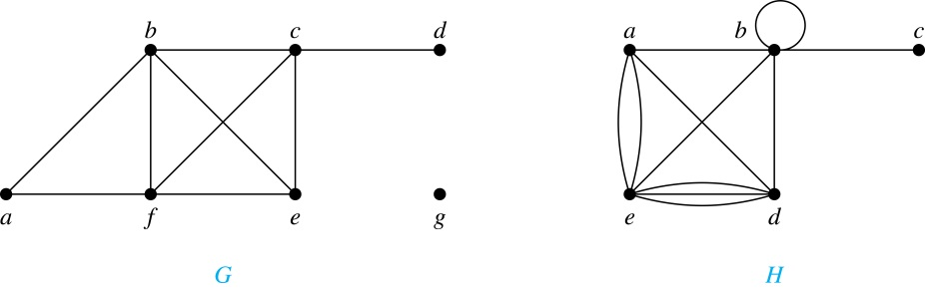
Degrees and Neighborhoods of Vertices
Example: What are the degrees and neighborhoods of the vertices in the graphs G and H?
Solution:
G: deg(a) = 2, deg(b) = deg(c) = deg(f ) = 4, deg(d ) = 1,
deg(e) = 3, deg(g) = 0.
N(a) = {b, f }, N(b) = {a, c, e, f }, N(c) = {b, d, e, f }, N(d) = {c},
N(e) = {b, c , f }, N(f) = {a, b, c, e}, N(g) = ∅ .
H: deg(a) = 4, deg(b) = deg(e) = 6, deg(c) = 1, deg(d) = 5.
N(a) = {b, d, e}, N(b) = {a, b, c, d, e}, N(c) = {b},
N(d) = {a, b, e}, N(e) = {a, b ,d}.

Slide 23
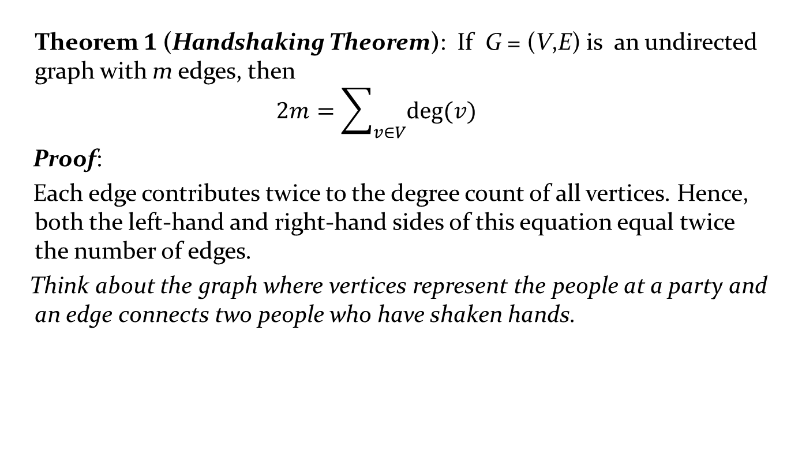
Degrees of Vertices
Theorem 1 (Handshaking Theorem): If G = (V,E) is an undirected graph with m edges, then
$$2m=\sum_{v∈V}{deg⁡(v)}$$
Proof:
Each edge contributes twice to the degree count of all vertices. Hence, both the left-hand and right-hand sides of this equation equal twice the number of edges.
Think about the graph where vertices represent the people at a party and an edge connects two people who have shaken hands.

Slide 24
Handshaking Theorem
We now give two examples illustrating the usefulness of the handshaking theorem.
Example: How many edges are there in a graph with 10 vertices of degree six?
Solution: Because the sum of the degrees of the vertices is 6 ⋅ 10 = 60, the handshaking theorem tells us that 2m = 60. So the number of edges m = 30.
Example: If a graph has 5 vertices, can each vertex have degree 3?
Solution: This is not possible by the handshaking thorem, because the sum of the degrees of the vertices 3 ⋅ 5 = 15 is odd.

Slide 25
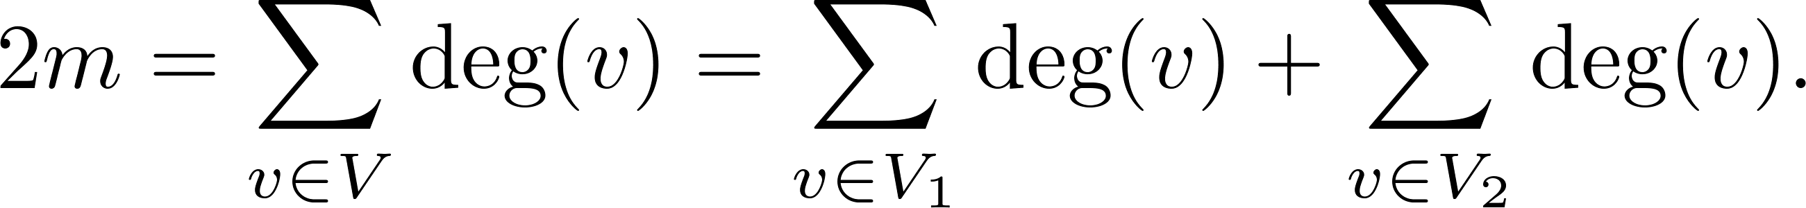
Degree of Vertices
Theorem 2: An undirected graph has an even number of vertices of odd degree.
Proof: Let V₁ be the vertices of even degree and V₂ be the vertices of odd degree in an undirected graph G = (V, E) with m edges. Then
even
This sum must be even because 2m is even and the sum of the degrees of the vertices of even degrees is also even. Because this is the sum of the degrees of all vertices of odd degree in the graph, there must be an even number of such vertices.
must be even since deg(v) is even for each v ∈ V₁

Slide 26
Directed Graphs
Recall the definition of a directed graph.
Definition: An directed graph G = (V, E) consists of V, a nonempty set of vertices (or nodes), and E, a set of directed edges or arcs. Each edge is an ordered pair of vertices. The directed edge (u,v) is said to start at u and end at v.
Definition: Let (u,v) be an edge in G. Then u is the initial vertex of this edge and is adjacent to v and v is the terminal (or end) vertex of this edge and is adjacent from u. The initial and terminal vertices of a loop are the same.

Slide 27
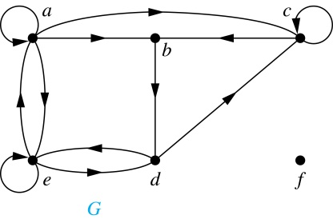
Directed Graphs (continued)
Definition: The in-degree of a vertex v, denoted deg⁻(v), is the number of edges which terminate at v. The out-degree of v, denoted deg⁺(v), is the number of edges with v as their initial vertex. Note that a loop at a vertex contributes 1 to both the in-degree and the out-degree of the vertex.
Example: In the graph G we have
deg⁻(a) = 2, deg⁻(b) = 2, deg⁻(c) = 3, deg⁻(d) = 2,
deg⁻(e) = 3, deg⁻(f) = 0.
deg⁺(a) = 4, deg⁺(b) = 1, deg⁺(c) = 2, deg⁺(d) = 2,
deg⁺ (e) = 3, deg⁺(f) = 0.

Slide 28
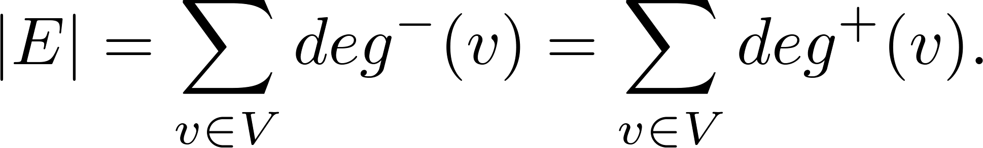
Directed Graphs (continued)
Theorem 3: Let G = (V, E) be a graph with directed edges. Then:
Proof: The first sum counts the number of outgoing edges over all vertices and the second sum counts the number of incoming edges over all vertices. They are equal since every outgoing edge is also an incoming edge.

Slide 29
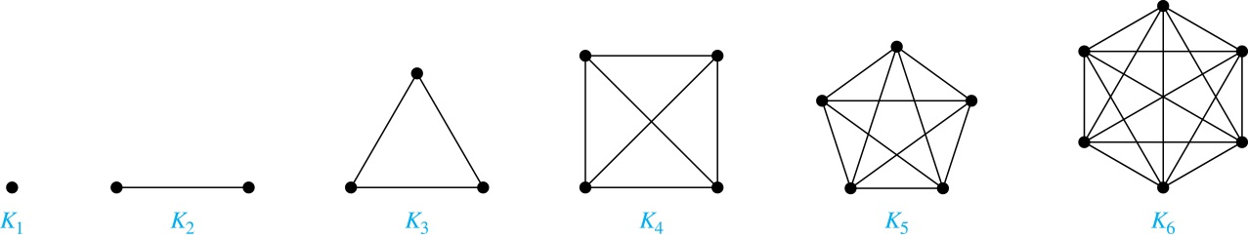
Special Types of Simple Graphs: Complete Graphs
A complete graph on n vertices, denoted by K_{n}, is the simple graph that contains exactly one edge between each pair of distinct vertices.

Slide 30
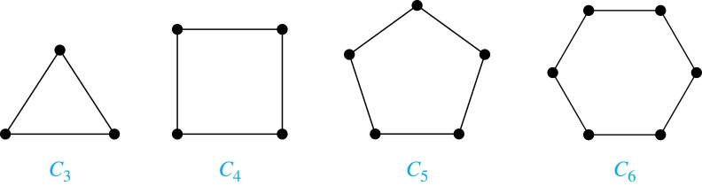
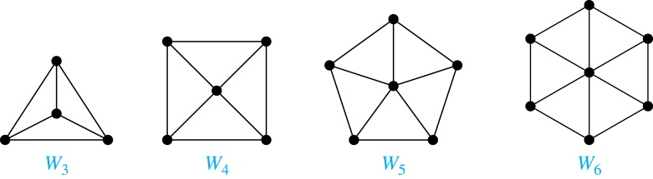
Special Types of Simple Graphs:
Cycles and Wheels
A cycle C_{n} for n ≥ 3 consists of n vertices v₁, v₂ ,⋯ , v_{n}, and edges {v₁, v₂}, {v₂, v₃} ,⋯ , {v_{n-1}, v_{n}}, {v_{n}, v₁}.
A wheel W_{n} is obtained by adding an additional vertex to a cycle C_{n} for n ≥ 3 and connecting this new vertex to each of the n vertices in C_{n} by new edges.

Slide 31
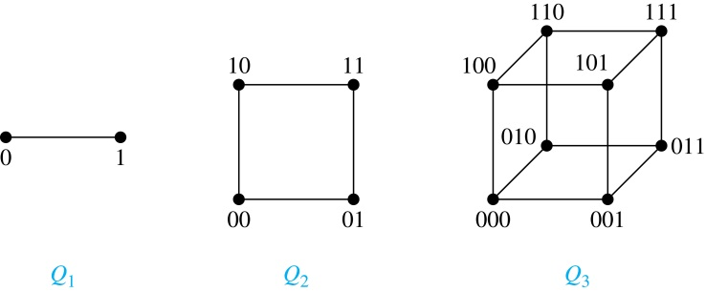
Special Types of Simple Graphs: n-Cubes
An n-dimensional hypercube, or n-cube, Q_{n}, is a graph with 2^{n} vertices representing all bit strings of length n, where there is an edge between two vertices that differ in exactly one bit position.

Slide 32
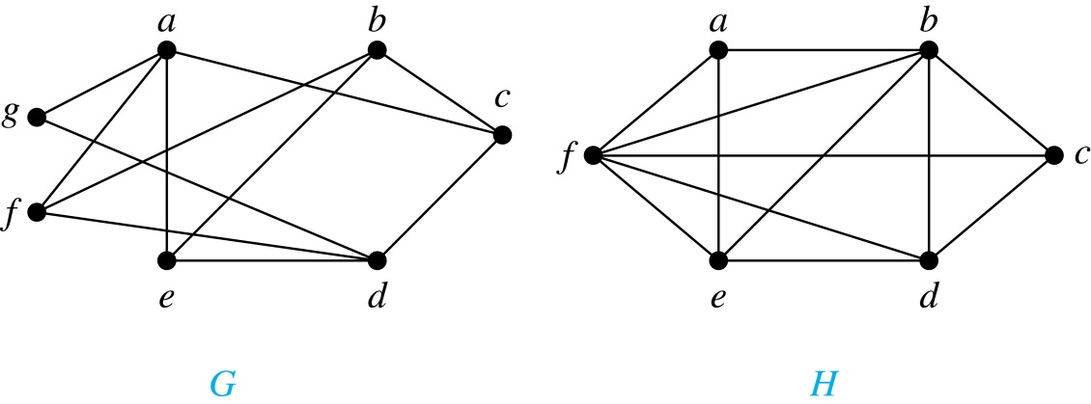
Bipartite Graphs
Definition: A simple graph G is bipartite if V can be partitioned into two disjoint subsets V₁ and V₂ such that every edge connects a vertex in V₁ and a vertex in V₂. In other words, there are no edges which connect two vertices in V₁ or in V₂.
It is not hard to show that an equivalent definition of a bipartite graph is a graph where it is possible to color the vertices red or blue so that no two adjacent vertices are the same color.
H is not bipartite
since if we color a red, then the adjacent vertices f and b must both be blue.
G is bipartite

Slide 33
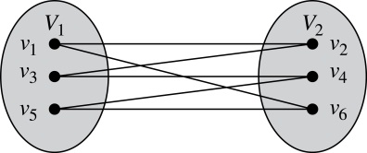
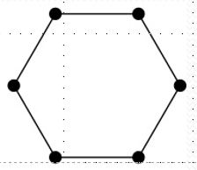
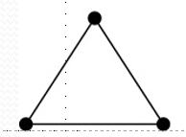
Bipartite Graphs (continued)
Example: Show that C₆ is bipartite.
Solution: We can partition the vertex set into
V₁ = {v₁, v₃, v₅} and V₂ = {v₂, v₄, v₆} so that every edge of C₆
connects a vertex in V₁ and V₂ .
Example: Show that C₃ is not bipartite.
Solution: If we divide the vertex set of C₃ into two nonempty sets, one of the two must contain two vertices.
But in C₃ every vertex is connected to every other vertex.
Therefore, the two vertices in the same partition
are connected. Hence, C₃ is not bipartite.

Slide 34
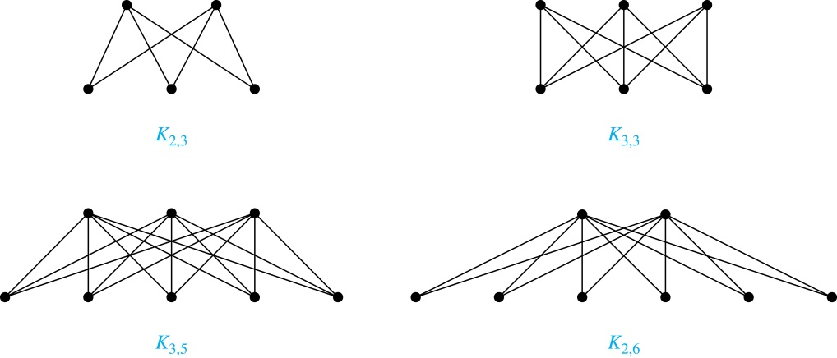
Complete Bipartite Graphs
Definition: A complete bipartite graph K_{m,n} is a graph that has its vertex set partitioned into two subsets V₁ of size m and V₂ of size n such that there is an edge from every vertex in V₁ to every vertex in V₂.
Example: Four complete bipartite graphs:

Slide 35
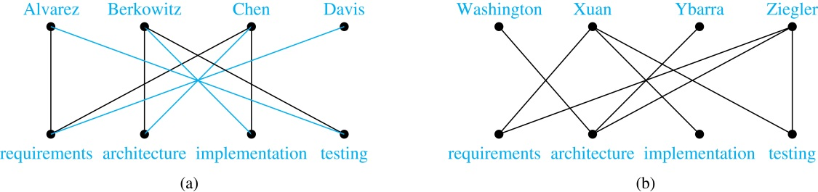
Bipartite Graphs and Matchings
Bipartite graphs are used to model applications that involve matching the elements of one set to elements in another, for example:
Job assignments - vertices represent the jobs and the employees, edges link employees with those jobs they have been trained to do. A common goal is to match jobs to employees so that the most jobs are done.
Marriage - vertices represent the men and the women and edges link a a man and a woman if they are an acceptable spouse. We may wish to find the largest number of possible marriages.

Slide 36
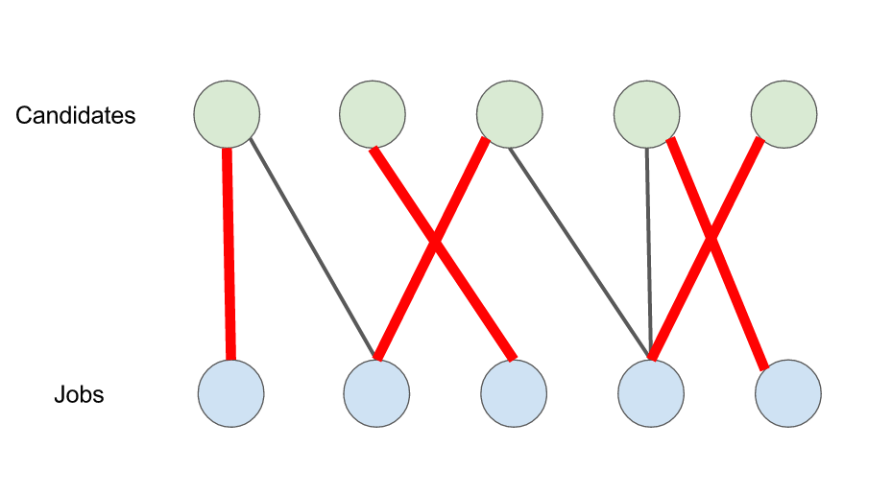
Bipartite Graphs and Matchings
A matching M in a simple graph G = (V ,E) is a subset of the set E of edges of the graph such that no two edges are incident with the same vertex. A vertex that is the endpoint of an edge of a matching M is said to be matched in M; otherwise it is said to be unmatched.
A maximum matching is a matching with the largest number of edges.
A matching M in a bipartite graph G = (V ,E) with
bipartition (V1, V2) is a complete matching from V1 to V2 if every vertex in V1 is the endpoint of an edge in the matching, or equivalently, if |M| = |V1|.
A complete matching
is always a maximum matching.

Slide 37
Bipartite Graphs and Matchings
For example, to assign jobs to employees so that the largest number of jobs are assigned employees, we seek a maximum matching. To assign employees to all jobs we seek a complete matching from the set of jobs to the set of employees.
A complete matching from the set of jobs to the set of employees is shown as blue edges in (a), and this matching is a maximum matching.
No complete matching exists from the set of jobs to the employees in (b).

Slide 38
Bipartite Graphs and Matchings
HALL’S MARRIAGE THEOREM (1935)
The bipartite graph G = (V ,E) with bipartition (V1, V2) has a complete matching from V1 to V2 if and only if
|N(A)| ≥ |A| for all subsets A of V1.
The proof by Hall was not constructive, i.e., we cannot construct an algorithm based on this proof that finds a complete matching in a bipartite graph. For a constructive proof that can be used as the basis of an algorithm, see A. Gibbons, Algorithmic Graph Theory, Cambridge University Press, Cambridge, 1985

Slide 39
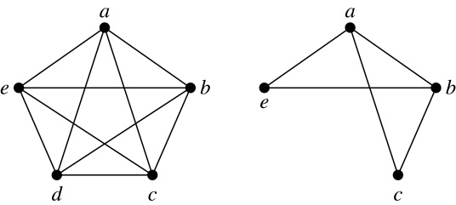
New Graphs from Old
Definition: A subgraph of a graph G = (V,E) is a graph (W,F), where W ⊂ V and F ⊂ E. A subgraph H of G is a proper subgraph of G if H ≠ G.
Example: Here we show K₅ and one of its subgraphs.
Definition: Let G = (V, E) be a simple graph. The subgraph induced by a subset W of the vertex set V is the graph (W,F), where the edge set F contains an edge in E if and only if both endpoints are in W.
Example: Here we show K₅ and the subgraph induced by W = {a,b,c,e}.

Slide 40
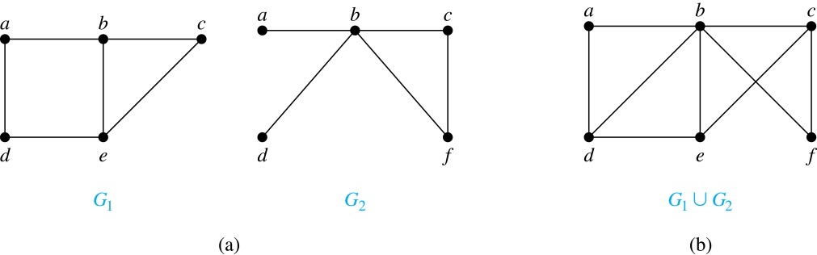
New Graphs from Old
Definition: The union of two simple graphs G₁ = (V₁, E₁) and G₂ = (V₂, E₂) is the simple graph with vertex set V₁ ⋃ V₂ and edge set E₁ ⋃ E₂. The union of G₁ and G₂ is denoted by G₁ ⋃ G₂.
Examples:
G₁
G₂
G₁ ∪ G₂ = K₅

Slide 41
Representing Graphs and Graph Isomorphism
Section 10.3

Slide 42
Section Summary
Adjacency Lists
Adjacency Matrices
Incidence Matrices
Isomorphism of Graphs

Slide 43
Representing Graphs
a
a
d
b
b
d
c
c
Adjacency Lists
Vertex
Adjacent Vertices
Initial Vertex
Terminal Vertices
a
b, c, d
a
c
b
a, d
b
a
c
a, d
c
d
a, b, c
d
a, b, c

Slide 44
Representing Graphs
Definition: Let G = (V, E) be a simple graph with |V| = n (no two edges connect the same pair of vertices and each edge connects two different vertices). Suppose that the vertices of G are listed in arbitrary order as v₁, v₂, …, v_{n}.
The adjacency matrix A (or A_{G}) of G, with respect to this listing of the vertices, is the n×n zero-one matrix with 1 as its (i, j) entry when v_{i} and v_{j} are adjacent, and 0 otherwise.
In other words, for an adjacency matrix A = [a_{ij}],
a_{ij} = 1 if {v_{i}, v_{j}} is an edge of G,
a_{ij} = 0 otherwise.

Slide 45
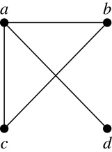
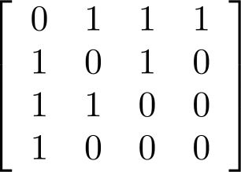
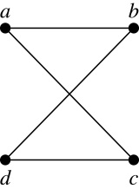
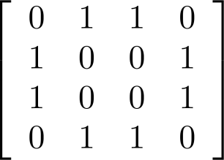
Adjacency Matrices
Examples:
The ordering of vertices is a, b, c, d.
When a graph is sparse, that is, it has few edges relatively to the total number of possible edges, it is much more efficient to represent the graph using an adjacency list than an adjacency matrix. But for a dense graph, which includes a high percentage of possible edges, an adjacency matrix is preferable.
The adjacency matrix of a simple graph is symmetric, i.e., a_{ij} = a_{ji}
Also, since there are no loops, each diagonal entry a_{ij} is 0
for i = 1, …, n.

Slide 46
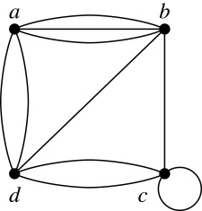
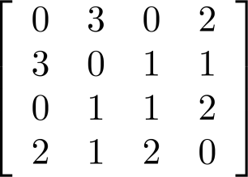
Adjacency Matrices
Adjacency matrices can also be used to represent graphs with loops and multiple edges.
A loop at the vertex v_{i} is represented by a 1 at the (i, j)th position of the matrix.
When multiple edges connect the same pair of vertices v_{i} and v_{j}, (or if multiple loops are present at the same vertex), the (i, j)th entry equals the number of edges connecting the pair of vertices.
Example: We give the adjacency matrix of the pseudograph shown here using the ordering of vertices a, b, c, d.

Slide 47
Representing Directed Graphs
a
Example: What is the adjacency matrix A_{G} for the following directed graph G based on the order of vertices a, b, c, d ?
d
b
c
Solution:
    The adjacency matrix for a directed graph does not have to be symmetric: there may not be an edge from v_{i} to v_{j}, when there is an edge from v_{j} to v_{i}.
    To represent directed multigraphs, the value of a_{ij} is the number of edges connecting v_{i} to v_{j}.

Slide 48
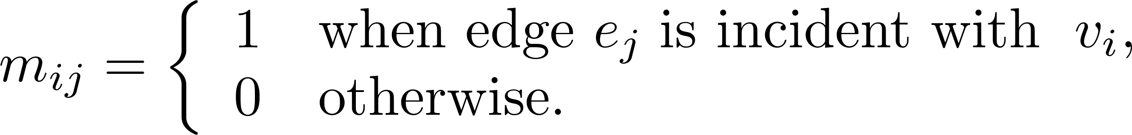
Representation of Graphs:
Incidence Matrices
Definition: Let G = (V, E) be an undirected graph with vertices where v₁, v₂, … v_{n} and edges e₁, e₂, … e_{m}. The incidence matrix with respect to the ordering of V and E is the n × m matrix M = [m_{ij}], where
Note: Incidence matrices of undirected graphs contain two 1s per column for edges connecting two vertices and one 1 per column for loops.

Slide 49
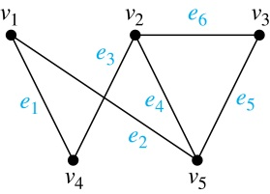
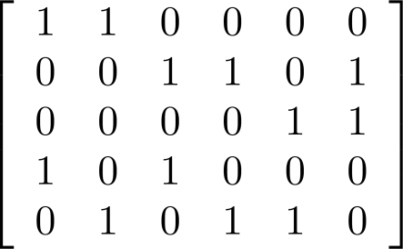
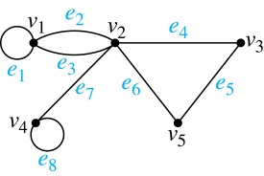
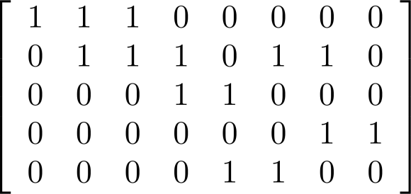
Incidence Matrices
Example: Simple Graph and Incidence Matrix
The rows going from top to bottom represent v₁ through v₅ and the columns going from left to right represent e₁ through e₆.
Example: Pseudograph and Incidence Matrix

Slide 52
Isomorphism of Graphs
Definition: The simple graphs G₁ = (V₁, E₁) and G₂ = (V₂, E₂) are isomorphic if there is a bijection (an one-to-one and onto function) f from V₁ to V₂ with the property that a and b are adjacent in G₁ if and only if f(a) and f(b) are adjacent in G₂, for all a and b in V₁.
Such a function f is called an isomorphism.
In other words, G₁ and G₂ are isomorphic if their vertices can be ordered in such a way that the adjacency matrices M_{G1} and M_{G2} are identical.

Slide 53
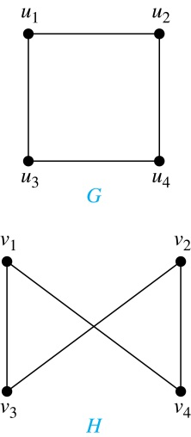
Isomorphism of Graphs
Example: Show that the graphs G =(V, E) and H = (W, F) are isomorphic.
Solution:
The function f with
f(u₁) = v₁, f(u₂) = v₄, f(u₃) = v₃, and f(u₄) = v₂
is a one-to-one bijection between V and W.
Note that adjacent vertices in G are
u₁ and u₂, u₁ and u₃, u₂ and u₄, and u₃ and u₄.
Each of the pairs f(u₁) = v₁ and f(u₂) = v₄, f(u₁) = v₁ and f(u₃) = v₃ , f(u₂) = v₄ and f(u₄) = v₂ , and f(u₃) = v₃ and f(u₄) = v₂ consists of two adjacent vertices in H.

Slide 54
Isomorphism of Graphs
Example: Are the following two graphs isomorphic?
a
a
b
e
e
b
c
d
c
d
Solution: Yes, they are isomorphic, because they can be arranged to look identical. You can see this if in the right graph you move vertex b to the left of the edge {a, c}. Then the isomorphism f from the left to the right graph is:
f(a) = e, f(b) = a, f(c) = b, f(d) = c, f(e) = d.

Slide 55
Isomorphism of Graphs
Example: How about these two graphs?
a
a
b
e
e
b
c
c
d
d
Solution: No, they are not isomorphic, because they differ in the degrees of their vertices. Vertex d in the right graph is of degree one, but there is no such vertex in the left graph.

Slide 56
Isomorphism of Graphs
From a visual standpoint, G₁ and G₂ are isomorphic if they can be arranged in such a way that their displays are identical (of course without changing adjacency).
Unfortunately, for two simple graphs, each with n vertices, there are n! possible isomorphisms that we have to check in order to show that these graphs are isomorphic. The problem is not known to be solvable in polynomial time nor to be NP-complete.
However, there are algorithms with linear average-case time complexity. You can use a public domain program called NAUTY to determine in less than a second whether two graphs with as many as 100 vertices are isomorphic.
However, showing that two graphs are not isomorphic can be easy.

Slide 57
Isomorphism of Graphs
For this purpose we can check invariants, that is, properties that two isomorphic simple graphs must both have.
For example, they must have
the same number of vertices,
the same number of edges, and
the same degrees of vertices.
Note that two graphs that differ in any of these invariants are not isomorphic, but two graphs that match in all of them are not necessarily isomorphic.

Slide 58
Example
Are these two graphs isomorphic?
u₁ u₂
u₅ u₄ u₃
v₁ v₂
v₅
v₃
v₄
G H
  They both have 5 vertices
  They both have 8 edges
  They have the same number of vertices with the same degrees: 2, 3, 3, 4, 4.

Slide 59
Example (Cont.)
G H H → G?
u₁ u₂ u₃ u₄ u₅
u₁ 0 1 0 1 1
u₂ 1 0 1 1 1
u₃ 0 1 0 1 0
u₄ 1 1 1 0 1
u₅ 1 1 0 1 0
v₁ v₂ v₃ v₄ v₅
v₁ 0 0 1 1 1
v₂ 0 0 1 0 1
v₃ 1 1 0 1 1
v₄ 1 0 1 0 1
v₅ 1 1 1 1 0
v₁ v₃ v₂ v₅ v₄
v₁
v₃
v₂
v₅
v₄
  G and H don’t appear to be isomorphic.
  However, we haven’t tried mapping vertices from G onto H yet.

Slide 60
Example (Cont.)
Start with the vertices of degree 2 since each graph only has one:
  deg(u₃) = deg(v₂) = 2 therefore f(u₃) = v₂
u₁ u₂
u₅ u₄ u₃
v₁ v₂
v₅
v₃
v₄
G H

Slide 61
Example (Cont.)
Now consider vertices of degree 3
  deg(u₁) = deg(u₅) = deg(v₁) = deg(v₄) = 3
  therefore we must have either one of
    f(u₁) = v₁ and f(u₅) = v₄
    f(u₁) = v₄ and f(u₅) = v₁
u₁ u₂
u₅ u₄ u₃
v₁ v₂
v₅
v₃
v₄
G H

Slide 62
Example (Cont.)
Now try vertices of degree 4:
  deg(u₂) = deg(u₄) = deg(v₃) = deg(v₅) = 4
therefore we must have one of:
    f(u₂) = v₃ and f(u₄) = v₅ or
    f(u₂) = v₅ and f(u₄) = v₃
u₁ u₂
u₅ u₄ u₃
v₁ v₂
v₅
v₃
v₄
G H

Slide 63
Example (Cont.)
There are four possibilities (this can get messy!)
  f(u₁) = v₁, f(u₂) = v₃, f(u₃) = v₂, f(u₄) = v₅, f(u₅) = v₄
  f(u₁) = v₄, f(u₂) = v₃, f(u₃) = v₂, f(u₄) = v₅, f(u₅) = v₁
  f(u₁) = v₁, f(u₂) = v₅, f(u₃) = v₂, f(u₄) = v₃, f(u₅) = v₄
  f(u₁) = v₄, f(u₂) = v₅, f(u₃) = v₂, f(u₄) = v₃, f(u₅) = v₁
u₁ u₂
u₅ u₄ u₃
v₁ v₂
v₅
v₃
v₄
G H

Slide 64
Example (Cont.)
G H H’
u₁ u₂ u₃ u₄ u₅
u₁ 0 1 0 1 1
u₂ 1 0 1 1 1
u₃ 0 1 0 1 0
u₄ 1 1 1 0 1
u₅ 1 1 0 1 0
v₁ v₂ v₃ v₄ v₅
v₁ 0 0 1 1 1
v₂ 0 0 1 0 1
v₃ 1 1 0 1 1
v₄ 1 0 1 0 1
v₅ 1 1 1 1 0
v₁ v₃ v₂ v₅ v₄
v₁ 0 1 0 1 1
v₃ 1 0 1 1 1
v₂ 0 1 0 1 0
v₅ 1 1 1 0 1
v₄ 1 1 0 1 0
We permute the adjacency matrix of H (per function choices above) to see if we get the adjacency of G. Let’s try:
f(u₁) = v₁, f(u₂) = v₃, f(u₃) = v₂, f(u₄) = v₅, f(u₅) = v₄
Does G = H’? Yes!

Slide 65
Example (Cont.)
G H H’
u₁ u₂ u₃ u₄ u₅
u₁ 0 1 0 1 1
u₂ 1 0 1 1 1
u₃ 0 1 0 1 0
u₄ 1 1 1 0 1
u₅ 1 1 0 1 0
v₁ v₂ v₃ v₄ v₅
v₁ 0 0 1 1 1
v₂ 0 0 1 0 1
v₃ 1 1 0 1 1
v₄ 1 0 1 0 1
v₅ 1 1 1 1 0
v₄ v₃ v₂ v₅ v₁
v₄ 0 1 0 1 1
v₃ 1 0 1 1 1
v₂ 0 1 0 1 0
v₅ 1 1 1 0 1
v₁ 1 1 0 1 0
It turns out that
f(u₁) = v₄, f(u₂) = v₃, f(u₃) = v₂, f(u₄) = v₅, f(u₅) = v₁
also works.

Slide 66
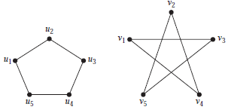
Examples
Determine if the following two graphs G₁ and G₂ are isomorphic:

Slide 67
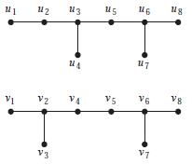
Examples
Determine if the following two graphs G₁ and G₂ are isomorphic:

Slide 68
Connectivity
Section 10.4

Slide 69
Section Summary
Paths
Connectedness in Undirected Graphs
Vertex Connectivity and Edge Connectivity (not currently included in overheads)
Connectedness in Directed Graphs
Paths and Isomorphism (not currently included in overheads)
Counting Paths between Vertices

Slide 70
Paths
Informal Definition: A path is a sequence of edges that begins at a vertex of a graph and travels from vertex to vertex along edges of the graph. As the path travels along its edges, it visits the vertices along this path, that is, the endpoints of these.
Applications: Numerous problems can be modeled with paths formed by traveling along edges of graphs such as:
  determining whether a message can be sent between two computers.
  efficiently planning routes for mail delivery.

Slide 71
Paths
Definition: Let n be a nonnegative integer and G an undirected graph. A path of length n from u to v in G is a sequence of n edges e₁, … , e_{n} of G for which there exists a sequence x₀ = u, x₁, …, x_{n-1}, x_{n} = v of vertices such that e_{i} has, for i = 1, …, n, the endpoints x_{i-1} and x_{i}.
  When the graph is simple, we denote this path by its vertex sequence x₀, x₁, … , x_{n}(since listing the vertices uniquely determines the path).
  The path is a circuit if it begins and ends at the same vertex (u = v) and has length greater than zero.
  The path or circuit is said to pass through the vertices x₁, x₂, … , x_{n-1} and traverse the edges e₁, … , e_{n}.
  A path or circuit is simple if it does not contain the same edge more than once.
This terminology is readily extended to directed graphs. (see text)

Slide 72
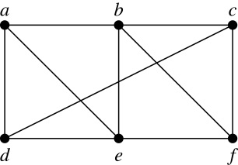
Paths (continued)
Example: In the simple graph here:
  a, d, c, f, e is a simple path of length 4.
  d, e, c, a is not a path because e is not connected to c.
  b, c, f, e, b is a circuit of length 4.
  a, b, e, d, a, b is a path of length 5, but it is not a simple path.

Slide 73
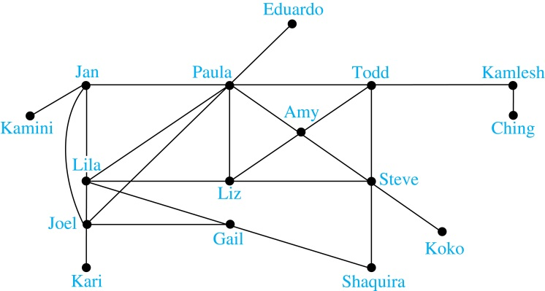
Degrees of Separation
Example: Paths in Acquaintanceship Graphs. In an acquaintanceship graph there is a path between two people if there is a chain of people linking these people, where two people adjacent in the chain know one another. In this graph there is a chain of six people linking Kamini and Ching.
Some have speculated that almost every pair of people in the world are linked by a small chain of no more than six, or maybe even, five people. The play Six Degrees of Separation by John Guare is based on this notion.

Slide 74

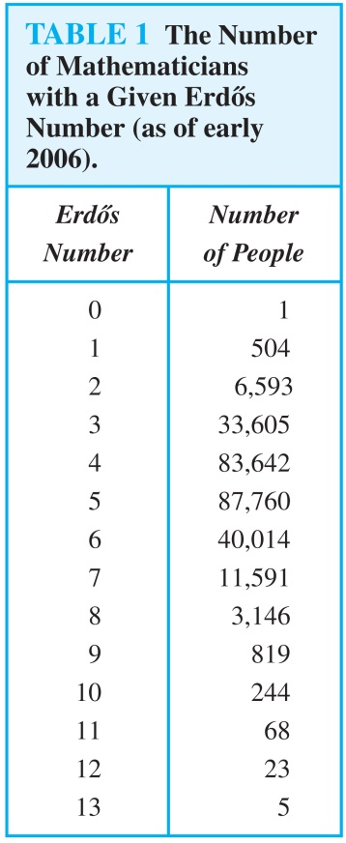
Erdős numbers
Paul Erdős
Example: Erdős numbers. In a collaboration graph, two people a and b are connected by a path when there is a sequence of people starting with a and ending with b such that the endpoints of each edge in the path are people who have collaborated.
In the academic collaboration graph of people who have written papers in mathematics, the Erdős number of a person m is the length of the shortest path between m and the prolific mathematician Paul Erdős.
  To learn more about Erdős numbers, visit
  http://www.ams.org/mathscinet/collaborationDistance.html

Slide 75
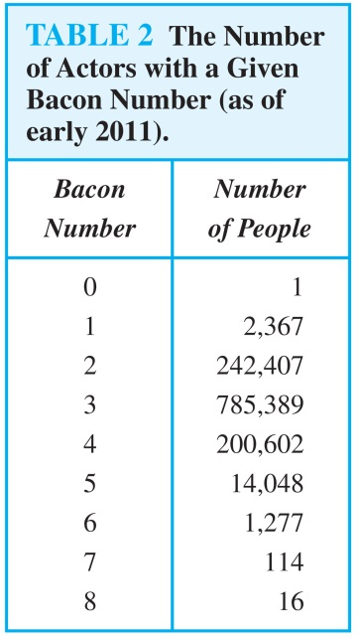
Bacon Numbrers
In the Hollywood graph, two actors a and b are linked when there is a chain of actors linking a and b, where every two actors adjacent in the chain have acted in the same movie.
The Bacon number of an actor c is defined to be the length of the shortest path connecting c and the well-known actor Kevin Bacon. (Note that we can define a similar number by replacing Kevin Bacon by a different actor.)
  The oracle of Bacon web site http://oracleofbacon.org/how.php provides a tool for finding Bacon numbers.

Slide 76
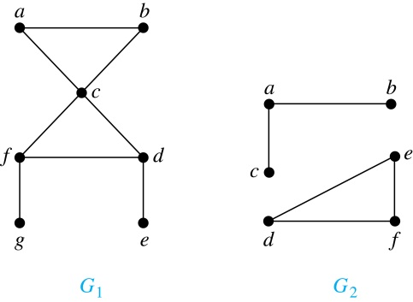
Connectedness in Undirected Graphs
Definition: An undirected graph is called connected if there is a path between every pair of vertices. An undirected graph that is not connected is called disconnected. We say that we disconnect a graph when we remove vertices or edges, or both, to produce a disconnected subgraph.
Example: G₁ is connected because there is a path between any pair of its vertices, as can be easily seen. However G₂ is not connected because there is no path between vertices a and f, for example.

Slide 77
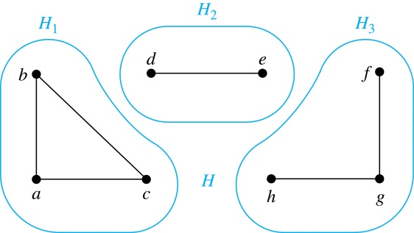
Connected Components
Definition: A connected component of a graph G is a connected subgraph of G that is not a proper subgraph of another connected subgraph of G. A graph G that is not connected has two or more connected components that are disjoint and have G as their union.
Example: The graph H is the union of three disjoint subgraphs H₁, H₂, and H₃, none of which are proper subgraphs of a larger connected subgraph of G.These three subgraphs are the connected components of H.

Slide 78
Connectedness in Directed Graphs
Definition: A directed graph is strongly connected if there is a path from a to b and a path from b to a whenever a and b are vertices in the graph.
Definition: A directed graph is weakly connected if there is a path between every two vertices in the underlying undirected graph, which is the undirected graph obtained by ignoring the directions of the edges of the directed graph.

Slide 79

Connectedness in Directed Graphs (continued)
Example: G is strongly connected because there is a path between any two vertices in the directed graph. Hence, G is also weakly connected. The graph H is not strongly connected, since there is no directed path from a to b, but it is weakly connected.
Definition: The subgraphs of a directed graph G that are strongly connected but not contained in larger strongly connected subgraphs, that is, the maximal strongly connected subgraphs, are called the strongly connected components or strong components of G.
Example (continued): The graph H has three strongly connected components, consisting of the vertex a; the vertex e; and the subgraph consisting of the vertices b, c, d and edges (b,c), (c,d), and (d,b).

Slide 80
The Connected Components of the Web Graph
Recall that at any particular instant the web graph provides a snapshot of the web, where vertices represent web pages and edges represent links. According to a 1999 study, the Web graph at that time had over 200 million vertices and over 1.5 billion edges. (The numbers today are several orders of magnitude larger.)
The underlying undirected graph of this Web graph has a connected component that includes approximately 90% of the vertices.
There is a giant strongly connected component (GSCC) consisting of more than 53 million vertices. A Web page in this component can be reached by following links starting in any other page of the component. There are three other categories of pages with each having about 44 million vertices:
  pages that can be reached from a page in the GSCC, but do not link back.
  pages that link back to the GSCC, but can not be reached by following links from pages in the GSCC.
  pages that cannot reach pages in the GSCC and can not be reached from pages in the GSCC.

Slide 81
Counting Paths between Vertices
We can use the adjacency matrix of a graph to find the number of paths between two vertices in the graph.
Theorem: Let G be a graph with adjacency matrix A with respect to the ordering v₁, … , v_{n} of vertices (with directed or undirected edges, multiple edges and loops allowed). The number of different paths of length r from v_{i} to v_{j}, where r >0 is a positive integer, equals the (i,j)th entry of A^{r}.
  Proof by mathematical induction:
  Basis Step: By definition of the adjacency matrix, the number of paths from v_{i} to v_{j} of length 1 is the (i,j)th entry of A.
  Inductive Step: For the inductive hypothesis, we assume that that the (i,j)th entry of A^{r} is the number of different paths of length r from v_{i} to v_{j}.
  Because A^{r+1} = A^{r} A, the (i,j)th entry of A^{r+1} equals b_{i1}a_{1j} + b_{i2}a_{2j} + ⋯ + b_{in}a_{nj}, where b_{ik} is the (i,k)th entry of A^{r}. By the inductive hypothesis, b_{ik} is the number of paths of length r from v_{i} to v_{k}.
  A path of length r + 1 from v_{i} to v_{j} is made up of a path of length r from v_{i} to some v_{k} , and an edge from v_{k} to v_{j}. By the product rule for counting, the number of such paths is the product of the number of paths of length r from v_{i} to v_{k} (i.e., b_{ik} ) and the number of edges from from v_{k} to v_{j} (i.e, a_{kj}). The sum over all possible intermediate vertices v_{k} is b_{i1}a_{1j} + b_{i2}a_{2j} + ⋯ + b_{in}a_{nj} .

Slide 82


Counting Paths between Vertices (continued)
  Example: How many paths of length four are there from a to d in the graph G.
  Solution: The adjacency matrix of G (ordering the vertices as a, b, c, d) is given above. Hence the number of paths of length four from a to d is the (1, 4)th entry of A⁴ . The eight paths are as:
adjacency matrix of G
G
A =
A⁴ =
a, b, a, b, d a, b, a, c, d
a, b, d, b, d a, b, d, c, d
a, c, a, b, d a, c, a, c, d
a, c, d, b, d a, c, d, c, d

Slide 83
Euler and Hamiltonian Graphs
Section 10.5

Slide 84
Section Summary
Euler Paths and Circuits
Hamilton Paths and Circuits
Applications of Hamilton Circuits

Slide 85



Euler Paths and Circuits
Leonard Euler (1707-1783)
The town of Kӧnigsberg, Prussia (now Kalingrad, Russia) was divided into four sections by the branches of the Pregel river. In the 18th century seven bridges connected these regions.
People wondered whether it was possible to follow a path that crosses each bridge exactly once and returns to the starting point.
The Swiss mathematician Leonard Euler proved that no such path exists. This result is often considered to be the first theorem ever proved in graph theory.
Multigraph Model of the Bridges of Kӧnigsberg
The 7 Bridges of Kӧnigsberg

Slide 86

Euler Paths and Circuits (continued)
Definition: An Euler circuit in a graph G is a simple circuit containing every edge of G. An Euler path in G is a simple path containing every edge of G.
Example: Which of the undirected graphs G₁, G₂, and G₃ has a Euler circuit? Of those that do not, which has an Euler path?
Solution: The graph G₁ has an Euler circuit (e.g., a, e, c, d, e, b, a). But, as can easily be verified by inspection, neither G₂ nor G₃ has an Euler circuit. Note that G₃ has an Euler path (e.g., a, c, d, e, b, d, a, b), but there is no Euler path in G₂, which can be verified by inspection.

Slide 87
Necessary Conditions for Euler Circuits and Paths
An Euler circuit begins with a vertex a and continues with an edge incident with a, say {a, b}. The edge {a, b} contributes one to deg(a).
Each time the circuit passes through a vertex it contributes two to the vertex’s degree.
Finally, the circuit terminates where it started, contributing one to deg(a). Therefore deg(a) must be even.
We conclude that the degree of every other vertex must also be even.
By the same reasoning, we see that the initial vertex and the final vertex of an Euler path have odd degree, while every other vertex has even degree. So, a graph with an Euler path has exactly two vertices of odd degree.
In the next slide we will show that these necessary conditions are also sufficient conditions.

Slide 88

Sufficient Conditions for Euler Circuits and Paths
Suppose that G is a connected multigraph with ≥ 2 vertices, all of even degree. Let x₀ = a be a vertex of even degree. Choose an edge {x₀, x₁} incident with a and proceed to build a simple path {x₀, x₁}, {x₁, x₂}, …, {x_{n-1}, x_{n}} by adding edges one by one until another edge can not be added.
The path begins at a with an edge of the form {a, x}; we show that it must terminate at a with an edge of the form {y, a}. Since each vertex has an even degree, there must be an even number of edges incident with this vertex. Hence, every time we enter a vertex other than a, we can leave it. Therefore, the path can only end at a.
If all of the edges have been used, an Euler circuit has been constructed. Otherwise, consider the subgraph H obtained from G by deleting the edges already used.
We illustrate this idea in the graph G here. We begin at a and choose the edges {a, f}, {f, c}, {c, b}, and {b, a} in succession.
In the example H consists of the vertices c, d, e.

Slide 89
Sufficient Conditions for Euler Circuits and Paths (continued)
Because G is connected, H must have at least one vertex in common with the circuit that has been deleted.
Every vertex in H must have even degree because all the vertices in G have even degree and for each vertex, pairs of edges incident with this vertex have been deleted. Beginning with the shared vertex construct a path ending in the same vertex (as was done before). Then splice this new circuit into the original circuit.
Continue this process until all edges have been used. This produces an Euler circuit. Since every edge is included and no edge is included more than once.
Similar reasoning can be used to show that a graph with exactly two vertices of odd degree must have an Euler path connecting these two vertices of odd degree
In the example, the vertex is c.
In the example, we end up with the circuit a, f, c, d, e, c, b, a.

Slide 90
Algorithm for Constructing an Euler Circuits
In our proof we developed this algorithms for constructing a Euler circuit in a graph with no vertices of odd degree.
procedure Euler(G: connected multigraph with all vertices of even degree)
circuit := a circuit in G beginning at an arbitrarily chosen vertex with edges
successively added to form a path that returns to this vertex.
H := G with the edges of this circuit removed
while H has edges
subciruit := a circuit in H beginning at a vertex in H that also is
an endpoint of an edge in circuit.
H := H with edges of subciruit and all isolated vertices removed
circuit := circuit with subcircuit inserted at the appropriate vertex.
return circuit{circuit is an Euler circuit}

Slide 91
Necessary and Sufficient Conditions for Euler Circuits and Paths (continued)
Theorem: A connected multigraph with at least two vertices has an Euler circuit if and only if each of its vertices has an even degree and it has an Euler path if and only if it has exactly two vertices of odd degree.
Example: Two of the vertices in the multigraph model of the Kӧnigsberg bridge problem have odd degree. Hence, there is no Euler circuit in this multigraph and it is impossible to start at a given point, cross each bridge exactly once, and return to the starting point.

Slide 92

Euler Circuits and Paths
Example:
G₁ contains exactly two vertices of odd degree (b and d). Hence it has an Euler path, e.g., d, a, b, c, d, b.
G₂ has exactly two vertices of odd degree (b and d). Hence it has an Euler path, e.g., b, a, g, f, e, d, c, g, b, c, f, d.
G₃ has six vertices of odd degree. Hence, it does not have an Euler path.

Slide 93
Applications of Euler Paths and Circuits
Euler paths and circuits can be used to solve many practical problems such as finding a path or circuit that traverses each
  street in a neighborhood,
  road in a transportation network,
  connection in a utility grid,
  link in a communications network.
Other applications are found in the
  layout of circuits,
  network multicasting,
  molecular biology, where Euler paths are used in the sequencing of DNA.

Slide 94



Hamilton Paths and Circuits
William Rowan Hamilton (1805- 1865)
Euler paths and circuits contained every edge only once. Now we look at paths and circuits that contain every vertex exactly once.
William Hamilton invented the Icosian puzzle in 1857. It consisted of a wooden dodecahedron (with 12 regular pentagons as faces), illustrated in (a), with a peg at each vertex, labeled with the names of different cities. String was used to used to plot a circuit visiting 20 cities exactly once
The graph form of the puzzle is given in (b).
The solution (a Hamilton circuit) is given here.

Slide 95
Hamilton Paths and Circuits
Definition: A simple path in a graph G that passes through every vertex exactly once is called a Hamilton path, and a simple circuit in a graph G that passes through every vertex exactly once is called a Hamilton circuit.
That is, a simple path x₀, x₁, …, x_{n-1}, x_{n} in the graph G = (V, E) is called a Hamilton path if V = {x₀, x₁, … , x_{n-1,} x_{n} } and x_{i} ≠ x_{j} for 0≤ i < j ≤ n, and the simple circuit x₀, x₁, …, x_{n-1}, x_{n}, x₀ (with n > 0) is a Hamilton circuit if x₀, x₁, … , x_{n-1}, x_{n} is a Hamilton path.

Slide 96
Hamilton Paths and Circuits (continued)
Example: Which of these simple graphs has a Hamilton circuit or, if not, a Hamilton path?
Solution: G₁ has a Hamilton circuit: a, b, c, d, e, a.
G₂ does not have a Hamilton circuit (Why?), but does have a Hamilton path : a, b, c, d.
G₃ does not have a Hamilton circuit, or a Hamilton path. Why?

Slide 97


Necessary Conditions for
Hamilton Circuits
Gabriel Andrew Dirac
(1925-1984)
Unlike for an Euler circuit, no simple necessary and sufficient conditions are known for the existence of a Hamiton circuit.
However, there are some useful necessary conditions. We describe two of these now.
Dirac’s Theorem: If G is a simple graph with n ≥ 3 vertices such that the degree of every vertex in G is ≥ n/2, then G has a Hamilton circuit.
Ore’s Theorem: If G is a simple graph with n ≥ 3 vertices such that deg(u) + deg(v) ≥ n for every pair of nonadjacent vertices, then G has a Hamilton circuit.
Øysten Ore
(1899-1968)

Slide 98
Applications of Hamilton Paths and Circuits
Applications that ask for a path or a circuit that visits each intersection of a city, each place pipelines intersect in a utility grid, or each node in a communications network exactly once, can be solved by finding a Hamilton path in the appropriate graph.
The famous traveling salesperson problem (TSP) asks for the shortest route a traveling salesperson should take to visit a set of cities. This problem reduces to finding a Hamilton circuit such that the total sum of the weights of its edges is as small as possible.
A family of binary codes, known as Gray codes, which minimize the effect of transmission errors, correspond to Hamilton circuits in the n-cube Q_{n}. (See the text for details.)

