Slide 1
Chapter 2
Matrix Arithmetic
Fundamentals of Matrix Algebra By Gregory Hartman
Instructor Longin Jan Latecki

Slide 2
2.1 Matrix Addition and Scalar Multiplication

Slide 3
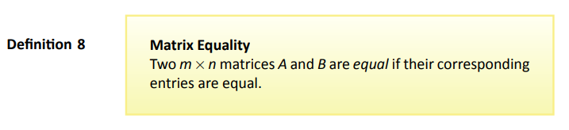
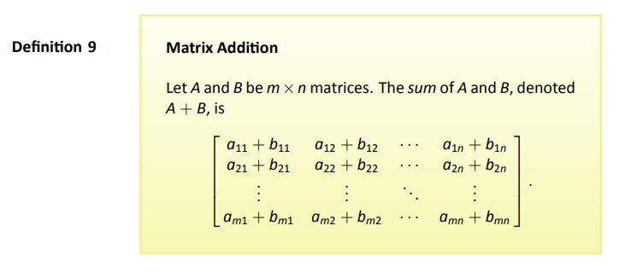
Definitions

Slide 4
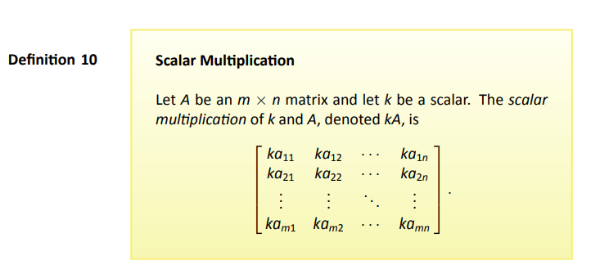
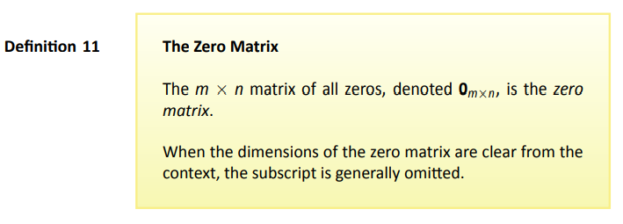
Definitions
Page 4

Slide 5
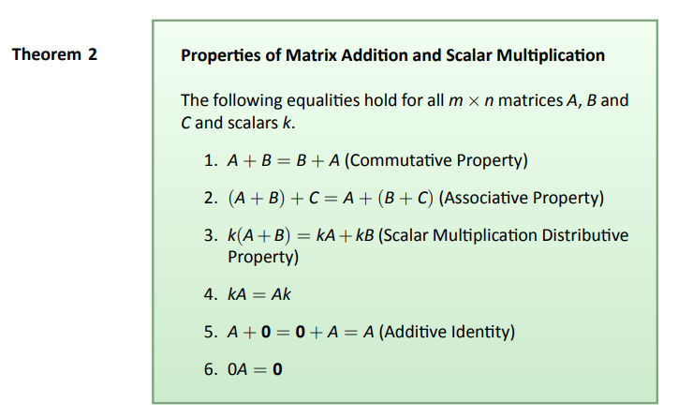
Theorem
Page 5

Slide 6
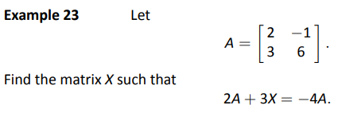
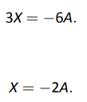


Slide 7
2.2 Matrix Multiplation

Slide 8
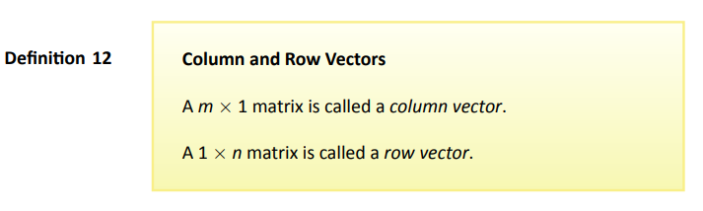
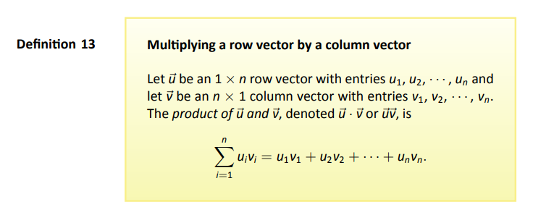
Definitions

Slide 9
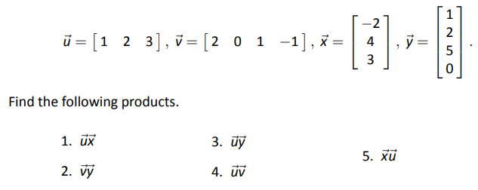

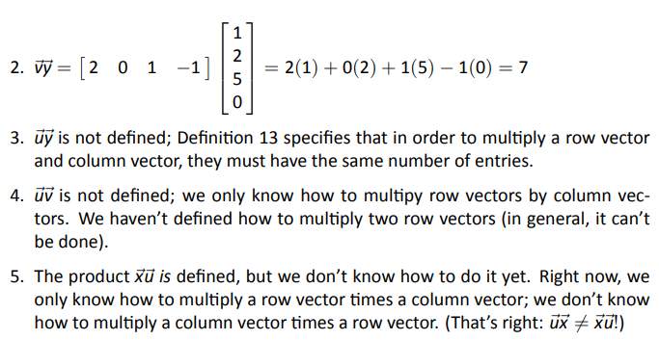
Example 24

Slide 10
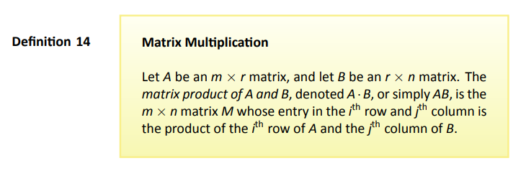
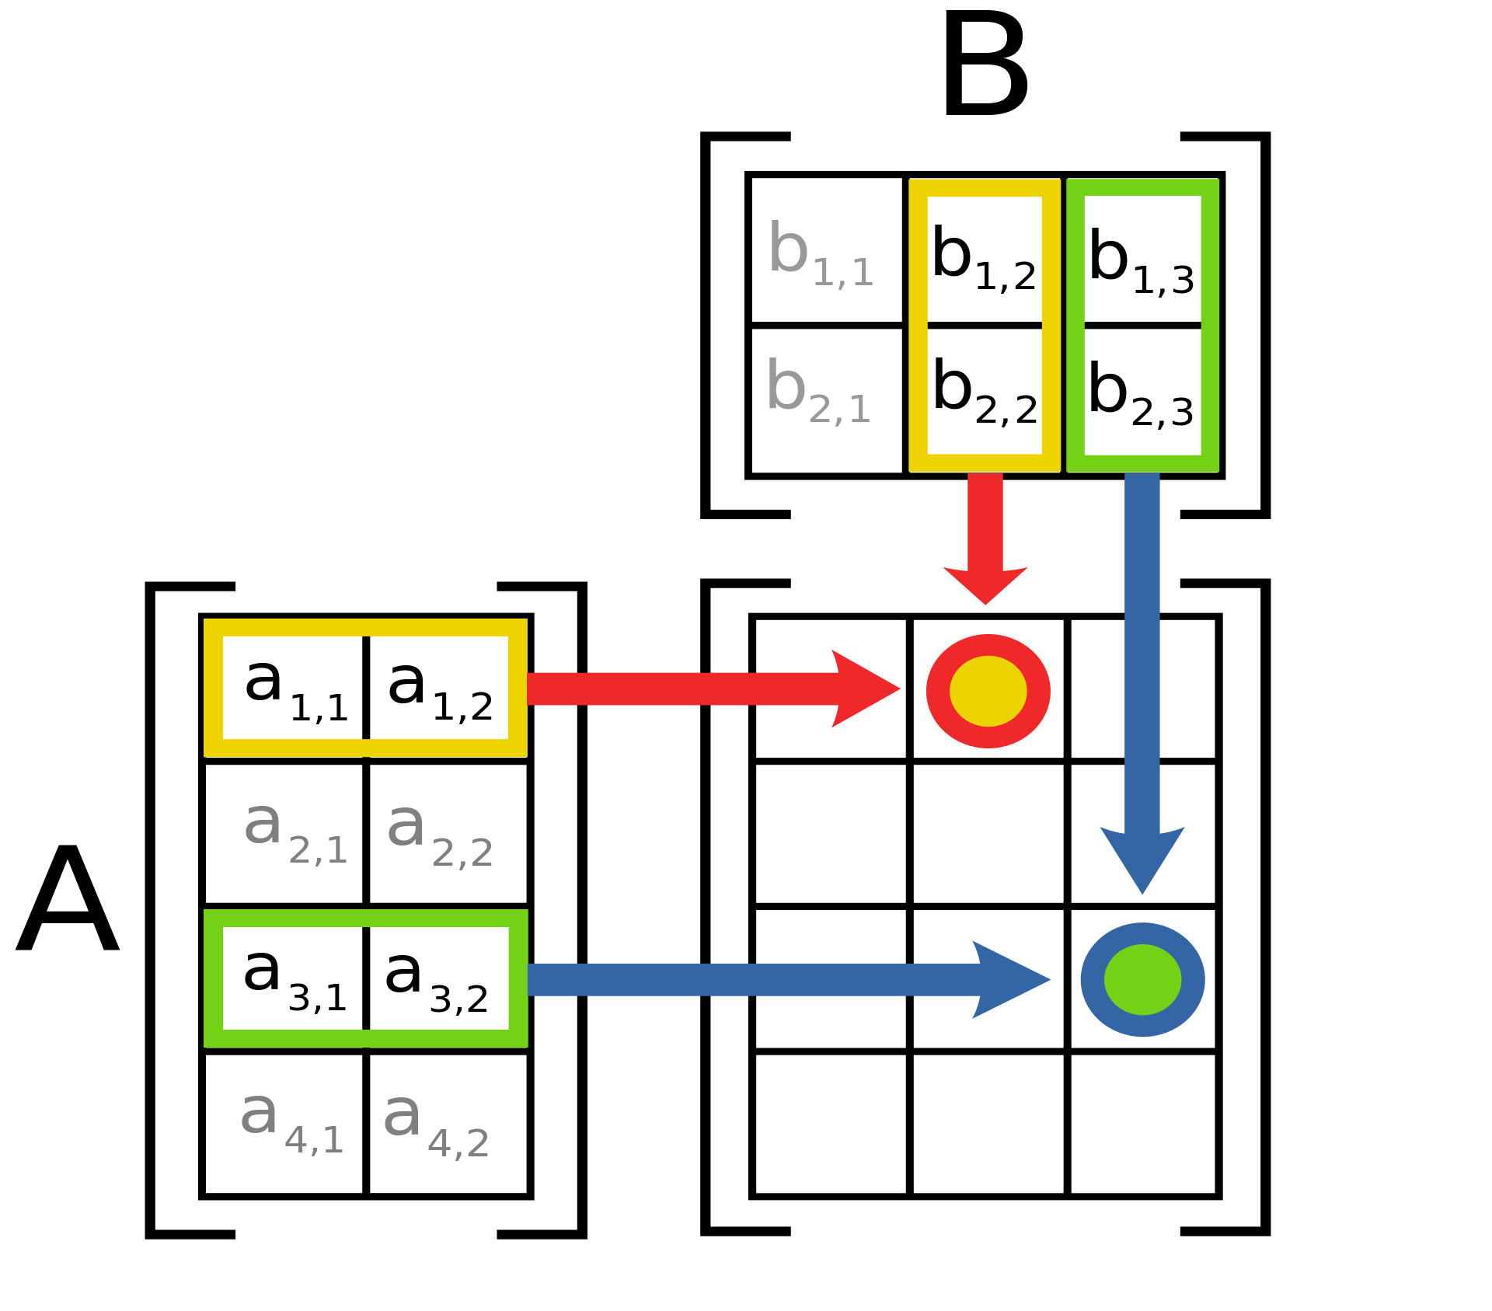
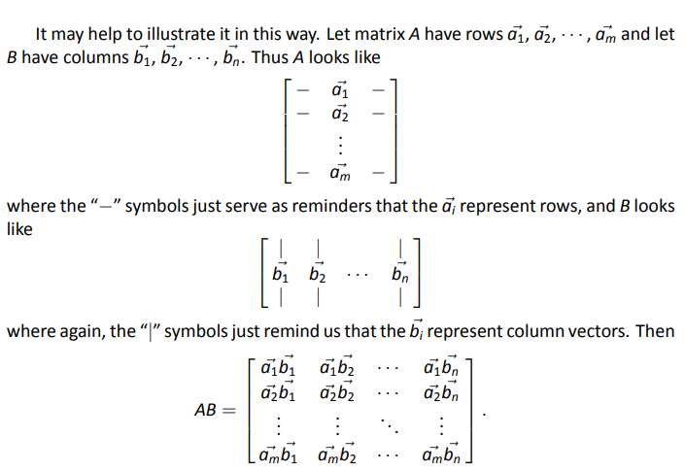
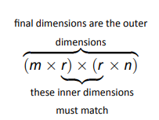
Important

Slide 11





Example 25
……….

Slide 12
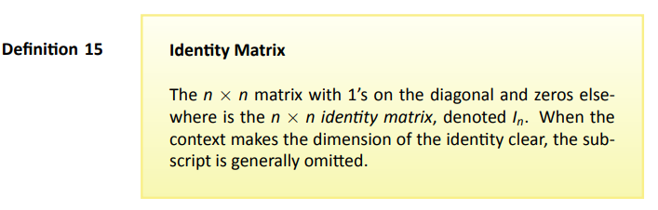
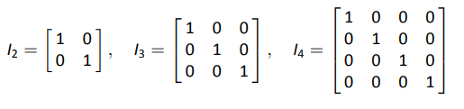
Definition
Examples

Slide 13
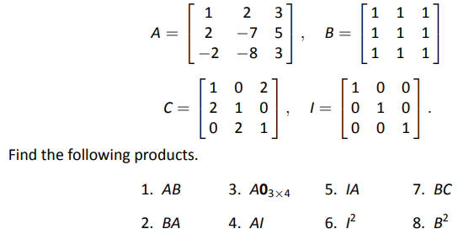
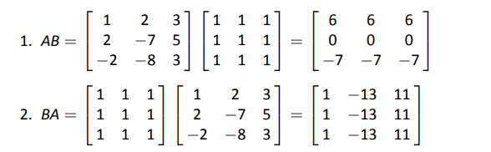
Example 29
So, AB ≠ BA! When dealing with numbers, we have ab = ba.

Slide 14
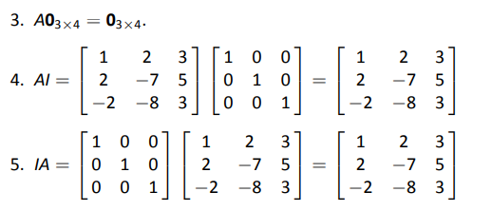
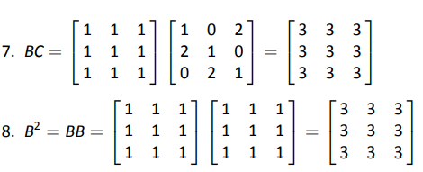
Example 29 : Solution (cont)
So, AI = IA. It is easy to prove that
matrix I is the multiplicative identity.
So, BB = BC, but B ≠ C.
This is different from numbers,
where xa = xb implies a = b for x ≠ 0.

Slide 15
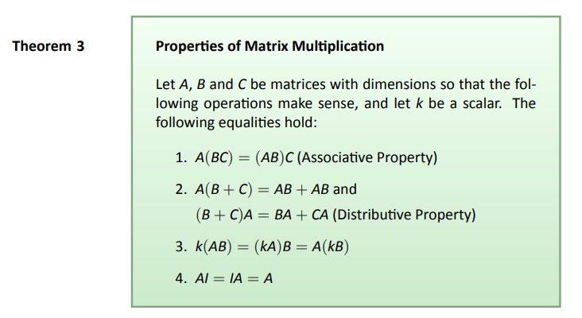
Theorem

Slide 16
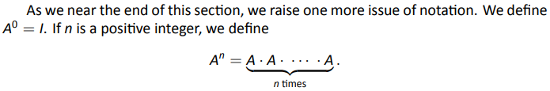
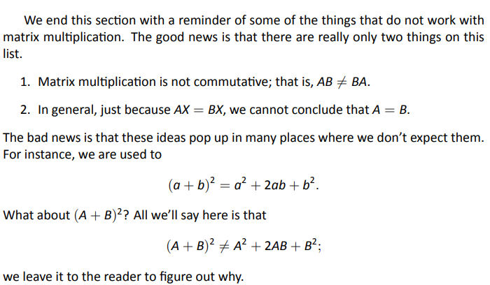
Final Thoughts

Slide 17
2.3 Visualizing Matrix Arithmetic in 2D

Slide 18
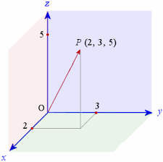
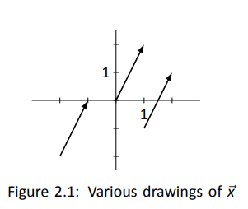

Graphing a Vector

Slide 19
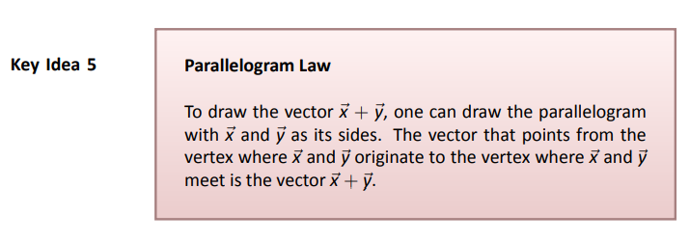
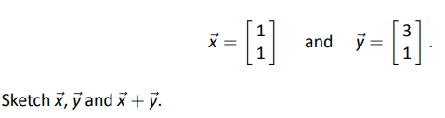

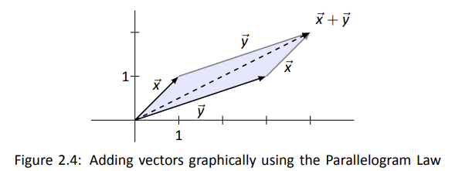
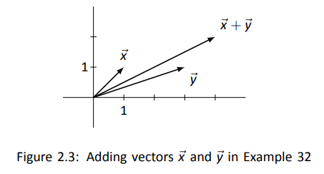
Example 32
Problem
Solution

Slide 20
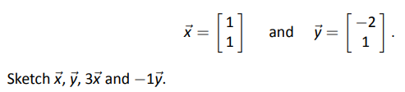

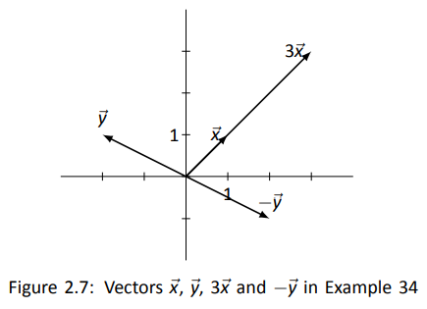
Example 34
Problem
Solution

Slide 21
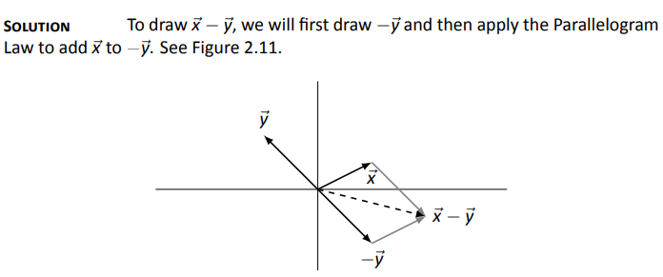
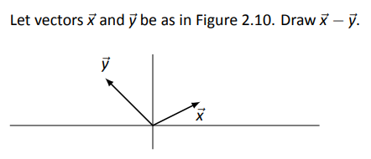
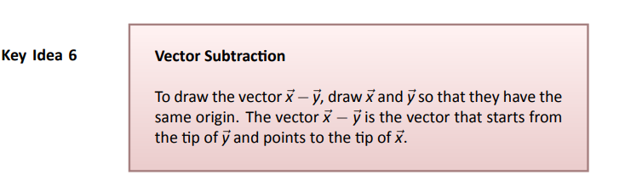
Example 36
Problem

Slide 22
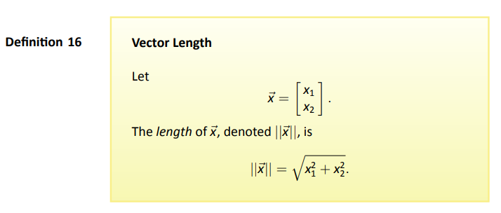
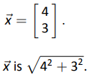
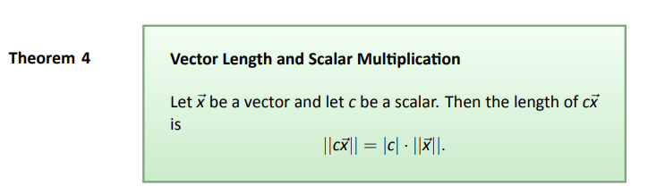

Slide 23
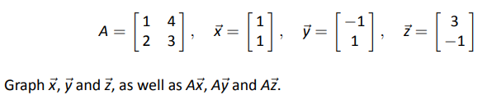
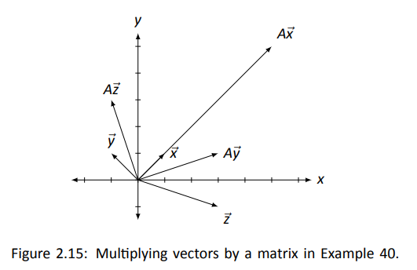
Example 40
Problem
Solution

Slide 24
2.4 Vector Solutions to Linear Systems

Slide 25
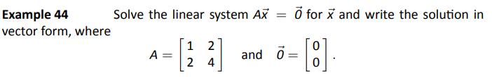

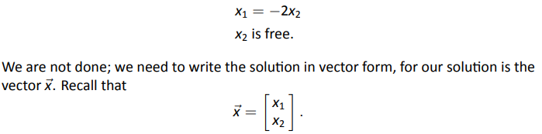



Example 44
Problem
Solution

Slide 26
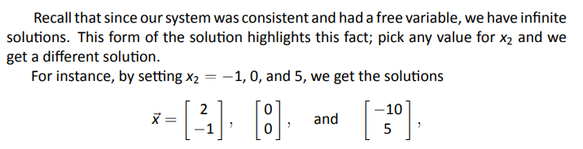
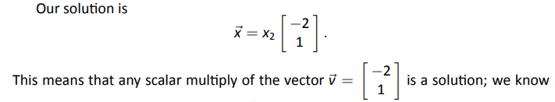
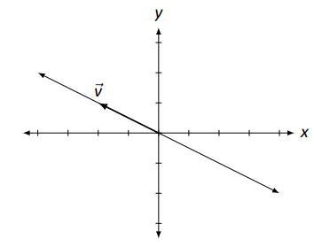
Example 44 (cont)

Slide 27
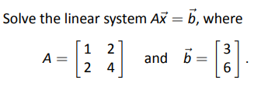

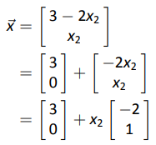
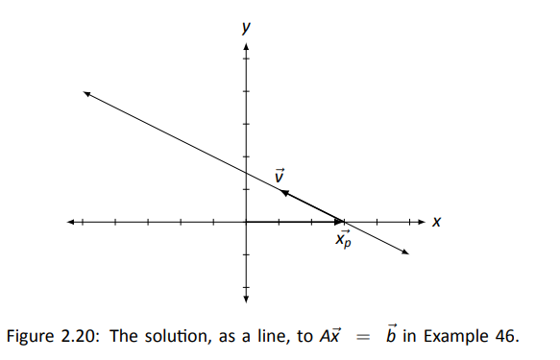





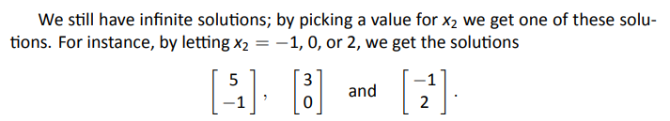
Example 46
Problem
Solution
1.
2.

Slide 28
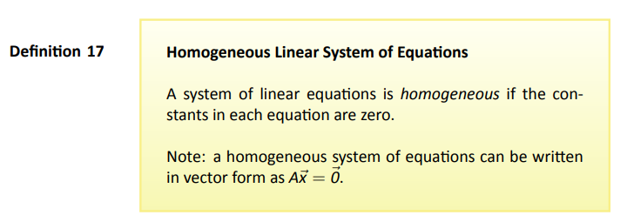

The term homogeneous comes from two Greek words; homo meaning “same” and genus meaning “type.”

Slide 29






Determining How Many Solutions
Recall earlier example
Solutions
Recall earlier notation

Slide 30


Key Idea

Slide 31



Example 49
Problem
Solution
First, we solve for

Slide 32







Example 50
Problem
Solution
Next we solve for
First, we solve for

Slide 33





Example 47
Problem
Solution
First, we solve for
Again, we pull apart this
vector, but this time we
break it into three
vectors: one with “x₃”
stuff, one with “x₄” stuff,
and one with just
constants.

Slide 34



Example 47 (cont)
Problem
Solution
Next we solve for
Again, we pull apart this
vector, but this time we
break it into three
vectors: one with “x₃”
stuff, one with “x₄” stuff,
and one with just
constants.

Slide 35
2.5 Solving Matrix Equations AX = B

Slide 36






Overview of (new) Problem Solving Method

Slide 37



Example 51

Slide 38

Why Does This Work?

Slide 39




Why Does This Work? (cont)

Slide 40

Key Idea

Slide 41
2.6 The Matrix Inverse

Slide 42

Inverse 101

Slide 43





Example 53
Problem
Solution
We also have:
This means that AX = I = XA

Slide 44



Example 54

Slide 45

Key Idea

Slide 46




Slide 47

Theorem

Slide 48


What if A⁻¹ exists?
Can more than one solution exist?

Slide 49

Theorem (we just proved)

Slide 50



Example 57
Problem
Solution

Slide 51
2.7 Properties of Matrix Inverse

Slide 52



Slide 53


