Slide 1
Chapter 5
Fundamentals of Matrix Algebra By Gregory Hartman

Slide 2
5.1 Transformation of the Cartesian Plane

Slide 3
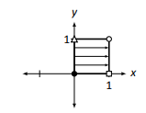
Transitioning to a New Topic
Now we will multiply every vector in the Cartesian plane by a matrix A instead of just an individual vector.
Because of the Distributive Property, the Cartesian plane will be transformed in a very nice, predictable way.
One way of studying how the whole Cartesian plane is affected by multiplication
by matrix A is to study how the unit square is affected.
Each unit square corner can be represented by a vector that points to it; multiply each of these vectors by A
and we get an idea of how A affects the whole Cartesian plane.
Page 3

Slide 4

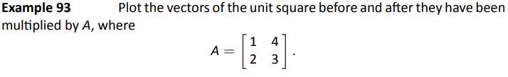
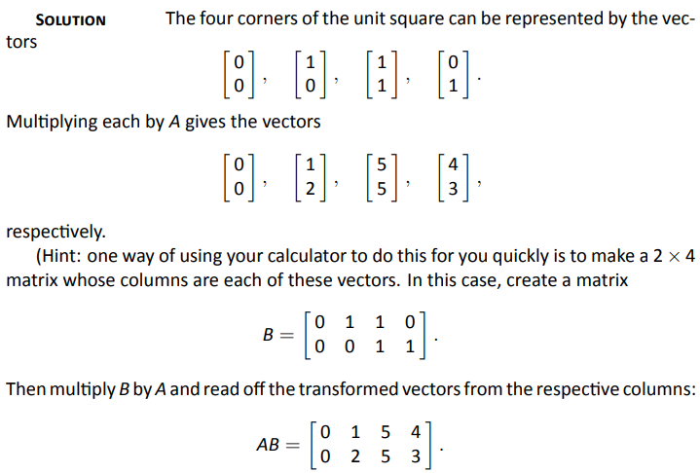
Example 93
Problem
Solution
Page 4

Slide 5
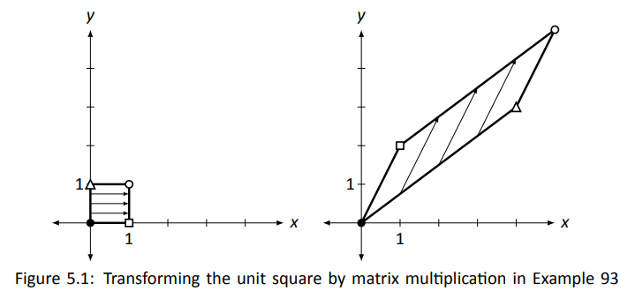
Example 93
Problem
Problem
A really interesting thing is how the triangular and square vertices seem
to have changed places – it is as though the square, in addition to being
stretched out of shape, was flipped.
Solution
Note the arrows inside the squares. Note that relative distances have been preserved.
Page 5

Slide 6

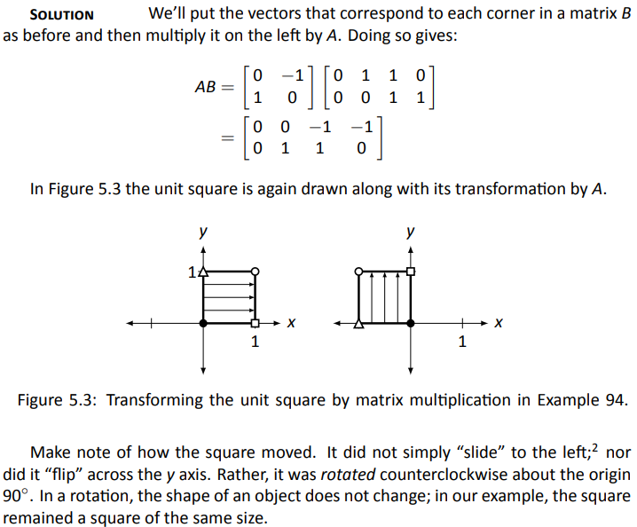
Example 94
Plot the transformed unit square after it has been transformed by A, where
Solution
Page 6

Slide 7
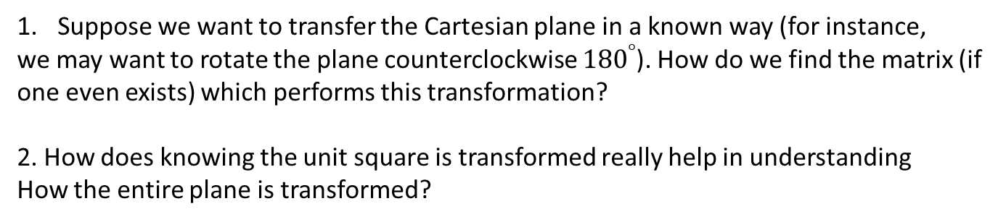
Questions to Consider
We have broached the topic of how the Cartesian plane can be transformed via multiplication by a 2×2 matrix A
Suppose we want to transfer the Cartesian plane in a known way (for instance,
we may want to rotate the plane counterclockwise ${180}^{°}$). How do we find the matrix (if
one even exists) which performs this transformation?
2. How does knowing the unit square is transformed really help in understanding
How the entire plane is transformed?

Slide 8
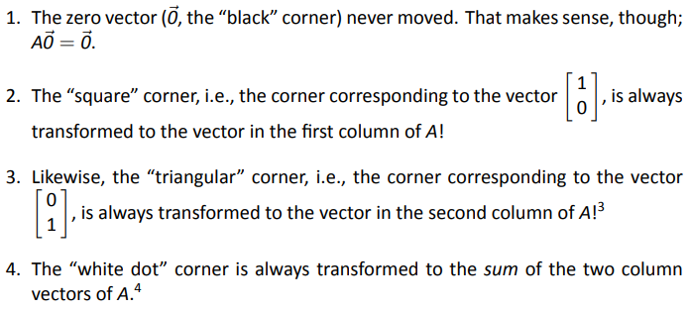
Groundwork for Answering Questions
Explanation given
on next slide
Page 8

Slide 9
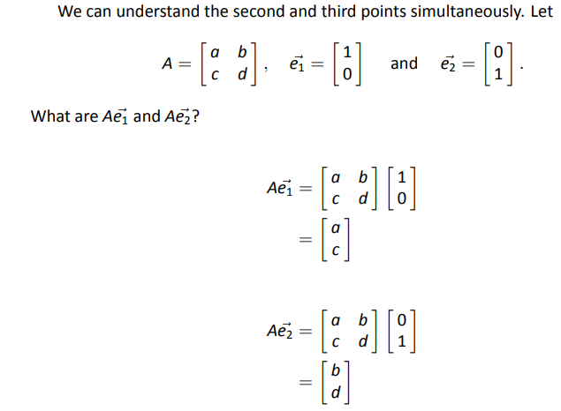


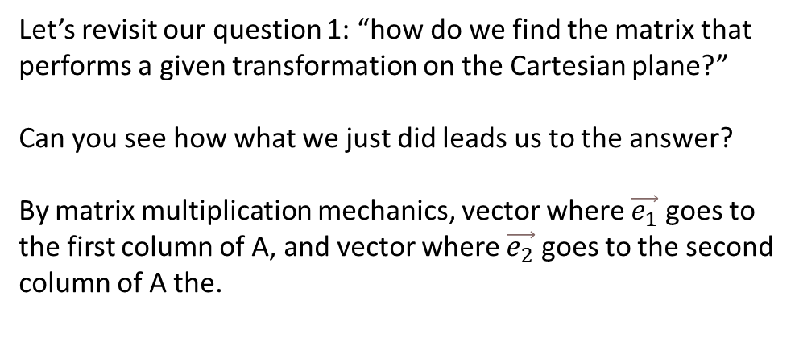


Further explanation
$$\left[\begin{matrix}0 \\ 1\end{matrix}\right]$$
$$\left[\begin{matrix}a \\ c\end{matrix}\right]$$
$$\left[\begin{matrix}1 \\ 0\end{matrix}\right]$$
$$\left[\begin{matrix}b \\ d\end{matrix}\right]$$
Let’s revisit our question 1: “how do we find the matrix that performs a given transformation on the Cartesian plane?”
Can you see how what we just did leads us to the answer?
By matrix multiplication mechanics, vector where $\vec{e_{1}}$ goes to the first column of A, and vector where $\vec{e_{2}}$ goes to the second column of A the.

Slide 10
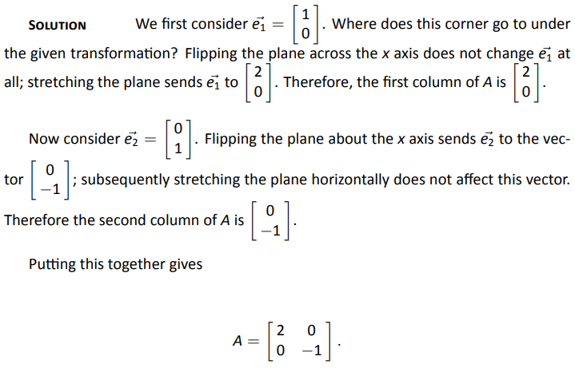
Example 95
Problem

Slide 11
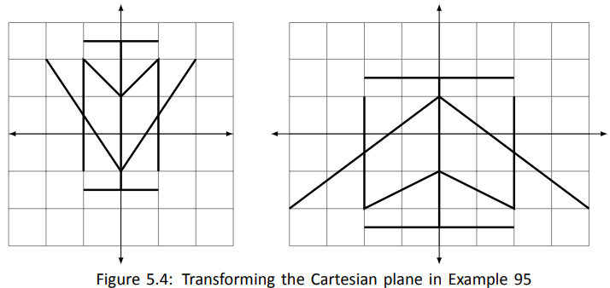

Example 95
Problem
Solution
$$A=\left[\begin{matrix}2 & 0 \\ 0 & −1\end{matrix}\right]$$

Slide 12
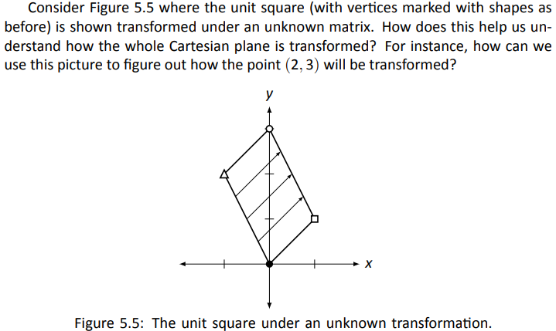

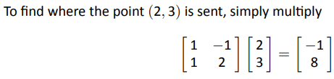
Transformation of a Point : Method 1
Page 12

Slide 13
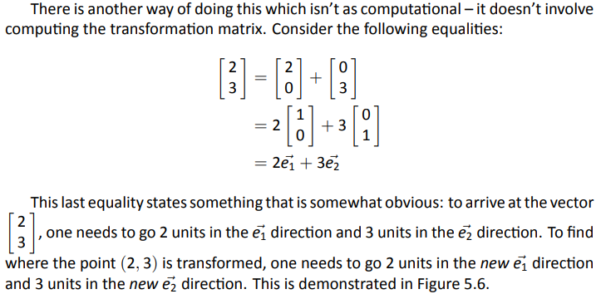
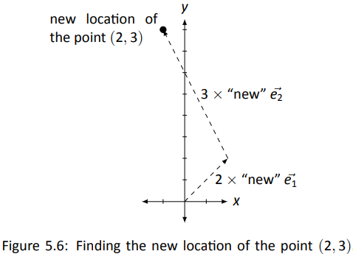
Transformation of a Point : Method 2
Page 13

Slide 14
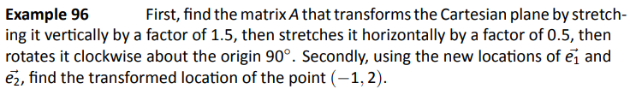
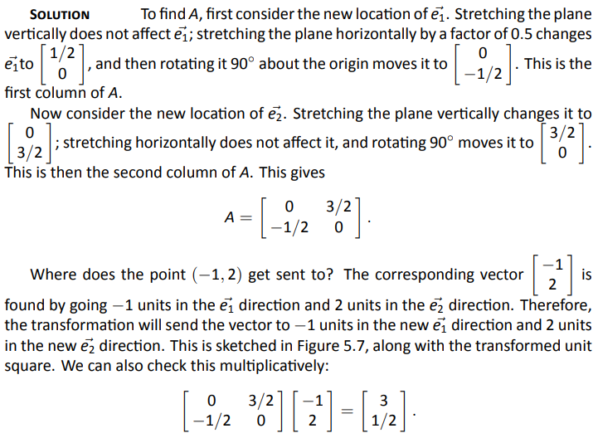
Example 96
Problem

Slide 15
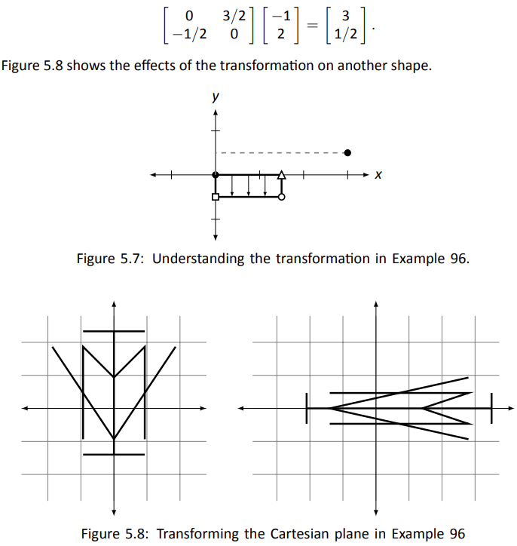
Example 96
Solution

Slide 16
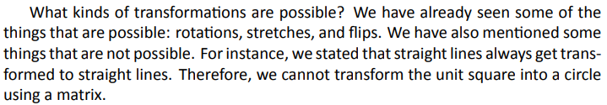
2D Matrix Transformations
The original unit square will be drawn lightly as well to serve as a reference in the slides ahead.

Slide 17
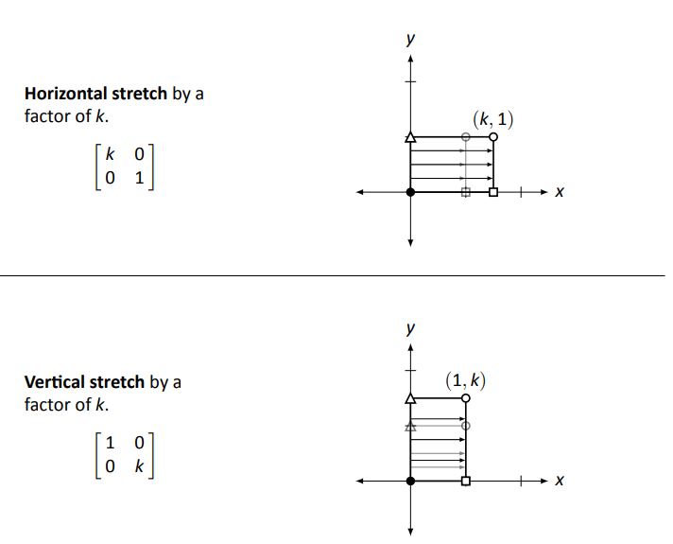
Stretches

Slide 18
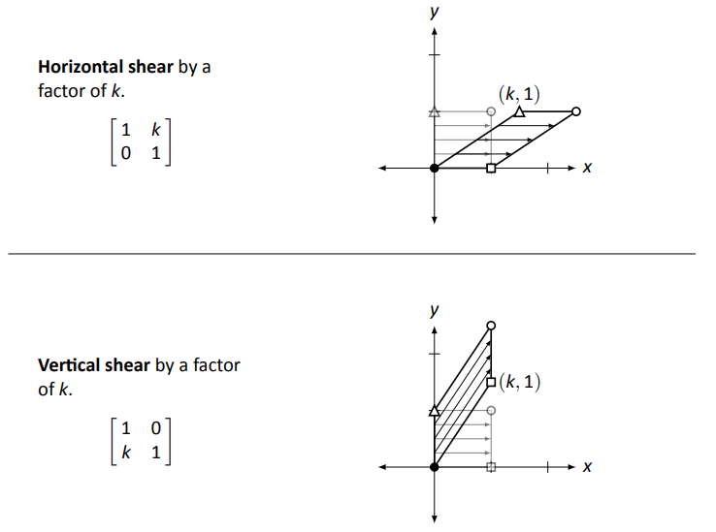
Shears

Slide 19
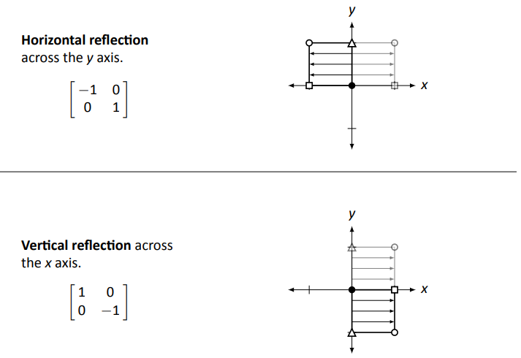
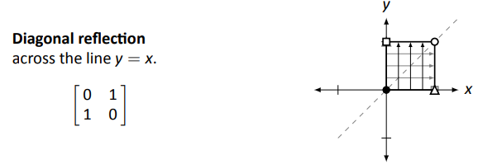
Reflections

Slide 20
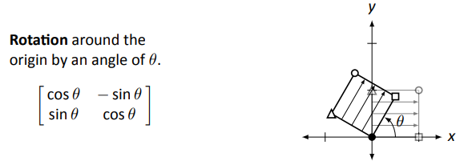
Rotation

Slide 21
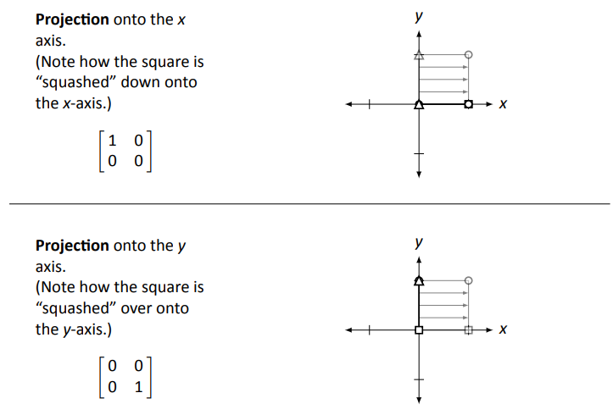
Projections

Slide 22
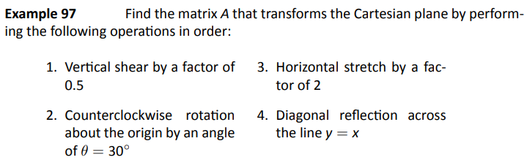
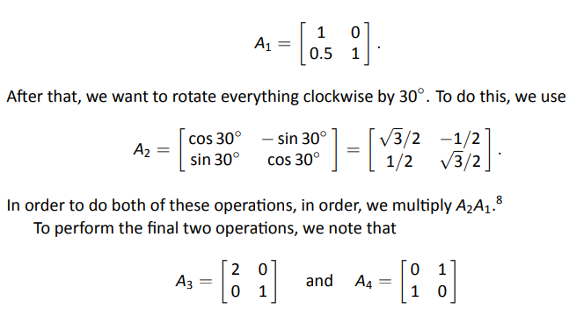
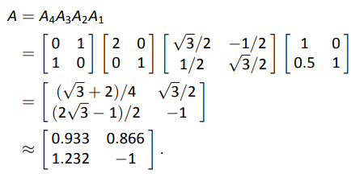
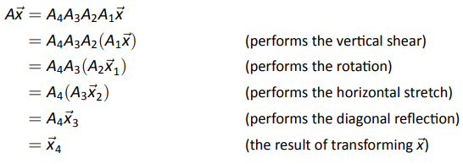

Example 97
Problem
Solution

Slide 23
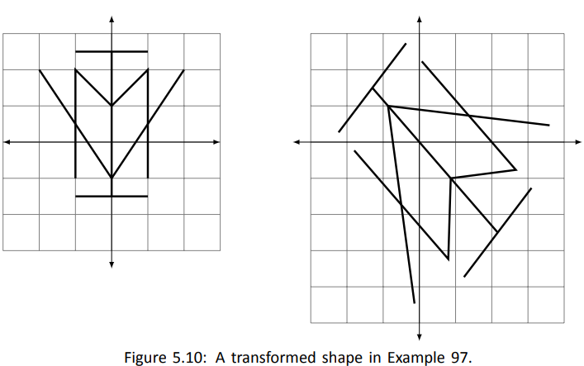
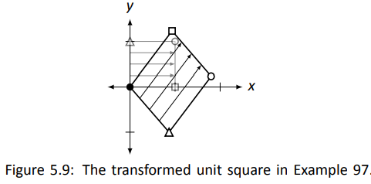

Example 97
Problem
Solution
Once we know what matrices perform the basic transformations,
performing complex transformations on the Cartesian plane really
isn’t that . . . complex. It boils down to multiplying by a series of matrices.

Slide 24
5.2 Properties of Linear Transformation

Slide 25
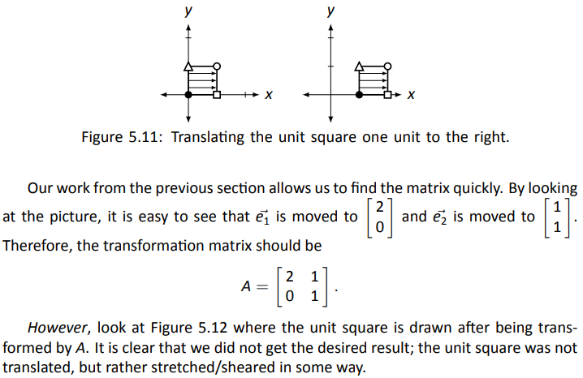
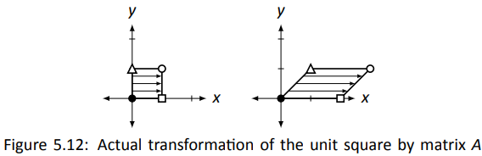
Translation vs Transformation

Slide 26

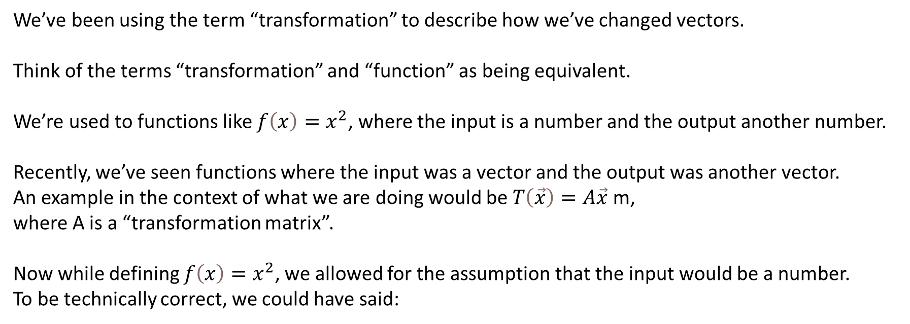
Transformation = Function
We’ve been using the term “transformation” to describe how we’ve changed vectors.
Think of the terms “transformation” and “function” as being equivalent.
We’re used to functions like $f\left(x\right)=x^{2}$, where the input is a number and the output another number.
Recently, we’ve seen functions where the input was a vector and the output was another vector.
An example in the context of what we are doing would be $T\left(\vec{x}\right)=A\vec{x}$ m,
where A is a “transformation matrix”.
Now while defining $f\left(x\right)=x^{2}$, we allowed for the assumption that the input would be a number.
To be technically correct, we could have said:

Slide 27
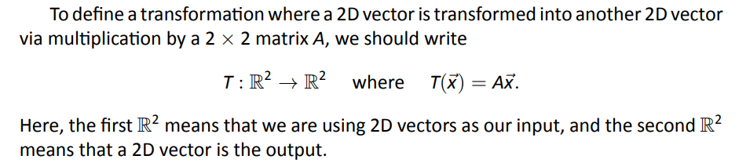
Transformation = Function
The first and second $ℝs$ tells us that the input and output (respectively) were real numbers.

Slide 28
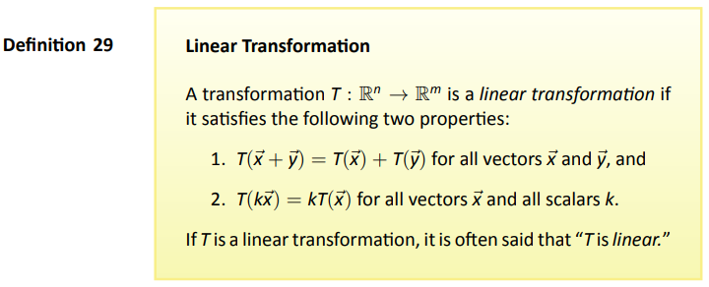
Definition

Slide 29
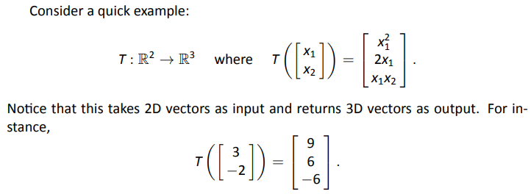
Linear Transformation?

Slide 30
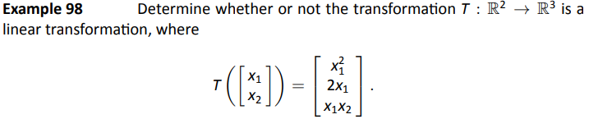
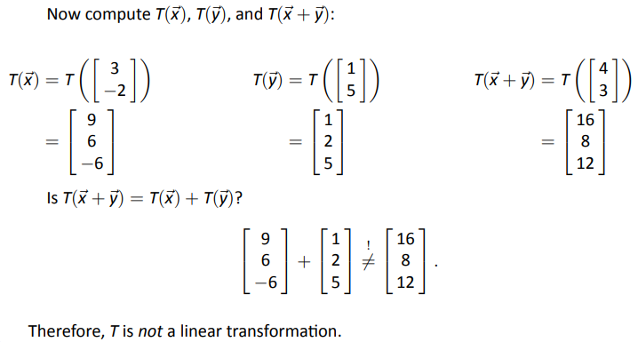
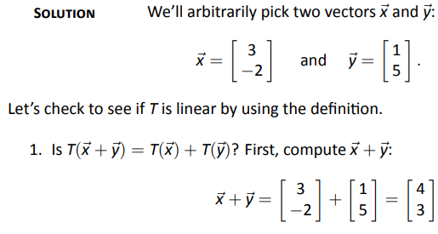
Example 98
Problem
Problem
Solution

Slide 31
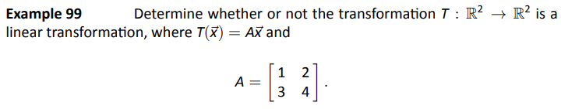
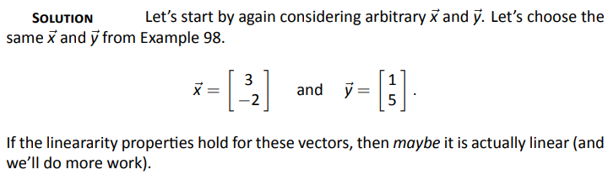
Example 99
Problem
Solution

Slide 32
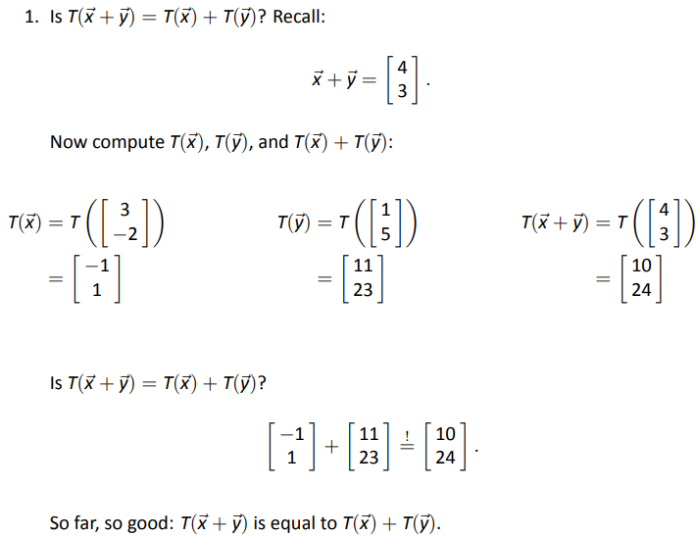
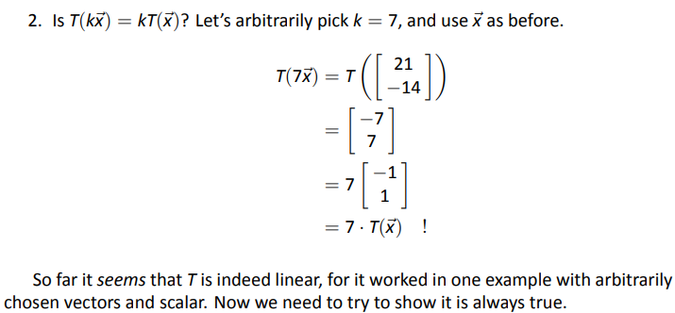
Example 99
Problem
Problem
Solution

Slide 33
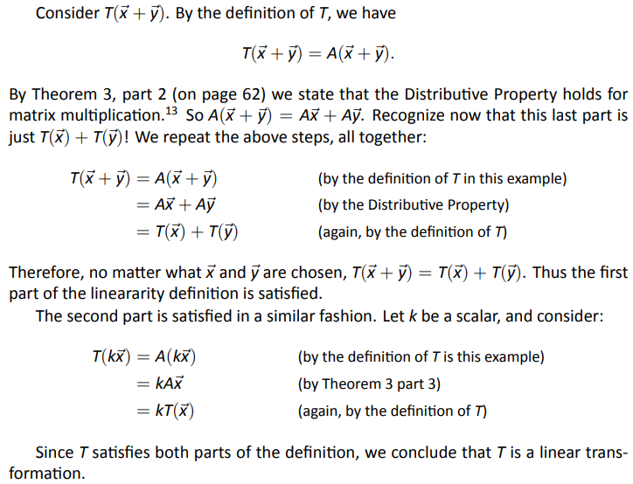
Example 99
Problem
Problem
Solution

Slide 34
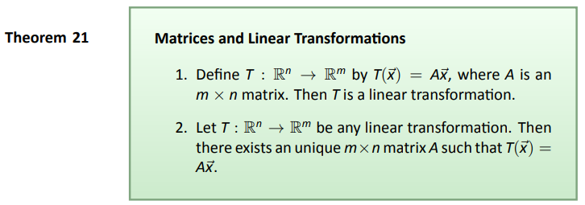
Theorem
Note: the second part of the theorem says that all linear transformations
can be described using matrix multiplication

Slide 35
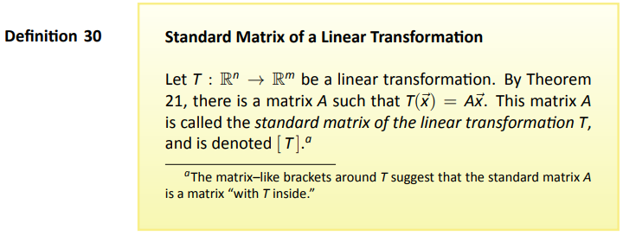
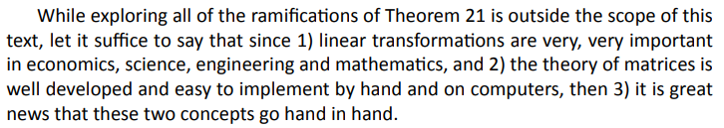
Definition

Slide 36
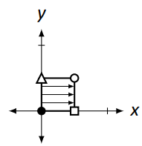
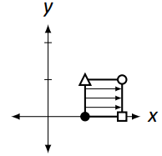


Revisiting Our Original Example
Remember the example at the beginning of this section?
We might have guessed things went wrong because
the translation transformation was not a linear transformation.
While true, this does not explain things very well.
The second part of the linear transformation definition that states $T\left(k\vec{x}\right)=kT\left(\vec{x}\right)$ for all scalars k.
If we let k = 0, we have $T\left(O\vec{x}\right)=O∙T\left(\vec{x}\right)$,
or more simply, $T\left(\vec{0}\right)=\vec{0}$.
In other words, if T is a linear transformation,
it must send the zero vector to the zero vector.

Slide 37



Slide 38


Examples of this Definition:

Slide 39

Theorem

Slide 40


Example 100
Problem
Solution

Slide 41


Example 100
Problem
Check

Slide 42




Example 101
Problem
Setup
T
=

Slide 43

Example 101
Problem
Wrap up

Slide 44




Linear Transformation?
Reasoning

Slide 45


Key Idea

Slide 46



Example 102
Problem
Solution

