Slide 1
Euler and Hamiltonian Graphs
Section 10.5
Based on Discrete Mathematics and Its Applications, 8th ed., by Kenneth H. Rosen, published by McGraw Hill.
Instructor: Longin Jan Latecki
latecki@temple.edu

Slide 2
Section Summary
Euler Paths and Circuits
Hamilton Paths and Circuits
Applications of Hamilton Circuits

Slide 3
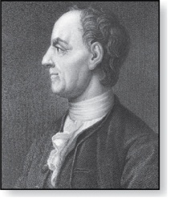
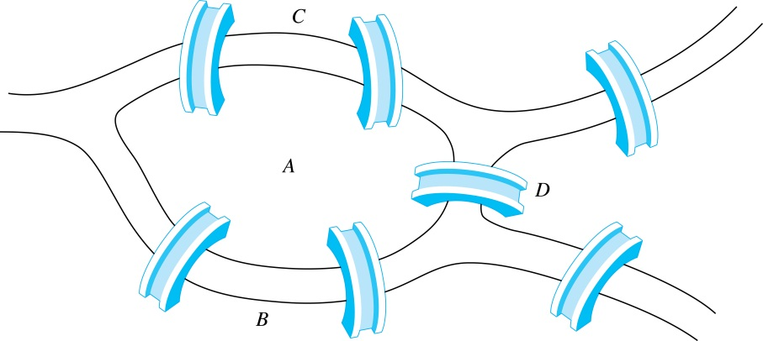
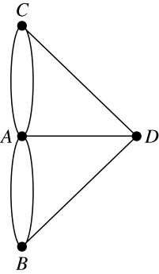
Euler Paths and Circuits
Leonard Euler (1707-1783)
The town of Kӧnigsberg, Prussia (now Kalinigrad, Russia) was divided into four sections by the branches of the Pregel river. In the 18th century seven bridges connected these regions.
People wondered whether it was possible to follow a path that crosses each bridge exactly once and returns to the starting point.
The Swiss mathematician Leonard Euler proved that no such path exists. This result is often considered to be the first theorem ever proved in graph theory.
Multigraph Model of the Bridges of Kӧnigsberg
The 7 Bridges of Kӧnigsberg

Slide 4
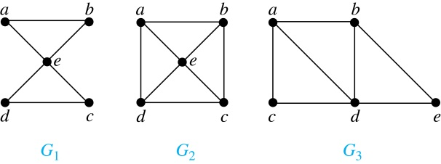
Euler Paths and Circuits (continued)
Definition: A Euler circuit in a graph G is a simple circuit containing every edge of G. A Euler path in G is a simple path containing every edge of G.
Example: Which of the undirected graphs G₁, G₂, and G₃ has a Euler circuit? Of those that do not, which has a Euler path?
Solution:
Graph G₁ has a Euler circuit (e.g., a, e, c, d, e, b, a). But, as can easily be verified by inspection, neither G₂ nor G₃ has a Euler circuit.
G₃ has a Euler path (e.g., a, c, d, e, b, d, a, b), but there is no Euler path in G₂, which can be verified by inspection.

Slide 5
Necessary and Sufficient Conditions
A connected multigraph has a Euler circuit iff each of its vertices has an even degree.
A connected multigraph has a Euler path but not a Euler circuit iff it has exactly two vertices of odd degree.
C
Does this graph have a Euler circuit?
A
D
No.
B

Slide 6
Euler Paths
Example:
G₁ contains exactly two vertices of odd degree (b and d). Hence it has a Euler path, e.g., d, a, b, c, d, b.
G₂ has exactly two vertices of odd degree (b and d). Hence it has a Euler path, e.g., b, a, g, f, e, d, c, g, b, c, f, d.
G₃ has six vertices of odd degree. Hence, it does not have a Euler path.

Slide 7
Necessary Conditions for Euler Circuits and Paths
We assume that a connected multigraph has a Euler circuit.
A Euler circuit begins with a vertex a and continues with an edge incident with a, say {a, b}. The edge {a, b} contributes one to deg(a).
Each time the circuit passes through a vertex it contributes two to the vertex’s degree.
Finally, the circuit terminates where it started, contributing one to deg(a). Therefore deg(a) must be even.
We conclude that the degree of every other vertex must also be even.
By the same reasoning, we see that the initial vertex and the final vertex of a Euler path have odd degree, while every other vertex has even degree. So, a graph with a Euler path has exactly two vertices of odd degree.
In the next slide we will show that these necessary conditions are also sufficient conditions.

Slide 8
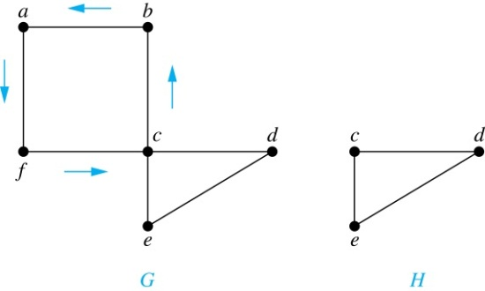
Sufficient Conditions for Euler Circuits and Paths
Suppose that G is a connected multigraph with ≥ 2 vertices, all of even degree. Let x₀ = a be a vertex of even degree. Choose an edge {x₀, x₁} incident with a and proceed to build a simple path {x₀, x₁}, {x₁, x₂}, …, {x_{n-1}, x_{n}} by adding edges one by one until another edge can not be added.
The path begins at a with an edge of the form {a, x}; we show that it must terminate at a with an edge of the form {y, a}. Since each vertex has an even degree, there must be an even number of edges incident with this vertex. Hence, every time we enter a vertex other than a, we can leave it. Therefore, the path can only end at a.
If all of the edges have been used, a Euler circuit has been constructed. Otherwise, consider the subgraph H obtained from G by deleting the edges already used.
We illustrate this idea in the graph G here. We begin at a and choose the edges {a, f}, {f, c}, {c, b}, and {b, a} in succession.
In the example H consists of the vertices c, d, e.

Slide 9
Sufficient Conditions for Euler Circuits and Paths (continued)
Because G is connected, H must have at least one vertex in common with the circuit that has been deleted.
Every vertex in H must have even degree because all the vertices in G have even degree and for each vertex, pairs of edges incident with this vertex have been deleted. Beginning with the shared vertex construct a path ending in the same vertex (as was done before). Then splice this new circuit into the original circuit.
Continue this process until all edges have been used. This produces a Euler circuit. Since every edge is included and no edge is included more than once.
Similar reasoning can be used to show that a graph with exactly two vertices of odd degree must have a Euler path connecting these two vertices of odd degree
In the example, the vertex is c.
In the example, we end up with the circuit a, f, c, d, e, c, b, a.

Slide 10
Algorithm for Constructing an Euler Circuits
In our proof we developed this algorithms for constructing a Euler circuit in a graph with no vertices of odd degree.
procedure Euler(G: connected multigraph with all vertices of even degree)
circuit := a circuit in G beginning at an arbitrarily chosen vertex with edges
successively added to form a path that returns to this vertex.
H := G with the edges of this circuit and all isolated vertices removed
while H has edges
subciruit := a circuit in H beginning at a vertex in H that also is
an endpoint of an edge in circuit.
H := H with edges of subciruit and all isolated vertices removed
circuit := circuit with subcircuit inserted at the appropriate vertex.
return circuit{circuit is an Euler circuit}

Slide 11
Necessary and Sufficient Conditions for Euler Circuits and Paths (continued)
Theorem: A connected multigraph with at least two vertices has a Euler circuit if and only if each of its vertices has an even degree and it has a Euler path if and only if it has exactly two vertices of odd degree.
Example: Four vertices in the multigraph model of the Kӧnigsberg bridge problem have odd degree.
Hence, there is no Euler circuit in this multigraph,
and it is impossible to start at a given point, cross each bridge exactly once, and return to the starting point.

Slide 12
Euler Circuit in Directed Graphs
NO (a, g, c, b, g, e, d, f, a) NO

Slide 13
Euler Path in Directed Graphs
NO (a, g, c, b, g, e, d, f, a) (c, a, b, c, d, b)

Slide 14
Necessary and Sufficient Conditions for Euler Circuits and Paths in Directed Graphs

Slide 15
Applications of Euler Paths and Circuits
Euler paths and circuits can be used to solve many practical problems such as finding a path or circuit that traverses each
street in a neighborhood,
road in a transportation network,
connection in a utility grid,
link in a communications network.
Other applications are found in the
layout of circuits,
network multicasting,
molecular biology, where Euler paths are used in the sequencing of DNA.

Slide 16
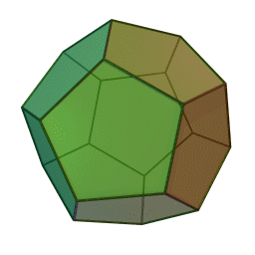
Hamilton Paths and Circuits
Dodecahedron is a polyhedron with twelve flat faces

Slide 17
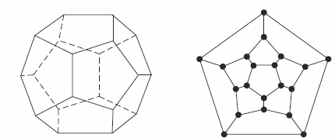
Hamilton Circuits
Dodecahedron puzzle and it equivalent graph
Is there a circuit in this graph that passes through each vertex exactly once?

Slide 18
Hamilton Circuits
Yes; this is a circuit that passes through each vertex exactly once.

Slide 19
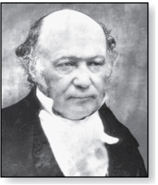
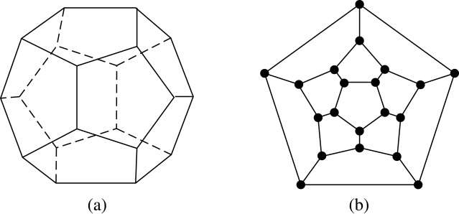
Hamilton Paths and Circuits
William Rowan Hamilton (1805- 1865)
Euler paths and circuits contained every edge only once. Now we look at paths and circuits that contain every vertex exactly once.
William Hamilton invented the Icosian puzzle in 1857. It consisted of a wooden dodecahedron (with 12 regular pentagons as faces), illustrated in (a), with a peg at each vertex, labeled with the names of different cities. String was used to used to plot a circuit visiting 20 cities exactly once
The graph form of the puzzle is given in (b).
Definition: A simple path in a graph G that passes through every vertex exactly once is called a Hamilton path, and a simple circuit in a graph G that passes through every vertex exactly once is called a Hamilton circuit.

Slide 20
Finding Hamilton Circuits
Which of these three figures has a Hamilton circuit? Or, if no Hamilton circuit, a Hamilton path?

Slide 21
Finding Hamilton Circuits
G₁ has a Hamilton circuit: a, b, c, d, e, a
G₂ does not have a Hamilton circuit, but does have a Hamilton path: a, b, c, d
G₃ has neither.

Slide 22
Euler versus Hamilton Circuit
Property | Euler | Hamilton
Repeated visits to a given node allowed? | Yes | No
Repeated traversals of a given edge allowed? | No | No
Omitted nodes allowed? | No | No
Omitted edges allowed? | No | Yes

Slide 23
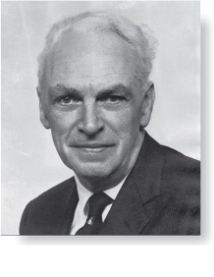
Necessary Conditions for Hamilton Circuits
Gabriel Andrew Dirac
(1925-1984)
Unlike for a Euler circuit, no simple necessary and sufficient conditions are known for the existence of a Hamiton circuit.
However, there are some useful necessary conditions.
We describe two of these now.
Dirac’s Theorem: If G is a simple graph with n ≥ 3 vertices such that the degree of every vertex in G is ≥ n/2, then G has a Hamilton circuit.
Ore’s Theorem: If G is a simple graph with n ≥ 3 vertices such that deg(u) + deg(v) ≥ n for every pair of nonadjacent vertices, then G has a Hamilton circuit.
Øysten Ore
(1899-1968)

Slide 24
Time Complexity
The best algorithms known for finding a Hamilton circuit in a graph or determining that no such circuit exists have exponential worst-case time complexity (in the number of vertices of the graph).
Finding an algorithm that solves this problem with polynomial worst-case time complexity would be a major accomplishment because it has been shown that this problem is NP-complete. Consequently, the existence of such an algorithm would imply that many other seemingly intractable problems could be solved using algorithms with polynomial worst-case time complexity.

Slide 25
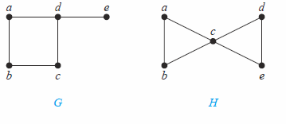
Show that neither graph displayed below has a Hamilton circuit.
There is no Hamilton circuit in G because G has a vertex of degree one: e.
Now consider H. Because the degrees of the vertices a, b, d, and e are all two, every edge incident with these vertices must be part of any Hamilton circuit. No Hamilton circuit can exist in H, for any Hamilton circuit would have to contain four edges incident with c, which implies that we would need to pass through c twice, which is not allowed in a Hamilton circuit.

Slide 26
Properties to look for ...
No vertex of degree 1
No cut edges
If a node has degree 2, then both edges incident to it must be in any Hamilton circuit.
No smaller circuits contained in any Hamilton circuit (the start/endpoint of any smaller circuit would have to be visited twice).

Slide 27
Applications of Hamilton Paths and Circuits
Applications that ask for a path or a circuit that visits each intersection of a city, each place pipelines intersect in a utility grid, or each node in a communications network exactly once, can be solved by finding a Hamilton path in the appropriate graph.
The famous traveling salesperson problem (TSP) asks for the shortest route a traveling salesperson should take to visit a set of cities. This problem reduces to finding a Hamilton circuit such that the total sum of the weights of its edges is as small as possible.
A family of binary codes, known as Gray codes, which minimize the effect of transmission errors, correspond to Hamilton circuits in the n-cube Q_{n}. (See the text for details.)

