Slide 1
Chapter 3
Fundamentals of Matrix Algebra By Gregory Hartman

Slide 2
3.1 The Matrix Transpose

Slide 3
Example 60

Slide 4
Example 61
Problem
Solution
Note
Page 4

Slide 5
Definition
Page 5

Slide 6
Example 62
Problem
Solution

Slide 7
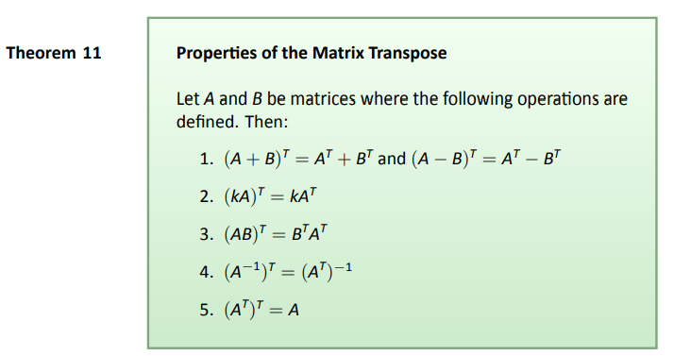
Theorem 11

Slide 8
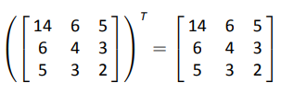
Example
So why is AA^{T} symmetric?

Slide 9
Theorem
Proof

Slide 10
Interesting Thought

Slide 11
3.2 The Matrix Trace

Slide 12
Example 67

Slide 13
Theorem

Slide 14
3.3 The Determinant

Slide 15
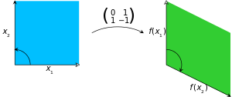
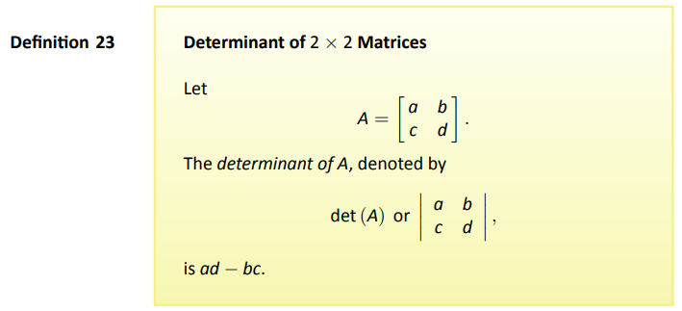
Definition
The determinant of this matrix is −1,
as the area of the green parallelogram at the right is 1,
but the map reverses the orientation,
since it turns the counterclockwise orientation
of the vectors to a clockwise one.
The absolute value of determinant equals the area (in R²) or volume (in R³) of the image of the unit square (or cube), while its sign corresponds to the orientation of the corresponding linear map: the determinant is positive if and only if the orientation is preserved.

Slide 16
Example 68
Problem
Solution

Slide 17
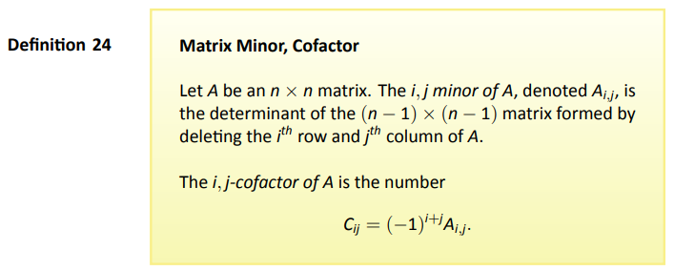
Definition

Slide 18
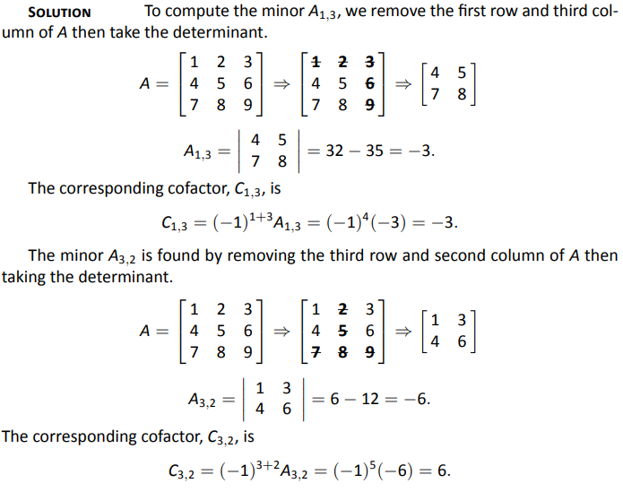
Example 69

Slide 19
Example 69
Solution

Slide 20
Example 69
Solution

Slide 21
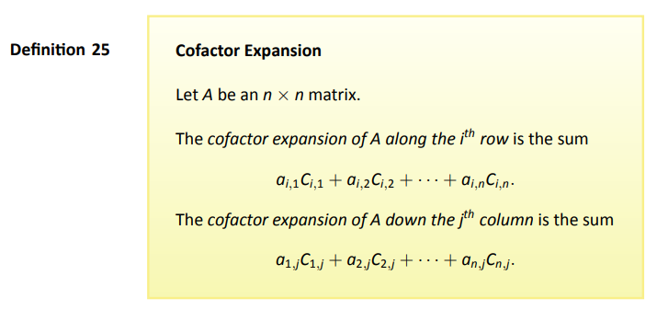
Definition

Slide 22
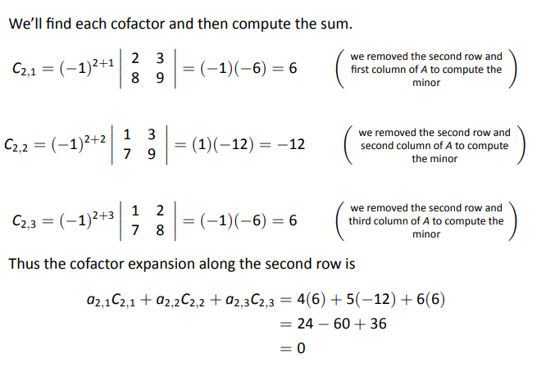
Example 70
Problem
Solution

Slide 23
Definition

Slide 24
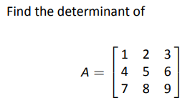
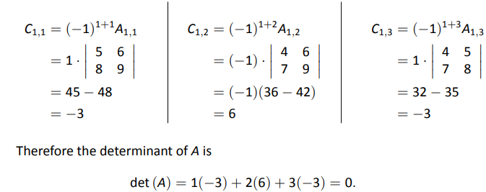
Example 71
Problem
Solution

Slide 25
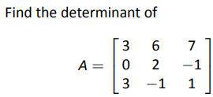
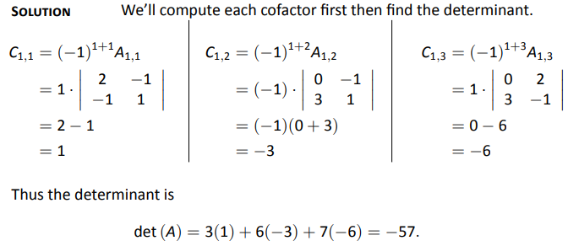
Example 72
Problem
Solution

Slide 26
3.4 Properties of the Determinant

Slide 27
Theorem

Slide 28
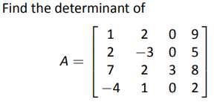
Example 74
Problem
Solution

Slide 29
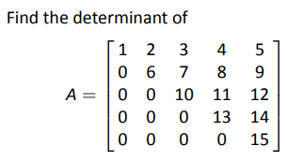
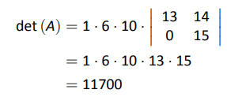
Example 75
Problem
Solution
We chose the first column.
We again use cofactor expansion
along the first column. This cofactor
expansion is

Slide 31
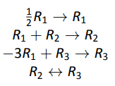
Example 78
Problem
Solution

Slide 32
Theorem

Slide 33
Theorem

Slide 34
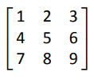
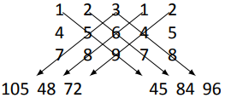
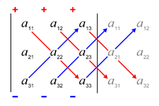
Rule of Sarrus: 3 X 3 Determinant Computing Shortcut
The determinant of the 3x3 matrix
is the sum of the products along the red diagonals
minus the sum of the products along the blue diagonals.

Slide 35
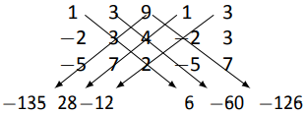
Example 81
Problem
Solution

