Slide 1
Random Walks and Semi-Supervised Learning
Longin Jan Latecki
Based on :
Xiaojin Zhu. Semi-Supervised Learning with Graphs. PhD thesis. CMU-LTI-05-192, May 2005
Page, Lawrence and Brin, Sergey and Motwani, Rajeev and Winograd, Terr.y The PageRank Citation Ranking: Bringing Order to the Web. Technical Report. Stanford InfoLab, 1999.
Ya Xu. SEMI-SUPERVISED LEARNING ON GRAPHS– A STATISTICAL APPROACH.
PhD Thesis, STANFORD UNIVERSITY, May 2010

Slide 2
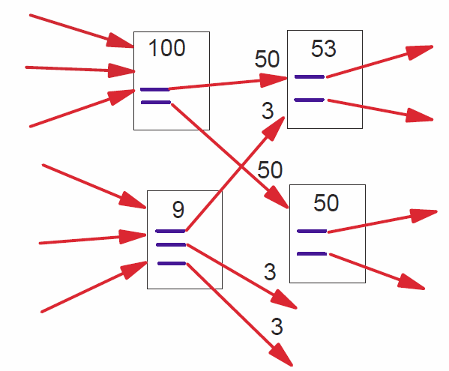
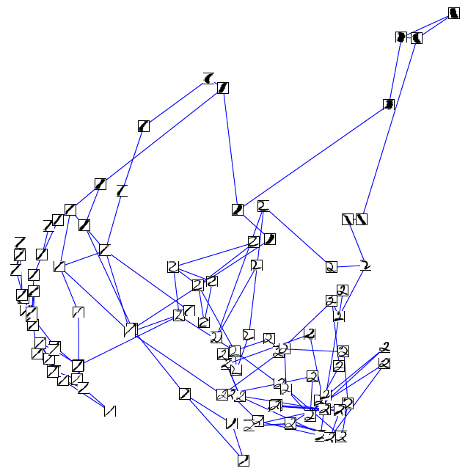
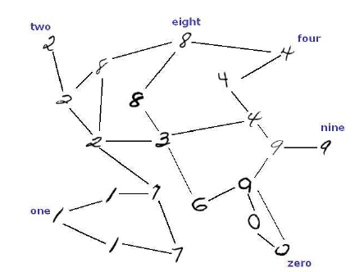
Random walk propagates information on a graph based on similarity of graph nodes
Graph of web pages
Graphs of hand written digits

Slide 3
Structure of real graphs
One of the most essential characteristics is sparsity. The total number of edges in real graphs, particularly in large real graphs, usually grows linearly with the number of nodes n (instead of n² as in a fully connected graph).
As we can see in the table in all four real graphs the average degrees are less than ten, even though there are thousands of nodes. The sparsity property makes it possible to scale many prediction algorithms to very large graphs.
Another key property is the degree distribution, which gives the probability that a randomly picked node has a certain degree.
It follow a power-law distribution, which means there is usually
only a very small fraction of nodes that have very large degrees.

Slide 4
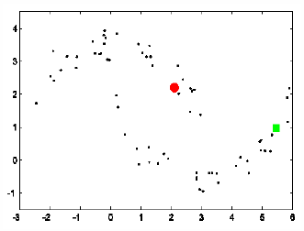
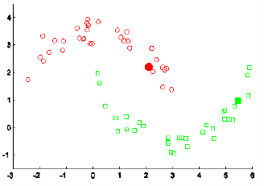
Semi-Supervised Learning
Large amounts of unlabeled training data
Some limited amounts of labeled data

Slide 5
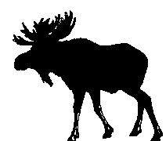
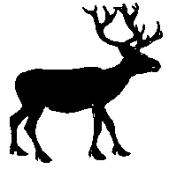
Graph Construction Example
Vertecies are objects
The edge weights are determined by shape similarity

Slide 9
Random walk propagates similarities on the data manifold

Slide 10
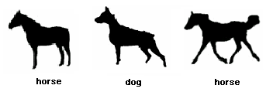
Key idea of random walk label propagation
Pair-wise similarity lacks accuracy in some cases
The similarity propagated among objects is helpful for revealing the intrinsic relation.
The two horses are very different so that the dog looks more similar to the left horse.
However, their similarity is reviled in the context of other horses.
Random walk allows us to find paths that link them.

Slide 11
Problem Setup
{(x₁, y₁) . .. (x_{l}, y_{l})} be the labeled data, y in {1 . . .C}, and
{x_{l+1} . . . x_{l+u}} the unlabeled data, usually l << u.
Hence we have total of n = l + u data points.
We will often use L and U to denote the sets of labeled and unlabeled data.
We assume the number of classes C is known, and all classes are present in the labeled data. We study the transductive problem of finding the labels for U.
The inductive problem of finding labels for points outside of L and U will not be discussed.
Intuitively we want data points that are similar to have the same label.
We create a graph where the nodes are all the data points, both labeled and unlabeled. The edge between nodes i, j represents their similarity.
We assume the graph is fully connected with the following weights:
where α is a bandwidth hyperparameter.

Slide 12
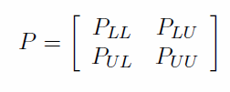
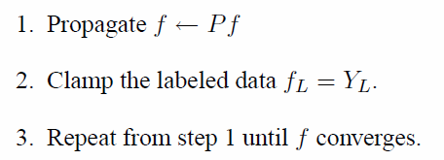
Label Propagation Algorithm
We assume that we only have two label classes C = {0, 1}.
Y_{L} is l × 1 label of ones.
f is n × 1 vector of label probabilities,
e.g., entry f(i) is the probability of y_{i}=1.
We want that f(i) = 1 if i belongs to L.
The initialization of f for unlabeled points is not important.
The label propagation algorithm: or equivalently:

Slide 13
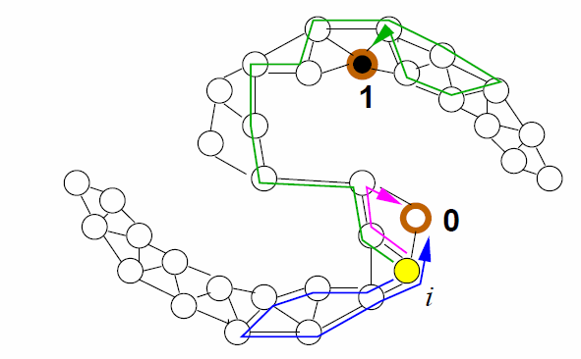
Random Walk Interpretation
Imagine a random walk on the graph.
Starting from an unlabeled node i, we move to a node j with probability P_{ij} after one step.
The walk stops when we hit a labeled node.
Then f(i) is the probability that the random walk, starting from node i,
hits a labeled node with label 1.
Here the labeled node is viewed as an absorbing state.
This interpretation requires that the random walk is irreducible and aperiodic.

Slide 14
Random Walk Hitting Probability
According to slide 30 in Markov Process we need to solve:
Since we know that f_{L} is composed of ones for label points, we only need to find f_{U}:
The fact that the matrix inverse exists follows from the next slides.

Slide 15
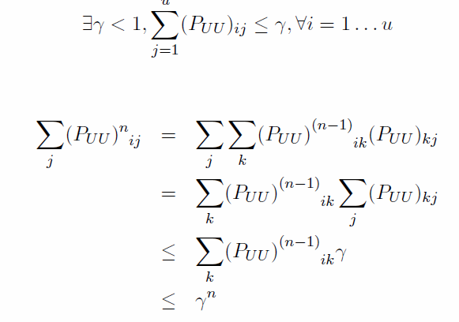
For Label Propagation algorithm we want to solve:
Since P is row normalized, and P_{UU} is a sub-matrix of P, it follows:
Hence 0
and we obtain a closed form
solution:

Slide 16
The identity
holds if and only if the maximum of the absolute values of the
eigenvalues of A is smaller than 1.
Since we assume that A has nonnegative entries, this maximum is
smaller than or equal to the maximum of the row-wise sums of matrix A.
Therefore, it is sufficient to show that the sum of each row of A is smaller than 1.

Slide 17
Energy Minimization Interpretation
The solution f minimizes the following energy function over all functions
under the constraint that f(i) = 1 if i belongs to L.
This energy can be equivalently written as
where is graph Laplacian and D is a diagonal matrix with
The solution f also minimizes the following for large λ₀, where Y⁽⁰⁾ =Y_{L}:

Slide 19
More on Graph Laplacian
Given is an undirected graph G=(V, E, W), where V is a set of n vertices, E is set of edges, and W is a symmetric n x n weight or (affinity) matrix with all nonnegative entries such that w(i,j) = 0 if and only if there is no edge between nodes i and j.
We consider two different definitions of graph Laplacian :

Slide 20
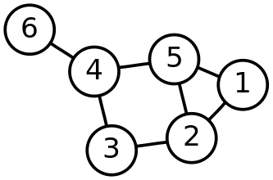
Example of a Graph Laplacian
Computer the Laplacian for the following graph:

Slide 21
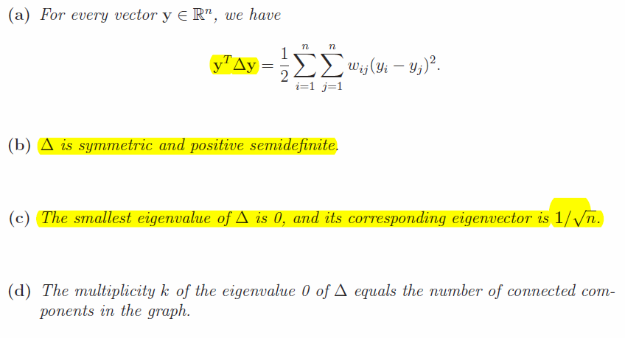
Graph Laplacian has following properties:

Slide 22
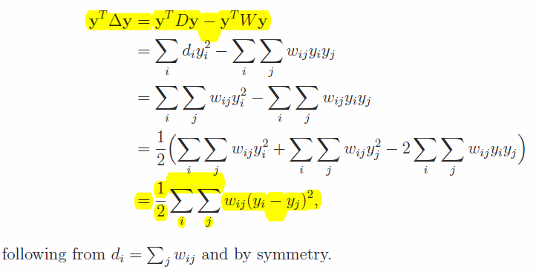
Proof:
a)
(b) follows directly from (a). (c) is a trivial result of (a) and the following

