Slide 1
ML/DL method-based User Identification using touches on Smartwatches
Zhengkun Ye

Slide 2
Introduction
The initial idea was coming from a paper named EchoLock which published in ASIA CCS 2020.
EchoLock: a novel technique leveraging acoustic sensing of structure-borne sound to measure biometric characteristics and can identify users with over 94%accuracy, without requiring any active user input.
This project idea is to utilize acoustic signal and vibration data collected by Android Smartwatches to build a cross-domain system capable of identifying different users.
Reference: Yilin Yang, Yan Wang, Yingying Chen, and Chen Wang. 2020. EchoLock: Towards Low-effort Mobile User Identification Leveraging Structure-borne Echos. In Proceedings of the 15th ACM Asia Conference on Computer and Communications Security (ASIA CCS '20). Association for Computing Machinery, New York, NY, USA, 772–783. DOI:https://doi.org/10.1145/3320269.3384741
Notes:
How presentation will benefit audience: Adult learners are more interested in a subject if they know how or why it is important to them.
Presenter’s level of expertise in the subject: Briefly state your credentials in this area, or explain why participants should listen to you.

Slide 3
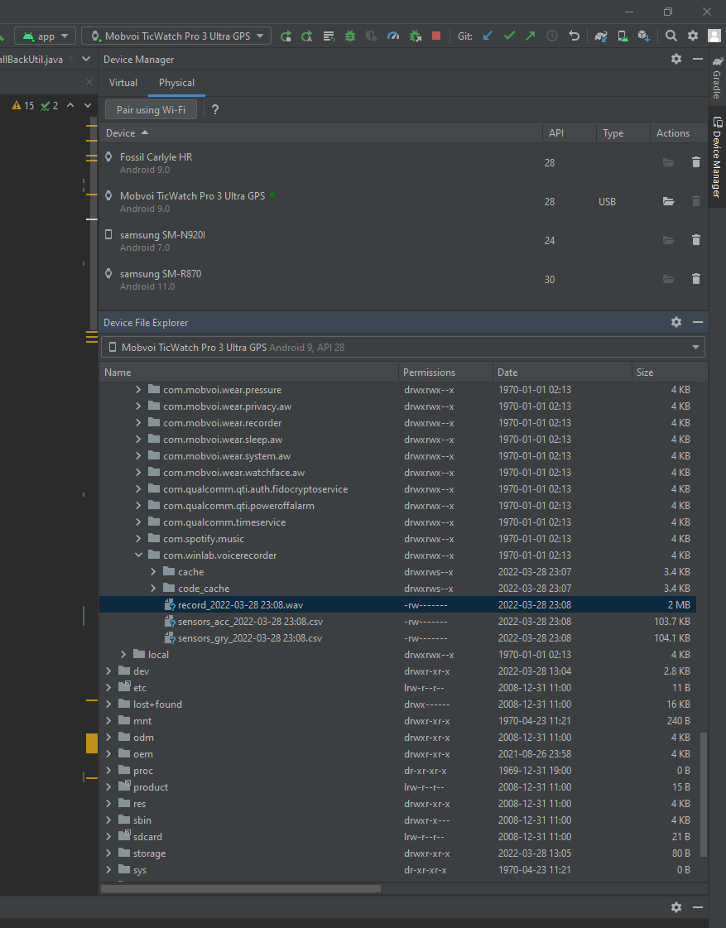
Android App Development
First step was to build up an App tailored to my project that can capture the audio signal and vibration at the same time.
The output format of audios was .WAV with 44.1K HZ sample rate.
The output format of vibration datasets were .CSV files
The vibration datasets were collected from Accelerometer + Gyroscope sensors
App Available at: https://github.com/yzhengk/Accelerometer_Gyroscope
Notes:
Lesson descriptions should be brief.

Slide 4
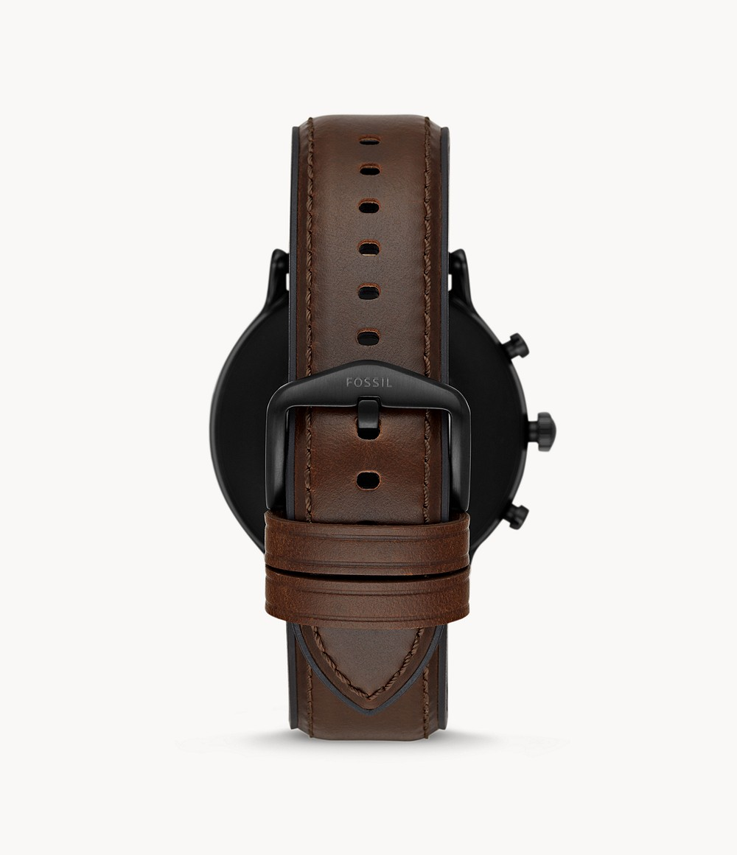
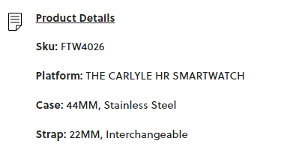
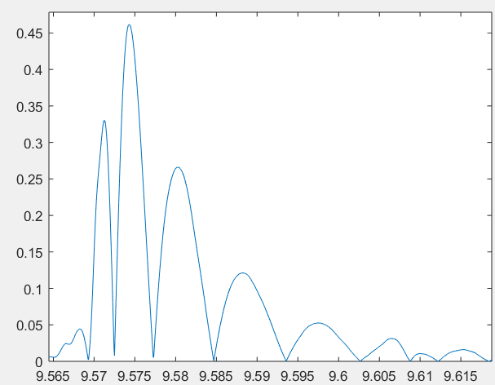
Structure-borne & Air-borne sound Separation
Tightness Level 1-10
Diameter = 44 mm
Mic
Circumference = 138.23 mm
Structure-borne Distance between Mic and Speaker = 34.56 mm
Air-borne propagation
Speaker
Air-borne Distance between Mic and Speaker = 31.11 mm
Structure-borne propagation
Speed of Sound (Steel) = 5940 m/s, Arrival Time = 0.3456/5940 = 5.82e-5 s
Speed of Sound (Air) = 343.2 m/s, Arrival Time = 0.3111/343.2 = 9.0646853e-4 s
Arrival Time Difference = 8.4826853e-4 s (0.000848s)

Slide 5
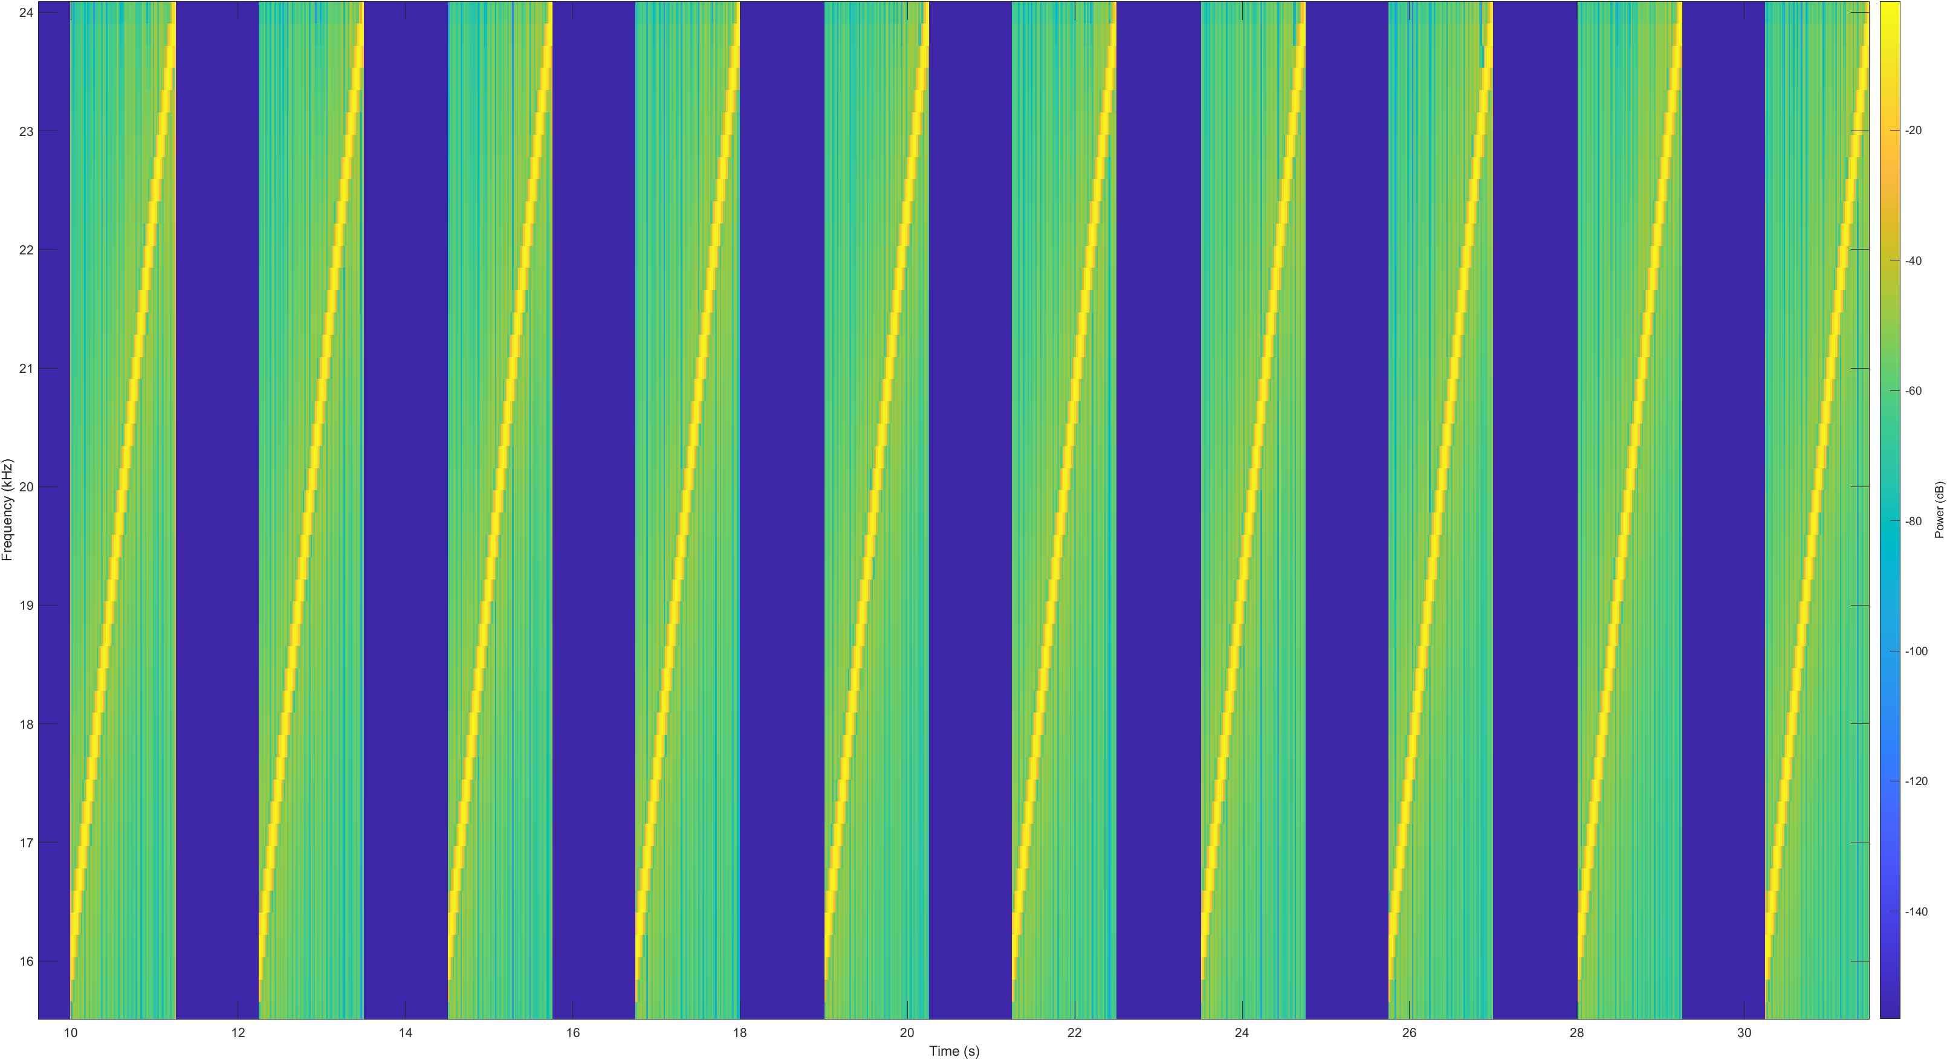
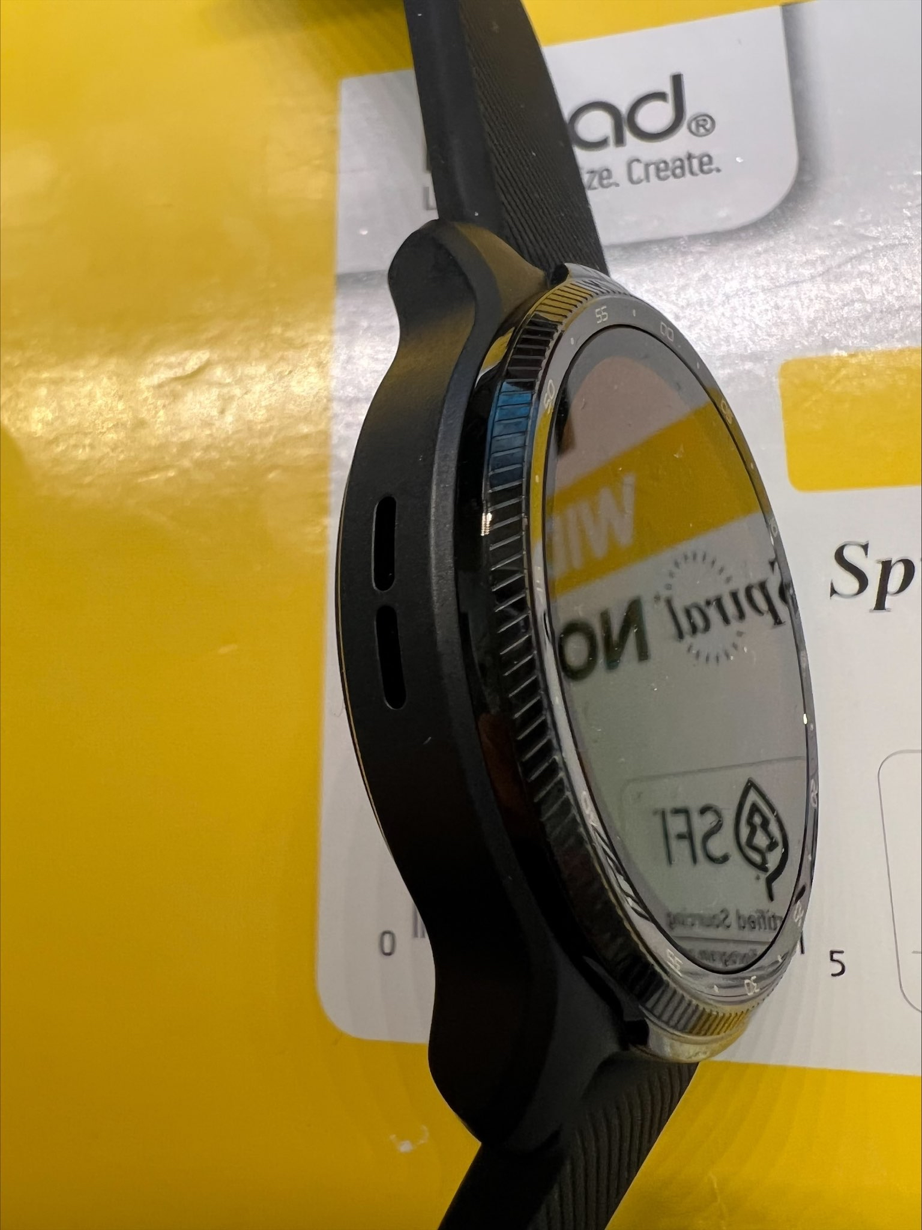
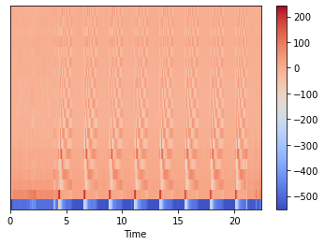
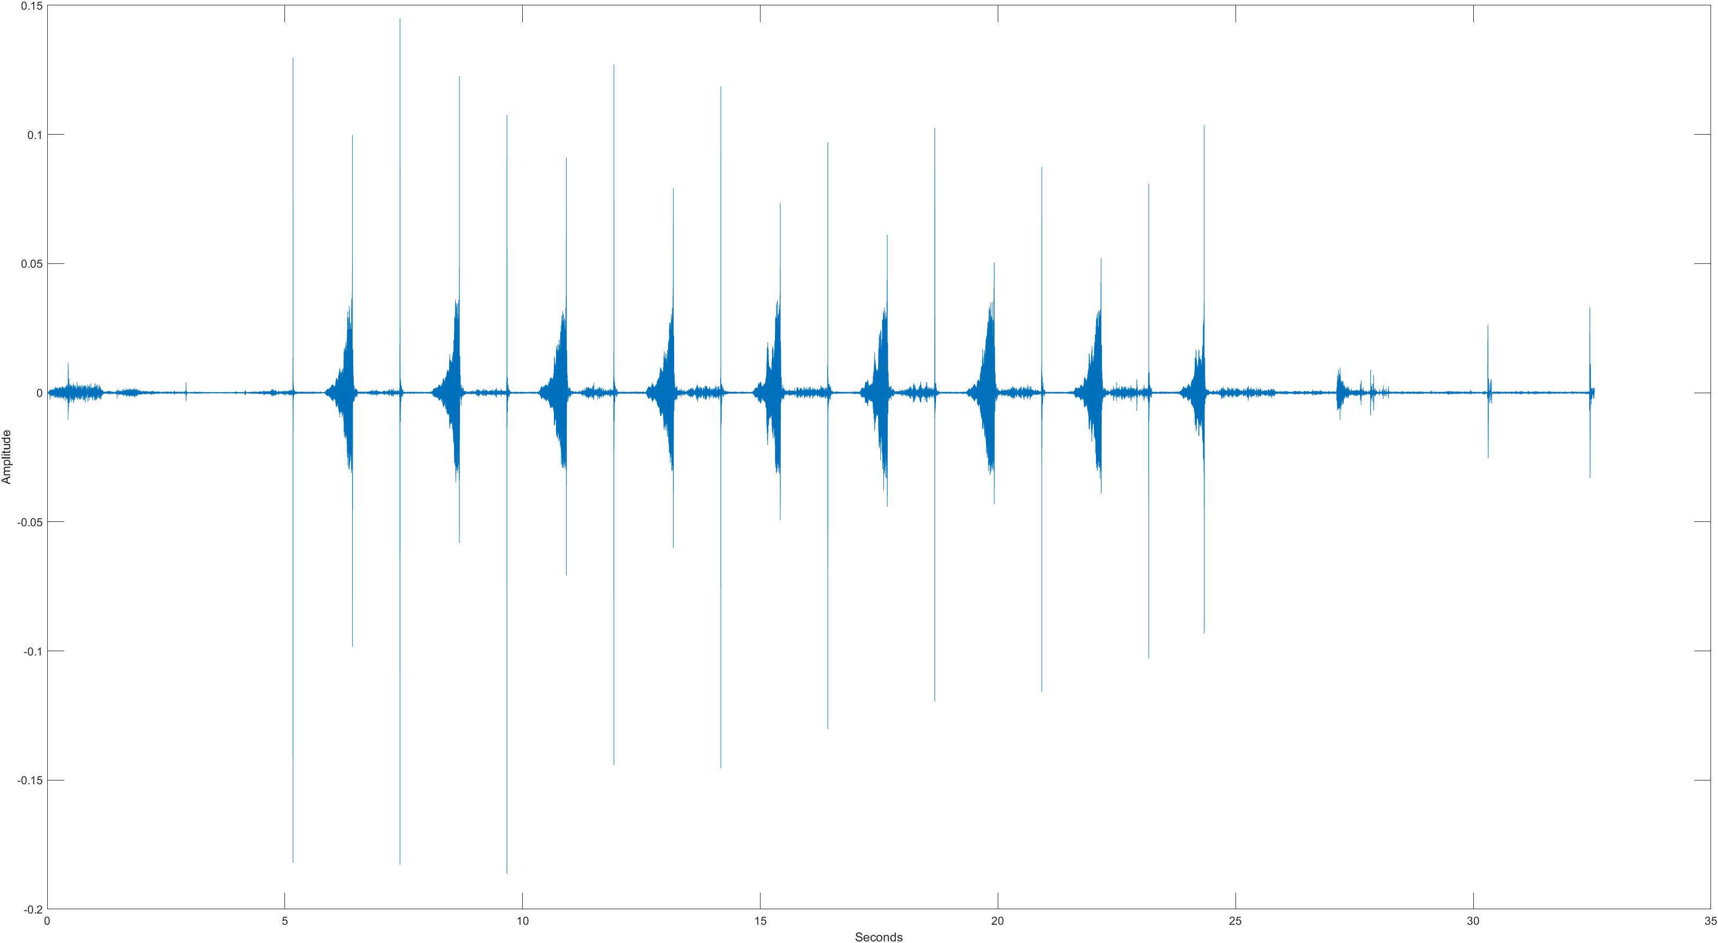
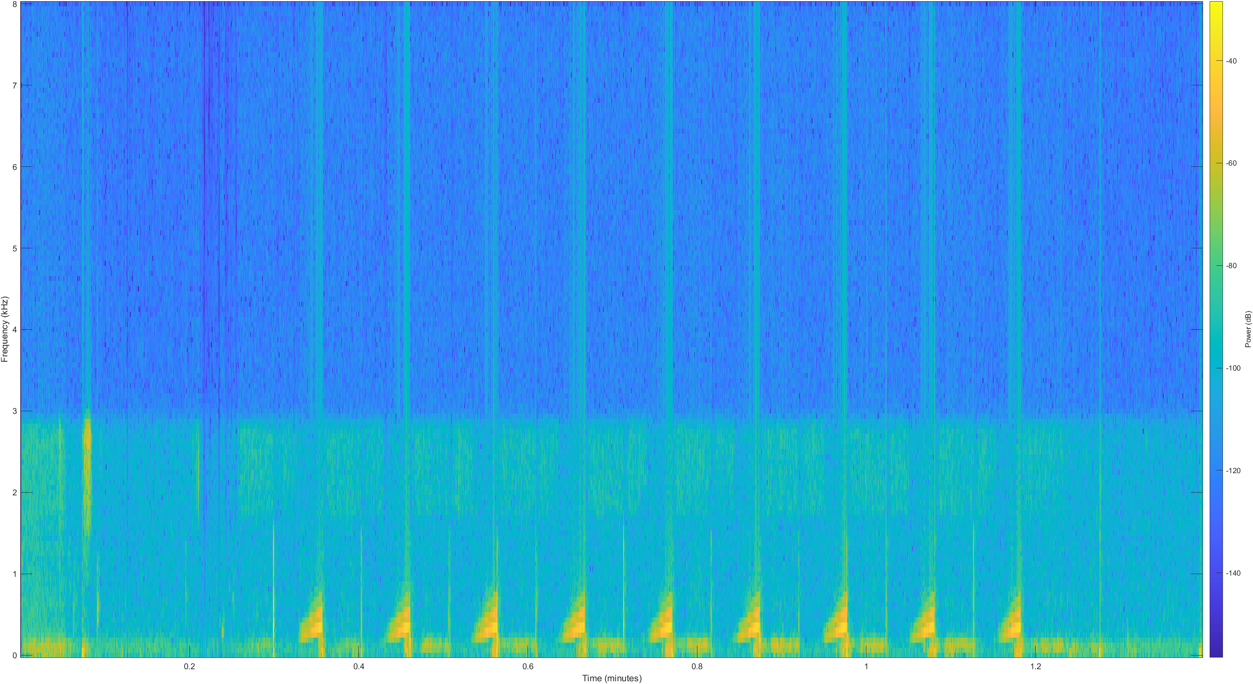
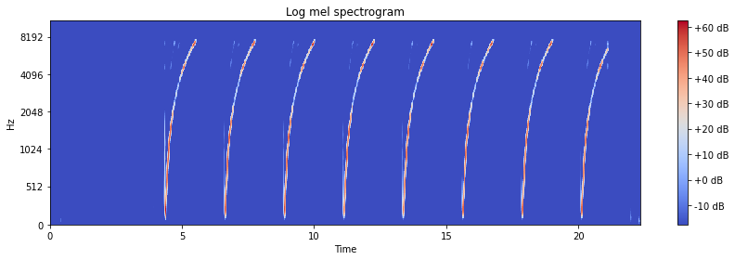
Self Designed Chirp Signal & Gestures
10-chirp sequence:
Sampling frequency 16kHz (highest possible on smartwatch)
Individual chirp signal sweeping from 50Hz-8kHz (based on Nyquist Theorem)
Chirp signal duration 125ms
Signal will contain airborne and structure-borne sound
10 chirps played during single transmission
Gestures: Press on Surface (One Finger)/ Press two sides (Cover the Speaker)
Structure-borne and Airborne sound separation
Separation dependent on time difference of arrival
Acoustic signal propagation faster in solid material than air
Based on previous calculations, less than 1ms of structure-borne sound can be measured before mixed with airborne sound due to short distance
My current analysis will not distinguish between structure-borne and airborne sound

Slide 6
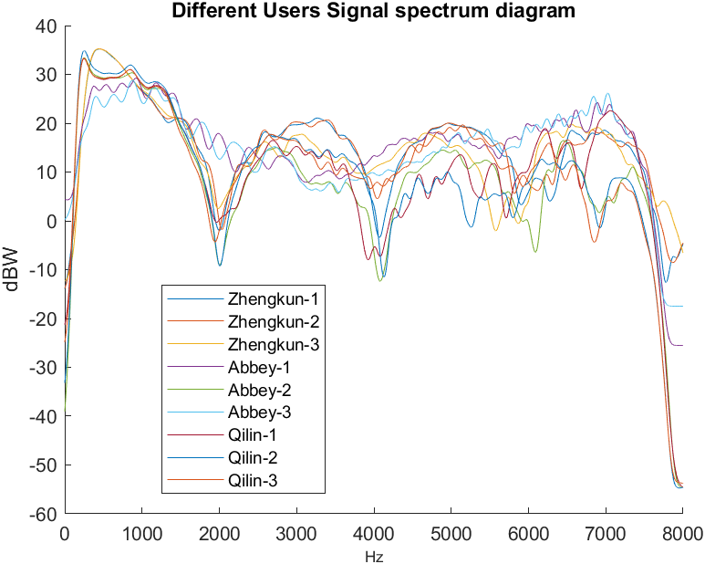
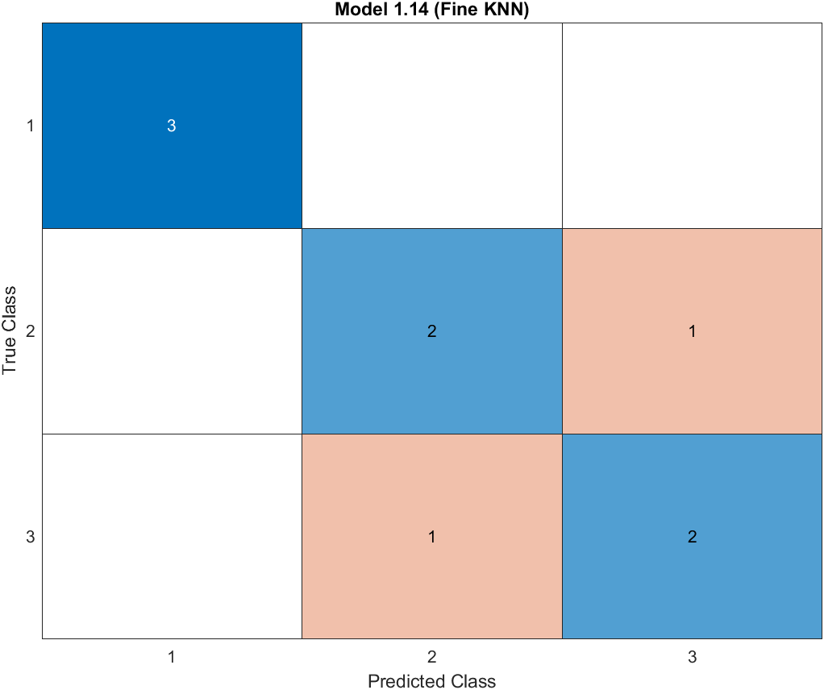
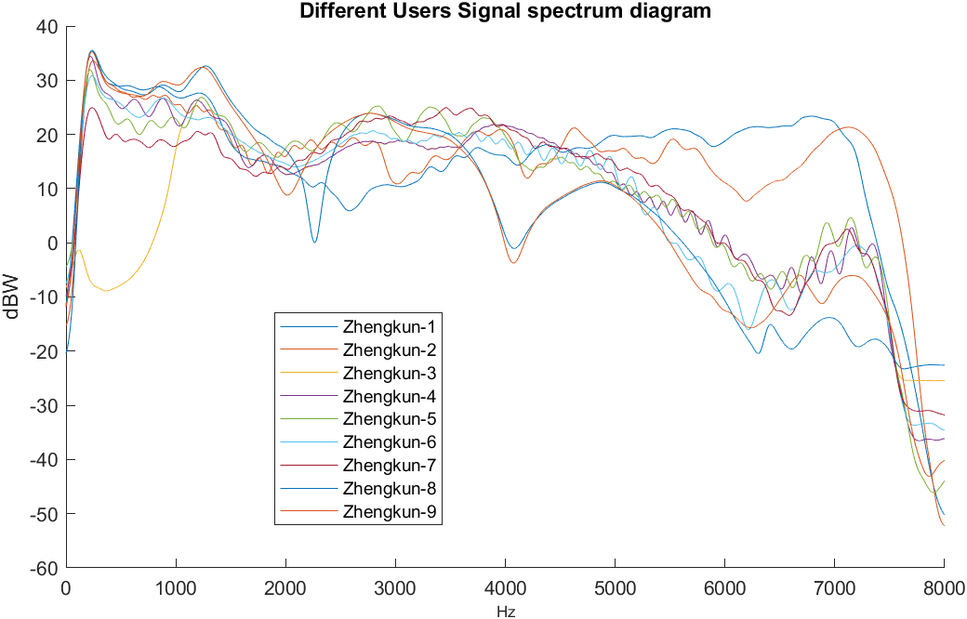
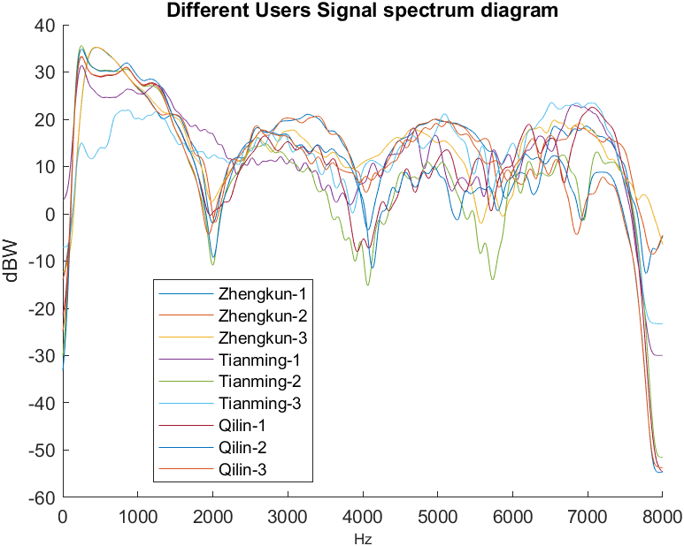
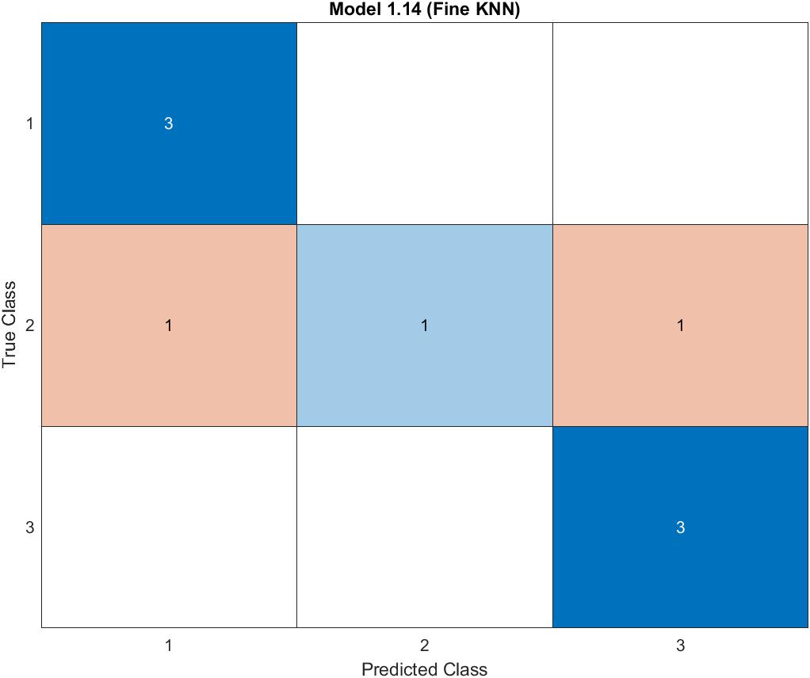
Feature 1: Spectrogram
Both K-NN classifier and Neural Network can achieve 77.8% accuracy by far
K-NN classifier can achieve 77.8% accuracy by now

Slide 7
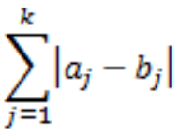
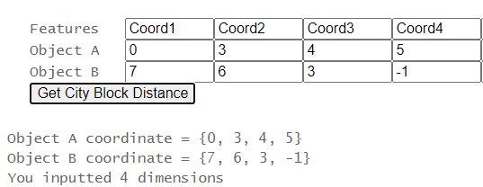
Feature 2: MFCC
In sound processing, the mel-frequency cepstrum is a representation of the short-term power spectrum of a sound
Mel-frequency cepstral coefficients are coefficients that collectively make up an MFC.
Use the city block distance (also referred to as Manhattan distance) to measure the distance between MFCC features
Reference: Jian Liu, Yan Wang, Gorkem Kar, Yingying Chen, Jie Yang, and Marco Gruteser. 2015. Snooping Keystrokes with mm-level Audio Ranging on a Single Phone. In Proceedings of the 21st Annual International Conference on Mobile Computing and Networking (MobiCom '15). Association for Computing Machinery, New York, NY, USA, 142–154. DOI:https://doi.org/10.1145/2789168.2790122
The City block distance between two points, a and b, with k dimensions is calculated as:

Slide 8
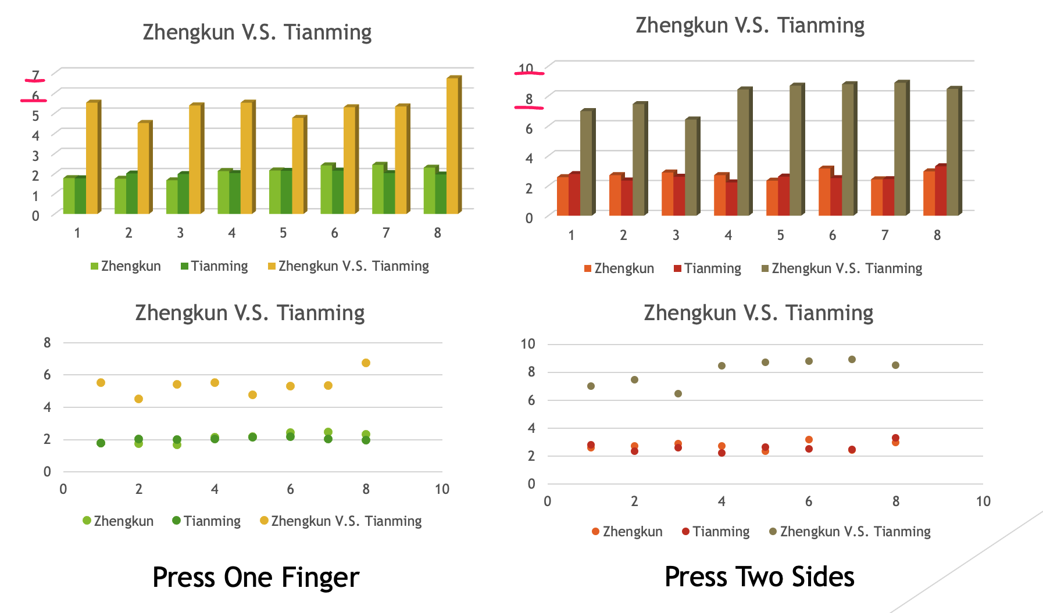
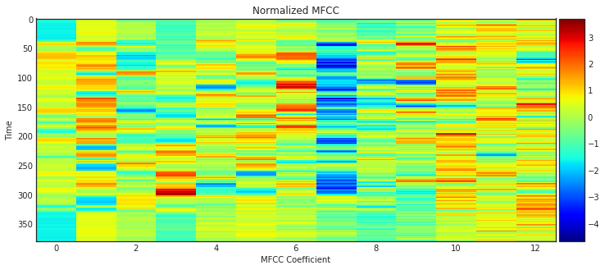
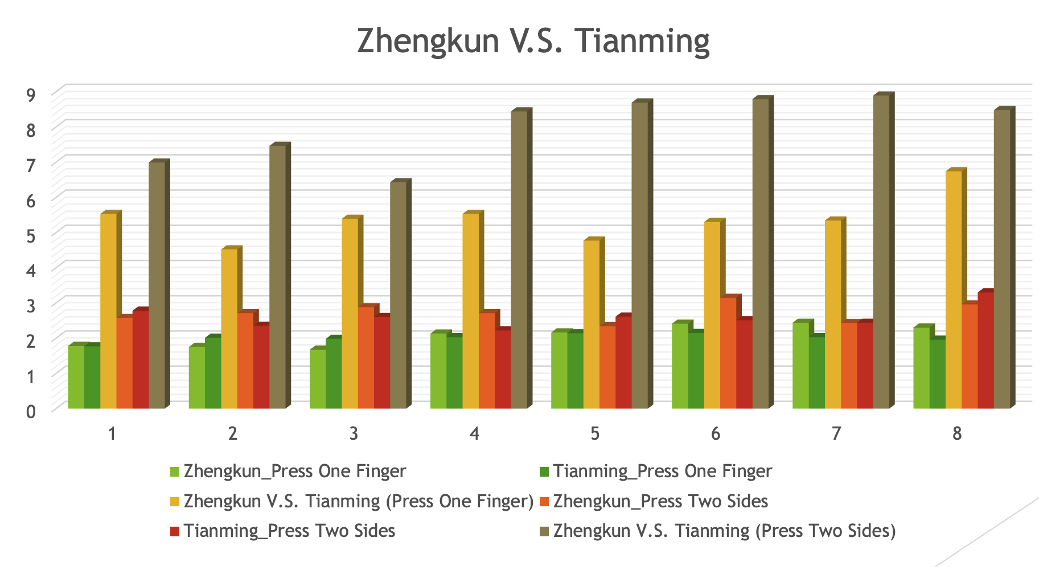
For MFCCs, Pressing Two Sides (one finger covering the speaker of the smartwatch) would cause more significant difference than pressing with one finger on the surface of the smartwatch.
For gesture “Press One Finger,” we may still see clear difference between different users.
For MFCC feature, the two gestures can be utilized.
Shape of MFCC : (X, Y), at each time window, the MFCC feature yields a feature vector that characterizes the sound within the window. Note that the MFCC feature is much lower-dimensional than the spectrogram feature, which could help an acoustic model to avoid overfitting to the training dataset.

Slide 9
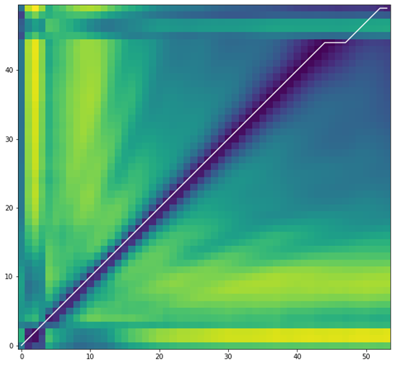
Assessment and Evaluation
Equipment: Samsung S4
Gesture: Pressing Two Sides (Covering Speaker)
Signal: 8 Chirp Signals
Tests: Zhengkun V.S. Tianming (Note: I conducted the new three attempts on three different dates (Wed, Thu, Fri), for Tianming’s three attempts, each time he took off the smartwatch and then wear it on wrist again, we both used right thumb to cover the speaker (left side), right index finger attached to the right side. )
I calculate the Manhattan Distance between MFCC values of each two chirp signals, and then normalize the distance by dividing 1000 to make the number (ratio) small to read
 | Chirp 1 | Chirp 2 | Chirp 3 | Chirp 4 | Chirp 5 | Chirp 6 | Chirp 7 | Chirp 8
Chirp 1 | 0 | 1768.6527376174927 | 2811.9013242721558 | 2544.0964498519897 | 3410.229274749756 | 2436.264347076416 | 3080.1724433898926 | 3433.507131576538
Chirp 2 | 1768.6527376174927 | 0 | 1893.2888045310974 | 1949.5326595306396 | 2519.2024183273315 | 2584.593309402466 | 2690.633083343506 | 3033.0756397247314
Chirp 3 | 2811.9013242721558 | 1893.2888045310974 | 0 | 2020.7420177459717 | 1452.5691547393799 | 3177.5010480880737 | 2811.115412712097 | 4040.4758262634277
Chirp 4 | 2544.0964498519897 | 1949.5326595306396 | 2020.7420177459717 | 0 | 2031.48379611969 | 2157.1053037643433 | 1422.7099075317383 | 3418.908416748047
Chirp 5 | 3410.229274749756 | 2519.2024183273315 | 1452.5691547393799 | 2031.48379611969 | 0 | 2878.777009010315 | 2112.4440994262695 | 3835.551975250244
Chirp 6 | 2436.264347076416 | 2584.593309402466 | 3177.5010480880737 | 2157.1053037643433 | 2878.777009010315 | 0 | 1974.8968839645386 | 2379.5843572616577
Chirp 7 | 3080.1724433898926 | 2690.633083343506 | 2811.115412712097 | 1422.7099075317383 | 2112.4440994262695 | 1974.8968839645386 | 0 | 2985.6616315841675
Chirp 8 | 3433.507131576538 | 3033.0756397247314 | 4040.4758262634277 | 3418.908416748047 | 3835.551975250244 | 2379.5843572616577 | 2985.6616315841675 | 0
Average | 2783.546244 | 2348.425522 | 2601.084798 | 2220.654079 | 2605.751104 | 2512.674608 | 2439.661923 | 3303.823568
Average | 2.78 | 2.35 | 2.60 | 2.22 | 2.61 | 2.51 | 2.44 | 3.30
The number is smaller, MFCCs are more similar

Slide 10
Summary in Short
MFCCs difference by using press two sides gesture was bigger than by using press with one finger gesture.
MFCCs between different users with press with one finger gesture still has clear difference, we can also utilize press with one finger gesture when use MFCC feature.
Background noise reduction function of smartwatches for human talking/reading worked well starting from (around) 0.5m

Slide 11
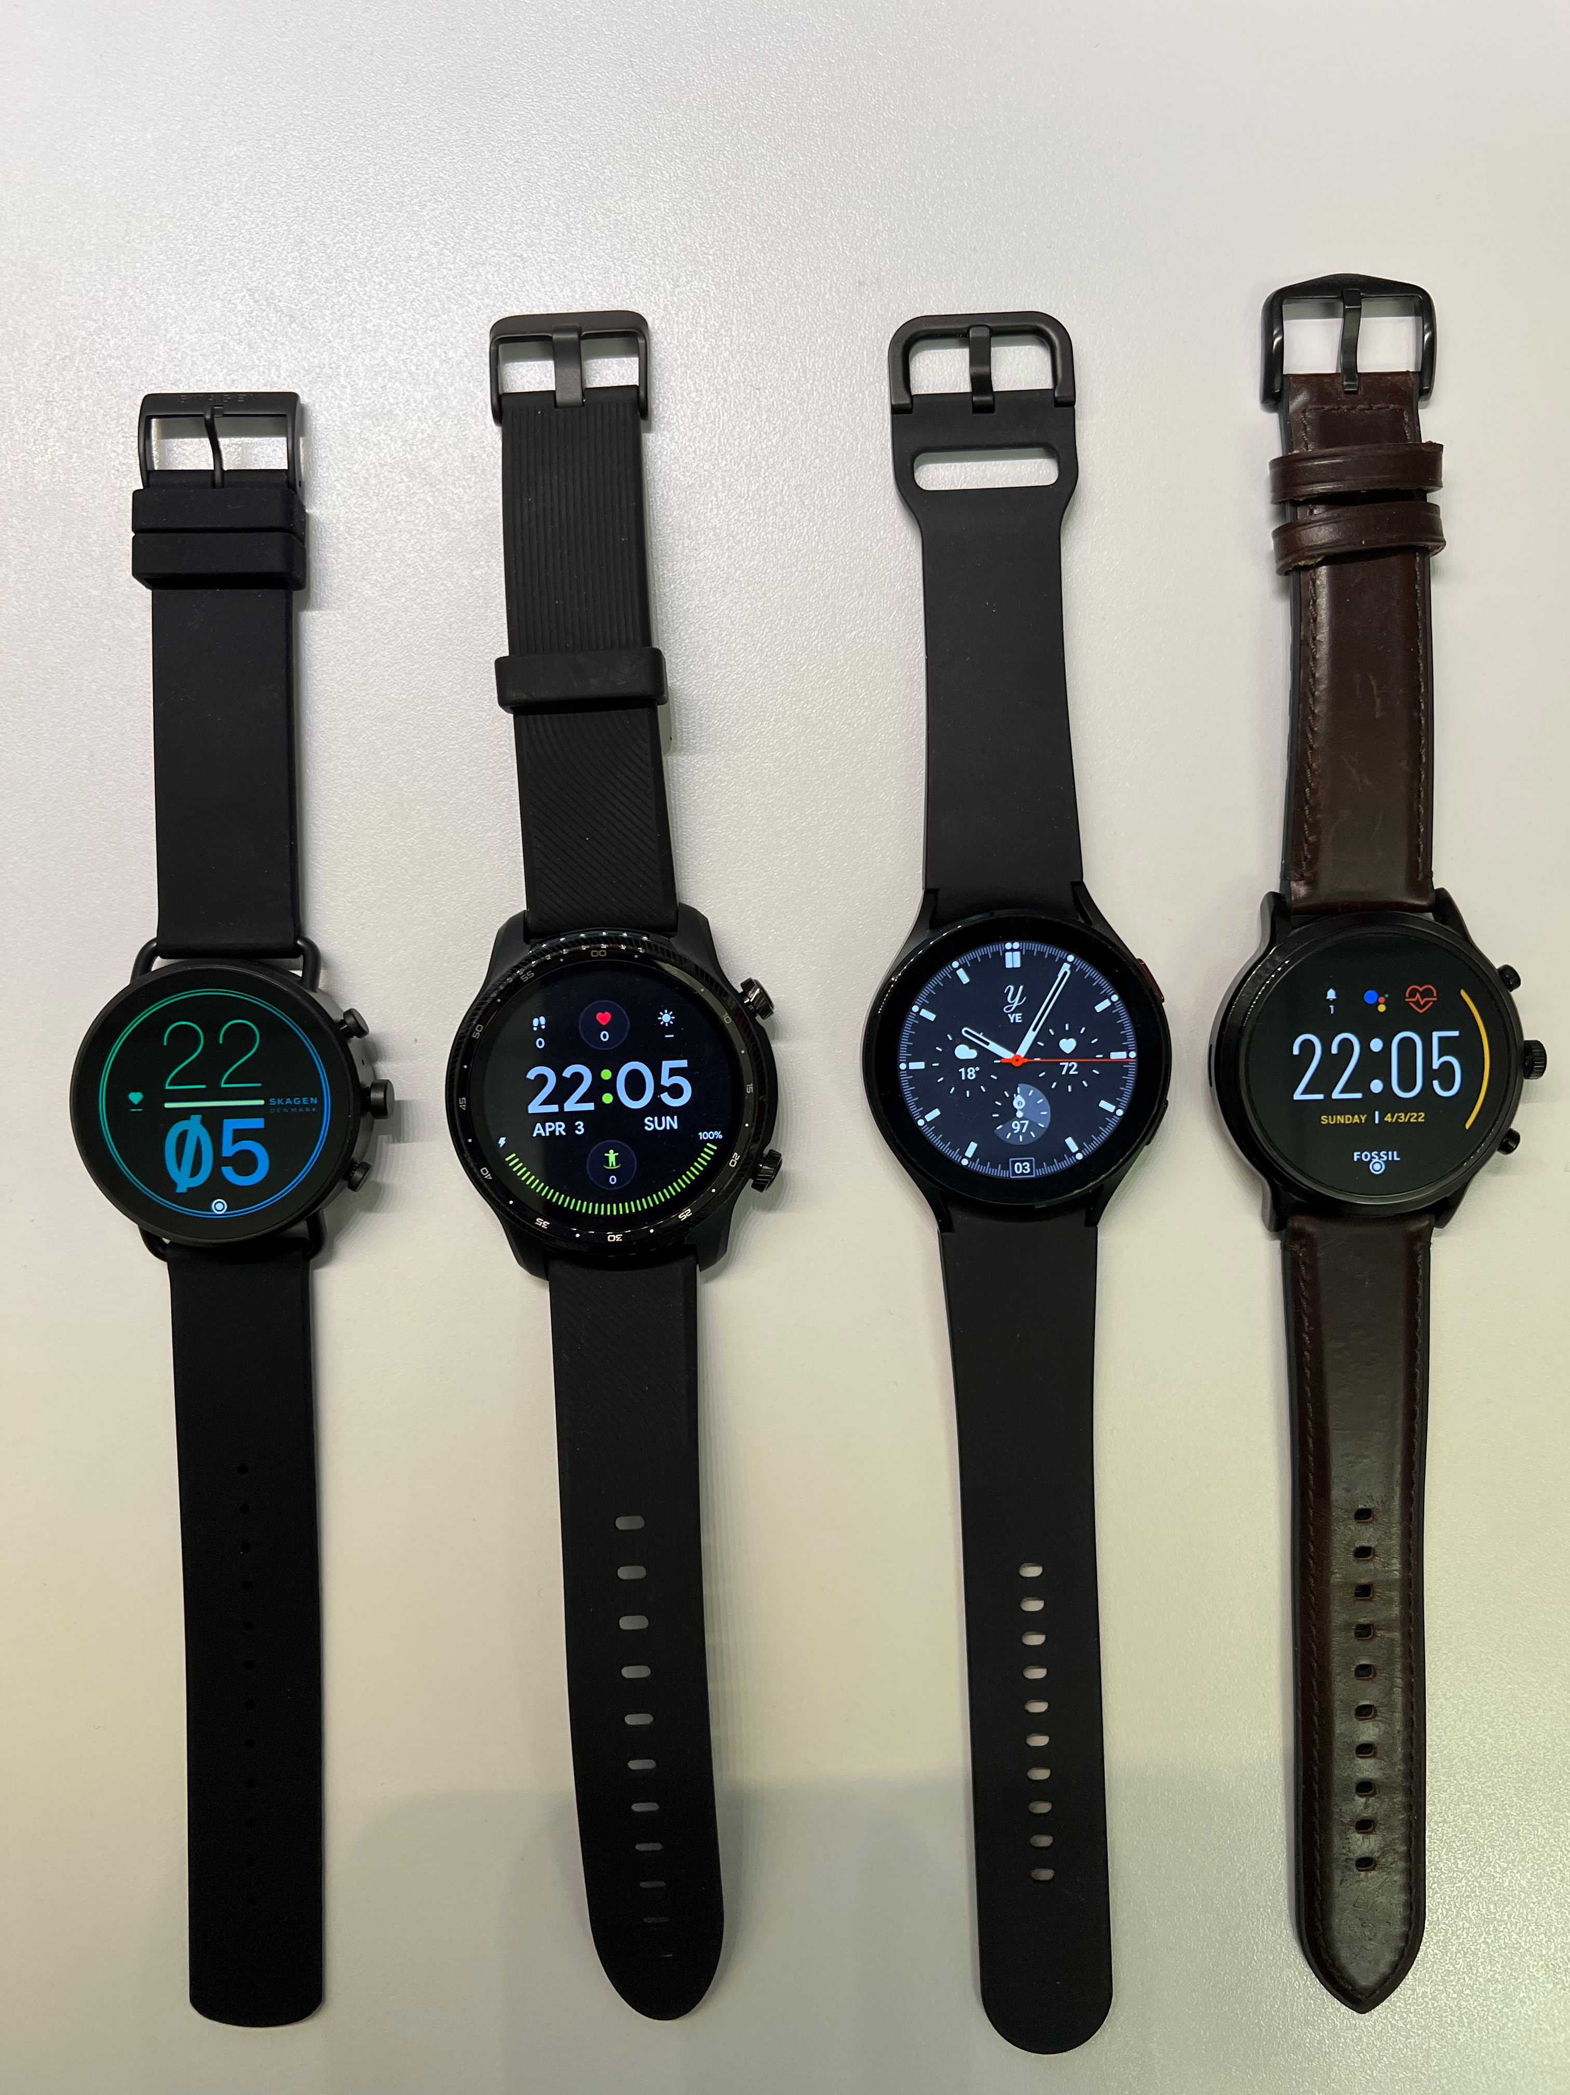
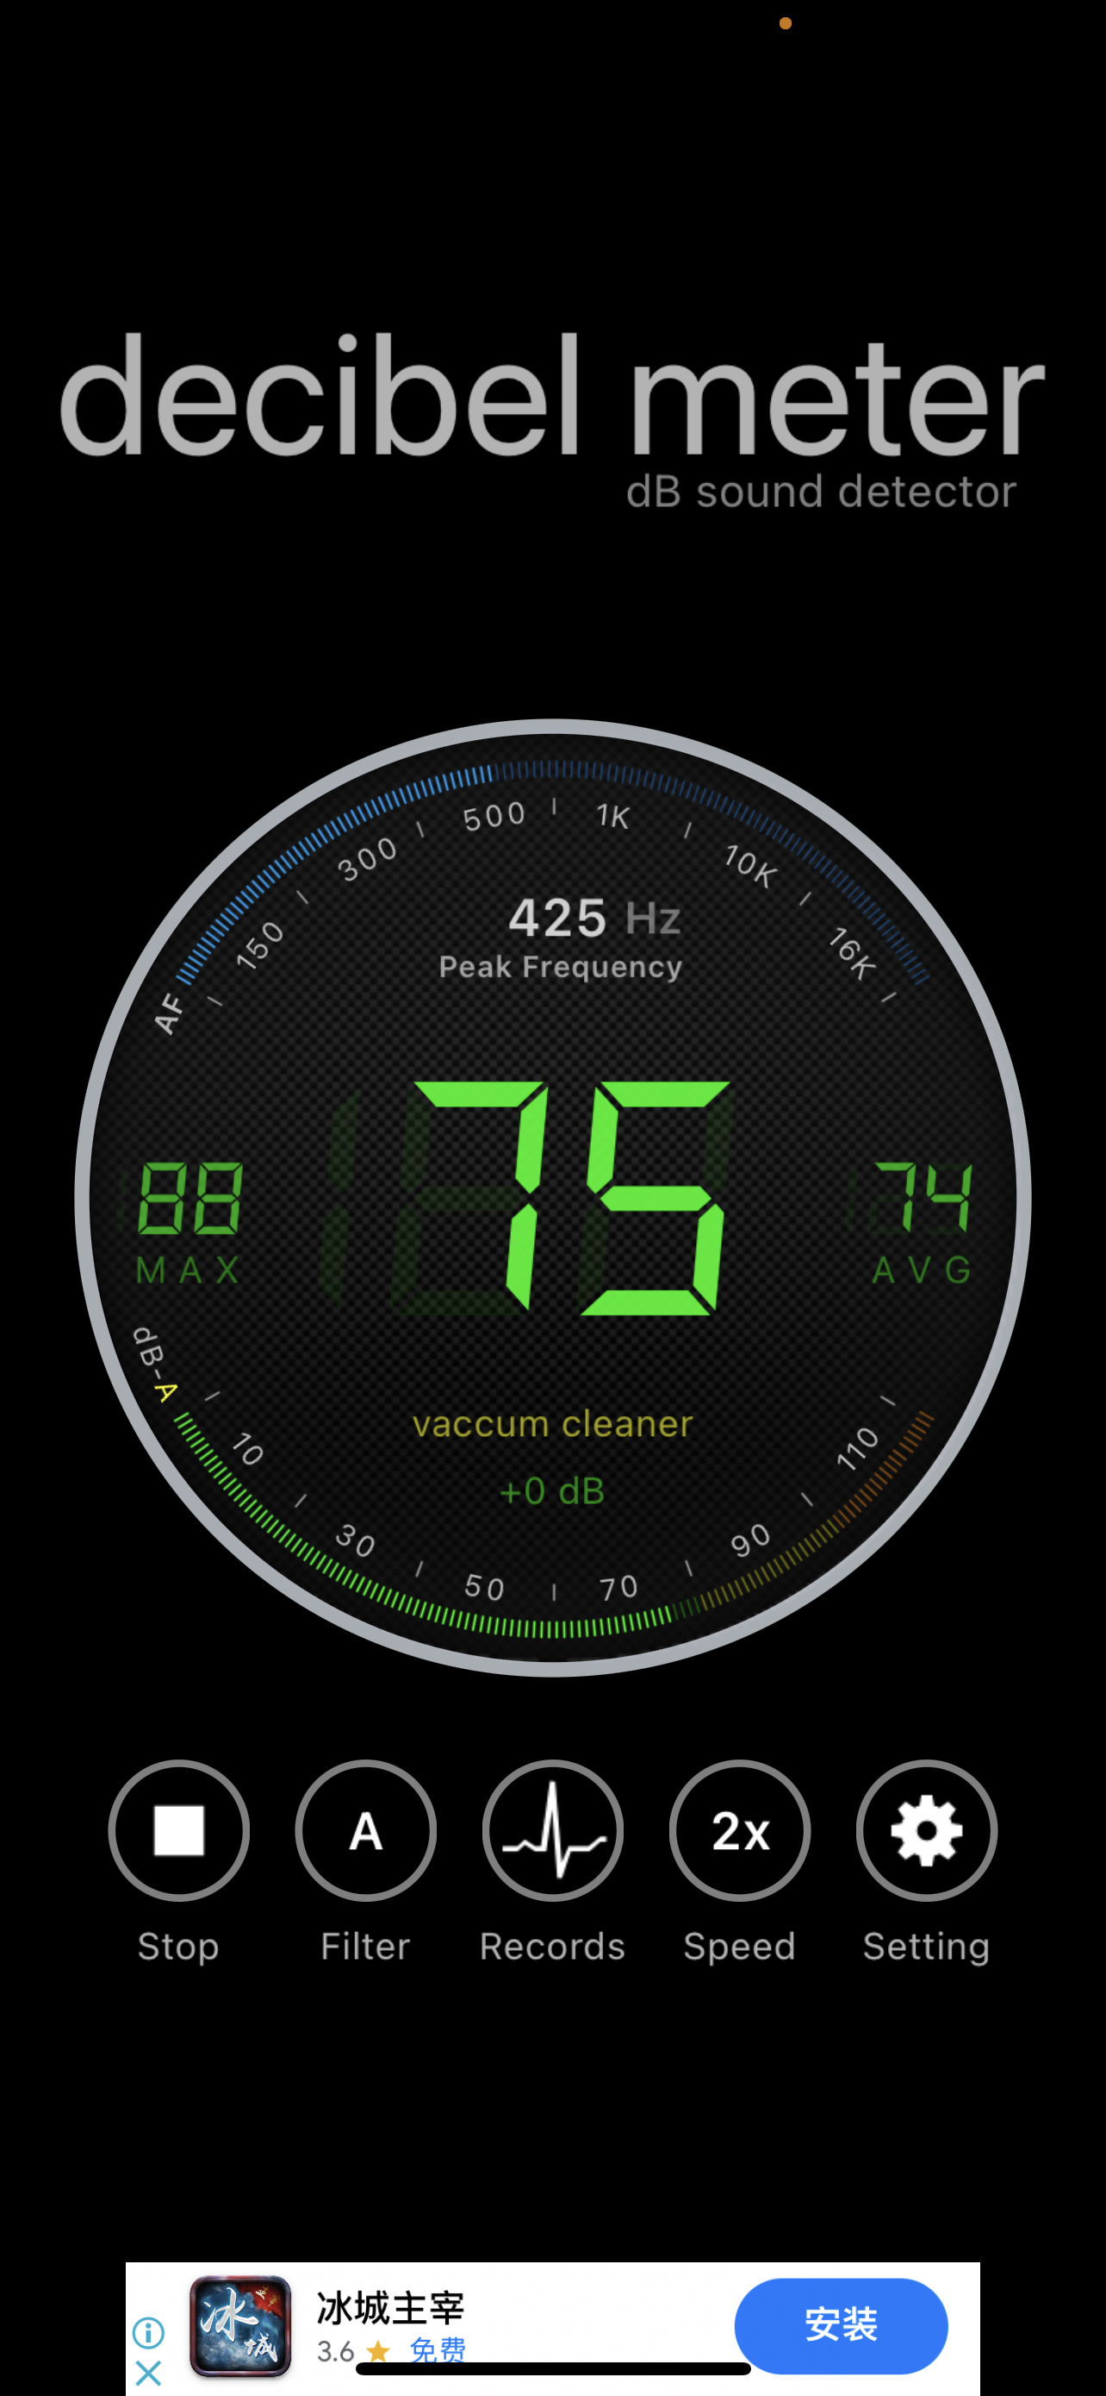
Noise Reduction Effect Ranges_Play Recordings
Record the chirp signal, meanwhile play Noise Audio
Decibel Meter App to detect the dB
Range detection tests on four Android Watch Models: Skagen Gen 6, Tic Pro 3, Samsung S4, and Fossil Gen 5
Experiments in quiet Lab room:
1. Use Bluetooth Speaker to play human talking voice recording around 75 db
2. Use laptop to play YouTube Video (people chatting) around 75 db
Results (when play back recordings, can completely hear no background voice):
 | Skagen Gen 6 | Tic Pro 3 | Samsung S4 | Fossil Gen 5
Exp 1 | 4m | 5m | 4.5m | 4m
Exp 2 | 4.5m | 4.5m | 4.5m | 4m
Note: Distance values were in a manner lacking refinement and precision, measured by foot

Slide 12
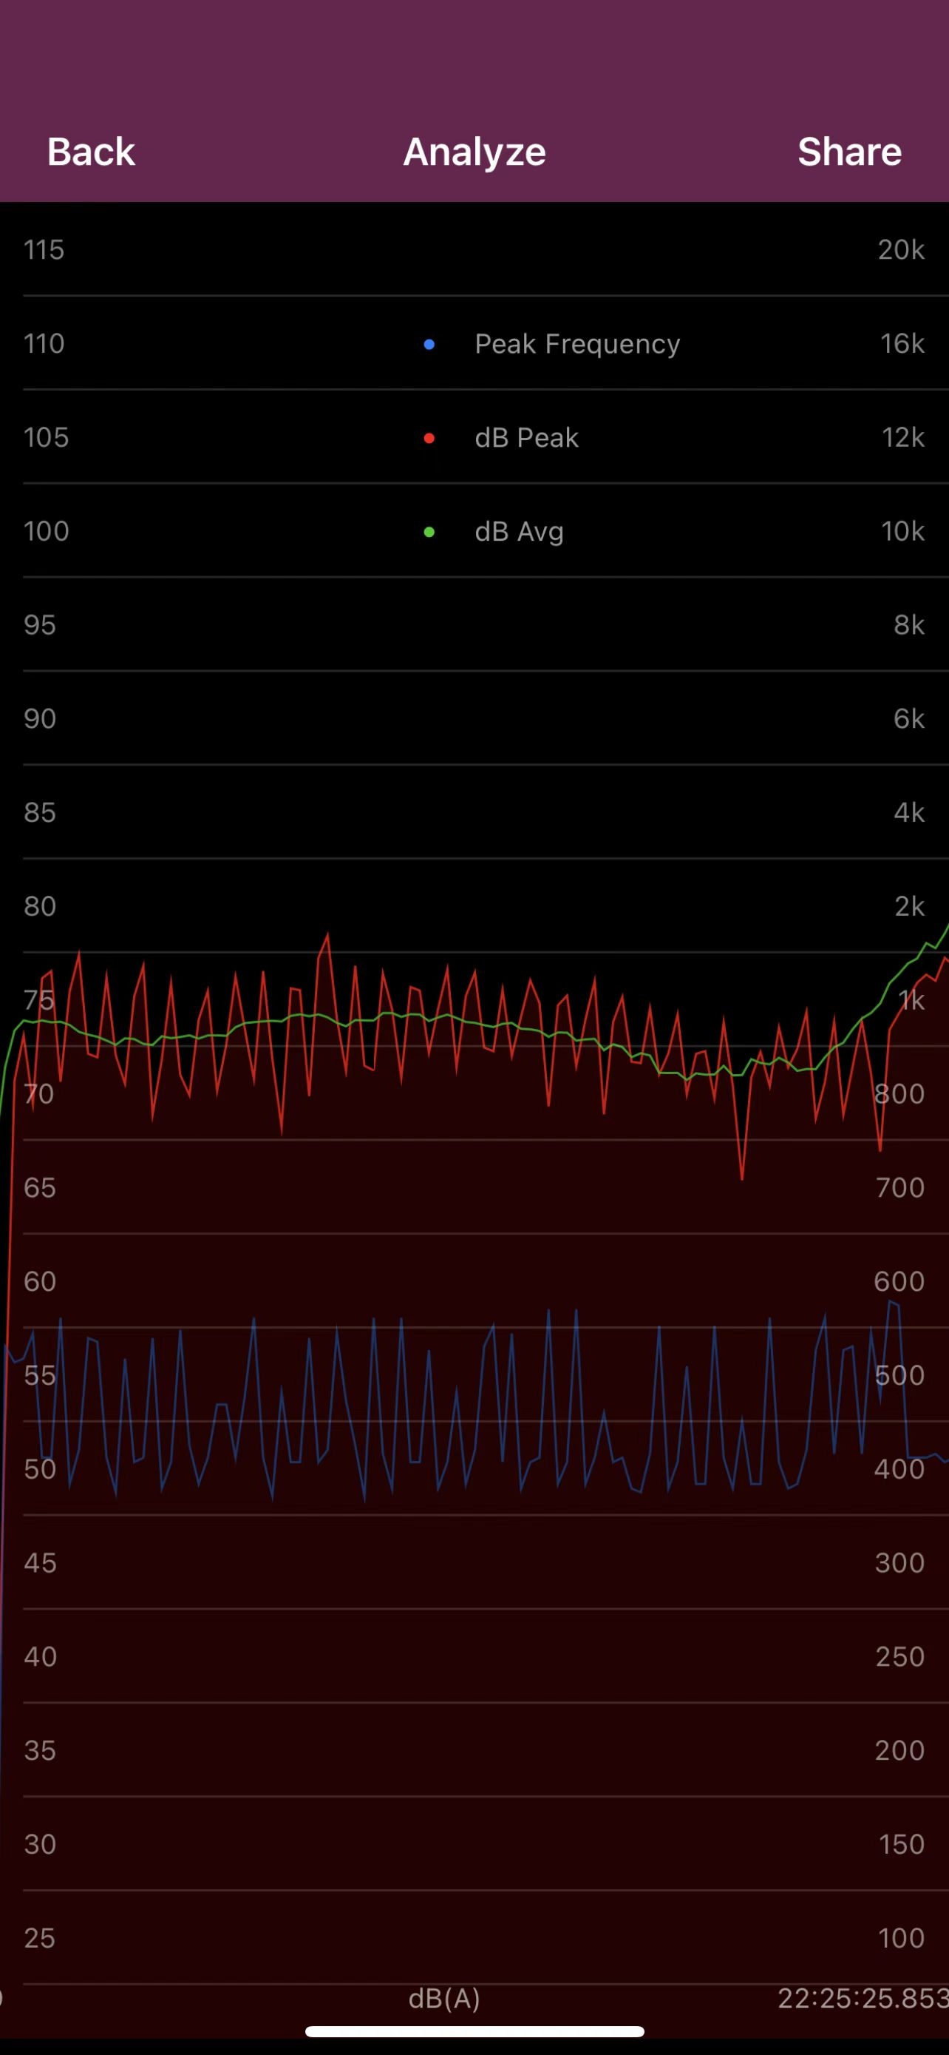
Noise Reduction Effect Ranges_Real Human Voice
Watch Models: Skagen Gen 6, Tic Pro 3, Samsung S4, and Fossil Gen 5
Participants: Zhengkun Ye, Ke Xu
Experiment: Ke Xu was reading email (sitting in front of laptop), led her try to keep voice around 75 dB, I worn smartwatches and sat next to her (roughly 0 m), behind her 0.5m, behind her 1m, behind her 1.5m, behind her 2m.
Results:
 | Skagen Gen 6 | Tic Pro 3 | Samsung S4 | Fossil Gen 5
Exp | 0.5m ~ 1m (0.7/0.8m) | 0.5m ~ 1m (0.7/0.8m) | 0.5m | 0.5m
Note: Distance values were in a manner lacking refinement and precision, measured by iPhone LiDAR Camera

Slide 13
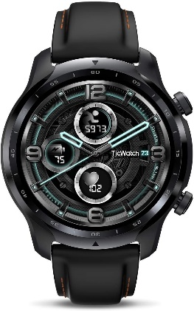
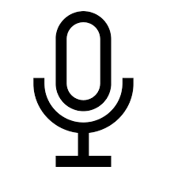
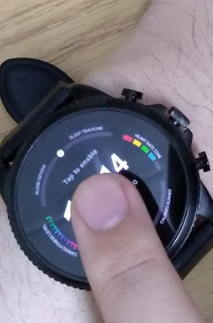
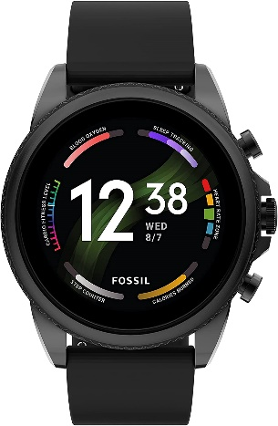
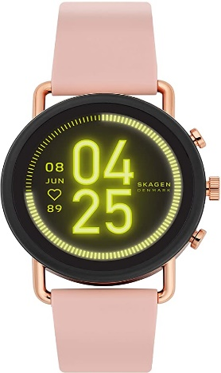
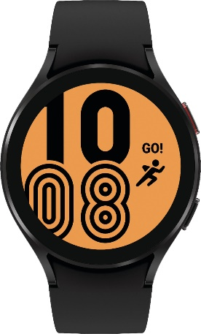
Data Collection Progress
General User Identification
TicWatch Pro 3* (8 users)
Impact Factors
Noisy Environments (using Tic Pro 3 Watch)
75db Noise Level, Human Speech Background (1 user)
7 users’ data collected with other hardware
Different Gestures (using Tic Pro 3 Watch)
Press on Surface (1 user)
Press on Side (4 users)
13 users’ data collected with other hardware
Sensing During Motion (using Tic Pro 3 Watch)
While moving arm
While walking
Sitting still/Standing still
Different Hardware
Fossil 5/6 Watch (13 users)
Samsung 4 Watch (7 users)
Skagen Falster Gen 3 Watch (2 users)

Slide 14
User Identification
After we train the CNN model for each type of data, we can use them to extract features.
Build the user profile
We use the CNN model to get the feature (An array of vectors)
The features will be used for building the user’s profile
Identification
When the participant press the smartwatch, the data will be collected and get the features through the CNN model
We compute the Manhattan distance between the feature extracted from the input and profiles
We can get the deviation of each data of each feature and get the average deviation of each feature
If the average deviation is less than the threshold value (set by user), we accept the user.

Slide 15
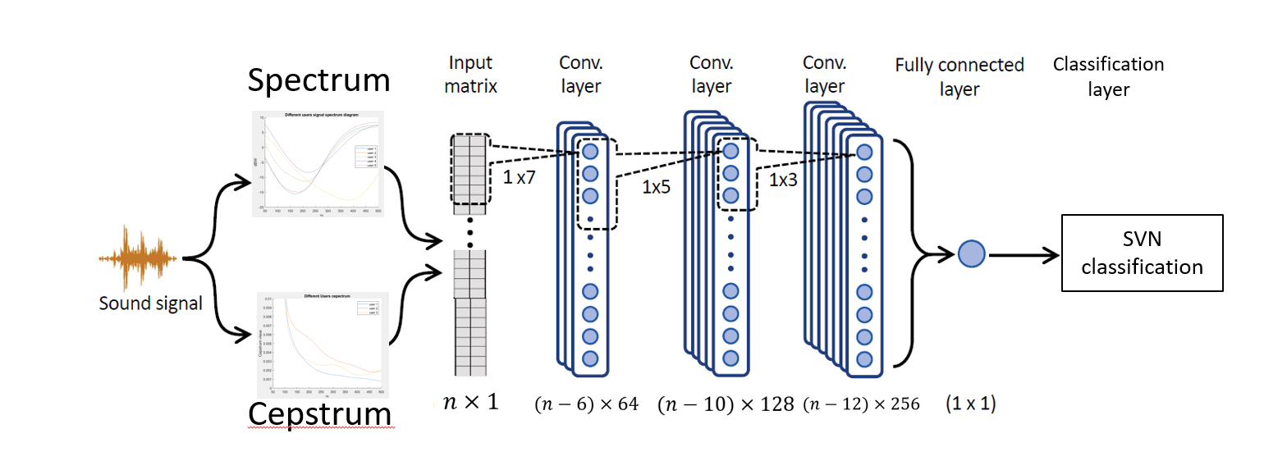
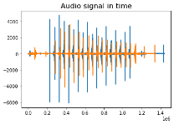
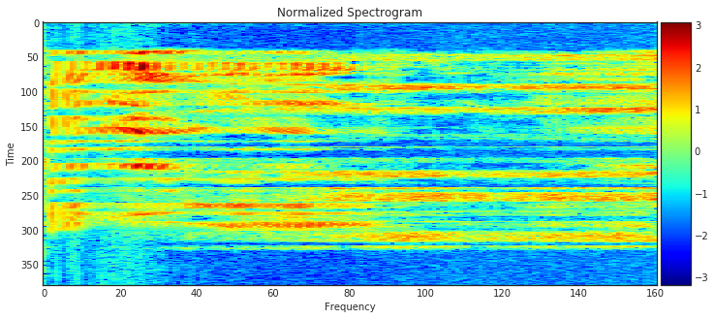
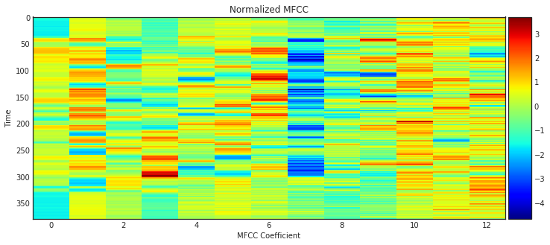
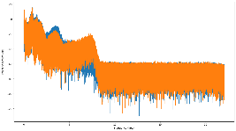
System Overview
Signal Transmission
Acoustic capture via microphone
Vibration capture via motion sensors
Signal Pre-processing
Noise cancellation algorithm
Bandpass Filtration
Cross-correlation
Feature Extraction
Frequency Domain
Spectrogram
Power Spectral Density
MFCCs
Vibration Domain
ML/DL models
Feature 1: Spectrogram
Feature 2: MFCCs

Slide 16
Wrap-up
Hardware Study
Fossil Watch
Samsung Watch
Ticwatch
Falster Watch
Sensing Method Study
Acoustic Signals
Audible Chirp Signal (50hz-8khz)
Low-Frequency Chirp Signal (50hz-500hz)
Accelerometers + Gyroscope
Impact Factor Study
Robustness to White Noise
Robustness to Human Speech
Impact of Wrist Strap Tightness
Impact of Hand Posture
Consistency Over Time
*Studied in Detail
*Partially Studied
*Not Studied in Detail yet

Slide 17
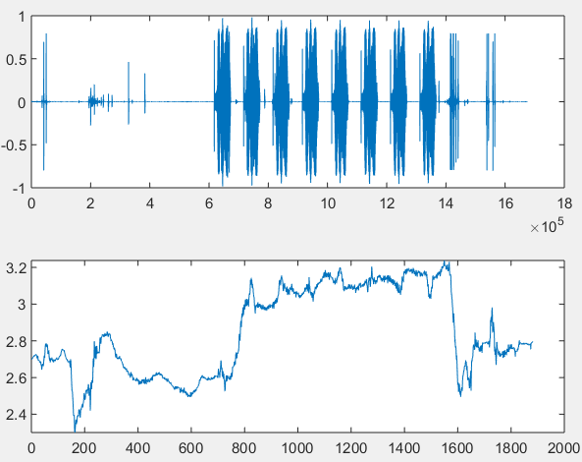
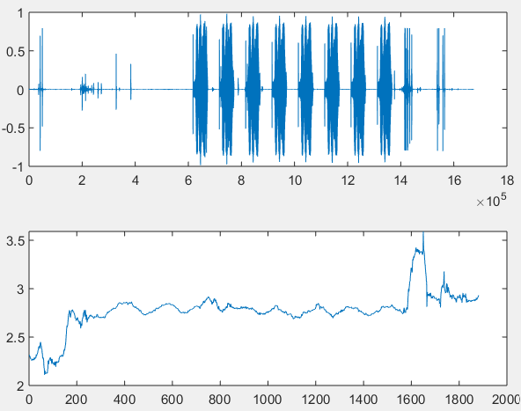
Comparing Vibration-Acoustic Domains
Transmit Chirp Signals
Measure acoustic domain (microphone audio time series)
Measure vibration domain (accelerometer and gyroscope time series)
Both accelerometer and gyroscope provide 3-axis inertial data
Results obtained on Falster Gen 6 Smartwatch during “press side” action
Accelerometer X
Accelerometer Y
Accelerometer Z

Slide 18
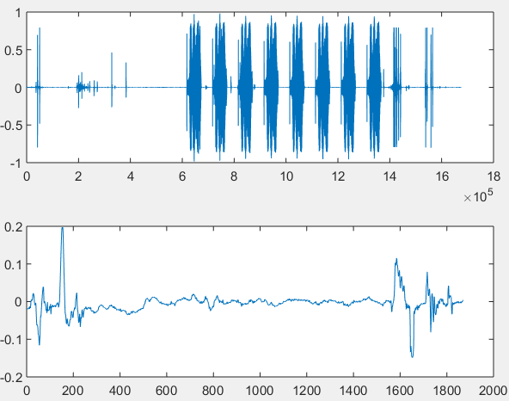
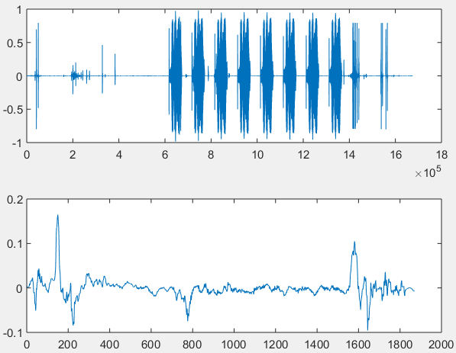
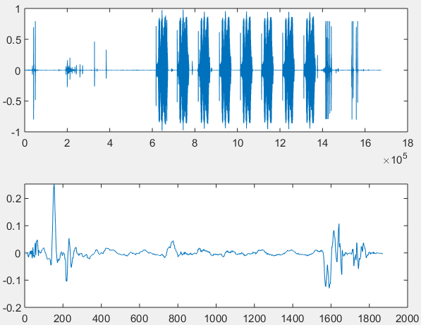
Comparing Vibration-Acoustic Domains
Transmit Chirp Signals
Measure acoustic domain (microphone audio time series)
Measure vibration domain (accelerometer and gyroscope time series)
Both accelerometer and gyroscope provide 3-axis inertial data
Results obtained on Falster Gen 6 Smartwatch during “press side” action
Gyroscope X
Gyroscope Y
Gyroscope Z

Slide 19
Comparing Vibration-Acoustic Domains
Accelerometer Z-axis
Most chirps in the acoustic domain cause a corresponding change in the vibration domain
Accelerometer values appear to drop once user presses on watch, then drops further when chirp signal is playing
Audio
Accelerometer Z

Slide 20
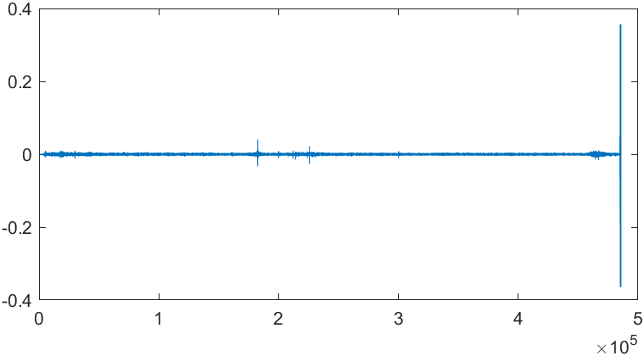
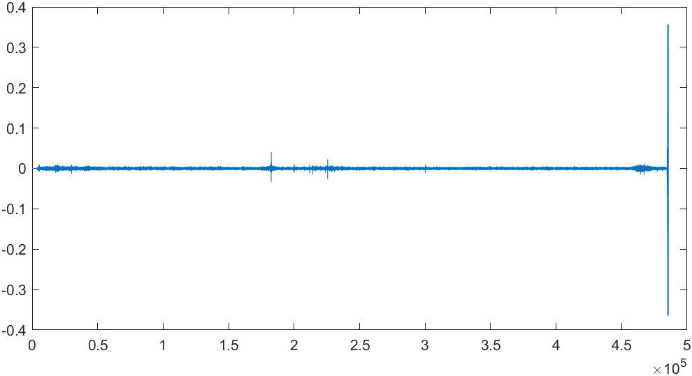
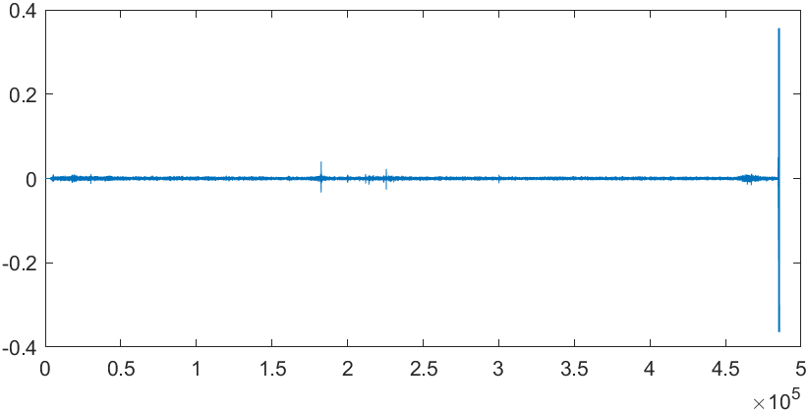
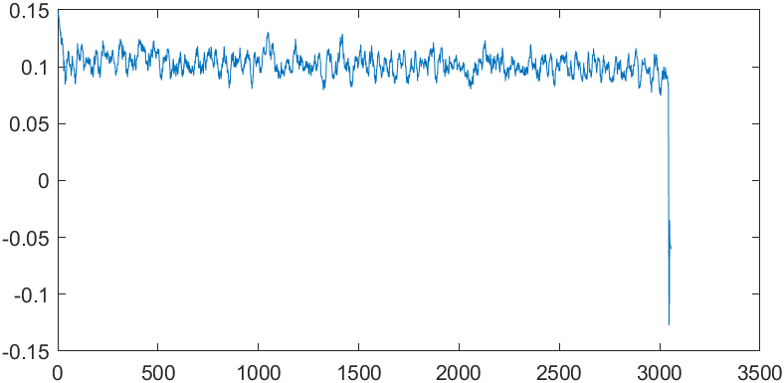
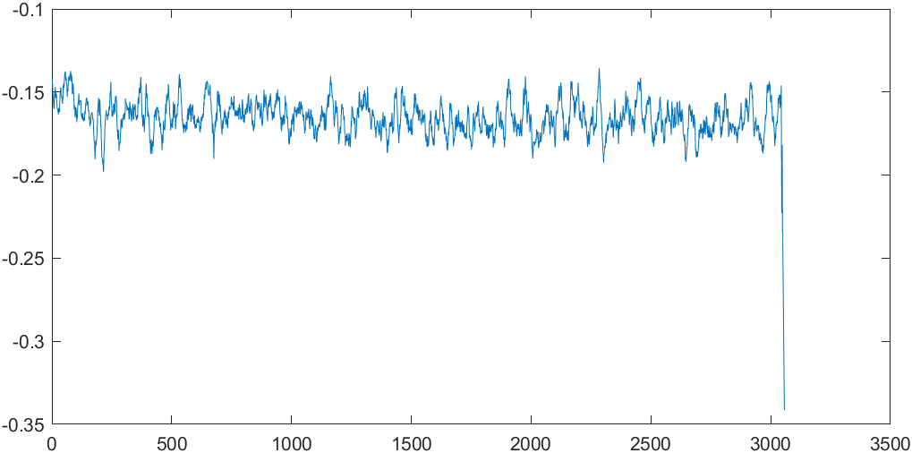
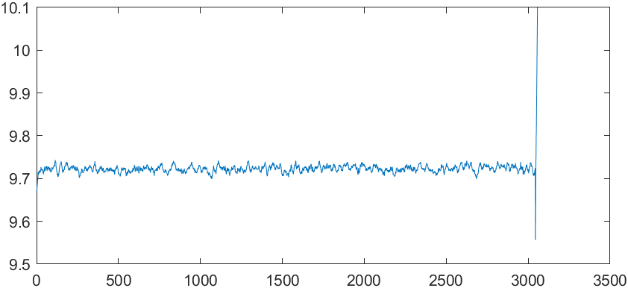
Vibration_Accelerometer
Audio Recording
The Samsung 4 smartwatch is place on desk
X
Y
Z

Slide 21
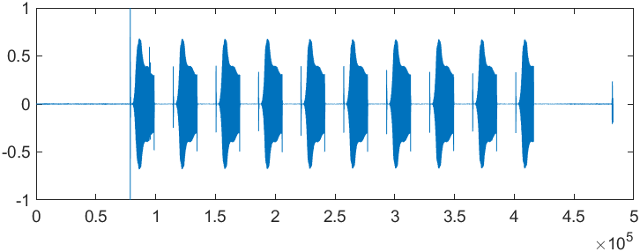
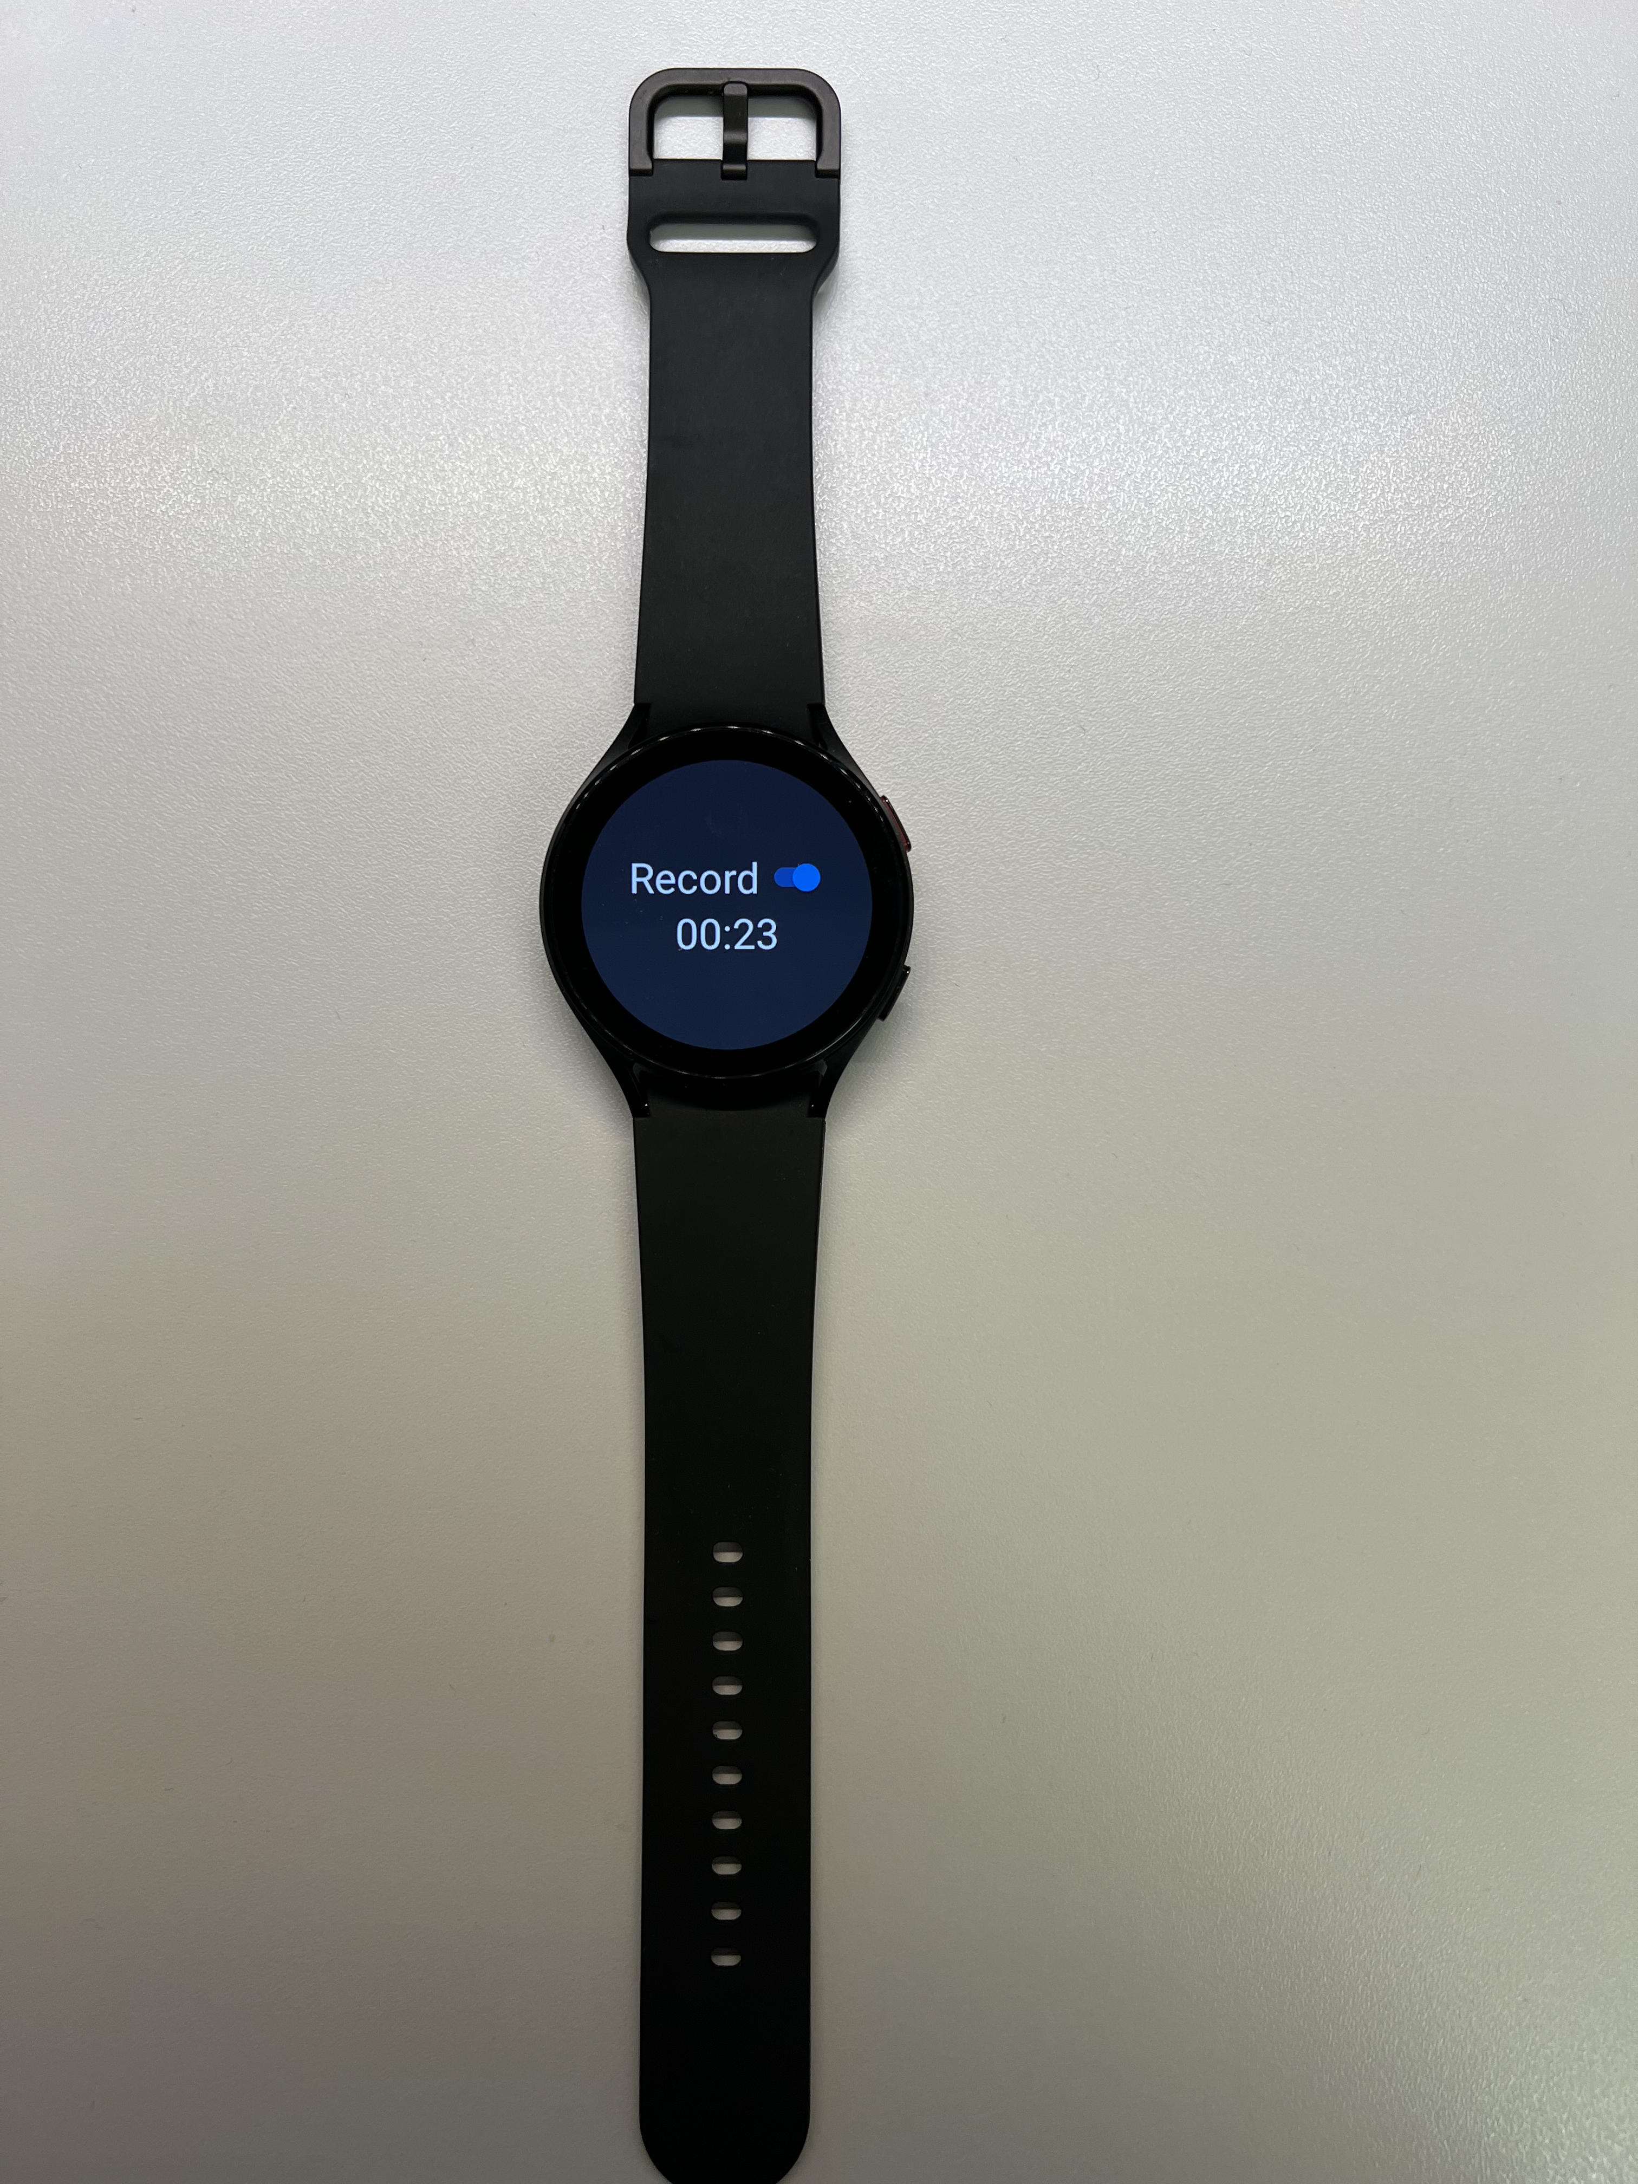
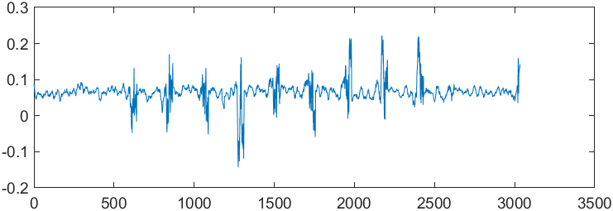
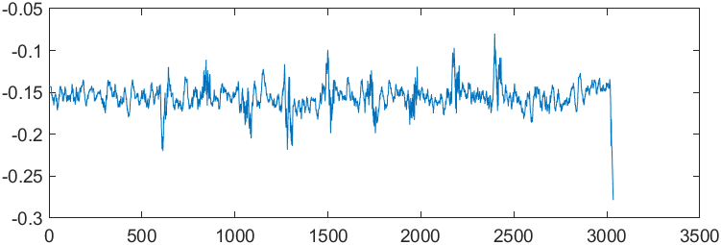
Vibration_Accelerometer
Audio Recording
The Samsung 4 smartwatch is placed on the same desk with 50 – 500 HZ 10 repeated Chirp Signal playing
X
Y
Z

Slide 22
Touch on different positions of the surface
Touch with One Finger
5 Touch Positions
UP
LEFT
RIGHT
DOWN
CENTER

Slide 23
Position_CENTER
X
Y
Z

Slide 24
Position_UP (Top Area)
X
Y
Z
UP v.s. CENTER MFCC difference_distance = 27056.263871192932

Slide 25
Position_DOWN
X
Y
Z
DOWN v.s. CENTER MFCC difference_distance = 23289.378344535828

Slide 26
Position_LEFT
X
Y
Z
LEFT v.s. CENTER MFCC difference_distance = 22497.668041229248

Slide 27
Position_RIGHT
X
Y
Z
RIGHT v.s. CENTER MFCC difference_distance = 27057.736876010895

Slide 28
MFCCs | CENTER | UP | DOWN | LEFT | RIGHT
CENTER | 0 | 27056.26387 | 23289.37834 | 22497.66804 | 27057.73688
UP | 27056.26387 | 0 | 24660.78337 | 25434.17214 | 27507.6494
DOWN | 23289.37834 | 24660.78337 | 0 | 22772.87098 | 24602.96932
LEFT | 22497.66804 | 25434.17214 | 22772.87098 | 0 | 26297.5055
RIGHT | 27057.73688 | 27507.6494 | 24602.96932 | 26297.5055 | 0

Slide 29
Project Report (05/03/2022)
I think the vibration data captured by motion sensors of the Android Smartwatch may help identify the users in different scenarios such as walking/jogging and enhance the accuracy.
Whereas, due to the time limit and the data cleaning hardness, I am not planning to dig out and include this part in the final project report. Instead, I will leave it for future work.
Data Gathering (13 Users: 9 Male + 4 Female) √
Data Cleaning (Chirp signal division : 104 WAVE files) √
Feature Engineering(MFCCs + Spectrogram) √
Model Selection + Training (Improve the Accuracy) ٭
Evaluation ٭
Final Report Writing Δ
Vibration Part Discussion: Limitation & Outlook
Impact of playing chirp signal can also be clearly observed in vibration domain using motion sensors
This can help in distinguishing the signal from noise in the acoustic domain since low-frequency sounds and daily noise may overlap
The accelerometer contributes more significant information compared to the gyroscope
Sensitivity of the vibration domain to different users on smartwatches to be determined
We can investigate if accelerometer and gyroscope data can be clearly associated with specific people
The complete. ipynb notebook is available on my personal website: www.yezhengkun.com, there is a repository on the right top corner named as “SPEECH RECOGNIZER.”

Slide 30
REFERENCES
[1] Mekruksavanich, Sakorn, and Anuchit Jitpattanakul. 2022. "Deep Residual Network for Smartwatch-Based User Identification through Complex Hand Movements" Sensors 22, no. 8: 3094. https://doi.org/10.3390/s22083094
[2] F. Ciuffo and G. M. Weiss, "Smartwatch-based transcription biometrics," 2017 IEEE 8th Annual Ubiquitous Computing, Electronics and Mobile Communication Conference (UEMCON), 2017, pp. 145-149, doi: 10.1109/UEMCON.2017.8249014.
[3] A. H. Johnston and G. M. Weiss, "Smartwatch-based biometric gait recognition," 2015 IEEE 7th International Conference on Biometrics Theory, Applications and Systems (BTAS), 2015, pp. 1-6, doi: 10.1109/BTAS.2015.7358794.
[4] X. Yu, Z. Zhou, M. Xu, X. You and X. Li, "ThumbUp: Identification and Authentication by Smartwatch using Simple Hand Gestures," in 2020 IEEE International Conference on Pervasive Computing and Communications (PerCom), Austin, TX, USA, 2020 pp. 1-10. doi: 10.1109/PerCom45495.2020.9127367
[5] Chang, B., Li, Y., Wang, Q. et al. Making a good thing better: enhancing password/PIN-based user authentication with smartwatch. Cybersecur 1, 7 (2018). https://doi.org/10.1186/s42400-018-0009-4
[6] Lee, Sunwoo & Choi, Wonsuk & Lee, Dong Hoon. (2021). Usable User Authentication on a Smartwatch using Vibration. 304-319. 10.1145/3460120.3484553.
[7] Wang, Z., Shen, C., Chen, Y. (2017). Handwaving Authentication: Unlocking Your Smartwatch Through Handwaving Biometrics. In: , et al. Biometric Recognition. CCBR 2017. Lecture Notes in Computer Science(), vol 10568. Springer, Cham. https://doi.org/10.1007/978-3-319-69923-3_59
[8] I. Griswold-Steiner, R. Matovu and A. Serwadda, "Handwriting watcher: A mechanism for smartwatch-driven handwriting authentication," 2017 IEEE International Joint Conference on Biometrics (IJCB), 2017, pp. 216-224, doi: 10.1109/BTAS.2017.8272701.
[9] A. Buriro, R. Van Acker, B. Crispo and A. Mahboob, "AirSign: A Gesture-Based Smartwatch User Authentication," 2018 International Carnahan Conference on Security Technology (ICCST), 2018, pp. 1-5, doi: 10.1109/CCST.2018.8585571.
[10] Gierad Laput, Robert Xiao, Xiang’Anthony’ Chen, Scott E Hudson, and Chris Harrison. 2014. Skin buttons: cheap, small, low-powered and clickable fixed icon laser projectors. In Proceedings of the 27th annual ACM symposium on User interface software and technology. 389–394.
[11] Martin Weigel, Tong Lu, Gilles Bailly, Antti Oulasvirta, Carmel Majidi, and Jürgen Steimle. 2015. Iskin: flexible, stretchable and visually customizable on-body touch sensors for mobile computing. In Proceedings of the 33rd Annual ACM Conference on Human Factors in Computing Systems. 2991–3000.
[12] Srinath Sridhar, Anders Markussen, Antti Oulasvirta, Christian Theobalt, and Sebastian Boring. 2017. Watchsense: On-and above-skin input sensing through a wearable depth sensor. In Proceedings of the 2017 CHI Conference on Human Factors in Computing Systems. 3891–3902.
[13] Wenqiang Chen, Maoning Guan, Yandao Huang, Lu Wang, Rukhsana Ruby, Wen Hu, and Kaishun Wu. 2018. Vitype: A cost efficient on-body typing system through vibration. In 2018 15th Annual IEEE International Conference on Sensing, Communication, and Networking (SECON). IEEE, 1–9.
[14] Maotian Zhang, Qian Dai, Panlong Yang, Jie Xiong, Chang Tian, and Chaocan Xiang. 2018. idial: Enabling a virtual dial plate on the hand back for arounddevice interaction. Proceedings of the ACM on Interactive, Mobile, Wearable and Ubiquitous Technologies 2, 1 (2018), 1–20.
[15] Cheng Zhang, AbdelKareem Bedri, Gabriel Reyes, Bailey Bercik, Omer T Inan, Thad E Starner, and Gregory D Abowd. 2016. TapSkin: Recognizing on-skin input for smartwatches. In Proceedings of the 2016 ACM International Conf. on Interactive Surfaces and Spaces. 13–22.

