Slide 1
Neurodiversity and Employment on Reddit With NLP
Michael West and Maddie Upthegrove

Slide 2
Overview
Introduction
Methods
Results
Discussion

Slide 3
Introduction

Slide 4
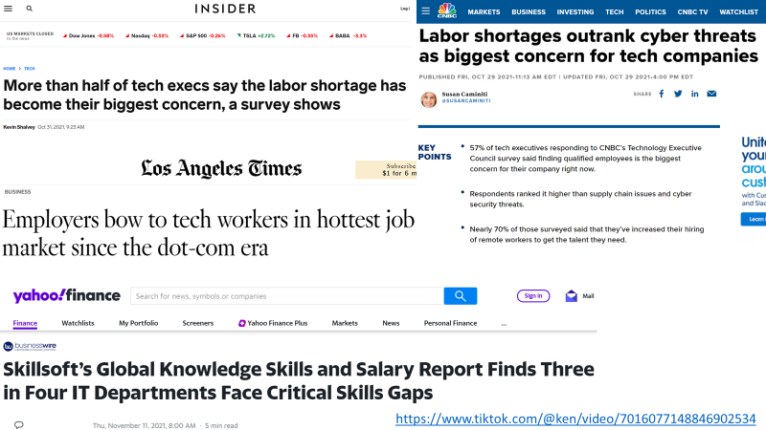

Slide 5
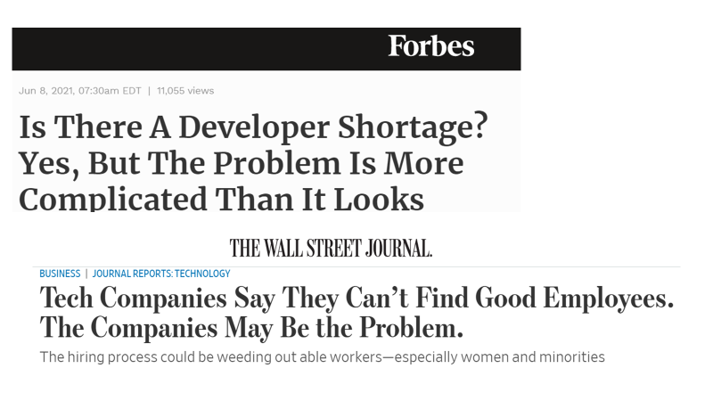

Slide 6
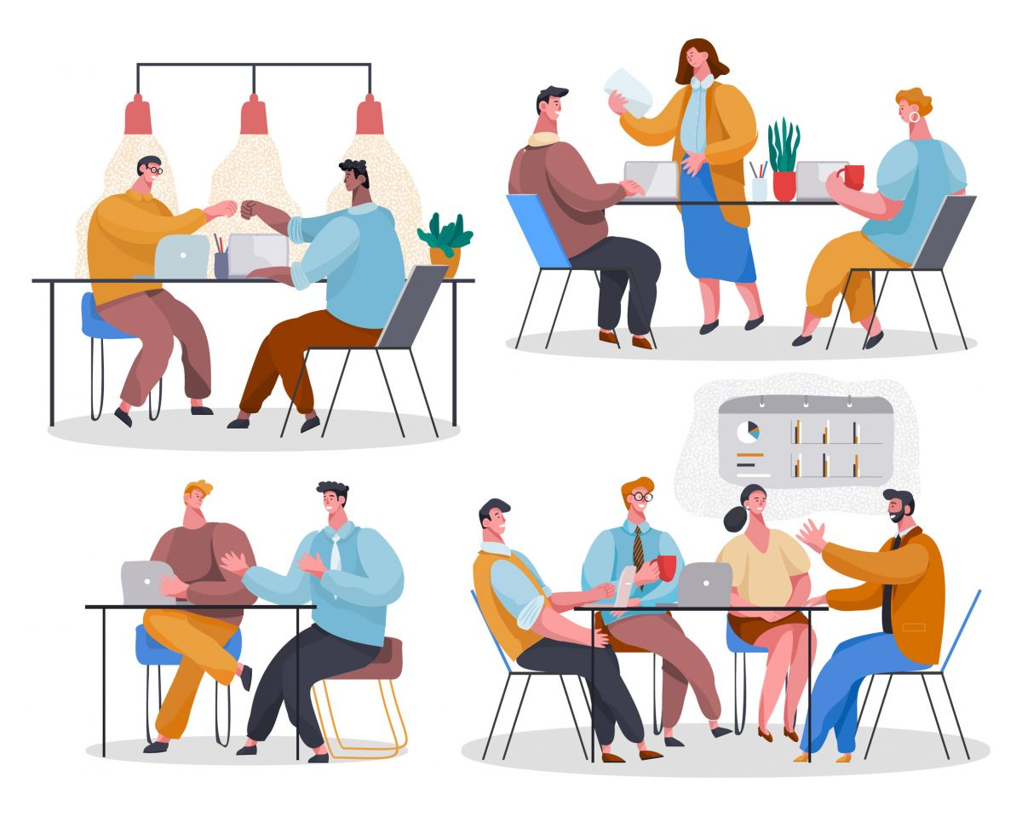
Autism and Employment
US unemployment rate in 2019: 3.5% unemployed (U. S. Department of Labor, 2019)
Autistic young adults in their early 20s: 58% employed (Roux et al, 2015)
Of 18,000 individuals with ASD in state-funded vocational rehabilitation programs in 2014: 60% employed (CDC, 2018)
Ex-convicts in the US: 75% employed (National Justice Institute, 2013)

Slide 7
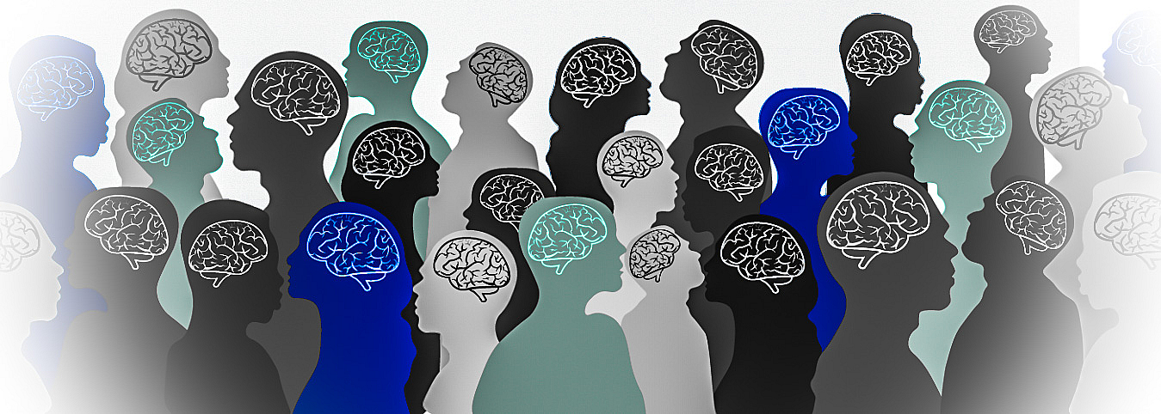
What is Autism
“If you’ve met one person with autism, you’ve met one person with autism”
DSM-5 diagnostic criteria: (American Psychiatric Association, 2013)
Difficulty with communication and interaction with other people
Restricted interests and repetitive behaviors
Symptoms that affect their ability to function in school, work, and other areas of life

Slide 8
Autistic Employees (Solomon, 2020)
Traditional Strengths:
Traditional Barriers:
•Reliability and dependability
•Concentration and patience for repetitive work
•Accuracy
•Trustworthiness, honesty, and integrity
•Challenges adapting to change in routine
•Social difficulties
•Interview is a social test:
•Focused attention
•Listening without interrupting
•Grooming, hygiene, dressing
•Handshakes
•Understanding and reciprocating facial expressions
•Eye contact
•Self-advocacy and confidence

Slide 9
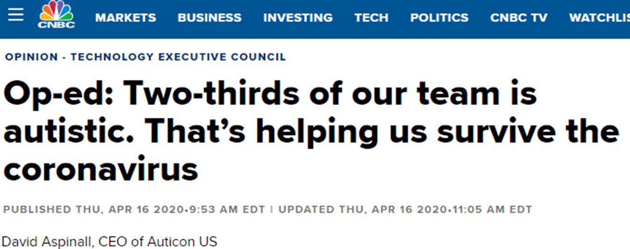
“People with autism often excel at business intelligence, quality-assurance test automation and complex software development projects. They have unique cognitive strengths: attention to detail, a systematic way of working, logical analysis, pattern recognition, error detection and sustainable concentration for routine activities.”

Slide 10
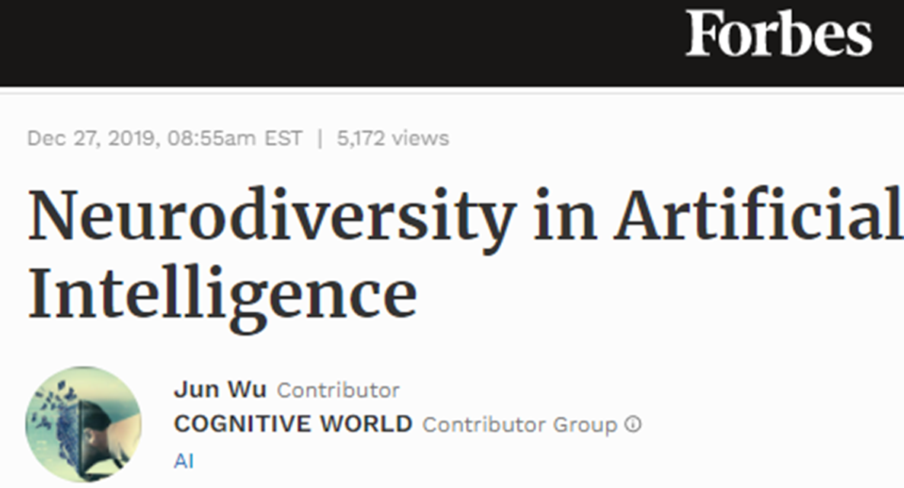
“Many of these employees contribute their special skills in pattern recognition, memory, or mathematics on teams working to solve highly complex problems… in machine learning testing, many companies have found that Neurodiverse employees will outperform anyone else. At the same time, modeling and data science where recognizing patterns and understanding quantitative concepts is essential, can allow neurodiverse talent to shine. ”

Slide 11
Reddit
Network of web-based online forums (communities)
Alleviates difficulties of social interactions and communication
Subreddits
r/autism

Slide 12
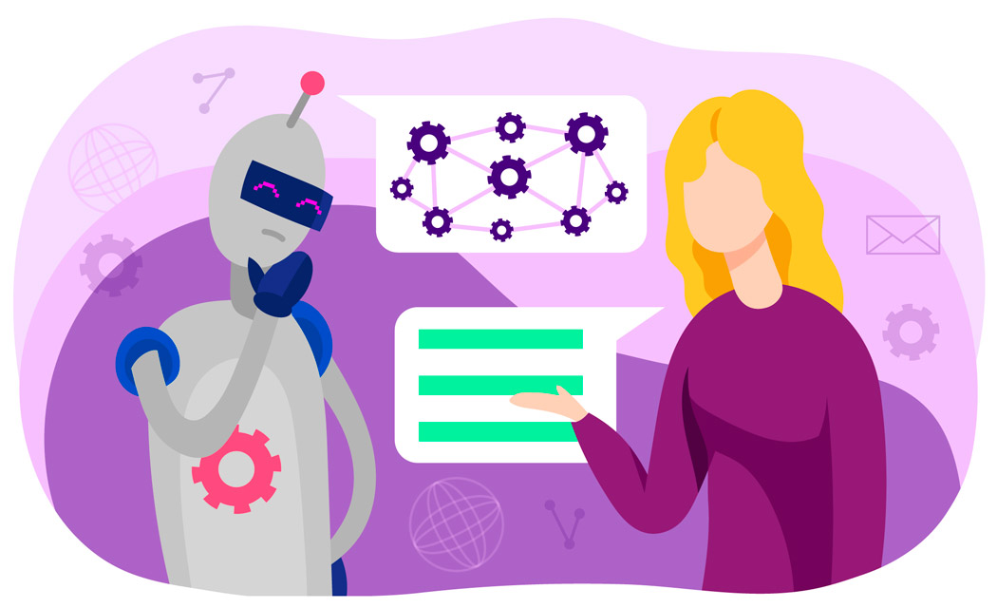
Natural Language Processing (NLP) and Topic Discovery
NLP
A broad class of AI problems
Deals with processing text from non-formal human languages
Generally involves tokenizing / vectorizing text
Topic Discovery
Sub problem of NLP
Seeks to discover underlying semantic topics in a text corpus
Classify documents from within the corpus or outside the corpus into topical subsets

Slide 13
Previous Similar Work
Previous work has compared document and topic clustering techniques on reddit and twitter [1]
Previous work has evaluated the distribution of a specific topic cluster (e-ciggarettes) across different reddit communities [2]
Present program differs in that investigators are looking for a specific topic within a specific community
[1] Curiskis, Stephan A., et al. "An evaluation of document clustering and topic modelling in two online social networks: Twitter and Reddit." Information Processing & Management 57.2 (2020): 102034.
[2] Barker, Joshua O., and Jacob A. Rohde. "Topic clustering of e-cigarette submissions among Reddit communities: A network perspective." Health Education & Behavior 46.2_suppl (2019): 59S-68S.

Slide 14
Methods

Slide 15
Dataset
Reddit Mental Health Dataset
Collected Reddit posts from 15 mental health specific subreddits, 2 broad mental health subreddits and 11 control subreddits between 2018 and 2020
Original authors focused on the impact of the Covid-19 pandemic on mental health discussions
Of particular interest to this project is r/autism
8869 posts
7177 unique users

Slide 16
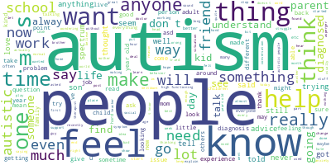
Preprocessing
8869 posts from r/autism
Removed punctuation, whitespace and markdown remnants
Removed stop words
Tokenized the documents

Slide 17
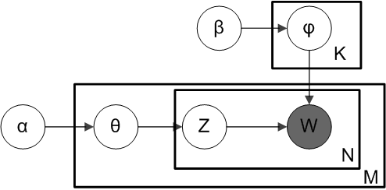
Latent Dirichlet Allocation (LDA)
Unsupervised generative statistical topic model
For a set of documents, posits that:
Each document is a mixture of underlying (latent) semantic topics
The presence of a word in a document is attributable to one of the latent topics

Slide 18
Results

Slide 19
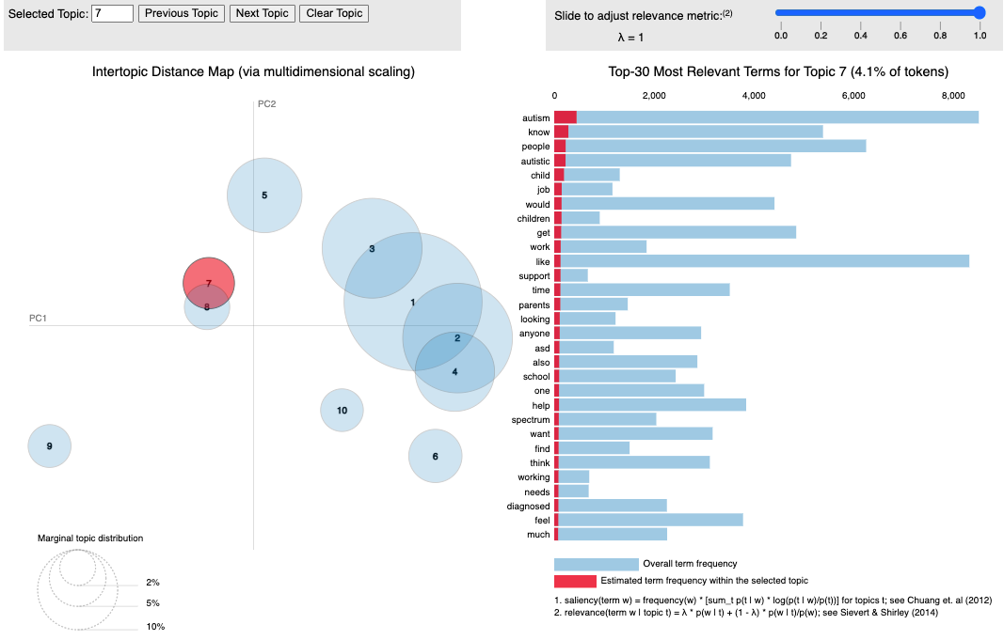

Slide 20
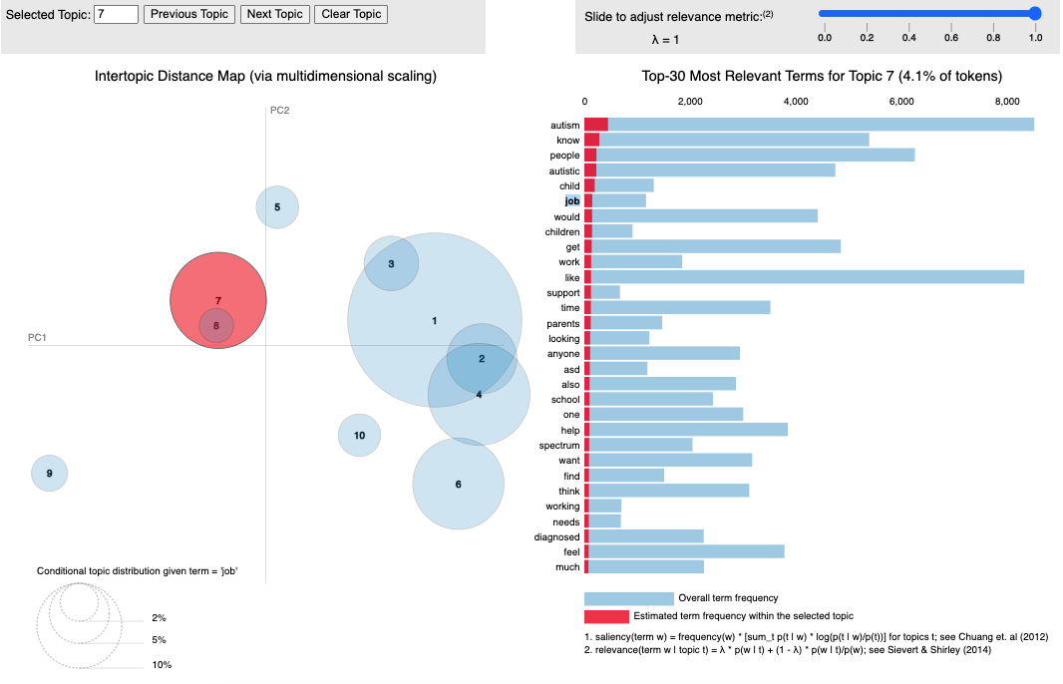

Slide 21
Labeling Topics
Topic | Count | Label | Relevance to Work
1 | 210 | Broad medical acceptance/conformity | Low
2 | 67 | Dark toned medical | Low
3 | 58 | Desired/not current nonmedical conformity to main social culture | Low
4 | 89 | Autistic people addressing common cultural problems with a positive tone | Medium/ High
5 | 554 | Autistic people addressing common cultural problems with a dark tone/negative emotions | Medium
6 | 371 | Pointed advice/recruitment for specific resources (such as parents, doctors, therapy) | Medium
7 | 2451 | Very high intelligent autistics with masking difficulties in complex and close interpersonal relationships (romantic, familiar, work) | High
8 | 1914 | Diagnosis, disclosure, lacking experience with autism | Medium
9 | 2075 | Trauma, therapies, fetishes, harm, drugs, danger | Low
10 | 1076 | Medical issues/sensitivities inhibiting masking | Medium

Slide 22
Most Relevant Topics
 | 3 grams | 4 grams | 5 grams
Topic 7 High n= 2461 | (('a', 'lot', 'of'), 359) (('on', 'the', 'spectrum'), 341) (('i', 'feel', 'like'), 261) (('i', 'want', 'to'), 233) (('i', 'have', 'a'), 211) | (('know', 'what', 'to' , 'do'), 86) (('i', 'feel', 'like', 'i'), 62) (('i', "don't", 'want', 'to'), 52) (('i', 'was', 'diagnosed', 'with') , 51) (('i', 'just', 'want', 'to'), 50) | (("don't", 'know', 'what', 'to', 'do'), 40) (('donâ€™t’, 'know', 'what', 'to', 'do'), 38) (('i', "don't", 'know', 'how', 'to'), 31 (('i', "don't", 'know', 'what', 'to'), 28) (('i', 'donâ€™t', 'know', 'what', 'to'), 25)
Topic 4 Medium/High n=89 | (('i', "don't", 'know'), 14) (('i', 'feel', 'like'), 13) (('a', 'lot', 'of'), 10) (('when', 'i', 'was'), 10) (('know', 'how', 'to'), 9) | (('i', "don't", 'know', 'if'), 6) (('on', 'the', 'autism', 'spectrum'), 5) (('know', 'what', 'to', 'do'), 5) (('i', "don't", 'know', 'how'), 4) (("don't", 'know', 'how', 'to'), 4) (('i', 'would', 'like', 'to'), 4) | (('i', "don't", 'know', 'how', 'to'), 4) (('i', 'am', '"not', 'autistic', 'enough"'), 3)

Slide 23
Example Irrelevant Topics
 | 3 grams | 4 grams | 5 grams
Topic 9 Low n = 2075 | (('a', 'lot', 'of'), 295) (('on', 'the', 'spectrum'), 263) (('i', 'want', 'to'), 210) (('i', 'have', 'a'), 187) (('i', 'feel', 'like'), 184) | (('know', ‘what', 'to', 'do'), 65) (('i', 'just', 'want', 'to'), 62) (('i', 'feel', 'like', 'i'), 58) (('on', 'the', 'autism', 'spectrum'), 49) (('i', "don't", 'want', 'to'), 45) (('does', 'anyone', 'have', 'any'), 45) | (('i', "don't", 'know', 'how', 'to'), 30) (("don't", 'know', 'what', 'to', 'do'), 29) (('i', "don't", 'know', 'what', 'to'), 26) (('i', 'was', 'wondering', 'if', 'anyone'), 19) (('donâ€™t', 'know', 'what', 'to', 'do'), 18) (('i', 'have', 'a', 'lot', 'of'), 18) (('i', 'donâ€™t', 'know', 'how', 'to'), 18)
Topic 3 Low n=210 | (('i', "don't", 'know'), 14 (('i', 'wanted', 'to'), 12) (('to', 'be’, 'a'), 10) (('that', 'i', 'have'), 9) (('i', 'have', 'a'), 8) (('wanted', 'to', 'be'), 8) (('on', 'the', 'spectrum'), 8) | (('i', 'wanted', 'to', 'be'), 8) (('because', 'i', 'wanted', 'to'), 6) (('wanted', 'to', 'be', 'a'), 6) (("don't", 'know', 'how', 'to'), 6) (('i', "don't", 'know', 'how'), 5) | (('i', 'wanted', 'to', 'be', 'a'), 6) (('i', "don't", 'know', 'how', 'to'), 5) (('listen', 'to', 'one', 'song', 'for'), 4) (('consume', 'certain', 'pieces', 'of', 'art'), 4) (('i', "don't", 'know', 'why', 'i'), 4) (("don't", 'know', 'why', 'i', "can't"), 4) (("don't", 'know', 'how', 'to', 'stop'), 4) (('know', 'how', 'to', 'stop', 'this'), 4)

Slide 24
Discussion

Slide 25
Discussion
Overall:
Human labeling had high agreement with LDA topics
Topics labeled as most relevant had significant overlap with less relevant topics
Limitations:
Even with N=8869, some topics very small
Range: [67,2451]
LDA may be more appropriate for making sense of a dataset rather than looking for a specific topic
Low Medium Medium/High High

Slide 26
Future Directions
This project:
Continue analysis of identified topics looking for work specific postings
Determine conclusions and implications for both employees and employers
Future Projects
Collect more data
Implement in an online fashion
Test other topic discovery techniques

Slide 27
References
American Psychiatric Association. (2013). Diagnostic and statistical manual of mental disorders (5th ed.). https://doi.org/10.1176/appi.books.9780890425596
Center for Disease Control and Prevention. (2018). Community Report on Autism.
Low, D. M., Rumker, L., Talker, T., Torous, J., Cecchi, G., & Ghosh, S. S. Natural Language Processing Reveals Vulnerable Mental Health Support Groups and Heightened Health Anxiety on Reddit during COVID-19: An Observational Study. Journal of medical Internet research. doi: 10.2196/22635
National Justice Institute. (2013) Overview of Offender Reentry. Retrieved from https://nij.ojp.gov/topics/articles/overview-offender-reentry
Roux, Anne M., Shattuck, Paul T., Rast, Jessica E., Rava, Julianna A., and Anderson, Kristy, A. National Autism Indicators Report: Transition into Young Adulthood. Philadelphia, PA: Life Course Outcomes Research Program, A.J. Drexel Autism Institute, Drexel University, 2015.
Solomon, C. (2020). Autism and employment: Implications for employers and adults with ASD. Journal of Autism and Developmental Disorders, 50, 4209-4217.
U.S. Department of Labor. (2019). Employment situation summary. November 1.

