Slide 1
Facial Emotion Detector
smriti.roy@temple.edu

Slide 2
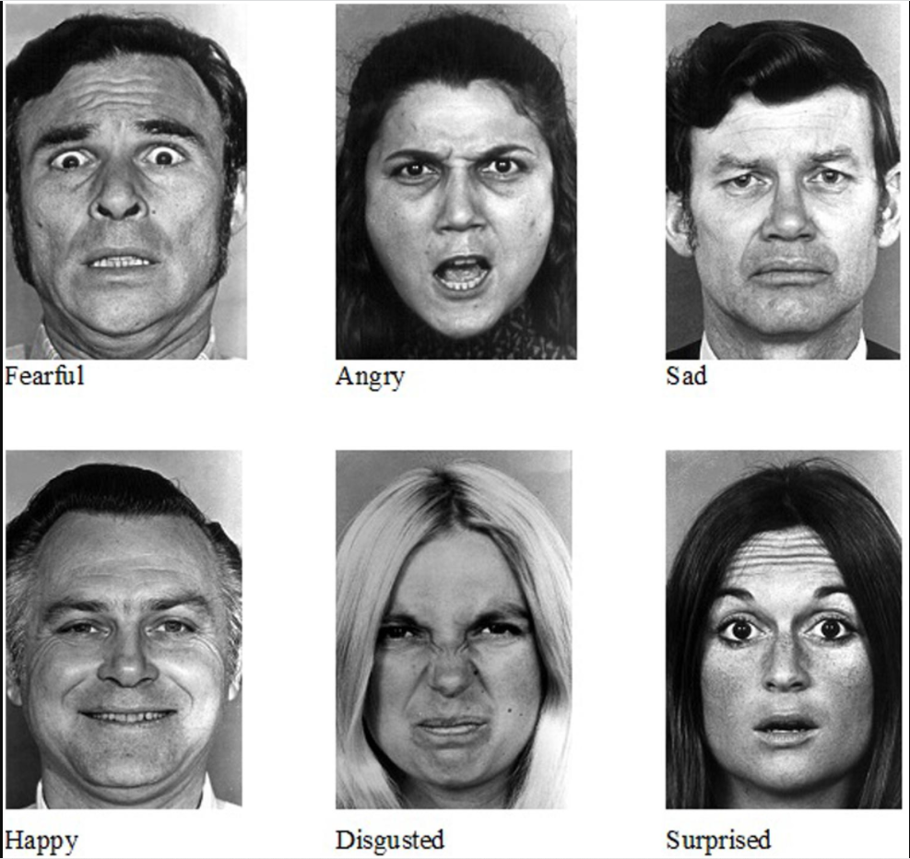
Introduction
Emotion is one of the very few words in the English language that do not have a concrete definition and it is understandable. It is abstract. Yet, almost every decision we have ever made in our lives is driven by emotion. Marketing research has proven that predicting sentiments correctly can be a huge source of growth for businesses and that’s what we will be working on today — Reading Emotions.
The facial expressions for Happiness, Sadness, anger,Surprise,fear,and disgust are the same across cultures.

Slide 3
Applications of Facial Expression Recognition
Facial Expression Recognition Technology can be used for medical research in autism therapy.
FER technology can be leveraged to ensure safe driving on roads. So, if a driver is feeling drowsy and is about to faint, the ride-hailing service can deploy a system to raise the alarm after reading their facial expressions.
The facial emotion recognition project solution codes are widely used to automate clicking selfies. An individual must look at the camera with beautiful smiles, and the device will click the image without any external push.
Another everyday use case is for businesses. They can use this technology to analyze the feedback emotions of their customers for their service. They can leverage that information to plan their next course of action in upscaling their business growth. For example, serving a sad customer can be prioritized.

Slide 4
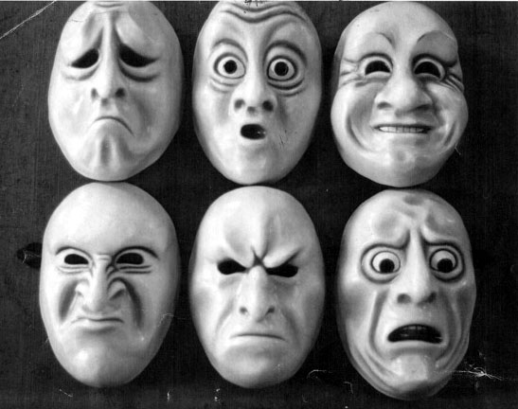
Problem Statement
The goal is to design and implement software system that detects facial emotion for frontal faces.
The system should work on embedded platform.

Slide 5
Face Expression Recognition Dataset
The data set used for training is the Kaggle FER2013 emotion recognition data set : https://www.kaggle.com/c/challenges-in-representation-learning-facial-expression-recognition-challenge/data
The data consists of 48x48 pixel grayscale images of faces. The faces have been automatically registered so that the face is centered and occupies about the same amount of space in each image. The task is to categorize each face based on the emotion shown in the facial expression in to one of seven categories (0=Angry, 1=Disgust, 2=Fear, 3=Happy, 4=Sad, 5=Surprise, 6=Neutral).

Slide 6
Dataset Challenges
Imbalance: Imbalance is when one class has many more images than another class. This results in the model being biased towards one class. For example, if there are 2000 images for the happy expression and 500 images for the fear expression, then the model will be biased towards the happy expression. Data augmentation is done to avoid this problem. Data augmentation increases the amount of data using techniques like cropping, padding, and horizontal flipping.
Intra-class variation: Some images in the dataset are not human faces as there are drawings and animated faces. Model performance will be better if all images in the dataset are human faces so other images should be removed.
Occlusion: Occlusion is when part of the image is covered. This can occur when a hand covers a part of the face such as the right eye or nose. A person wearing sunglasses or a mask also creates occlusion. Eyes and noses have primary features which are important to extract and recognize emotions. Thus, occluded images should be removed from the dataset as the model cannot recognize emotions from these images

Slide 7
Methodology

Slide 8
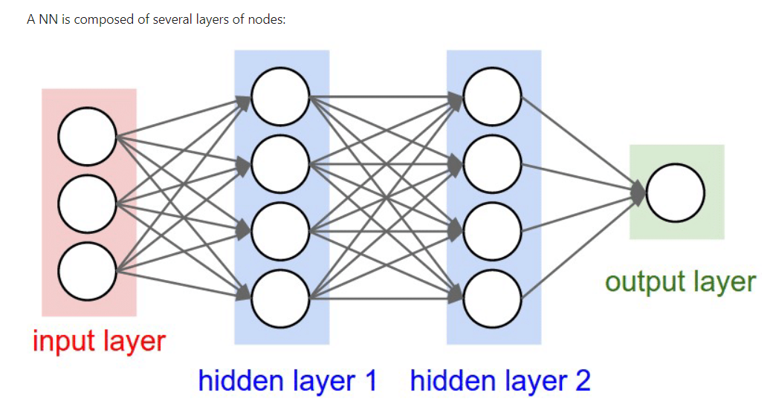
Setup our Convolutional Neural Network (CNN)
Convolutional Neural Network is used in order to tackle this face recognition problem. Indeed , this type of Neural Network (NN) is good for extracting the features of images and is widely used for image analysis subjects like image classification.
Quick reminder of what a NN is:
A Neural Network is a learning framework that consists in multiple layers of artificial neurons (nodes). Each node gets weighted input data, passes it into an activation function and outputs the result of the function:

Slide 9
Continue..
An input layer that will get the data. The size of the input layer depends on the size of the input data.
Some hidden layers that will allow the NN to learn complex interactions within the data. A Neural Network with a lot of hidden layers is called a Deep Neural Network.
An output layer that will give the final result, for instance a class prediction. The size of this layer depends on the type of output we want to produce (e.g., how many classes do we want to predict?)
Classic NNs are usually composed of several fully connected layers. This means that every neuron of one layer is connected to every neurons of the next layer.
Convolutional Neural Networks also have Convolutional layers that apply sliding functions to group of pixels that are next to each other. Therefore, those structures have a better understanding of patterns that we can observe in images.

Slide 10
CNN Model Architecture
We have defined our CNN with the following global architecture:
4 convolutional layers
2 fully connected layers
The convolutional layers will extract relevant features from the images and the fully connected layers will focus on using these features to classify well our images
A convolution operator: extracts features from the input image using sliding matrices to preserve the spatial relations between the pixels. The following image summarizes how it works
We applied the ReLU function to introduce non-linearity in our CNN. Other functions like tanh or sigmoid could also be used, but ReLU has been found to perform better in most situations.
Pooling is used to reduce the dimensionality of each features while retaining the most important information. Like for the convolutional step, we applied a sliding function on our data. Different functions can be applied: max, sum, mean... The max function usually performs better.

Slide 11
Continue…
Some common techniques applied for each layer:
Batch normalization: improves the performance and stability of NNs by providing inputs with zero mean and unit variance.
Dropout: reduces overfitting by randomly not updating the weights of some nodes. This helps prevent the NN from relying on one node in the layer too much.
Softmax is chosen as our last activation function as it is commonly used for multi-label classification.
Now that our CNN is defined, we can compile it with a few more parameters. We chose the Adam optimizer as it is one of the most computationally effective. We chose the categorical cross-entropy as our loss function as it is quite relevant for classification tasks. Our metric will be the accuracy, which is also quite informative for classification tasks on balanced datasets

Slide 12
Training and Testing the Model

Slide 13
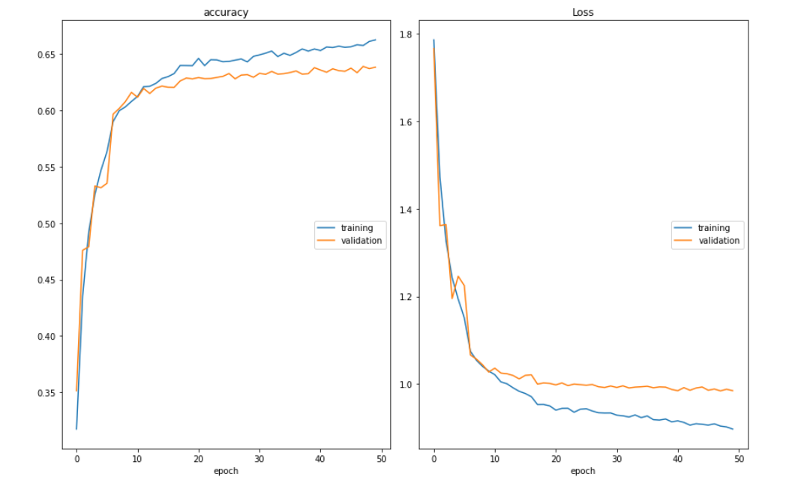
Training and Evaluating Model
Our model managed to obtain a validation accuracy of approximately 67% in 50 Epochs, which is quite good given the fact that our target class has 7 possible values!

Slide 14
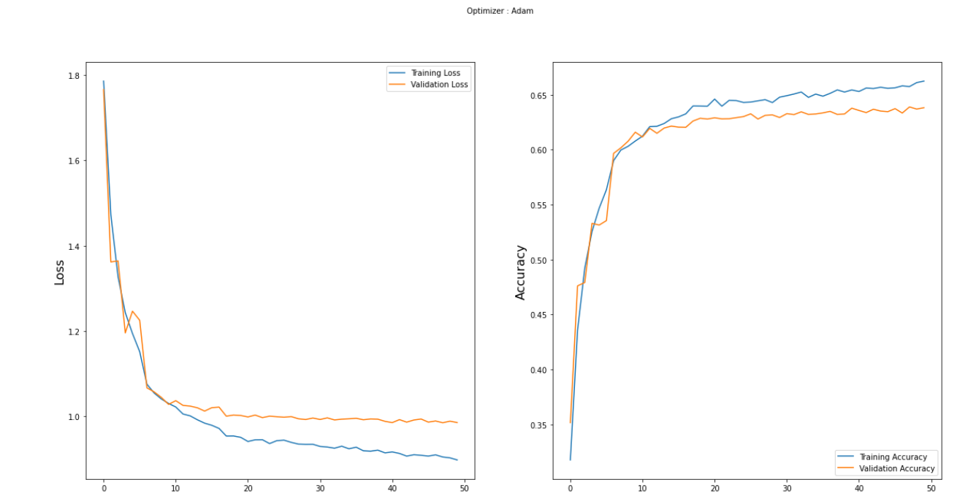
Analyzing the results
The validation accuracy starts to stabilize at the end of the 50 epochs between 60% and 65% accuracy.
The training loss is slightly higher than the validation loss for the first epochs which can be surprising. Indeed we are more used to see higher validation losses than training losses in machine learning. Here this is simply due to the presence of dropout, which is only applied during the training phase and not during the validation phase.
We can see that the training loss is becoming much smaller than the validation loss after the 20th iteration. This means that our model starts to overfit our training dataset after too much epochs. That is why the validation loss does not decrease a lot after. One solution consists in early-stopping the training of the model.
We could also use some different dropout values and performing data augmentation. Those methods were tested on this dataset, but they did not significantly increase the validation accuracy although they reduced the overfitting effect. Using them slightly increased the training duration of the model.

Slide 15
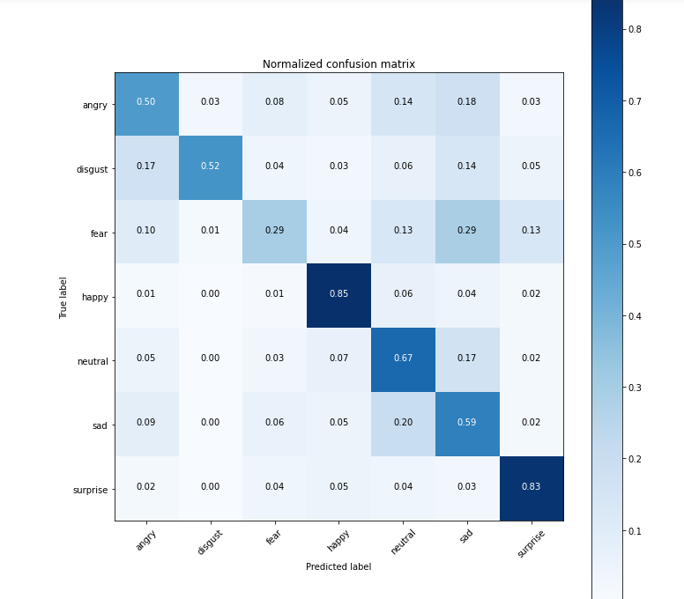
Analyzing the results
We got an accuracy of nearly 67% on the dataset by running only 50 epochs. we can run for more epochs and can change some other parameters to score a higher accuracy
Our model is very good for predicting happy and surprised faces. However, it predicts quite poorly feared faces because it confuses them with sad faces.
With more research and more resources this model could certainly be improved

Slide 16
Loading the Saved model and Using Webcam Feed

Slide 17
Testing the Model using Webcam Feed
Read Frames and apply Preprocessing using OpenCV
Loading Har-Cascade for Face Detection
Loading the saved model
Now The Fun Part !!! Run It

Slide 18
Running the Webcam Feed

Slide 19
Continue…

Slide 20
Conclusion
In this project an Emotion/Facial Recognition model has been trained and saved. It can recognize/detect the facial expressions of an individual on a real time basis that whether the individual is Neutral, Angry, Disgust, Fear, Happy, Sad, Surprised
We can improve accuracy further by :
Using pre-trained models like VGG-16 or Resnet etc.
Using Stacked Model.
Performing some fine-tuning.

Slide 21
Future work
Facial emotion recognition is an emerging field so considering other Neural Networks such as Recurrent Neural Networks (RNNs) may improve the accuracy. The feature extraction is similar to pattern recognition which is used in intelligence, military and forensics for identification purposes. Thus, techniques such as the Capsnet algorithm for pattern recognition can be considered. Deep Learning based approaches require a large labeled dataset, significant memory and long training and testing times which makes them difficult to implement on mobile and other platforms with limited resources. Thus, simple solutions should be developed with lower data and memory requirements.

Slide 22
References
K. Kaulard, D.W. Cunningham, H.H. Bulthoff, C. Wallraven, The MPI facial expression database: A validated database of emotional and conversational facial expressions, PLoS One, vol. 7, no. 3, art. e32321, (2012).
G.E. Hinton et al., Deep neural networks for acoustic modeling in speech recognition: The shared views of four research groups, IEEE Signal Processing Magazine, vol. 29, no. 6, pp. 82-97, (2012).
A. Pentland, Social signal processing, IEEE Signal Processing Magazine, vol. 24, no. 4, pp. 108- 111, (2007).
M. Xie, Development of artificial intelligence and effects on financial system, Journal of Physics: Conference Series 1187, art. 032084, (2019).
A. Nandi, F. Xhafa, L. Subirats, S. Fort, Real time emotion classification using electroencephalogram data stream in e-learning contexts, Sensors, vol. 21, no. 5, art. 1589, (2021).
A. Raheel, M. Majid, S.M. Anwar, M. Alnowami, Physiological sensors based emotion recognition while experiencing tactile enhanced multimedia, Sensors, vol. 20, no. 14, art. 04037, (2020).
D. Keltiner, P. Ekrman M. Lewis, J.H. Jones, Handbook of Emotions (2nd ed.), Guilford Publications (New York), pp. 236-249, (2000).
B.C. Ko, A Brief review of facial emotion recognition based on visual information, Sensors, vol. 18, no. 2, art. 401, (2018).
M.Sambhare, FER-2013 database, version 1, available online: https://www.kaggle.com/msambare/fer2013/metadata (2013).
B. Zafar, R. Ashraf, N. Ali, M. Iqbal, M. Sajid, S. Dar, N. Ratyal, A novel discriminating and relative global spatial image representation with applications in CBIR, Applied Sciences, vol. 8, no. 11, art. 2242, (2018).

Slide 23
Thank You

