Slide 1
Earthquake prediction by Machine learning algorithms
Presented by: Xuanzhang Liu

Slide 2
Outline
Motivations
Feature Engineering
Experiment Results by different algorithms
Conclusion

Slide 3
Motivation
﻿Current scientific studies related to earthquake forecasting focus on three key points:
﻿when the event will occur
﻿﻿where it will occur
﻿﻿how large it will be
﻿﻿Previous methods only considered and extracted limited features from the real time seismic data which achieved unsatisfactory results.
﻿Fluctuate pattern of acoustic signal level
Predict the possible time to failure

Slide 4
Motivation
Our Tasks:
﻿﻿Employ the Fourier transformation to each chunk of the data.
Implement Random Forest and Support ﻿Vector Machine as the baseline models.
Consider the famous variant of the recurrent neural network – Long Short Term Memory (LSTM) in order to better capture the time-sensitive sequential feature from the real-time seismic data.
Notes:
This is based on a fact that

Slide 5
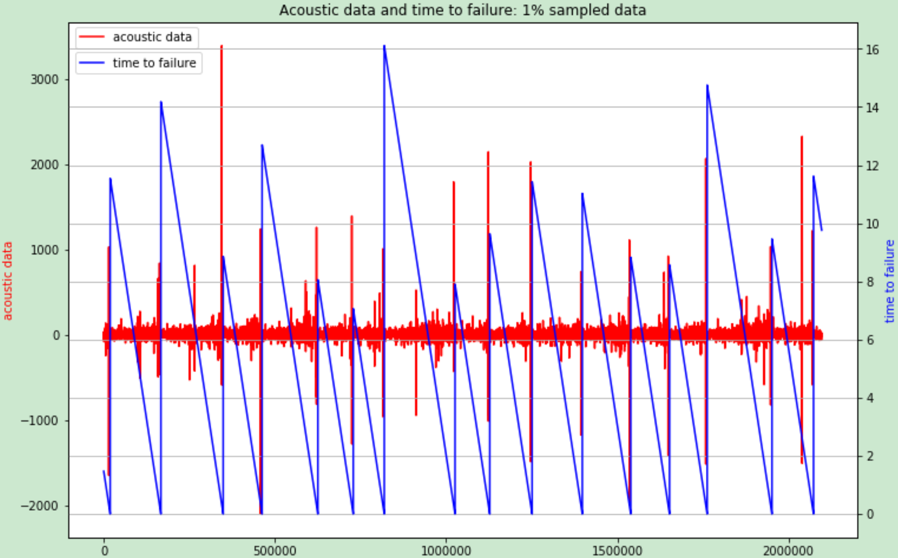
Feature Engineering
﻿If earthquake will not happen in a short time, there will only be some low frequency data. However, when earthquake is about to happen, high frequency data appears.
Notes:
This is based on a fact that

Slide 6
Feature Engineering
﻿Feature engineering steps:
﻿Read in the training data as chunks of given lines
﻿Further divided into 3 parts and features are generated separately for each part
﻿For each part, the following statistical measurements are used as features:
﻿Mean, Standard deviation, Maximum and minimum
Kurtosis: measure of tailedness of data
Skew: measure of asymmetry of data
Quantiles(0.01 / 0.05 / 0.95 / 0.99): cut point that dividing distribution
Mean and Standard deviation at frequency domain
﻿Fourier transformation is applied to each chunk of data. we can extract some more features that can not be seen in time domain.
Notes:
This is based on a fact that

Slide 7
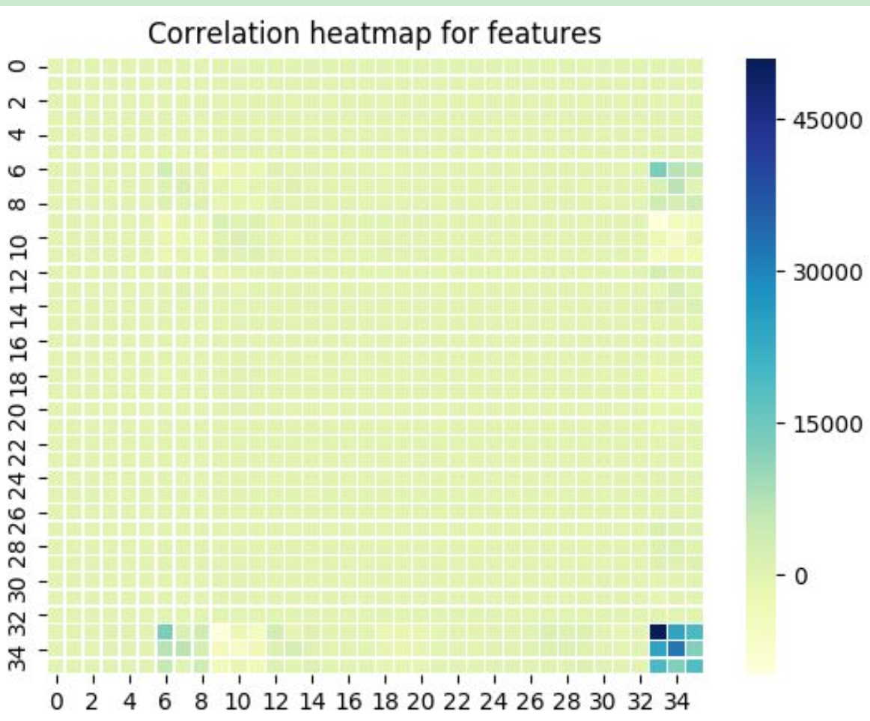
Feature Engineering
﻿Correlations of each features: ﻿the lower correlation between two features, the better features they are. Here it shows our features mostly all have relative low correlations﻿.
Notes:
This is based on a fact that

Slide 8
Experiment Results by different algorithms
﻿Random Forest: ﻿it is an ensemble method that multiple decision trees are constructed during training time and regression results are the average voting of each tree.
Notes:
It is an imporved decision tree learning

Slide 9
Experiment Results by different algorithms
bootstrap: a method to pick a subset of the training set with replacement.
max_depth: the maximum number of depth of each decision tree
max_features: number of features used to generate trees
n_estimators: total number of trees inside this RF
﻿Mean absolute error (MAE) is applied to measure the performances of different models:
Notes:
The purpose is to use different to construct each individual decision tree.

Slide 10
Experiment Results by different algorithms
﻿﻿Support Vector Machine: ﻿﻿it is a deterministic classification model, using support vector to get the decision boundary that has a largest margin to nearest data. It can also be used as a regression method, maintaining all the main features that characterize the algorithm.
﻿To extend it to fit nonlinear functions, kernel functions are introduced. It can ﻿map the data to higher dimension from which it can be differentiate by a single line or a hyperplane.
﻿In scikit-learn there are two kinds of SVR implement, one is SVR, a normal support vector regressor, the other one is NuSVR, which has an restrict on number of support vectors.
Notes:
It is an imporved decision tree learning

Slide 11
Experiment Results by different algorithms
﻿grid search is used on some important hyperparameters: number of support vectors, penalty parameter, kernel and degree of polynomial kernel, and 5-fold validation is performed
Notes:
It is an imporved decision tree learning

Slide 12
Experiment Results by different algorithms
﻿﻿﻿Recurrent Neural Network: ﻿﻿it ﻿is a neural network structure aiming at dealing with sequential. ﻿During learning all neural cells share the same parameters and update together.
﻿Weakness: losing what has been learned before in the situation that the time sequence is long enough and gradient vanishing
﻿Using L﻿ong-Short Term Memory (LSTM) structure. In the cell of LSTM, there are three “gates” to determine what to forget, what to update and what to output.
Notes:
It is an imporved decision tree learning

Slide 13
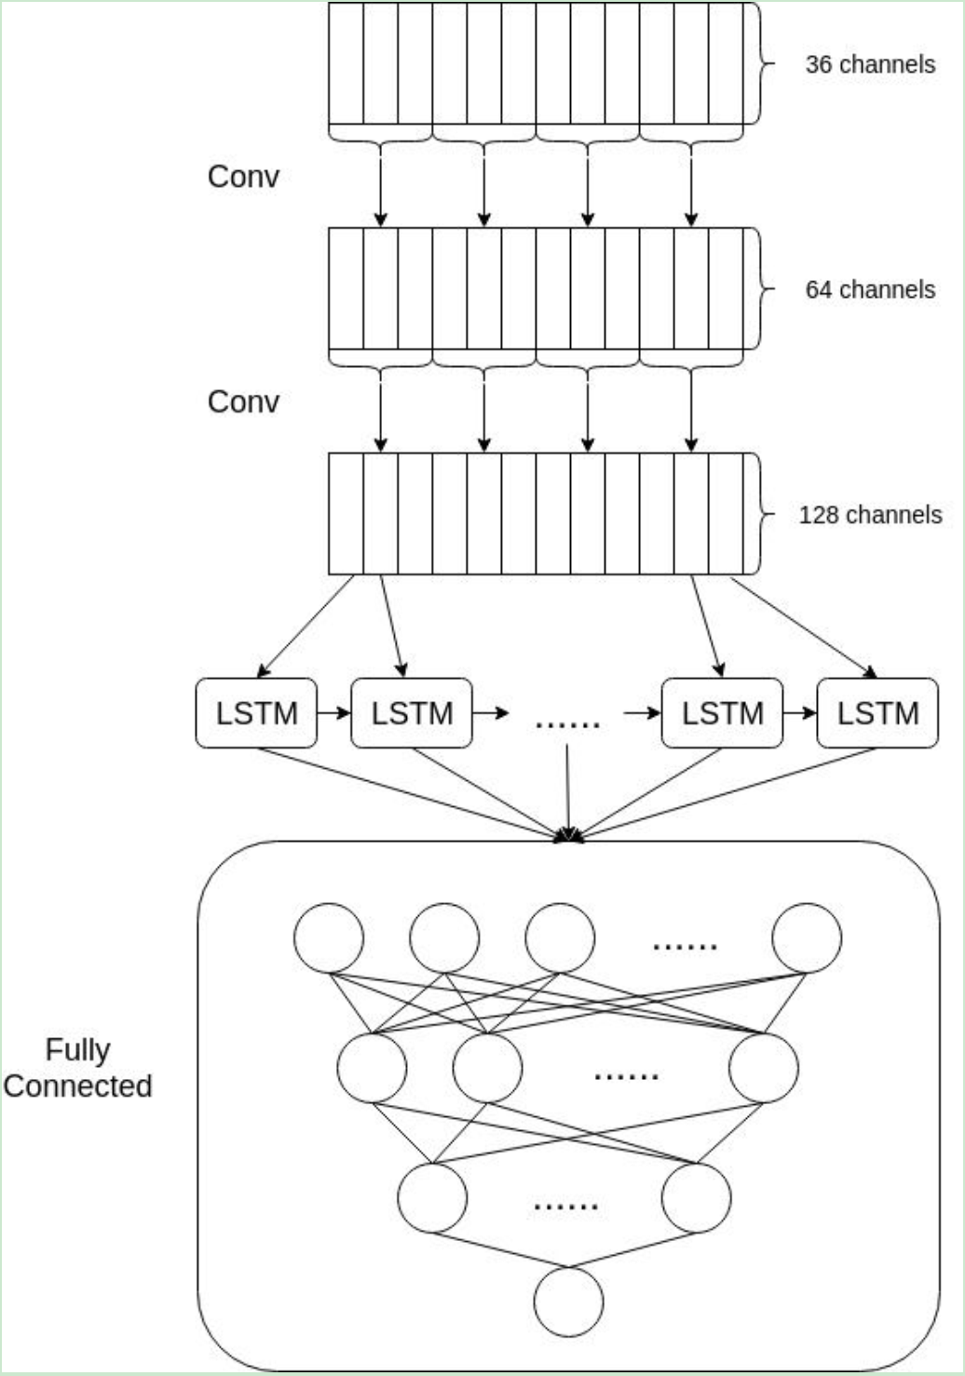
Experiment Results by different algorithms
﻿The first convolution layer will generate64 features based on the manually extracted features
﻿The second layer will extend them to 128 features
﻿The whole sequence of features will be feeded to LSTM and outputs have dimensionality of 64.
﻿A two-layer fully connected network is added to each output from LSTM.
﻿﻿Two dropout layers are added to the fully connected layers to avoid overfitting
Notes:
It is an imporved decision tree learning

Slide 14
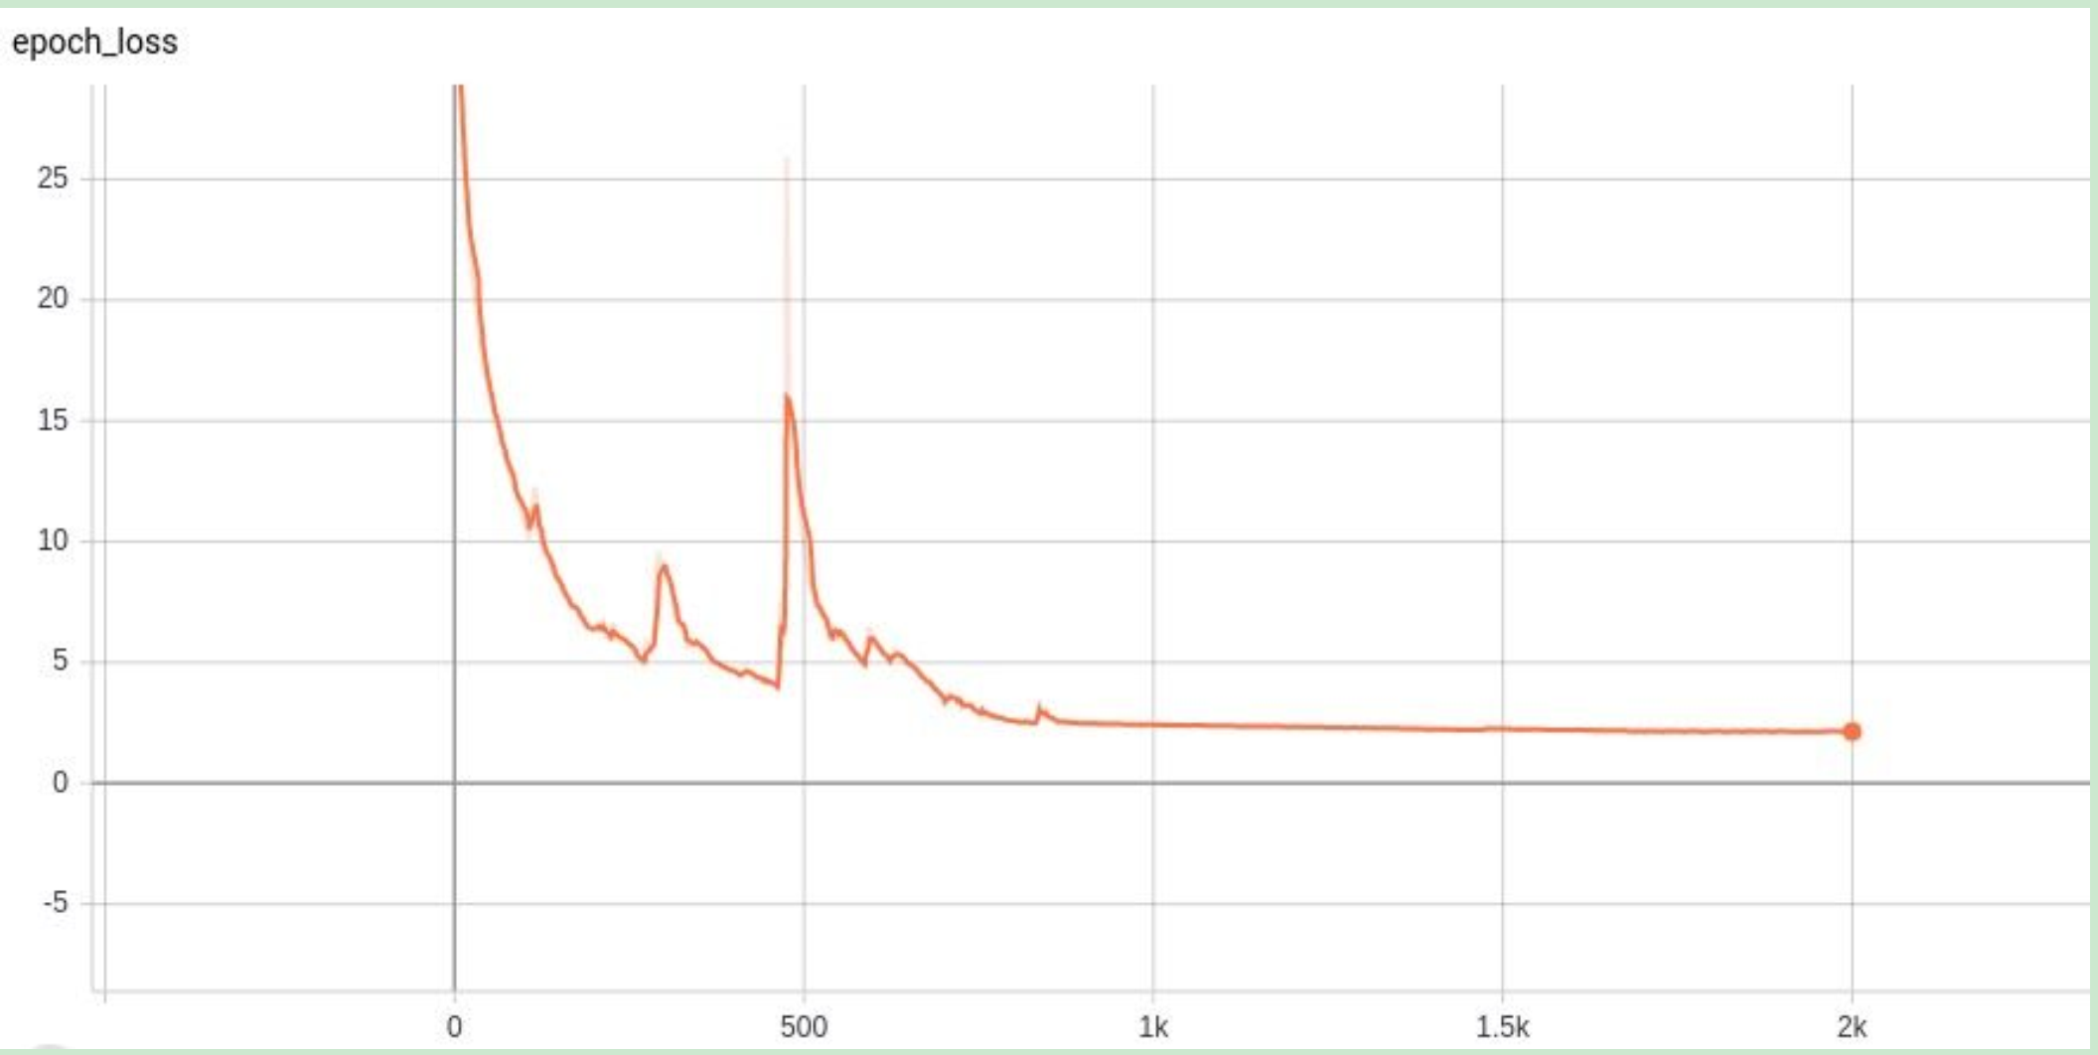
Experiment Results by different algorithms
﻿The learning rate to 0.0045 and it will decay exponentially every 850 epochs
﻿The loss after 2000 epochs is 2.14, and the mean absolute error on test data is 2.11
Notes:
It is an imporved decision tree learning

Slide 15
Conclusion
I predict when the earthquake will occur based on given acoustic data
I analyze the data and extract features based on ​Fourier transformation​.
Two baseline algorithm RF and SVM are trained in this project.
To improve the performance of prediction, I design a deep neural network combining convolution layers, recurrent neural network and fully connected layers to make sure that our model has strong representation power﻿.
For the future work, apart from bagging (e.g., random forest algorithm), there is another ensemble method - boosting that we can use to get better models. Several support vector regressors can be assembled to outperform a single model by giving samples that are not fitted perfectly higher weights
Notes:
It is an imporved decision tree learning

Slide 16
THANKS

