Slide 1
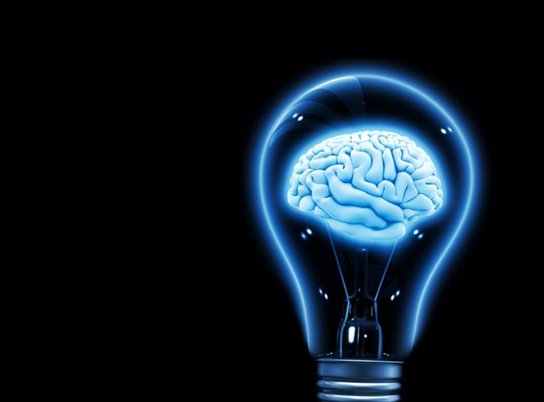
Feasibility of Using Machine Learning Algorithms to Determine Future Price Points of Stocks
By: Alexander Dumont

Slide 2
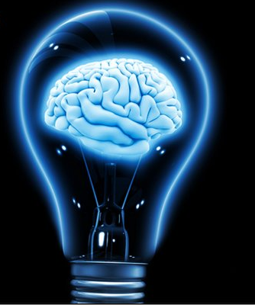
Introduction
The Stock Market is a gamble
Can Machine Learning algorithms predict future stock prices?
Which algorithm will perform best?
Accurate enough to confidently invest?

Slide 3
Organization
Stock info from YAHOO API
21 days of stock prices
Days close, open, high, low
Average to represent the whole days’ trading price
Classified data by stock price 21 days later
$$\left[\begin{matrix}1 \\ 2 \\ 3 \\ 4 \\ 5\end{matrix}\right]=\left[\begin{matrix}x>1.5 \\ 1.1<x<1.5 \\ .9≤x≤1.1 \\ .5≤x<.9 \\ x<.5\end{matrix}\right]$$
Strong Buy
Strong Sell

Slide 4
SQL Database
Extraction time from SQL was ~1 s for ~32,000 stock points
Have to run SQLSaver first time use
2015 data only
Could have run from 1960
Companies like AAPL would take precedence over newer companies
Skews results

Slide 5
Website Parser
Traverses 12 major websites (CNNmoney, WSJ, Bloomberg, etc.)
Compares phrases found with Loughran McDonald’s master dictionary
If phrase contains positive words, no negative words and a ticker, display phrase and ticker

Slide 6
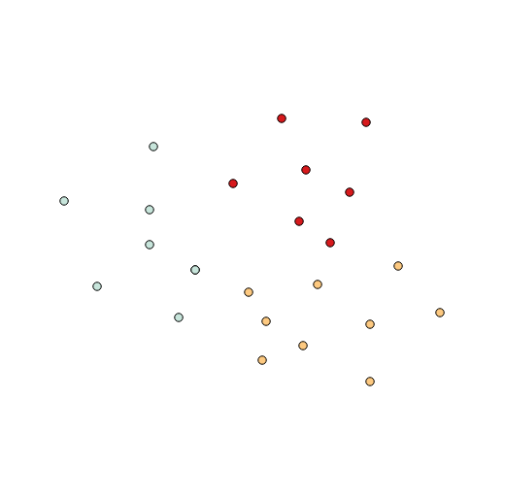
Naïve Bayes Algorithm
Naïve Bayes works well when feature collection is high
Independence between features
$P\left(C | F_{1},F_{2}…F_{n}\right)=\frac{P\left(C\right)P\left(F_{1},F_{2}…F_{n}\right)}{P\left(F_{1},F_{2}…F_{n}\right)}$
Probability of 21 features being in particular classifier is multiplication of:
P(C) $→$Probability of classifier (A priori)
P($F_{i})→$Probability of item being in C having $F_{i}$

Slide 7
Results
For 5 classifier
RMS: 1.77
% Accuracy: 14.23%
If item is classified at C3, it could just as likely be 1 or 5
For 3 classifier
RMS: 0.92
% Accuracy: 47.69

Slide 8
K Nearest Neighbor
One of simplest ML algorithms
Classify point in N-space by k neighbors and their classification
Majority vote based on weight of k nearest classifier
Changing distance algorithm did not produce changes
$$k$$ | $$RMS$$ | $$Accuracy$$
$$1$$ | $$0.68$$ | $$34\%$$
$$2$$ | $$0.68$$ | $$34\%$$
$$4$$ | $$0.65$$ | $$36\%$$
$$8$$ | $$0.64$$ | $$37\%$$
$$16$$ | $$0.59$$ | $$39\%$$
$$32$$ | $$0.57$$ | $$40\%$$
$$k$$ | $$Distance Algorithm$$ | $$RMS$$
$$2$$ | $$Chebyshev$$ | $$0.77$$
$$2$$ | $$Hellinger$$ | $$0.74$$
$$2$$ | $$Euclidean$$ | $$0.67$$

Slide 9
How kNN works
In $R^{2}$, for simplicity
k: 3
k: 2
k: 1

Slide 10
ANN (Artificial Neural Network)
Tries to make model that fits training data and apply it to test data
with and without back-propagation and epochs
Neural networks inspired by the brain of humans
Brain is incredibly complex
ANN is simplified version
Segregates into input, hidden, output neurons
Atypical to have this structure in human brain
Each connection (n2n) has weight associated with it

Slide 11
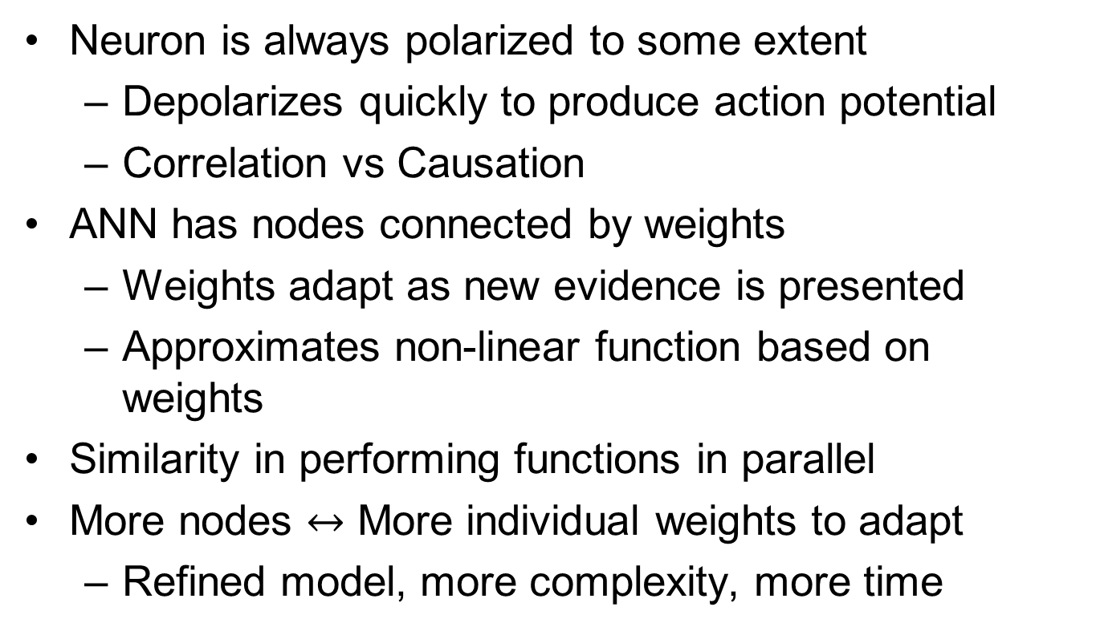
Comparison of ANN to Human Brain
Neuron is always polarized to some extent
Depolarizes quickly to produce action potential
Correlation vs Causation
ANN has nodes connected by weights
Weights adapt as new evidence is presented
Approximates non-linear function based on weights
Similarity in performing functions in parallel
More nodes $↔$ More individual weights to adapt
Refined model, more complexity, more time

Slide 12
Results of ANN
$$Percent values different test to train ratios$$
 | $$Training Error$$ | $$Testing Error$$
$$50/50$$ | $$56\%$$ | $$56\%$$
$$40/60$$ | $$57\%$$ | $$57\%$$
$$30/70$$ | $$56\%$$ | $$56\%$$
$$20/80$$ | $$56\%$$ | $$56\%$$
Tried the algorithm with different train to test ratio
Different epochs (how many times the algorithm does a forward/backward pass)
Different learning rate, momentum
$$Epochs$$ | $$Training Accuracy$$ | $$Testing Accuracy$$ | $$Time(s)$$
$$0$$ | $$0\%$$ | $$0\%$$ | $$1.50$$
$$100$$ | $$56\%$$ | $$55\%$$ | $$22.04$$
$$200$$ | $$57\%$$ | $$57\%$$ | $$38.53$$
$$Epoch$$ | $$Learning Rate$$ | $$Momentum$$ | $$Training Accuracy$$ | $$Testing Accuracy$$
$$10$$ | $$0.005$$ | $$0.01$$ | $$57\%$$ | $$57\%$$
$$10$$ | $$0.010$$ | $$0.01$$ | $$56\%$$ | $$56\%$$
$$10$$ | $$0.015$$ | $$0.01$$ | $$33\%$$ | $$34\%$$
$$10$$ | $$0.005$$ | $$0.02$$ | $$57\%$$ | $$57\%$$
$$10$$ | $$0.005$$ | $$0.005$$ | $$56\%$$ | $$57\%$$
ANN is pretty powerful tool in predicting stock prices.
Relatively time efficient.

Slide 13
Back-propagation Resilient Algorithm
Algorithm provided by ACCORD.NET
One of fastest learning algorithm for feed-forward learning
RMS: 0.75
20% accuracy on test data
Fast but not so accurate for 5 classification

Slide 14
Deep Neural Network
Functions the same way as ANN
Instead of 1 hidden layer, many hidden layers
Increased complexity and time
Overfitting seems to have occurred
Suffers ANN problem
modeling random events
$$Hidden Layers$$ | $$Epochs$$ | $$Time\left(s\right)$$ | $$Split$$ | $$Accuracy(\%)$$
$$[100, 10, 4]$$ | $$10$$ | $$163.45$$ | $$60/40$$ | $$36.23$$
$$\left[10,4\right]$$ | $$10$$ | $$24.16$$ | $$60/40$$ | $$36.23$$
$$\left[10,4,2\right]$$ | $$0$$ | $$36.34$$ | $$60/40$$ | $$36.23$$
$$\left[100,10,4,2\right]$$ | $$0$$ | $$240.65$$ | $$60/40$$ | $$36.23$$

Slide 15
C45 Learning
Algorithm made by J. Ross Quinlan
Uses information entropy to classify features to corresponding classifiers
Example: flipping coin
1st toss: maximum entropy, no way to distinguish if heads
2nd toss: probability goes towards previous toss, i.e. if previous was head, more chance of head this turn
Algorithm takes a long time to run: 45 minutes
Final accuracy: 52%
better than ANN/DNN

Slide 16
Support Vector Machine
Certain mapping between $x↔y$ where x is feature set, y is classifier
Set is shattered in Chervonenkis planes
Aim of SVN is to optimize placement of plane to maximize the gap between classifiers
Future data points fall on one side of the plane
2 different algorithms provided by
ACCORD.NET
LIBSVM.NET

Slide 17
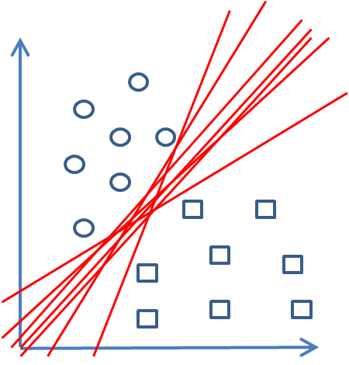
How Does SVM work?
Infinite solutions to produce line that separates circles and square
Find line that maximizes gap

Slide 18
Results
5 classifiers
ACCORD.NET
Could only do 5000 samples before getting Out of Memory Exception
Did 5000 training set, next 5000 testing set
Accuracy:57-60%
LIBSVM.NET
Split into 50/50 training testing sets
RMS: 1.26
Accuracy: 60%

Slide 19
What did I find out
Stock Market can be completely random
In this case, ML will fail, since it looks for pattern, no patterns in chaos
No model based algorithm provided accuracy we wanted
Reduce classifier #, better accuracy, not as much info
All algorithms seem to top out at 50-60% accuracy (not good enough)
Overfitting is a problem with ANN/DNN
All papers seem to do the same, overfit data

Slide 20
Conclusion
Algorithms tested did not have the sensitivity to correctly predict future prices
Alternative approaches
Web Parser seems better way to predict where a particular stock is going
Random dice would probably compare with these algorithms if they were allowed to trade

