Slide 1
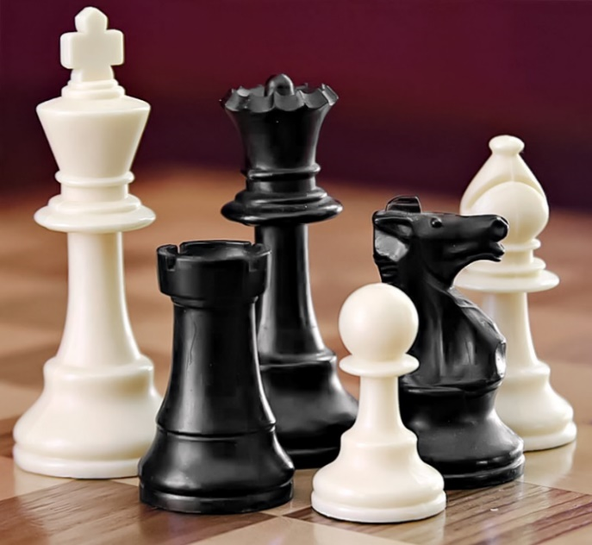
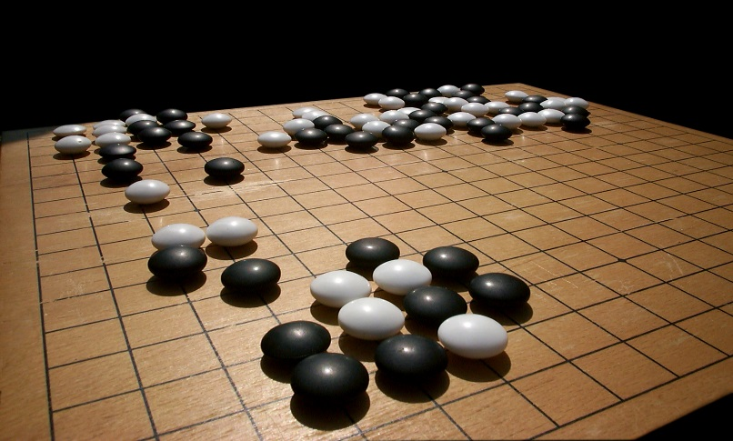
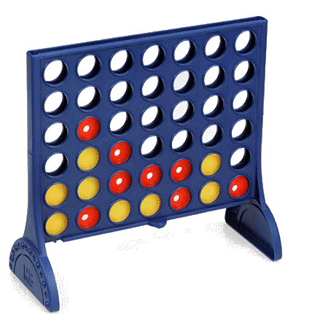
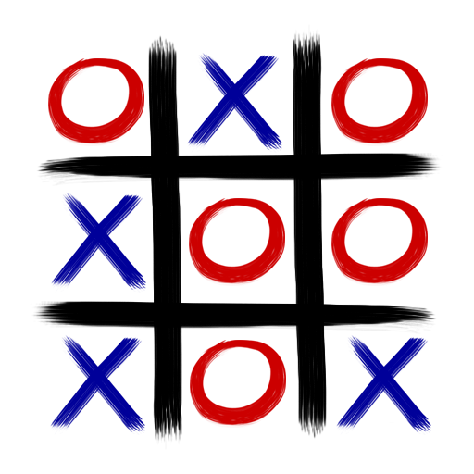
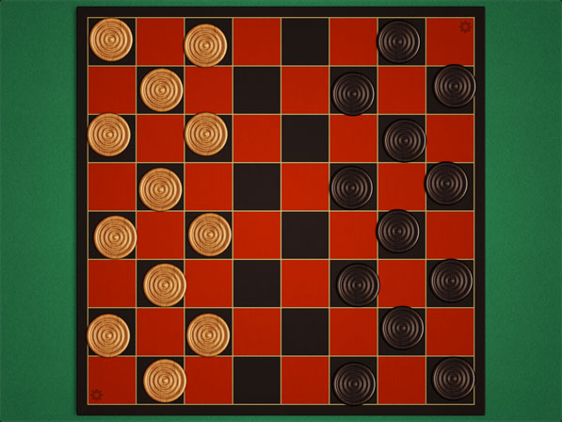
Understanding AI of 2 Player Games

Slide 2
Motivation
Not much experience in AI (first AI project) and no specific interests/passion that I wanted to explore before AI
Safe skill level for my experience and gain some learning.
Topic/subject matter doesn’t seem too abstract or complex to understand.
Rules of games are relatively easy follow
Optimal strategies for the games I chose were “relatively” simple
Allows me to implement one of the algorithms we learned in class to an actual program

Slide 3
Results of Project
Created unbeatable Tic-Tac-Toe but not “expert” Tic-Tac-Toe program
Created a somewhat intelligent Checkers program that plays reasonably intelligent in early to mid game but considerably less intelligently towards the end of a game (few pieces remaining)
No where close to unbeatable
Heuristics become difficult to design for more complex games.

Slide 4
General Methods for AI program for 2 Player Game
Transposition Tables
Limited Discrepancy Search
Intelligent Backtracking
Quiescence
Minimax Search ←This is what I try to implement
Alpha-Beta Pruning ←This is what I try to implement
Heuristic value ←Use more deterministic Heuristic values

Slide 5
Basic Structure of Application Code for both Checkers and TicTacToe
1 method to generate all possible next 1 turn moves for a game state.
Methods to set rules for the game board as well as the rules for AI program.
1 method for mini-max
1 method for mini-max-alpha-beta (tic-tac-toe only).
1 method to calculate final heuristic (checkers only).

Slide 6
AI algorithms
Used Mini-Max to make an unbeatable tic-tac-toe game (but not optimal) that can see every possible combination.
Used Alpha-Beta improvement to make an unbeatable tic-tac-toe game (but not optimal) in order to understand the difference in the recursive calls made to Mini-Max vs. Mini-Max-Alpha-Beta
Used Mini-Max to try to make an checkers AI program that can see 8 moves into the future without lag and 10 moves into future for Alpha-Beta without lag.

Slide 7
Heuristics
Checkers (based off strategies of Checkers players)
+120 for Kings and -120 for opposing Kings
+40 for Pawns and -40 for opposing Pawns
+25 for Edge positions
+10 for Back Row
+5 for each neighbor ally piece
Tic-Tac-Toe
Return +10 for win
Return -10 for loss
Return 0 for draw

Slide 8
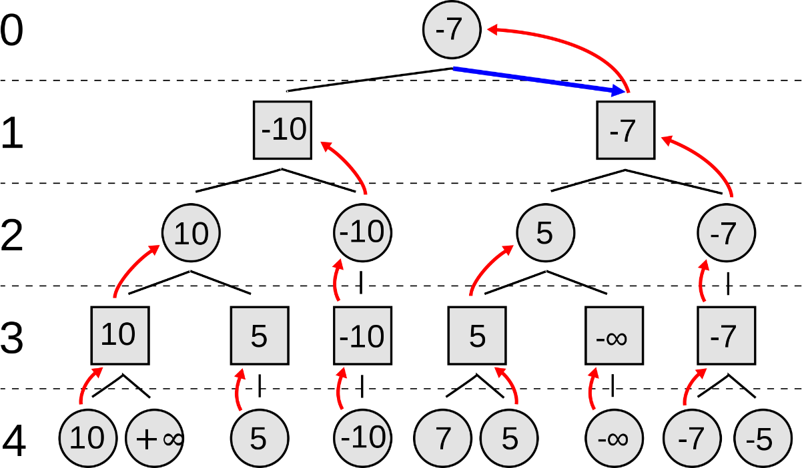
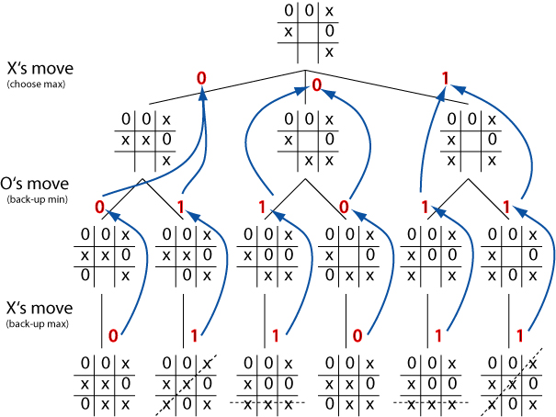
MiniMax
From a certain game state,
It simulates all possible “next” game states for the next X turns (X is determined by programmer for how into the future MiniMax will see), and returns the best value from these possibilities.

Slide 9
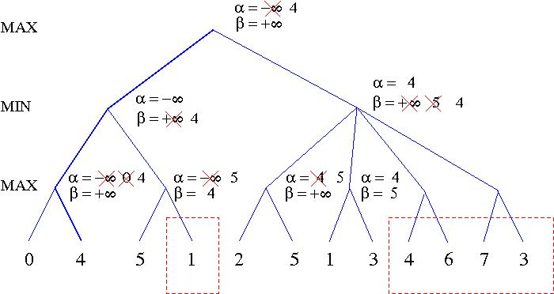
Alpha-Beta Modification to increase Efficiency of Minimax
Adds Alpha, Beta variables at each recursion call.
Alpha receives highest heuristic value, Beta receives lowest heuristic value
Whenever Alpha > Beta, you return Alpha to higher level recursion call to prune decision tree

Slide 10
Decision Tree Scale Comparison
Tic Tac Toe: Approximate moves per turn, max 9
Perfect 2 player game example for AI program
Able to create an unbeatable AI program without the use of an end-game database
Mini-Max is the only property necessary to solve
Connect 4:
Able to create an unbeatable AI program without the use of an end-game database
No need for Alpha-Beta Prune.
Unbeatable in 1989 (first player always wins or draws)
Checkers (one million times more complex than connect 4):
Chinook, 2007, unbeatable AI program. Perfect players always end in draw.
parallel processing
Chess: Approximate moves per turn is 20
parallel processing
Requires heuristics (estimates) so you know for sure not optimal. State space is too huge to be solved by deterministic turing machine.
NP problem?
Go: Approximate moves per turn is 200
NP problem?

Slide 11
observations
Not much difference between TTT vs Checkers program besides the algorithm to generate all next possible states. (Considerably more annoying for Checkers)
Heuristics have more flexible for Checkers. No need for more complex heuristics for TTT
You can see how much more annoying it will get for GO and Chess.
Increase in number of combinations TTT vs Checkers
TTT combinations decreased as game went further.
Checkers combinations increased as game went further as more pieces had options to move.
Program ran much slower towards the middle part of game.
Tic-Tac-Toe
If AI goes first, it sometimes chooses the 12 O’Clock, 3 O’Clock, 6 O’Clock, and 9 O’Clock positions. It set heuristic values for all 9 possible positions to 0. Assumes player it plays against is optimal. Loses opportunities to win easily against naïve players.
Checkers (some similarities to Humans)
The lower the depths, the more defensive the AI programs tended to play. Makes sense intuitively since you tend to play cautious if you can predict what is going on next. Clump units together. Game turns increased as a result.
AI interestingly kept all of its units at the back as long as possible. Similar to how some expert chess players play.
AI programs took more risks at greater depths.
Infinite loop when AI vs AI towards end.

Slide 12
Improvements that COULD have been made
My checkers AI program ran too slow if I allowed it to search into the future > 8 moves for min-max and >10 for alpha beta prune.
Could have used a file to store states
My heuristic function may have been too basic
Not enough stack memory in IDE to run an algorithm that considers chain kills >2.
Could have considered additional AI methods (evaluator methods, etc.)
Wasted too much time due to incorrect assumptions.

Slide 13
Some Philosophical thoughts I thought about
What is the missing link between AI and Human Int.
Self-Learning algorithms
Psychological behavior analysis
Humans don’t know if there is an unbeatable AI for chess or GO because we don’t understand limitations of human intelligence
Unbeatable checkers program (Chinook) relied on moves from Checkers Grand Masters, instead of self-learning
Humans have not been able to solve P = NP problem

Slide 14
Continued.
Experienced human players are good at ruling out an entire decision branches based on subconscious tendencies
AI programs are good at precision searching very fast. (brute-force) humans are not capable of doing.
AI programs have a more difficult time than Human beings at considering decision trees that have don’t have an obvious outcome (“better” or “worse” moves are fuzzy), but experienced players are able to see based on experiences. Example: GO
AI players cannot consider Psychology of opponent.

