Slide 1
Probability and Statistics for Computer Scientists Third Edition, By Michael Baron Section 9.1: Parameter estimation CIS 2033. Computational Probability and Statistics Pei Wang

Slide 2
Parameters of distributions
After determining the family of distribution, the next step is to estimate the parameters
Example 9.1: The number of defects on each chip is believed to follow Pois(λ)
Since λ = E(X) is the expectation of a Poisson variable, it can be estimated with a sample mean X-bar
This correspondence can be extended

Slide 3
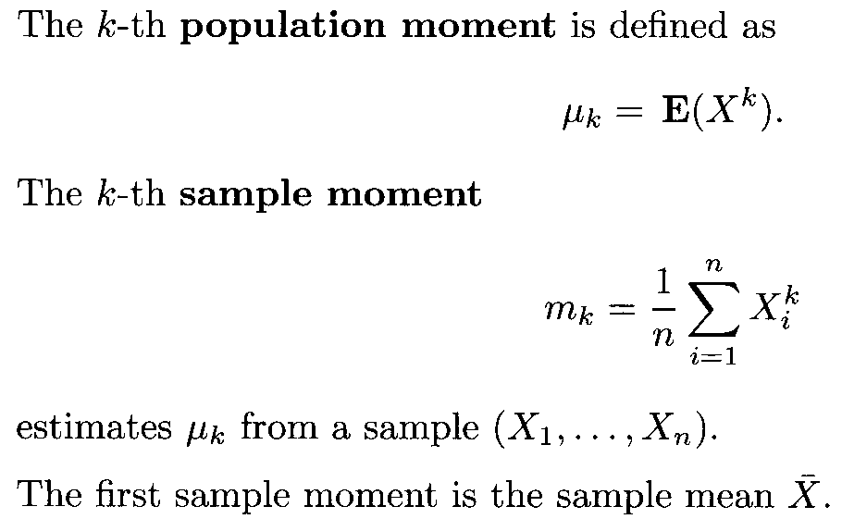
Moments

Slide 4
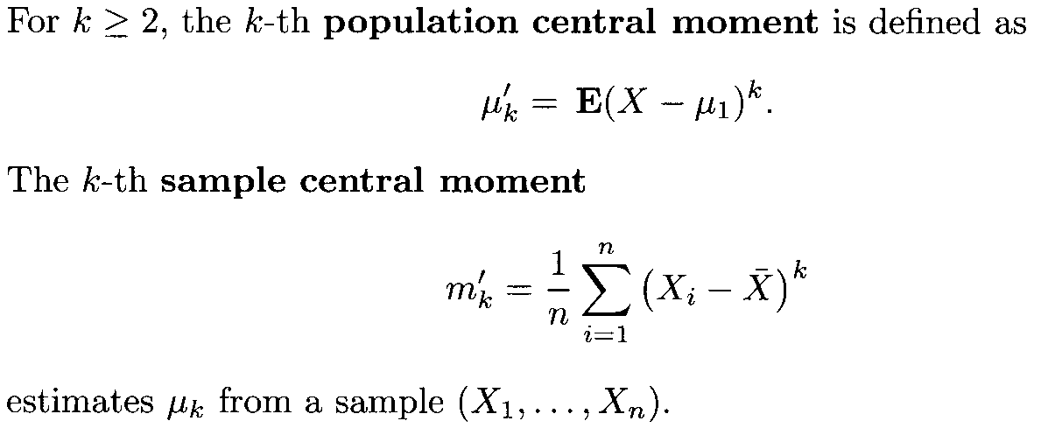
Central moments
Special cases: μ’₂ = Var(X), and m’₂ ≈ s²

Slide 5
Calculating sample moments
Given 10 numbers, find m₁, m₂, m’₁, m’₂
DATA |  |  |  |  |  |  |  |  |  |  | AVG | MOMENT
X_{i} | 1 | 0 | 3 | 1 | 2 | -2 | 1 | 3 | -1 | 2 | 1 | m₁
X_{i}² | 1 | 0 | 9 | 1 | 4 | 4 | 1 | 9 | 1 | 4 | 3.4 | m₂
X_{i} − X-bar | 0 | -1 | 2 | 0 | 1 | -3 | 0 | 2 | -2 | 1 | 0 | m'₁
(X_{i} − X-bar)² | 0 | 1 | 4 | 0 | 1 | 9 | 0 | 4 | 4 | 1 | 2.4 | m'₂

Slide 6
Method of moments
To estimate k parameters, we may equate the first k population and sample moments (or their centralized version), i.e.
μ₁ = m₁ , … …, μ_{k} = m_{k}
where the left-hand sides of these equations decide the parameters, while the right-hand sides can be computed from data
The method of moments finds estimators by solving the above equations

Slide 7
Method of moments example
The CPU time for 30 randomly chosen tasks of a certain type are (in seconds)
9 15 19 22 24 25 30 34 35 35
36 36 37 38 42 43 46 48 54 55
56 56 59 62 69 70 82 82 89 139
If they are the values of a random variable X, what is the model?

Slide 8
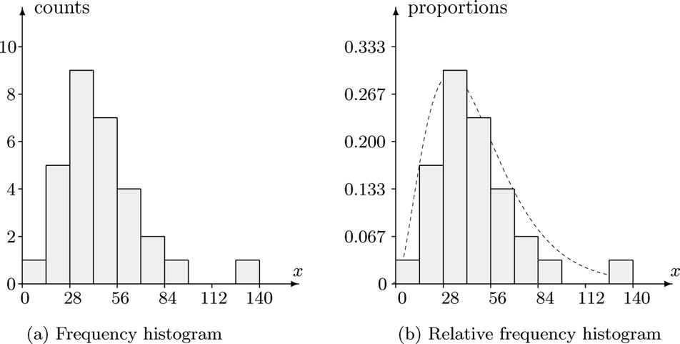
Method of moments example (2)
The histogram of the data:

Slide 9
Method of moments example (3)
It does not look like any of the following …

Slide 10
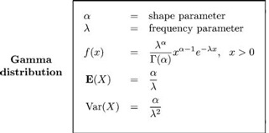
Method of moments example (4)
… but this one:

Slide 11
Method of moments example (5)
From data, we compute
and use two equations
Solving them for α and λ, we get

Slide 12
Water-pump simulation revisited
Inter-arrival times: Exp(λ)
Since E[X] = 1/λ, λ can be estimated by 1/m₁
Service requirement: U(a, b)
The parameter a and b can be estimated from
m₁ ≈ (a + b) / 2, m’₂ ≈ (b − a)² / 12
So [a, b] ≈ [m₁ − (3m’₂)^{1/2}, m₁ + (3m’₂)^{1/2}]

Slide 13
Method of maximum likelihood
Maximum likelihood estimator of a parameter is the value that maximizes the likelihood of the observed sample, L(x₁, …, x_{n})
L(x₁, …, x_{n}) is defined as p(x₁, …, x_{n}) for a discrete distribution, and f(x₁, …, x_{n}) for a continuous distribution
When the variables X₁, …, X_{n} are independent, L(x₁, …, x_{n}) is obtained by multiplying the marginal pmfs or pdfs

Slide 14
Likelihood
A simple example: You learned that a coin is biased and the probability for one side is 0.6, though you don’t know which side, so there are two hypotheses: Ber(0.6) and Ber(0.4)
You tossed three times and got dataset D: 0 1 0
If it is Ber(0.6), L(D) = 0.4 * 0.6 * 0.4
If it is Ber(0.4), L(D) = 0.6 * 0.4 * 0.6
The so Ber(0.4) explains D better

Slide 15
Maximum likelihood
Maximum likelihood estimator is the parameter value that maximizes the likelihood L(θ) of the observed sample, x₁, …, x_{n}
When the observations are independent of each other, L(θ) =
p_{θ}(x₁)*...*p_{θ}(x_{n}) for a discrete variable
f_{θ}(x₁)*...*f_{θ}(x_{n}) for a continuous variable
Which is a function with θ as variable

Slide 16
Where is the maximum value
We only consider two types of L(θ):
If the function always increases or decreases, the maximum value is at the boundary, i.e., the min or max of θ
If the function first increases then decreases, the maximum value is at where its derivative L’(θ) is zero

Slide 17
Example of Type 1
To estimate the θ in U(0, θ) given positive data x₁, …, x_{n}, e.g., 20, 35, 41, 29, 8, 30
L(θ) is 1/θ^{n} when θ ≥ max(x₁, …, x_{n}), otherwise 0
Since L(θ) is a decreasing function when θ ≥ max(x₁, …, x_{n}), the best estimator is 41
Similarly, if x₁, …, x_{n} are generated by U(a, b), the maximum likelihood estimate is
a = min(x₁, …, x_{n}), b = max(x₁, …, x_{n})

Slide 18
Example of Type 2
If the distribution is Ber(p), and m of the n sample values are 1, e.g., 0, 1, 1, 1, 0, n=5, m=3
L(p) = p^{m}(1 – p)^{n–m}
L’(p) = mp^{m–1}(1 – p)^{n–m} – p^{m}(n – m)(1 – p)^{n–m–1}
= (m – np)p^{m–1}(1 – p)^{n–m–1}
L’(p) is 0 when p = m/n, which also covers the situation where p is 0 or 1
So the sample mean is a maximum likelihood estimator of p in Ber(p)

Slide 19

Example of incomplete pmf
Estimate p(5) and p(6) from the given dataset
Let p(5) = θ, then p(6) = 1 – (0.6 + θ) = 0.4 – θ
L(θ) = 0.1¹²$×$ 0.1¹⁰$×$ 0.2¹⁹$×$ 0.2²³$×$θ⁹$×$(0.4–θ)²⁷
L’(θ) = C[9θ⁸ (0.4–θ)²⁷ – 27θ⁹ (0.4–θ)²⁶] = 0
9θ⁸ (0.4–θ)²⁷ = 27θ⁹ (0.4–θ)²⁶, 0.4–θ = 3θ, θ = 0.1
a | 1 | 2 | 3 | 4 | 5 | 6
p(a) | 0.1 | 0.1 | 0.2 | 0.2 | ? | ?
count | 12 | 10 | 19 | 23 | 9 | 27

Slide 20
Log-likelihood
Log function turns multiplication into addition, and power into multiplication
E.g. ln(f × g) = ln(f) + ln(g)
ln(f ^{g}) = g × ln(f)
Log-likelihood function and likelihood function reach maximum at the same value
Therefore, ln(L(θ)) may be easier for getting maximum likelihood

Slide 21
Log-likelihood (2)
E. g., L(p) = p^{m}(1 – p)^{n–m}
ln(L(p)) = m(ln(p)) + (n – m)(ln(1 – p))
[ln(L(p))]’ = m/p – (n – m)/(1 – p)
m/p – (n – m)/(1 – p) = 0
m/p = (n – m)/(1 – p)
m – mp = np – mp
p = m/n

Slide 22
Competing estimators
A parameter may have multiple estimators derived using different methods
For example, variance (also known as μ’₂, the 2nd population central moment) has an unbiased estimator s² (sample variance), as well as a maximum likelihood estimator m’₂ (the 2nd sample central moment), and they are different

Slide 23
Comparing estimators
For an estimator T for parameter θ, its standard error is Std(T), which and the bias of T indicate the quality of an estimator

Slide 24
Mean squared error
When both the bias and variance of estimators are known, usually people prefer the estimator with the smallest mean squared error (MSE)
For estimator T of parameter θ,
MSE(T) = E[(T − θ)²] = E[T²] −2θE[T] + θ²
= Var(T) + (E[T] − θ)²
= Var(T) + Bias(T)²
MSE summarizes variance and bias

Slide 25
MSE example
Let T₁ and T₂ be two unbiased estimators for the same parameter θ based on a sample of size n, and it is known that
Var(T₁) = (θ + 1)(θ − n) / (3n)
Var(T₂) = (θ + 1)(θ − n) / [(n + 2)n]
Since n + 2 > 3 when n > 1, MSE(T₁) > MSE(T₂) , so T₂ is a better estimator for all values of θ

Slide 26
MSE example (2)
Let T₁ and T₂ be two estimators for the same parameter, and it is known that
Var(T₁) = 5/n², Bias(T₁) = -2/n
Var(T₂) = 1/n², Bias(T₂) = 3/n
MSE(T₁) = (5 + 4) / n²
MSE(T₂) = (1 + 9) / n²
Since MSE(T₁) < MSE(T₂) for all n values, T₁ is a better estimator for the parameter

Slide 27
Summary
1. The method of moments
2. The method of maximum likelihood
3. Mean-Squared Error

