Slide 1
Probability and Statistics for Computer Scientists
Third Edition, By Michael Baron
Chapter 4:
Continuous Distributions
CIS 2033. Computational Probability and Statistics Pei Wang

Slide 2
Continuous random variables
A continuous random variable can take any value in an interval, open or closed, so it has innumerable values
Examples: the height or weight of a chair
For such a variable X, the probability assigned to an exact value P(X = a) is always 0, though the probability for it to fall into interval [a, b], that is, P(a ≤ X ≤ b), can be a positive number

Slide 3
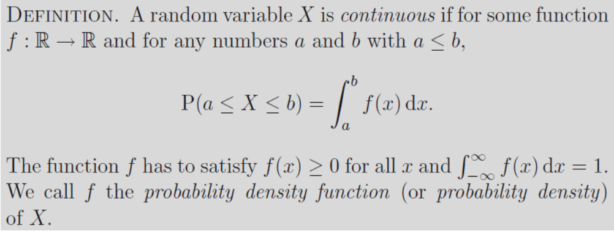
Probability density function
One way to get P(a ≤ X ≤ b): to integrate the probability density function of X

Slide 4
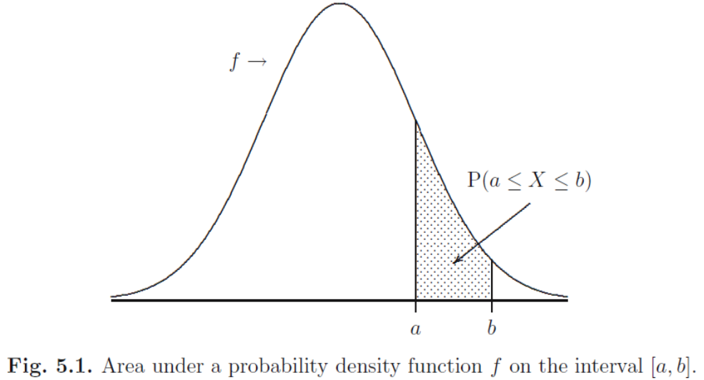
Probability density function (2)
P(a ≤ X ≤ b) = P(a < X ≤ b) = P(a < X < b) = P(a ≤ X < b)

Slide 5
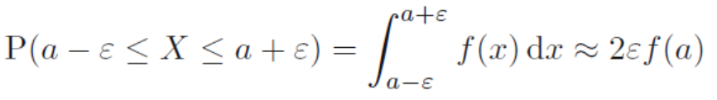
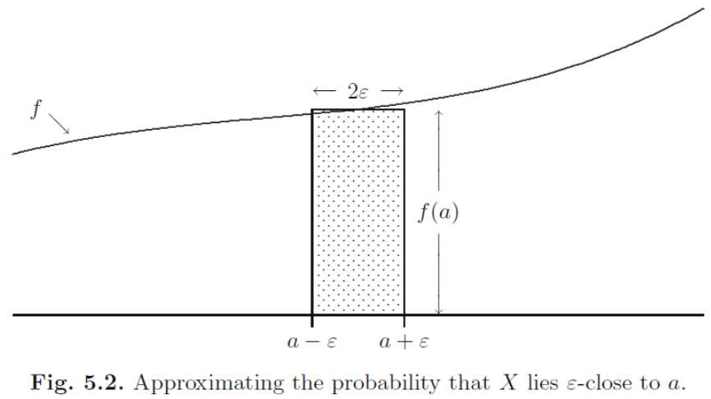
Probability density function (3)

Slide 6

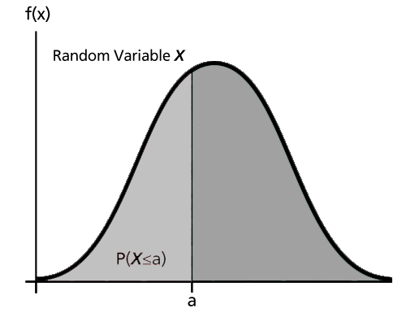
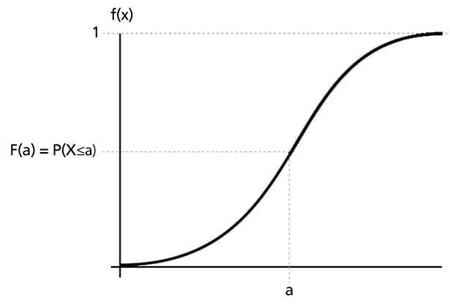
Cumulative distribution function
F(b) is still defined as P(X ≤ b), or P(-∞ < X ≤ b)

Slide 7
Cdf (2)
Another way to get P(a ≤ X ≤ b):
P(a < X ≤ b) = P(X ≤ b) – P(X ≤ a) = F(b) – F(a)
A discrete random variable has no pdf f(x), a continuous random variable has no useful pmf p(x), but both have cdf F(x)
 |  | Discrete
 | P(E) | p(a) = P(X = a)
Continuous | f(a) ≈ P(a-ε < X < a+ε)/2ε | F(a) = P(X ≤ a)
P | p
f | F

Slide 8
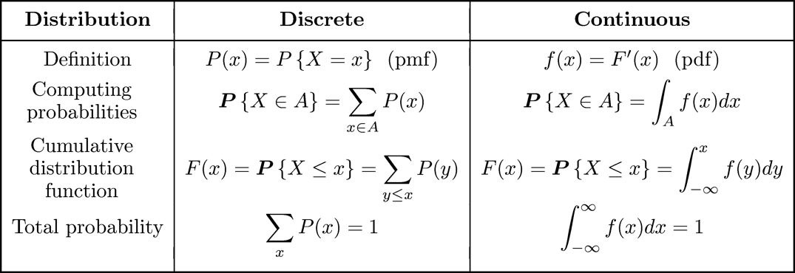
Pmf p(x) versus pdf f(x)

Slide 9
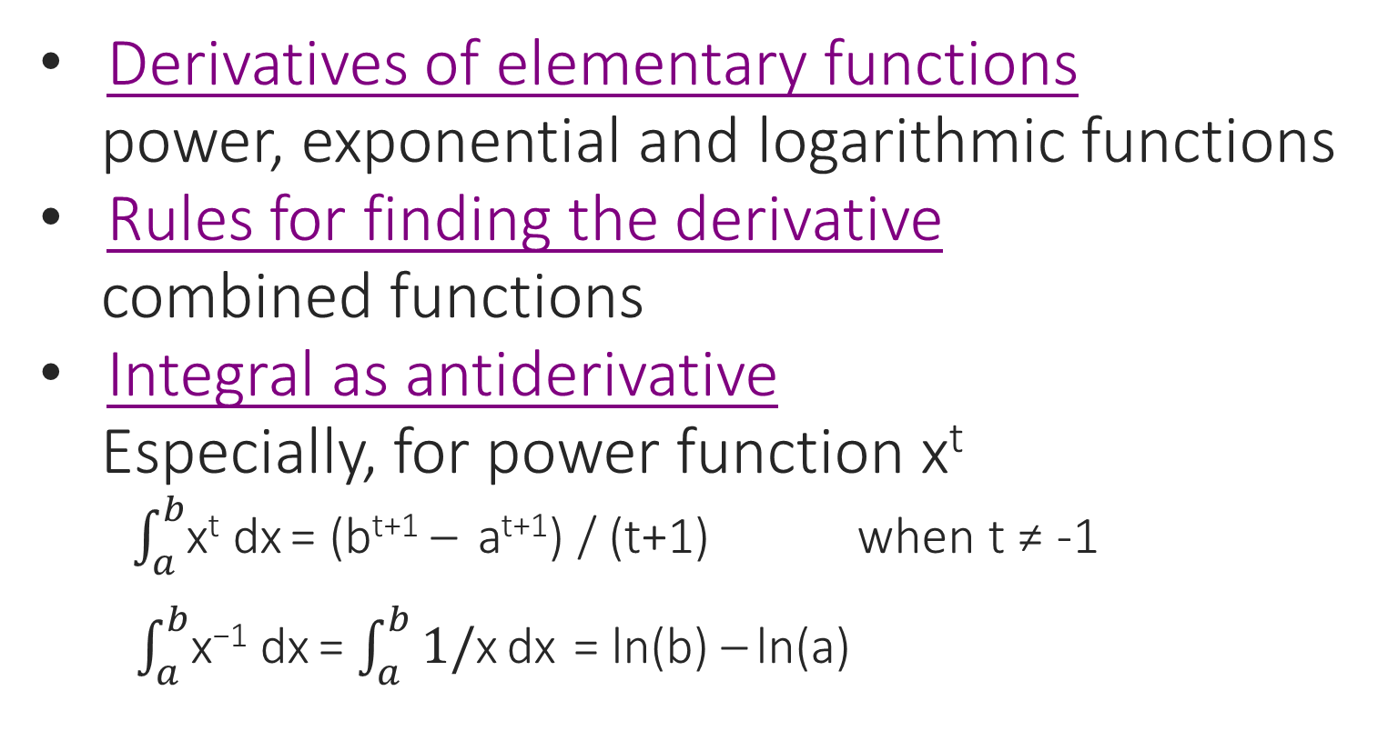
Review: derivative and integral
Derivatives of elementary functions
power, exponential and logarithmic functions
Rules for finding the derivative
combined functions
Integral as antiderivative
Especially, for power function x^{t}
$\int_{a}^{b}{\text{x}\text{t}}$dx = (b^{t+1} – a^{t+1}) / (t+1) when t ≠ -1
$\int_{a}^{b}{\text{x}\text{−1}}$dx = $\int_{a}^{b}{\text{1/}\text{x}}$dx = ln(b) – ln(a)

Slide 10
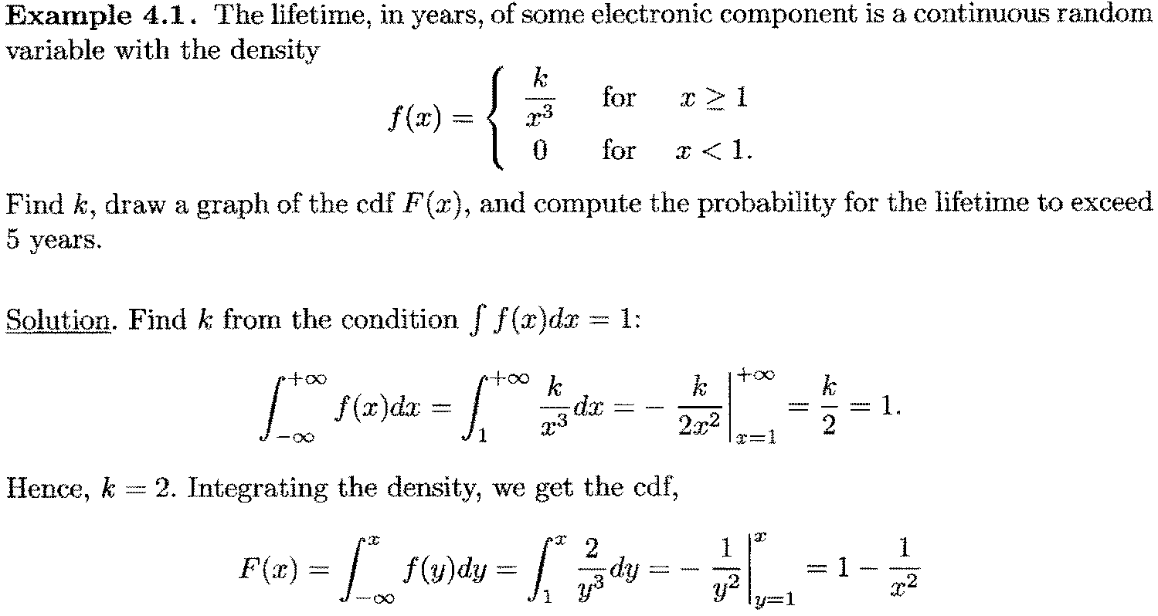
Example 4.1 (1)

Slide 11
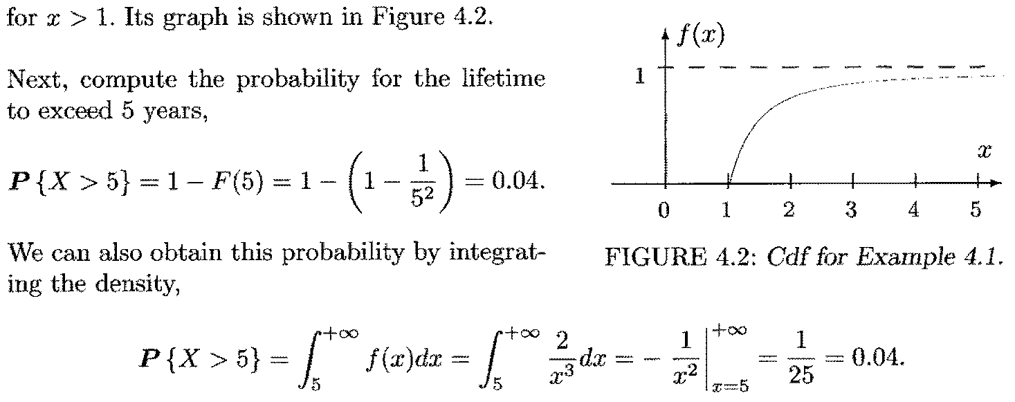
Example 4.1 (2)

Slide 12
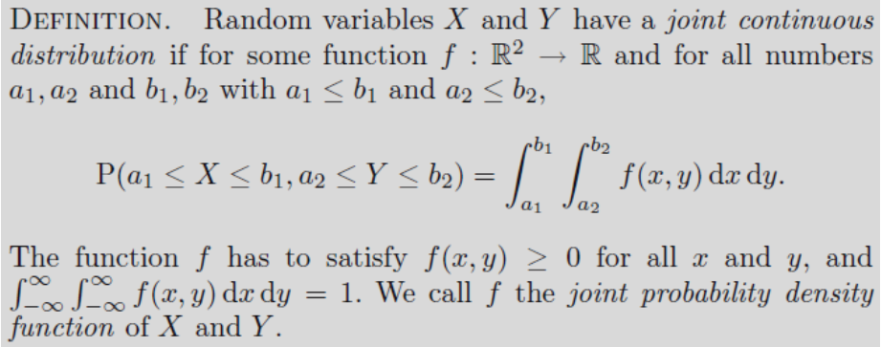
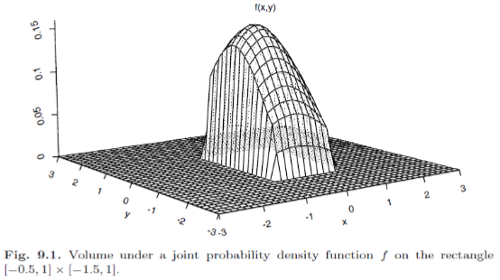
Joint distributions: continuous

Slide 13
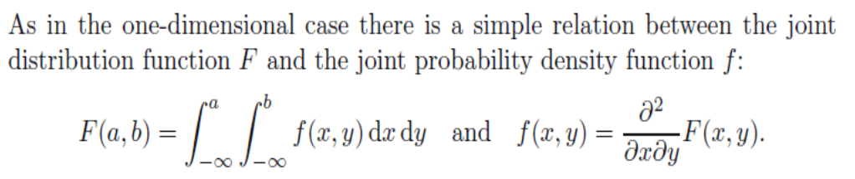
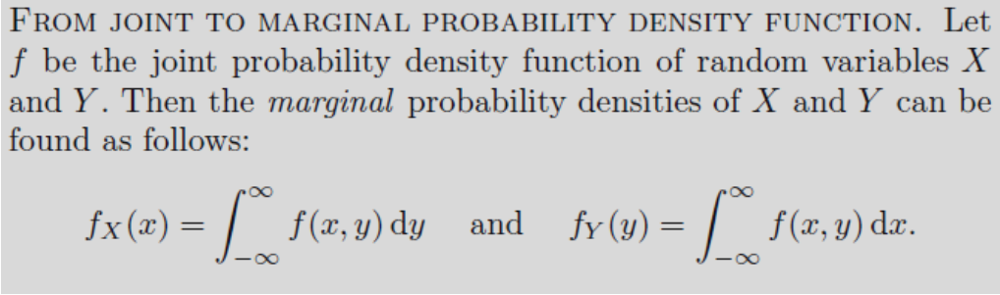
Joint distributions: continuous (2)

Slide 14
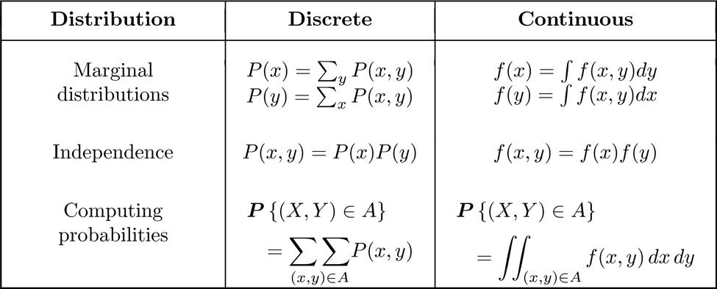
Pmf p(x) versus pdf f(x): joint

Slide 15

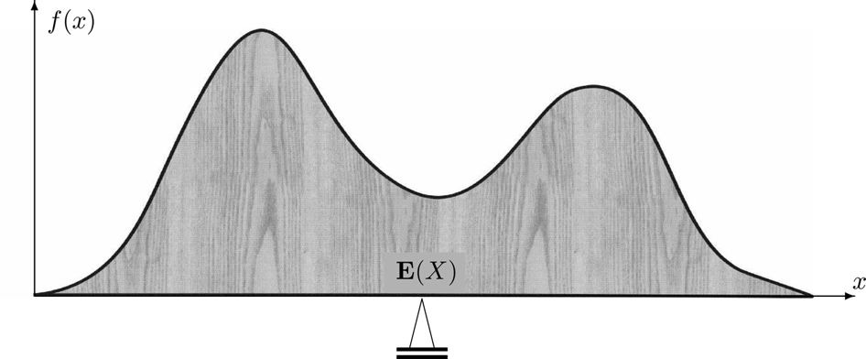
Expectation of continuous variable

Slide 16
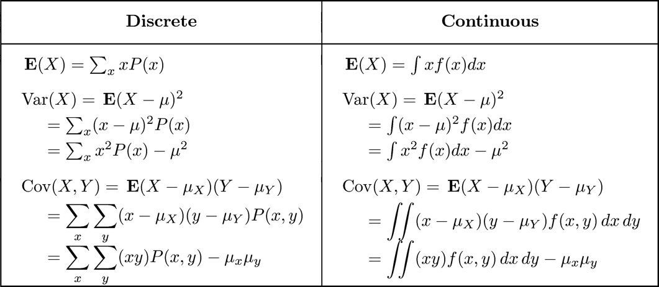
p(x) vs. f(x): E[X] and Var(X)

Slide 17
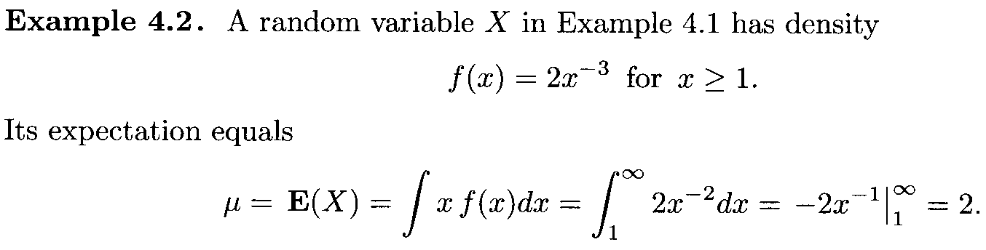
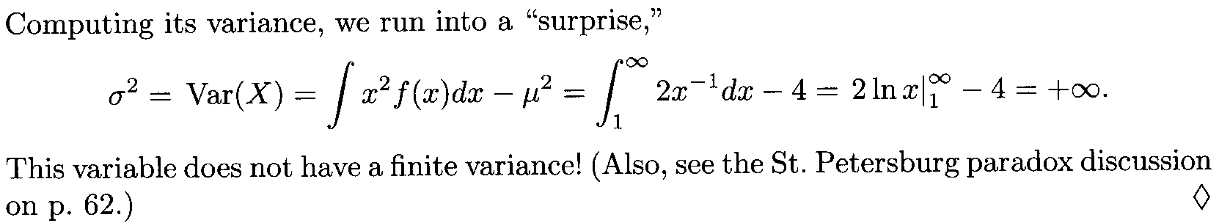
Example 4.2

Slide 18
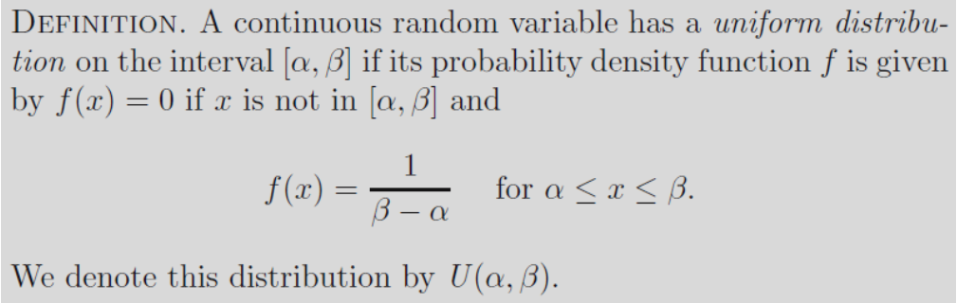
Uniform distribution
The distribution function F of a random variable that has a U(α, β) distribution is given by
F(x) = 0 if x < α
F(x) = (x − α) / (β − α) if α ≤ x ≤ β
F(x) = 1 if x > β

Slide 19
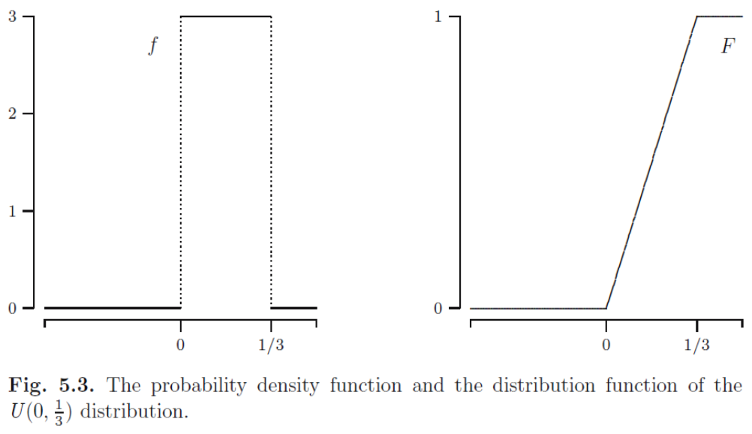
Uniform distribution (2)

Slide 20
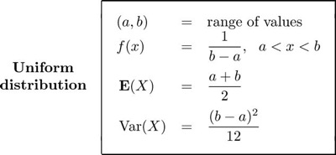
Uniform distribution (3)
U(0, 1) is called Standard Uniform distribution
Its density is f(x) = 1 for 0 < x < 1
If X is U(a, b), then Y = (X – a) / (b – a) is U(0, 1)

Slide 21
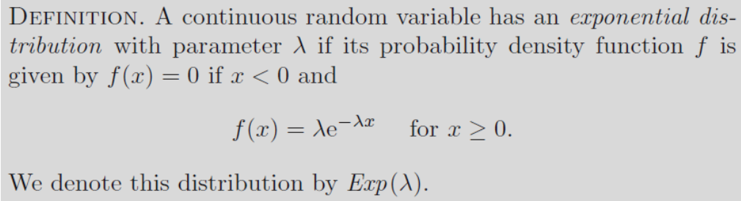

Exponential distribution
When the number of events is Poisson, the time between events is exponential
E[X] = 1 / λ, Var(X) = 1 / λ²

Slide 22
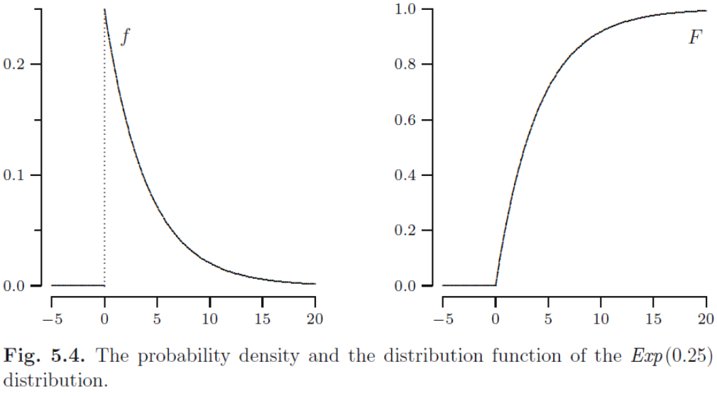
Exponential distribution (2)

Slide 23
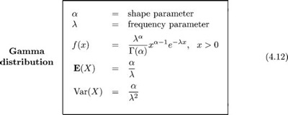
Gamma distribution
When a process consists of α independent steps, and each step takes Exp(λ) amount of time, then the total time has a distribution Gamma(α, λ), though α may not be an integer

Slide 24
Gamma distribution (2)

Slide 25
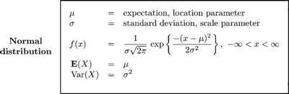
Normal distribution
Normal (Gaussian) distribution N(μ,σ²) is often used as a model for physical variables like weight, height, temperature, or examination grade.

Slide 26
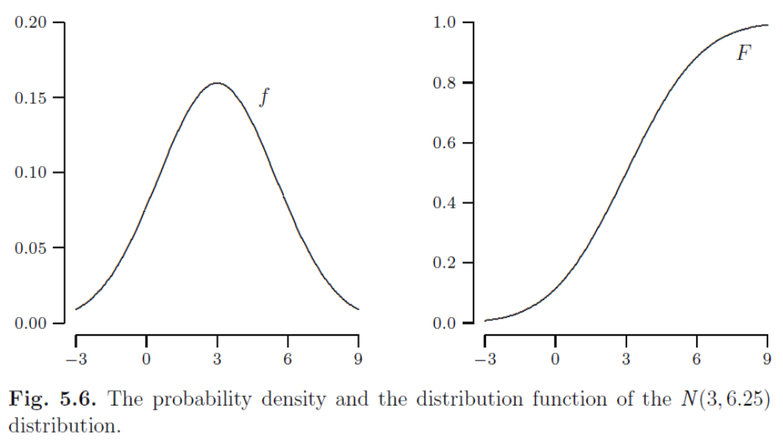
Normal distribution (2)

Slide 27

Normal distribution (3)
Bin(n, p) ≈ N(np, np(1 – p)) when n is large, and p is moderate. Example: bean machine
N(0, 1) is called Standard Normal distribution, written as φ(x). See Table A4.

Slide 28
Central Limit Theorem
The Central Limit Theorem (CLT) states that, in most situations, when many independent random variables of the same type are added, their properly normalized sum tends toward a normal distribution, even if the original variables themselves are not normally distributed, that is, they can have any distribution

Slide 29



Central Limit Theorem (2)
Let X₁, X₂,… be independent random variables with the same expectation μ = E(X_{i}) and the same standard deviation σ = Std(X_{i}), and let
As n → ∞, the standardized sum
converges in distribution to a Standard Normal random variable for all z

Slide 30
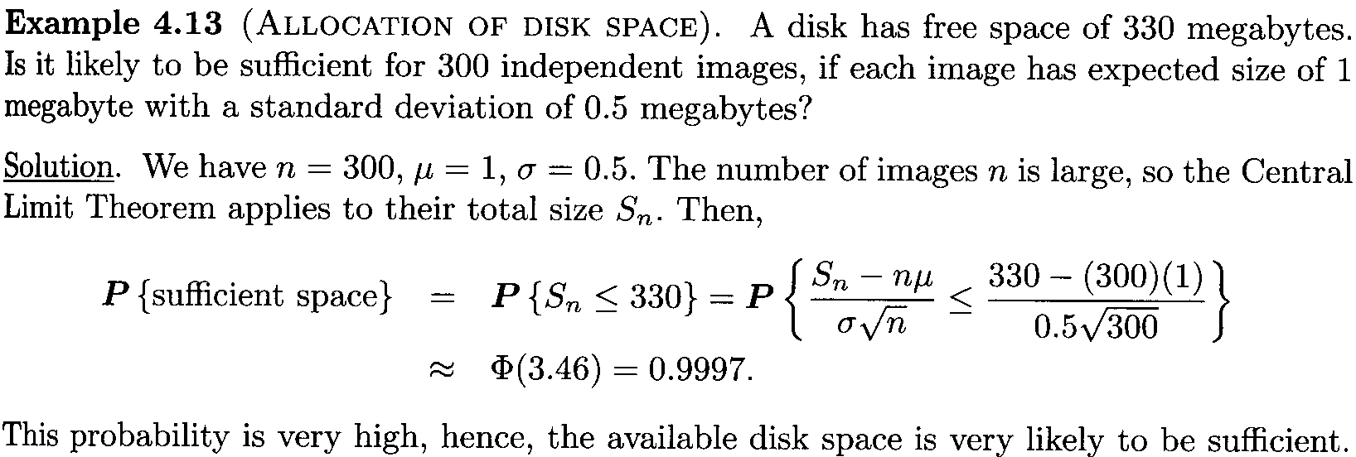
Central Limit Theorem (3)

Slide 31
Summary
1. Continuous random variable X
P(a ≤ X ≤ b) from f_{X} and F_{X}
2. Random vector (X, Y)
f_{(X,Y)} and F_{(X,Y)}, Independence
3. Features
E[X], Var(X)
4. Families
U(α, β), Exp(λ), Gamma(α, λ), N(μ, σ²)

Slide 32
Summary (2)
FAMILY | f(x) | E[X] | Var(X)
U(α, β) | 1 / (β − α) for α ≤ x ≤ β | (α + β) / 2 | (β − α)² / 12
Exp(λ) | λe^{-λx} for λ ≥ 0 | 1 / λ | 1 / λ²
Gamma(α, λ) |  | α / λ | α / λ²
N(μ, σ²) |  | μ | σ²

