Slide 1
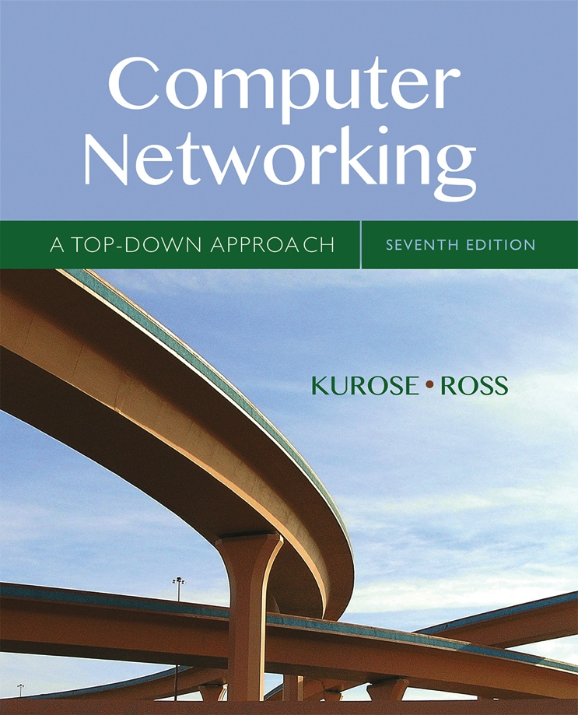

Chapter 5
Network Layer:
The Control Plane
A note on the use of these Powerpoint slides:
We’re making these slides freely available to all (faculty, students, readers). They’re in PowerPoint form so you see the animations; and can add, modify, and delete slides (including this one) and slide content to suit your needs. They obviously represent a lot of work on our part. In return for use, we only ask the following:
Computer Networking: A Top Down Approach
If you use these slides (e.g., in a class) that you mention their source (after all, we’d like people to use our book!)
If you post any slides on a www site, that you note that they are adapted from (or perhaps identical to) our slides, and note our copyright of this material.
Thanks and enjoy! JFK/KWR
All material copyright 1996-2016
J.F Kurose and K.W. Ross, All Rights Reserved
7th edition
Jim Kurose, Keith Ross
Pearson/Addison Wesley
April 2016

Slide 2
Chapter 5: network layer control plane
chapter goals: understand principles behind network control plane
traditional routing algorithms
SDN controlllers
Internet Control Message Protocol
network management
and their instantiation, implementation in the Internet:
OSPF, BGP, OpenFlow, ODL and ONOS controllers, ICMP, SNMP

Slide 3
Chapter 5: outline
5.1 introduction
5.2 routing protocols
link state
distance vector
5.3 intra-AS routing in the Internet: OSPF
5.4 routing among the ISPs: BGP
5.5 The SDN control plane
5.6 ICMP: The Internet Control Message Protocol
5.7 Network management and SNMP

Slide 4
Network-layer functions
Recall: two network-layer functions:
forwarding: move packets from router’s input to appropriate router output
data plane
routing: determine route taken by packets from source to destination
control plane
Two approaches to structuring network control plane:
per-router control (traditional)
logically centralized control (software defined networking)

Slide 5

Per-router control plane
Individual routing algorithm components in each and every router interact with each other in control plane to compute forwarding tables
Routing
Algorithm
control
plane
data
plane

Slide 6
Logically centralized control plane
A distinct (typically remote) controller interacts with local control agents (CAs) in routers to compute forwarding tables
Remote Controller
control
plane
data
plane
CA
CA
CA
CA
CA

Slide 7
Chapter 5: outline
5.1 introduction
5.2 routing protocols
link state
distance vector
5.3 intra-AS routing in the Internet: OSPF
5.4 routing among the ISPs: BGP
5.5 The SDN control plane
5.6 ICMP: The Internet Control Message Protocol
5.7 Network management and SNMP

Slide 8
Routing protocols
Routing protocol goal: determine “good” paths (equivalently, routes), from sending hosts to receiving host, through network of routers
path: sequence of routers packets will traverse in going from given initial source host to given final destination host
“good”: least “cost”, “fastest”, “least congested”
routing: a “top-10” networking challenge!

Slide 9
Graph abstraction of the network
5
v
3
w
2
5
u
2
1
z
3
1
2
x
y
1
graph: G = (N,E)
N = set of routers = { u, v, w, x, y, z }
E = set of links ={ (u,v), (u,x), (v,x), (v,w), (x,w), (x,y), (w,y), (w,z), (y,z) }
aside: graph abstraction is useful in other network contexts, e.g.,
P2P, where N is set of peers and E is set of TCP connections

Slide 10
Graph abstraction: costs
5
c(x,x’) = cost of link (x,x’)
e.g., c(w,z) = 5
cost could always be 1, or
inversely related to bandwidth,
or inversely related to
congestion
v
3
w
2
5
u
2
1
z
3
1
2
x
y
1
cost of path (x₁, x₂, x₃,…, x_{p}) = c(x₁,x₂) + c(x₂,x₃) + … + c(x_{p-1},x_{p})
key question: what is the least-cost path between u and z ?
routing algorithm: algorithm that finds that least cost path

Slide 11
Routing algorithm classification
Q: global or decentralized information?
global:
all routers have complete topology, link cost info
“link state” algorithms
decentralized:
router knows physically-connected neighbors, link costs to neighbors
iterative process of computation, exchange of info with neighbors
“distance vector” algorithms
Q: static or dynamic?
static:
routes change slowly over time
dynamic:
routes change more quickly
  periodic update
  in response to link cost changes

Slide 12
Chapter 5: outline
5.1 introduction
5.2 routing protocols
link state
distance vector
5.3 intra-AS routing in the Internet: OSPF
5.4 routing among the ISPs: BGP
5.5 The SDN control plane
5.6 ICMP: The Internet Control Message Protocol
5.7 Network management and SNMP

Slide 13
A link-state routing algorithm
Dijkstra’s algorithm
net topology, link costs known to all nodes
  accomplished via “link state broadcast”
  all nodes have same info
computes least cost paths from one node (‘source”) to all other nodes
  gives forwarding table for that node
iterative: after k iterations, know least cost path to k dest.’s
notation:
c(x,y): link cost from node x to y; = ∞ if not direct neighbors
D(v): current value of cost of path from source to dest. v
p(v): predecessor node along path from source to v
N': set of nodes whose least cost path definitively known

Slide 14
Dijsktra’s algorithm
1 Initialization:
2 N' = {u}
3 for all nodes v
4 if v adjacent to u
5 then D(v) = c(u,v)
6 else D(v) = ∞
7
8 Loop
9 find w not in N' such that D(w) is a minimum
10 add w to N'
11 update D(v) for all v adjacent to w and not in N' :
12 D(v) = min( D(v), D(w) + c(w,v) )
13 /* new cost to v is either old cost to v or known
14 shortest path cost to w plus cost from w to v */
15 until all nodes in N'

Slide 15
Dijkstra’s algorithm: example
D(v)
p(v)
D(w)
p(w)
D(x)
p(x)
D(y)
p(y)
D(z)
p(z)
Step
N'
0
u
7,u
3,u
5,u
∞
∞
1
uw
6,w
5,u
11,w
∞
2
uwx
6,w
11,w
14,x
3
uwxv
10,v
14,x
4
uwxvy
12,y
5
uwxvyz
x
9
notes:
construct shortest path tree by tracing predecessor nodes
ties can exist (can be broken arbitrarily)
5
7
4
8
u
3
w
y
z
2
3
7
4
v

Slide 16
Dijkstra’s algorithm: another example
Step
0
1
2
3
4
5
N'
u
ux
uxy
uxyv
uxyvw
uxyvwz
D(v),p(v)
2,u
2,u
2,u
D(w),p(w)
5,u
4,x
3,y
3,y
D(x),p(x)
1,u
D(y),p(y)
∞
2,x
D(z),p(z)
∞
∞
4,y
4,y
4,y
5
v
3
w
2
5
u
2
1
z
3
1
2
x
y
1
* Check out the online interactive exercises for more examples: http://gaia.cs.umass.edu/kurose_ross/interactive/

Slide 17
Dijkstra’s algorithm: example (2)
resulting shortest-path tree from u:
v
w
u
z
x
y
resulting forwarding table in u:
destination
link
v
(u,v)
x
(u,x)
y
(u,x)
w
(u,x)
z
(u,x)

Slide 18
Dijkstra’s algorithm, discussion
algorithm complexity: n nodes
each iteration: need to check all nodes, w, not in N
n(n+1)/2 comparisons: O(n²)
more efficient implementations possible: O(nlogn)
oscillations possible:
e.g., support link cost equals amount of carried traffic:
A
A
A
A
1
1+e
2+e
0
0
2+e
2+e
0
D
B
D
B
D
B
D
B
0
0
1+e
1
0
0
1+e
1
0
C
e
0
0
1
0
0
1
C
C
1+e
C
1
e
initially
given these costs,
find new routing….
resulting in new costs
given these costs,
find new routing….
resulting in new costs
given these costs,
find new routing….
resulting in new costs

Slide 19
Chapter 5: outline
5.1 introduction
5.2 routing protocols
link state
distance vector
5.3 intra-AS routing in the Internet: OSPF
5.4 routing among the ISPs: BGP
5.5 The SDN control plane
5.6 ICMP: The Internet Control Message Protocol
5.7 Network management and SNMP

