Slide 1
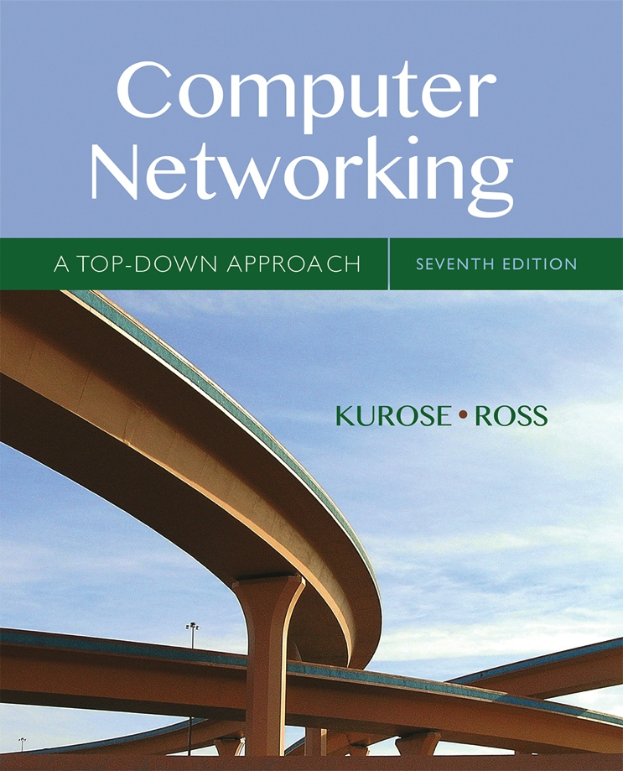

Chapter 6
The Link Layer
and LANs
A note on the use of these Powerpoint slides:
We’re making these slides freely available to all (faculty, students, readers). They’re in PowerPoint form so you see the animations; and can add, modify, and delete slides (including this one) and slide content to suit your needs. They obviously represent a lot of work on our part. In return for use, we only ask the following:
Computer Networking: A Top Down Approach
If you use these slides (e.g., in a class) that you mention their source (after all, we’d like people to use our book!)
If you post any slides on a www site, that you note that they are adapted from (or perhaps identical to) our slides, and note our copyright of this material.
Thanks and enjoy! JFK/KWR
All material copyright 1996-2016
J.F Kurose and K.W. Ross, All Rights Reserved
7th edition
Jim Kurose, Keith Ross
Pearson/Addison Wesley
April 2016

Slide 2
Chapter 6: Link layer and LANs
our goals:
understand principles behind link layer services:
  error detection, correction
  sharing a broadcast channel: multiple access
  link layer addressing
  local area networks: Ethernet, VLANs
instantiation, implementation of various link layer technologies

Slide 3
Link layer, LANs: outline
6.1 introduction, services
6.2 error detection, correction
6.3 multiple access protocols
6.4 LANs
  addressing, ARP
  Ethernet
  switches
  VLANS
6.5 link virtualization: MPLS
6.6 data center networking
6.7 a day in the life of a web request

Slide 4

















Link layer: introduction
terminology:
hosts and routers: nodes
communication channels that connect adjacent nodes along communication path: links
  wired links
  wireless links
  LANs
layer-2 packet: frame, encapsulates datagram
data-link layer has responsibility of
transferring datagram from one node
to physically adjacent node over a link

Slide 5
Link layer: context
datagram transferred by different link protocols over different links:
  e.g., Ethernet on first link, frame relay on intermediate links, 802.11 on last link
each link protocol provides different services
  e.g., may or may not provide rdt over link
transportation analogy:
trip from Princeton to Lausanne
  limo: Princeton to JFK
  plane: JFK to Geneva
  train: Geneva to Lausanne
tourist = datagram
transport segment = communication link
transportation mode = link layer protocol
travel agent = routing algorithm

Slide 6
Link layer services
framing, link access:
  encapsulate datagram into frame, adding header, trailer
  channel access if shared medium
  “MAC” addresses used in frame headers to identify source, destination
    different from IP address!
reliable delivery between adjacent nodes
  we learned how to do this already (chapter 3)!
  seldom used on low bit-error link (fiber, some twisted pair)
  wireless links: high error rates
    Q: why both link-level and end-end reliability?

Slide 7
Link layer services (more)
flow control:
  pacing between adjacent sending and receiving nodes
error detection:
  errors caused by signal attenuation, noise.
  receiver detects presence of errors:
    signals sender for retransmission or drops frame
error correction:
  receiver identifies and corrects bit error(s) without resorting to retransmission
half-duplex and full-duplex
  with half duplex, nodes at both ends of link can transmit, but not at same time

Slide 8
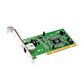
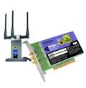

Where is the link layer implemented?
in each and every host
link layer implemented in “adaptor” (aka network interface card NIC) or on a chip
  Ethernet card, 802.11 card; Ethernet chipset
  implements link, physical layer
attaches into host’s system buses
combination of hardware, software, firmware
application
transport
network
link
cpu
memory
link
physical
host
bus
(e.g., PCI)
controller
physical
transmission
network adapter
card

Slide 9
Adaptors communicating
datagram
datagram
controller
controller
sending host
receiving host
datagram
frame
sending side:
  encapsulates datagram in frame
  adds error checking bits, rdt, flow control, etc.
receiving side
  looks for errors, rdt, flow control, etc.
  extracts datagram, passes to upper layer at receiving side

Slide 10
Link layer, LANs: outline
6.1 introduction, services
6.2 error detection, correction
6.3 multiple access protocols
6.4 LANs
  addressing, ARP
  Ethernet
  switches
  VLANS
6.5 link virtualization: MPLS
6.6 data center networking
6.7 a day in the life of a web request

Slide 11
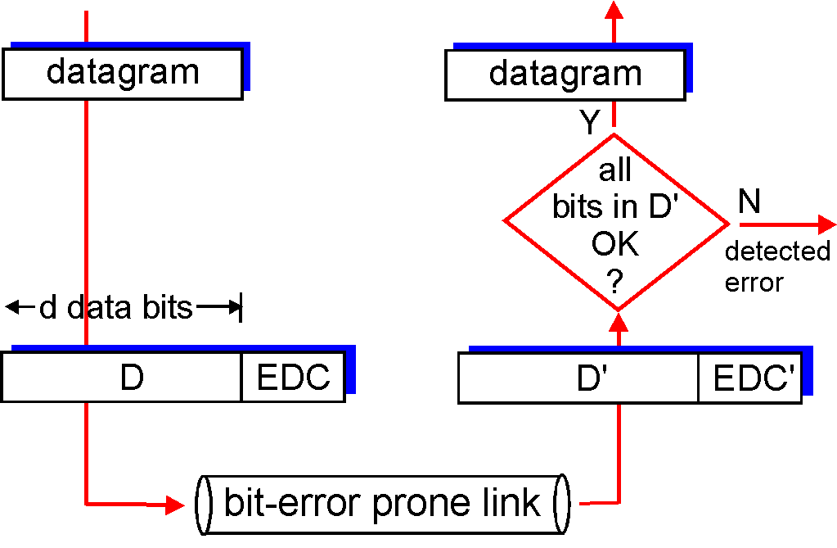
Error detection
EDC= Error Detection and Correction bits (redundancy)
D = Data protected by error checking, may include header fields
Error detection not 100% reliable!
  protocol may miss some errors, but rarely
  larger EDC field yields better detection and correction
otherwise

Slide 12
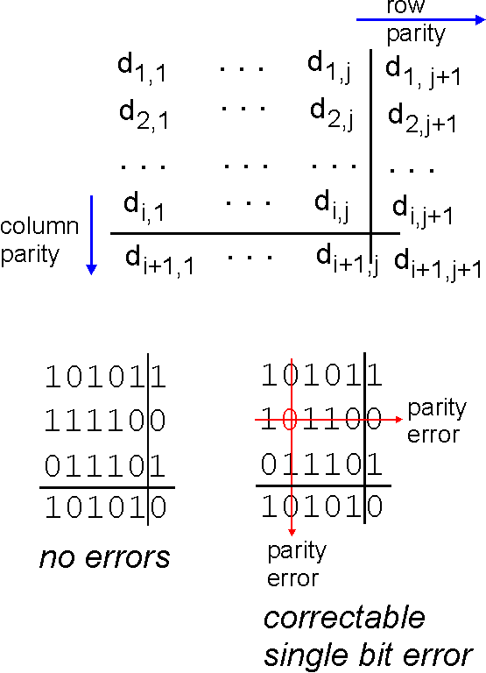
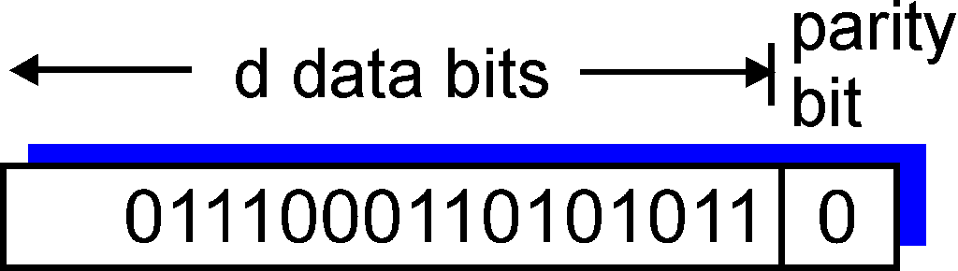
Parity checking
single bit parity:
detect single bit errors
two-dimensional bit parity:
detect and correct single bit errors
0
0
* Check out the online interactive exercises for more examples: http://gaia.cs.umass.edu/kurose_ross/interactive/

Slide 13
Internet checksum (review)
goal: detect “errors” (e.g., flipped bits) in transmitted packet (note: used at transport layer only)
sender:
treat segment contents as sequence of 16-bit integers
checksum: addition (1’s complement sum) of segment contents
sender puts checksum value into UDP checksum field
receiver:
compute checksum of received segment
check if computed checksum equals checksum field value:
  NO - error detected
  YES - no error detected. But maybe errors nonetheless?

Slide 14
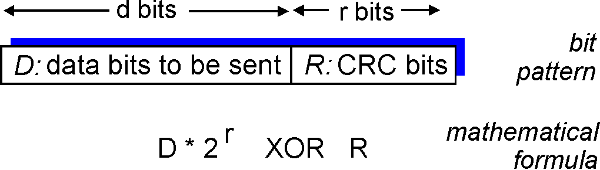
Cyclic redundancy check
more powerful error-detection coding
view data bits, D, as a binary number
choose r+1 bit pattern (generator), G
goal: choose r CRC bits, R, such that
  <D,R> exactly divisible by G (modulo 2)
  receiver knows G, divides <D,R> by G. If non-zero remainder: error detected!
  can detect all burst errors less than r+1 bits
widely used in practice (Ethernet, 802.11 WiFi, ATM)

Slide 15
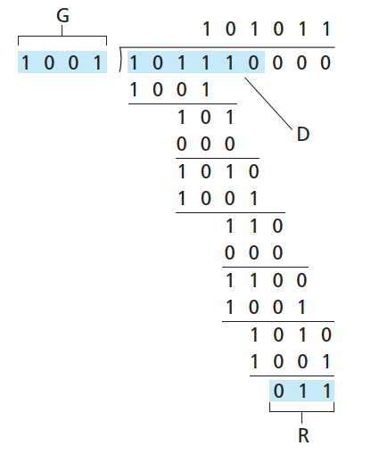
CRC example
want:
  D.2^{r} XOR R = nG
equivalently:
  D.2^{r} = nG XOR R
equivalently:
if we divide D.2^{r} by G, want remainder R to satisfy:
D.2^{r}
G
R = remainder[ ]
* Check out the online interactive exercises for more examples: http://gaia.cs.umass.edu/kurose_ross/interactive/

Slide 16
Link layer, LANs: outline
6.1 introduction, services
6.2 error detection, correction
6.3 multiple access protocols
6.4 LANs
  addressing, ARP
  Ethernet
  switches
  VLANS
6.5 link virtualization: MPLS
6.6 data center networking
6.7 a day in the life of a web request

Slide 17




Multiple access links, protocols
two types of “links”:
point-to-point
  PPP for dial-up access
  point-to-point link between Ethernet switch, host
broadcast (shared wire or medium)
  old-fashioned Ethernet
  upstream HFC
  802.11 wireless LAN
shared wire (e.g.,
cabled Ethernet)
shared RF
(e.g., 802.11 WiFi)
shared RF
(satellite)
humans at a
cocktail party
(shared air, acoustical)

Slide 18
Multiple access protocols
single shared broadcast channel
two or more simultaneous transmissions by nodes: interference
  collision if node receives two or more signals at the same time
multiple access protocol
distributed algorithm that determines how nodes share channel, i.e., determine when node can transmit
communication about channel sharing must use channel itself!
  no out-of-band channel for coordination

Slide 19
An ideal multiple access protocol
given: broadcast channel of rate R bps
desiderata:
  1. when one node wants to transmit, it can send at rate R.
  2. when M nodes want to transmit, each can send at average rate R/M
  3. fully decentralized:
    no special node to coordinate transmissions
    no synchronization of clocks, slots
  4. simple

Slide 20
MAC protocols: taxonomy
three broad classes:
channel partitioning
  divide channel into smaller “pieces” (time slots, frequency, code)
  allocate piece to node for exclusive use
random access
  channel not divided, allow collisions
  “recover” from collisions
“taking turns”
  nodes take turns, but nodes with more to send can take longer turns

Slide 21
Channel partitioning MAC protocols: TDMA
TDMA: time division multiple access
access to channel in "rounds"
each station gets fixed length slot (length = packet transmission time) in each round
unused slots go idle
example: 6-station LAN, 1,3,4 have packets to send, slots 2,5,6 idle
6-slot
frame
6-slot
frame
1
3
4
1
3
4

Slide 22
Channel partitioning MAC protocols: FDMA
FDMA: frequency division multiple access
channel spectrum divided into frequency bands
each station assigned fixed frequency band
unused transmission time in frequency bands go idle
example: 6-station LAN, 1,3,4 have packet to send, frequency bands 2,5,6 idle
time
frequency bands
FDM cable

Slide 23
Random access protocols
when node has packet to send
  transmit at full channel data rate R.
  no a priori coordination among nodes
two or more transmitting nodes ➜ “collision”,
random access MAC protocol specifies:
  how to detect collisions
  how to recover from collisions (e.g., via delayed retransmissions)
examples of random access MAC protocols:
  slotted ALOHA
  ALOHA
  CSMA, CSMA/CD, CSMA/CA

Slide 24
Slotted ALOHA
assumptions:
all frames same size
time divided into equal size slots (time to transmit 1 frame)
nodes start to transmit only slot beginning
nodes are synchronized
if 2 or more nodes transmit in slot, all nodes detect collision
operation:
when node obtains fresh frame, transmits in next slot
  if no collision: node can send new frame in next slot
  if collision: node retransmits frame in each subsequent slot with prob. p until success

Slide 25
Slotted ALOHA
node 1
1
1
1
1
node 2
2
2
2
node 3
3
3
3
C
E
C
S
E
C
E
S
S
Pros:
single active node can continuously transmit at full rate of channel
highly decentralized: only slots in nodes need to be in sync
simple
Cons:
collisions, wasting slots
idle slots
nodes may be able to detect collision in less than time to transmit packet
clock synchronization

Slide 26
Slotted ALOHA: efficiency
efficiency: long-run
fraction of successful slots
(many nodes, all with many frames to send)
max efficiency: find p* that maximizes
Np(1-p)^{N-1}
for many nodes, take limit of Np*(1-p*)^{N-1} as N goes to infinity, gives:
max efficiency = 1/e = .37
suppose: N nodes with many frames to send, each transmits in slot with probability p
prob that given node has success in a slot = p(1-p)^{N-1}
prob that any node has a success = Np(1-p)^{N-1}
at best: channel
used for useful
transmissions 37%
of time!
!

Slide 27
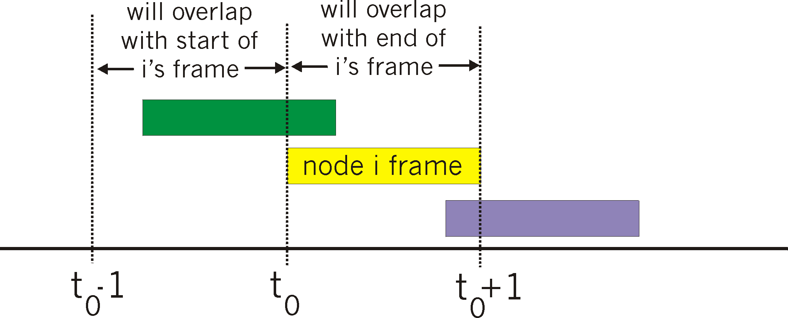
Pure (unslotted) ALOHA
unslotted Aloha: simpler, no synchronization
when frame first arrives
  transmit immediately
collision probability increases:
  frame sent at t₀ collides with other frames sent in [t₀-1,t₀+1]

Slide 28
Pure ALOHA efficiency
P(success by given node) = P(node transmits) .
P(no other node transmits in [t₀-1,t₀] .
P(no other node transmits in [t₀-1,t₀]
= p . (1-p)^{N-1 .} (1-p)^{N-1}
= p . (1-p)^{2(N-1)}
… choosing optimum p and then letting n
= 1/(2e) = .18
even worse than slotted Aloha!

Slide 29
CSMA (carrier sense multiple access)
CSMA: listen before transmit:
if channel sensed idle: transmit entire frame
if channel sensed busy, defer transmission
human analogy: don’t interrupt others!

Slide 30
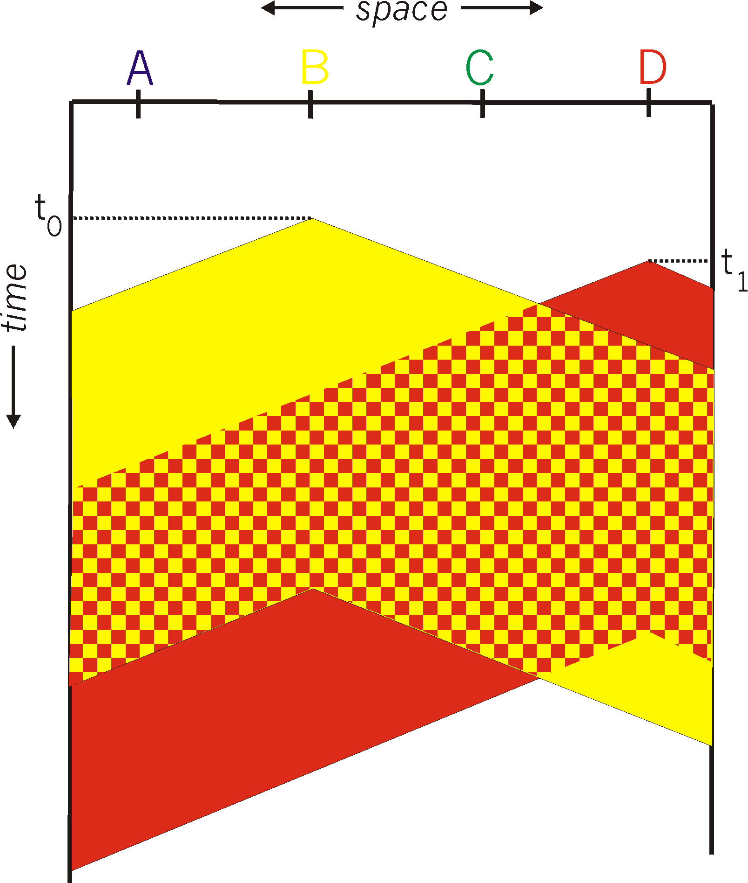
CSMA collisions
spatial layout of nodes
collisions can still occur: propagation delay means two nodes may not hear each other’s transmission
collision: entire packet transmission time wasted
  distance & propagation delay play role in in determining collision probability

Slide 31
CSMA/CD (collision detection)
CSMA/CD: carrier sensing, deferral as in CSMA
  collisions detected within short time
  colliding transmissions aborted, reducing channel wastage
collision detection:
  easy in wired LANs: measure signal strengths, compare transmitted, received signals
  difficult in wireless LANs: received signal strength overwhelmed by local transmission strength
human analogy: the polite conversationalist

Slide 32
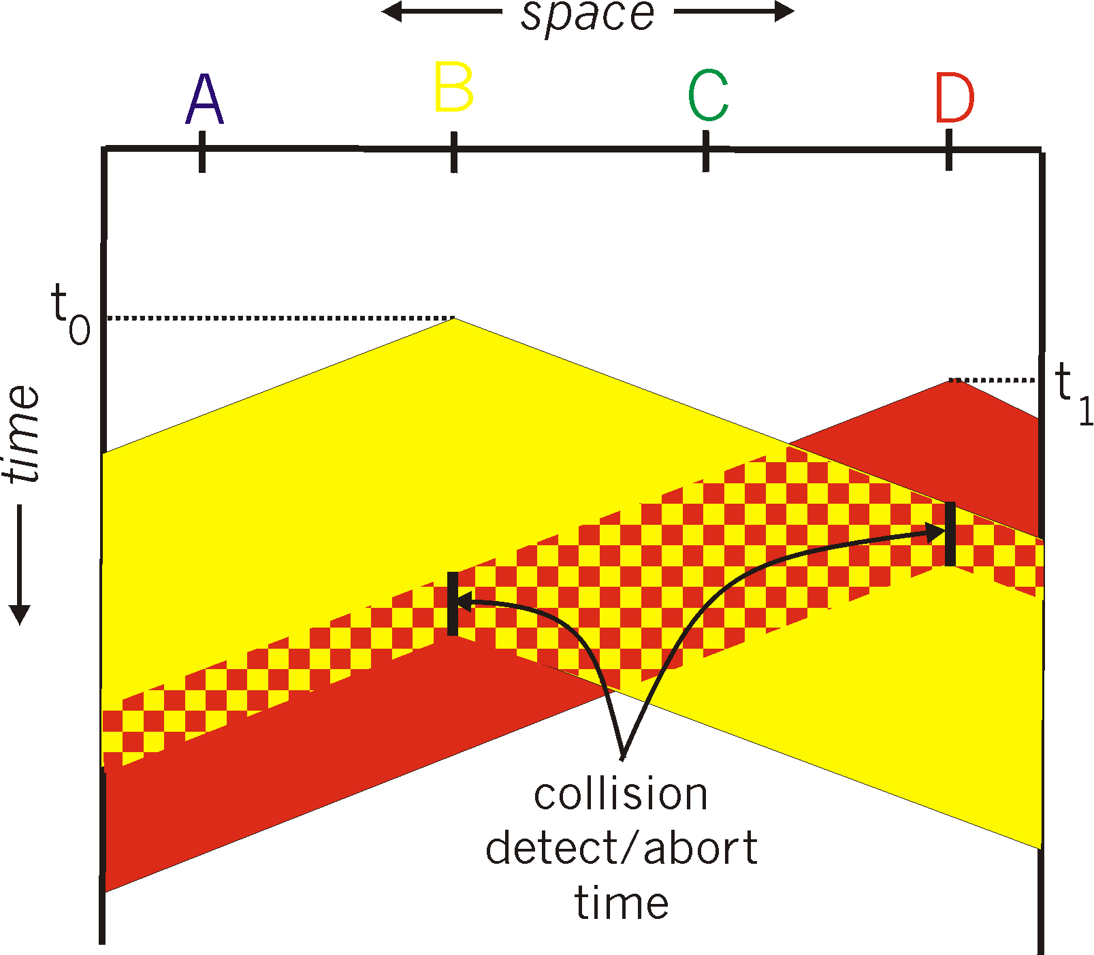
CSMA/CD (collision detection)
spatial layout of nodes

Slide 33
Ethernet CSMA/CD algorithm
1. NIC receives datagram from network layer, creates frame
2. If NIC senses channel idle, starts frame transmission. If NIC senses channel busy, waits until channel idle, then transmits.
3. If NIC transmits entire frame without detecting another transmission, NIC is done with frame !
4. If NIC detects another transmission while transmitting, aborts and sends jam signal
5. After aborting, NIC enters binary (exponential) backoff:
  after mth collision, NIC chooses K at random from {0,1,2, …, 2^{m}-1}. NIC waits K·512 bit times, returns to Step 2
  longer backoff interval with more collisions

Slide 34
CSMA/CD efficiency
T_{prop} = max prop delay between 2 nodes in LAN
t_{trans} = time to transmit max-size frame
efficiency goes to 1
  as t_{prop} goes to 0
  as t_{trans} goes to infinity
better performance than ALOHA: and simple, cheap, decentralized!

Slide 35
“Taking turns” MAC protocols
channel partitioning MAC protocols:
  share channel efficiently and fairly at high load
  inefficient at low load: delay in channel access, 1/N bandwidth allocated even if only 1 active node!
random access MAC protocols
  efficient at low load: single node can fully utilize channel
  high load: collision overhead
“taking turns” protocols
  look for best of both worlds!

Slide 36
“Taking turns” MAC protocols
polling:
master node “invites” slave nodes to transmit in turn
typically used with “dumb” slave devices
concerns:
  polling overhead
  latency
  single point of failure (master)
data
poll
master
data
slaves

Slide 37
“Taking turns” MAC protocols
token passing:
control token passed from one node to next sequentially.
token message
concerns:
  token overhead
  latency
  single point of failure (token)
T
(nothing
to send)
T
data

Slide 38
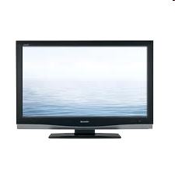


Cable access network
Internet frames, TV channels, control transmitted
downstream at different frequencies
cable headend
…
CMTS
…
splitter
cable
modem
cable modem
termination system
ISP
upstream Internet frames, TV control, transmitted
upstream at different frequencies in time slots
multiple 40Mbps downstream (broadcast) channels
  single CMTS transmits into channels
multiple 30 Mbps upstream channels
  multiple access: all users contend for certain upstream channel time slots (others assigned)

Slide 39
Cable access network
cable headend
MAP frame for
Interval [t1, t2]
CMTS
Downstream channel i
Upstream channel j
t₁
t₂
Residences with cable modems
Minislots containing
minislots request frames
Assigned minislots containing cable modem
upstream data frames
DOCSIS: data over cable service interface spec
FDM over upstream, downstream frequency channels
TDM upstream: some slots assigned, some have contention
  downstream MAP frame: assigns upstream slots
  request for upstream slots (and data) transmitted random access (binary backoff) in selected slots

Slide 40
Summary of MAC protocols
channel partitioning, by time, frequency or code
  Time Division, Frequency Division
random access (dynamic),
  ALOHA, S-ALOHA, CSMA, CSMA/CD
  carrier sensing: easy in some technologies (wire), hard in others (wireless)
  CSMA/CD used in Ethernet
  CSMA/CA used in 802.11
taking turns
  polling from central site, token passing
  Bluetooth, FDDI, token ring

Slide 41
Link layer, LANs: outline
6.1 introduction, services
6.2 error detection, correction
6.3 multiple access protocols
6.4 LANs
  addressing, ARP
  Ethernet
  switches
  VLANS
6.5 link virtualization: MPLS
6.6 data center networking
6.7 a day in the life of a web request

