Slide 1


Chapter 5
Network Layer:
The Control Plane
A note on the use of these Powerpoint slides:
We’re making these slides freely available to all (faculty, students, readers). They’re in PowerPoint form so you see the animations; and can add, modify, and delete slides (including this one) and slide content to suit your needs. They obviously represent a lot of work on our part. In return for use, we only ask the following:
Computer Networking: A Top Down Approach
If you use these slides (e.g., in a class) that you mention their source (after all, we’d like people to use our book!)
If you post any slides on a www site, that you note that they are adapted from (or perhaps identical to) our slides, and note our copyright of this material.
Thanks and enjoy! JFK/KWR
All material copyright 1996-2016
J.F Kurose and K.W. Ross, All Rights Reserved
7th edition
Jim Kurose, Keith Ross
Pearson/Addison Wesley
April 2016

Slide 2
Chapter 5: outline
5.1 introduction
5.2 routing protocols
link state
distance vector
5.3 intra-AS routing in the Internet: OSPF
5.4 routing among the ISPs: BGP
5.5 The SDN control plane
5.6 ICMP: The Internet Control Message Protocol
5.7 Network management and SNMP

Slide 3
Internet inter-AS routing: BGP
BGP (Border Gateway Protocol): the de facto inter-domain routing protocol
  “glue that holds the Internet together”
BGP provides each AS a means to:
  eBGP: obtain subnet reachability information from neighboring ASes
  iBGP: propagate reachability information to all AS-internal routers.
  determine “good” routes to other networks based on reachability information and policy
allows subnet to advertise its existence to rest of Internet: “I am here”

Slide 4
eBGP, iBGP connections
2b
∂
2a
2c
1b
3b
2d
∂
1a
1c
3a
3c
AS 2
1d
3d
AS 1
eBGP connectivity
AS 3
iBGP connectivity
1c
gateway routers run both eBGP and iBGP protools

Slide 5
BGP basics
BGP session: two BGP routers (“peers”) exchange BGP messages over semi-permanent TCP connection:
  advertising paths to different destination network prefixes (BGP is a “path vector” protocol)
when AS3 gateway router 3a advertises path AS3,X to AS2 gateway router 2c:
  AS3 promises to AS2 it will forward datagrams towards X
AS 3
3b
AS 1
1b
3a
3c
1a
1c
AS 2
2b
3d
X
1d
2a
2c
BGP advertisement:
AS3, X
2d

Slide 6
Path attributes and BGP routes
advertised prefix includes BGP attributes
  prefix + attributes = “route”
two important attributes:
  AS-PATH: list of ASes through which prefix advertisement has passed
  NEXT-HOP: indicates specific internal-AS router to next-hop AS
Policy-based routing:
  gateway receiving route advertisement uses import policy to accept/decline path (e.g., never route through AS Y).
  AS policy also determines whether to advertise path to other other neighboring ASes

Slide 7
BGP path advertisement
AS3
3b
AS1
1b
3a
3c
1a
1c
AS2
2b
3d
X
1d
AS3,X
AS2,AS3,X
2a
2c
2d
AS2 router 2c receives path advertisement AS3,X (via eBGP) from AS3 router 3a
Based on AS2 policy, AS2 router 2c accepts path AS3,X, propagates (via iBGP) to all AS2 routers
Based on AS2 policy, AS2 router 2a advertises (via eBGP) path AS2, AS3, X to AS1 router 1c

Slide 8
BGP path advertisement
AS3
3b
AS1
1b
AS3,X
3a
3c
1a
1c
AS2
2b
3d
X
1d
AS3,X
AS2,AS3,X
2a
2c
2d
gateway router may learn about multiple paths to destination:
AS1 gateway router 1c learns path AS2,AS3,X from 2a
AS1 gateway router 1c learns path AS3,X from 3a
Based on policy, AS1 gateway router 1c chooses path AS3,X, and advertises path within AS1 via iBGP

Slide 9
BGP messages
BGP messages exchanged between peers over TCP connection
BGP messages:
  OPEN: opens TCP connection to remote BGP peer and authenticates sending BGP peer
  UPDATE: advertises new path (or withdraws old)
  KEEPALIVE: keeps connection alive in absence of UPDATES; also ACKs OPEN request
  NOTIFICATION: reports errors in previous msg; also used to close connection

Slide 10
BGP, OSPF, forwarding table entries
Q: how does router set forwarding table entry to distant prefix?
AS3
3b
AS1
1b
AS3,X
1
AS3,X
3a
3c
1a
2
1c
local link interfaces
at 1a, 1d
AS2
2b
3d
X
2
1d
1
AS3,X
AS2,AS3,X
2a
2c
physical link
2d
dest
interface
recall: 1a, 1b, 1c learn about dest X via iBGP from 1c: “path to X goes through 1c”
…
…
…
…
X
1
1d: OSPF intra-domain routing: to get to 1c, forward over outgoing local interface 1

Slide 11
BGP, OSPF, forwarding table entries
Q: how does router set forwarding table entry to distant prefix?
AS3
3b
AS1
1b
1
3a
3c
1a
2
1c
AS2
2b
3d
X
1d
2a
2c
2d
dest
interface
recall: 1a, 1b, 1c learn about dest X via iBGP from 1c: “path to X goes through 1c”
…
…
…
…
X
2
1d: OSPF intra-domain routing: to get to 1c, forward over outgoing local interface 1
1a: OSPF intra-domain routing: to get to 1c, forward over outgoing local interface 2

Slide 12
BGP route selection
router may learn about more than one route to destination AS, selects route based on:
  local preference value attribute: policy decision
  shortest AS-PATH
  closest NEXT-HOP router: hot potato routing
  additional criteria

Slide 13
Hot Potato Routing
AS3
3b
AS1
1b
3a
3c
1a
1c
AS2
2b
3d
X
1d
112
152
AS3,X
AS1,AS3,X
2a
263
2c
201
OSPF link weights
2d
2d learns (via iBGP) it can route to X via 2a or 2c
hot potato routing: choose local gateway that has least intra-domain cost (e.g., 2d chooses 2a, even though more AS hops to X): don’t worry about inter-domain cost!

Slide 14
BGP: achieving policy via advertisements
legend:
provider
B
network
X
W
A
customer
C
network:
Y
Suppose an ISP only wants to route traffic to/from its customer networks (does not want to carry transit traffic between other ISPs)
A advertises path Aw to B and to C
B chooses not to advertise BAw to C:
  B gets no “revenue” for routing CBAw, since none of C, A, w are B’s customers
  C does not learn about CBAw path
C will route CAw (not using B) to get to w

Slide 15
BGP: achieving policy via advertisements
legend:
provider
B
network
X
W
A
customer
C
network:
Y
Suppose an ISP only wants to route traffic to/from its customer networks (does not want to carry transit traffic between other ISPs)
A,B,C are provider networks
X,W,Y are customer (of provider networks)
X is dual-homed: attached to two networks
policy to enforce: X does not want to route from B to C via X
  .. so X will not advertise to B a route to C

Slide 16
Why different Intra-, Inter-AS routing ?
policy:
inter-AS: admin wants control over how its traffic routed, who routes through its net.
intra-AS: single admin, so no policy decisions needed
scale:
hierarchical routing saves table size, reduced update traffic
performance:
intra-AS: can focus on performance
inter-AS: policy may dominate over performance

Slide 17
Chapter 5: outline
5.1 introduction
5.2 routing protocols
link state
distance vector
5.3 intra-AS routing in the Internet: OSPF
5.4 routing among the ISPs: BGP
5.5 The SDN control plane
5.6 ICMP: The Internet Control Message Protocol
5.7 Network management and SNMP

Slide 18
Software defined networking (SDN)
Internet network layer: historically has been implemented via distributed, per-router approach
  monolithic router contains switching hardware, runs proprietary implementation of Internet standard protocols (IP, RIP, IS-IS, OSPF, BGP) in proprietary router OS (e.g., Cisco IOS)
  different “middleboxes” for different network layer functions: firewalls, load balancers, NAT boxes, ..
~2005: renewed interest in rethinking network control plane

Slide 19

Recall: per-router control plane
Individual routing algorithm components in each and every router interact with each other in control plane to compute forwarding tables
Routing
Algorithm
control
plane
data
plane

Slide 20
Recall: logically centralized control plane
A distinct (typically remote) controller interacts with local control agents (CAs) in routers to compute forwarding tables
Remote Controller
control
plane
data
plane
CA
CA
CA
CA
CA

Slide 21
Software defined networking (SDN)
Why a logically centralized control plane?
easier network management: avoid router misconfigurations, greater flexibility of traffic flows
table-based forwarding (recall OpenFlow API) allows “programming” routers
  centralized “programming” easier: compute tables centrally and distribute
  distributed “programming: more difficult: compute tables as result of distributed algorithm (protocol) implemented in each and every router
open (non-proprietary) implementation of control plane

Slide 22
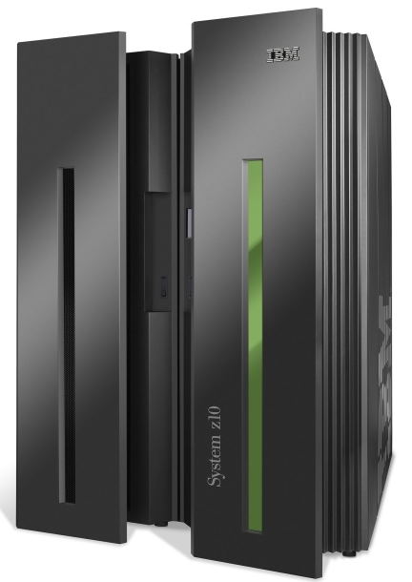
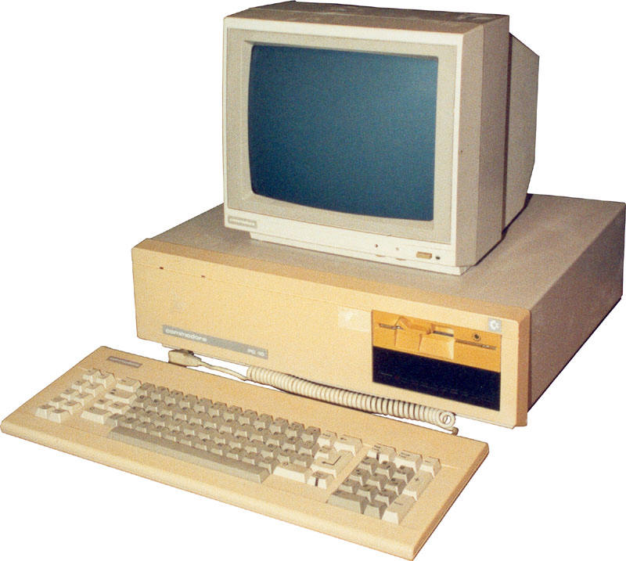
Analogy: mainframe to PC evolution*
App
App
App
App
App
App
App
App
App
App
App
Specialized
Applications
Open Interface
Specialized
Operating
System
Windows
(OS)
Linux
Mac
OS
or
or
Specialized
Hardware
Open Interface
Microprocessor
Vertically integrated
Closed, proprietary
Slow innovation
Small industry
Horizontal
Open interfaces
Rapid innovation
Huge industry
* Slide courtesy: N. McKeown

Slide 23

Traffic engineering: difficult traditional routing
5
3
v
w
5
2
u
2
1
z
3
1
2
x
y
1
Q: what if network operator wants u-to-z traffic to flow along uvwz, x-to-z traffic to flow xwyz?
A: need to define link weights so traffic routing algorithm computes routes accordingly (or need a new routing algorithm)!
Link weights are only control “knobs”: wrong!
Notes:
Note: implicit assumption here: destination based forwarding

Slide 24
Traffic engineering: difficult
5
3
v
w
5
2
u
2
1
z
3
1
2
x
y
1
Q: what if network operator wants to split u-to-z traffic along uvwz and uxyz (load balancing)?
A: can’t do it (or need a new routing algorithm)
Notes:
Note: implicit assumption here: destination based forwarding

Slide 25
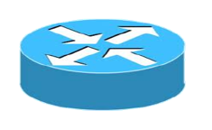
Traffic engineering: difficult
Networking 401
5
v
3
w
2
v
w
5
u
2
1
z
3
z
1
2
x
y
x
1
y
Q: what if w wants to route blue and red traffic differently?
A: can’t do it (with destination based forwarding, and LS, DV routing)
Notes:
Note: implicit assumption here: destination based forwarding

Slide 26
Software defined networking (SDN)
4. programmable control applications
…
3. control plane functions external to data-plane switches
routing
access control
load
balance
Remote Controller
control
plane
data
plane
CA
2. control, data plane separation
CA
CA
CA
CA
1: generalized“ flow-based” forwarding (e.g., OpenFlow)

Slide 27
SDN perspective: data plane switches
Data plane switches
fast, simple, commodity switches implementing generalized data-plane forwarding (Section 4.4) in hardware
switch flow table computed, installed by controller
API for table-based switch control (e.g., OpenFlow)
  defines what is controllable and what is not
protocol for communicating with controller (e.g., OpenFlow)
network-control applications
…
routing
access
control
load
balance
control
plane
northbound API
SDN Controller
(network operating system)
southbound API
data
plane
SDN-controlled switches

Slide 28
SDN perspective: SDN controller
SDN controller (network OS):
maintain network state information
interacts with network control applications “above” via northbound API
interacts with network switches “below” via southbound API
implemented as distributed system for performance, scalability, fault-tolerance, robustness
network-control applications
…
routing
access
control
load
balance
control
plane
northbound API
SDN Controller
(network operating system)
southbound API
data
plane
SDN-controlled switches

Slide 29
SDN perspective: control applications
network-control apps:
“brains” of control: implement control functions using lower-level services, API provided by SND controller
unbundled: can be provided by 3rd party: distinct from routing vendor, or SDN controller
network-control applications
…
routing
access
control
load
balance
control
plane
northbound API
SDN Controller
(network operating system)
southbound API
data
plane
SDN-controlled switches

Slide 30
Components of SDN controller
routing
access
control
load
balance
Interface layer to network control apps: abstractions API
Interface, abstractions for network control apps
…
network graph
RESTful
API
intent
Network-wide state management layer: state of networks links, switches, services: a distributed database
…
statistics
flow tables
SDN
controller
Network-wide distributed, robust state management
…
Link-state info
host info
switch info
…
communication layer: communicate between SDN controller and controlled switches
OpenFlow
SNMP
Communication to/from controlled devices

Slide 31

OpenFlow protocol
operates between controller, switch
TCP used to exchange messages
  optional encryption
three classes of OpenFlow messages:
  controller-to-switch
  asynchronous (switch to controller)
  symmetric (misc)
OpenFlow Controller

Slide 32
OpenFlow: controller-to-switch messages
Key controller-to-switch messages
features: controller queries switch features, switch replies
configure: controller queries/sets switch configuration parameters
modify-state: add, delete, modify flow entries in the OpenFlow tables
packet-out: controller can send this packet out of specific switch port
OpenFlow Controller

Slide 33
OpenFlow: switch-to-controller messages
Key switch-to-controller messages
packet-in: transfer packet (and its control) to controller. See packet-out message from controller
flow-removed: flow table entry deleted at switch
port status: inform controller of a change on a port.
OpenFlow Controller
Fortunately, network operators don’t “program” switches by creating/sending OpenFlow messages directly. Instead use higher-level abstraction at controller

Slide 34
SDN: control/data plane interaction example
Dijkstra’s link-state
Routing
1
S1, experiencing link failure using OpenFlow port status message to notify controller
4
5
…
network graph
RESTful
API
intent
2
SDN controller receives OpenFlow message, updates link status info
3
…
statistics
flow tables
…
3
Dijkstra’s routing algorithm application has previously registered to be called when ever link status changes. It is called.
Link-state info
host info
switch info
2
…
OpenFlow
SNMP
6
4
Dijkstra’s routing algorithm access network graph info, link state info in controller, computes new routes
1
s2
s1
s4
s3

Slide 35
SDN: control/data plane interaction example
Dijkstra’s link-state
Routing
4
5
…
network graph
RESTful
API
intent
5
link state routing app interacts with flow-table-computation component in SDN controller, which computes new flow tables needed
3
…
statistics
flow tables
…
Link-state info
host info
switch info
2
…
6
Controller uses OpenFlow to install new tables in switches that need updating
OpenFlow
SNMP
6
1
s2
s1
s4
s3

Slide 36
OpenDaylight (ODL) controller
…
Traffic
Engineering
ODL Lithium controller
network apps may be contained within, or be external to SDN controller
Service Abstraction Layer: interconnects internal, external applications and services
REST API
Network service apps
Basic Network Service Functions
topology
manager
switch
manager
stats
manager
Access
Control
forwarding
manager
host
manager
Service Abstraction Layer (SAL)
…
OpenFlow 1.0
SNMP
OVSDB

Slide 37
ONOS controller
…
Network
control apps
control apps separate from controller
intent framework: high-level specification of service: what rather than how
considerable emphasis on distributed core: service reliability, replication performance scaling
northbound abstractions,
protocols
REST API
Intent
hosts
paths
flow rules
topology
ONOS
distributed core
devices
links
statistics
device
link
host
flow
packet
southbound abstractions,
protocols
OpenFlow
Netconf
OVSDB

Slide 38
SDN: selected challenges
hardening the control plane: dependable, reliable, performance-scalable, secure distributed system
  robustness to failures: leverage strong theory of reliable distributed system for control plane
  dependability, security: “baked in” from day one?
networks, protocols meeting mission-specific requirements
  e.g., real-time, ultra-reliable, ultra-secure
Internet-scaling

Slide 39
Chapter 5: outline
5.1 introduction
5.2 routing protocols
link state
distance vector
5.3 intra-AS routing in the Internet: OSPF
5.4 routing among the ISPs: BGP
5.5 The SDN control plane
5.6 ICMP: The Internet Control Message Protocol
5.7 Network management and SNMP

Slide 40
ICMP: internet control message protocol
used by hosts & routers to communicate network-level information
  error reporting: unreachable host, network, port, protocol
  echo request/reply (used by ping)
network-layer “above” IP:
  ICMP msgs carried in IP datagrams
ICMP message: type, code plus first 8 bytes of IP datagram causing error
Type Code description
0 0 echo reply (ping)
3 0 dest. network unreachable
3 1 dest host unreachable
3 2 dest protocol unreachable
3 3 dest port unreachable
3 6 dest network unknown
3 7 dest host unknown
4 0 source quench (congestion
control - not used)
8 0 echo request (ping)
9 0 route advertisement
10 0 router discovery
11 0 TTL expired
12 0 bad IP header

Slide 41

Traceroute and ICMP
source sends series of UDP segments to destination
  first set has TTL =1
  second set has TTL=2, etc.
  unlikely port number
when datagram in nth set arrives to nth router:
  router discards datagram and sends source ICMP message (type 11, code 0)
  ICMP message include name of router & IP address
when ICMP message arrives, source records RTTs
stopping criteria:
UDP segment eventually arrives at destination host
destination returns ICMP “port unreachable” message (type 3, code 3)
source stops
3 probes
3 probes
3 probes

Slide 42
Chapter 5: outline
5.1 introduction
5.2 routing protocols
link state
distance vector
5.3 intra-AS routing in the Internet: OSPF
5.4 routing among the ISPs: BGP
5.5 The SDN control plane
5.6 ICMP: The Internet Control Message Protocol
5.7 Network management and SNMP

Slide 43
What is network management?
autonomous systems (aka “network”): 1000s of interacting hardware/software components
other complex systems requiring monitoring, control:
  jet airplane
  nuclear power plant
  others?
"Network management includes the deployment, integration
and coordination of the hardware, software, and human
elements to monitor, test, poll, configure, analyze, evaluate,
and control the network and element resources to meet the
real-time, operational performance, and Quality of Service
requirements at a reasonable cost."

Slide 44


Infrastructure for network management
definitions:
managing entity
agent
data
managing
entity
managed devices contain managed objects whose data is gathered into a Management Information Base (MIB)
data
managed device
network
management
protocol
agent
data
managed device
agent
data
managed device
agent
data
agent
data
managed device
managed device

Slide 45
SNMP protocol
Two ways to convey MIB info, commands:
managing
entity
managing
entity
request
trap msg
response
agent
data
agent
data
managed device
managed device
request/response mode
trap mode

Slide 46
SNMP protocol: message types
Message type
Function
GetRequest
GetNextRequest
GetBulkRequest
manager-to-agent: “get me data”
(data instance, next data in list, block of data)
InformRequest
manager-to-manager: here’s MIB value
SetRequest
manager-to-agent: set MIB value
Response
Agent-to-manager: value, response to
Request
Trap
Agent-to-manager: inform manager
of exceptional event

Slide 47
SNMP protocol: message formats
Get/set header
Variables to get/set
PDU
type
(0-3)
Error
Status
(0-5)
Request
ID
Error
Index
Name
Value
Name
Value
….
PDU
type
4
Trap
Type
(0-7)
Enterprise
Agent
Addr
Specific
code
Time
stamp
Name
Value
….
Trap header
Trap info
SNMP PDU
More on network management: see earlier editions of text!

Slide 48
Chapter 5: summary
we’ve learned a lot!
approaches to network control plane
  per-router control (traditional)
  logically centralized control (software defined networking)
traditional routing algorithms
  implementation in Internet: OSPF, BGP
SDN controllers
  implementation in practice: ODL, ONOS
Internet Control Message Protocol
network management
next stop: link layer!

