Slide 1
Probability and Statistics for Computer Scientists
Third Edition, By Michael Baron
Chapter 8: Introduction to Statistics
CIS 2033. Computational Probability and Statistics Pei Wang

Slide 2
Statistics
Statistics: the analysis and interpretation of data, where the set of observations is called a “dataset” or “sample”
Assumptions:
The observations are the values of random variables of the same type
The sample represents the population from which it is selected

Slide 3
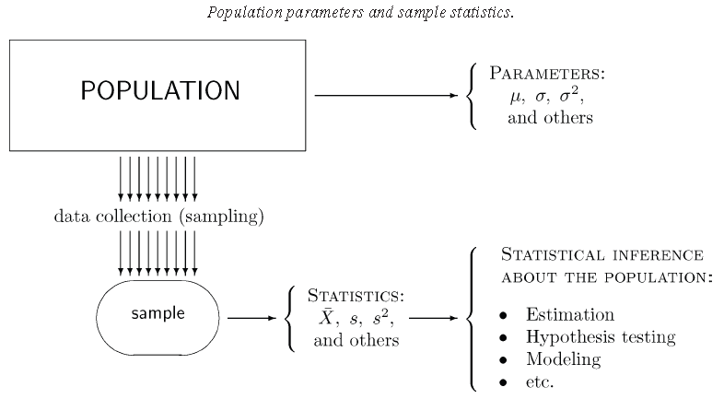
Population and sample

Slide 4
Topics in statistics
From data to model (the reverse of simulation), or from sample to population
to summarize and visualize the data
to approximate the (p, f, or F) function that specifies the model
to estimate a parameter of a model
to estimate a population feature using a sample statistic

Slide 5
Sampling
What is the right way to do sampling?
Simple random sampling: data are collected from the entire population independently of each other, all being equally likely to be selected
This process reduces the bias in the sample x₁, …, x_{n}, which is taken to be values of iid (independent, identically distributed) random variables X₁, …, X_{n}

Slide 6
Parameter estimation
A dataset is often modeled as a realization of a random sample from a probability distribution determined by one or more parameters
Let t = h(x₁, . . . , x_{n}) be an estimate of a parameter based on the dataset x₁, . . . , x_{n} only
Then t is a realization of the random variable
T = h(X₁, . . .,X_{n}), which is called an estimator

Slide 7
Bias and consistency
An estimator T (or θ-hat, ) is called an unbiased estimator for the parameter θ, if E[T] = θ, irrespective of the value of θ; otherwise T has a bias E[T] − θ, which can be positive or negative
An estimator T is consistent for a parameter θ if the probability of its sampling error of any magnitude converges to 0 as the sample size increases to infinity, i.e., For any ε, P(|T – θ| > ε) → 0 when n → ∞

Slide 8
Simple descriptive statistics
mean, measuring the average value
median, measuring the central value
quantiles and quartiles, showing where certain portions of a sample are located
variance, standard deviation, and interquartile range, measuring variability
Each statistic is a random variable because it changes from sample to sample

Slide 9

Mean
The sample mean, X-bar ( ) , of a dataset measures the arithmetic average of the data
X-bar is an unbiased estimator of μ
X-bar is also consistent with μ
When n is large, X-bar has a Normal distribution

Slide 10
Median
Sample median M_{n} (or M-hat )) is a number that is exceeded by at most a half of data items and is preceded by at most a half of data items
Population median M of a random variable X is a number satisfying both
P(X < M) ≤ 0.5
P(X > M) ≤ 0.5

Slide 11
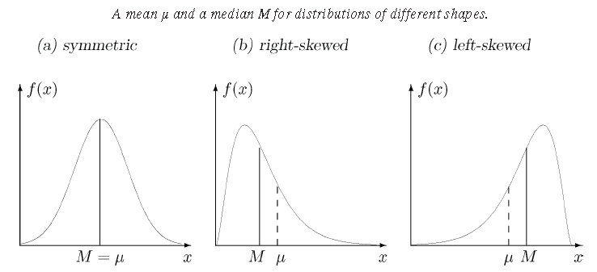
Mean vs. median
Center of gravity vs. half of the area

Slide 12
Median of a continuous variable
M satisfies F(M) = 0.5, so M = F⁻¹(0.5)
Example: U(a, b) has the median (a+b)/2

Slide 13
Median of a discrete variable
For a discrete random variable X
if one of its value x_{i} satisfies F(x_{i}) = 0.5
then M can be any value in (x_{i}, x_{i+1})
else M is the smallest x_{i} satisfying
F(x_{i}) > 0.5
Example: Bin(5, 0.5) has median in (2, 3)
Bin(5, 0.4) has median 2

Slide 14
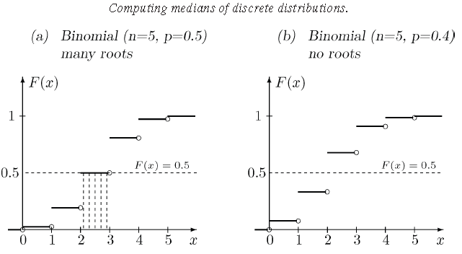
Median of a discrete variable (2)

Slide 15
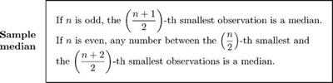
Sample median
After the dataset is sorted, M-hat will be the middle element (if there is one) or between the middle two ⎯ we will take their average

Slide 16
Quantiles and quartiles
A p-quantile of a population is such a number q that satisfies P(X < q) ≤ p and P(X > q) ≤ 1 – p, and intuitively equals F⁻¹(p)
A sample p-quantile is any number that exceeds at most proportion p, and is exceeded by at most proportion 1 − p, of the sample
First, second, and third quartiles (Q₁, Q₂, Q₃) are the sample 0.25-, 0.50-, and 0.75-quantiles, respectively

Slide 17
Quartiles example
General rule: after sorting the data, let i be (1/4)n or (2/4)n or (3/4)n. If i is an integer, take (A[i]+A[i+1])/2 as the quartile, otherwise take A[ceiling(i)], i.e., the next integer
Example 8.14: The 30 data are (after sorting)
9 15 19 22 24 25 30 34 35 35
36 36 37 38 42 43 46 48 54 55
56 56 59 62 69 70 82 82 89 139

Slide 18
Quartiles example (2)
In the previous example, n = 30,
Q₁ has np = 7.5 and n(1–p) = 22.5, therefore it is the 8th number that has no more than 7.5 observations to the left and no more than 22.5 observations to the right of it
Q₂ (median) is the average of the 15th and the 16th number
Q₃ is the 23rd number, since 3n/4 = 22.5

Slide 19
Interquartile range
The interquartile range (IQR) Q₃ – Q₁ indicates the spread of the middle quarters, and is insensitive to outliers
Outliers are usually defined as data items outside [Q₁ – 1.5(IQR), Q₃ + 1.5(IQR)]
For Example 8.14, IQR = 25, 1.5(IQR) = 37.5, so the interval is [-3.5, 96.5], and 139 is the only outlier

Slide 20
Five-number summary
For a given dataset, its five-number summary are: min, Q₁, M_{n}, Q₃, max
Here min and max exclude outliers
For Example 8.14, it is 9, 34, 42.5, 59, 89
Procedure:
  get Q₁, M_{n}, Q₃
  exclude outliers
  get min, max

Slide 21
Five-number summary (2)
Example: the previous dataset with n = 30
(1/4)30, (2/4)30, (3/4)30 : 7.5, 15, 22.5
Q1, Q2, Q3: 34, (42+43)/2, 59
IQR = Q₃ – Q₁ = 59 – 34 = 25, 1.5(IQR) = 37.5
[Q₁ – 1.5(IQR), Q₃ + 1.5(IQR)] = [-3.5, 96.5]
Outlier: 139
Five number summary: 9, 34, 42.5, 59, 89

Slide 22

Sample variance
For a sample (x₁, x₂,…, x_{n}), a sample variance is defined as
Sample variance is an unbiased and consistent estimator of Var(X), i.e., E[(X − µ)²]
Sample standard deviation is the square root of sample variance, and an estimator of Std(X)

Slide 23

Sample variance (2)
Similar to Var(X) = E[X²] − µ², it is easier to use
Many calculators and statistics software provide procedures to calculate sample variance and/or sample standard deviation

Slide 24
Summary of descriptive statistics
The simple descriptive (numerical) statistics introduced so far belong to two systems:
With mean for center and standard deviation for spread
With median for center and quartiles for spread
Either system can be applied to the sample (data), as well as to the population (model)

Slide 25
Graphical statistics
A quick look at a graph of a dataset may clearly suggest
a probability model
statistical methods suitable for the data
presence or absence of outliers
existence of patterns
relation between two or several variables

Slide 26
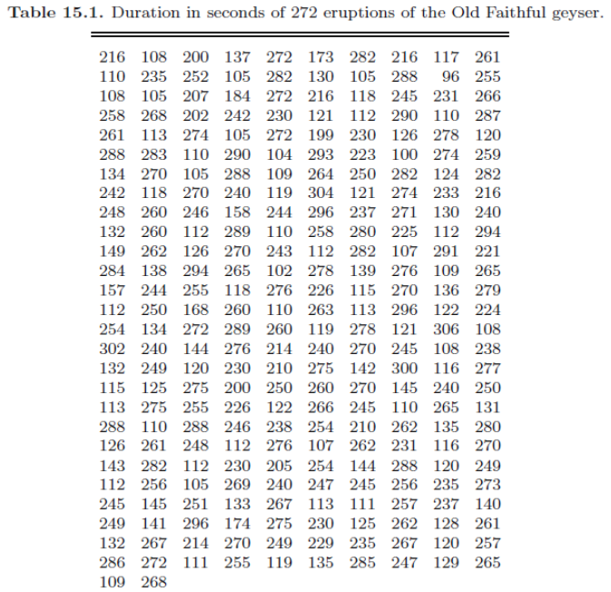
Example: Old Faithful data

Slide 27
Histogram
A histogram distributes data items into bins

Slide 28
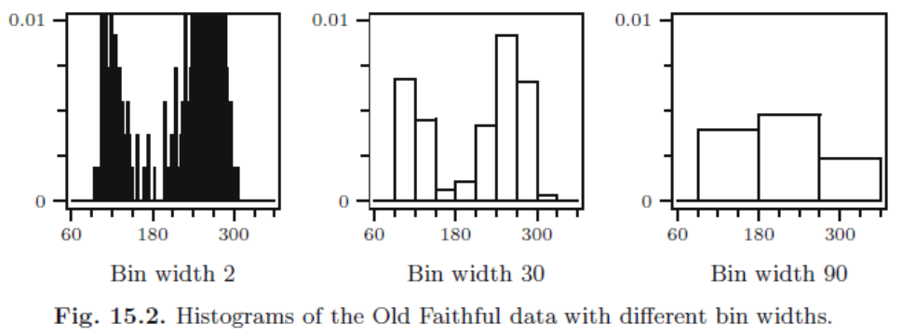
Width of bin
Neither too few nor too many
Be informative and natural
Handle the boundary values consistently

Slide 29
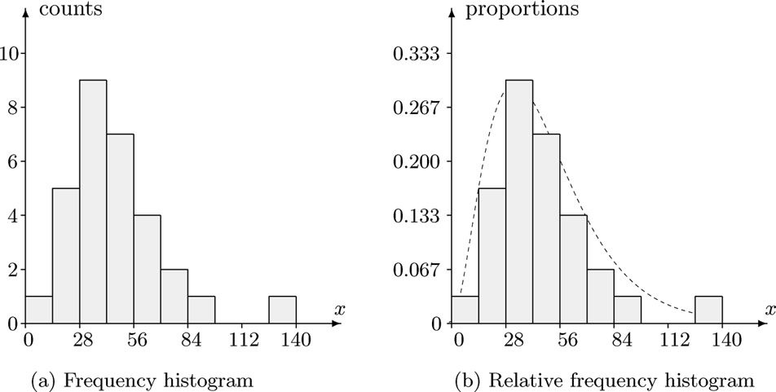
Height of bin
As counts, h_{i} = c_{i}
As proportions, h_{i} = c_{i}/n, for p(x)
As areas, h_{i} = c_{i}/(n*w), for f(x)

Slide 30
Histogram example
9 15 19 22 24 25 30 34 35 35 36 36 37 38 42 43 46 48 54 55 56 56 59 62 69 70 82 82 89 139
14 bins: (0, 10], (10, 20], (20, 30], … ... , (120, 130], (130, 140]
_{Cell height = 1/300 (pdf)}

Slide 31
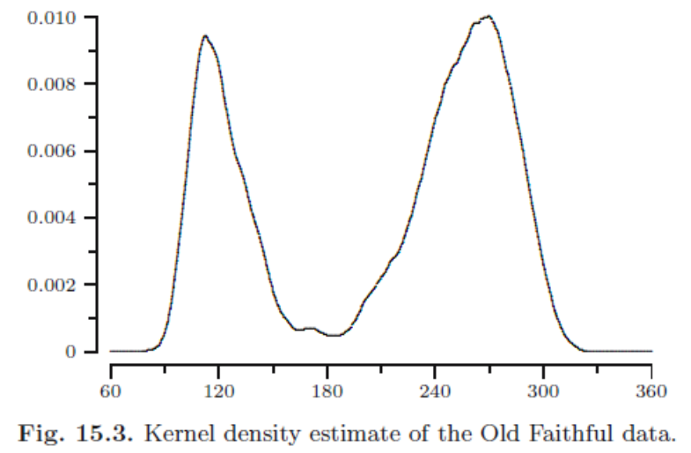
Kernel density estimates
Each data item is a “block” in histograms, but a “pile of sand” in kernel density estimates (0:24-4:28)

Slide 32
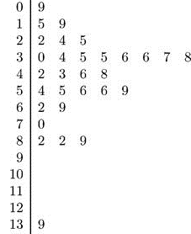
Stem-and-leaf plot
To cluster numbers by their “stem”, i.e., digits except the last one, which is “leaf”, sorted
Example: the dataset is 9, 15, 19, 22, 24, 25, 30, 34, 35, … …, 89, 139

Slide 33
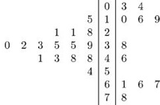
Stem-and-leaf plot (2)
To compare two datasets, the stem of two plots can be merged, with the leaves extend to opposite directions
Example: with a leaf unit of 0.001, a stem unit of 0.01

Slide 34

Approximated pmf
For a sample X₁, . . . , X_{n} from a discrete distribution with probability mass function p, the function can be approximated by the relative frequency of the values in the dataset
To estimate the pmf of a die:
p(i) = c_{i} / n, i = 1,…,6
1 2 3 4 5 6

Slide 35

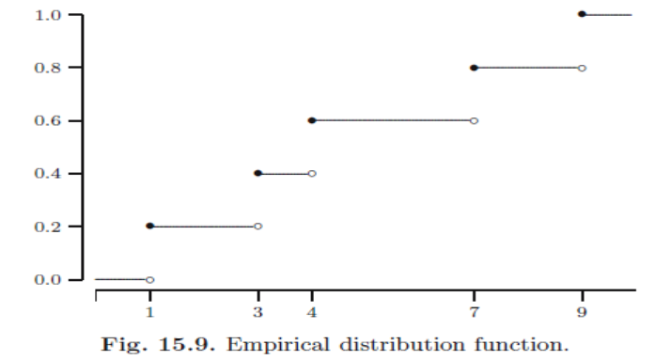
Empirical distribution function
For example, if the data is 4 3 9 1 7, then

Slide 36
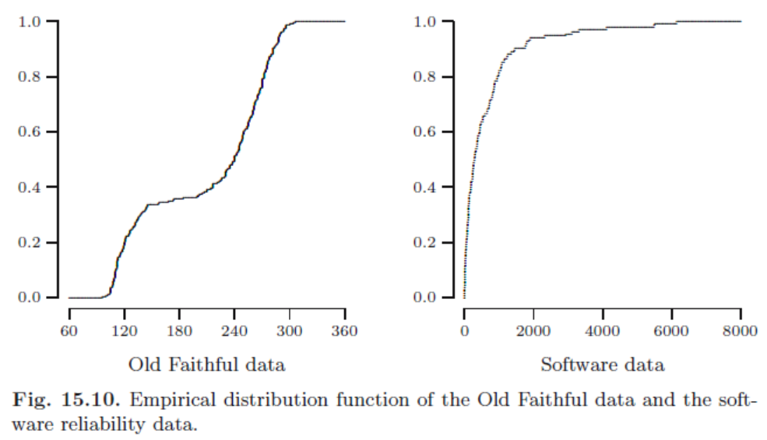
Empirical distribution function (2)

Slide 37
Boxplot
Boxplot (a.k.a. box-and-whisker plot) shows the five-number summary of a dataset:
min, Q₁, M_{n}, Q₃, max
In a boxplot, the box is from Q₁ to Q₃, with M_{n} as a bar in the middle. Optionally, mean is at ‘+’
The two whiskers from the box extend to the min and max, respectively
Outliers are drawn separately as circles or dots

Slide 38
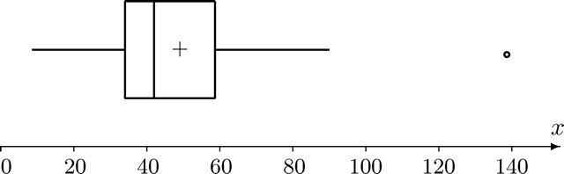
Boxplot example
Example: the previous dataset
9 … … 34 … … 42 43 … … 59 … … 89 139

Slide 39
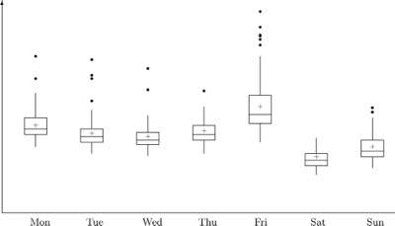
Parallel boxplots of internet traffic

Slide 40
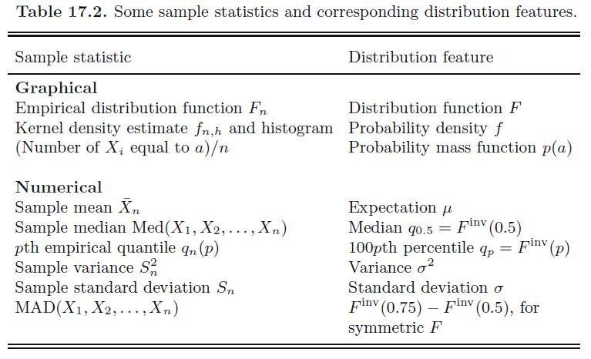
One variable statistics

Slide 41

Scatter plots
Scatter plots are used to show a relationship between two variables, in which each data item is a point with two coordinates

Slide 42
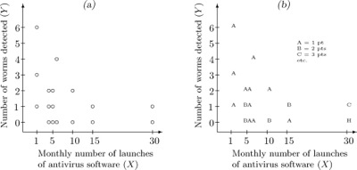
Scatter plots (2)

Slide 43
Scatter plots (3)

Slide 44
Summary
Concepts of statistics
Descriptive statistics
    Sample mean, sample variance
    Five-number summary
Graphical statistics
    Approximated p, f, F
    Box-plot
Scatter plot

