Slide 1
Probability and Statistics for Computer Scientists Third Edition, By Michael Baron Section 5.2: Simulation of Random Variables CIS 2033. Computational Probability and Statistics Pei Wang

Slide 2
Simulation
Simulation: to use a model to study what would happen in the real world
Monte Carlo methods: computer simulations involving random numbers
Such a method requires values of a random variable with a certain distribution
Example: coin tossing before a game
Simulation is from Model (p, f, or F) to Data

Slide 3
Random number generator
A device that generates numbers that can be seen as the realization of a random variable
Examples:
A fair coin is Ber(0.5)
A fair die generates {1,2,3,4,5,6} evenly
A table of random numbers, Table A1
A program that generates random values

Slide 4
Turn one distribution into another
How to generate random numbers of one distribution from those of another?
To simulate a fair coin with a fair die
To simulate an even distribution on {a,b,c,d} with a fair coin
To simulate a fair die with a fair coin
To simulate a fair coin with a unfair coin

Slide 5
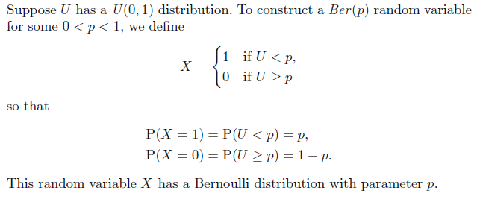
To get Ber(p) from U(0,1)

Slide 6
Pseudocode
Pseudocode describes an algorithm in a semi-formal format
Example:
Ber(p)
u = U(0, 1)
if (u < p)
return 1
return 0

Slide 7
To generate Bin
Bin(n, p) can be generated using a for-loop to sum n Ber(p)
Pseudocode:
Bin(n, p)
count = 0
for(n)
count = count + Ber(p)
return count

Slide 8
To generate Geo
Geo(p) can be generated using a while-loop to count the number of Ber(p) until the first 1 is obtained
Pseudocode:
Geo(p)
count = 1
while (Ber(p) == 0)
count++
return count

Slide 9
To generate NegBin
NegBin(n, p) can be generated using a while-loop to count the number of Ber(p) until the nth 1 is obtained, or a for-loop to sum n Geo(p)
Pseudocode:
NegBin(n, p)
count = 0
for(n)
count = count + Geo(p)
return count

Slide 10
To simulate discrete variable
A random variable Y has outcomes 1, 3, and 4 with the following probabilities:
P(Y = 1) = 3/5
P(Y = 3) = 1/5
P(Y = 4) = 1/5
How to generate Y from a U(0, 1)?
3 4
0.6 0.2 0.2
0
1

Slide 11
To simulate discrete variable (2)
a | 1 | 3 | 4
p(a) | 0.6 | 0.2 | 0.2
F(a) | 0.6 | 0.8 | 1
u = U(0, 1)
if (u < 0.6)
return 1
if (u < 0.8)
return 3
return 4

Slide 12
To simulate discrete variable (3)
Algorithm:
1. Divide [0, 1] according to F(a), that is,
2. Get u = U(0, 1)
3. Generate a_{i} (the ith value) when u is in A_{i}

Slide 13
To simulate discrete variable (4)
u

Slide 14
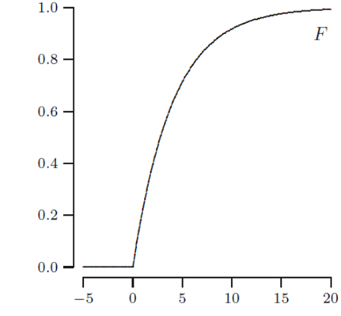
The inverse function of cdf
For a continuous random variable X, if its cdf F strictly increases, the inverse function F⁻¹ exists
F(5)
F⁻¹(0.8)

Slide 15
To simulate continuous variable
When F⁻¹ is applied on U that is U(0, 1), event U ≤ F(a) corresponds to event F⁻¹(U) ≤ a
So P(F⁻¹(U) ≤ a) = P(U ≤ F(a)) = F(a)
Therefore, X can be simulated by F⁻¹(U)
To obtain the formula of F⁻¹, solve the equation F(y) = u for y
E.g. If y = 4x – 5, then x = (y + 5) / 4

Slide 16
To simulate U(a, b)
As stated in Ch. 4:
If X is U(a, b), then Y = (X – a) / (b – a) is U(0, 1)
The inverse function is used to simulate U(a, b)
u = U(0, 1)
return u * (b – a) + a

Slide 17
To simulate Exp(λ)
If u = F(y) = 1 − e^{−λy}, then y = −(1/λ) ln(1 − u)
Since 1 − U is also uniform, it can be replaced by U, so the simulation function is −(1/λ)ln(u)
Pseudocode:
u = U(0, 1)
return −(1/λ)ln(u)

Slide 18
To simulate arbitrary variable
The previous solution still works even if the random variable is partly discrete and partly continuous:
If F has a jump at b, then P(X = b) is the height of the jump
If F is flat at [b, c], then P(X = a) is 0 for any a in [b, c], and F⁻¹ can be made to take any value in [b, c]

Slide 19
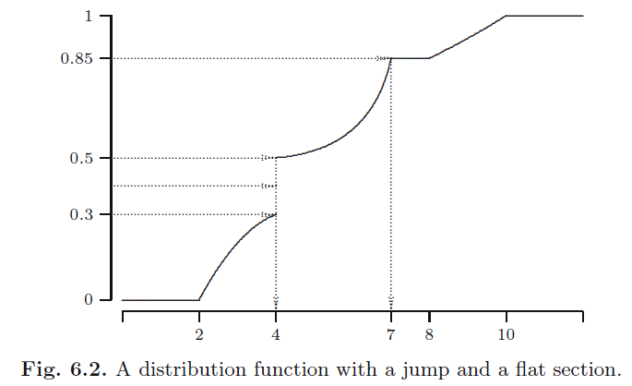
To simulate arbitrary variable (2)

Slide 20
Rejection method
For a continuous random variable, if the cdf F(a) is not available, but the pdf f(a) is, then the latter can be used to generate its values
Generating points (X, Y) in a region including f(a), while X any Y are both uniform. Among the points “under f(a)”, i.e., Y < f(X), the X values roughly have the density function f(a)
This is an example of Monte Carlo method

Slide 21
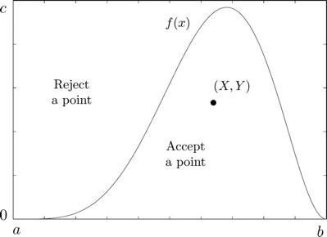
Rejection method (2)

Slide 22
Rejection method (3)

Slide 23
Simulation example
People waiting to get water from a pump. Let T_{i} be the inter-arrival time between the ith customer and the previous one, so
Customers arrival: T₁, T₁+T₂, T₁+T₂+T₃, ...
Their service times: S₁, S₂, S₃, ...
The pump capacity v is a model parameter to be determined, and S_{i} = R_{i} / v for all i, where R_{i} is the demand of the ith customer.

Slide 24
Simulation example (2)
An analysis of the situation leads to the following assumptions:
Inter-arrival times: every T_{i} has an Exp(0.5) distribution (minutes)
Service requirement: every R_{i} has a U(2, 5) distribution (liters)

Slide 25
Simulation example (3)
Let W_{i} be the waiting time of the ith customer:
W_{i} = max{W_{i-1} + S_{i-1} − T_{i}, 0}.

Slide 26
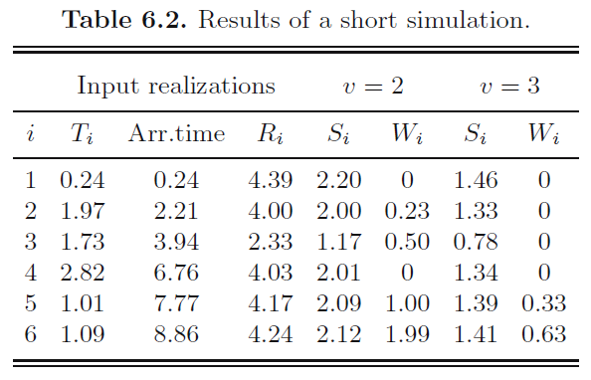
Simulation example (4)

Slide 27
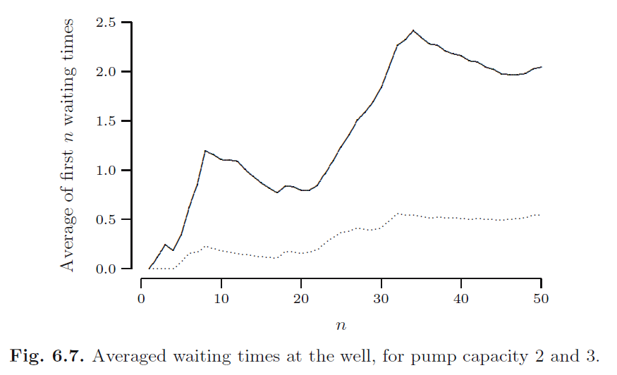
Simulation example (5)

Slide 28
Simulation example (6)
When the pump capacity is 2 (liters/minute),
the average waiting time is around 2.0 (minutes)
When the pump capacity is 3 (liters/minute)
the average waiting time is around 0.5 (minutes)

Slide 29
Summary
1. Using a coin to simulate a discrete random variable with N equally probable values
2. Using U(0, 1) to simulate a random variable
Ber, Bin, Geo, NegBin
Given p(x), f(x), or F(x)
3. Use case of problem-solving by simulation

