Slide 1
Probability and Statistics for Computer Scientists
Third Edition, By Michael Baron
Chapter 3: Discrete Random Variables and Their Distributions
CIS 2033. Computational Probability and Statistics Pei Wang

Slide 2
Sample space and probability
An example: Tossing a coin three times, the sample space includes 8 possible outcomes, and the probability of any event E can be obtained by adding the included probabilities
w | TTT | TTH | THT | THH | HTT | HTH | HHT | HHH
P(w) | (1-p)³ | p(1-p)² | p(1-p)² | p²(1-p) | p(1-p)² | p²(1-p) | p²(1-p) | p³
E | 0 | 1 | 0 | 1 | 0 | 1 | 1 | 0

Slide 3
Random variables
An experiment can be taken as a “random variable” with each outcome as its value
Such a variable is a function that maps each outcome to a real number, X = f(w) or X:Ω→R
Benefit: the probability table of outcomes may be represented by a formula
Discrete random variable: it takes a countable (maybe infinite) number of values

Slide 4
Discrete random variables
An example: Tossing three coins, the number of heads is a discrete random variable X, and Y can be (the absolute value of) the difference between the numbers of heads and tails
Ω | TTT | TTH | THT | THH | HTT | HTH | HHT | HHH
X | 0 | 1 | 1 | 2 | 1 | 2 | 2 | 3
Y | 3 | 1 | 1 | 1 | 1 | 1 | 1 | 3

Slide 5
Discrete random variables (2)
More examples:
Throwing a die twice, the sum of the two numbers
Throwing a die twice, the max of the two numbers
The number of tossing of a coin until the first head appears

Slide 6
sum | 1 | 2 | 3 | 4 | 5 | 6
1 | 2 | 3 | 4 | 5 | 6 | 7
2 | 3 | 4 | 5 | 6 | 7 | 8
3 | 4 | 5 | 6 | 7 | 8 | 9
4 | 5 | 6 | 7 | 8 | 9 | 10
5 | 6 | 7 | 8 | 9 | 10 | 11
6 | 7 | 8 | 9 | 10 | 11 | 12
max | 1 | 2 | 3 | 4 | 5 | 6
1 | 1 | 2 | 3 | 4 | 5 | 6
2 | 2 | 2 | 3 | 4 | 5 | 6
3 | 3 | 3 | 3 | 4 | 5 | 6
4 | 4 | 4 | 4 | 4 | 5 | 6
5 | 5 | 5 | 5 | 5 | 5 | 6
6 | 6 | 6 | 6 | 6 | 6 | 6

Slide 7
Probability mass function
The probability mass function (pmf) p of a discrete random variable X is the function p_{X}:R→[0, 1] defined by
p_{X}(a) = P(X = a) for -∞ < a < ∞
If X is a discrete random variable that takes on the values a₁, a₂, . . ., then
  p_{X}(a_{i}) > 0, p_{X}(a₁) + p_{X}(a₂) + · · · = 1
  p_{X}(a) = 0 for all the other values of a

Slide 8
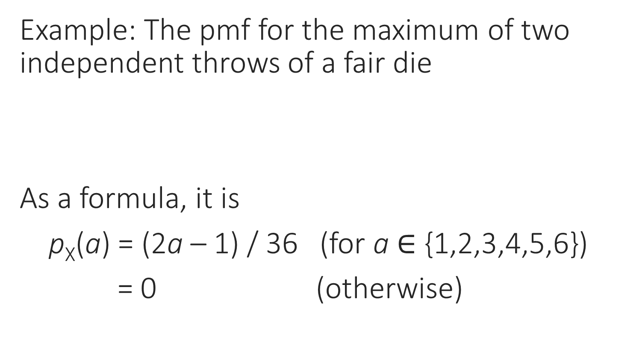
Probability mass function (2)
Example: The pmf for the maximum of two independent throws of a fair die
As a formula, it is
p_{X}(a) = (2a – 1) / 36 (for a $∈$ {1,2,3,4,5,6})
= 0 (otherwise)
a | 1 | 2 | 3 | 4 | 5 | 6
p(a) | 1/36 | 3/36 | 5/36 | 7/36 | 9/36 | 11/36

Slide 9
Cumulative distribution function
The cumulative distribution function (cdf) F of a discrete random variable X is the function F_{X}:R→[0, 1] defined by
F_{X}(a) = P(X ≤ a) for -∞ < a < ∞
This function is also called distribution function
F(a) can be obtained as Ʃp(a’) for all a’ ≤ a
Also, P(a < X ≤ b) = F(b) – F(a)

Slide 10
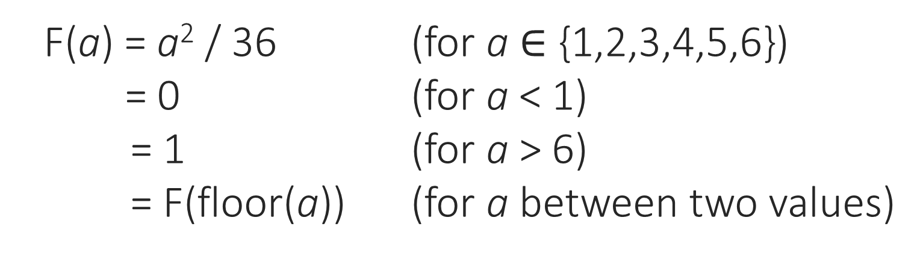
Distribution function (2)
Example: The p(a) and F(a) for the maximum of two independent throws of a fair die
a | 1 | 2 | 3 | 4 | 5 | 6
p(a) | 1/36 | 3/36 | 5/36 | 7/36 | 9/36 | 11/36
F(a) | 1/36 | 4/36 | 9/36 | 16/36 | 25/36 | 36/36
F(a) = a² / 36 (for a $∈$ {1,2,3,4,5,6})
= 0 (for a < 1)
= 1 (for a > 6)
= F(floor(a)) (for a between two values)

Slide 11
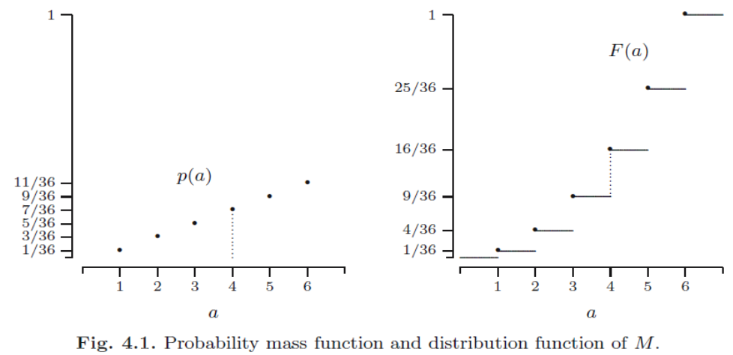
Distribution function (3)

Slide 12
To specify a random variable X
[Given a sample space and the probability of each outcome]
Calculate the value of X for each outcome
List every value a of X where P(X = a) > 0 in increasing order
Decide p(a) by adding the probability values of all outcomes where X = a
Decide F(a) by adding the p(a) values where X ≤ a

Slide 13
Multiple random variables
Multiple random variables may be defined on the same sample space, and their relations can be studied
If X and Y are random variables, then the pair (X, Y) is a random vector. Its distribution is called the joint distribution of X and Y
Individual distributions of X and Y are then called the marginal distributions

Slide 14
Joint functions
The joint probability mass function of discrete random vector (X, Y) is the function
p: R²→[0, 1] defined by p(a, b) = P(X = a, Y = b) for −∞ < a, b < ∞
The joint cumulative distribution function of random vector (X, Y) is the function
F: R²→[0, 1] defined by F(a, b) = P(X ≤ a, Y ≤ b) for −∞ < a, b < ∞

Slide 15
Random vector example
For example, two random variables S and M, the sum and the maximum of two throws of a fair die, have the following sample space
(S, M) | 1 | 2 | 3 | 4 | 5 | 6
1 | 2, 1 | 3, 2 | 4, 3 | 5, 4 | 6, 5 | 7, 6
2 | 3, 2 | 4, 2 | 5, 3 | 6, 4 | 7, 5 | 8, 6
3 | 4, 3 | 5, 3 | 6, 3 | 7, 4 | 8, 5 | 9, 6
4 | 5, 4 | 6, 4 | 7, 4 | 8, 4 | 9, 5 | 10, 6
5 | 6, 5 | 7, 5 | 8, 5 | 9, 5 | 10, 5 | 11, 6
6 | 7, 6 | 8, 6 | 9, 6 | 10, 6 | 11, 6 | 12, 6

Slide 16
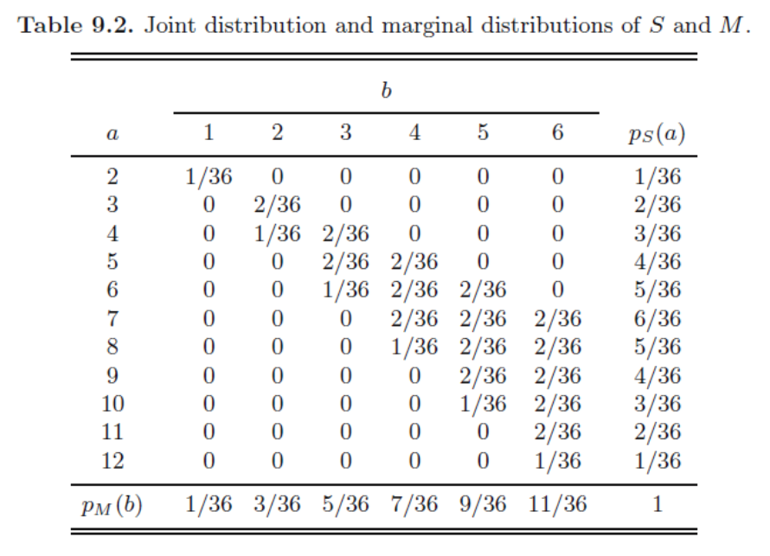
Random vector example (2)

Slide 17
Relations among the functions
The marginal probability mass function of discrete random variables X or Y can be obtained from p(a, b) by summing the values of the other variable
However, the joint probability mass function p_{(X,Y)} cannot be obtained from the marginal probability mass functions p_{X} and p_{Y}, unless X and Y satisfy some special condition

Slide 18
Relations among the functions (2)
The relation between p(a, b) and F(a, b) is like that of p(a) and F(a): F(a, b) is the sum of all p(a’, b’) in the matrix where a’ ≤ a, b’ ≤ b
F_{X}(a) and F_{Y}(b) are the same as the last raw and the last column of F_{(X,Y)}(a, b), respectively

Slide 19
Independent random variables
Random variables X and Y are independent if every event involving only X is independent of every event involving only Y, that is,
p_{(X,Y)} (a, b) = P({X = a} ∩{Y = b})
= P({X = a})P({Y = b}) = p_{X}(a)p_{Y}(b)
Or F_{(X,Y)}(a, b) = F_{X}(a)F_{Y}(b)
P(X = a|Y = b) = P(X = a), for all a and b
P(X ≤ a|Y ≤ b) = P(X ≤ a), for all a and b

Slide 20
An example
Assume X can be 0, 1, or -1, Y can be 0 or 1, and p_{(X,Y)}(a,b) = 1/[4(a²+b)] when a²+b > 0, then what are p_{X}(a), p_{Y}(b), F_{(X,Y)}(a,b), F_{X}(a), and F_{Y}(b)?
p_{(X,Y)} | -1 | 0 | 1 | p_{Y}
0 | 1/4 | 0 | 1/4 | 1/2
1 | 1/8 | 1/4 | 1/8 | 1/2
p_{X} | 3/8 | 1/4 | 3/8 | 1
F_{(X,Y)} | -1 | 0 | 1 | F_{Y}
0 | 1/4 | 1/4 | 1/2 | 1/2
1 | 3/8 | 5/8 | 1 | 1
F_{X} | 3/8 | 5/8 | 1 | 1

Slide 21
An example (2)
Assume X and Y are independent and with the same marginal functions as the previous case, what are their joint functions?
p_{(X,Y)} | -1 | 0 | 1 | p_{Y}
0 | 3/16 | 1/8 | 3/16 | 1/2
1 | 3/16 | 1/8 | 3/16 | 1/2
p_{X} | 3/8 | 1/4 | 3/8 | 1
F_{(X,Y)} | -1 | 0 | 1 | F_{Y}
0 | 3/16 | 5/16 | 1/2 | 1/2
1 | 3/8 | 5/8 | 1 | 1
F_{X} | 3/8 | 5/8 | 1 | 1

Slide 22
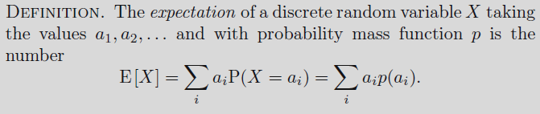
Expectation
The expectation (expected value) or mean of a random variable X is the weighted average of its values, written as E[X] (also E(X), EX) or µ
It is a constant feature value, not random

Slide 23
Expectation (2)
Intuitive meaning: the fair price of a gamble,
or the center of gravity

Slide 24
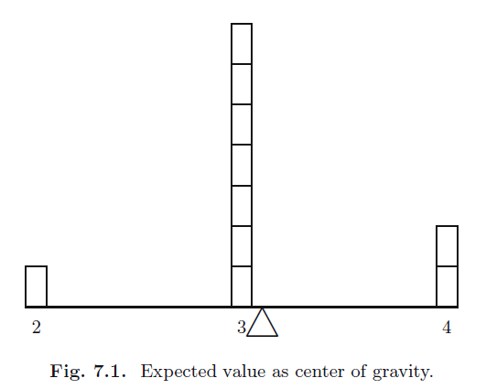
Expectation (3)
a | 2 | 3 | 4 | SUM
p(a) | 0.1 | 0.7 | 0.2 | 1
a*p(a) | 0.2 | 2.1 | 0.8 | 3.1

Slide 25
Expectation of a lottery
Calculate the expectation of the following lottery, step by step:
PRIZE | none | 3rd | 2nd | 1st | SUM
a_{i} | 0 | 50 | 2,000 | 1,000,000 | -
p(a_{i}) | _ | 0.1 | 0.001 | 0.000,001 | 1
a_{i*}p(a_{i}) | 0 | 5 | 2 | 1 | 8
The fair price for a ticket of this lottery is $8. A higher price favors the seller, while a lower price favors the buyer.

Slide 26
Expectation of a lottery (2)
Between two lotteries, how to decide which one to choose if their awards are A₁ and A₂, and probabilities of winning are p₁ and p₂, respectively?
What if a lottery has multiple awards?
What if their ticket prices are t₁ and t₂, respectively?

Slide 27
Properties of expectation
If the n values are equally probable, the expectation is their average (Ʃa_{i})/n
The expectation of a discrete random variable may not be a valid value of the variable
The expectation may not be exactly at the half-way between the min value and the max value, though it is always in [min, max]

Slide 28
St. Petersburg paradox
In a game, a fair coin is tossed. The initial award is 2 dollars and is doubled every time heads appears. The first time tails appears, the game ends and the player wins the reward.
What would be a fair price to pay for entering the game?
a | 2 | 4 | 8 | 16 | 32 | 64 | … | SUM
p(a) | 1/2 | 1/4 | 1/8 | 1/16 | 1/32 | 1/64 | … | 1
a*p(a) | 1 | 1 | 1 | 1 | 1 | 1 | … | ∞

Slide 29
Expectation of a function
If a random variable Y = g(X), then
E[Y] = Ʃg(a_{i})p_{X}(a_{i}) for all X = a_{i}
If a random variable Z = g(X, Y), then
E[Z] = Ʃg(a_{i},b_{j})p_{XY}(a_{i},b_{j}) for all X = a_{i}, Y = b_{j}
Special cases:
If Z = aX + bY + c, E[Z] = aE[X] + bE[Y] + c
If X and Y are independent, E[XY] = E[X]E[Y]

Slide 30
Variance
Very often, just to know the expectation of a random variable is not enough, since its spread (around the expectation) is also of importance
Example: X and Y have the same expectation, but are still very different in spread
a | 4 | 6 | SUM
p_{X}(a) | 0.5 | 0.5 | 1
a*p_{X}(a) | 2 | 3 | 5
a | 1 | 9 | SUM
p_{Y}(a) | 0.5 | 0.5 | 1
a*p_{Y}(a) | 0.5 | 4.5 | 5

Slide 31
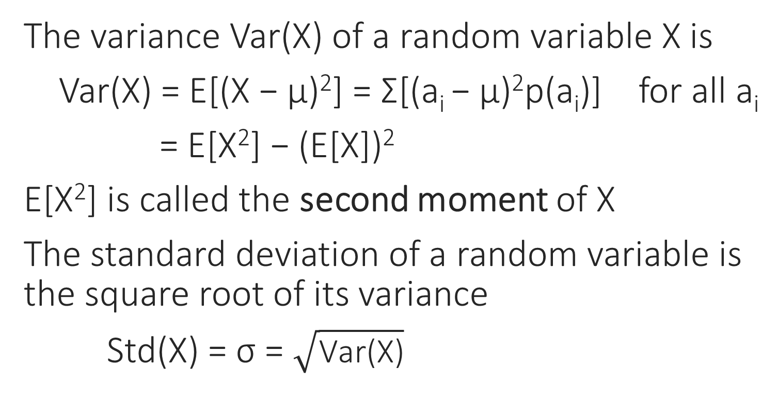
Variance and standard deviation
The variance Var(X) of a random variable X is
Var(X) = E[(X − µ)²] = Ʃ[(a_{i} − µ)²p(a_{i})] for all a_{i}
= E[X²] − (E[X])²
E[X²] is called the second moment of X
The standard deviation of a random variable is the square root of its variance
Std(X) = σ = $\sqrt{\text{Var}\text{(}\text{X}\text{)}}$

Slide 32
Var and std: example
a | 4 | 6 | SUM
p_{X}(a) | 1/2 | 1/2 | 1
a*p_{X}(a) | 2 | 3 | 5
a² | 16 | 36 | -
a²*p_{X} (a) | 8 | 18 | 26
a | 1 | 9 | SUM
p_{Y}(a) | 1/2 | 1/2 | 1
a*p_{Y}(a) | 1/2 | 9/2 | 5
a² | 1 | 81 | -
a²*p_{Y} (a) | 1/2 | 81/2 | 41
E[X] = 5
E[X²] = 26
Var(X) = 1
Std(X) = 1
E[Y] = 5
E[Y²] = 41
Var(Y) = 16
Std(Y) = 4

Slide 33
Var and std: example (2)
E.g. The maximum of two fair die throws
a | 1 | 2 | 3 | 4 | 5 | 6 | SUM
p(a) | 1/36 | 3/36 | 5/36 | 7/36 | 9/36 | 11/36 | 1
a*p(a) | 1/36 | 6/36 | 15/36 | 28/36 | 45/36 | 66/36 | 161/36
a² | 1 | 4 | 9 | 16 | 25 | 36 | -
a²*p(a) | 1/36 | 12/36 | 45/36 | 112/36 | 225/36 | 396/36 | 791/36
E[X] = 161/36 ≈ 4.47, E[X²] = 791/36
Var(X) = 791/36 – (161/36)² = 2555/1296 ≈ 1.97
Std(X) ≈ 1.40

Slide 34
Covariance and correlation
The covariance of X and Y
Cov(X, Y) = E[(X − E[X])(Y − E[Y])]
= E[XY] − E[X]E[Y]
In particular, Cov(X, X) = Var(X)
Cov(X, Y) > 0 : X and Y are positively correlated
Cov(X, Y) = 0 : X and Y are uncorrelated
Cov(X, Y) < 0 : X and Y are negatively correlated

Slide 35
Covariance and correlation (2)
The intuitive meaning of correlation:

Slide 36
An example (continued)
For the previous example given in the following table, what is Cov(X,Y)?
p_{(X,Y)} | -1 | 0 | 1 | p_{Y}
0 | 1/4 | 0 | 1/4 | 1/2
1 | 1/8 | 1/4 | 1/8 | 1/2
p_{X} | 3/8 | 1/4 | 3/8 | 1
E[X] = (-1)(3/8)+(0)(1/4) +(1)(3/8) = 0
E[Y] = (0)(1/2)+(1)(1/2) = 1/2
E[XY] = (-1)(0)(1/4)+(0)(0)(0)+(1)(0)(1/4)+ (-1)(1)(1/8)+(0)(1)(1/4)+(1)(1)(1/8) = 0
Cov(X,Y) = E[XY] − E[X]E[Y] = 0

Slide 37
Another example
X \ Y | 0 | 1 | p_{X}
1 | 0.1 | 0.2 | 0.3
2 | 0.3 | 0.4 | 0.7
p_{Y} | 0.4 | 0.6 | 1
E[X] = 1*0.3+2*0.7 = 1.7, E[Y] = 0*0.4+1*0.6 = 0.6
E[XY] = 1*1*0.2 + 2*1*0.4 = 1.0
Cov(X,Y) = E[XY] − E[X]E[Y] = 1.0 – 1.02 = -0.02

Slide 38
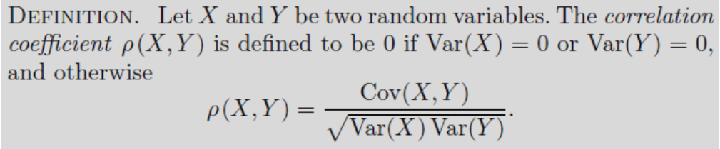
Correlation coefficient
Correlation coefficient is a rescaled, normalized covariance. It is in [-1, 1], and remains the same absolute value under change of unit in both variables

Slide 39
Covariance and variance

Slide 40

Chebyshev's inequality
The range of values of a random variable can be estimated from its expectation and variance
“The chance for the variable to take a value far away from its expectation is small.”

Slide 41
Chebyshev's inequality (2)
When ε = kσ, Chebyshev's inequality becomes
P(|X – μ| > kσ) ≤ (1/k)²
k = 2: P(|X – μ| > 2σ) ≤ 1/4 = 0.25
k = 3: P(|X – μ| > 3σ) ≤ 1/9 ≈ 0.111
k = 4: P(|X – μ| > 4σ) ≤ 1/16 = 0.0625
k = 5: P(|X – μ| > 5σ) ≤ 1/25 = 0.04
k = 10: P(|X – μ| > 10σ) ≤ 1/100 = 0.01

Slide 42
Financial application (1)
Example 3.13
We would like to invest $10,000 into shares of companies XX and YY. Shares of XX cost $20 per share. The market analysis shows that their expected return is $1 per share with a standard deviation of $0.5. Shares of YY cost $50 per share, with an expected return of $2.50 and a standard deviation of $1 per share, and returns from the two companies are independent. In order to maximize the expected return and minimize the risk (standard deviation or variance), is it better to invest (A) all $10,000 into XX, (B) all $10,000 into YY, or (C) $5,000 in each company?

Slide 43
Financial application (2)
(a) The value of a share is X, so the total return A = (10000/20)X = 500X
E[A] = 500 E[X] = (500) (1) = 500
Var(A) = 500² Var(X) = (500²) (0.5²) = 62500, Std(A) = Var(A)^{0.5} = 250
(b) The value of a share is Y, so the total return B = (10000/50)Y = 200Y
E[B] = 200 E[Y] = (200) (2.5) = 500
Var(B) = 200² Var(Y) = (200²) (1²) = 40000, Std(B) = Var(B)^{0.5} = 200
(c) The total return C = 250X + 100Y
E[C] = 250 E[X] + 100 E[Y] = 250 + 250 = 500
Var(C) = 250² Var(X) + 100² Var(Y) = 25625, Std(C) = Var(C)^{0.5} ≈ 160

Slide 44
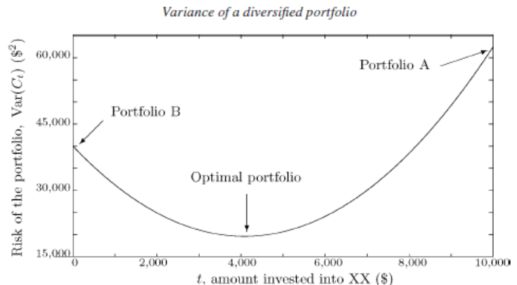
Financial application (3)
By diversifying the portfolio, one can keep the same expectation while reducing the variance

Slide 45
Bernoulli distribution
A random variable with two possible values, 0 and 1, is called a Bernoulli variable, and its distribution is Bernoulli distribution
Ber(p) is a Bernoulli distribution with parameter p, where 0 ≤ p ≤ 1, and
  p(1) = P(X = 1) = p
  p(0) = P(X = 0) = 1 − p
  E[X] = p, Var(X) = p(1 − p)

Slide 46
Binomial distribution
A binomial distribution Bin(n, p) is the number of 1s (successes) in n independent Ber(p)
Special cases: Bin(1, p) = Ber(p)
w | 00 | 01 | 10 | 11
X | 0 | 1 | 1 | 2
P(w) | (1-p)² | (1-p)p | p(1-p) | p²
Bin(2, p)
a | 0 | 1 | 2
p(a) | (1-p)² | 2p(1-p) | p²

Slide 47
Binomial distribution (2)
w | 000 | 001 | 010 | 011 | 100 | 101 | 110 | 111
X | 0 | 1 | 1 | 2 | 1 | 2 | 2 | 3
P(w) | (1-p)³ | p(1-p)² | p(1-p)² | p²(1-p) | p(1-p)² | p²(1-p) | p²(1-p) | p³
Bin(3, p)
a | 0 | 1 | 2 | 3
p(a) | (1-p)³ | 3p(1-p)² | 3p²(1-p) | p³
In general
  p(k) = C(n,k)p^{k}(1 − p)^{n-k} for k = 0, 1, . . ., n
where C(n,k) = n! / [k! (n − k)!]

Slide 48
Binomial distribution examples
Bin(3, 1/2): tossing three fair coins, the number of heads

Slide 49
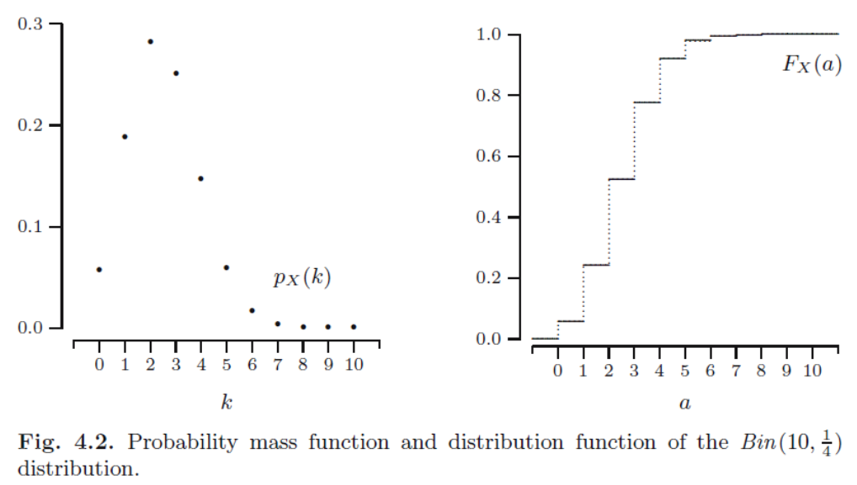
Binomial distribution examples (2)

Slide 50
Binomial distribution as program
Bin(n, p) can be remembered as Ber(p) repeated n times, with their sum returned:
  Bin(n, p)
  count = 0
  for (n)
  count = count + Ber(p)
  return count

Slide 51
Binomial distribution features
If X has a Bin(n, p) distribution, then it can be written as X = R₁ + R₂ + ... + R_{n}, where each R_{i} has a Ber(p) distribution, and is independent of the others
E[X] = E[R₁] + E[R₂] + ... + E[R_{n}] = np
Var(X) = Var(R₁) + ... + Var(R_{n}) = np(1−p)
Both are the feature of Ber(p) times n

Slide 52
Geometric distribution
The number of Ber(p) needed to get the first 1 has Geometric distribution, Geo(p)
Example: Geo(0.6)
w | 1 | 01 | 001 | 0001 | …
a | 1 | 2 | 3 | 4 | …
p(a) | 0.6 | 0.4*0.6 | 0.4²*0.6 | 0.4³*0.6 | …
Its probability mass function is given by
p(k) = (1 − p)^{k−1}p for k = 1, 2, . . . .

Slide 53
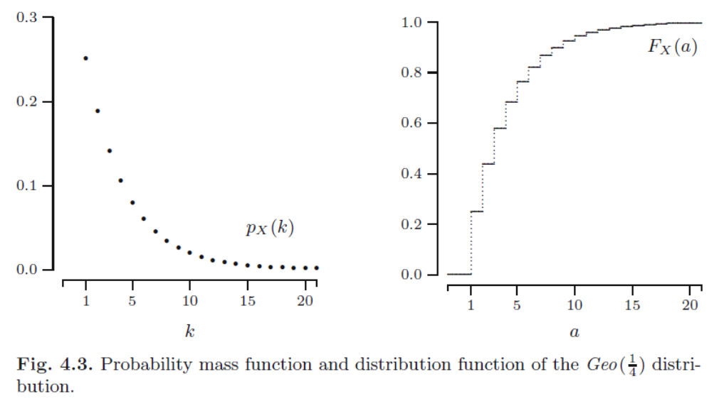
Geometric distribution example

Slide 54
Geometric distribution as program
Geo(p) can be remembered as Ber(p) repeated until the first 1, with the number of repetition returned:
  Geo(p)
  count = 1
  while (Ber(p) == 0)
  count = count + 1
  return count

Slide 55
Geometric distribution features
The expectation and variance of Geo(p) are
E[X] = 1/p
Var(X) = (1 − p) / p²
Example: If a lottery ticket has a chance of 1/10000 of winning, the expected number of tickets to buy until a win is . . .

Slide 56
Negative binomial distribution
In a sequence of independent Ber(p), the number of trials needed to obtain n 1s has Negative Binomial distribution NegBin(n, p)
Example: NegBin(2, 0.6)
w | 11 | 011 | 101 | 0011 | 0101 | 1001 | …
X | 2 | 3 | 3 | 4 | 4 | 4 | …
P(w) | 0.6² | 0.6²*0.4 | 0.6²*0.4 | 0.6²*0.4² | 0.6²*0.4² | 0.6²*0.4² | …
a | 2 | 3 | 4 | …
p(a) | 0.6² | 2*0.6²*0.4 | 3*0.6²*0.4² | …

Slide 57
Negative binomial distribution (2)
The pmf of NegBin(n, p) is
  p(k) = C(k−1,n−1)p^{n}(1−p)^{k-n} for k = n, n+1, . . .
as the last Ber(p) must be 1
Since it can be seen Geo(p) repeating n times independently, its features are
E[X] = n/p, Var(X) = n(1−p)/p²
As a special case, NegBin(1, p) = Geo(p)

Slide 58
Poisson distribution
Poisson process: a very large population of independent events, where each has a very small probability to occur, and the average occurrences in a range is roughly stable
Example: The expected number of telephone calls arriving at a telephone exchange during a time interval [0, t] is E[N_{t}] = λ, where λ is the frequency of the event in an interval of length t

Slide 59


Poisson distribution (2)

Slide 60
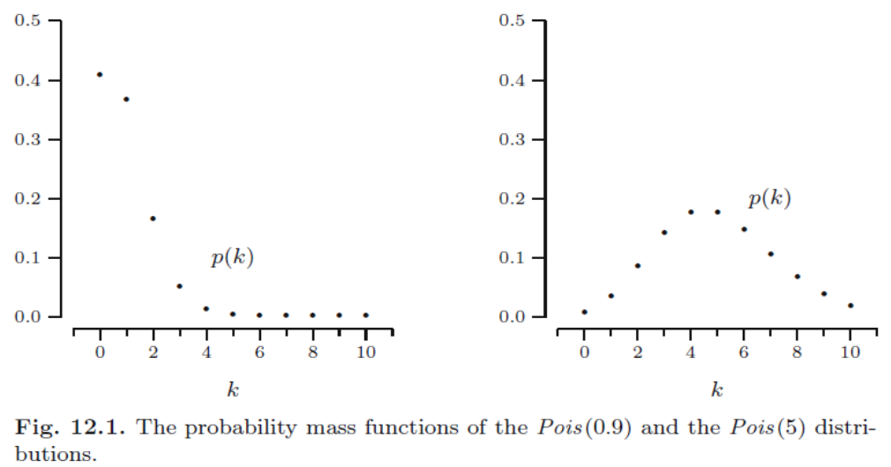
Poisson distribution (3)

Slide 61
Summary
1. Discrete random variable X
p_{X} and F_{X}
2. Random vector (X, Y)
p_{(X,Y)} and F_{(X,Y)}
3. Features
E[X], Var(X), Std(X), Cov(X,Y)
4. Families
Ber(p), Bin(n,p), Geo(p), NegBin(n, p), Pois(λ)

Slide 62
Summary (2)
FAMILY | p_{X}(k) | E[X] | Var(X)
Ber(p) | p(0) = 1−p; p(1) = p | p | p(1−p)
Bin(n, p) | C(n,k)p^{k}(1−p)^{n-k} n ≥ k ≥ 0 | np | np(1−p)
Geo(p) | p(1−p)^{k-1} k ≥ 1 | 1/p | (1−p)/p²
NegBin(n, p) | C(k−1,n−1)p^{n}(1−p)^{k-n} k ≥ n | n/p | n(1−p)/p²
Pois(λ) | e^{-λ}λ^{k}/k! k ≥ 0 | λ | λ

