Slide 1
Probability and Statistics for Computer Scientists Third Edition, By Michael Baron Chapter 2: Probability CIS 2033. Computational Probability and Statistics Pei Wang

Slide 2
Events and probability
Intuitively speaking, the probability of an event is its chance to happen.
Probability, as far as concerned in this course, is defined on events resulting in a repeated experiment, not on a one-time occurrence.
Repeated experiment: Each time the outcome is unknown in advance, but the overall scope of possible outcomes is known and unchanged.

Slide 3
Sample space
Sample space: The set of outcomes of an experiment, usually written as Ω (capital omega).
Examples:
The tossing of a coin: Ω = {H, T}
The month of a day: Ω = {Jan, ..., Dec}
The weight of an object: Ω = (0, ∞)

Slide 4
Event
An event is a description of the outcome, and it identifies a subset of the sample space.
Example: If Ω is the sample space of a die tossing, then “The outcome is an even number”, “The outcome is less than 5”, and “The outcome is 1” are all events.
In each Ω, there are 2^{|Ω|} different events, including the empty event ∅ and Ω itself.

Slide 5
Events as sets
Events can be represented by Venn diagrams.
Set operations can be defined on events: union, intersection, complement, difference, and Cartesian products.
De Morgan's Law: a relation among them.
Disjoint or mutually exclusive events have no common element.
The union of exhaustive events equals the sample space.

Slide 6
Probability of an event
Assumption: The chance of an event is fixed.
Related to frequency, likelihood, odds, etc.
Example: tossing a fair coin, we know
P({H}) = P({T}) = 1/2
which can be simplified to P(H) = P(T) = 1/2

Slide 7
Probability of a union
The sum of the probabilities of all outcomes equals 1.
The probability of an event can be obtained by summing the probabilities of the outcomes included in the event.
P(A) = P(A ∩ B) + P(A ∩ B^{c})
P(A ∪ B) = P(A) + P(B ∩ A^{c})
= P(A) + P(B) − P(A ∩ B)
= P(A) + P(B) [If A and B are disjoint]

Slide 8
Venn diagrams
Ω
A B
A ∩ B^{c} A ∩ B B ∩ A^{c}
A − B B − A
A ∪ B
B
B
B
B
B
B

Slide 9
Probability of a complement
P(A^{c}) = 1 − P(A)
P(B − A) = P(B ∩ A^{c}) = P(B) − P(A ∩ B)
= P(B) − P(A) [if A $⊆$ B]
P(∅) = 0
P(A^{cc}) = P(A)
Probability is always between 0 and 1!

Slide 10
Equally likely outcomes
If the sample space contains n equally likely outcomes, then
P(e₁) = P(e₂) = ... = P(e_{n}) = 1/n
Example: Tossing a fair die, each number has a probability 1/6 to appear.
If event A consists of m of the n outcomes, then
P(A) = m/n, that is, |A|/|Ω|.

Slide 11
Multi-step experiments
If an experiment consists of two separate steps, the overall sample space is the Cartesian product of the individual sample spaces,
i.e., Ω = Ω₁× Ω₂.
If |Ω₁| = r and |Ω₂|= s, then |Ω₁× Ω₂|= r × s.
This result can be extended to experiments of more than two steps.

Slide 12
Counting events in sampling
[Review of CIS 1166]
Sampling: to select k times from n different elements, how many different results are there?
There are 4 different cases:
 | with replacement | without replacement
with order | n^{k} | P(n, k) = n!/(n-k)!
no order | C(n+k-1, k) = (n+k-1)!/[(n-1)! x k!] | C(n, k) = n!/[(n-k)! x k!]

Slide 13
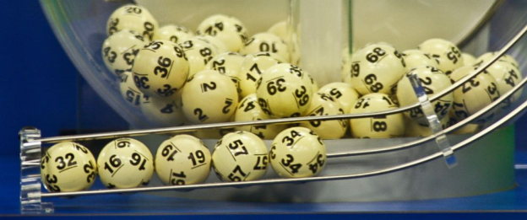
Counting events in sampling (2)
Examples: Drawing 2 balls from 5
 | with replacement | without replacement
with order | 5² = 5x5 = 25 | P(5, 2) = 5!/3! = 5x4 = 20
no order | C(5+2-1, 2) = 6!/(4! x 2!) = 3x5 = 15 | C(5, 2) = 5!/(3! x 2!) = 5x2 = 10
 | 1 | 2 | 3 | 4 | 5
1
2
3
4
5

Slide 14
Example: A fair die thrown twice
What is the probability to get each of the following results?
double 6
no 6
at least one 6
exactly one 6
the total is 10
 | 1 | 2 | 3 | 4 | 5 | 6
1
2
3
4
5
6

Slide 15
Multiple independent steps
If an event in a multi-step experiment consists of multiple events, each can be analyzed independently, then its probability is the product of the probability values of the steps.
P((w₁, w₂, ..., w_{n})) = P(w₁) × P(w₂) × ... × P(w_{n})
Which cases in the previous example can be calculated in this way?

Slide 16
Infinite-step experiments
The definition of probability can be extended to infinite sample space where |Ω| = $∞$.
Example: If a coin is tossed repeatedly until the first head turns up, and assume the probability of a head is p, what is the probability for each number of tossing to occur?
Ω = {1, 2, 3, ... }, P(1) = p, P(2) = (1−p)p, ...,
P(n) = (1−p)^{n−1}p = (1/2)^{n} [when the coin is fair]

Slide 17
Conditional probability
Knowing the occurrence of an event may change the probability evaluation of another event (in the same sample space).
Example: Throwing a fair die, what is the probability of getting a 5? What if it is already known that the outcome is an odd number? Or an even number?

Slide 18
Conditional probability (2)
The conditional probability of A given C: P(A|C) = P(A ∩ C) / P(C) , provided P(C) > 0
While unconditional probability is with respect to the sample space, conditional probability is with respect to the condition, i.e.,
P(A) = P(A|Ω) = P(A ∩ Ω) / P(Ω)
If event A includes m of the n equally probable elements in C, P(A|C) = m/n =|A ∩ C| / |C|

Slide 19
The multiplication rule
For any events A and C:
P(A ∩ C) = P(A|C) x P(C) = P(C|A) x P(A)
Example: The probability for two arbitrarily chosen people to have different birthdays is
P(B₂) = 1 – 1/365
the event B₃ can be seen as the intersection of B₂ with event A₃ “the third person has a birthday that does not coincide with that of one of the first two”
P(B₃) = P(A₃ ∩ B₂) = P(A₃|B₂)P(B₂)
= (1 – 2/365) (1 – 1/365)

Slide 20
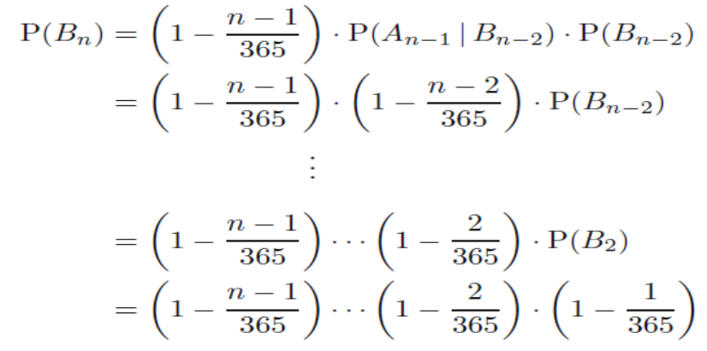
The multiplication rule (2)

Slide 21
The multiplication rule (3)
P(B₂₂) = 0.5243, P(B₂₃) = 0.4927

Slide 22
The multiplication rule (4)
For any events A and C:
P(A ∩ C) = P(A|C) x P(C) = P(C|A) x P(A)
though one of the two may be easier to calculate than the other.
In the previous example,
P(B₃) = P(A₃ ∩ B₂) = P(B₂|A₃)P(A₃)
though it doesn't make much sense intuitively.

Slide 23
Law of total probability
Suppose C₁, C₂, . . . , C_{m} are disjoint events such that C₁∪C₂∪· · ·∪C_{m} = Ω. They form a partition of the sample space. Using them, the probability of an arbitrary event A can be expressed as:
P(A) = P(A∩C₁) + P(A∩C₂) + · · · + P(A∩C_{m}) =
P(A|C₁)P(C₁) + P(A|C₂)P(C₂) + · · · + P(A|C_{m})P(C_{m})
When m = 2, P(A) = P(A|B)P(B) + P(A|B^{c})P(B^{c})

Slide 24
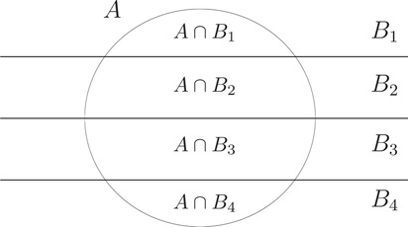
Total probability: example
P(B₁) = P(B₄) = 0.2
P(B₂) = P(B₃) = 0.3
P(A|B₁) = P(A|B₄) = 0.3 P(A|B₂) = P(A|B₃) = 0.5
P(A) = P(A|B₁)P(B₁) + P(A|B₂)P(B₂) + P(A|B₃)P(B₃) + P(A|B₄)P(B₄)
= 0.3*0.2 + 0.5*0.3 + 0.5*0.3 + 0.3*0.2
= 0.42

Slide 25
Bayes’ rule
From P(B|A) x P(A) = P(A|B) x P(B) and P(A) > 0
it directly follows that
P(B|A) = P(A|B) x P(B) / P(A)
= P(A|B)P(B) / [P(A|B)P(B) + P(A|B^{c})P(B^{c})]
This rule is widely used in belief revision given new evidence, and it has several forms.

Slide 26
Bayes’ rule (2)
Examples

Slide 27
Monty Hall Problem
Pick A
A
B
C
Open B
A
B
C
To C?
A
B
C

Slide 28
Independence
An event A is called independent of event B if
P(A|B) = P(A)
Intuitively, if A is independent of B, then B is independent of A, so the two are independent of each other.
If two events are not independent, they are called dependent of each other.

Slide 29
Independence (2)
To show that A and B are independent it suffices to prove just one of the following:
P(A|B) = P(A)
P(B|A) = P(B)
P(A ∩ B) = P(A)P(B)
where A may be replaced by A^{c} and B replaced by B^{c}, or both.

Slide 30
Special Venn diagrams
A and B are disjoint, complement, inclusive, and independent, respectively
B
B
B
B

Slide 31
Special cases for conditionals
What is P(A|B) if
A and B are disjoint
B is a subset of A
A is a subset of B
P(A^{c}|B) is known
P(A|B^{c}) is known

Slide 32
Independence of multiple events
Events A₁, A₂, . . . , A_{m} are called independent if
P(A₁∩A₂∩ · · · ∩A_{m}) = P(A₁)P(A₂) · · · P(A_{m})
and here any number of the events A₁, . . . , A_{m} can be replaced by their complements throughout the formula.
Special case: the outcomes of a multiple-step experiment with independent steps
P((w₁, w₂, ..., w_{n})) = P(w₁) × P(w₂) × ... × P(w_{n})

Slide 33
Independence of multiple events (2)
Example. A fair coin is tossed twice, and events
A: The first toss gets a head, {HH, HT}
B: The second toss gets a head, {HH, TH}
C: The two tosses get the same, {HH, TT}
P(A) P(B) P(C)
P(A∩B) P(B∩C) P(A∩C)
P(A∩B∩C)

Slide 34
Independence of multiple events (3)
In the previous example, the three events A, B, C are pairwise independent (A-B, B-C, A-C), but dependent altogether (A-B-C), so these two relations are different.

Slide 35
Summary (1)
Division:
P(A|B) = m/n [when A∩B includes m of the n equally probable outcomes in B]
Subtraction:
P(A^{c}|B) = 1 − P(A|B); P(A|B) = 1 − P(A^{c}|B)
In both rules B can be Ω, then the conditional probability becomes unconditional probability

Slide 36
Summary (2)
Multiplication:
P(A ∩ B) = P(A|B) × P(B) = P(B|A) × P(A)
= P(A) × P(B) [when A and B are independent]
Addition:
P(A ∪ B) = P(A) + P(B) − P(A ∩ B)
= P(A) + P(B) [when A and B are disjoint]
Both can be extended to more than two events

Slide 37
Summary (3)
Law of total probability:
P(A) = P(A|B)P(B) + P(A|B^{c})P(B^{c})
where {B, B^{c}} can be replaced by any partition
Bayes’ rule:
P(B|A) = P(A|B) x P(B) / P(A) (P(A) > 0)
Event A and B are independent if and only if
P(A|B) = P(A) or P(A ∩ B) = P(A)P(B)

