Slide 1
Algorithms for NP-hard Optimization Problems and Cluster Analysis
Dissertation Defense
Nan Li
Committee: Dr. Longin Jan Latecki (Advisor)
Dr. Haibin Ling
Dr. Slobodan Vucetic
Dr. Yimin Zhang

Slide 2
Outline
Chapter 1: Algorithms for Weighted Set Cover and Minimum Weighted Dominating Set Problems
Chapter 2: Affinity Learning for Mixed Data Clustering
Chapter 3: Clustering Aggregation as Maximum-Weight Independent Set

Slide 3
Chapter 1 Algorithms for Weighted Set Cover and Minimum Weighted Dominating Set Problems

Slide 4
Weighted Set Cover Problem
Given a set of items, called the universe $U$, and a collection $ℱ$ of sets whose union equals $U$, the set cover (SC) problem is to find the smallest sub-collection of $ℱ$whose union equals the universe $U$.
The weighted set cover (WSC) problem, in which each set is associated with a positive weight, is to find the sub-collection of $ℱ$ whose union equals $U$ with the minimum sum of weights.

Slide 5
Minimum Weighted Dominating Set Problem
Given an undirected graph $G = (V, E)$, a dominating set is a subset $D⊆V$ such that for every vertex $v∈V$, either $v∈D$or at least one neighbor of $v$ is in $D$. The minimum dominating set (MDS) problem is to find a dominating set of the minimum size.
If each vertex is associated with a positive weight, the minimum weighted dominating set (MWDS) problem is to find a dominating set for which the sum of weights is minimized.

Slide 6
Equivalent Problems under L-reductions
From dominating set to set covering
Given a graph $G = \left(V, E\right)$, construct a set cover instance as follows: the universe $U$ is $V$, and each set $Sv$ in the family $ℱ$ consists of the items corresponding to vertex $v$ and all vertices adjacent to $v$
From set covering to dominating set
Given a set cover instance $(U, ℱ)$, construct a graph $G = \left(V, E\right)$ as follows: the set of vertices is $V = I ∪ U$, where $I$is the set of set indices; there is an edge $\{i, j\} ∈ E$ between each pair $i, j ∈ I$, and there is also an edge $\{i, u\}$ for each $i ∈ I$ and $u ∈ Si$

Slide 7
Applications
Artificial intelligence
Location recognition
Action recognition
Multi-document summarization
Multi-topic blog-watch
Vanishing point detection
Video motion segmentation
…
Operations research, planning, computer networking, bioinformatics, web technology, social networks, database, …

Slide 8
NP-hard Optimization Problems
Exact algorithms
require exhaustive exploration of exponentially many options
infeasible in practice
Approximation and heuristic algorithms
find reasonably good solutions in polynomial time
widely used in real applications

Slide 9
Approximation and Heuristic Algorithms
Approximation algorithms
with guaranteed approximation ratios
Greedy heuristic algorithms
without guaranteed approximation ratios
Local search algorithms
achieve good results on small or medium instances
too complex to process large instances

Slide 10
Classic Greedy Algorithms
Set cover problem
repeatedly picks a set that contains the largest number of uncovered items until all the items in the universe are covered
approximation ratio $lnδ⁡+1$, $δ$ is the maximum cardinality of sets in $ℱ$
Weighted set cover problem
repeatedly selects a set by the number of uncovered items it contains per unit weight or the inverse
approximation ratio $ln⁡|U|+1$, where $|U|$is the cardinality of universe $|U|$

Slide 11
Classic Greedy Algorithms
Minimum dominating set problem
repeatedly picks a vertex which covers the maximum number of previously uncovered vertices until a dominating set is obtained
approximation ratio $lnδ′⁡+ 2$, $δ′$ is the maximum degree of $G$
Minimum weighted dominating set problem
repeatedly selects a vertex by the number of uncovered vertices it covers per unit weight or the inverse
approximation ratio $ln⁡|V|+1$, where $|V|$is the number of vertices

Slide 12
Our Algorithms
Essential idea
Build a robust solution and then improve it
Three-step strategy
reserve indispensable sets/vertices and reduce problem size
build a robust solution with a novel greedy heuristic
remove redundant sets/vertices

Slide 13
WSC Algorithm - 1st step
Reserve indispensable sets
Every indispensable set covers at least one item on its own
Reduce to smaller WSC problem $(U^{′}, ℱ^{′}, w)$
Remove the items covered by the indispensable sets
Remove the empty sets (include but not limited to the reserved sets)

Slide 14
WSC Algorithm - 2nd step
Build a robust solution with a novel greedy heuristic
start with an empty set ${ℱ′}_{C}=∅$
repeatedly select a set with the maximum coverage benefit (CB), which covers at least one uncovered item
stop when the union of sets in ${ℱ′}_{C}$ equals $U′$

Slide 15
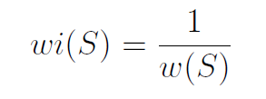
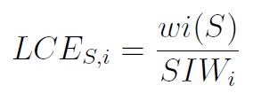
WSC Algorithm - 2nd step
Let $wi(S)$ denote the inverse of weight $w(S)$ of set $S$
For each item $i$, we compute the sum of weight inverses of the sets containing $i$
For each set $S$, we define its local coverage efficiency on each item $i ∈ S$

Slide 16
WSC Algorithm - 2nd step
For each set $S$, we define its global coverage capacity
In each iteration, we define the local coverage gain of each set $S$
For each set $S$, its coverage benefit is defined as

Slide 17
WSC Algorithm - 3rd step
Remove the redundant sets
keep every set in ${ℱ′}_{C}$ which covers at least one item in $U′$ on its own
remove the other sets, which are considered as potentially redundant
recover the full coverage of ${ℱ′}_{C}$ from the potentially redundant sets with the classic WSC algorithm
Final solution

Slide 18
WSC Algorithm - Theoretic Analysis
Time complexity
1st step: $𝒪(|ℱ||U|)$
2nd step
complexity of each iteration is the same as that of the classic greedy algorithm
generally needs more iterations to reach the full coverage
3rd step
In the worst case, it is to run the classic greedy algorithm on the instance with sets ${ℱ′}_{C}$ and items in $U′$
Approximation ratio
when applied to the (unweighted) set cover problem, by setting $β_{l} = 0$ and $γ= 0$, our algorithm becomes a variant of the classic greedy approximation algorithm, therefore can guarantee the approximation ratio of $lnδ⁡+1$, $δ$ is the maximum cardinality of sets in $ℱ$

Slide 19
MWDS Algorithm
Reserve indispensable vertices
isolated vertices with degree zero
for each vertex $v$ with degree one and its neighbor $u$, if $w\left(v\right) ≥ w(u)$, $u$ is added
Convert into WSC problem

Slide 20
Experimental Evaluations
Four groups of experiments on WSC, SC, MWDS and MDS
Extensive evaluation on widely used synthetic and real world instances
Parameters $β_{l}$, $β_{g}$ and $γ$
vary with grid search
guidelines for choosing values

Slide 21
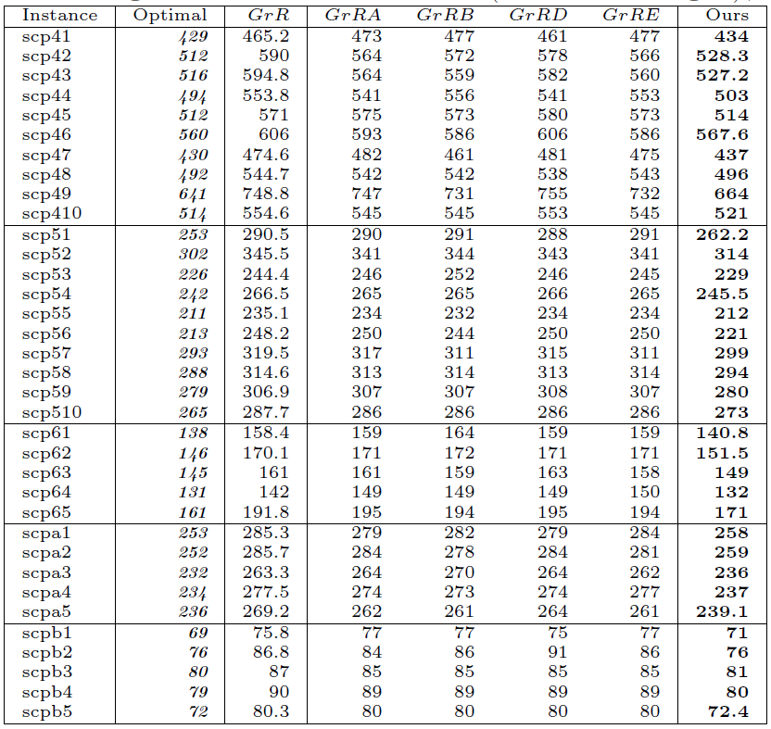
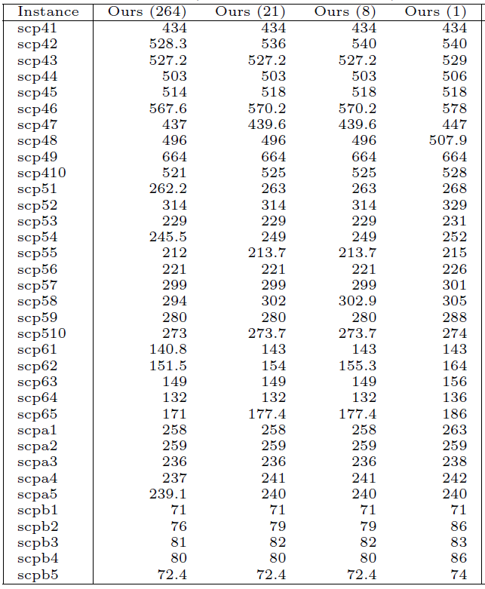
Results – WSC Problem
70 synthetic instances from OR-Library

Slide 22
Results – SC Problem
8 real world instances from Frequent Itemset Mining Dataset Repository

Slide 23
Results – MWDS Problem
41 graphs from BHOSLIB benchmark
37 graphs from DIMACS complementary benchmark
139 undirected simple graphs in Network Data Repository

Slide 24
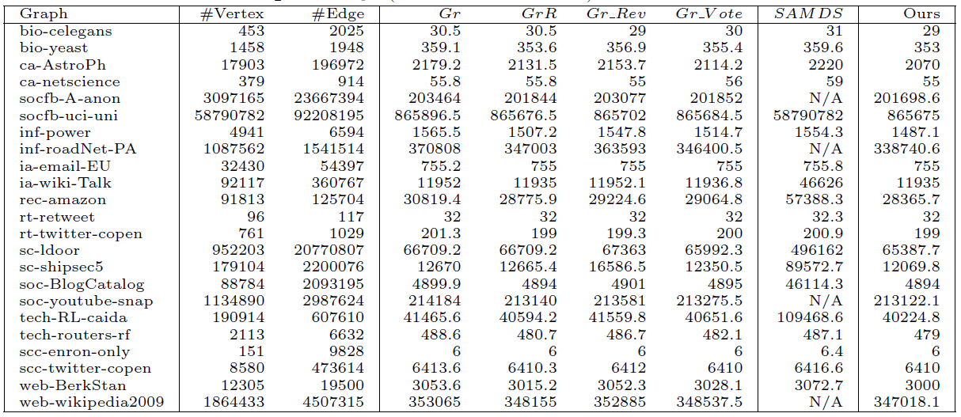
Results – MDS Problem
139 undirected simple graphs in Network Data Repository

Slide 25
Evaluation of Efficiency

Slide 26
Chapter 2 Affinity Learning for Mixed Data Clustering

Slide 27
Introduction
Mixed data clustering
data with mixed-type (continuous, categorical or ordinal) attributes
common in real applications, but received relatively less attention
How to measure affinity or distance between data points?
Widely used methods compute affinity locally between two data points
1-hot (1-of-K) encoding, Gower’s similarity coefficient and its extensions
We propose to compute affinity globally by taking into account the interconnections among the attribute values of all data points

Slide 28
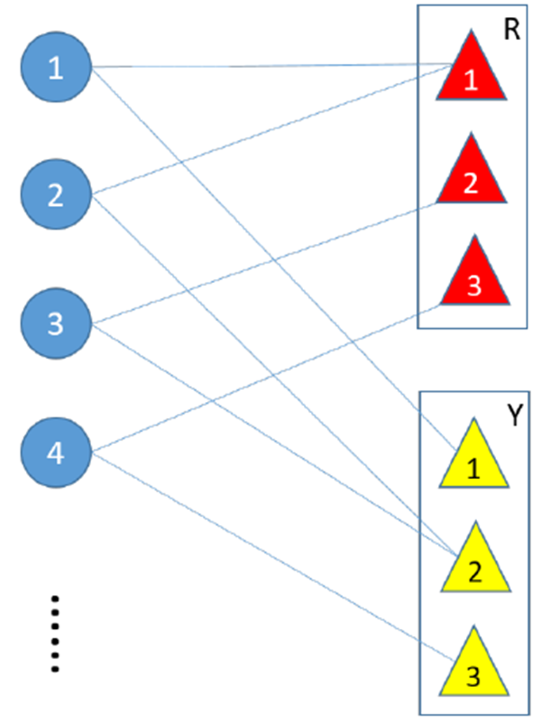
Introduction
Intuitively, $x_{1}$ is more affinitive to $x_{3}$ than to $x_{4}$
because of the existence of $x_{2}$, which shares one
common attribute value with $x_{1}$ and $x_{3}$ respectively
Gower’s similarity coefficient or 1-hot encoding
$S_{13}=S_{14}=0$
Our affinity learning based method
$S_{13}>S_{14}$
blue circle: data point $x$
rectangle: categorical attribute

Slide 29
Mixed Data Processing
Transform data points and their mixed-type attribute values into abstract objects and initial affinities
Categorical attribute
Each category is defined as an abstract object. Its affinities to the data points in this category are initialized to 1, while its initial affinities to the rest data points are 0
Ordinal attribute
All possible values are first ranked and then replaced by their ranks. The new ordinal attributes are processed as continuous attributes

Slide 30
Mixed Data Processing
Continuous attribute
Two abstract objects are defined to represent the minimum and maximum values, $C_{min}$ and $C_{max}$
Attribute value $x_{C}$ of data point $x$ is transformed into two initial affinities $a$ and $b$ to $C_{min}$ and $C_{max}$, which satisfy
$x_{C}$ is first scaled with the Min-Max normalization
After normalization, $C_{min}^{′}=0$ and $C_{max}^{′}=1$, we have

Slide 31
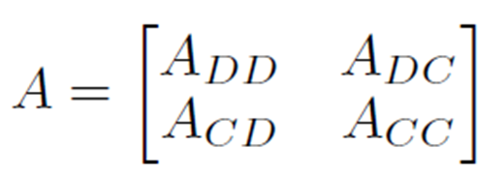
Affinity Learning
Construct affinity matrix $A$ for abstract objects of data points ($D$) and attributes ($C$)
Scale nonzero entries in $A$ with a common scaling factor $∆$
Scaled matrix $A^{′}$ with $a_{ij}^{′}<1$ and $ρ\left(A^{′}\right)<1,$ we have

Slide 32
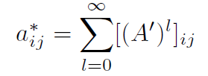
Affinity Learning
Compute matrix $A^{∗}$ as
Each entry $a_{ij}^{∗}$ of $A^{∗}$ denotes a value
The inferred affinities between data points are in $A_{DD}^{∗}$
The refined affinities between data points and abstract objects of attributes are in $A_{DC}^{∗}$

Slide 33
Clustering with Learned Affinities
Inferred affinities between data points
complete-linkage, single-linkage, …
Refined affinities of data points to abstract objects of attributes as new data features
Any clustering algorithms for data with continuous attributes

Slide 34
Experimental Evaluation
Our algorithms
IA+CL (Inferred Affinities + Complete-Linkage)
FRA+CL (Feature from Refined Affinities + Complete-Linkage)
FRA+KM (Feature from Refined Affinities + K-Means)
Comparison algorithms
OH+CL (Feature from One-Hot encoding + Complete-Linkage)
OH+KM (Feature from One-Hot encoding + K-Means)
GC+CL (Gower’s Coefficient + Complete-Linkage)
KP (k-prototypes)
KMM (K-means-mixed)
LIA+CL (Locally Inferred Affinities + Complete-Linkage)
FNRA +CL (Feature from Non-Refined Affinities + Complete-Linkage)
FNRA +KM (Feature from Non-Refined Affinities + K-Means)

Slide 35
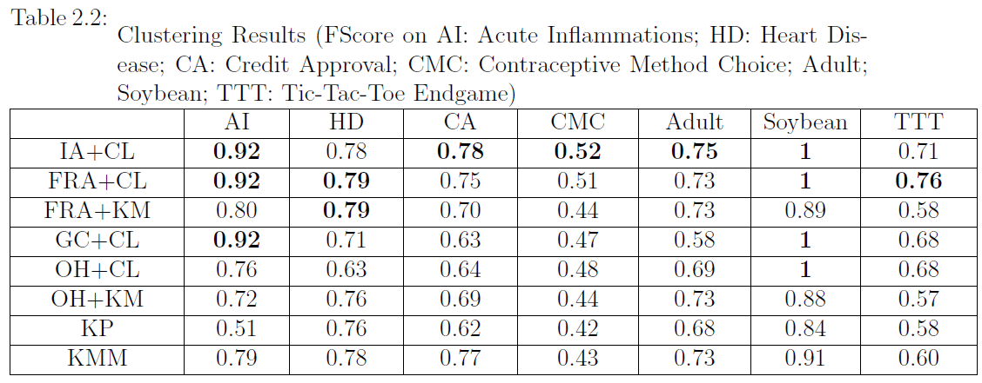
Results - 1
Notes:
These are the clustering results on 7 data sets from the UCI repository
We can see our algorithms achieve superior performance

Slide 36
Results - 2

Slide 37
Results - 3

Slide 38
Chapter 3 Clustering Aggregation as Maximum-Weight Independent Set

Slide 39
Introduction
Clustering Aggregation
a.k.a. consensus clustering or clustering ensemble
find a superior clustering from multiple clusterings on the same data set
Maximum-Weight Independent Set (MWIS) problem
find an independent set with maximum total weight in an undirected graph with weights on vertices
complementary problem of Maximum-Weight Clique

Slide 40
Clustering Aggregation as Maximum-Weight Independent Set
An attributed graph is constructed from the multiple clusterings
The vertices, which represent clusters, are weighted based on an internal index measuring both cohesion and separation
The edges connect the vertices whose corresponding clusters overlap
The vertices corresponding to each input clustering form a maximal independent set (MIS)
Find maximum-weight independent set of the attributed graph
Optimal subset of non-overlapping clusters partitioning the data set

Slide 41
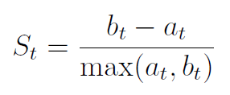
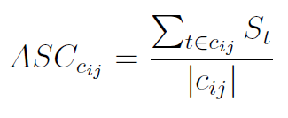
Vertex Weight
Silhouette coefficient of each individual data object $t$
$a_{t}$ is the average distance from $t$ to the other data objects in the same cluster as $t$
$b_{t}$ is the minimum average distance from $t$ to data objects in a different cluster, minimized over clusters
Average silhouette coefficient of each cluster $c_{ij}$
Weight on vertex $i$ which represents cluster $c_{i}$

Slide 42
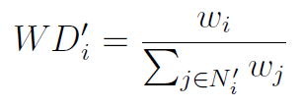
Our MWIS Algorithm
Simulated annealing metaheuristic
Start with each MIS
Local search heuristic
remove a proportion of lower-weight vertices
the probability that a vertex $i$ will be retained is proportional to its $WD$ value
add compatible vertices one by one
select the vertex with the largest $WD′$ value

Slide 43
Experimental Evaluation - 1
Four synthetic 2-d data sets with different degree of cluster overlapping
K-means as underlying clustering algorithm with K = 5 : 1 : 25
The aggregated clustering obtained by our approach has the correct number (15) of clusters and near-perfect structure

Slide 44
Experimental Evaluation - 2
Synthetic data set consisting of 7 distinct groups of 2-d data points, which have significantly different shapes and sizes
Four different underlying clustering algorithms: single linkage, complete linkage, Ward's clustering and K-means
Specify the desired number of clusters as 4 : 1 : 10
Our approach is able to combine the advantages of different underlying clustering algorithms and canceling out the errors introduced by them

Slide 45
Experimental Evaluation - 3
Seven real data sets from UCI machine learning repository
k-means and complete-linkage with desired cluster number as 2 : 1 : 10

Slide 46
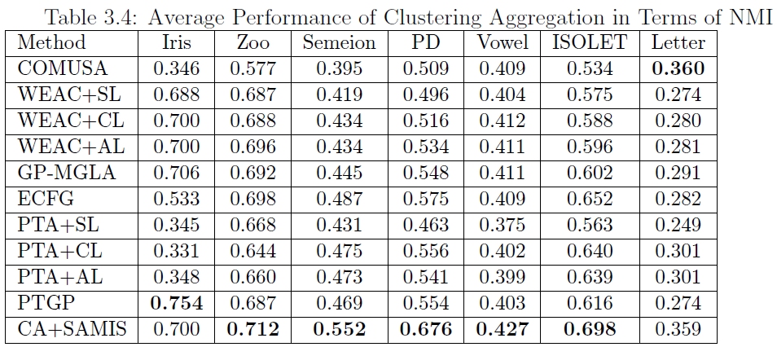
Experimental Evaluation - 3
Performance of our MWIS algorithm SAMIS is very close to those of state-of-the-art
Our approach CA+SAMIS to clustering aggregation is very competitive in comparison to state-of-the-art

Slide 47
My Publications
Nan Li and Longin Jan Latecki. “Affinity Learning for Mixed Data Clustering”. Int. Joint Conf. on Artificial Intelligence (IJCAI), 2017.
Nan Li and Longin Jan Latecki. “Enhanced Affinity Inference Based Recommender Systems”. IEEE/WIC/ACM Int. Conf. on Web Intelligence (WI), 2016.
Nan Li and Longin Jan Latecki. “Jointly Reweighing Labeled Data and Learning Affinities on an Augmented Graph for Semi-Supervised Learning”. European Conference on Artificial Intelligence (ECAI), 2016.
Nan Li and Longin Jan Latecki. “Affinity Inference with Application to Recommender Systems”. IEEE/WIC/ACM Int. Conf. on Web Intelligence (WI), 2015.
Nan Li and Longin Jan Latecki. “Clustering Aggregation as Maximum-Weight Independent Set”. Neural Information Processing Systems Conf. (NIPS), 2012.
Yi Fan, Nan Li, Chengqian Li, Zongjie Ma, Longin Jan Latecki, Kaile Su. “Restart and Random Walk in Local Search for Maximum Vertex Weight Cliques”. Int. Joint Conf. on Artificial Intelligence (IJCAI), 2017.
Nan Li and Longin Jan Latecki. “Approximation Algorithms for Set Cover and Minimum Dominating Set Problems”
Nan Li and Longin Jan Latecki. “An Approximation Algorithm Framework for Weighted Set Cover and Minimum Weighted Dominating Set Problems”.
Yi Fan, Nan Li, Chengqian Li, Zongjie Ma, Longin Jan Latecki, Kaile Su. “Efficient Local Search for Minimum Dominating Sets in Large Real-world Graphs”.

Slide 48
Q & A
Thank You!

