Slide 1

Joint Scheduling of Overlapping Phases in the MapReduce Framework
Jie Wu
Collaborators: Huanyang Zheng and Yang Chen
Center for Networked Computing
Temple University
Notes:
1

Slide 2

Road Map
  1. Introduction
  2. Model and Formulation
  3. General Greedy Solutions
  4. Experiment
  5. Conclusion

Slide 3
1. Introduction
  Map-Shuffle-Reduce
  Map and Reduce: CPU-intensive
  Shuffle: I/O-intensive
  TeraSort
  Map: sample & partition data
  Shuffle: partitioned data
  Reduce: locally sort data
Map
Shuffle
Reduce
Data partition
Local
sort
Data partition
Local
sort
Notes:
Data buckets for TeraSort

Slide 4
Map-Shuffle-Reduce
  Multiple jobs
  TeraSort, WordCount, etc.
  Reduce is not significant (Zaharia, OSDI 2008)
  7% of jobs are reduce-heavy
  Centralized scheduler
  Determines a sequential order for jobs on the map and shuffle pipelines

Slide 5
Job Classification
  Dependency relationship
  Map emits data at a certain rate
  Shuffle waits for the map data
  Job classification
  Map-heavy: map > shuffle (m > s)
  Balanced: map = shuffle (m = s)
  Shuffle-heavy: map < shuffle (m < s)

Slide 6
Execution Order
  Impact of overlapping map and shuffle
Map pipeline
Shuffle pipeline
WordCount (map-heavy)
TeraSort (shuffle-heavy)

Slide 7
2. Model and Formulation
  Schedule objective:
  Minimize the average job completion time for all jobs; J_{i} includes the wait time before the job starts.
  Schedule is NP-hard
  Offline scenarios
  All jobs arrive at the beginning (and wait for schedule)

Slide 8
Related Work: Flow Shop
  Minimize last job completion time
  l-phase flow shop is solvable when l=2
  G_{m}: map-heavy jobs sorted in increasing order of map load
  G_{s}: shuffle-heavy jobs sorted in decreasing order of shuffle load
  Optimal schedule: G_{s} followed by G_{m}
  S. M. Johnson, Optimal two-and three-stage production schedules with setup times included, Naval Research Logistics Quarterly, 1954.
Map
J₁
J₂
J₃
J₄
J₂
J₄
J₁
J₃
Shuffle
J₁
J₂
J₃
J₄
J₂
J₄
J₁
J₃

Slide 9
Related Work: Strong Pair
  Minimize average job completion time
  Strong pair
  J₁ and J₂ are a strong pair if m₁ = s₂ and s₁ = m₂
  Optimal schedule: jobs are strong pairs
  Pair jobs and rank pairs by total workloads
  H. Zheng, Z. Wan, and J. Wu, Optimizing MapReduce framework through joint scheduling of overlapping phases, Proc. of IEEE ICCCN, 2016.
Map
J₄
J₁
J₃
J₁
J₂
J₂
J₃
J₄
Shuffle
J₄
J₁
J₂
J₃
J₁
J₂
J₃
J₄

Slide 10
First Special Case
  When all jobs are map-heavy, balanced, or shuffle-heavy
  Optimal schedule:
  Sort jobs ascendingly by dominant workload max{m, s}
  Execute smaller jobs earlier
Map
pipeline
Shuffle
pipeline
  Finishing times J₁, J₂, J₃: 1, 3, 6 vs. J₃, J₂, J₁: 3, 5, 6

Slide 11
Second Special Case
  Jobs J₁ and J₂ can be “paired”
  if m₁ ≤ m₂, s₁ ≥ s₂, and m₁+m₂=s₁+s₂
  (non-dominance) (balance)
  Optimal schedule:
  Pair jobs: shuffle-heavy before map-heavy
  Sort job pair: by total workload m+s
  Execute smaller pairs earlier
Map
Shuffle

Slide 12
Why Non-dominance?
  Cannot pair small and large jobs J₁ and J₂

Slide 13
Theorem
If jobs can be paired, paired job scheduling is optimal if
(1) job pairs with smaller workloads are executed earlier and
(2) all pairs are executed together (shuffle-heavy first).
Proof ideas
In each pair, shuffle-heavy job is executed before map-heavy job
Otherwise a swap leads to a better result
Job pairs with smaller total workloads are executed earlier
Otherwise a swap leads to a better result
Paired jobs should not be separately executed (a bit more involved)

Slide 14
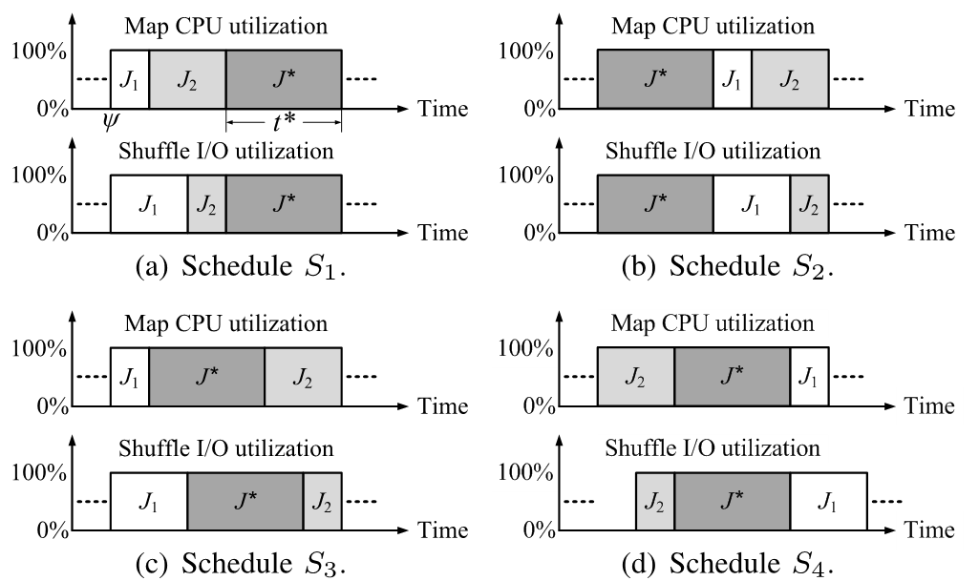
Proof
S₁ is better than S₃ and S₄ when J* is large
S₂ is better than S₃ and S₄ when J* is small

Slide 15
3. First General Algorithm
  Sort jobs based on their sizes (“workload”)
  Partition sorted list in k (group factor) groups
  Execute each group in order based on workload
  Order matters for inter-group!
  Pair jobs in each group
  Pairing matters for intra-group!

Slide 16
Group-Based Scheduling Policy (GBSP)
  Group jobs by their workloads (first factor)
  Optimally divide jobs into k groups
  minimize the sum of maximum job
  workload difference in each group
  Execute the group of smaller jobs earlier
  Pair jobs in each group (second factor)
  Jobs in each group have similar workloads
  Pair shuffle-heaviest and map-heaviest jobs
  Time complexity is O(n²k)

Slide 17
Example 1
  Group-based scheduling policy

Slide 18
Workload Definition
  Dominant workload scheduling policy (DWSP)
  Groups jobs by dominant workloads, max (m, s)
  Performs well when jobs are simultaneously map-heavy, balanced, or shuffle-heavy
  Total workload scheduling policy (TWSP)
  Groups jobs by total workloads, m+s
  Performs well when jobs can be perfectly paired
  Weighted workload scheduling policy (WWSP)
  A tradeoff between DWSP and TWSP
  Groups jobs by weighted workloads , α*max(m,s) + (1-α)*(m+s)

Slide 19
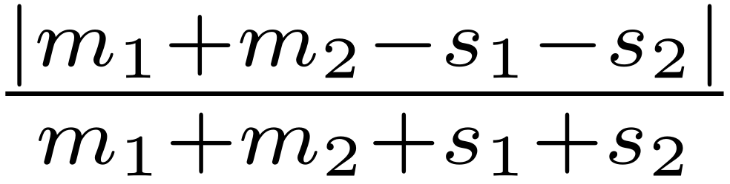
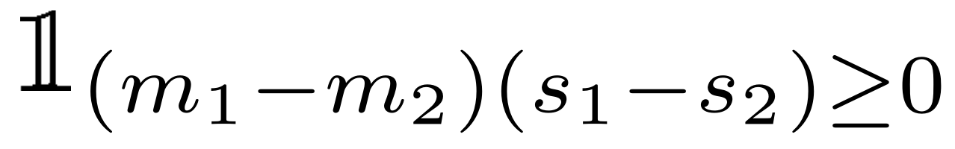
Second Algorithm Design
  Pair jobs through minimum weight maximum matching
  Matching weight for J₁ and J₂:
  β * balance factor + (1-β) * non-dominance factor
  Balance factor:
  Non-dominance factor:

Slide 20
  Match-Based Scheduling Policy (MBSP)
  Sort jobs by map-shuffle workload difference
  Cut jobs into two parts
  Use minimum weight maximum matching to pair jobs in the second part
  Exhaust all possible cuts and pick the best cut
  Sort jobs by their workloads after pairing
  Paired jobs are regarded as one job

Slide 21
Example 2
  Match-based scheduling policy

Slide 22
Theorem
  Match-based scheduling policy has an approximation ratio of 2 if
  (1) some jobs can be perfectly paired,
  (2) all remaining jobs are map-heavy, balanced, or shuffle-heavy,
  (3) dominant workload is used to sort jobs.
  Time complexity is O(n^{3.5})
  Exhausting all cuts takes O(n) iterations
  Matching in each iteration takes O(n^{2.5})

Slide 23
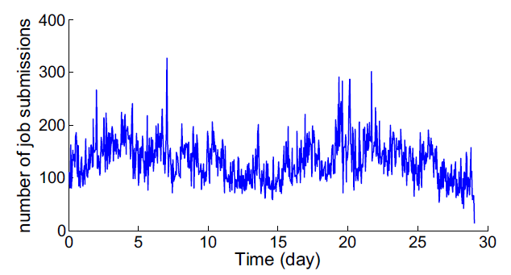
4. Experiment
  Google Cluster Simulation
  About 11,000 machines
  96,182 jobs over 29 days in May 2011
  Number of job submissions per hour (arrival rate)

Slide 24
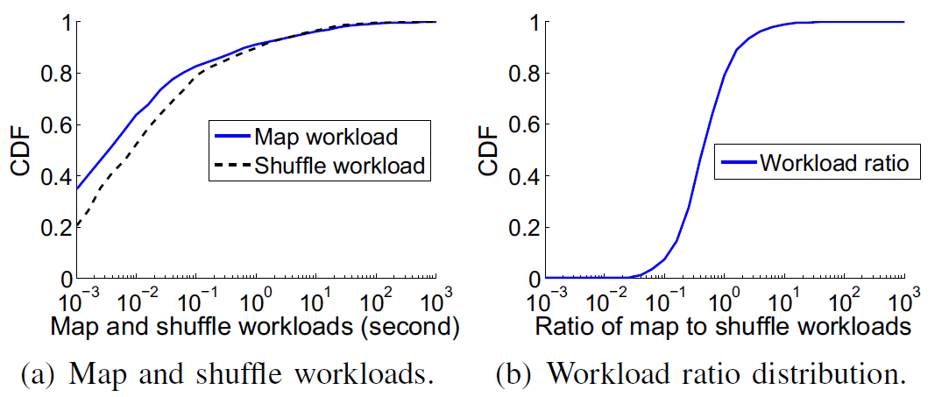
Google Cluster Dataset
  Distribution of map and shuffle time
  Slightly more map-heavy jobs

Slide 25
Comparison Algorithms
  Pairwise: has only one group then iteratively pairs the
  map-heaviest and shuffle-heaviest jobs in the group
  MaxTotal: ranks jobs by total workload m+s and executes jobs with smaller total workloads earlier
  MaxSRPT: ranks jobs by dominant workload max{m,s} and executes jobs with smaller dominant workloads earlier

Slide 26
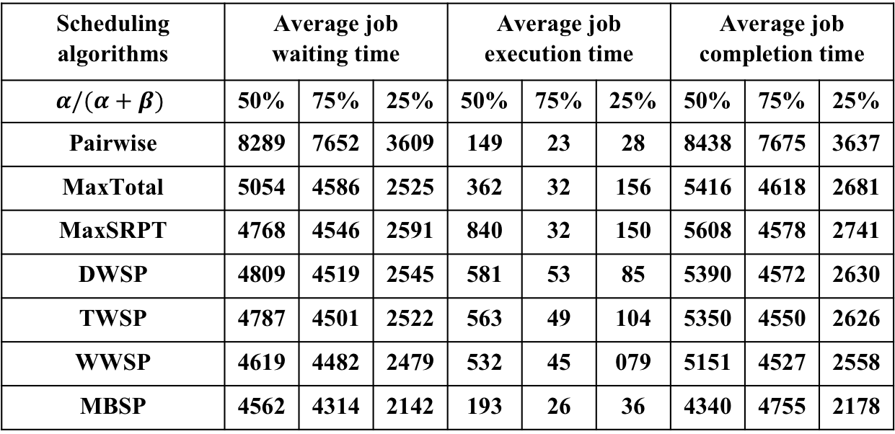
Waiting, Execution, and Completion
  Results (group k = 20, weight α = 0.5, β = 0.5)
  Control job waiting time using the workload of each group
  Control job execution time by pairing jobs within a group
Scheduling algorithms | Average job waiting time |  |  | Average job execution time |  |  | Average job completion time
$$α/(α+β)$$ | 50% | 75% | 25% | 50% | 75% | 25% | 50% | 75% | 25%
Pairwise | 8289 | 7652 | 3609 | 149 | 23 | 28 | 8438 | 7675 | 3637
MaxTotal | 5054 | 4586 | 2525 | 362 | 32 | 156 | 5416 | 4618 | 2681
MaxSRPT | 4768 | 4546 | 2591 | 840 | 32 | 150 | 5608 | 4578 | 2741
DWSP | 4809 | 4519 | 2545 | 581 | 53 | 85 | 5390 | 4572 | 2630
TWSP | 4787 | 4501 | 2522 | 563 | 49 | 104 | 5350 | 4550 | 2626
WWSP | 4619 | 4482 | 2479 | 532 | 45 | 079 | 5151 | 4527 | 2558
MBSP | 4562 | 4314 | 2142 | 193 | 26 | 36 | 4340 | 4755 | 2178
GBSP
The average job completion time ratio between MBSP and WWSP is 92.3%, 95.8% and 85.1%, respectively.

Slide 27
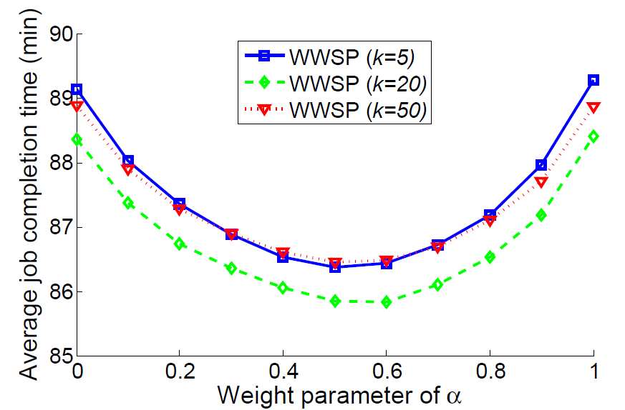
Impact of k and α in WWSP
  Group-based scheduling policy with k groups
  Sorts jobs by α*max(m,s) + (1-α)*(m+s)
  Small/large group k
  Small/large weight α
Minimized
when α = 0.57

Slide 28
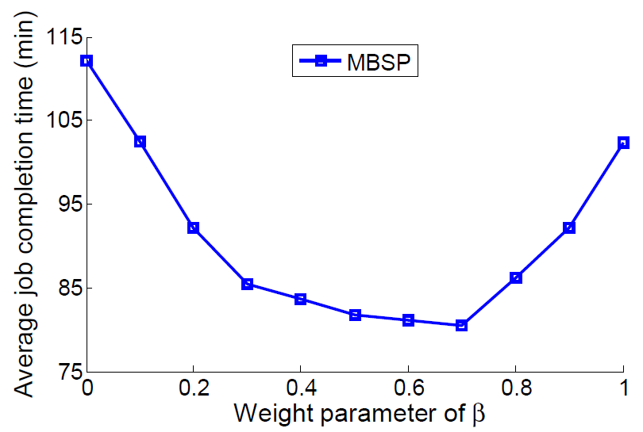
Impact of β in MBSP
  Match-based scheduling policy matches J₁ and J₂ by
  β * balance factor + (1-β) * non-dominance factor
  Small/large weight β
Minimized
when β = 0.68

Slide 29
Hadoop Testbed on Amazon EC2
  Testbed
  Ubuntu Server 14.04 LTS (HVM)
  Single core CPU and 8G SSD memory
  Jobs: WordCount jobs and TeraSort jobs
  6 WordCount uses books of different sizes
  2MB, 4MB, 6MB, 8MB, 10MB, 12MB
  6 TeraSort uses instances of different sizes
  1KB, 10KB, 100KB, 1MB, 10MB, 100MB

Slide 30
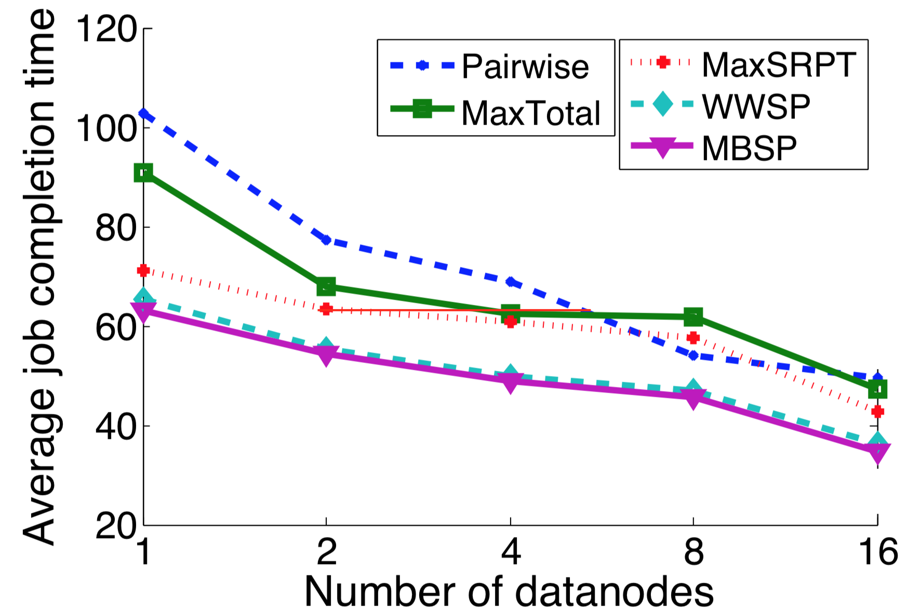
Waiting, Execution, and Completion
  Hadoop: one master node + several data nodes
  Number of data nodes: 1, 2, 4, 8, 16
  MBSP has a slightly larger job waiting time than WWSP, but a smaller job makespan.

Slide 31
Performance Comparison
  Pairwise has the smallest average execution time, but
  a large job wait time since workloads are ignored.
  MaxTotal and MaxSPRT do not balance the trade-off between job sizes and job pairs.
  DWSP, TWSP, WWSP, and MBSP jointly consider job sizes and job pairs.

Slide 32
5. Conclusion
  Map and Shuffle phases can overlap
  CPU and I/O resource
  Objective: minimize average job completion time
  Group-based and match-based schedules
  Job workloads (dominant factor)
  Job pairs (avoid I/O underutilization)
  Optimality under certain scenarios

Slide 33
Future Work
  Multiple phases
  Beyond 2-phase 3-phase example
  Batched online scheduling
    Window-based approach
  More simulations
  Imbalanced map and shuffle
  Impact of k, α, and β
  More testbed cases

