Slide 1


Joint Power Optimization Through VM Placement and Flow Scheduling in Data Centers
Dawei Li, Jie Wu (Temple Univeristy)
Zhiyong Liu, and Fa Zhang (Chinese Academy of Sciences)
33rd IEEE International Performance, Computing, and Communications Conference

Slide 2
Agenda
Introduction
Motivational Example
System Model and Problem Formulation
Special Case Solution
General Case Solution
Simulations
Conclusions

Slide 3
Agenda
Introduction
Motivational Example
System Model and Problem Formulation
Special Case Solution
General Case Solution
Simulations
Conclusion

Slide 4
Introduction
High power consumption in data centers has become a critical issue.
High power consumption of data centers not only results in high electricity bills, increases carbon dioxide emissions;
But also increases the possibility of system failures, because the corresponding power distribution and cooling systems are approaching their peak capacity.

Slide 5
Introduction
Two important components that consume the majority of IT power in data centers:
  the servers, and
  the Data Center Network (DCN).
Notes:
Existing works fail to fully utilize power management techniques both on the servers and in the DCN at the same time.
In this paper, we jointly consider VM placement on servers with scalable frequencies and flow scheduling in the DCN, to minimize the overall system’s power consumption.

Slide 6
Agenda
Introduction
Motivational Example
System Model and Problem Formulation
Special Case Solution
General Case Solution
Simulations
Conclusion

Slide 7


Motivational Example
Servers
Switches
VMs: totally 4 VMs, each has a utilization of 0.25; The only flows among the VMs are flow(1,3) from VM1 to VM3, and flow(2,4) from VM2 to VM4.
Notes:
We consider a two-level network with four switches and four servers; they are connected as in one pod of
the classic Fat-Tree [5] architecture. It is shown in the figure. We use rectangles to represent switches, and use circles to represent servers.

Slide 8
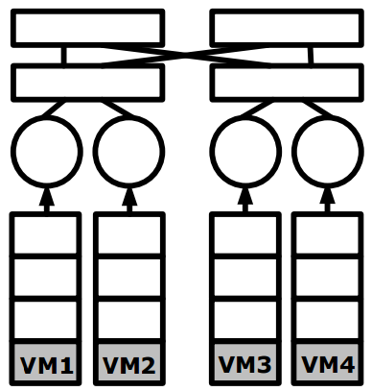
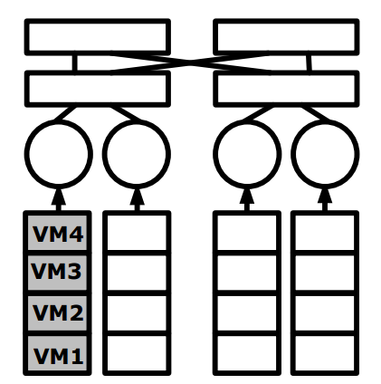
Motivational Example
Allocation 1:
  Power: 2.89
Allocation 2:
  Power: 1.4

Slide 9
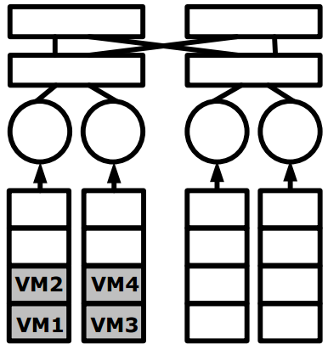
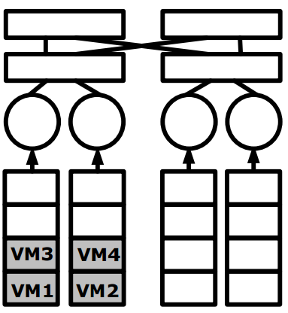
Motivational Example
Allocation 3:
  Power 1.54
Allocation 4:
  Power: 1.4
we should place VMs with large communication requirements close to each other,
and care should be taken to decide how many servers should be powered on to accommodate the VMs.

Slide 10

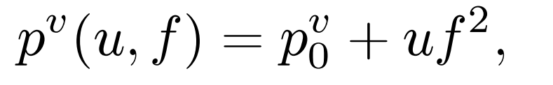


System Model and Problem Formulation
Server power model
Switch power model
VM model: each VM requires a normalized utilization under the maximum frequency of the server,

Slide 11



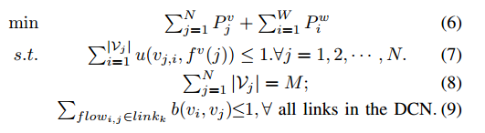
System Model and Problem Formulation
Utilization:
Server:
Switch
Formulation:

Slide 12
Special Case Solution
For special case, we mean:
Optimal VM Allocation Given the # of Servers to Be Used:

Slide 13


Special Case Solution
Server-Level VM grouping:
  Assume that we have chosen to use n servers. In order to achieve the minimal power consumption on the n servers, the VM allocation should be balanced. In other words, we should allocate to each of the first (M mod n) servers, and allocate VMs to each of the next n - (M mod n) servers.
  Intuition: assign a group of VMs that have high communication requirements among themselves to the same server, and assign VMs with low communication requirements to different servers.
Notes:
We denote b(vi; vj ) as the bandwidth requirement of flowi;j.

Slide 14

Special Case Solution
Rack-Level VM Grouping
  The similar balanced partitioning

Slide 15

Special Case Solution
Pod-Level VM Grouping

Slide 16
Special Case Solution
VM Placement and Flow Scheduling
  VM placement:
    symmetric architecture
    place the first category on the first pod, place the first part of the first category on the first rack of the first pod, and place the first group of each part on the first server in the corresponding rack.
  Flow Scheduling:
    In order to reduce the power consumption for communications, a common intuition is to consolidate the flows to the minimal number of switches and ports, such that the remaining network elements can be put into sleep mode for power saving.
    a heuristic based on the greedy bin packing strategy: for each flow between a pair of VMs, assign the flow to its leftmost path that has enough capacity for the flow.

Slide 17


Special Case Solution
Overall Approach

Slide 18



General Case Solution
Optimal VM Allocation Given the # of Servers to Be Used:
  The minimal power consumption on the n servers is
  Achieved when

Slide 19
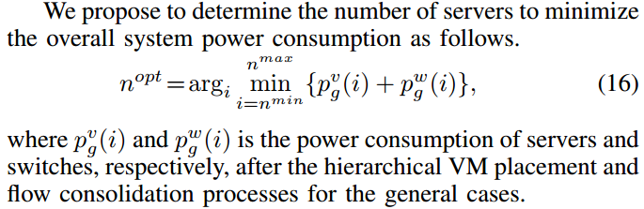
General Case Solution
Our Overall Approach

Slide 20
Simulations
Comparing methods
  J_SN
  No_SN
  N_S
  N_N
  S_SN

Slide 21


Simulations
Settings
  Special cases: Each server has a set of five available frequencies:
  Each VM’s normalized utilization is 0.2.
  General cases: servers have the following set of operating frequencies:
  VM’s utilizations are within [0.1, 0.3], with a mean value of 0.2.

Slide 22
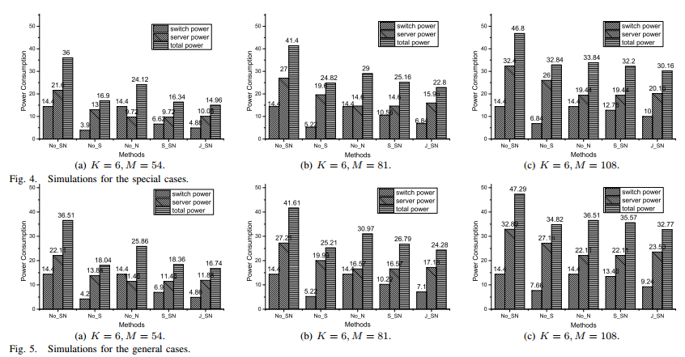
Simulations
Results

Slide 23
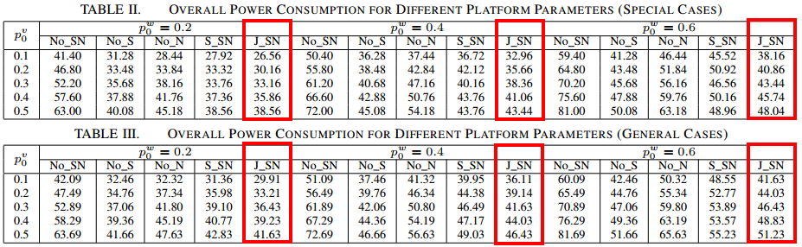
Simulations
Results

Slide 24
Conclusion
In this paper, we consider joint power optimization through VM placement on servers with scalable frequencies and flow scheduling in DCNs.
Due to the convex relation between a server’s power consumption and its operating frequency, we prove that, given the number of servers to be used, computation workload should be allocated to the chosen severs in a balanced way, to achieve minimal power consumption on servers.
To reduce the power consumption in the DCN, we further consider the flow requirements among the VMs during VM partitioning and assignment.
Also, after VM placement, a flow consolidation is applied to reduce the number of active switches and ports.
Extensive simulations show that, our joint power optimization method outperforms various existing state-of-the-art methods in terms of saving the system’s overall power consumption.

Slide 25
Thank you!
Questions can be forwarded to: dawei.li@temple.edu

