Slide 1
A Utility-based Multi-copy Forwarding Algorithm in Delay Tolerant Networks
Cong Liu, Yan Pan, Jun Zhang, Mingjun Xiao, Ai Chen, and Jie Wu
Presented by Yan Pan, ICCCN 2014

Slide 2
Outline
DTN preliminaries
Model and motivation
Our solution: the MOUF algorithm
Simulation

Slide 3
Delay tolerant network (DTN)
A DTN is a self-organized network of short-distance communication devises.
Messages are forwarded by predicting and using node mobility

Slide 4
Message forwarding in DTNs
Two contradictory objectives:
High delivery performance: achieved by improving the quality and quantity of the forwarding nodes.
Low forwarding overhead: via reducing the total number of forwarding nodes.

Slide 5
Outline
DTN preliminaries
Model and motivation
Our solution: the MOUF algorithm
Simulation

Slide 6
Model
Let N be the set of all nodes
I_{i,j} be the average inter-contact time between nodes i and j.
Each node i locally computes I_{i,j}s over a warm-up period.
If nodes i and j have no contact, I_{i,j} = ∞

Slide 7
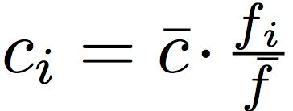
Model
Each message has a source, a dest, a TTL
Multi-copy forwarding of each message:
different copies are forwarded independently
Each copy have no knowledge of the others
Node charges for each copy it forwards

Slide 8
Motivation
DTN forwarding algorithms using simple metrics
delivery rate, delay and forwarding cost
These metrics can be contradictory
An algorithm that maximize delivery rate might create excessive forwarding cost
An algorithm that bounds forwarding cost inappropriately might results in low delivery rate.
We want user-preferred trade-offs

Slide 9
Outline
DTN preliminaries
Model and motivation
Our solution: the MOUF algorithm
Simulation

Slide 10
Our solution: a utility-based metrics
Utility function
B: initial benefit: maximum benefit
t: delay
c: sum of forwarder charges
∆ : benefit delay, trade-off between t and c
For failed-to-deliver messages

Slide 11
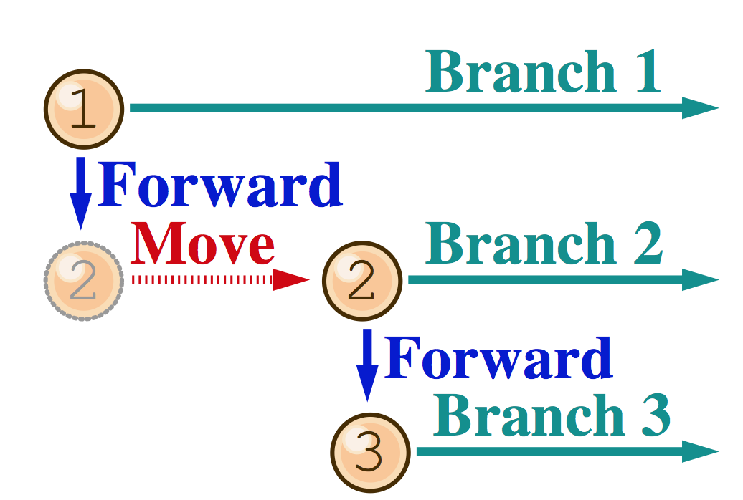
A simplified forwarding scheme
The forwarding tree
Copies on a branch Have no information about copies on other branches

Slide 12
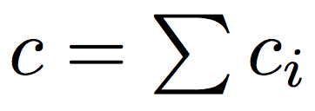
A simplified forwarding scheme
Key forwarder
One per message
Other forwarders can only forward to dest
Key forwarder keep looking for better j with smaller I_{j,d}, which if found, become the new key forwarder
Only the key forwarder
Forward to increase the utility of the message
It has the full knowledge of

Slide 13
A simplified forwarding scheme
Compare the key-forwarder scheme to the 2-hop forwarding scheme:
In 2-hop forwarding: the key-forwarder is always the source
In our scheme: the key-forwarder is always the nodes (known so far) that has the smallest inter-contact time with the dest

Slide 14
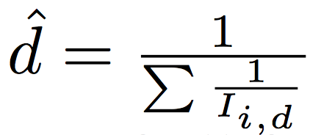
Utility maximization
The key-forwarder makes forwarding decision to maximize the expected utility:
The joint delay of all copies, locally estimated by the key forwarder:
t’ : the the time elapsed since the creation of the message
: the estimated delay starting from the current time

Slide 15
Utility maximization
Whenever the key-forwarder k of message m is connected with another node i, there are two options:
k forwards m to i, the expected utility:
k does not forward

Slide 16
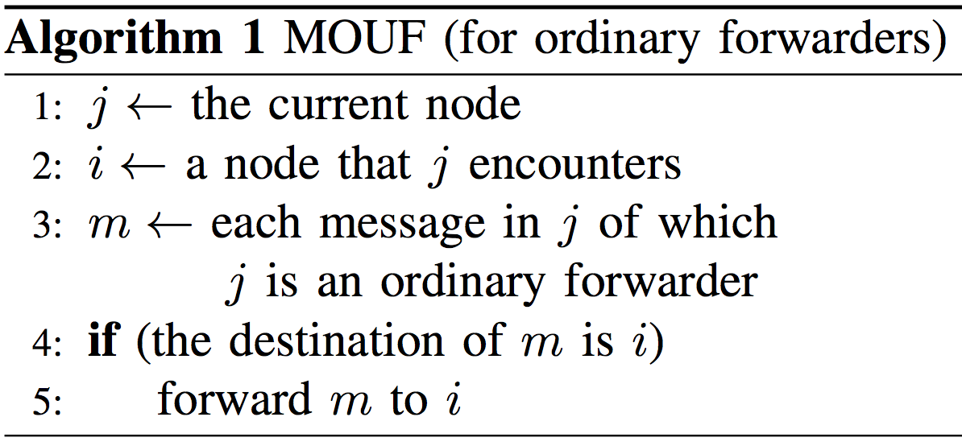
The MOUF algorithm

Slide 17
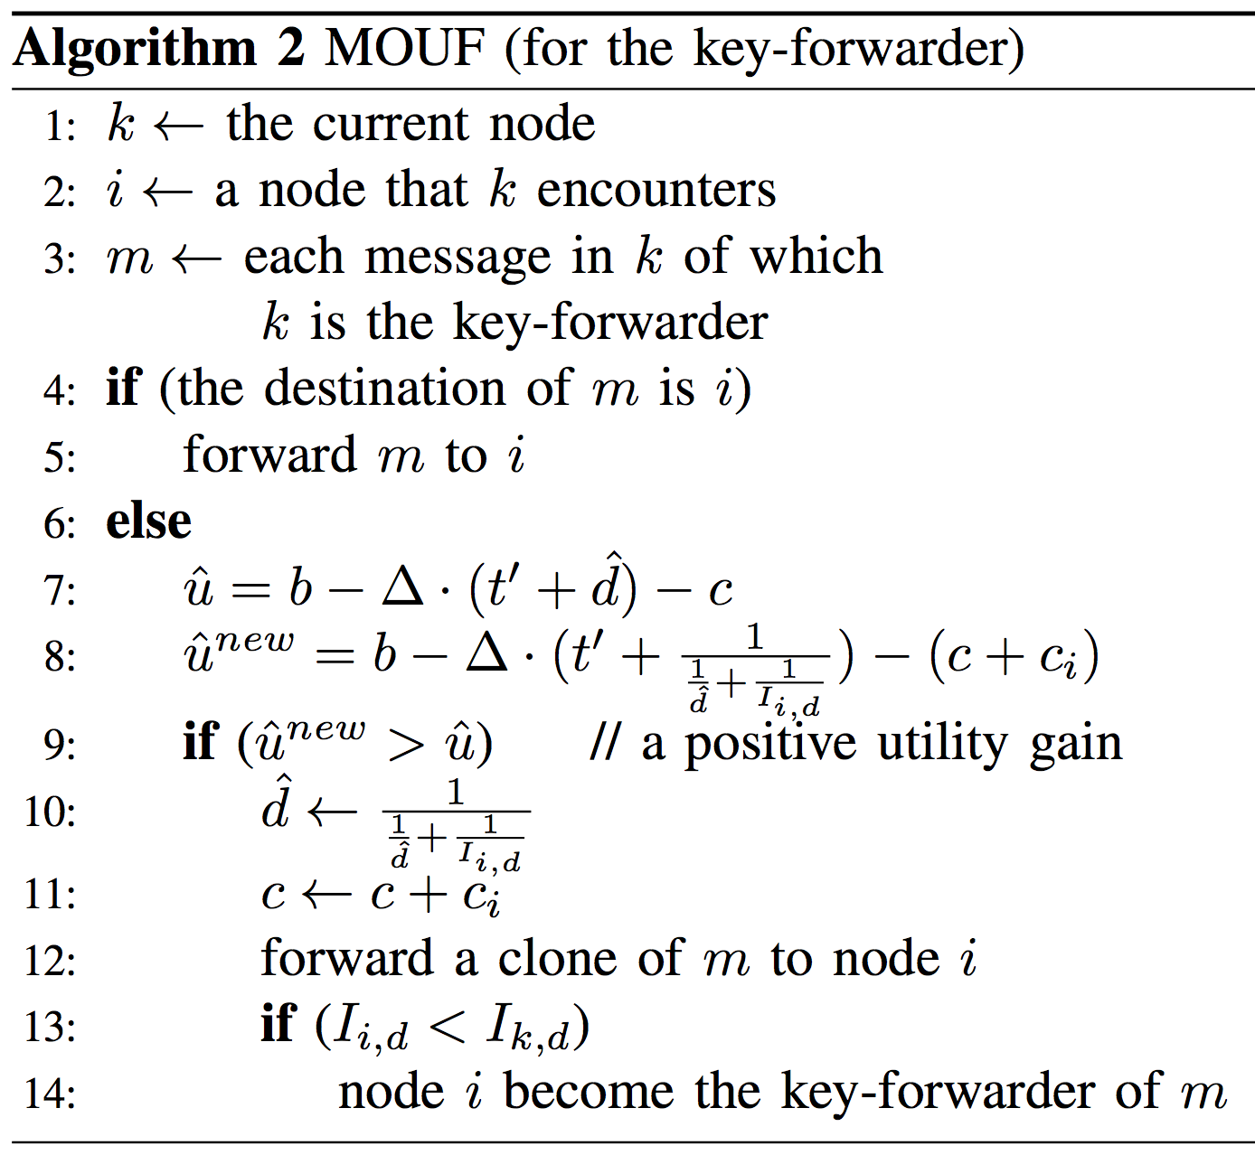
The MOUF algorithm

Slide 18
Outline
DTN preliminaries
Model and motivation
Our solution: the MOUF algorithm
Simulation

Slide 19
Simulation
We perform simulations on 7 real traces

Slide 20
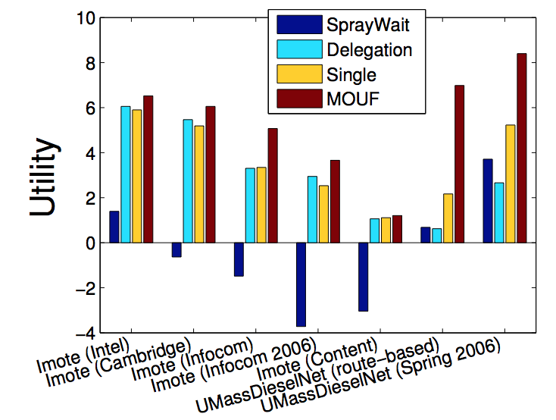
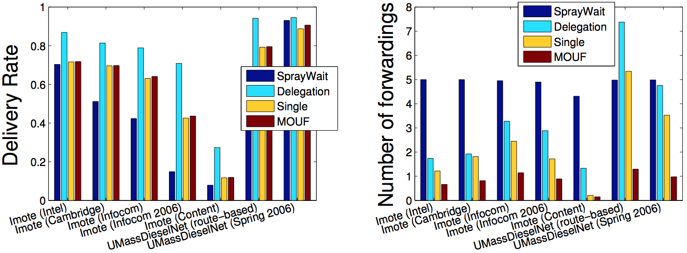
Simulation results

Slide 21
Thank you
Questions are welcome: liucong3@mail.sysu.edu.cn

